Slide 1
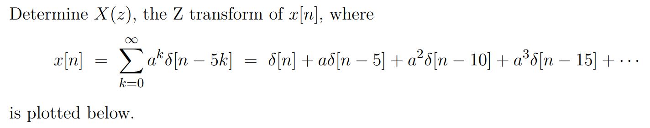
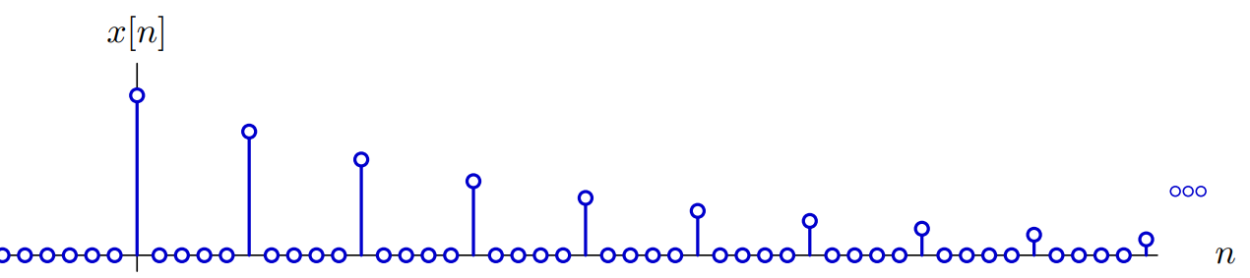

Slide 2
求下列象函数的双边z逆变换

Slide 3
求下列信号的单边z变换

Slide 4

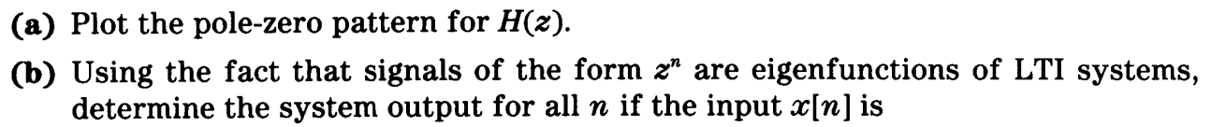


Slide 5
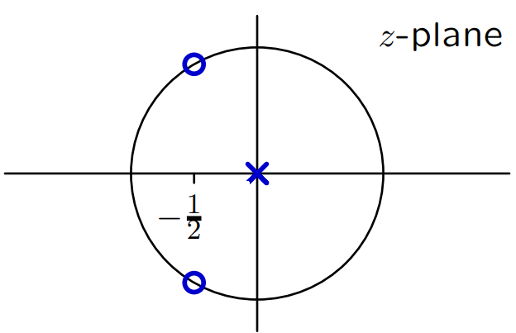
The pole-zero diagram for a DT system is shown below, where the circle has radius 1.
It is known that when the input is 1 for all n, the output is also 1 for all n. Determine the unit-sample response h[n] of the system

Slide 6
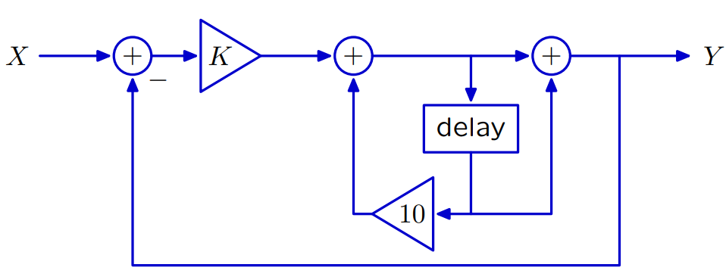
Determine the range of K for which the following discrete-time system is stable (and causal).

Slide 7
已知离散系统的方程为：
求：系统全响应、零输入、零状态

