Slide 1
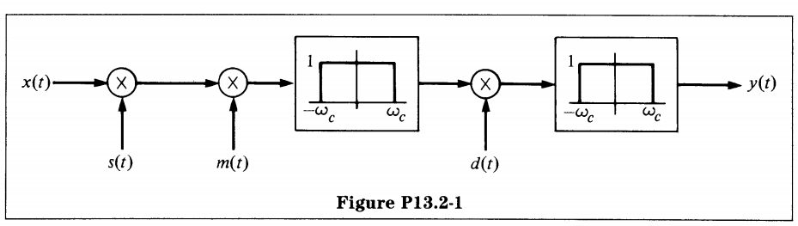

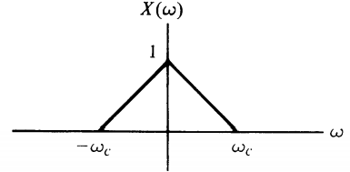
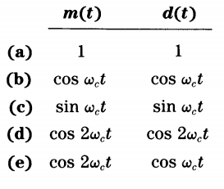
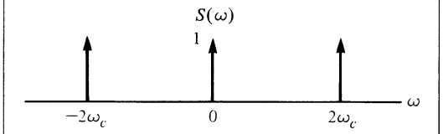
For which of the following choices for m(t) and d(t) , is y(t) nonzero?

Slide 2


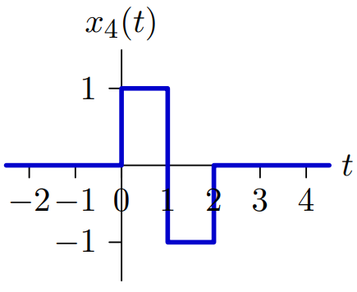
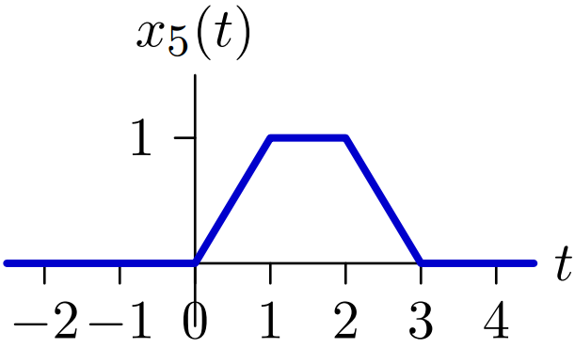
Determine the Laplace transforms (including the regions of convergence) of each of the following signals:

Slide 3
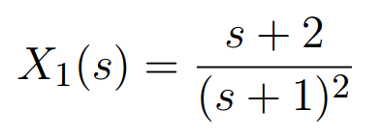
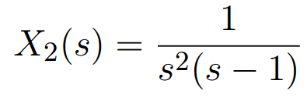
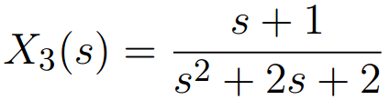
Determine all possible signals with Laplace transforms of the following forms.

Slide 4
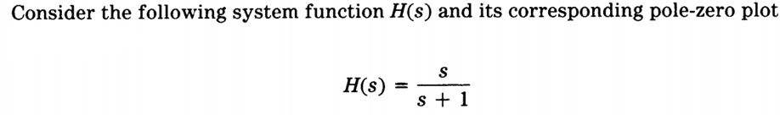
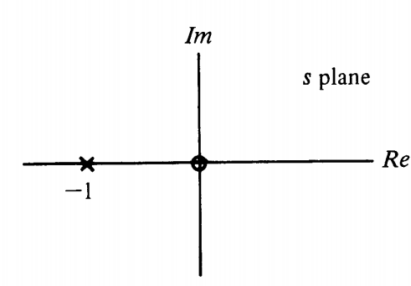

Slide 5
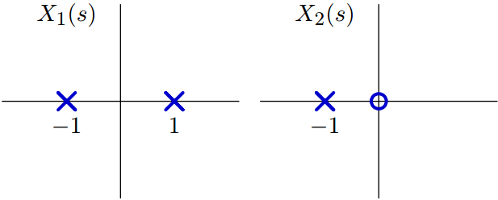
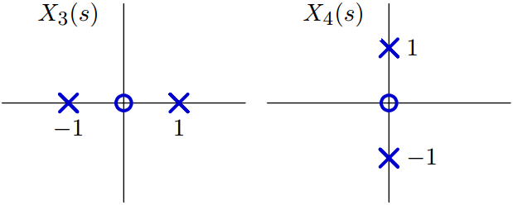
Determine which of the following pole-zero diagrams could represent Laplace transforms of even functions of time.

Slide 6
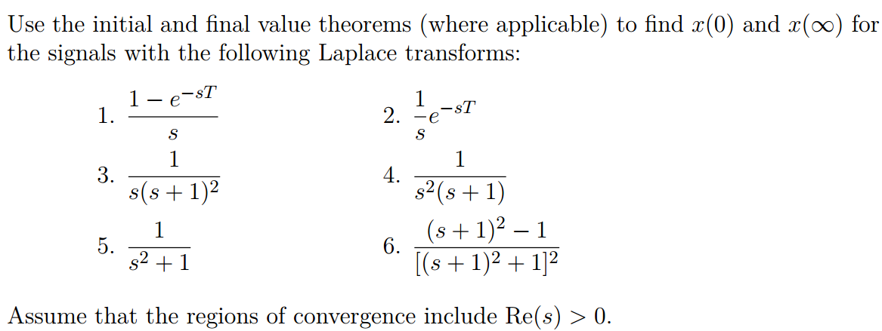

Slide 7
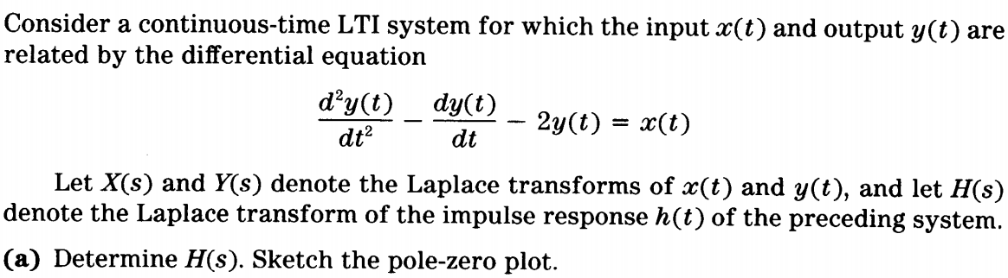
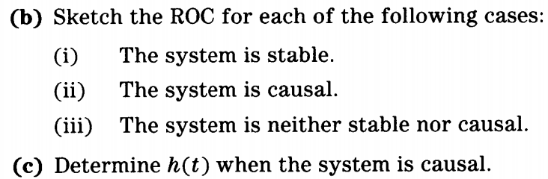

Slide 8
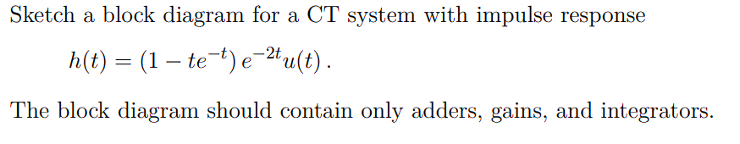

Slide 9
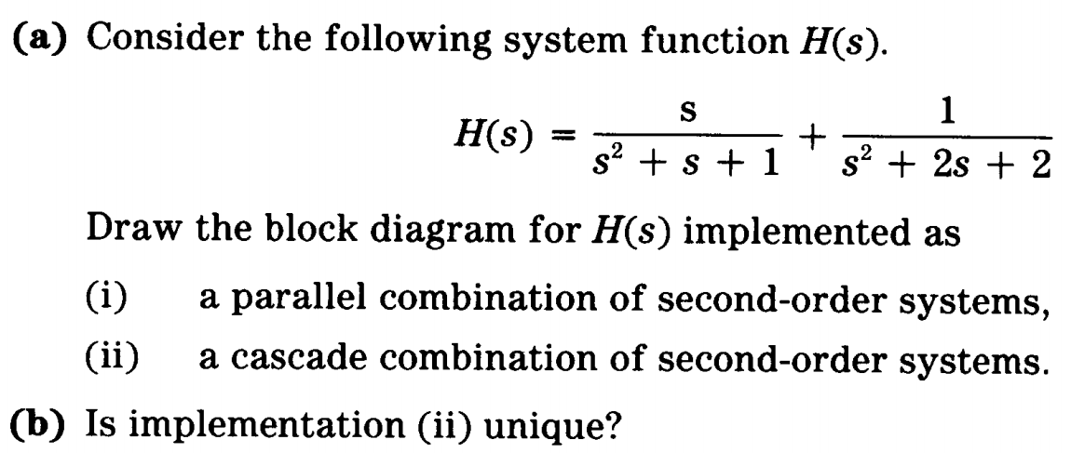

Slide 10
描述某LTI系统的微分方程为
y’’(t)+5y’(t)+6y(t)=2x(t)
已知初始状态 y(0-)=1，y’(0-)= -1，
激励x(t)=5cost·u(t)，求系统的全响应、零输入响应、零状态响应、强迫响应、自然响应、瞬态响应和稳态响应。

