Slide 1
Facial Expression Recognition on FER2013
Controlled experiments with a custom CNN, ResNet18, EfficientNet-B0, and CK+ external validation
Shaoya Zhang and Laura Guitart

Slide 2
CONTENT
Presentation structure
1. Introduction and motivation
2. Related work / state of the art
3. Dataset and preprocessing
4. Methodology and implemented models
5. Experiments and evaluated configurations
6. Results and analysis
7. Comparison against baselines and state-of-the-art approaches
9. Conclusions and future work

Slide 3
INTRODUCTION AND MOTIVATION
The goal of our project: emotion classification
Identifying facial expressions can be interesting for human-computer interactions, to prevent accidents by drivers falling asleep, blind people being able to detect emotions, etc.
Our goal:
Evaluation of:
Architectures
Transfer learning techniques
Training approaches
For the classification of FER2013 dataset
Notes:
We could mention other apps like preventing sleeping while driving, making blind people know emotions
This dataset is great because realistically we might not have high resolution images for certain applications.

Slide 4
RELATED WORK / STATE OF THE ART
Similar researches for FER2013 emotion classification
DTL-I-ResNet18: facial emotion recognition based on deep transfer learning and improved ResNet18
Comparison of different popular CNNs architectures for FER2013 classification problem.
They achieved a macro F1 Score of 64%.
DTL-I-ResNet18: facial emotion recognition based on deep transfer learning and improved ResNet18 | Request PDF
FacialExpression Recognition Using Deep Learning EfficientNetB0
They compared two Transfer Learning techniques for Efficientnetb0.
They achieved a macro F1 Score of 72%.
https://www.ijs.uobaghdad.edu.iq/index.php/eijs/article/view/13867/7846

Slide 5
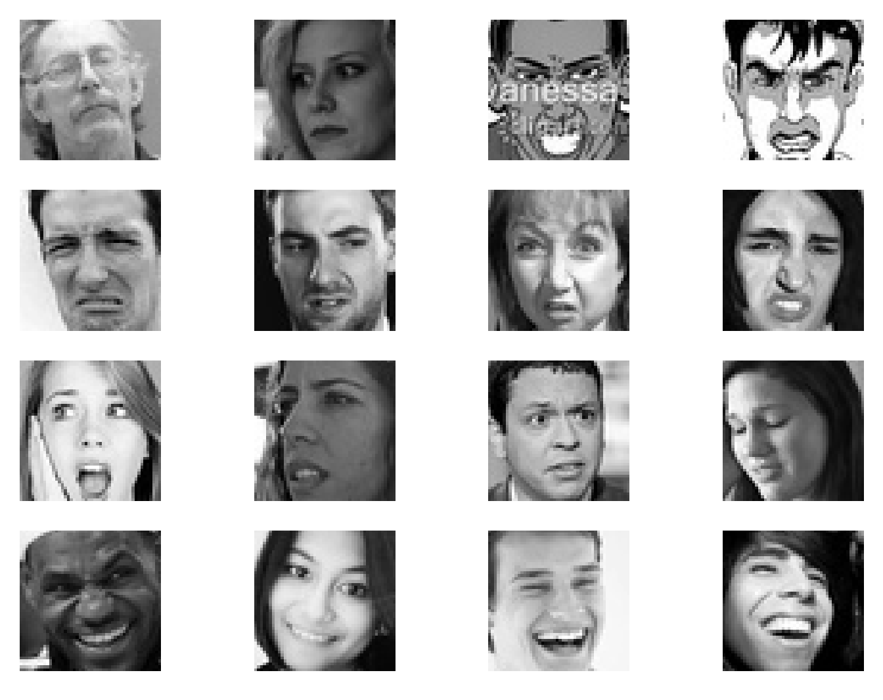
DATASET AND PREPROCESSING
FER2013: Sample images reveal ambiguity and low resolution.
Faces are small (48x48), grayscale, and sometimes poorly aligned.
Several classes differ by subtle mouth, eye, or eyebrow cues.
Human-visible ambiguity justifies evaluating more than a single aggregate score.

Slide 6
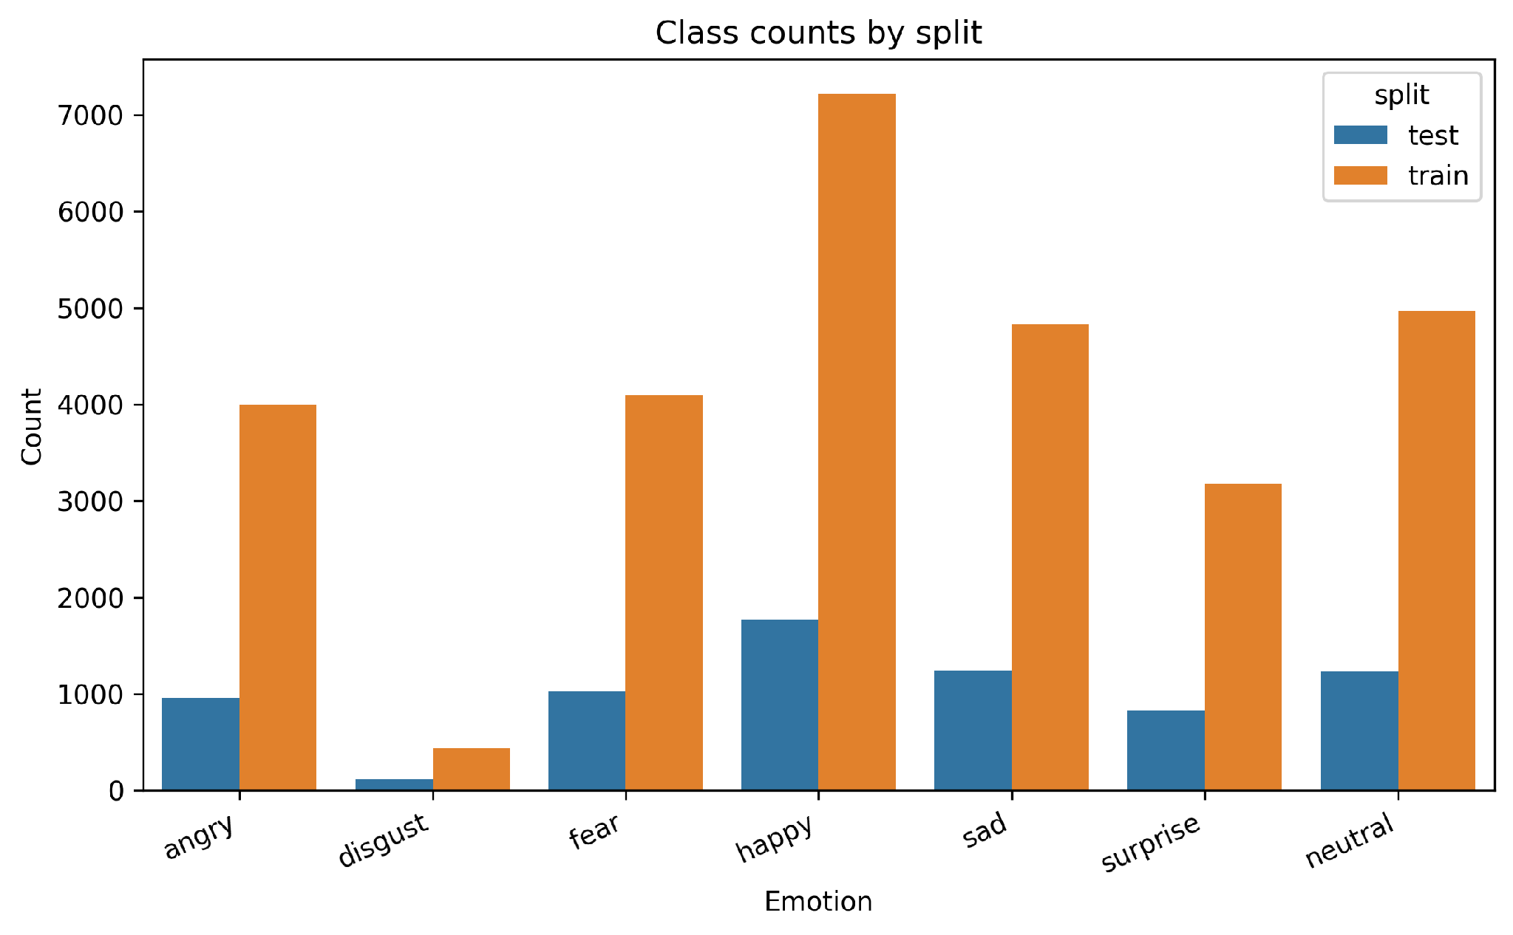
DATASET AND PREPROCESSING
Class imbalance and affect proximity explain why this dataset is difficult.
Happy has much more support than minority classes such as disgust.
We will need to handle this class imbalance during the training of our models
Takeaway: FER2013 requires augmentation, imbalance handling, macro/per-class F1, and confusion analysis.

Slide 7
DATASET AND PREPROCESSING
The split is fixed, and validation is created from the training folder.
FER2013 train
stratified split with fixed seed
90% train
10% validation
Emotion | Test | Train
Angry | 0.13 | 0.14
Disgust | 0.02 | 0.02
Fear | 0.14 | 0.14
Happy | 0.25 | 0.25
Neutral | 0.17 | 0.17
Sad | 0.17 | 0.17
Surprise | 0.12 | 0.11
FER2013 official test
full held-out test set
Dataset size
28,709 train
7,178 test
The train/validation split is stratified and reproducible with seed 42.
The official FER2013 test set is kept fixed and used without resampling.

Slide 8
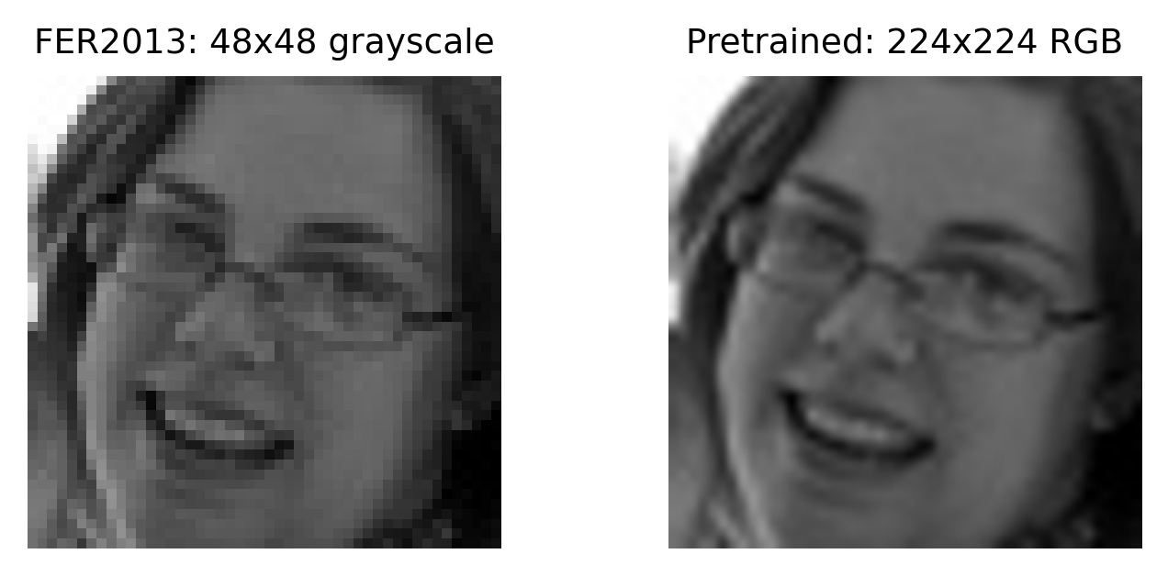
DATASET AND PREPROCESSING
Input preprocessing depends on whether the model is trained from scratch or pretrained.
CUSTOM CNN
48x48 grayscale input
Horizontal flip, affine transformations and rotations
mean 0.5 / std 0.5 normalization
RESNET18 AND EFFICIENTNET-B0
same transfer preprocessing for both pretrained backbones
resize to 224x224 and replicate grayscale to 3 channels
ImageNet normalization to match pretrained weights

Slide 9
METHODOLOGY
The methodology is built around controlled experiments/ablation.
Fix split
Change one factor/ablation
Train / select checkpoint
Evaluate same metrics
Analyze errors
The experiment compares model families under consistent train/validation/test logic.
Variables include architecture, imbalance handling, loss function, optimizer, transfer learning techniques, crop/TenCrop evaluation, and depth addition.
The same evidence types are reported: macro F1, weighted F1, per-class F1, loss curves, and confusion matrices.

Slide 10
METHODOLOGY
Architecture: custom CNN baseline trained from scratch.
48x48x1
3x3 conv 32 x2
MaxPool
3x3 conv 64 x2
MaxPool
3x3 conv 128
MaxPool
FC 256
7 logits
Baseline CNN implementation
1,321,191 Trainable Parameters
Feature channels: 32, 64, 128.
Convolution filters: 3x3, padding 1; block depths: 2, 2, 1.
Dropout2d after early pooling blocks; dropout before classifier output.
Purpose: establish a reproducible from-scratch baseline.

Slide 11
METHODOLOGY
Architecture: ResNet18 transfer learning.
224x224x3
7x7 stem conv
3x3 residual blocks
layer2
layer3
layer4
FC head
7 logits
~11.69M Trainable Parameters
Why RestNet18 as Pretrained Model
Standard and widely used transfer-learning baseline for image classification.
Residual connections make deeper convolutional networks easier to optimize.
Moderate model size: stronger than a small custom CNN but still practical for FER2013.
Easy to fine-tune systematically by progressively unfreezing later layers.

Slide 12
METHODOLOGY
Architecture: EfficientNet-B0 transfer learning.
224x224x3
3x3 stem conv
MBConv 1-5
last MBConv blocks
pooling
FC head
7 logits
5,288,548 parameters
Why include Efficient-B0?
Lightweight ImageNet-pretrained backbone, much smaller than ResNet18.
MBConv blocks and depthwise convolutions make feature extraction parameter-efficient.
Tests whether a compact pretrained model can achieve competitive FER2013 performance.
Useful comparison against ResNet18: standard transfer backbone vs efficient transfer backbone.

Slide 13
RESULTS AND ANALYSIS
The evaluation uses complementary metrics, not only one score.
MAIN METRICS
SUPPORTING EVIDENCE
Macro F1: primary metric because all classes count equally.
Loss curves: diagnose optimization and overfitting.
Weighted F1: reflects performance under the real class distribution.
F1 per class: identifies weak emotion categories.
Confusion matrix: shows the actual error pattern.
Precision and recall: show whether each class is over- or under-predicted.

Slide 14
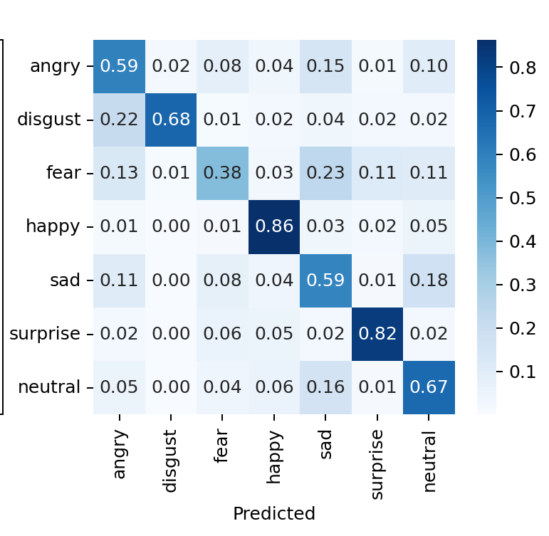
RESULTS AND ANALYSIS
Custom CNN results improve gradually, but plateau below transfer learning.
0.70
best val macro F1
0.644
0.662
0.65
0.627
0.60
0.566
0.55
0.50
0.485
0.45
CNN aug
+ CE
aug + sampler
+ CE
aug + sampler
+ CE + SGD
crop/TenCrop
CE + SGD
crop/TenCrop
CE 80ep
Test Macro F1 | 0.663 | Test Weighted F1 | 0.675
Selected custom CNN test per-class precision / recall / F1
metric
angry
disgust
fear
happy
sad
surprise
neutral
precision
0.59
0.67
0.57
0.87
0.53
0.77
0.61
recall
0.59
0.68
0.38
0.86
0.59
0.82
0.67
F1
0.59
0.68
0.45
0.87
0.55
0.79
0.64

Slide 15
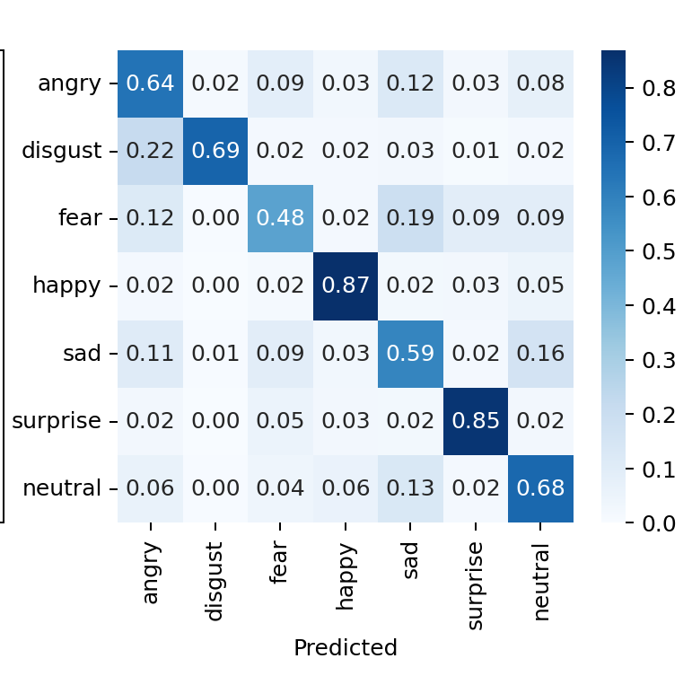
RESULTS AND ANALYSIS
ResNet18 improves when deeper layers are fine-tuned.
0.70
best val macro F1
0.654
0.676
0.685
0.648
0.649
0.60
0.602
0.50
0.40
0.346
0.30
feature
extract
unfreeze
layer4
unfreeze
layer3
class
weights
weights +
focal
focal +
SGD
crop +
TenCrop
Test Macro F1 | 0.685 | Test Weighted F1 | 0.695
Best ResNet18 test per-class precision / recall / F1
metric
angry
disgust
fear
happy
sad
surprise
neutral
precision
0.60
0.69
0.60
0.90
0.58
0.77
0.64
recall
0.64
0.69
0.48
0.87
0.59
0.85
0.68
F1
0.62
0.69
0.53
0.88
0.58
0.81
0.66

Slide 16
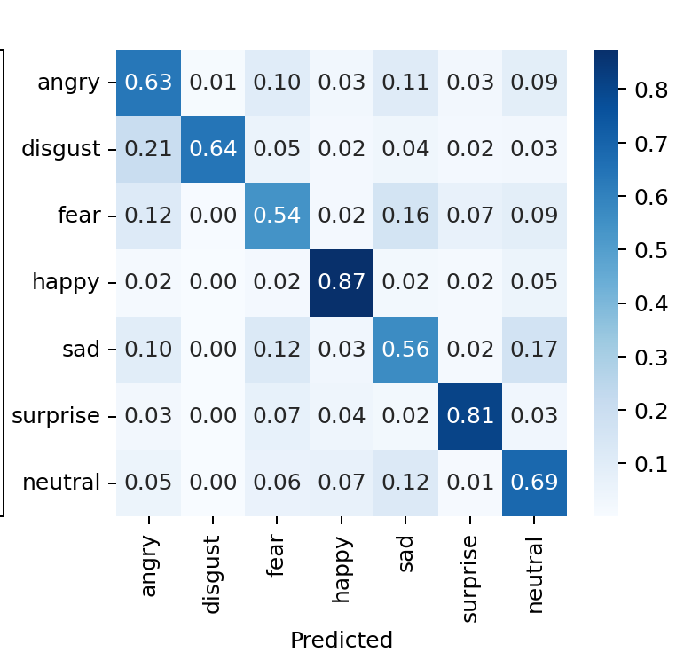
RESULTS AND ANALYSIS
EfficientNet-B0 is competitive on FER2013 after stronger fine-tuning.
best val macro F1
0.653
0.657
0.670
0.65
0.637
0.590
0.55
0.464
0.45
0.382
0.35
feature
extract
unfreeze
last block
unfreeze
last 2
unfreeze
last 3
last 3 +
sampler
sampler +
SGD
crop +
TenCrop
Test Macro F1 | 0.667 | Test Weighted F1 | 0.686
Best EfficientNet-B0 test per-class precision / recall / F1
metric
angry
disgust
fear
happy
sad
surprise
neutral
precision
0.62
0.77
0.56
0.88
0.59
0.81
0.63
recall
0.63
0.64
0.54
0.87
0.56
0.81
0.69
F1
0.62
0.70
0.55
0.88
0.58
0.81
0.65

Slide 17
RESULTS AND ANALYSIS
Top confusions show that errors cluster around similar emotions.
MODEL
TOP CONFUSION
COUNT
CLASS RATE
Custom CNN
sad -> neutral
259
20.8%
Sad, fear, and neutral dominate the top mistakes.
Custom CNN
fear -> sad
233
22.8%
The same error families appear across model architectures.
Custom CNN
neutral -> sad
162
13.1%
ResNet18
sad -> neutral
200
16.0%
The best model improves the score, but does not remove class ambiguity.
ResNet18
fear -> sad
197
19.2%
ResNet18
neutral -> sad
162
13.1%
EfficientNet-B0
sad -> neutral
206
16.5%
EfficientNet-B0
fear -> sad
163
15.9%
EfficientNet-B0
sad -> fear
154
12.3%

Slide 18
COMPARISON AGAINST BASELINES AND STATE OF THE ART
Comparison of our models with literature results
MACRO F1 COMPARISON BETWEEN OUR RESULTS AND STATE OF THE ART
 | Literature Resnet18 | Our Resnet18 | Literature EfficientNet-B0 | Our EfficientNet-B0 | Our Baseline model
Neutral | 0.57 | 0.66 | 0.70 | 0.65 | 0.64
Happy | 0.48 | 0.88 | 0.91 | 0.88 | 0.87
Sad | 0.52 | 0.58 | 0.58 | 0.58 | 0.55
Surprise | 0.79 | 0.81 | 0.84 | 0.81 | 0.79
Fear | 0.50 | 0.53 | 0.58 | 0.55 | 0.45
Disgust | 0.68 | 0.69 | 0.78 | 0.70 | 0.68
Angry | 0.57 | 0.62 | 0.65 | 0.62 | 0.59
Macro-average | 0.64 | 0.69 | 0.72 | 0.67 | 0.66

Slide 19
COMPARISON AGAINST BASELINES AND STATE OF THE ART
FER2013 and CK+ MacroF1 comparisons show promising results for ResNet18 and our custom CNN
0.75
FER2013
CK+
0.70
0.707
EfficientNet was not able to mantain performance regarding MacroF1.
This probably means it was not able to generalize expressions features, and learnt specifically the ones from FER2013.
0.682
0.685
0.670
0.65
0.654
0.60
0.556
0.55
0.50
Custom
CNN
ResNet18
EfficientNet
-B0

Slide 20
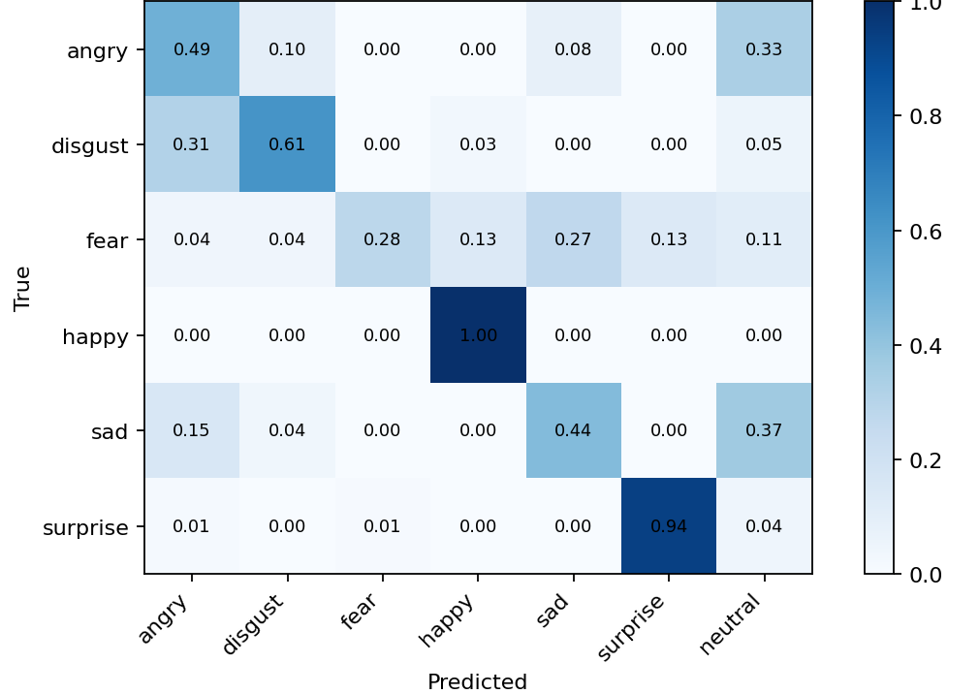
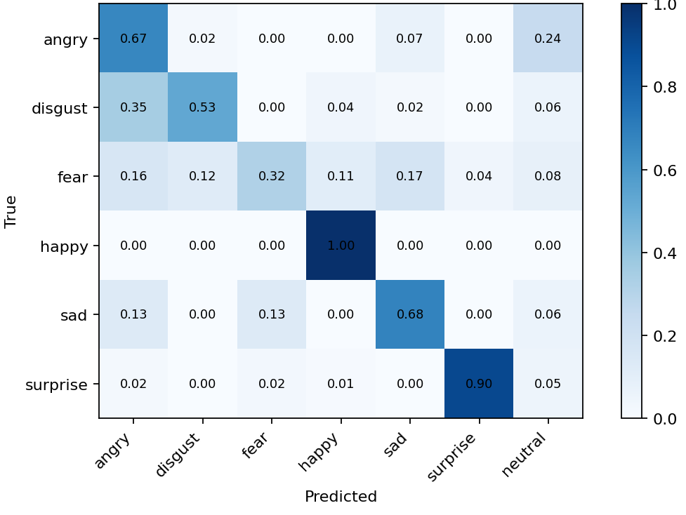
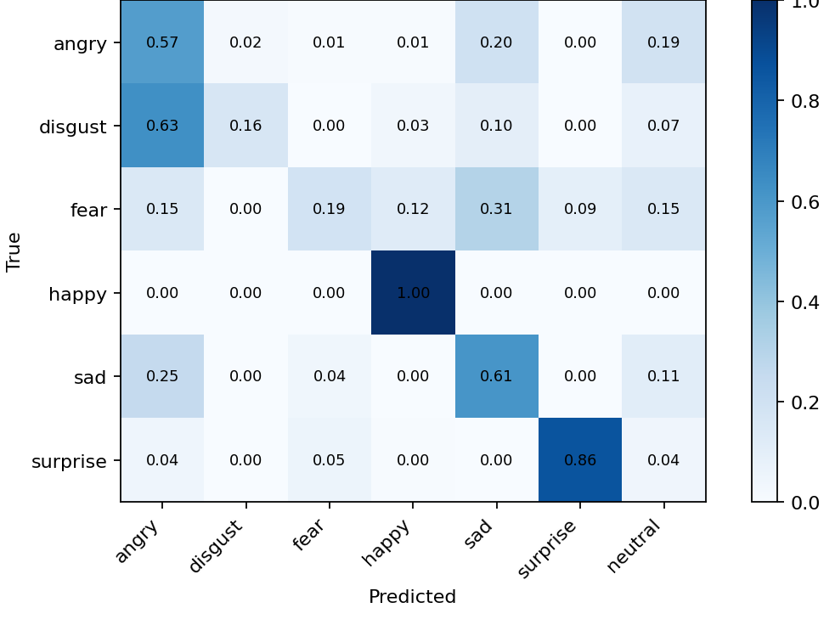
COMPARISON AGAINST BASELINES AND STATE OF THE ART
CK+ performance is worse in most emotions
Custom CNN CK+
ResNet18 CK+
EfficientNet-B0 CK+
CK+ Custom CNN per-class F1
CK+ ResNet18 per-class F1
CK+ EfficientNet-B0 per-class F1
angry
disgust
fear
happy
sad
surprise
angry
disgust
fear
happy
sad
surprise
angry
disgust
fear
happy
sad
surprise
0.48
0.71
0.43
0.97
0.49
0.95
0.57
0.66
0.41
0.96
0.69
0.94
0.42
0.28
0.26
0.96
0.51
0.91

Slide 21
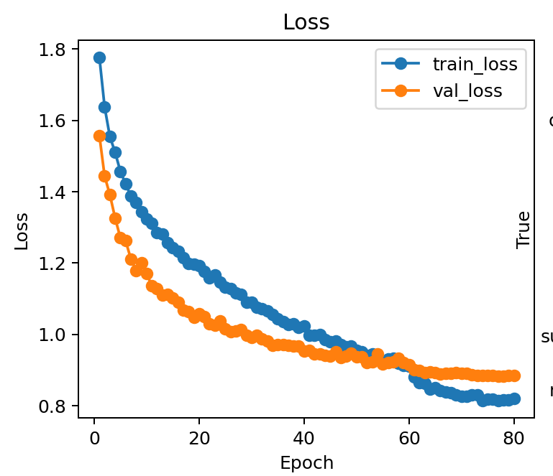
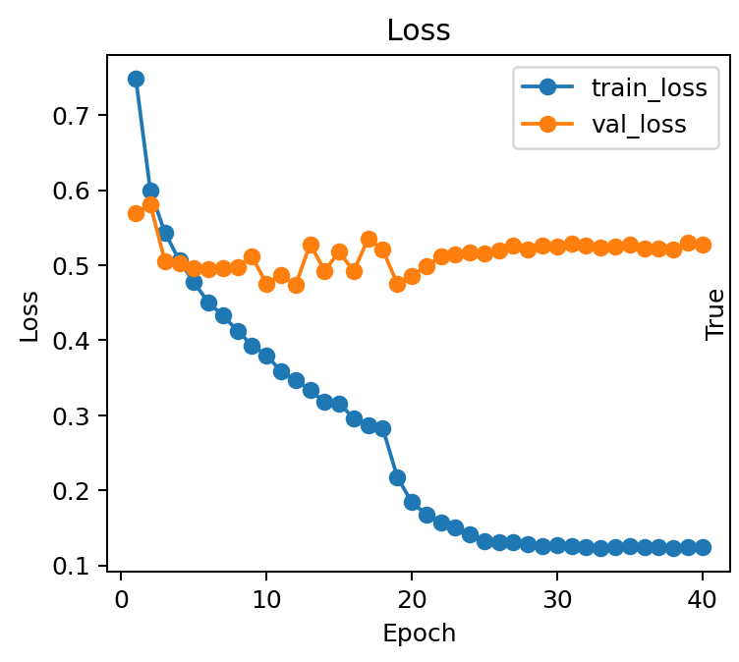
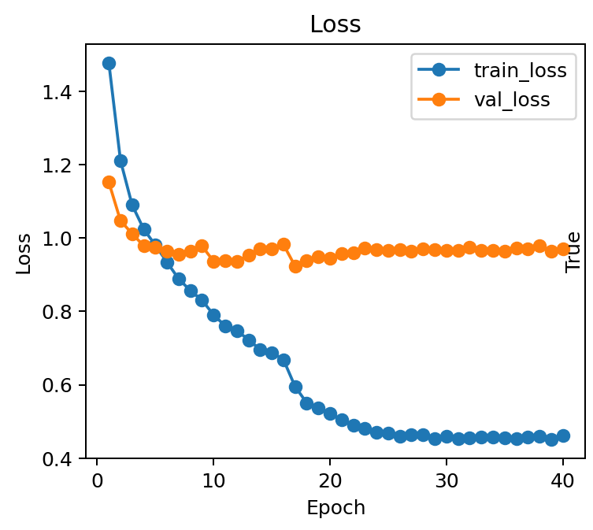
DISCUSSION OF LIMITATIONS AND OBSERVATIONS
Remaining errors come from ambiguous classes
Custom CNN
ResNet18
EfficientNet-B0
Weak classes drive the main limitations
Minor classes issue are mitigated through our strategies like class weights or weighted sampler
Some classes like fear, angry which are not minor classes, but still low true prediction rate, which could be caused by the dataset itself
Loss curves show overfitting in pretrained models

Slide 22
DISCUSSION OF LIMITATIONS AND OBSERVATIONS
What we can extract from our results
Weak classes drive the main limitations
Minor classes issues are mitigated through our strategies like class weights, weighted sampler…
Some classes have low performance even though being more represented in the dataset
The most confused emotions were repeated in the three models

Slide 23
CONCLUSIONS AND FUTURE WORK
The project improves balanced FER2013 recognition while showing where it still fails.
CONCLUSIONS
FUTURE WORK
Transfer learning provides moderate improvements over the custom CNN baseline, even though they were trained for different tasks
Establish human performance baseline
Clean noisy labels and use soft labels for ambiguous samples
Not all emotions are equally distinguishable
Extend external validation beyond CK+ and test stronger or ensemble backbones
Per-class analysis is essential because weak classes remain hidden in aggregate scores
Testing on external datasets can help to find issues in our models

Slide 24
Thank you for your attention!

