Slide 1
Facial Expression Recognition on FER2013
Custom CNN baselines, transfer learning, and CK+ external validation
Main question: which strategy generalizes best on imbalanced, low-resolution facial expression data?
Deep Learning Final Project

Slide 2
INTRODUCTION
FER is useful, but visually fragile.
Facial expressions are useful for affective computing and human-computer interaction.
Presentation thesis:
A fair comparison needs macro F1, per-class analysis, and external validation, not only one accuracy-like score.
The same emotion can look different across people, lighting, pose, and intensity.
FER2013 is a practical benchmark because it exposes these real-world difficulties.
02

Slide 3
RELATED WORK
Modern FER moved from features to learned representations.
Approach
Typical idea
Relevance here
Classical FER
Handcrafted features + classifier
Historical baseline
CNNs
Learn visual features from data
Custom CNN baseline
Transfer learning
Adapt pretrained visual backbones
ResNet18 / EfficientNet-B0
Recent SOTA
Attention, ensembles, transformers, alignment
Future work direction
Scope choice:
This project focuses on a controlled comparison of practical CNN strategies under class imbalance.
03

Slide 4
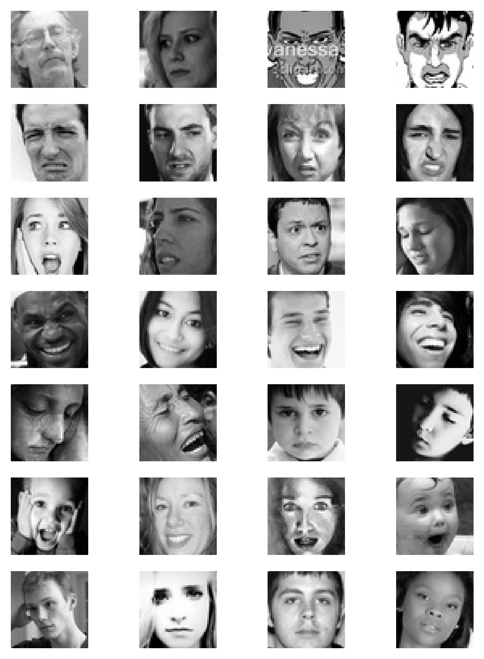
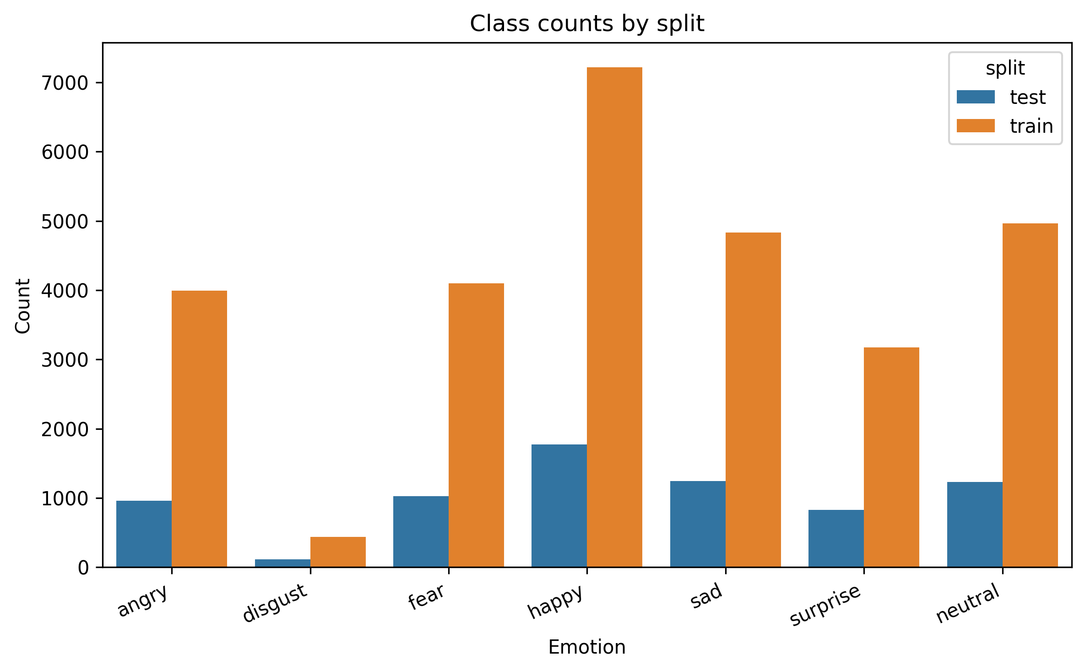
DATASET
FER2013 is small, imbalanced, and ambiguous.
48x48 grayscale face crops across seven classes.
Happy is frequent; disgust is rare. This motivates macro F1 and imbalance-aware training.
04

Slide 5
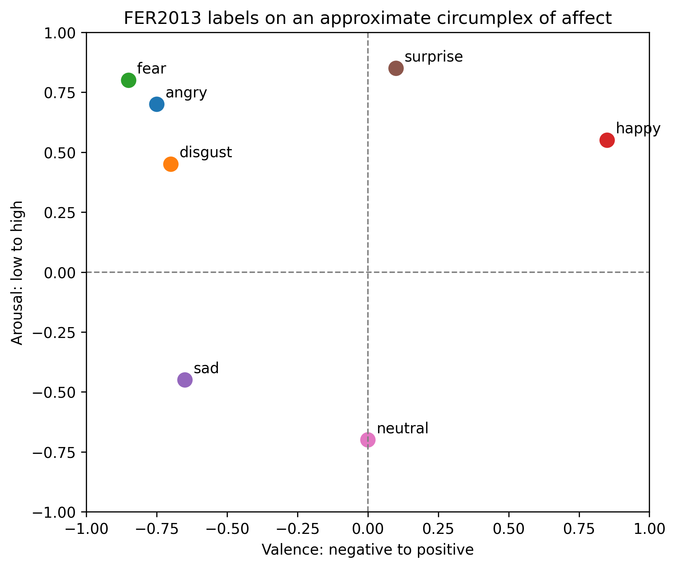
AFFECT SPACE
The label space is not emotionally independent.
Emotion classes can be close in valence-arousal space.
This supports interpreting confusions as meaningful ambiguity.
Sad, neutral, fear, and angry are expected to be difficult.
05

Slide 6
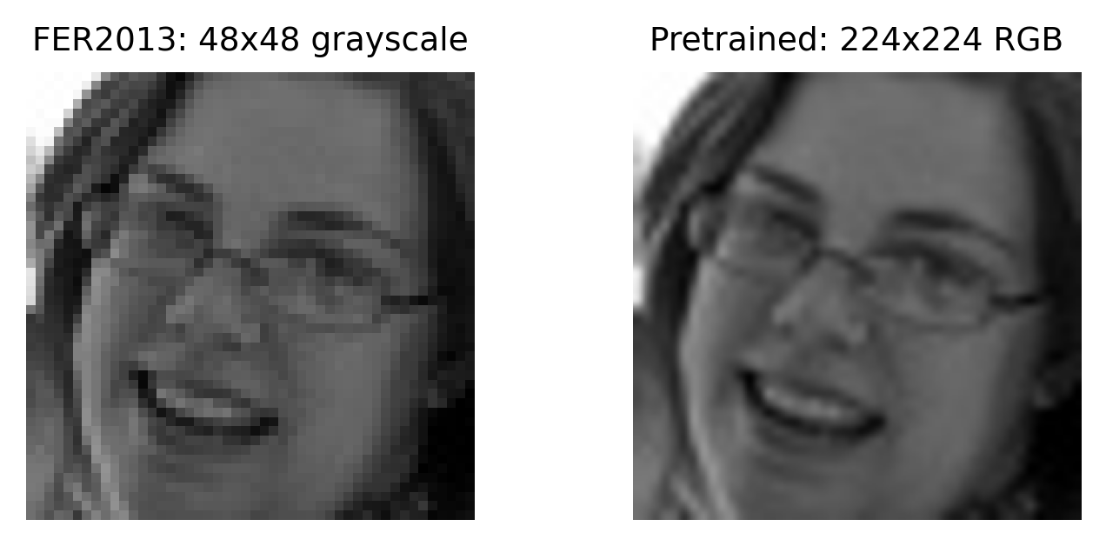
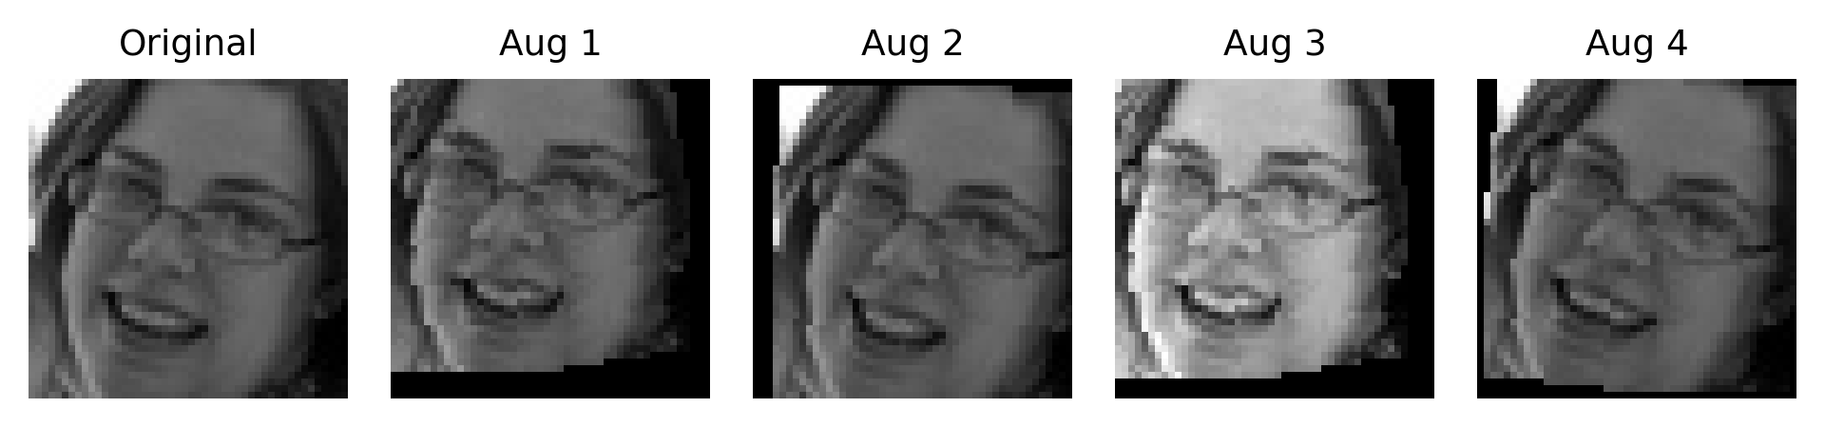
PREPROCESSING
Inputs were adapted to each model family.
Baseline CNNs use augmented 48x48 grayscale inputs.
Pretrained models use resized 224x224 three-channel inputs with ImageNet normalization.
06

Slide 7
METHODOLOGY
The model comparison follows a simple escalation path.
Custom CNN trained from scratch as the baseline.
Training strategies:
class weights, weighted sampling, focal loss, SGD scheduling, and crop-based evaluation.
Deeper CNN checks whether added capacity improves the baseline.
ResNet18 tests a standard ImageNet-pretrained backbone.
EfficientNet-B0 tests a lighter pretrained architecture.
07

Slide 8
EXPERIMENTS
Evaluation emphasizes balanced performance across classes.
Category
Evaluated configurations
Baseline CNN
augmentation, imbalance handling, deeper capacity
Optimization
focal loss, class weights, weighted sampler, SGD schedule
Transfer learning
ResNet18 and EfficientNet-B0 fine-tuning
Validation
FER2013 test set and CK+ external validation
Primary metric:
Macro F1, because high performance on common classes alone is not enough.
08

Slide 9
FER2013 RESULTS
ResNet18 fine-tuning gave the strongest FER2013 result.
Baseline CNN
0.624
EfficientNet-B0
0.625
ResNet18
0.676
Weighted F1 followed the same pattern: baseline 0.649, EfficientNet-B0 0.646, ResNet18 0.685.
Test macro F1 comparison:
ResNet18 improved the best custom CNN baseline by about 5.2 percentage points.
09

Slide 10
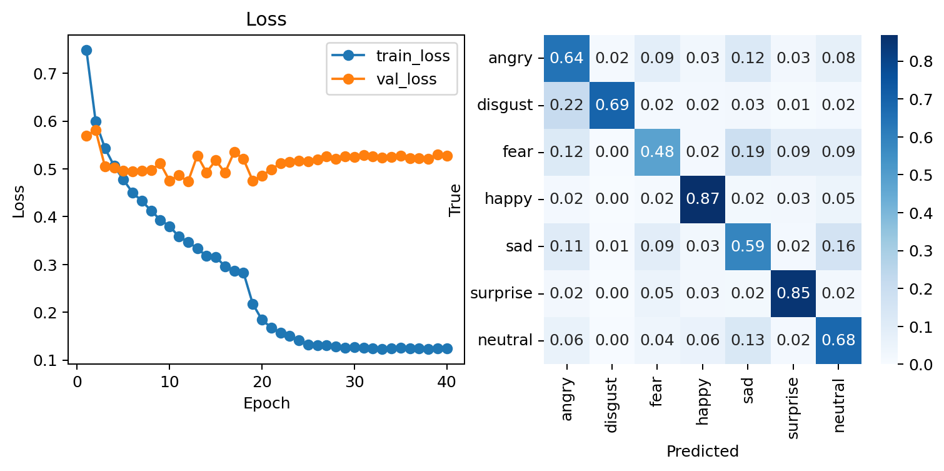
ERROR ANALYSIS
The dominant error is sad predicted as neutral.
Confusions are concentrated in visually close expressions.
Sad and neutral are repeatedly confused.
Fear, angry, sad, and neutral remain the difficult region.
10

Slide 11
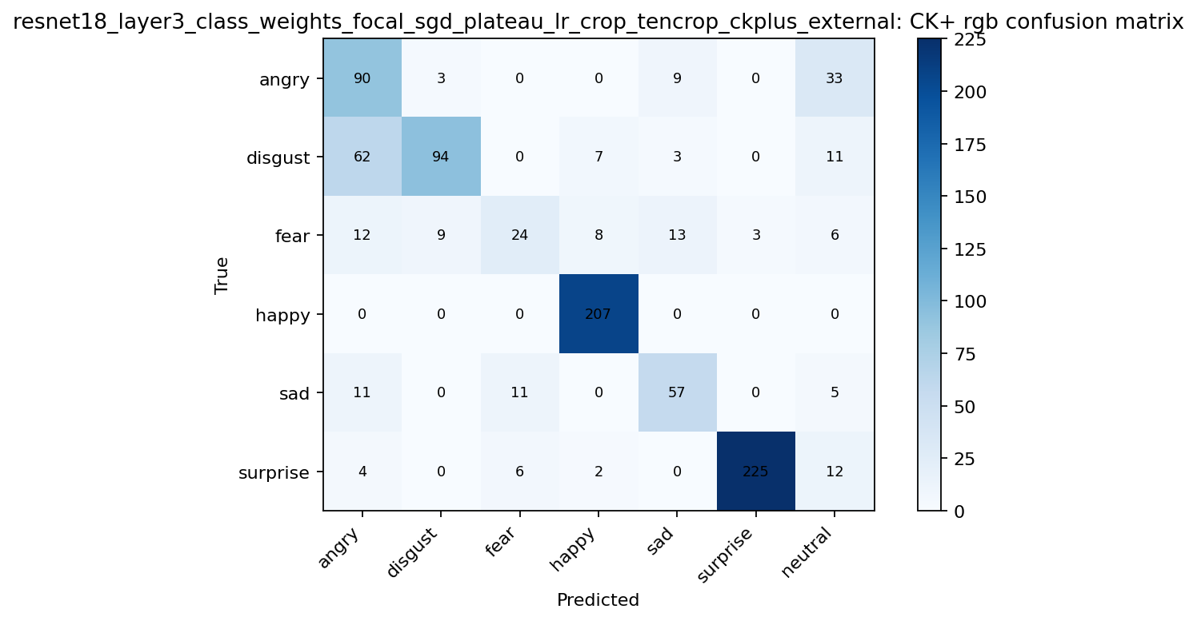
EXTERNAL VALIDATION
CK+ reveals a domain-shift story.
Model
CK+ macro F1
Baseline CNN
0.724
ResNet18
0.707
EfficientNet-B0
0.582
Observation:
The best FER2013 model is not automatically the best external model, so cross-dataset validation matters.
11

Slide 12
CONCLUSION
FER2013 performance improved, but generalization remains limited.
Transfer learning improved FER2013 performance, especially with ResNet18.
Macro F1 and confusion matrices were necessary because the dataset is imbalanced.
External validation showed that dataset shift can change model ranking.
Future work: face alignment, label-noise handling, stronger augmentation, ensembles, calibration, and attention-based models.
Final message:
The project is not only about higher scores; it is about understanding where FER models generalize and where they fail.
12

