Slide 1
Facial Expression Recognition on FER2013
From custom CNN baselines to transfer learning and CK+ external validation
PRIMARY METRIC
BEST FER2013
EXTERNAL CHECK
Macro F1
ResNet18
CK+
Chosen because FER2013 is strongly imbalanced.
0.676 test macro F1.
Shows domain-shift behavior.
12-minute final project presentation

Slide 2
PRESENTATION MAP
The talk follows the requested scientific structure.
Section
What it answers
Introduction and motivation
Why FER2013 is an important but difficult recognition task
Related work / state of the art
Where CNNs, transfer learning, and modern FER methods fit
Dataset and preprocessing
What data limitations shape the modeling choices
Methodology and implemented models
Which models were built and why
Experiments and configurations
Which ablations and fine-tuning settings were evaluated
Results, analysis, comparison
Which model worked best and what errors remain
Limitations, conclusions, future work
What the results do and do not prove
02

Slide 3
INTRODUCTION AND MOTIVATION
FER is useful, but ambiguity makes simple accuracy misleading.
Facial expressions provide cues for affective computing and human-computer interaction.
CENTRAL QUESTION
Real expressions vary by identity, pose, intensity, and image quality.
What generalizes?
Do stronger backbones and imbalance-aware training improve recognition across all emotions, or mainly the easy classes?
FER2013 is intentionally challenging: low-resolution grayscale faces and noisy labels.
The project therefore evaluates balanced performance and cross-dataset behavior.
03

Slide 4
RELATED WORK / STATE OF THE ART
The project sits between practical CNN baselines and stronger modern FER systems.
Family
Typical method
Relation to this project
Classical FER
Handcrafted features with shallow classifiers
Historical context
CNN baselines
Train visual features from expression data
Implemented custom CNNs
Transfer learning
Fine-tune ImageNet-pretrained CNN backbones
Implemented ResNet18 and EfficientNet-B0
Recent SOTA
Attention, ensembles, transformers, alignment, larger curated datasets
Used as future-work direction
A direct SOTA claim would be unfair without identical splits, face alignment, and training budgets.
The fair comparison here is against implemented baselines and practical transfer-learning alternatives.
04

Slide 5
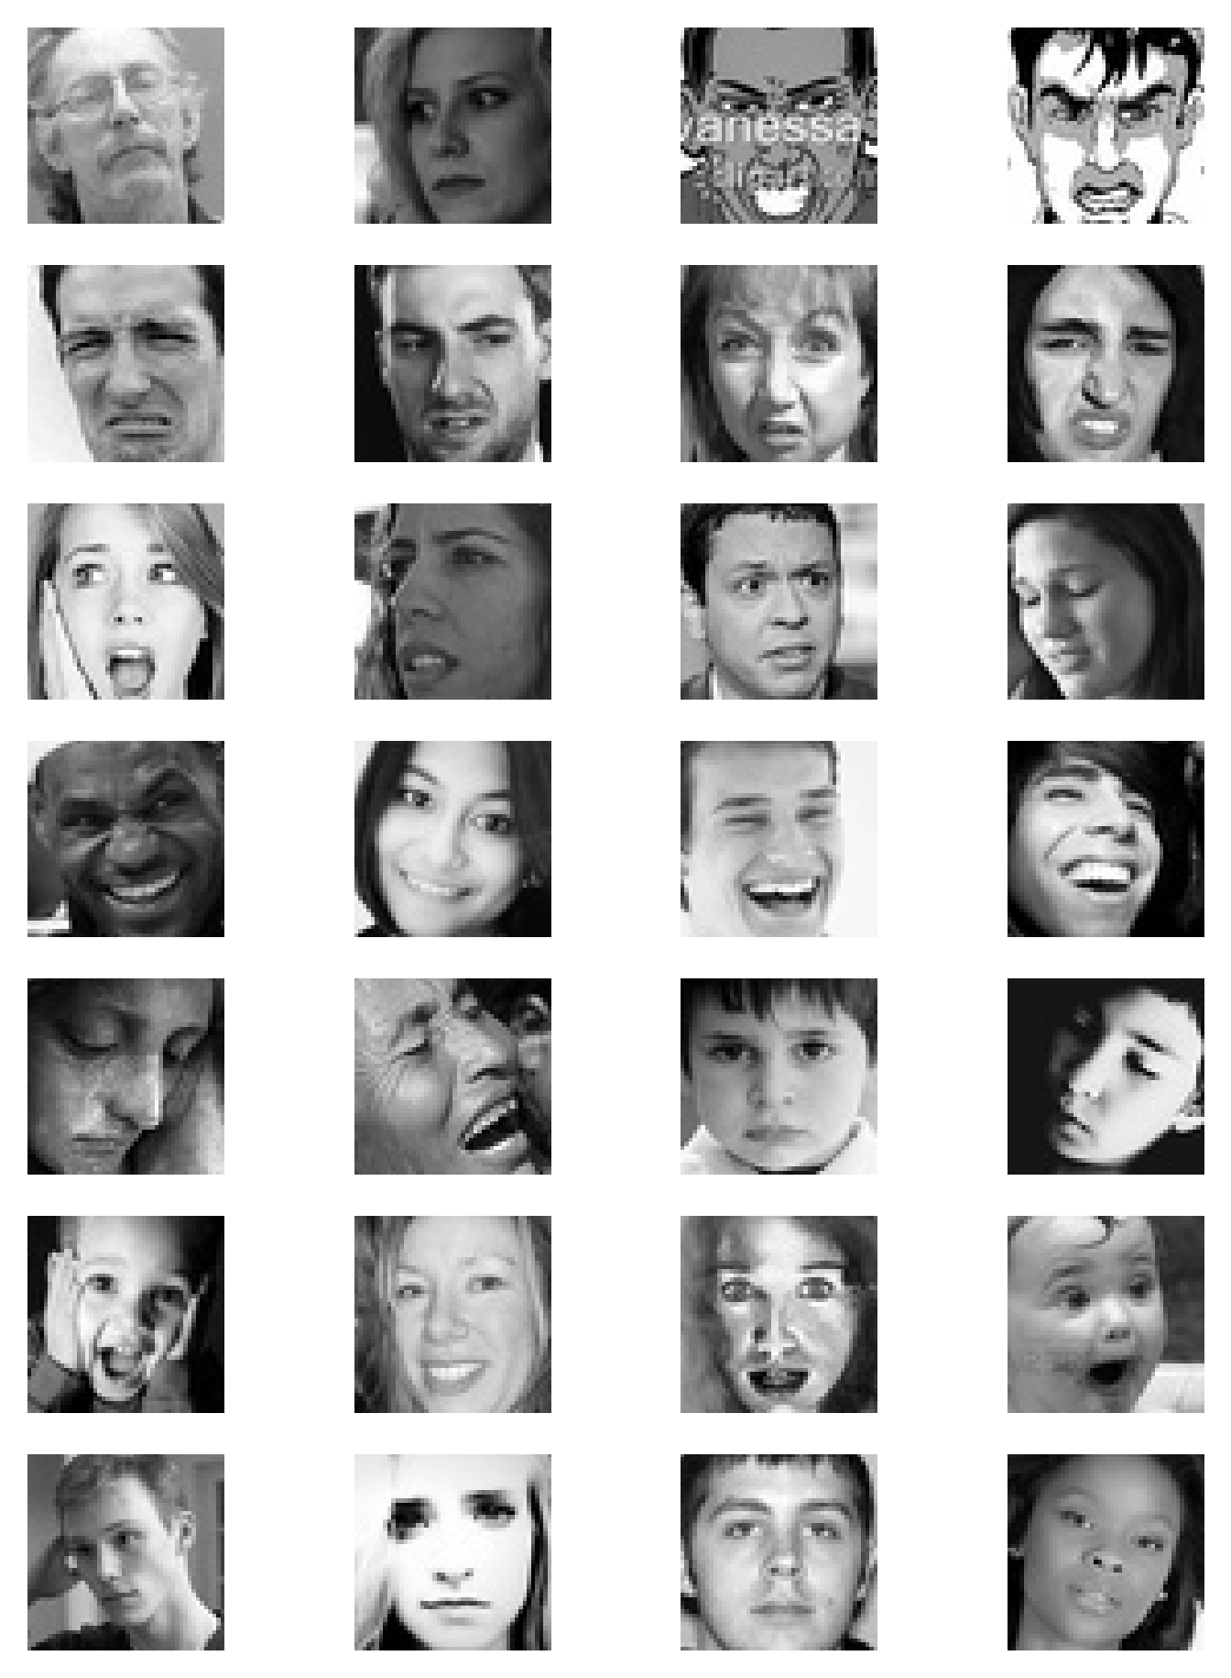
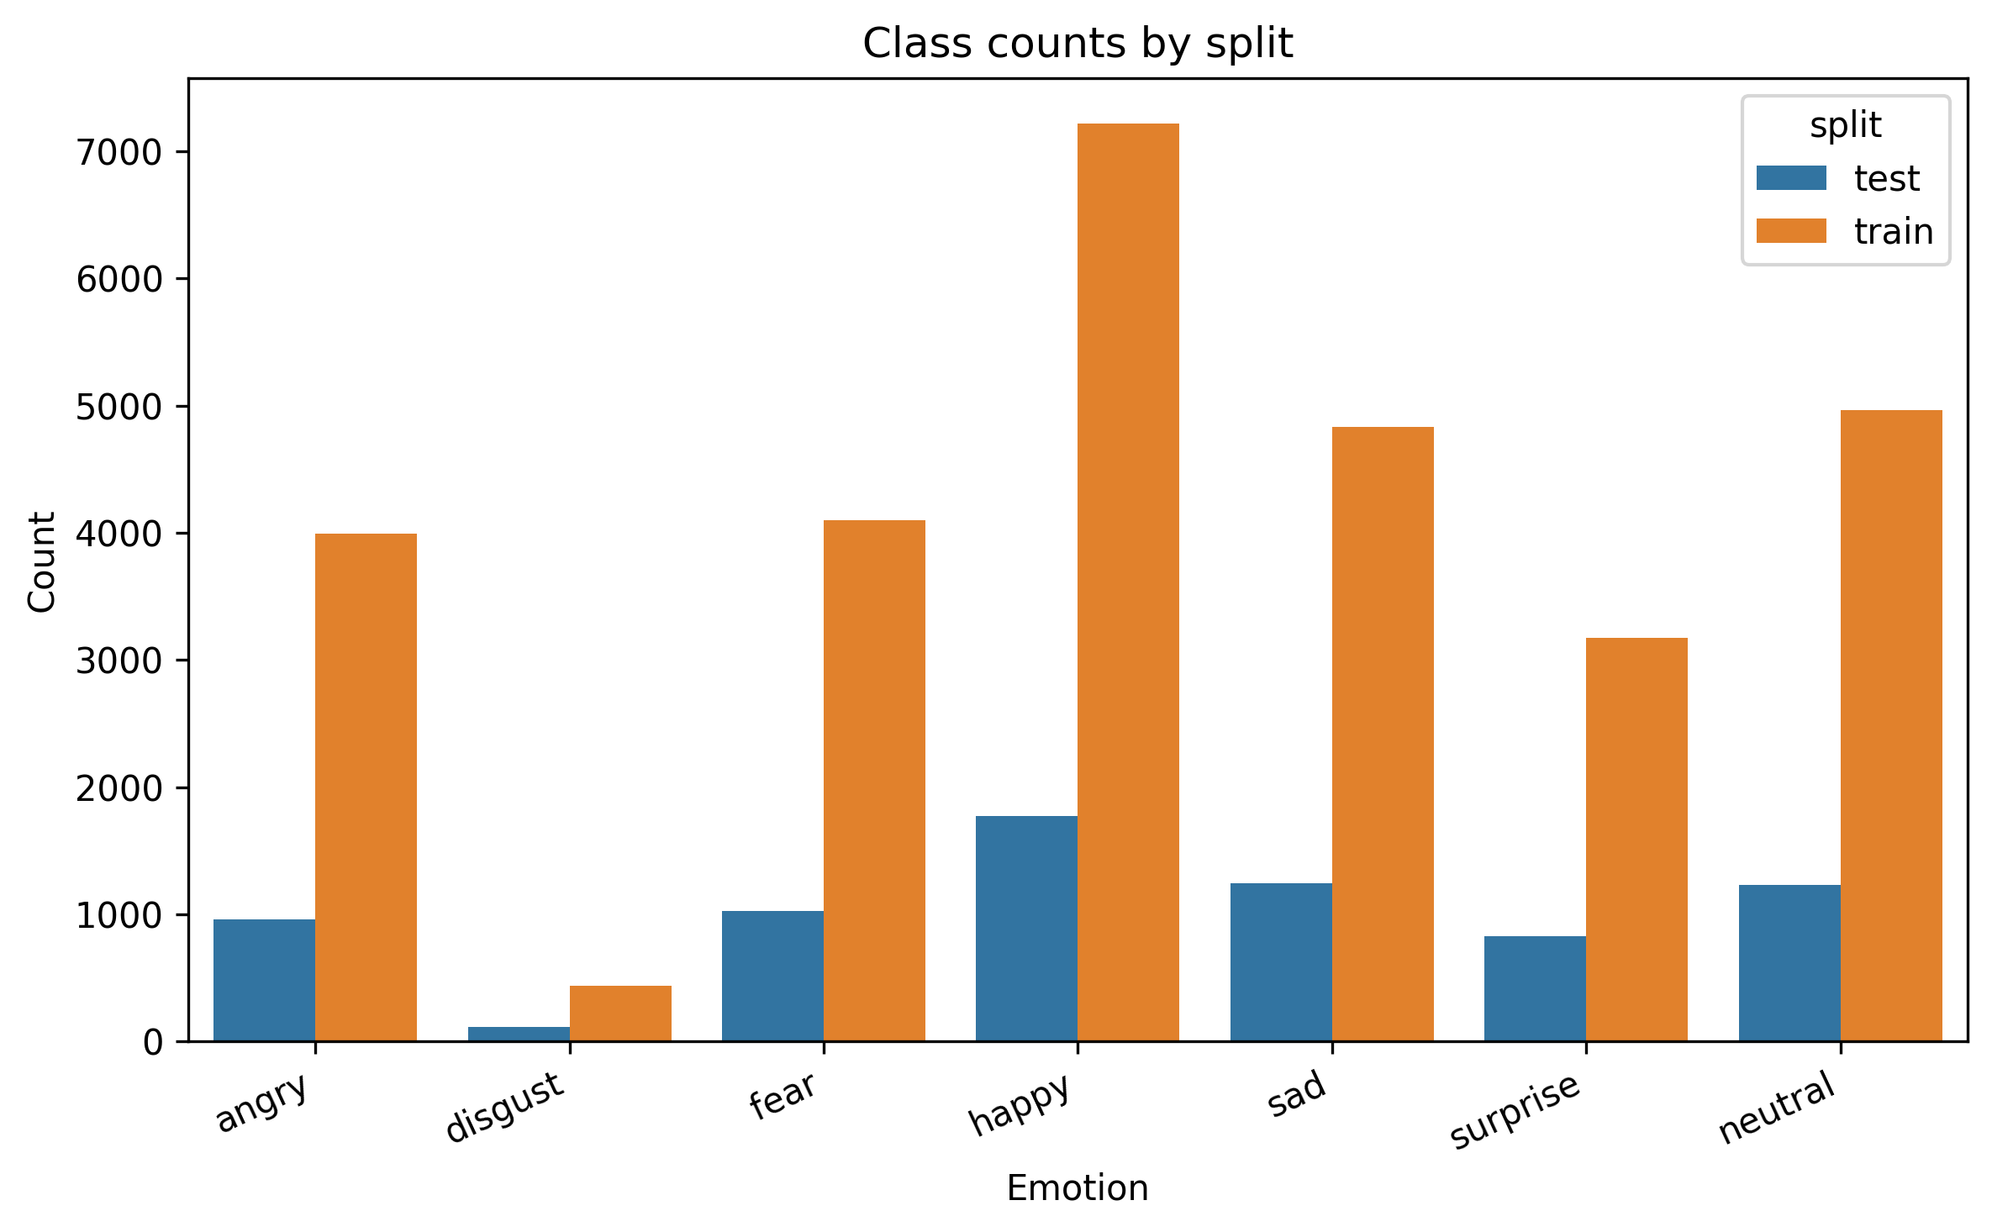
DATASET AND PREPROCESSING
FER2013 contains visible ambiguity and strong class imbalance.
Seven emotion classes, 48x48 grayscale face crops.
Class imbalance motivates macro F1 and imbalance-aware training.
05

Slide 6
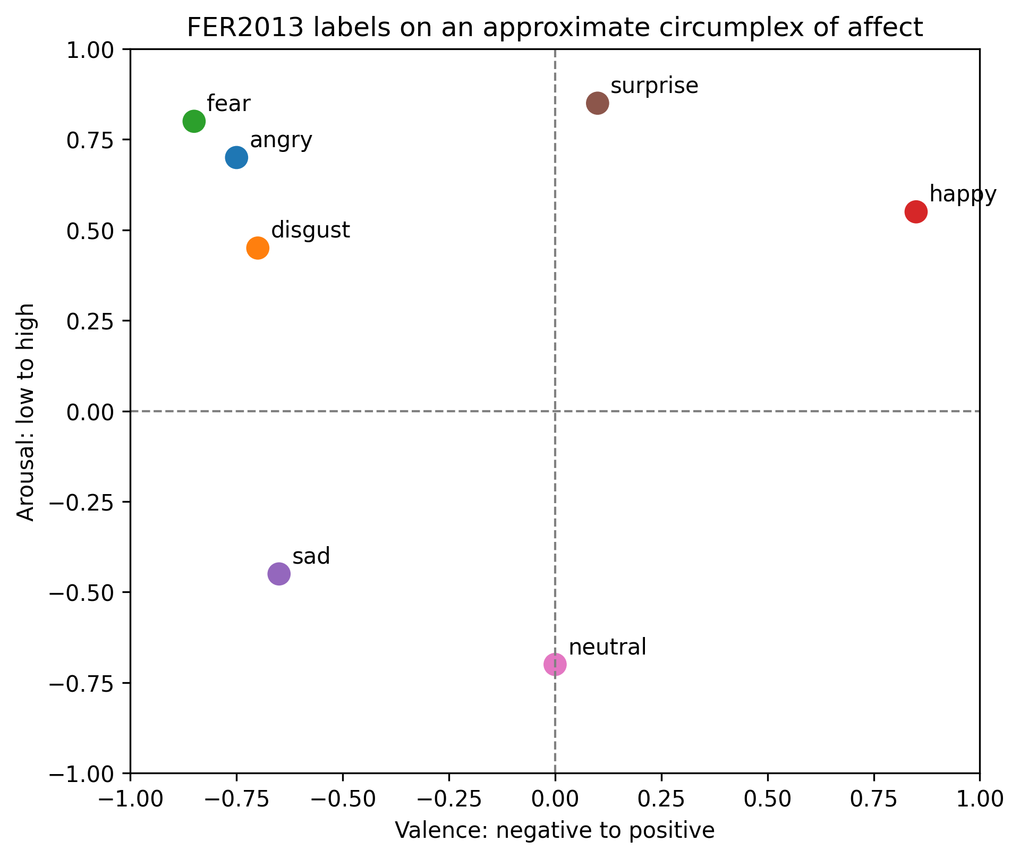
DATASET AND PREPROCESSING
The affect circumplex explains why some classes are naturally confused.
FER labels are categorical, but emotions are related in valence-arousal space.
Sad, neutral, fear, and angry occupy nearby or visually subtle regions.
This provides a scientific lens for error analysis, not an excuse for errors.
06

Slide 7
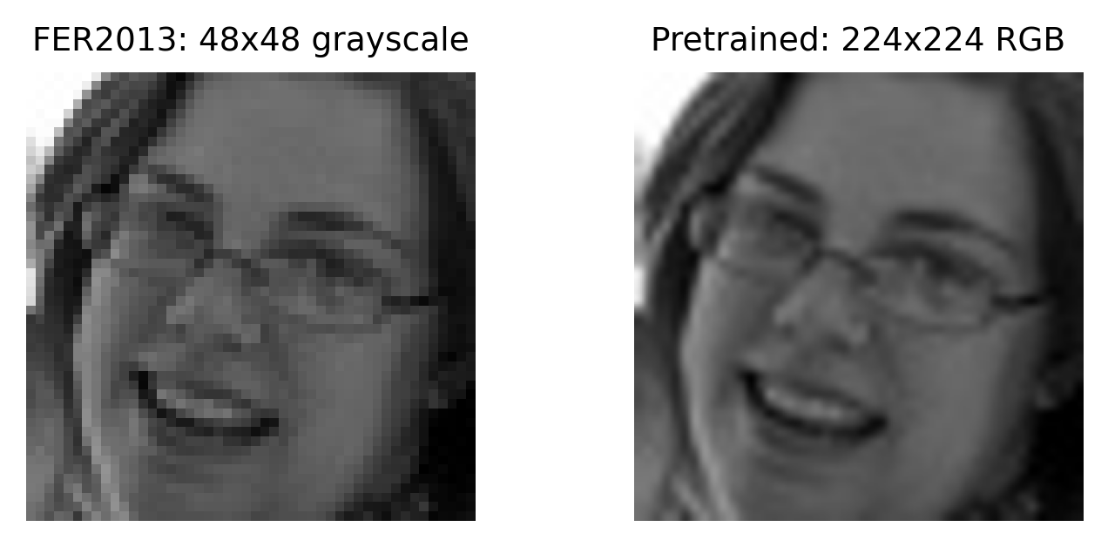
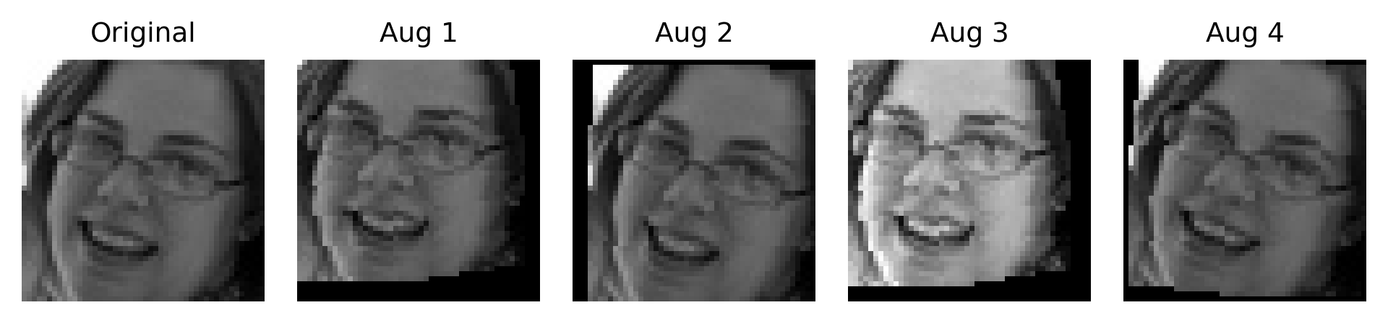
DATASET AND PREPROCESSING
The preprocessing path depends on the model family.
Baseline CNN: preserve the native 48x48 grayscale setting and use augmentation for robustness.
Pretrained CNNs: resize to 224x224, convert to 3 channels, and normalize with ImageNet statistics.
07

Slide 8
METHODOLOGY AND IMPLEMENTED MODELS
The models form an escalation from scratch training to transfer learning.
Model
Input
Purpose
Custom CNN
48x48 grayscale
Baseline trained from scratch
Deeper CNN
48x48 grayscale
Test whether capacity helps the baseline
ResNet18
224x224 RGB-like
Standard pretrained backbone for fine-tuning
EfficientNet-B0
224x224 RGB-like
Lightweight pretrained comparison
EVALUATION PRINCIPLE
Macro F1 first
Weighted F1 and confusion matrices are supporting evidence, not replacements.
08

Slide 9
EXPERIMENTS AND EVALUATED CONFIGURATIONS
The experiment plan is an ablation chain, not unrelated model trials.
Stage
Configuration idea
Reason
Baseline
CNN + augmentation
Reduce overfitting on small images
Imbalance
class weights, weighted sampler, focal loss
Improve minority and hard-class behavior
Optimization
SGD, plateau LR, gradient clipping
Stabilize refinement
Crop evaluation
RandomCrop + TenCrop-style averaging
Test prediction stability
Transfer
ResNet18 / EfficientNet-B0 partial fine-tuning
Reuse pretrained visual features
External validation on CK+ checks whether FER2013-trained models transfer to a different dataset.
09

Slide 10
RESULTS AND ANALYSIS
Baseline improvements show that capacity and training strategy matter.
Oversampling + focal
0.483
Best baseline
Value
Aug + sampler + CE
0.595
Test macro F1
0.624
Aug + sampler + focal
0.603
Weighted F1
0.649
Deeper CNN, 80 epochs
0.624
Top confusion
sad -> neutral
Fear F1
0.414
Happy F1
0.870
Neutral F1
0.626
10

Slide 11
RESULTS AND ANALYSIS
ResNet18 fine-tuning produced the strongest FER2013 test performance.
Feature extract FC
0.352
BEST RESNET18
Unfreeze layer4
0.607
0.676
Layer3 + sampler
0.649
test macro F1, with 0.685 weighted F1.
Layer3 + weights + focal + SGD
0.676
MAIN TRADEOFF
fine-tuning depth
Feature extraction alone was much weaker than partial unfreezing.
11

Slide 12
COMPARISON AGAINST BASELINES
The final FER2013 comparison favors ResNet18 over both implemented baselines.
Best baseline CNN
0.624
Model
Macro F1
Weighted F1
Top confusion
Best EfficientNet-B0
0.625
Baseline CNN
0.624
0.649
sad -> neutral
Best ResNet18
0.676
EfficientNet-B0
0.625
0.646
sad -> neutral
ResNet18
0.676
0.685
sad -> neutral
12

Slide 13
RESULTS AND ANALYSIS
Per-class scores show the model is strong on clear expressions and weaker on ambiguous ones.
Class
ResNet18 F1
Observation
Happy
0.881
Happy
0.881
clearest and most frequent class
Surprise
0.803
Surprise
0.803
distinct expression pattern
Neutral
0.646
Disgust
0.713
small class but improved with weighting
Sad
0.558
Neutral
0.646
often confused with sad
Fear
0.518
Angry
0.611
moderate ambiguity
Sad
0.558
main confusion with neutral
Fear
0.518
hardest class in final model
13

Slide 14
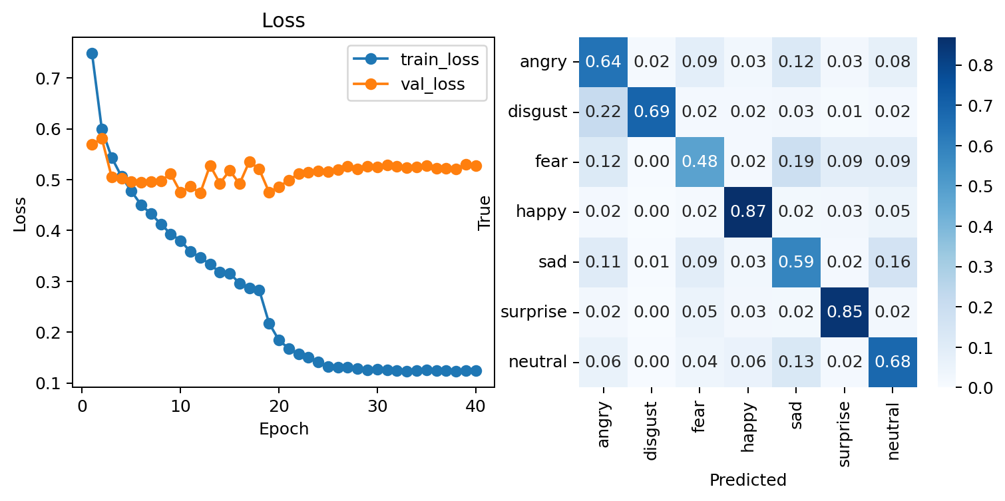
RESULTS AND ANALYSIS
The confusion matrix confirms the affect-space interpretation.
Repeated top confusion: sad -> neutral.
Fear is often absorbed into sad, angry, surprise, or neutral.
Happy and surprise are much cleaner than fear and sad.
The model learns useful structure, but subtle affective boundaries remain weak.
14

Slide 15
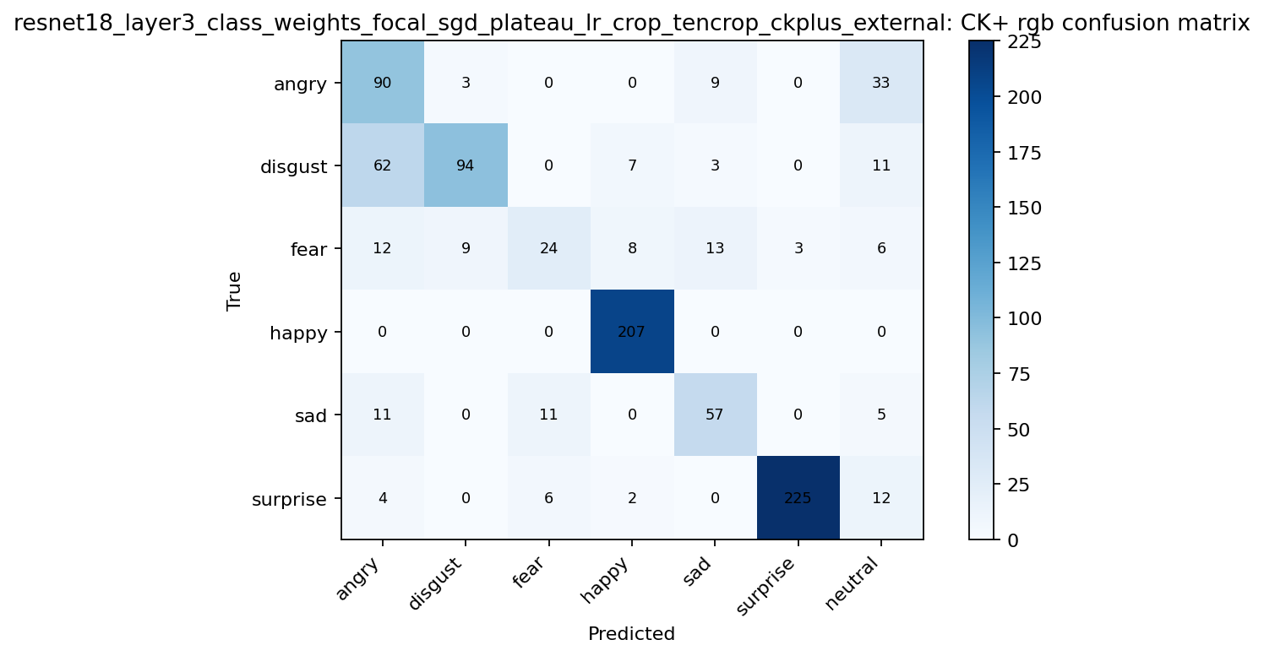
COMPARISON AND EXTERNAL VALIDATION
CK+ changes the ranking, showing domain shift.
Model
CK+ macro F1
CK+ weighted F1
Baseline CNN
0.724
0.799
ResNet18
0.707
0.774
EfficientNet-B0
0.582
0.676
OBSERVATION
FER2013 != CK+
The best FER2013 model does not dominate external validation, so dataset shift is a real limitation.
15

Slide 16
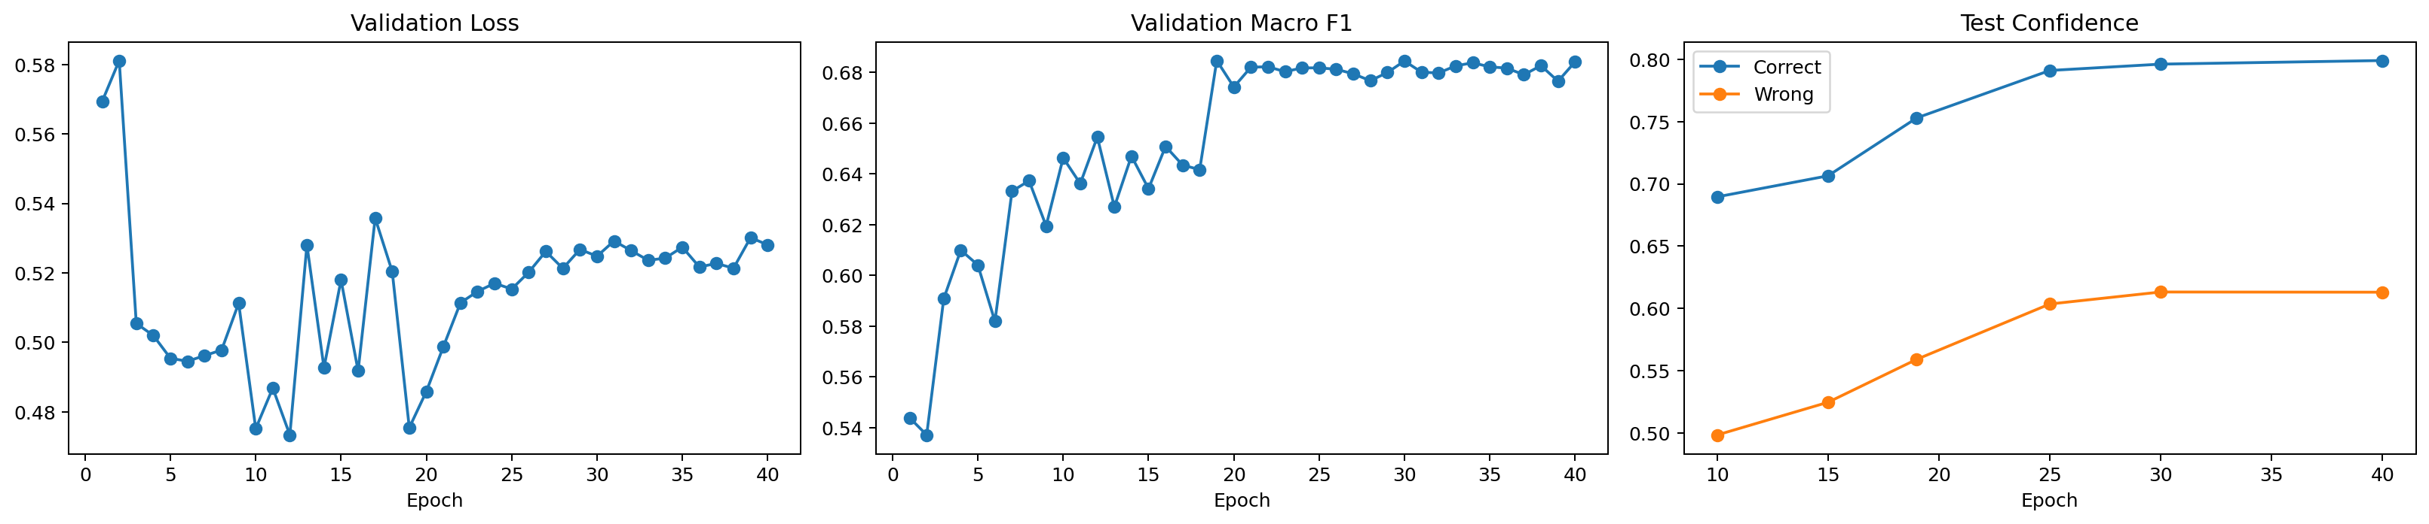
DISCUSSION OF LIMITATIONS AND OBSERVATIONS
The model is confident enough to be useful, but not reliable enough to overclaim.
Low image resolution and noisy labels limit the ceiling.
Class imbalance remains visible despite weighting and focal loss.
Emotion boundaries are not purely categorical; affect-space proximity matters.
External validation suggests domain shift between FER2013 and CK+.
No explicit face alignment pipeline was used.
16

Slide 17
CONCLUSIONS AND FUTURE WORK
The project improves FER2013 performance and clarifies where the problem remains hard.
CONCLUSION 1
CONCLUSION 2
CONCLUSION 3
ResNet18 wins
Metrics matter
Domain shift
Best FER2013 result among implemented models: 0.676 test macro F1.
Macro F1, per-class F1, and confusion matrices reveal behavior hidden by aggregate scores.
CK+ validation shows that dataset transfer changes the story.
Future work
Expected benefit
Face alignment and better cropping
Reduce pose and background variation
Label-noise handling
Reduce penalty from ambiguous/noisy annotations
Stronger augmentation or ensembles
Improve robustness
Attention or transformer-based FER
Model subtle spatial expression cues
Calibration and confidence analysis
Make predictions more trustworthy
17

