Slide 1
Facial Expression Recognition on FER2013
A controlled comparison of CNN baselines, transfer learning, and CK+ external validation
TASK
METRIC
EXTERNAL CHECK
7 classes
Macro F1
CK+
angry, disgust, fear, happy, sad, surprise, neutral
primary score due to class imbalance
zero-shot validation beyond FER2013

Slide 2
Presentation structure
The deck follows the required scientific structure explicitly.
1
Introduction and motivation
2
Related work / state of the art
3
Dataset and preprocessing
Why FER2013 is useful, difficult, and not well captured by accuracy alone.
How CNNs, transfer learning, and modern FER methods relate.
FER2013 images, imbalance, augmentation, and pretrained input adaptation.
4
Methodology
5
Experiments
6
Results, comparison, discussion
Controlled experiment design and implemented models.
Baseline progression, transfer-learning configurations, and CK+ validation.
Analyze results first, then compare models, then discuss limits and future work.
02

Slide 3
Introduction and motivation
Facial expression recognition is useful, but ambiguity makes evaluation delicate.
Facial expressions are useful cues for affective computing and human-computer interaction.
Expressions vary across people, pose, lighting, intensity, and annotation quality.
SCIENTIFIC QUESTION
Generalization
FER2013 is a good stress test because images are low-resolution and labels can be ambiguous.
Custom CNNs vs pretrained CNNs under imbalance-aware training and external validation.
The project asks which training strategy improves balanced recognition, not only common-class performance.
03

Slide 4
Related work / state of the art
Modern FER is dominated by learned visual features, but stronger systems add alignment and attention.
A
Classical FER
B
CNN-based FER
C
Transfer learning
Handcrafted descriptors with shallow classifiers; useful historically but weaker on varied images.
CNNs learn expression features directly from image data and form the main practical baseline.
ImageNet-pretrained backbones such as ResNet and EfficientNet are fine-tuned for emotion classes.
Recent state-of-the-art methods often use attention, transformers, ensembles, face alignment, and larger curated datasets.
This project does not claim SOTA; it compares implemented baselines and transfer-learning configurations under one evaluation protocol.
04

Slide 5
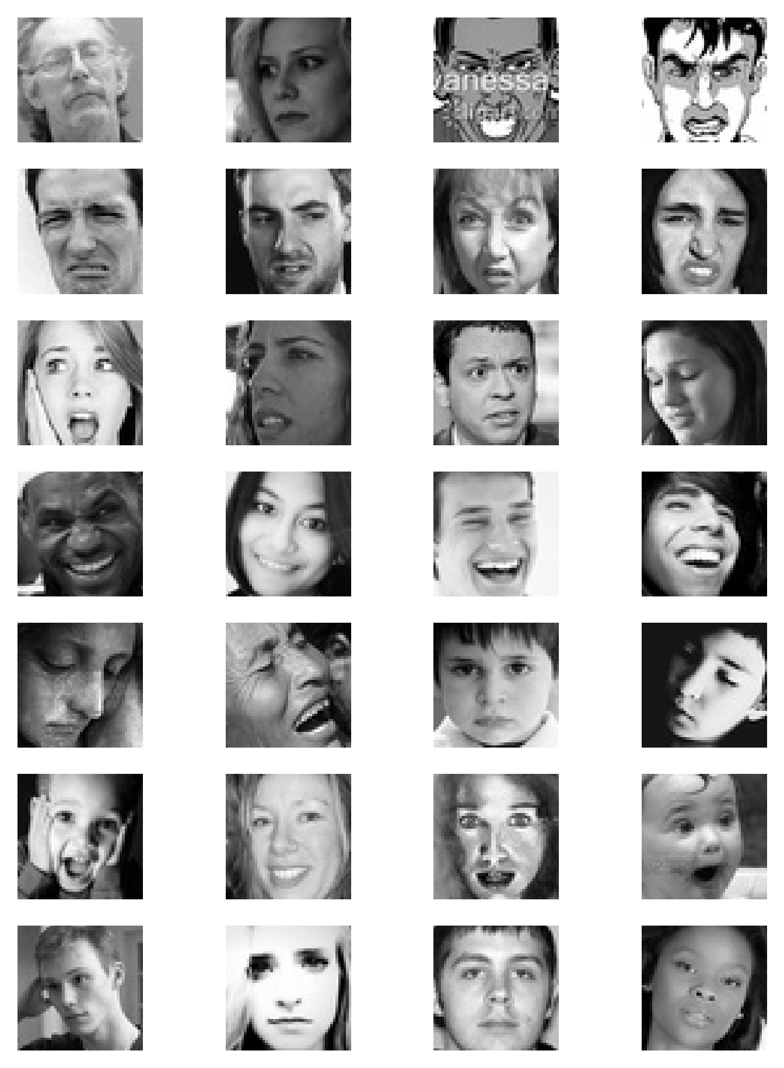
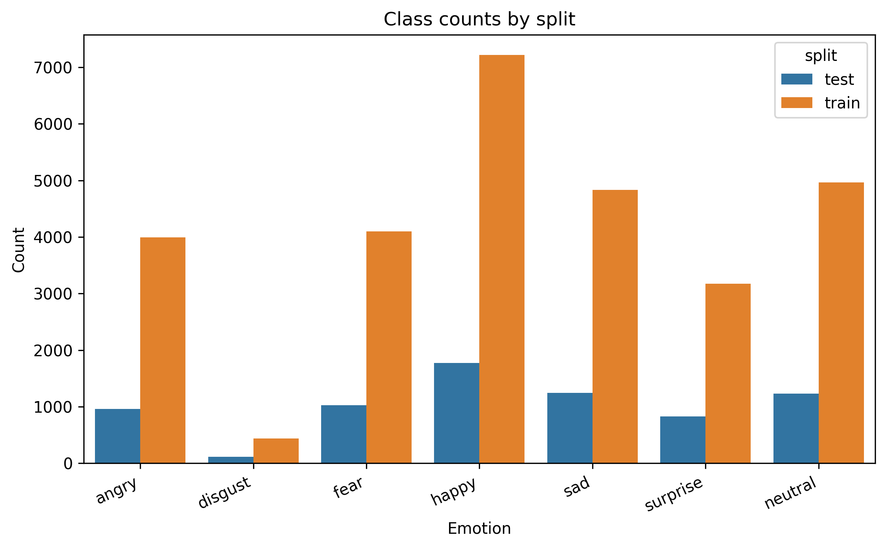
Dataset and preprocessing
FER2013 combines low-resolution faces, imbalance, and label ambiguity.
INPUT FORMAT
48x48
grayscale face crops
IMBALANCE
disgust
smallest class; happy is largest
Evaluation consequence: macro F1 is the primary model-selection metric; weighted F1 and confusion matrices support the analysis.
05

Slide 6
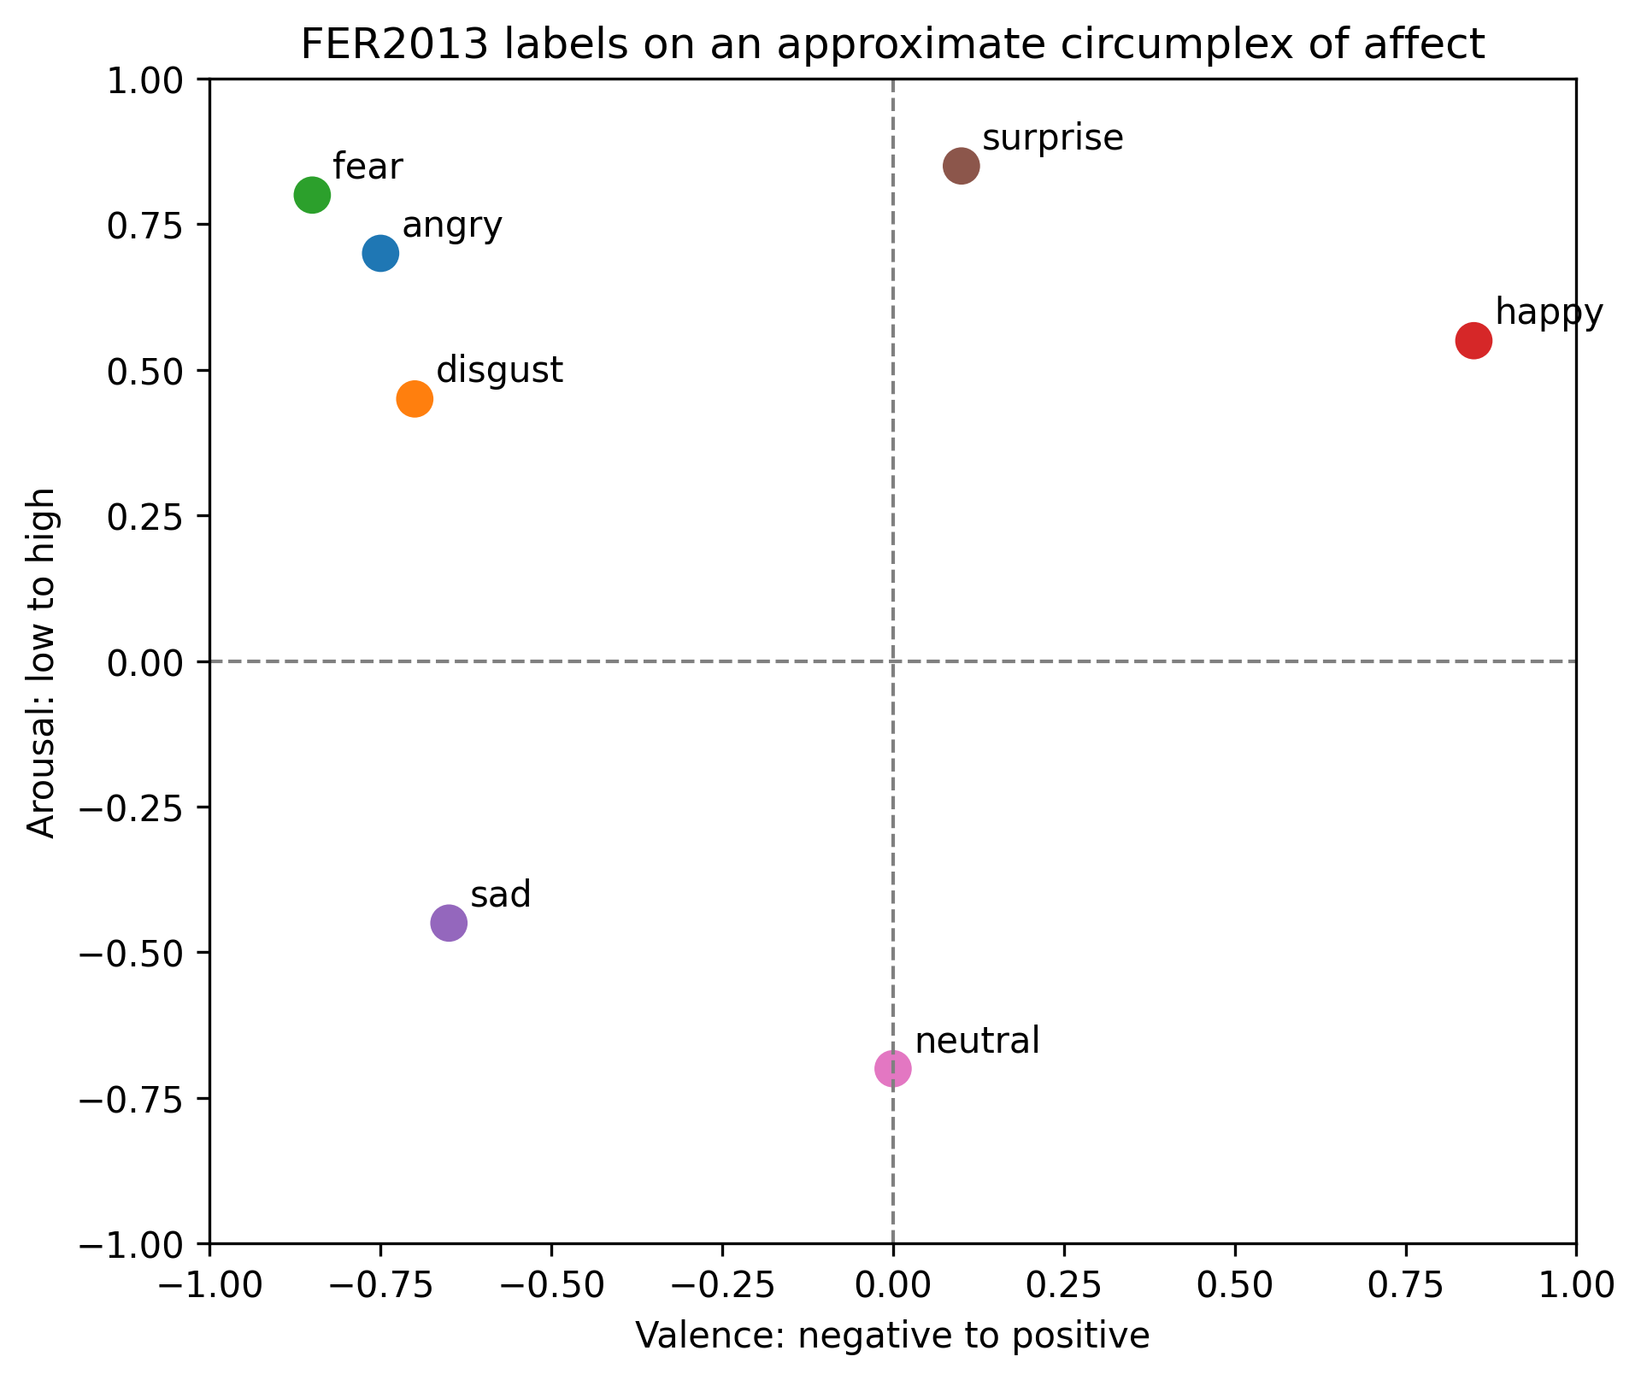
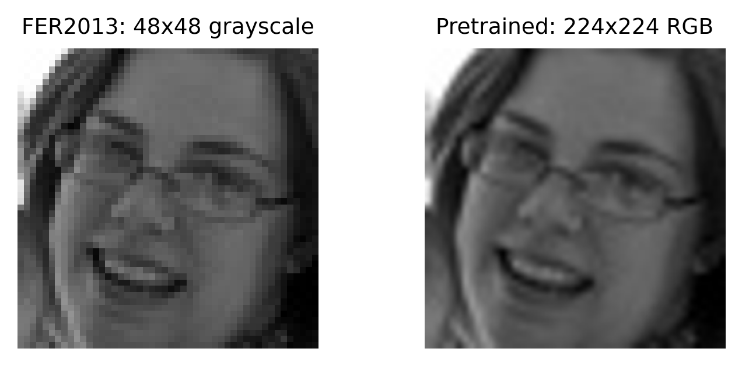
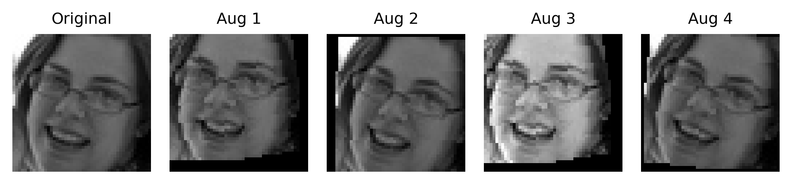
Dataset and preprocessing
Augmentation and input adaptation keep the comparison fair across model families.
Baseline CNNs stay close to native FER2013: 48x48 grayscale with data augmentation.
Pretrained CNNs require 224x224 three-channel inputs with ImageNet normalization.
Affect space explains why sad, neutral, fear, and angry are naturally hard to separate.
06

Slide 7
Methodology and implemented models
The methodology is a controlled experiment: change one modeling choice, then evaluate consistently.
1
Fix evaluation
2
Build baseline chain
3
Transfer learning
Same FER2013 test labels, same class order, macro F1 as primary metric.
Start from a custom CNN and add augmentation, imbalance handling, optimization, crop evaluation, and capacity.
Replace the learned-from-scratch feature extractor with ImageNet-pretrained ResNet18 and EfficientNet-B0.
4
Error analysis
5
External validation
Use confusion matrices, top confusions, and per-class F1 to explain failure modes.
Evaluate final checkpoints on CK+ to test cross-dataset robustness.
Controlled variable: model/training configuration. Fixed outputs: macro F1, weighted F1, per-class scores, confusion patterns.
07

Slide 8
Methodology and implemented models
The implemented models test capacity, pretraining, and efficiency.
CNN
Custom baseline
CNN
Deeper baseline
R18
ResNet18
Trained from scratch on 48x48 grayscale inputs; establishes the project-specific baseline.
Adds capacity to test whether the baseline is underpowered.
Standard pretrained CNN; partial fine-tuning from deeper layers.
B0
EfficientNet-B0
LOSS / SAMPLING
Lightweight pretrained CNN; tests efficiency-oriented transfer learning.
CE + focal
class weights and weighted sampler compared
08

Slide 9
Experiments and evaluated configurations
The baseline experiments progress from basic CNN design to stronger training recipes.
1
Basic CNN
2
Augmentation
3
Imbalance
4
Optimization
Custom CNN trained from scratch on FER2013.
Random transforms reduce overfitting.
Sampler, class weights, and focal loss.
SGD, plateau LR, and clipping.
5
Capacity / crops
Saved baseline results, test macro F1
Deeper CNN plus crop-based evaluation.
oversampling + focal
0.483
sampler + CE + SGD
0.595
sampler + focal + SGD
0.603
deeper CNN, 80 epochs
0.624
09

Slide 10
Experiments and evaluated configurations
Transfer-learning experiments compare fine-tuning depth and imbalance strategies.
ResNet18 configurations
EfficientNet-B0 configurations
feature extraction only
0.352
plain small classifier
0.587
layer4 fine-tuning
0.607
class weights
0.625
layer3 + class weights + focal + SGD
0.676
last blocks + sampler + SGD
0.666
layer3 + crop/TenCrop
0.682
last blocks + crop/TenCrop
0.685
CONTROLLED COMPARISON
same metrics
macro F1, weighted F1, per-class scores, confusion matrix
10

Slide 11
Results and analysis
Baseline improvements show that imbalance handling helps, but capacity alone is not enough.
oversampling + focal
0.483
BEST BASELINE
0.624
weighted sampler + CE + SGD
0.595
test macro F1; weighted F1 0.649
weighted sampler + focal + SGD
0.603
crop/TenCrop baseline
0.597
RECURRING ERROR
deeper CNN, 80 epochs
0.624
sad -> neutral
also fear -> sad in several baseline runs
11

Slide 12
Results and analysis
Transfer learning improves the strongest FER2013 results, especially after partial fine-tuning.
ResNet18 feature extraction
0.352
OBSERVATION
ResNet18 fine-tuned
0.676
fine-tuning matters
feature extraction alone is weak for FER2013
ResNet18 crop/TenCrop
0.682
EfficientNet-B0 class weights
0.625
BEST SAVED REPORT
EffNet-B0 crop/TenCrop
0.685
0.685
EfficientNet-B0 crop/TenCrop test macro F1
12

Slide 13
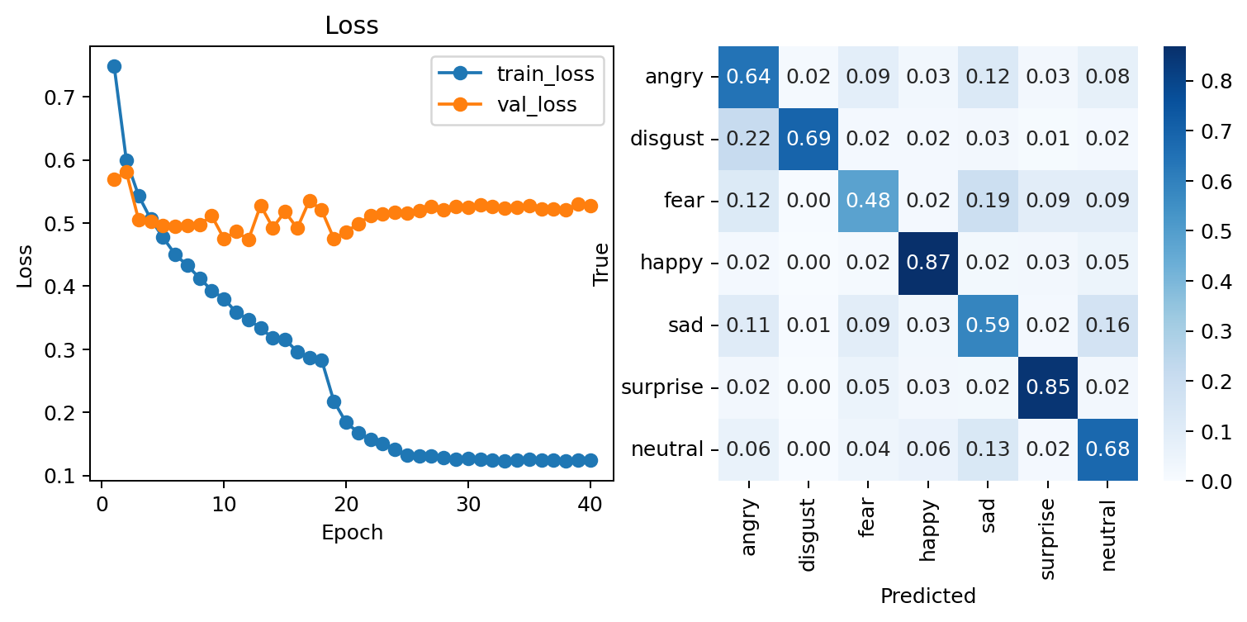
Results and analysis
The error analysis matches both the confusion matrix and affect-space intuition.
Happy and surprise are comparatively clean.
Fear and sad remain difficult classes.
Sad -> neutral is the most persistent confusion.
The affect circumplex supports this: some labels are close in emotion space.
13

Slide 14
Comparison against baselines and state of the art
Final comparison is separated from error analysis: implemented models first, SOTA context second.
Best custom CNN baseline
0.624
IMPLEMENTED COMPARISON
EffNet ~= R18
Best ResNet18
0.682
Both outperform the custom CNN baseline on FER2013.
Best EfficientNet-B0
0.685
SOTA CONTEXT
not claimed
Modern FER SOTA often uses stronger preprocessing, attention, ensembles, and larger training setups.
14

Slide 15
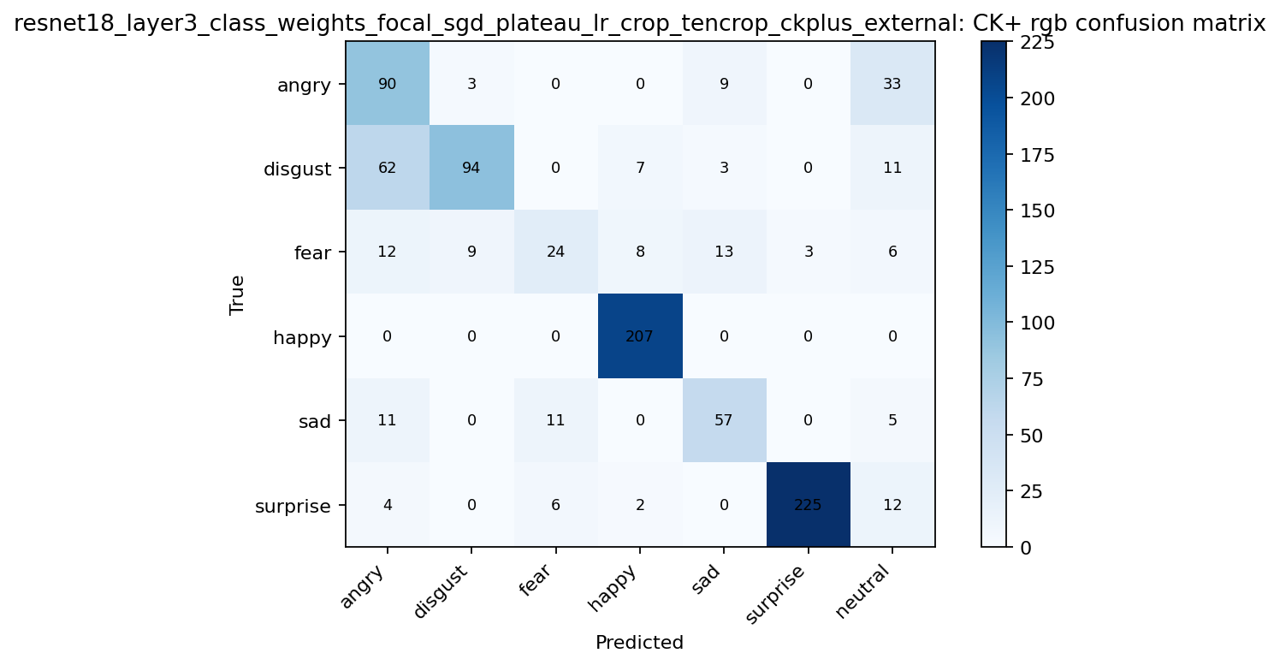
Comparison against baselines and state of the art
CK+ external validation changes the ranking and exposes domain shift.
Baseline CNN on CK+
0.724
ResNet18 on CK+
0.707
EfficientNet-B0 on CK+
0.556
OBSERVATION
domain shift
The best FER2013 model does not automatically dominate CK+.
15

Slide 16
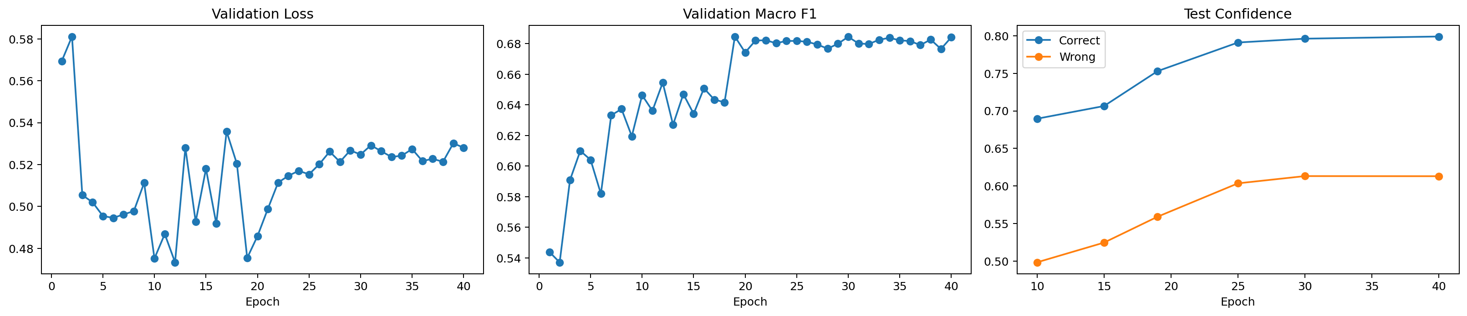
Discussion of limitations and observations
The results are useful, but the model should not be overclaimed.
FER2013 is low-resolution and contains ambiguous or noisy labels.
Class imbalance remains visible even after sampler and loss changes.
Emotion labels are categorical, but affect is continuous.
External validation shows dataset shift between FER2013 and CK+.
No explicit face alignment pipeline was included.
16

Slide 17
Conclusions and future work
The project improves FER2013 performance while identifying the remaining bottlenecks.
CONCLUSION 1
CONCLUSION 2
CONCLUSION 3
transfer helps
metrics matter
domain shift
ResNet18 and EfficientNet-B0 outperform the custom CNN baseline.
Macro F1 and per-class analysis reveal hard classes.
CK+ validation shows cross-dataset limits.
1
Face alignment
2
Label-noise handling
3
Stronger models
4
Calibration
Reduce pose and crop variation before training.
Account for ambiguous FER2013 annotations.
Attention, transformers, or ensembles.
Analyze confidence and high-confidence errors.
17

