Slide 1
Facial Expression Recognition on FER2013
Controlled CNN baselines, transfer learning, and CK+ external validation
TASK
PRIMARY METRIC
EXTERNAL VALIDATION
7 emotions
Macro F1
CK+
48x48 grayscale FER2013 images
balanced evaluation under class imbalance
zero-shot transfer beyond FER2013

Slide 2
PRESENTATION STRUCTURE
The required scientific structure is explicit.
Problem
Method
Evidence
Introduction and motivation
Related work / state of the art
Dataset and preprocessing
Controlled experiment design
Implemented models
Baseline progression
Transfer-learning configurations
Results and analysis
Comparison against baselines / SOTA
Limitations and observations
Conclusions and future work
02

Slide 3
INTRODUCTION AND MOTIVATION
The task is useful, but subtle expression boundaries make evaluation hard.
Facial expression recognition supports affective computing and human-computer interaction.
MAIN QUESTION
Expressions vary by identity, pose, lighting, intensity, and annotation quality.
What generalizes?
FER2013 is difficult: low-resolution grayscale crops and visually ambiguous labels.
custom CNNs vs pretrained CNNs under controlled evaluation
The project focuses on balanced recognition, not only the easiest or largest classes.
03

Slide 4
RELATED WORK / STATE OF THE ART
FER has moved from handcrafted features to pretrained and attention-based deep models.
Classical FER
CNN / transfer learning
Recent SOTA
Handcrafted descriptors with shallow classifiers. Useful historically, less robust to noisy images.
CNNs learn visual features directly. ResNet and EfficientNet are practical pretrained baselines.
Often uses alignment, attention or transformers, ensembles, and larger curated training setups.
This project does not claim state-of-the-art performance.
The fair comparison is between implemented baselines and transfer-learning configurations under the same protocol.
04

Slide 5
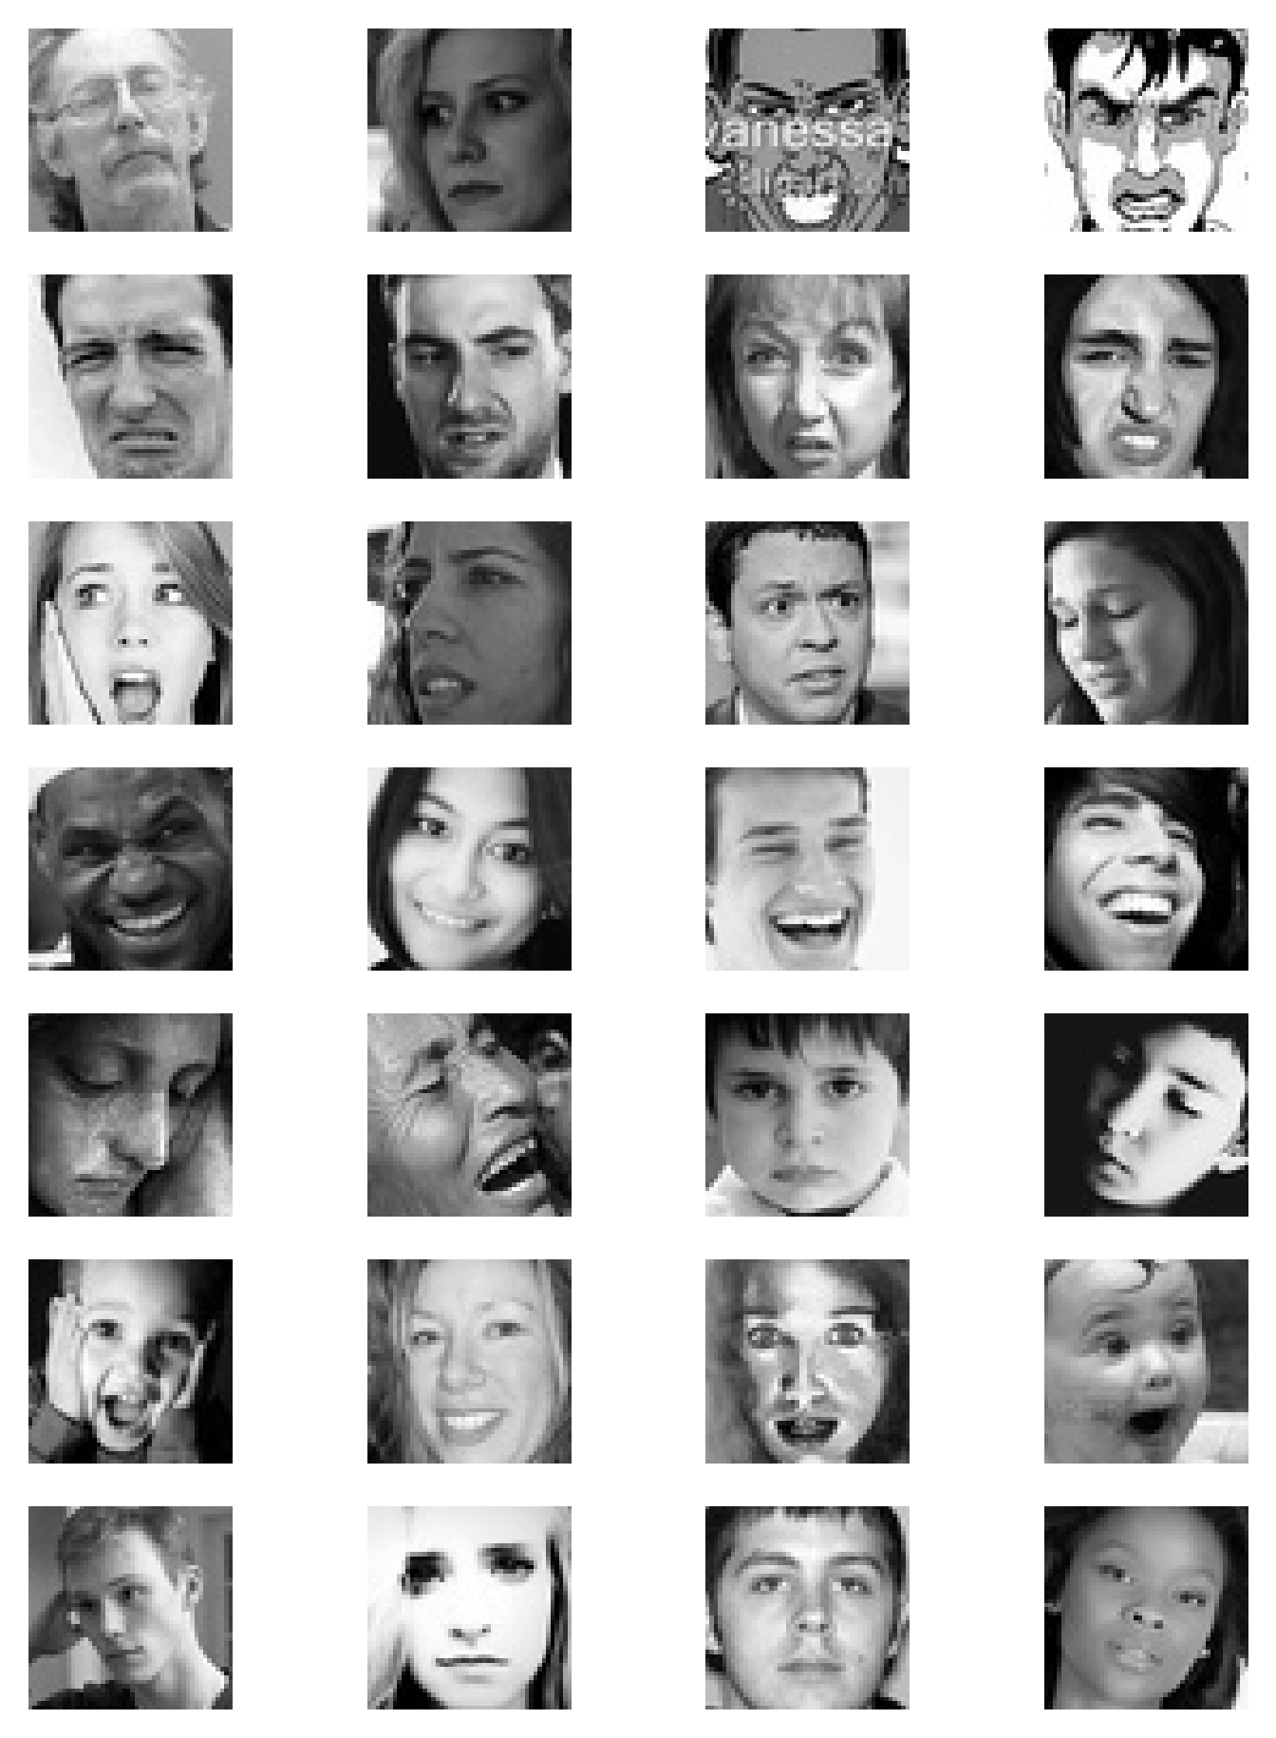
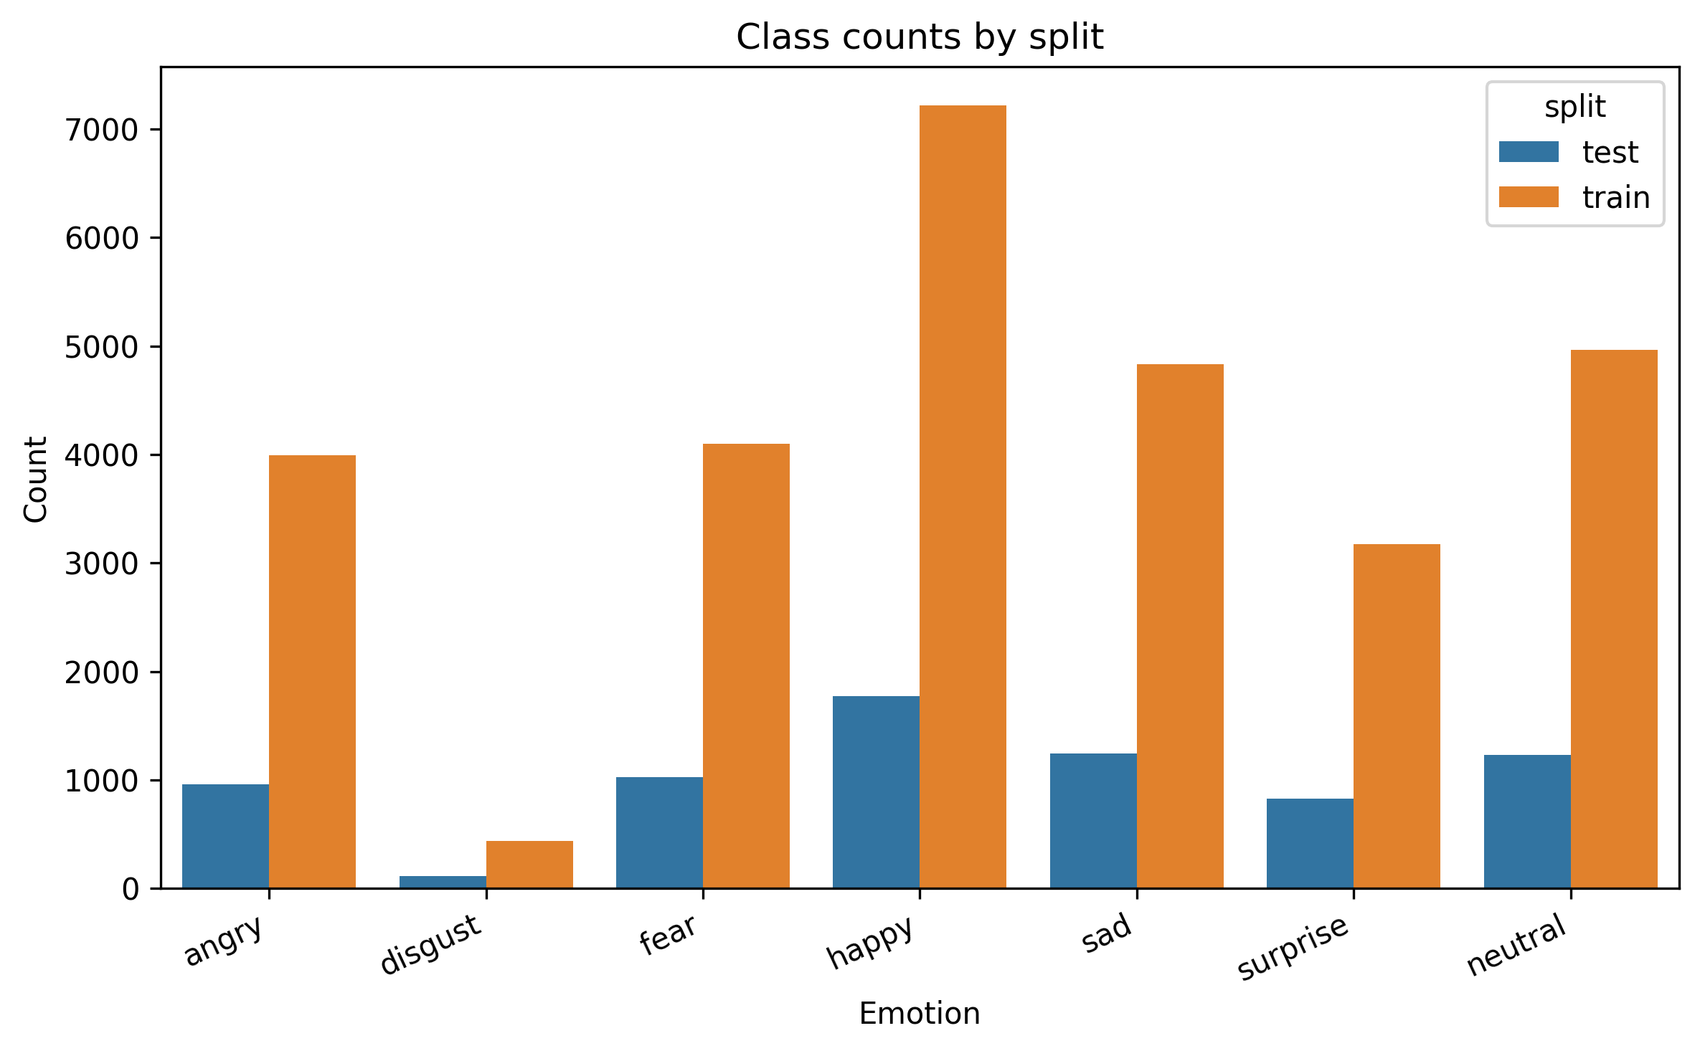
DATASET AND PREPROCESSING
FER2013 is compact, imbalanced, and visually ambiguous.
IMAGE FORMAT
48x48
grayscale face crops
IMBALANCE
disgust
smallest class; happy is largest
Consequence: macro F1 is the primary metric; weighted F1, per-class scores, and confusion matrices support the analysis.
05

Slide 6
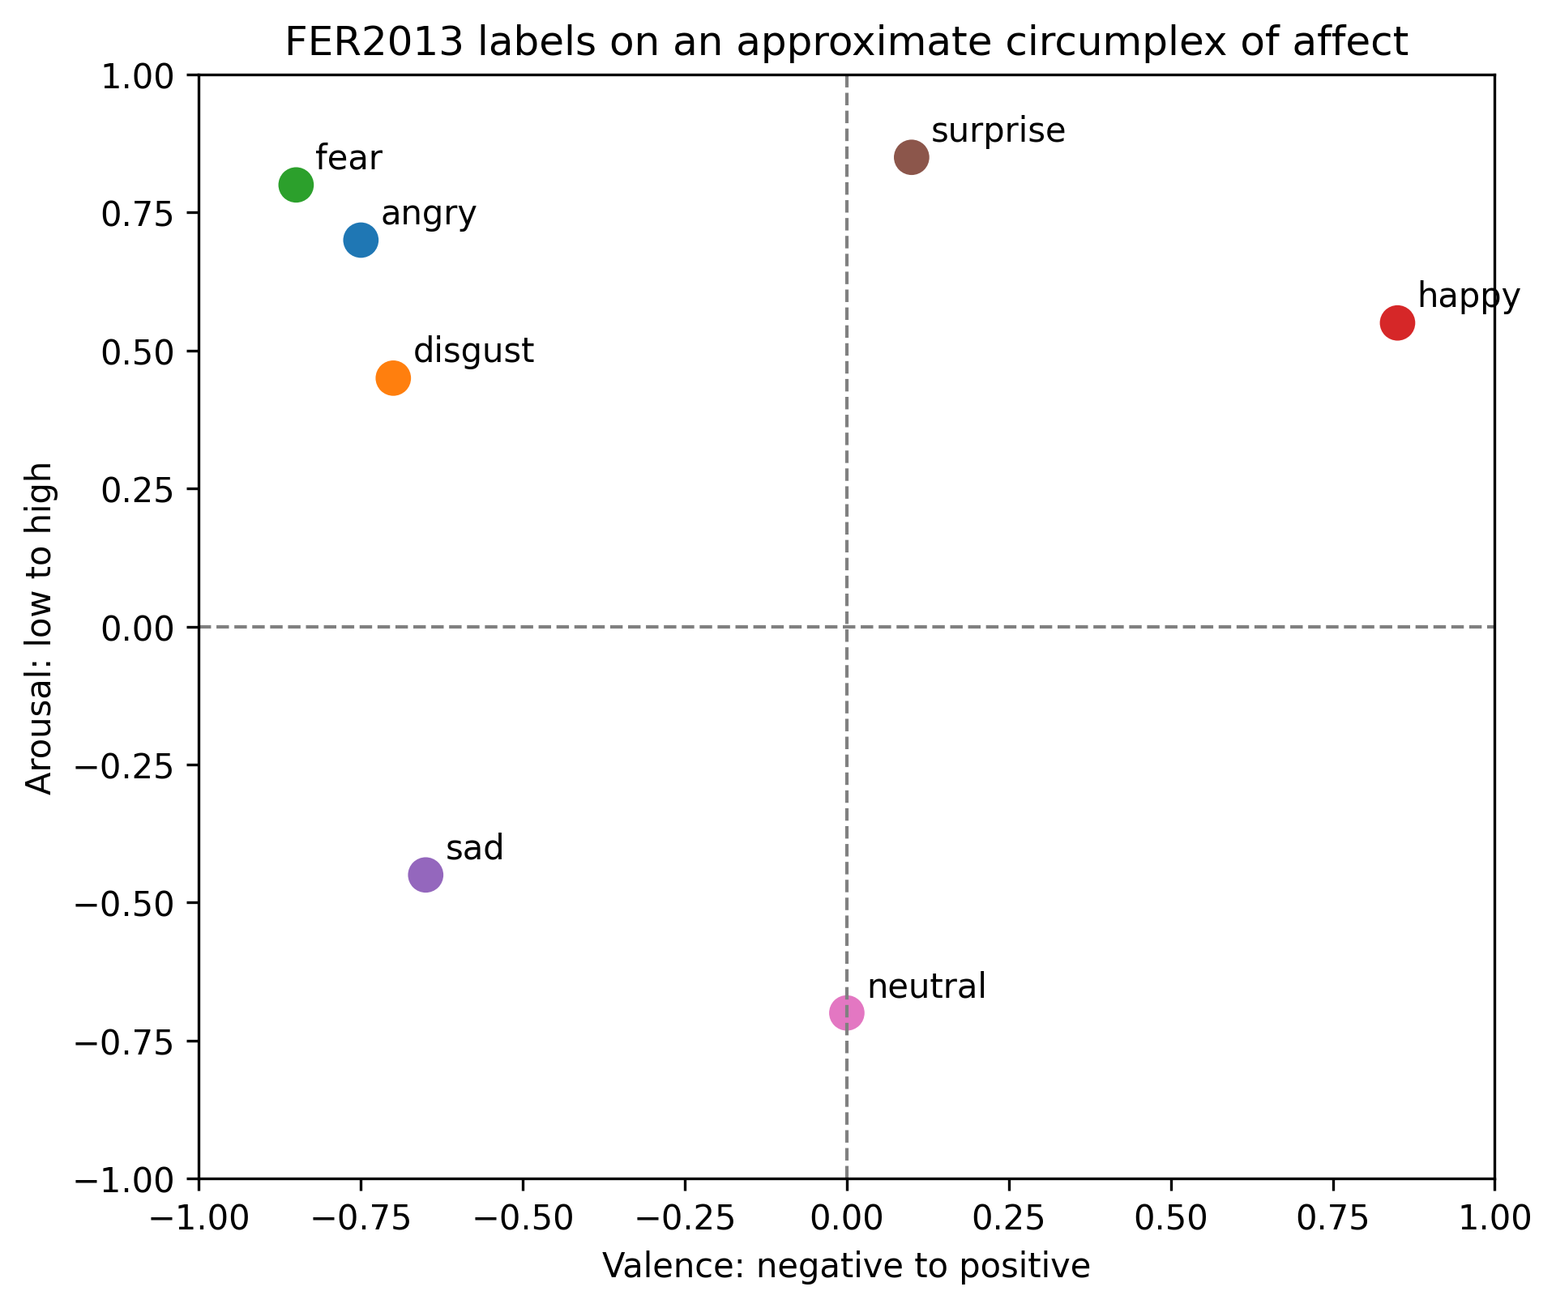
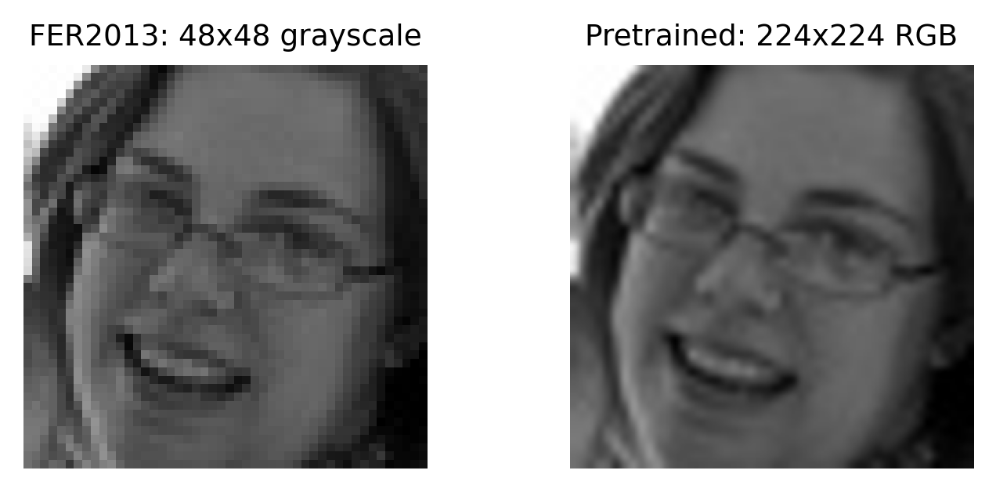
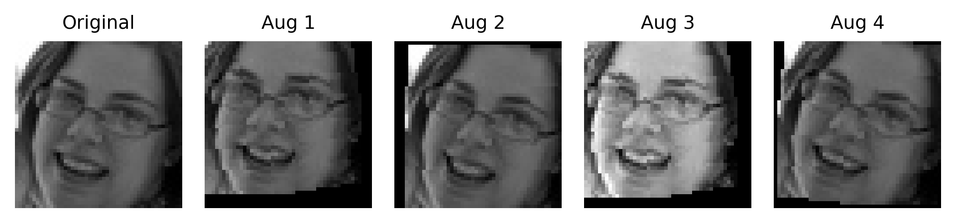
DATASET AND PREPROCESSING
Preprocessing differs by model family; affect space helps interpret errors.
Baseline CNNs: 48x48 grayscale with augmentation.
Pretrained CNNs: resized 224x224, three channels, ImageNet normalization.
Affect circumplex: sad, neutral, fear, and angry are close enough to expect confusions.
06

Slide 7
METHODOLOGY AND IMPLEMENTED MODELS
This is a controlled experiment, not a list of unrelated models.
1
2
3
4
Fix protocol
Change one choice
Compare evidence
Validate externally
same FER2013 test set, same label order, macro F1 first
architecture, imbalance strategy, optimizer, crop evaluation
macro F1, weighted F1, per-class F1, confusion matrix
zero-shot CK+ evaluation of final checkpoints
Controlled variable: training/model configuration.
Fixed outputs: macro F1, weighted F1, per-class scores, top confusions, confusion matrices.
Interpretation uses both numeric results and affect-space ambiguity.
07

Slide 8
METHODOLOGY AND IMPLEMENTED MODELS
The implemented models test from-scratch learning, capacity, pretraining, and efficiency.
Custom CNN
Deeper CNN
ResNet18
EfficientNet-B0
48x48 grayscale
trained from scratch
baseline for the project
48x48 grayscale
more feature channels / capacity
tests whether baseline is underpowered
224x224 RGB-like input
ImageNet pretrained
partial fine-tuning
224x224 RGB-like input
ImageNet pretrained
lightweight transfer comparison
TRAINING STRATEGIES
CE / focal
class weights, weighted sampler, SGD schedule, crop/TenCrop evaluation
08

Slide 9
EXPERIMENTS AND EVALUATED CONFIGURATIONS
Baseline progression starts from a simple CNN and adds one idea at a time.
1
2
3
4
5
Basic CNN
Augment
Imbalance
Optimize
Capacity
from-scratch baseline
flips, shifts, crops
weights, sampler, focal
SGD, LR plateau, clipping
deeper CNN, longer run
Saved baseline results, test macro F1
oversampling + focal
0.483
weighted sampler + CE + SGD
0.595
weighted sampler + focal + SGD
0.603
deeper CNN, 80 epochs
0.624
09

Slide 10
EXPERIMENTS AND EVALUATED CONFIGURATIONS
Transfer-learning configurations test fine-tuning depth and imbalance handling.
ResNet18 configurations
EfficientNet-B0 configurations
feature extraction only
0.352
plain small classifier
0.587
layer4 fine-tuning
0.607
class weights
0.625
layer3 + weights + focal + SGD
0.676
last blocks + sampler + SGD
0.666
layer3 + crop/TenCrop
0.682
last blocks + crop/TenCrop
0.685
CONTROLLED OUTPUT
same metrics
macro F1, weighted F1, per-class scores, confusion matrix
10

Slide 11
RESULTS AND ANALYSIS
Baseline improvements help, but from-scratch CNNs still plateau below transfer learning.
oversampling + focal
0.483
BEST BASELINE
weighted sampler + CE + SGD
0.595
0.624
weighted sampler + focal + SGD
0.603
test macro F1; weighted F1 0.649
crop/TenCrop baseline
0.597
MAIN ERROR
deeper CNN, 80 epochs
0.624
sad -> neutral
also fear -> sad in several runs
11

Slide 12
RESULTS AND ANALYSIS
Partial fine-tuning is the major gain in the pretrained models.
ResNet18 feature extraction
0.352
OBSERVATION
ResNet18 fine-tuned
0.676
fine-tuning
ResNet18 crop/TenCrop
0.682
feature extraction alone is too weak for FER2013
EfficientNet-B0 class weights
0.625
BEST REPORT
EfficientNet-B0 crop/TenCrop
0.685
0.685
EfficientNet-B0 crop/TenCrop macro F1
12

Slide 13
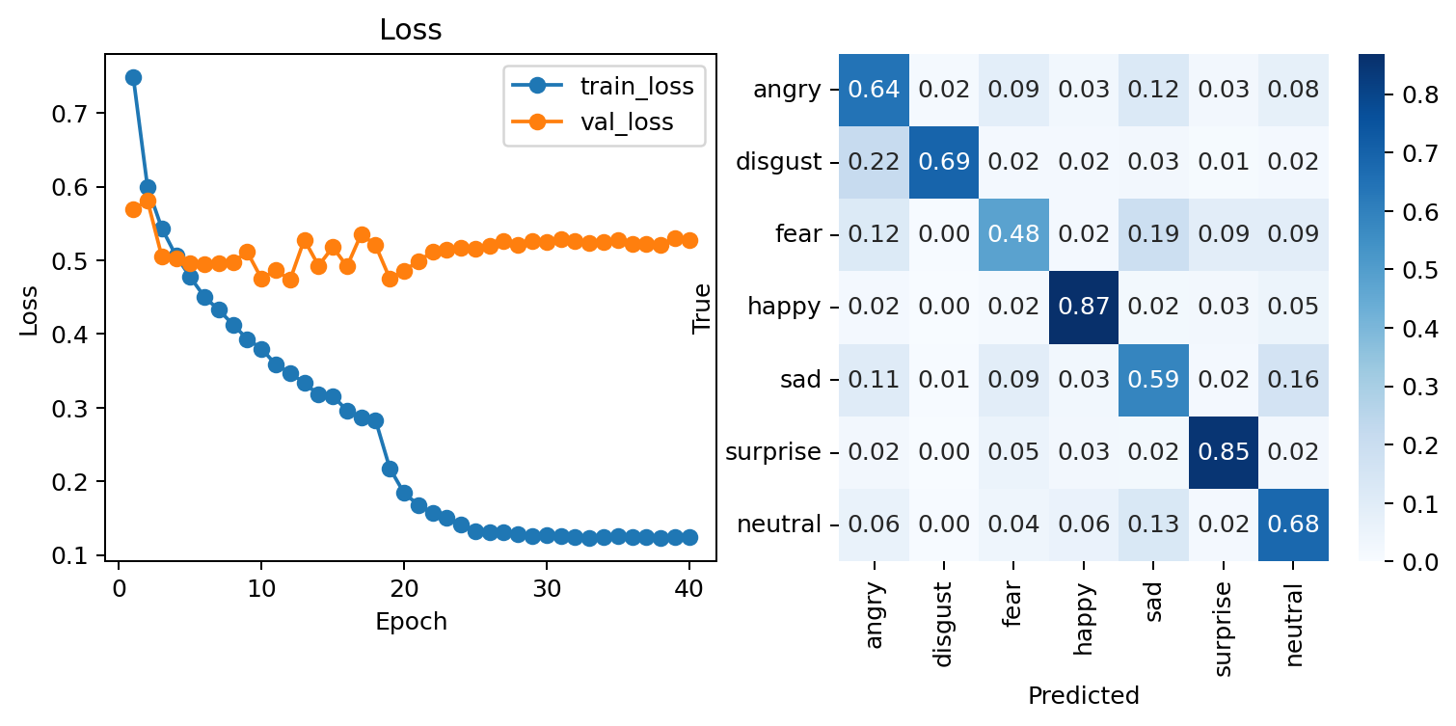
RESULTS AND ANALYSIS
The error analysis is consistent with both the confusion matrix and affect space.
Happy and surprise are comparatively clean.
Fear and sad remain difficult.
Sad -> neutral is the most persistent confusion.
Affect-space proximity supports the interpretation.
13

Slide 14
COMPARISON AGAINST BASELINES AND STATE OF THE ART
Comparison is separated from analysis: implemented models first, SOTA context second.
Best custom CNN
Best ResNet18
Best EfficientNet-B0
0.624
0.682
0.685
SOTA CONTEXT
not claimed
from-scratch baseline, test macro F1
partial fine-tuning with crop/TenCrop
last blocks fine-tuned with crop/TenCrop
alignment, attention, ensembles, larger setups
14

Slide 15
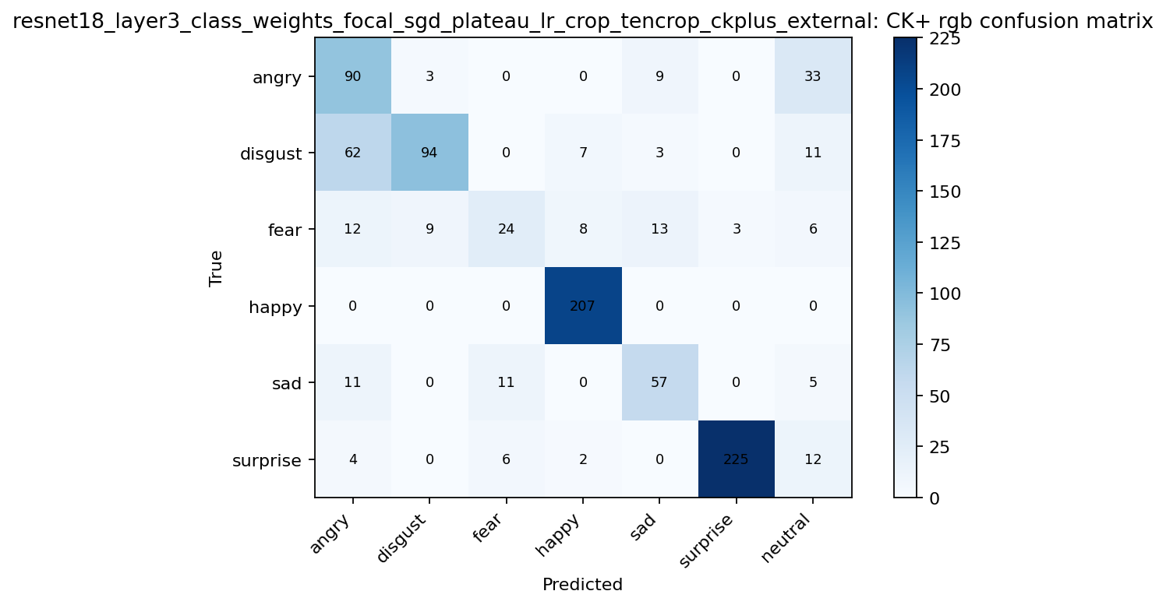
COMPARISON AGAINST BASELINES AND STATE OF THE ART
CK+ external validation changes the ranking and exposes domain shift.
Baseline CNN on CK+
0.724
ResNet18 on CK+
0.707
EfficientNet-B0 on CK+
0.556
OBSERVATION
domain shift
the best FER2013 model does not automatically dominate CK+
15

Slide 16
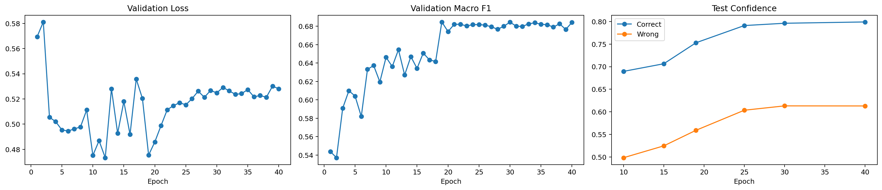
DISCUSSION OF LIMITATIONS AND OBSERVATIONS
The results are useful, but the model should not be overclaimed.
FER2013 is low-resolution and contains ambiguous or noisy labels.
Class imbalance remains visible even after sampler and loss changes.
Emotion labels are categorical, but affect is continuous.
External validation shows dataset shift between FER2013 and CK+.
No explicit face alignment pipeline was included.
16

Slide 17
CONCLUSIONS AND FUTURE WORK
The project improves FER2013 performance while identifying the remaining bottlenecks.
Transfer helps
Metrics matter
Domain shift remains
ResNet18 and EfficientNet-B0 outperform the custom CNN baseline.
Macro F1 and per-class analysis reveal hard classes and misleading aggregate behavior.
CK+ validation shows that FER2013 performance does not fully guarantee transfer.
1
2
3
4
Face alignment
Label noise
Stronger models
Calibration
better crop consistency
handle ambiguous annotations
attention, transformers, ensembles
confidence and high-error review
17

