Slide 1
Facial Expression Recognition on FER2013
Controlled CNN baselines, transfer learning, and external validation on CK+
TASK
PRIMARY METRIC
EXTERNAL CHECK
7 emotions
Macro F1
CK+
48x48 grayscale facial crops
balanced evaluation under class imbalance
zero-shot validation beyond FER2013

Slide 2
PRESENTATION STRUCTURE
I will follow the required scientific structure explicitly.
Problem and context
Method and evidence
Introduction and motivation
Methodology and implemented models
Related work / state of the art
Experiments and evaluated configurations
Dataset and preprocessing
Results, comparison, limitations, future work
The talk is organized as a scientific project report, not only a model leaderboard.
02

Slide 3
INTRODUCTION AND MOTIVATION
Facial expression recognition is useful, but hard to evaluate reliably.
The task supports affective computing and human-computer interaction.
FER2013 images are low resolution, grayscale, and visually ambiguous.
MAIN QUESTION
What generalizes?
Classes are imbalanced, so accuracy alone can hide weak minority-class behavior.
from custom CNNs to pretrained models and CK+
The project goal is not only a high score, but a controlled comparison of modeling choices.
03

Slide 4
RELATED WORK / STATE OF THE ART
FER has moved from handcrafted features to pretrained and attention-based deep models.
Earlier and standard approaches
State-of-the-art context
Classical FER used handcrafted descriptors with shallow classifiers.
Recent systems often add face alignment, attention, transformers, ensembles, or larger datasets.
CNNs learn expression features directly from pixels.
This project does not claim state-of-the-art performance.
ResNet and EfficientNet are common pretrained baselines for transfer learning.
The fair comparison is between implemented models under the same protocol.
This keeps the contribution honest: a controlled experimental study on FER2013.
04

Slide 5
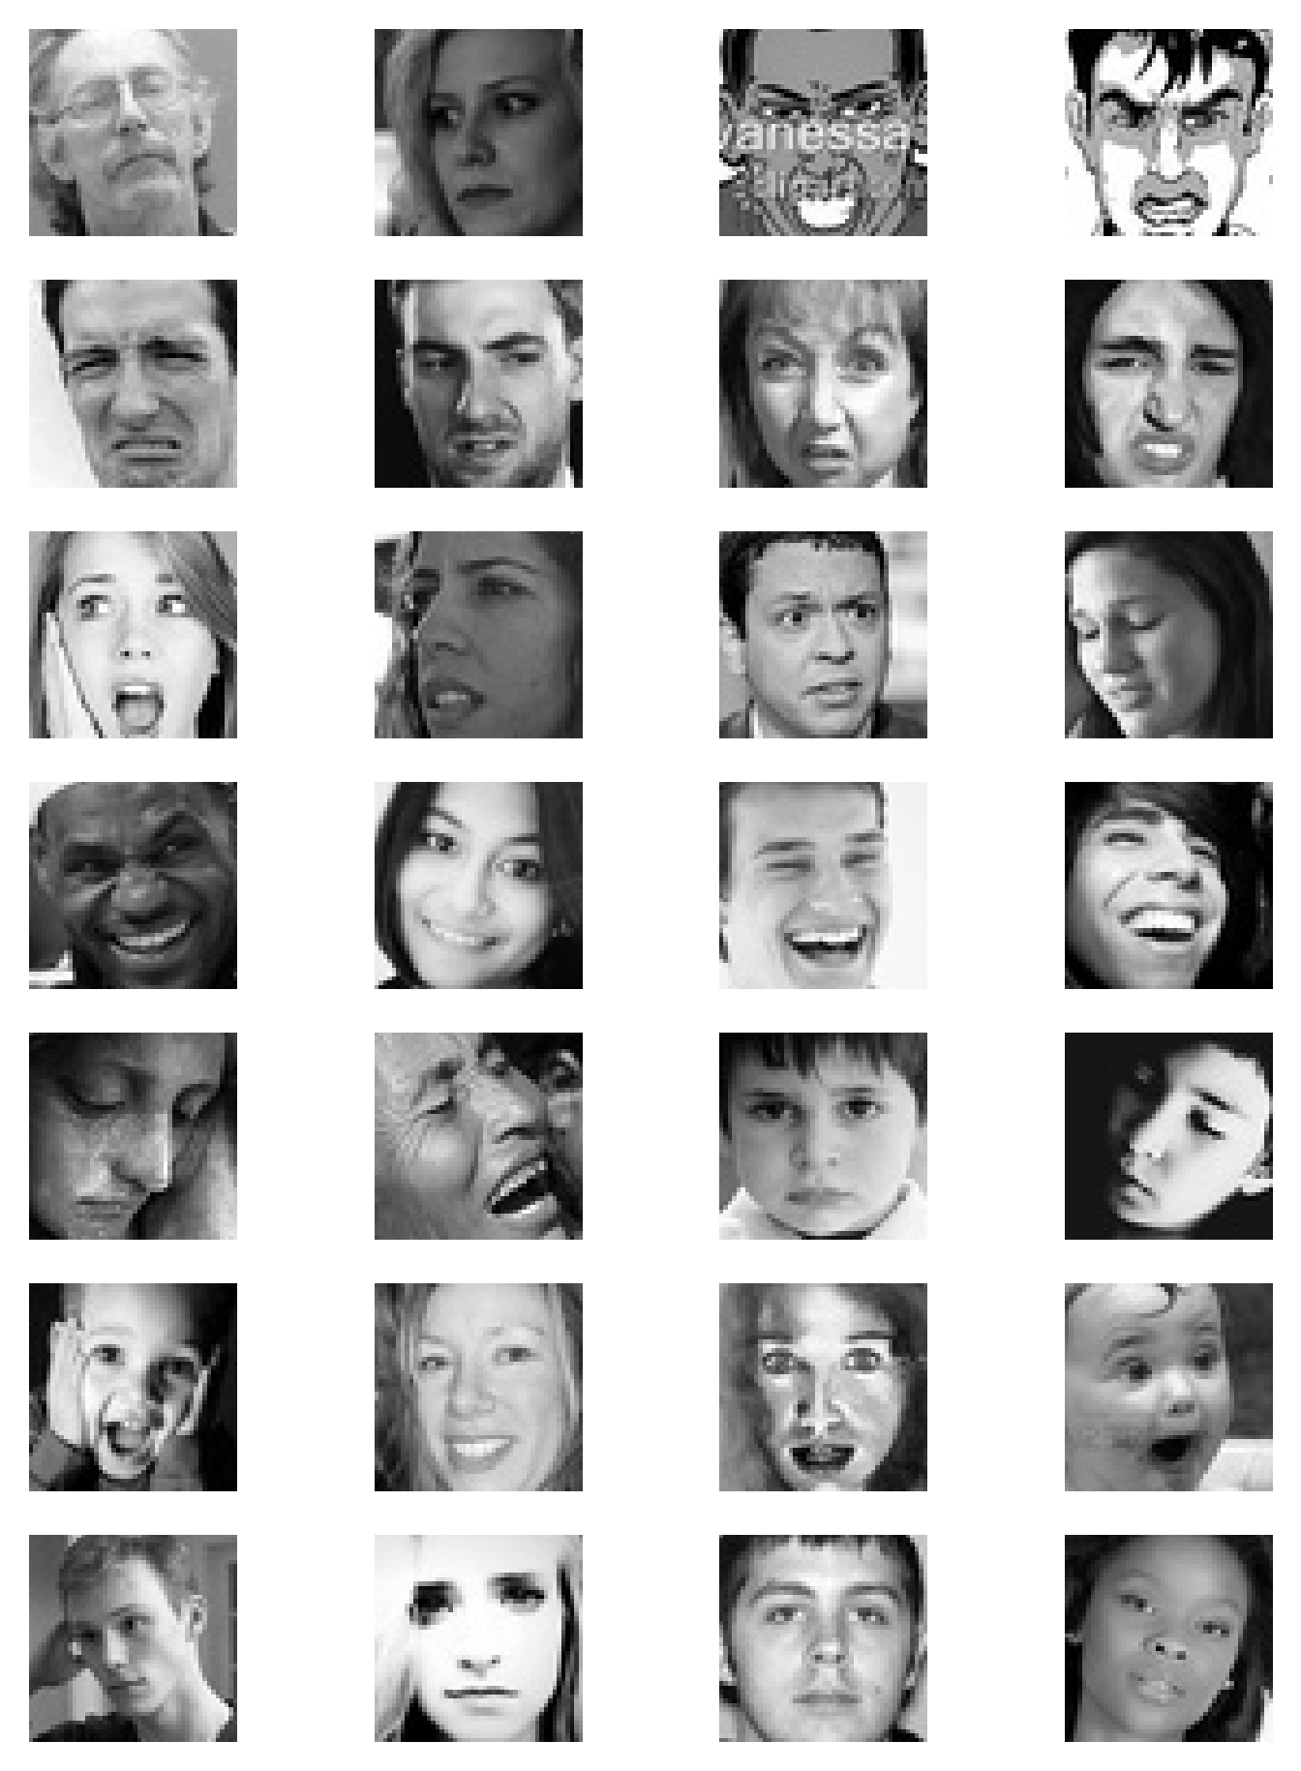
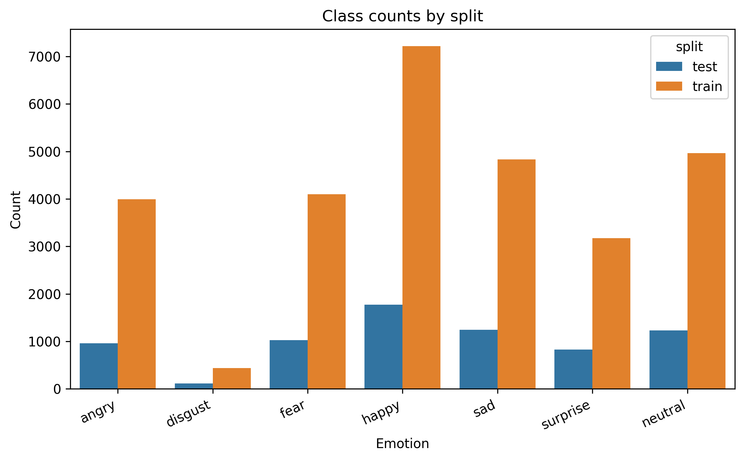
DATASET AND PREPROCESSING
FER2013 is compact, imbalanced, and visually ambiguous.
IMAGE FORMAT
48x48
grayscale face crops
IMBALANCE
disgust
smallest class; happy is largest
Macro F1 is used as the primary metric.
Weighted F1, per-class scores, and confusion matrices support the analysis.
05

Slide 6
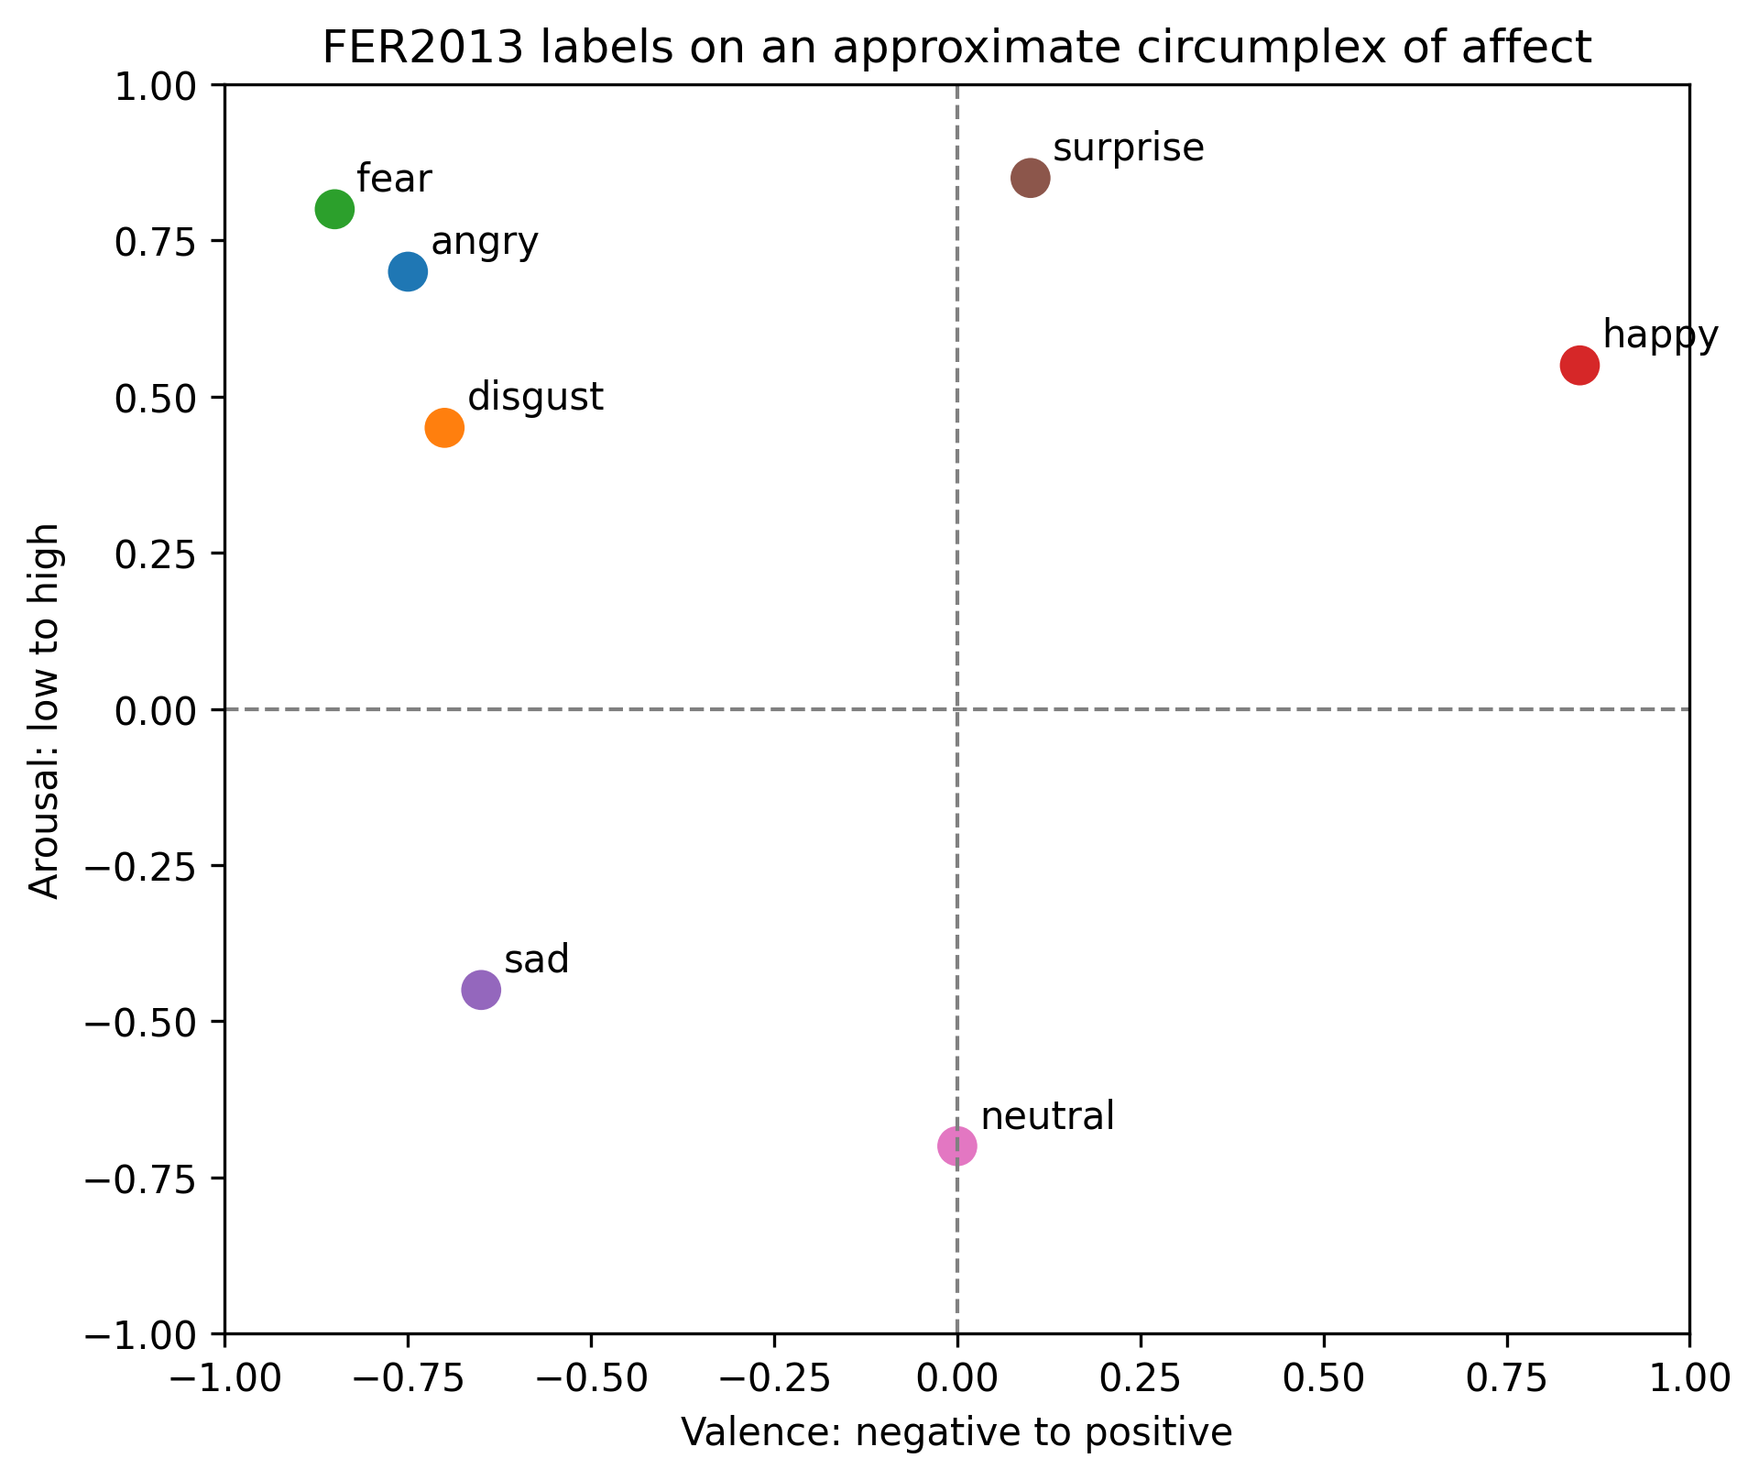
DATASET AND PREPROCESSING
Preprocessing differs by model family, and affect space helps interpret errors.
Custom CNNs use 48x48 grayscale inputs with augmentation.
Pretrained CNNs use resized 224x224, three-channel, normalized inputs.
Augmentation tests whether small shifts and crops improve robustness.
The affect circumplex explains why nearby emotions are naturally confused.
06

Slide 7
METHODOLOGY AND IMPLEMENTED MODELS
The methodology is a controlled experiment, not a list of unrelated models.
Fixed dataset split and label order across experiments.
CONTROLLED VARIABLE
Changed one modeling or training choice at a time when possible.
configuration
Compared macro F1, weighted F1, per-class scores, and confusion matrices.
architecture, imbalance handling, optimizer, fine-tuning depth
Used crop/TenCrop evaluation to test whether inference-time crops improve robustness.
OUTPUT
Validated selected final checkpoints on CK+ to observe domain transfer.
same metrics
so model families remain comparable
07

Slide 8
METHODOLOGY AND IMPLEMENTED MODELS
The implemented models test from-scratch learning, capacity, pretraining, and efficiency.
From-scratch CNNs
Pretrained CNNs
Custom CNN: simple baseline trained directly on 48x48 grayscale images.
ResNet18: standard pretrained backbone with partial fine-tuning.
Deeper CNN: increased capacity and longer training.
EfficientNet-B0: lightweight pretrained comparison.
Used class weights, weighted sampling, focal loss, and SGD variants.
Both use 224x224 RGB-like inputs adapted from FER2013.
The design tests whether extra capacity or pretrained features matter more.
08

Slide 9
EXPERIMENTS AND EVALUATED CONFIGURATIONS
The experiments build a gradual baseline progression before transfer learning.
Start with a basic custom CNN trained from scratch.
Saved baseline results, test macro F1
Add augmentation, then imbalance handling.
oversampling + focal: 0.483
Tune loss/optimizer choices: cross-entropy, focal loss, SGD, LR plateau, clipping.
weighted sampler + CE + SGD: 0.595
Increase model capacity with a deeper CNN and longer training.
weighted sampler + focal + SGD: 0.603
Compare against pretrained ResNet18 and EfficientNet-B0 configurations.
deeper CNN, 80 epochs: 0.624
09

Slide 10
RESULTS AND ANALYSIS
Baseline improvements help, but from-scratch CNNs plateau below transfer learning.
Naive imbalance handling alone did not solve the task.
best custom CNN macro F1: 0.624
Weighted sampling plus SGD improved the custom CNN baseline.
weighted F1: 0.649
The deeper CNN was the best from-scratch model in the saved runs.
crop/TenCrop baseline: 0.597
The main persistent error was sad being predicted as neutral.
INTERPRETATION
capacity helps
but not enough to close the transfer-learning gap
10

Slide 11
RESULTS AND ANALYSIS
Partial fine-tuning is the major gain in the pretrained models.
ResNet18 feature extraction alone was too weak for FER2013.
ResNet18 feature extraction: 0.352
Unfreezing deeper layers produced the main improvement.
ResNet18 fine-tuned: 0.676
ResNet18 crop/TenCrop: 0.682
Crop/TenCrop evaluation gave the best saved ResNet18 report.
EfficientNet-B0 crop/TenCrop: 0.685
EfficientNet-B0 with crop/TenCrop slightly exceeded ResNet18 on FER2013.
BEST FER2013 REPORT
0.685
EfficientNet-B0 macro F1
11

Slide 12
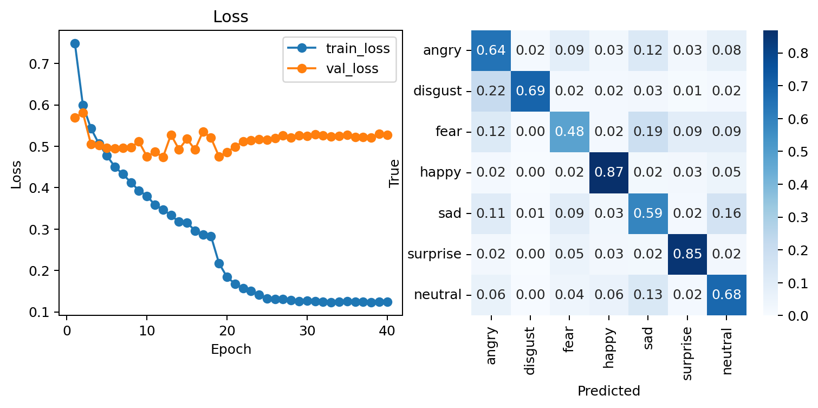
RESULTS AND ANALYSIS
The error analysis is consistent with the confusion matrix and affect space.
Happy and surprise are comparatively clean.
Fear and sad remain difficult classes.
Sad -> neutral is the most persistent confusion.
This matches the affect-space interpretation: nearby affective states are harder to separate.
12

Slide 13
COMPARISON AGAINST BASELINES AND STATE OF THE ART
The final comparison separates implemented baselines from broader SOTA claims.
Best custom CNN: 0.624 macro F1.
custom CNN: 0.624
Best ResNet18: 0.682 macro F1 with partial fine-tuning and crop/TenCrop.
ResNet18: 0.682
Best EfficientNet-B0: 0.685 macro F1 with last blocks fine-tuned and crop/TenCrop.
The project does not claim state-of-the-art; modern FER often uses alignment, attention, ensembles, and larger setups.
EfficientNet-B0: 0.685
MAIN CONCLUSION
pretraining helps
but architecture is not the only source of error
13

Slide 14
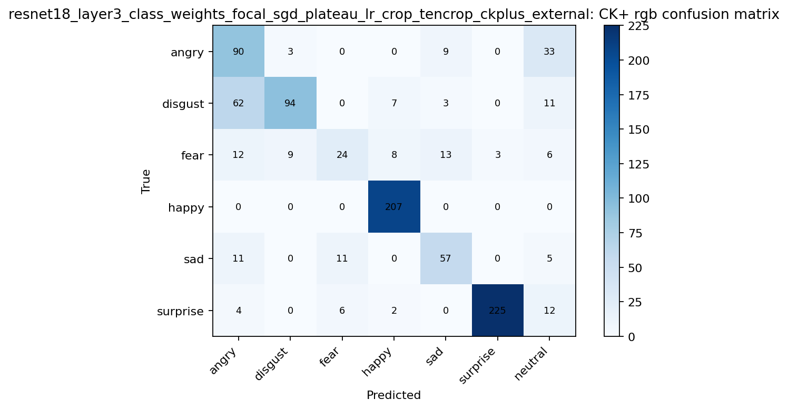
COMPARISON AGAINST BASELINES AND STATE OF THE ART
CK+ external validation changes the ranking and exposes domain shift.
baseline CNN on CK+: 0.724
ResNet18 on CK+: 0.707
EfficientNet-B0 on CK+: 0.556
The best FER2013 model does not automatically dominate CK+.
External validation suggests dataset shift between FER2013 and CK+.
This is why final conclusions should not rely only on the internal test split.
14

Slide 15
DISCUSSION OF LIMITATIONS AND OBSERVATIONS
The results are useful, but the model should not be overclaimed.
FER2013 is low-resolution and contains ambiguous or noisy labels.
Class imbalance remains visible even after sampler and loss changes.
OBSERVATION
metrics matter
Emotion labels are categorical, but affect is continuous.
macro F1 and per-class analysis reveal problems hidden by aggregate scores
External validation shows domain shift between FER2013 and CK+.
RISK
No explicit face alignment pipeline was included.
overfitting
improvements on FER2013 may not transfer cleanly
15

Slide 16
CONCLUSIONS AND FUTURE WORK
The project improves FER2013 performance while identifying the remaining bottlenecks.
Conclusions
Future work
Transfer learning clearly outperforms the custom CNN baseline.
Add explicit face alignment and better crop consistency.
EfficientNet-B0 and ResNet18 are close on FER2013 after crop/TenCrop.
Handle noisy or ambiguous labels more carefully.
Error analysis shows that fear, sad, and neutral remain challenging.
Evaluate stronger backbones, attention, transformers, or ensembles.
CK+ validation shows the importance of checking domain shift.
Calibrate confidence and review high-error classes.
Final message: the strongest result is not only the best macro F1, but the evidence explaining where it works and where it fails.
16

