Slide 1
Facial Expression Recognition on FER2013
Controlled experiments with a custom CNN, ResNet18, EfficientNet-B0, and CK+ external validation
Primary metric
Dataset
External validation
Macro F1
FER2013
CK+

Slide 2
CONTENT
Presentation structure
1. Introduction and motivation
2. Related work / state of the art
3. Dataset and preprocessing
4. Methodology and implemented models
5. Experiments and evaluated configurations
6. Results and analysis
7. Comparison against baselines and state-of-the-art approaches
8. Discussion of limitations and observations
9. Conclusions and future work
02

Slide 3
INTRODUCTION AND MOTIVATION
Expression recognition is useful, but FER2013 makes it hard.
Facial expressions are useful for affective computing and human-computer interaction.
Research question
FER2013 images are low-resolution 48x48 grayscale face crops.
Which modeling choices improve balanced recognition and generalization?
Expressions can be visually ambiguous; several emotions occupy nearby affective regions.
Class imbalance makes macro F1 and per-class analysis more appropriate than accuracy alone.
03

Slide 4
RELATED WORK / STATE OF THE ART
FER systems evolved from handcrafted features to deep transfer learning.
CLASSICAL FER
DEEP FER
Handcrafted descriptors plus shallow classifiers were common historically.
CNNs learn expression features directly from pixels.
They are less robust to pose, lighting, and dataset noise.
ImageNet-pretrained backbones such as ResNet and EfficientNet are practical baselines.
Recent state-of-the-art systems often add alignment, attention, transformers, ensembles, or larger datasets.
04

Slide 5
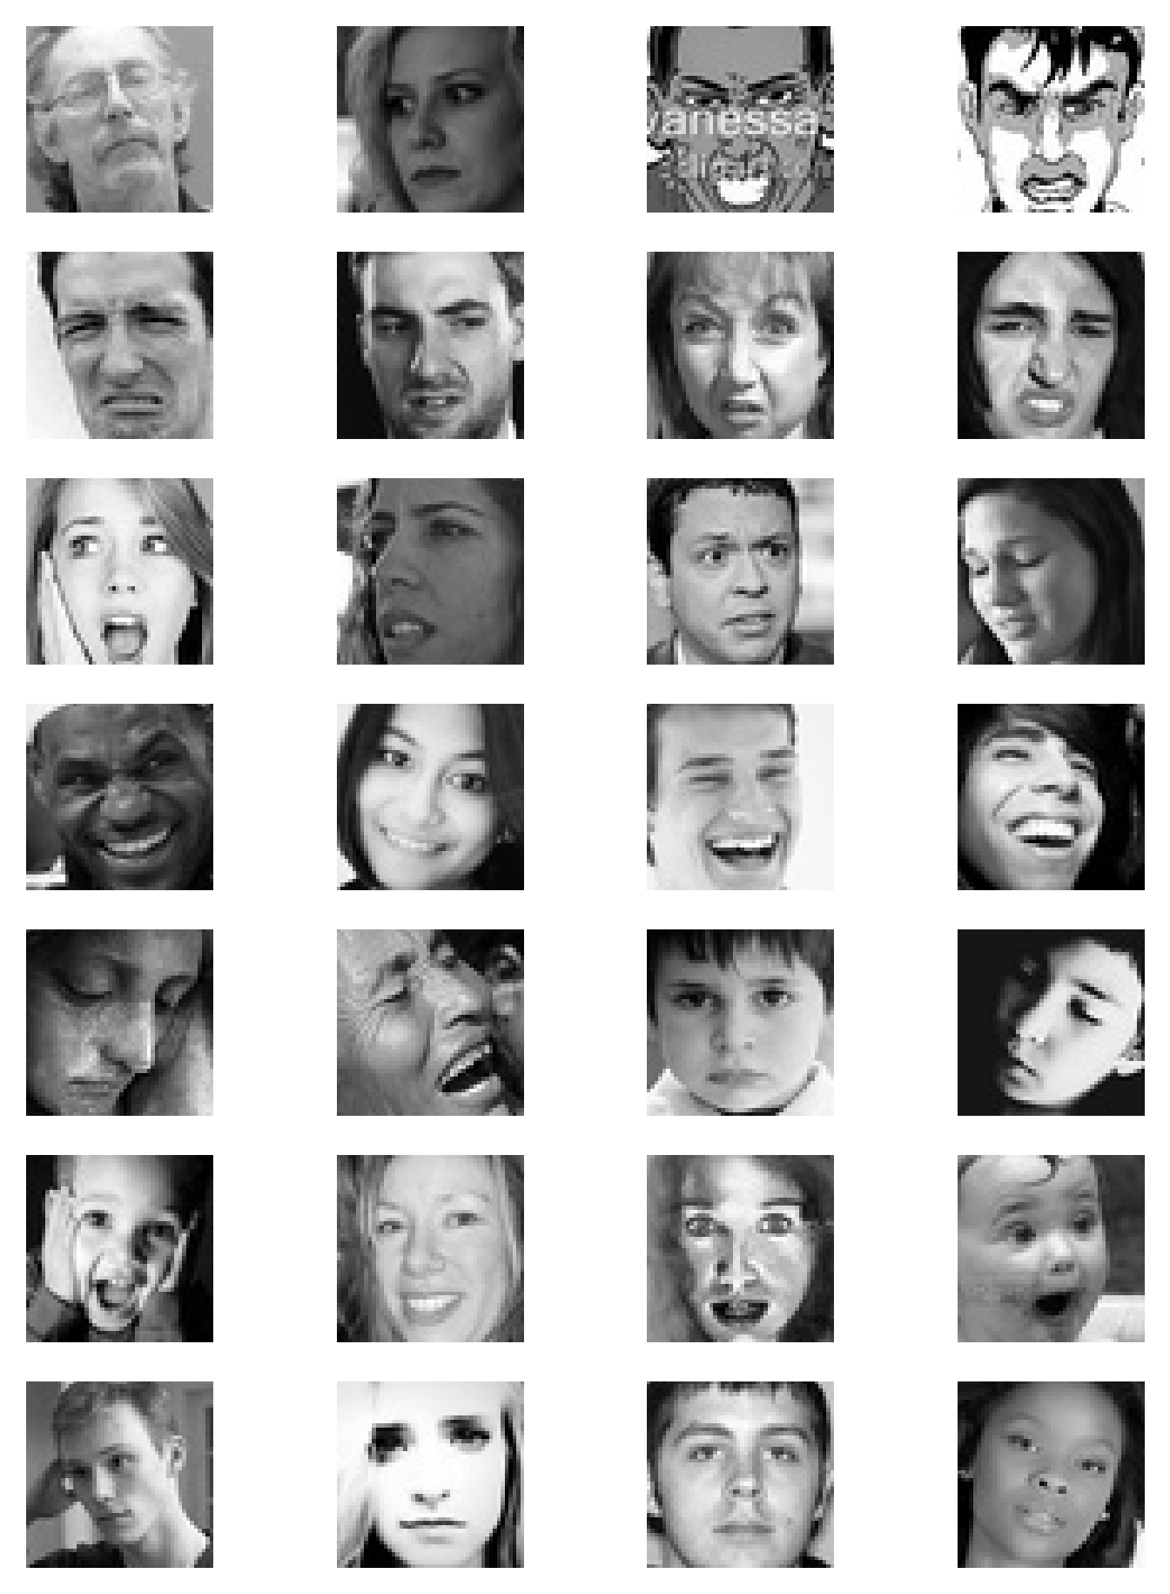
DATASET AND PREPROCESSING
Sample images reveal ambiguity and low resolution.
Faces are small, grayscale, and sometimes poorly aligned.
Several classes differ by subtle mouth, eye, or eyebrow cues.
Human-visible ambiguity justifies evaluating more than a single aggregate score.
05

Slide 6
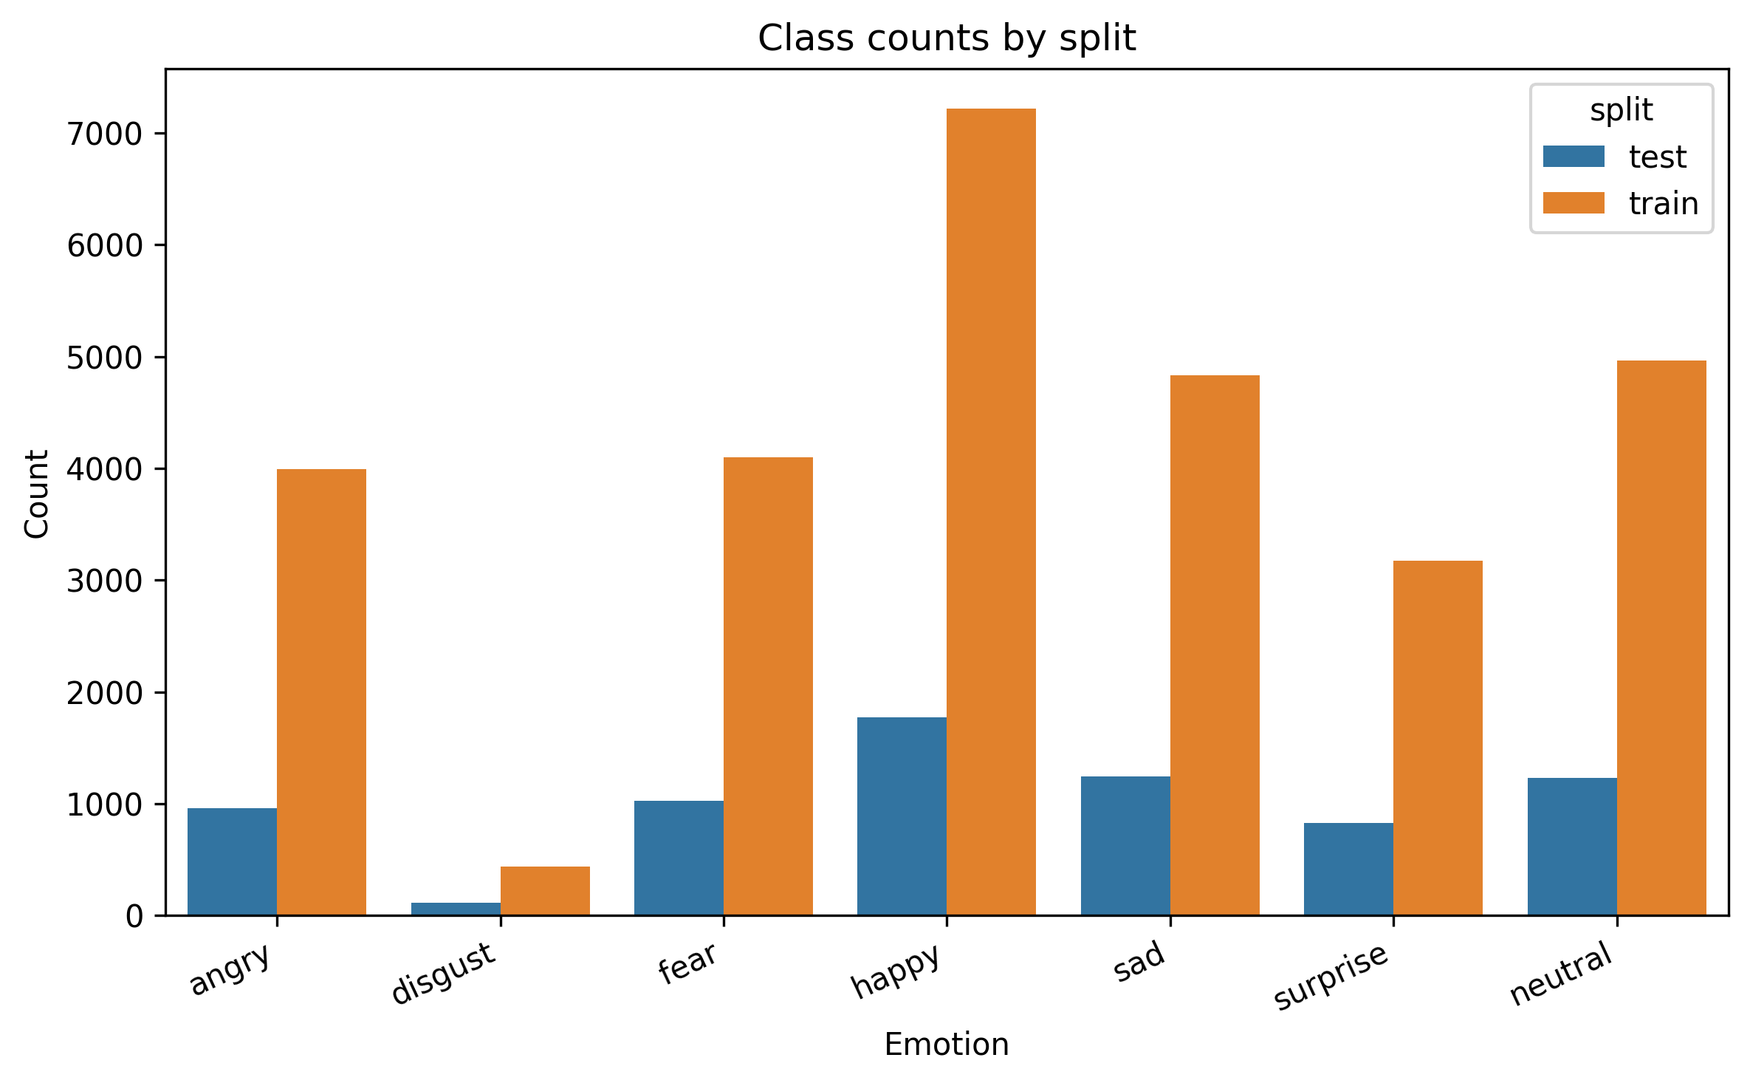
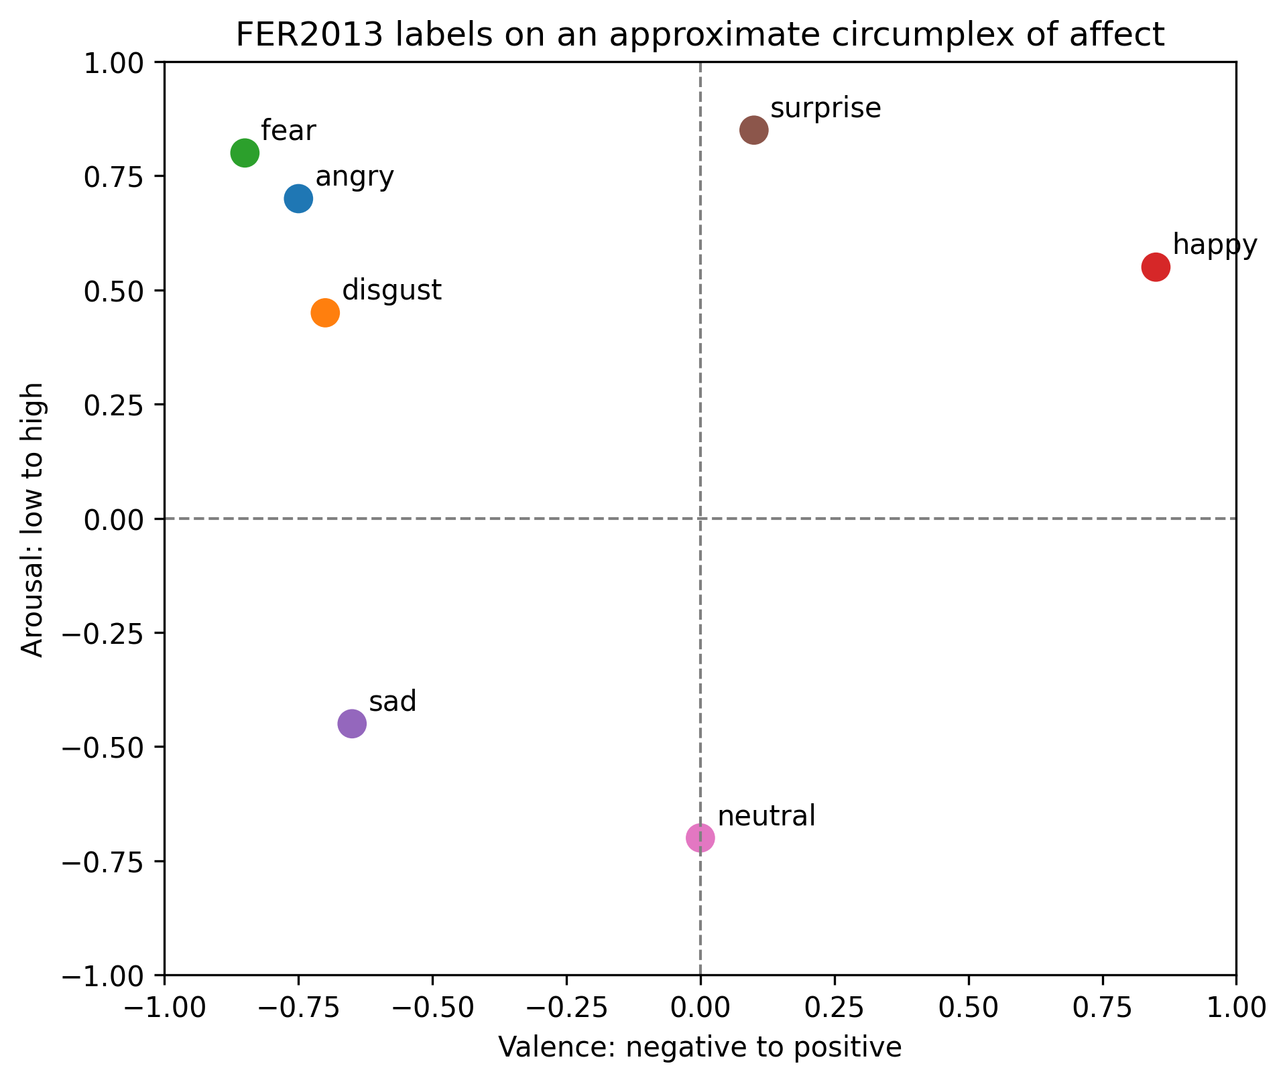
DATASET AND PREPROCESSING
Class imbalance and affect proximity explain why this dataset is difficult.
Dataset size
28,709 train
7,178 test
Happy has much more support than minority classes such as disgust.
Nearby affective states help explain confusions such as sad, fear, angry, and neutral.
This motivates macro F1, per-class F1, and confusion analysis.
06
Takeaway: FER2013 requires augmentation, imbalance handling, macro/per-class F1, and confusion analysis.

Slide 7
DATASET AND PREPROCESSING
The split is fixed, and validation is created from the training folder.
FER2013 train
fixed seed shuffle
90% train
10% validation
Sizes used
train folder: 28,709
test folder: 7,178
validation: 10% of train folder
FER2013 test
stratified test indices
held-out test
The train/validation split is reproducible with seed 42.
Smoke-test subsets, when used, are class-stratified.
Weighted sampling and oversampling are applied only to the training subset.
07

Slide 8
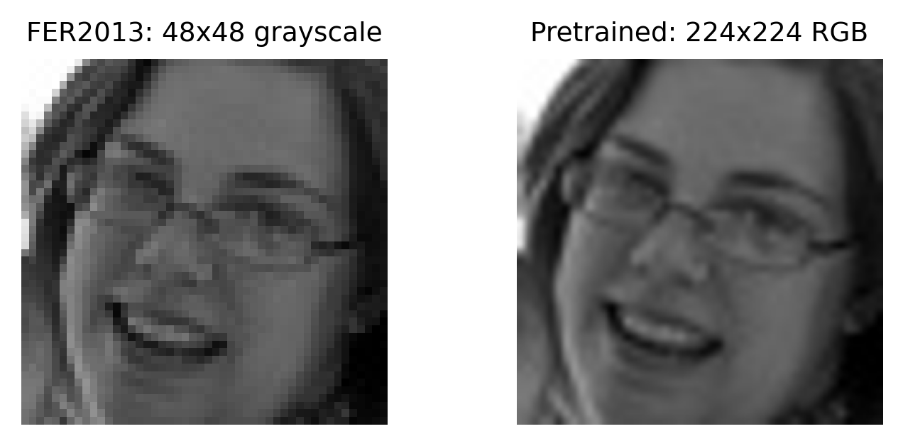
DATASET AND PREPROCESSING
Input preprocessing depends on whether the model is trained from scratch or pretrained.
CUSTOM CNN
48x48 grayscale input
random crop and horizontal flip
mean 0.5 / std 0.5 normalization
RESNET18 AND EFFICIENTNET-B0
same transfer preprocessing for both pretrained backbones
resize to 224x224 and replicate grayscale to 3 channels
ImageNet normalization to match pretrained weights
08

Slide 9
METHODOLOGY
The methodology is built around controlled experiments.
Fix split
Change one factor
Train / select checkpoint
Evaluate same metrics
Analyze errors
The experiment compares model families under consistent train/validation/test logic.
Variables include architecture, imbalance handling, loss function, optimizer, fine-tuning depth, and crop/TenCrop evaluation.
The same evidence types are reported: macro F1, weighted F1, per-class F1, loss curves, and confusion matrices.
09

Slide 10
METHODOLOGY
Architecture: custom CNN baseline trained from scratch.
48x48x1
3x3 conv 32 x2
MaxPool
3x3 conv 64 x2
MaxPool
3x3 conv 128
MaxPool
FC 256
7 logits
BaselineCNN implementation
Feature channels: 32, 64, 128.
Convolution filters: 3x3, padding 1; block depths: 2, 2, 1.
Dropout2d after early pooling blocks; dropout before classifier output.
Purpose: establish a reproducible from-scratch baseline.
10

Slide 11
METHODOLOGY
Architecture: ResNet18 transfer learning.
224x224x3
7x7 stem conv
3x3 residual blocks
layer2
layer3
layer4
FC head
7 logits
Fine-tuning design
Why this model: common transfer baseline, residual blocks, moderate size, easy to fine-tune systematically.
Classifier head is replaced with a 7-class FER2013 output; earlier layers keep ImageNet visual features.
Experiment path: frozen FC -> layer4 -> layer3 -> class weights -> focal loss -> SGD plateau -> crop/TenCrop.
11

Slide 12
METHODOLOGY
Architecture: EfficientNet-B0 transfer learning.
224x224x3
3x3 stem conv
MBConv 1-5
last MBConv blocks
pooling
FC head
7 logits
Why include it?
Why this model: lightweight ImageNet backbone with compound scaling and efficient MBConv blocks.
It tests whether a smaller model can match ResNet18 after comparable fine-tuning.
Experiment path: classifier only -> last block -> last two blocks -> last three blocks -> sampler + SGD plateau -> crop/TenCrop.
12

Slide 13
EXPERIMENTS AND EVALUATED CONFIGURATIONS
Each strategy tests a specific hypothesis.
STRATEGIES
CONFIGURATIONS
Augmentation: improve robustness to small face shifts and flips.
Custom CNN: basic, augmented, imbalance-aware, deeper 80-epoch run.
Class weights / weighted sampler / oversampling: reduce class imbalance effects.
ResNet18: feature extraction, layer4/layer3 unfreeze, imbalance and loss variants.
Focal loss: focus learning on hard examples.
EfficientNet-B0: classifier variants, last-block fine-tuning, weighted sampler, crop/TenCrop.
SGD + LR plateau: stabilize final fine-tuning.
Crop/TenCrop: test whether inference-time crops improve robustness.
13

Slide 14
RESULTS AND ANALYSIS
The evaluation uses complementary metrics, not only one score.
MAIN METRICS
SUPPORTING EVIDENCE
Macro F1: primary metric because all classes count equally.
Loss curves: diagnose optimization and overfitting.
Weighted F1: reflects performance under the real class distribution.
F1 per class: identifies weak emotion categories.
Confusion matrix: shows the actual error pattern.
Precision and recall: show whether each class is over- or under-predicted.
Confidence analysis: checks whether errors are made confidently.
14

Slide 15
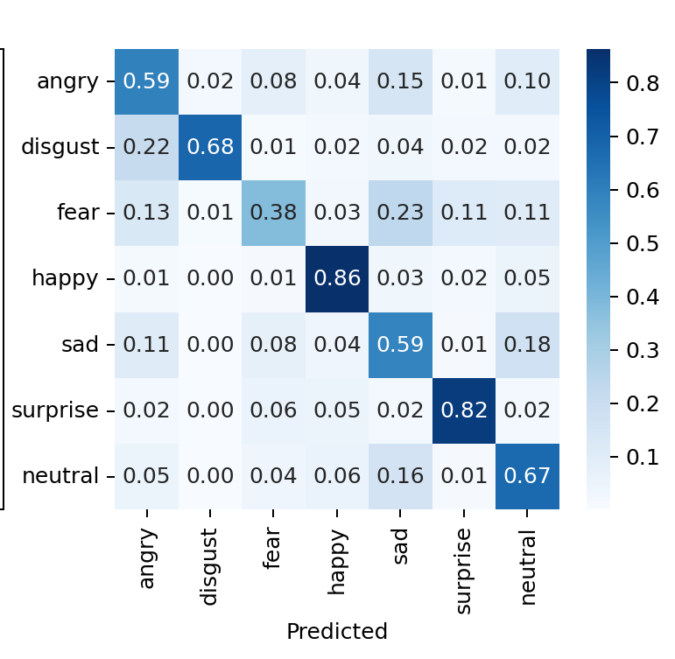
RESULTS AND ANALYSIS
Custom CNN results improve gradually, but plateau below transfer learning.
0.70
best val macro F1
0.644
0.662
0.65
0.627
0.60
0.566
0.55
0.50
0.485
0.45
CNN aug
+ CE
aug + sampler
+ CE
aug + sampler
+ CE + SGD
crop/TenCrop
CE + SGD
crop/TenCrop
CE 80ep
Selected custom CNN test per-class precision / recall / F1
metric
angry
disgust
fear
happy
sad
surprise
neutral
precision
0.59
0.67
0.57
0.87
0.53
0.77
0.61
recall
0.59
0.68
0.38
0.86
0.59
0.82
0.67
F1
0.59
0.68
0.45
0.87
0.55
0.79
0.64

Slide 16
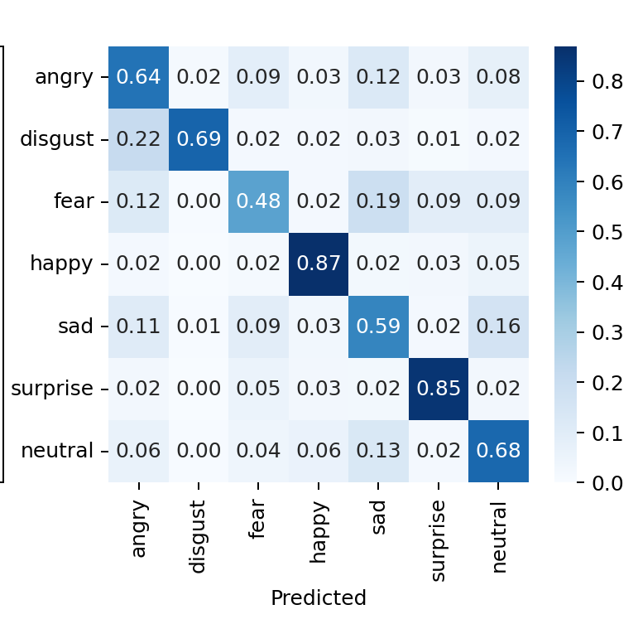
RESULTS AND ANALYSIS
ResNet18 improves when deeper layers are fine-tuned.
0.70
best val macro F1
0.654
0.676
0.685
0.648
0.649
0.60
0.602
0.50
0.40
0.346
0.30
feature
extract
unfreeze
layer4
unfreeze
layer3
class
weights
weights +
focal
focal +
SGD
crop +
TenCrop
Best ResNet18 test per-class precision / recall / F1
metric
angry
disgust
fear
happy
sad
surprise
neutral
precision
0.60
0.69
0.60
0.90
0.58
0.77
0.64
recall
0.64
0.69
0.48
0.87
0.59
0.85
0.68
F1
0.62
0.69
0.53
0.88
0.58
0.81
0.66
16

Slide 17
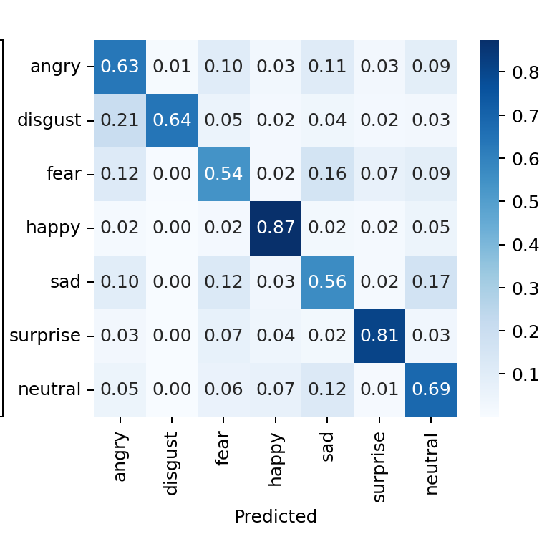
RESULTS AND ANALYSIS
EfficientNet-B0 is competitive on FER2013 after stronger fine-tuning.
best val macro F1
0.653
0.657
0.670
0.65
0.637
0.590
0.55
0.464
0.45
0.382
0.35
feature
extract
unfreeze
last block
unfreeze
last 2
unfreeze
last 3
last 3 +
sampler
sampler +
SGD
crop +
TenCrop
Best EfficientNet-B0 test per-class precision / recall / F1
metric
angry
disgust
fear
happy
sad
surprise
neutral
precision
0.62
0.77
0.56
0.88
0.59
0.81
0.63
recall
0.63
0.64
0.54
0.87
0.56
0.81
0.69
F1
0.62
0.70
0.55
0.88
0.58
0.81
0.65
17

Slide 18
RESULTS AND ANALYSIS
Top confusions show that errors cluster around similar emotions.
MODEL
TOP CONFUSION
COUNT
CLASS RATE
Custom CNN
sad -> neutral
259
20.8%
Sad, fear, and neutral dominate the top mistakes.
Custom CNN
fear -> sad
233
22.8%
Custom CNN
neutral -> sad
162
13.1%
The same error families appear across model architectures.
ResNet18
sad -> neutral
200
16.0%
ResNet18
fear -> sad
197
19.2%
This supports the affect-circumplex interpretation: adjacent emotions are harder to separate.
ResNet18
neutral -> sad
162
13.1%
EfficientNet-B0
sad -> neutral
206
16.5%
The best model improves the score, but does not remove class ambiguity.
EfficientNet-B0
fear -> sad
163
15.9%
EfficientNet-B0
sad -> fear
154
12.3%
18

Slide 19
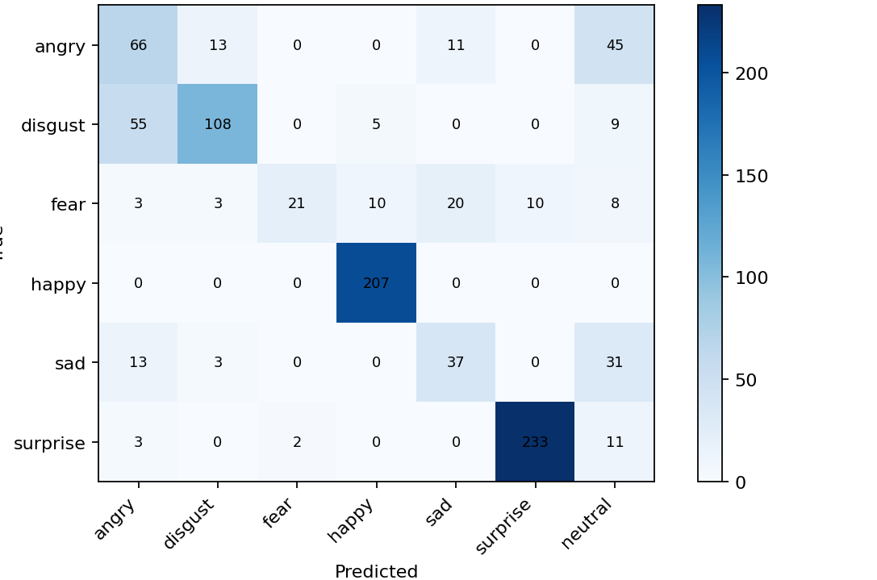
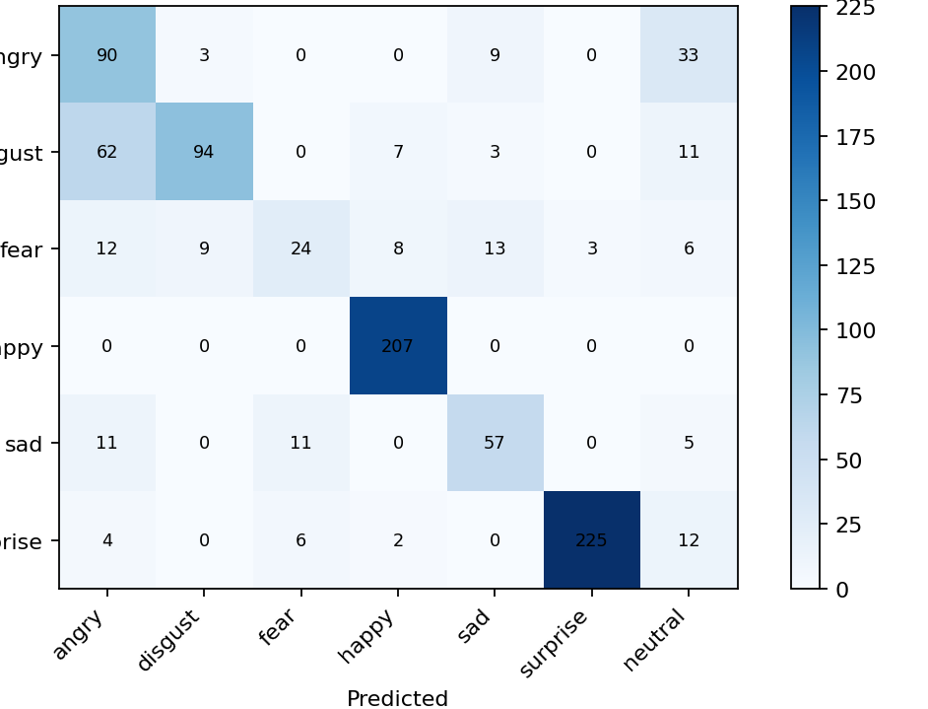
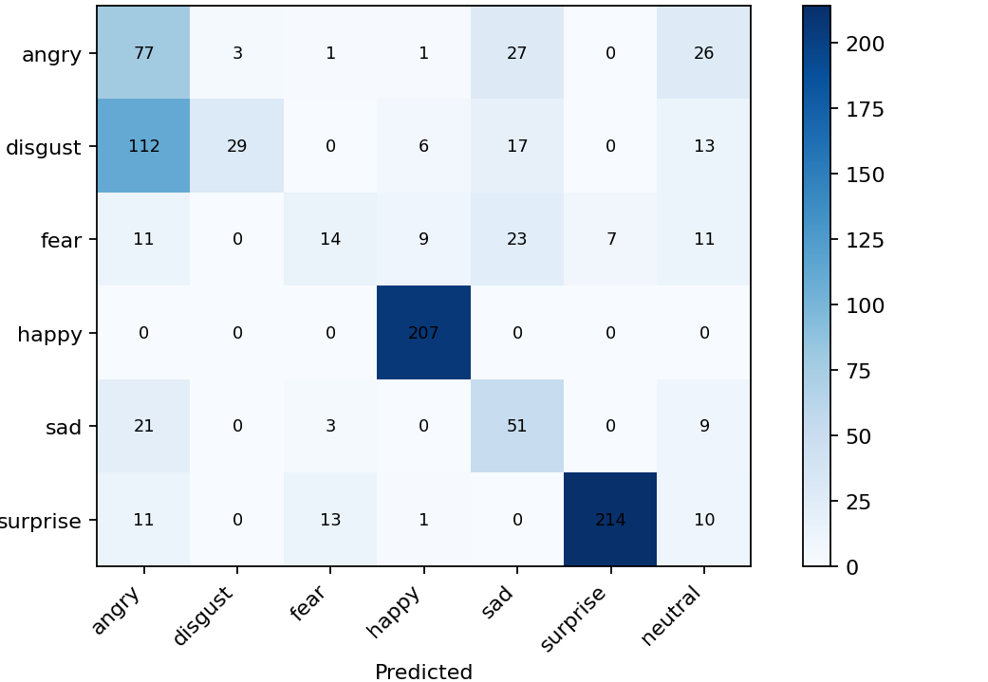
COMPARISON AGAINST BASELINES AND STATE OF THE ART
FER2013 and CK+ comparisons show both improvement and domain shift.
Custom CNN CK+
ResNet18 CK+
EfficientNet-B0 CK+
0.75
FER2013
CK+
Baseline CNN uses the selected crop/TenCrop CE 80-epoch checkpoint.
0.70
0.707
0.685
0.670
0.682
0.65
0.654
CK+ confirms strong happy/surprise transfer but weaker fear and disgust generalization.
0.60
0.55
0.556
0.50
Custom
CNN
ResNet18
EfficientNet
-B0
CK+ Custom CNN per-class F1
CK+ ResNet18 per-class F1
CK+ EfficientNet-B0 per-class F1
angry
disgust
fear
happy
sad
surprise
angry
disgust
fear
happy
sad
surprise
angry
disgust
fear
happy
sad
surprise
0.48
0.71
0.43
0.97
0.49
0.95
0.57
0.66
0.41
0.96
0.69
0.94
0.42
0.28
0.26
0.96
0.51
0.91
19

Slide 20
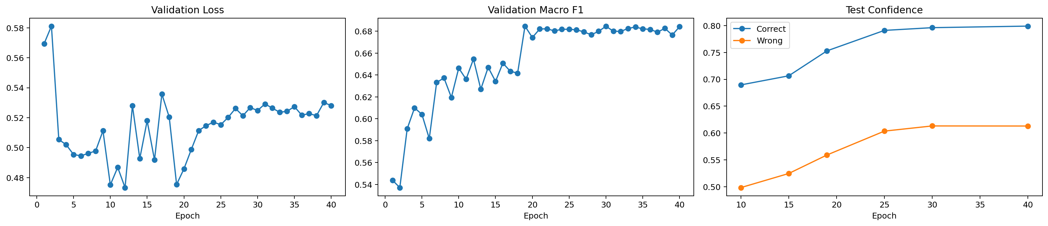
DISCUSSION OF LIMITATIONS AND OBSERVATIONS
Limitations concentrate in weak classes and confidence behavior.
Weak classes remain: fear, sad, angry, and neutral are harder to separate.
Low resolution and ambiguous labels limit the ceiling of model performance.
Class imbalance is reduced but not removed by sampler and loss choices.
Confidence analysis is useful for identifying high-confidence mistakes.
No explicit face alignment pipeline was included.
20

Slide 21
CONCLUSIONS AND FUTURE WORK
The project improves balanced FER2013 recognition while showing where it still fails.
CONCLUSIONS
FUTURE WORK
Transfer learning clearly improves over the custom CNN baseline.
Add face alignment and stronger crop consistency.
EfficientNet-B0 and ResNet18 are close on FER2013 after crop/TenCrop.
Handle label noise or ambiguous labels explicitly.
Test stronger backbones, attention, transformers, or ensembles.
Per-class analysis is essential because weak classes remain hidden in aggregate scores.
Use confidence calibration and targeted review of high-error classes.
21

