Slide 1
Toward Efficient Verification of the Finite Variant Property
Jiachen Qian | JUNE 2026

Slide 2
Talk Overview
Quick recap: From ProVerif to E-unification
FVPgen: An algorithm for automatically proving the FVP
Limitations caused by AC-redundant rules
FVPgen 2.0: A Flattening-based algorithm

Slide 3


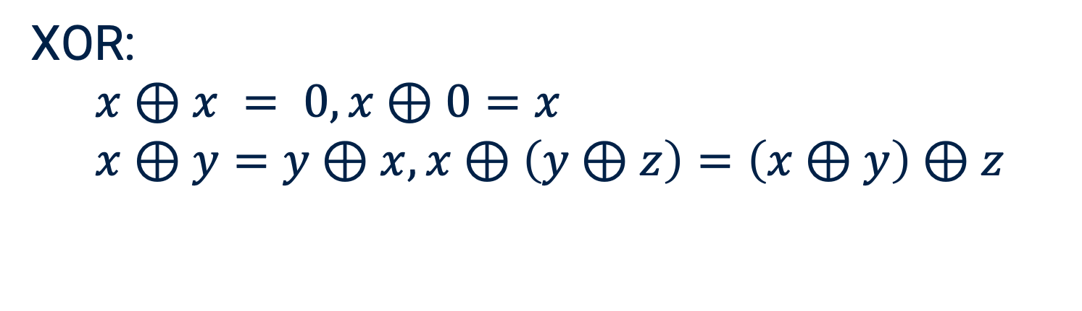
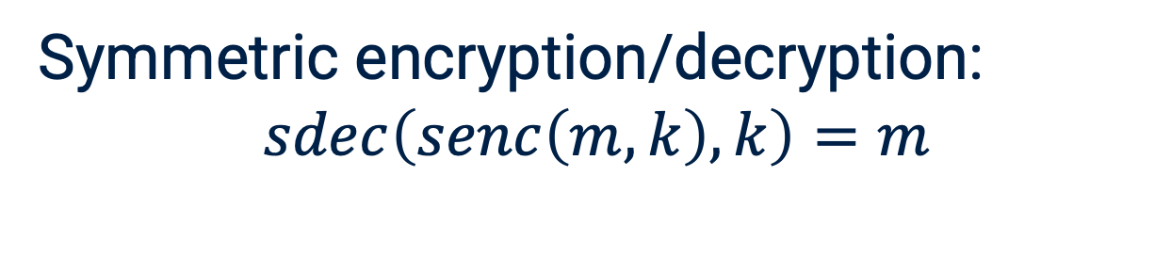
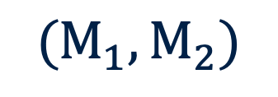
Symbolic Modelling of Cryptographic Protocols
Terms (Messages)
Equational theory (Algebraic properties)
Pair of message
$$(M_{1},M_{2})$$
Symmetric encryption/decryption:
$$sdec\left(senc\left(m,k\right),k\right)=m$$
Symmetric encryption
$$senc\left(m,k\right)$$
XOR:
$$x⊕x = 0, x⊕0=x \\ x⊕y=y⊕x,x⊕\left(y⊕z\right)=\left(x⊕y\right)⊕z$$
Signature
$$sign\left(m,sk_{A}\right)$$
Messages are represented as terms
Equational theory specifies how cryptographic primitives behave
Define what an attacker can compute

Slide 4




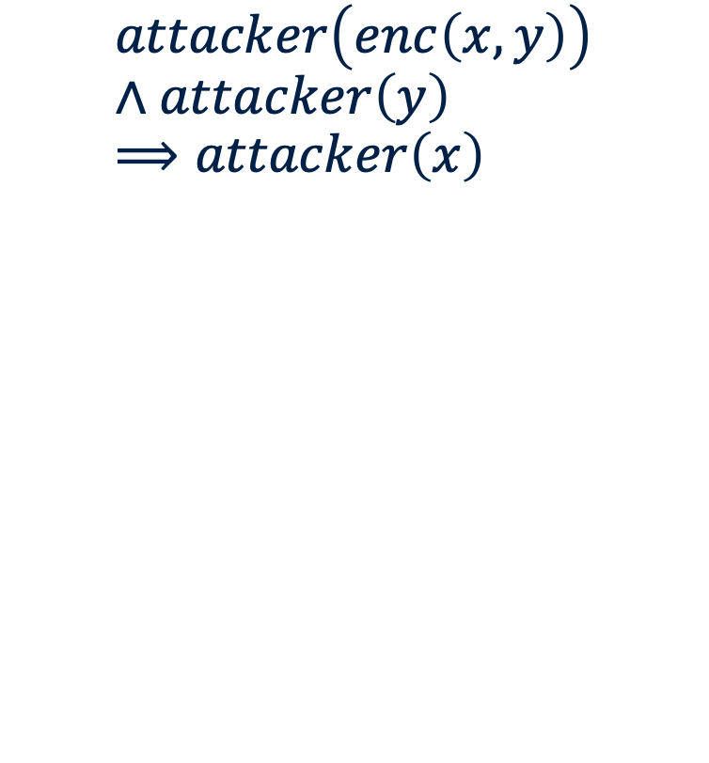

Why ProVerif Needs Unification?
A complete set of the Most General Unifiers(MGUs) is used to capture all the possible attacker behaviour.
Rules in ProVerif
Attacker
Unification
Results
$$attacker\left(enc\left(x,y\right)\right)σ$$
$$=attacker\left(enc\left(s,k\right)\right)σ$$
$$attacker\left(y\right)σ$$
$$=attacker\left(k\right)σ$$
$$attacker\left(enc\left(x,y\right)\right)∧attacker\left(y\right)⟹attacker\left(x\right)$$
$$attacker\left(enc\left(s,k\right)\right)$$
$$attacker\left(k\right)$$
$$attacker\left(s\right)$$
Horn clauses
$$σ= \{ x→ s, y→ k\}$$

Slide 5


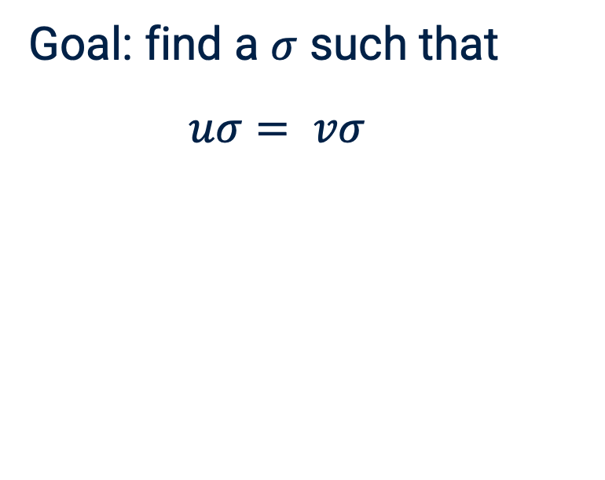
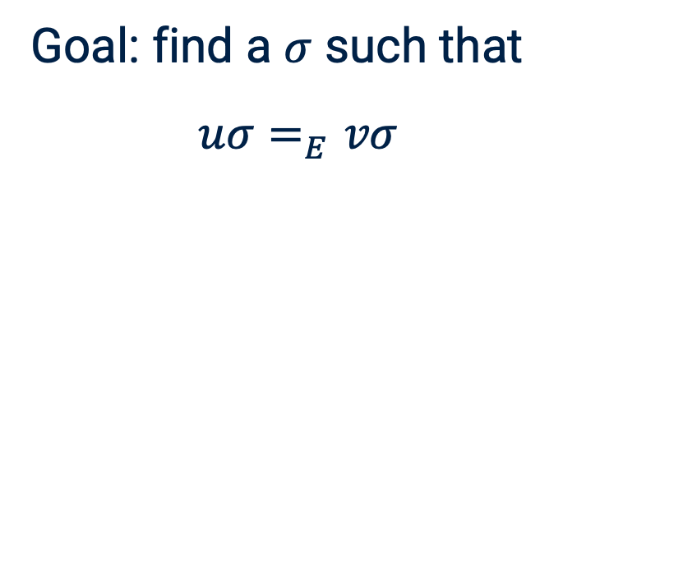

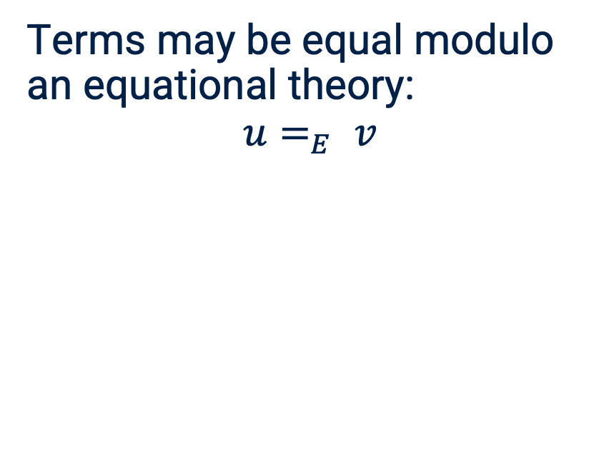
From Syntactic Unification to E-Unification
Syntactic unification
Equivalence relation
E-Unification
Goal: find a $σ$ such that
$uσ= vσ$
Terms may be equal modulo an equational theory:
$$u=_{E} v$$
Goal: find a $σ$ such that
$uσ=_{E}vσ$
Example:
$f\left(x\right)σ=f\left(y\right)σ$
$$σ=\{x→z,y→z\}$$
Example:
$$x⊕y⊕x=_{XOR}y$$
Example:
$$f\left(x\right)σ=_{XOR}f\left(x⊕y⊕x\right)σ$$
$$σ=\{x→z,y→z\}$$
Challenge: E-unification is usually undecidable.

Slide 6
Capability Boundary of ProVerif
✓
Native / Robust
≈
Restricted Support
×
Beyond ProVerif
•
Free constructors
•
Linear equations
•
Associativity and Commutativity
•
Destructor rewrite rules
•
Simplified Diffie–Hellman
•
XOR
•
Some convergent equations
•
Full Diffie–Hellman
hash, MAC, encryption, signatures
depends on the exact equations
often require genuine E-unification
Easy
Limited
Hard
Syntactic Unification
Reduction to syntactic unification
E-Unification
General E-Unification
Notes:
5 min

Slide 7
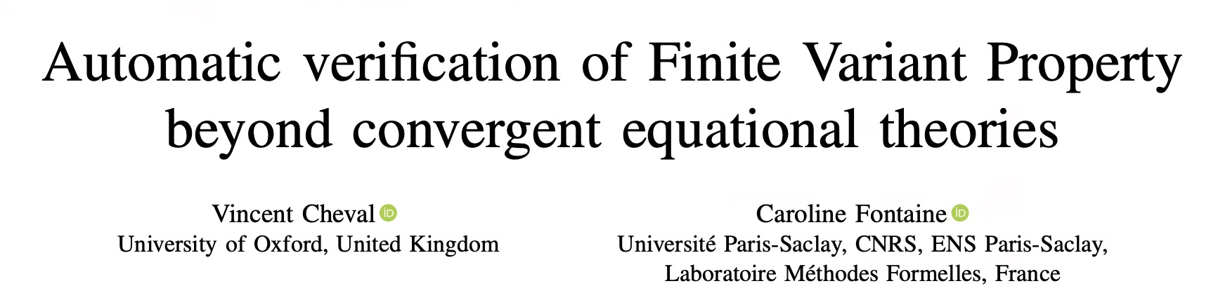
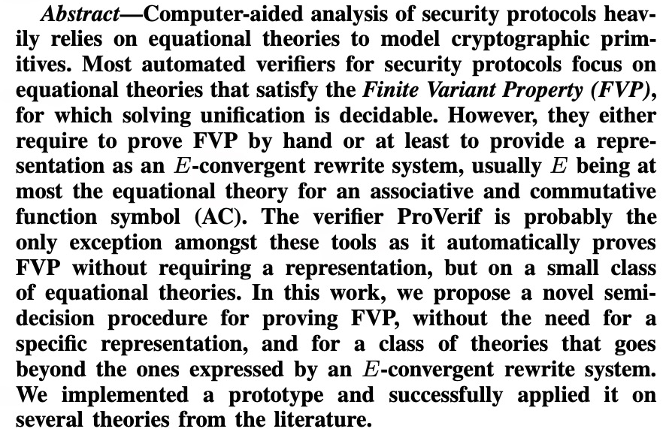
Existing Approaches
Basic narrowing
1
Fails when the equational theory contains AC symbols.
2
Ad-hoc algorithms
Work well in special cases, but lack generality.
3
Finite Variant Property
[Comon-Lundh & Delaune, 2005]
Reduce an unknown problem to a known one.
A very general method, but is almost impossible for a non-expert user to use that.

Slide 8
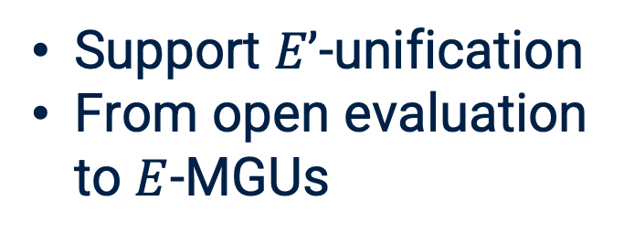
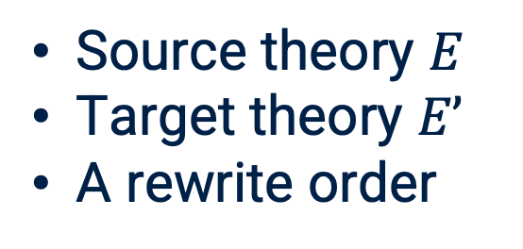
FVPgen: An Algorithm for Automatically Proving the FVP
Input
Output
ProVerif
Saturation loop
A rewrite theory
NEXT STEP
Support $E’$-unification
From open evaluation to $E$-MGUs
Source theory $E$
Target theory $E’$
A rewrite order
If the algorithm terminates, then E-unification can be reduced to E’-unification
Example: XOR-unification (source) -> AC-unification (target)

Slide 9
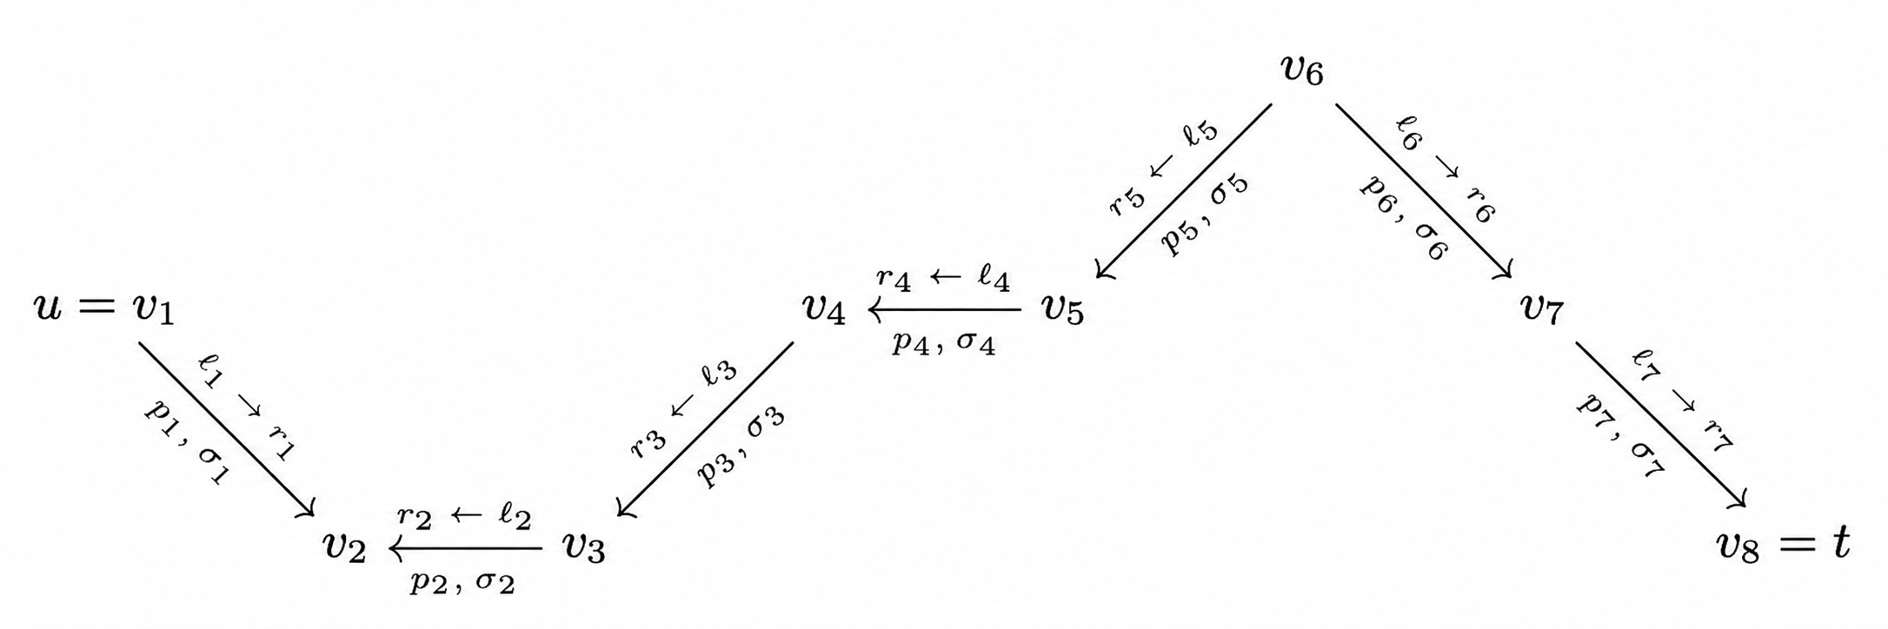
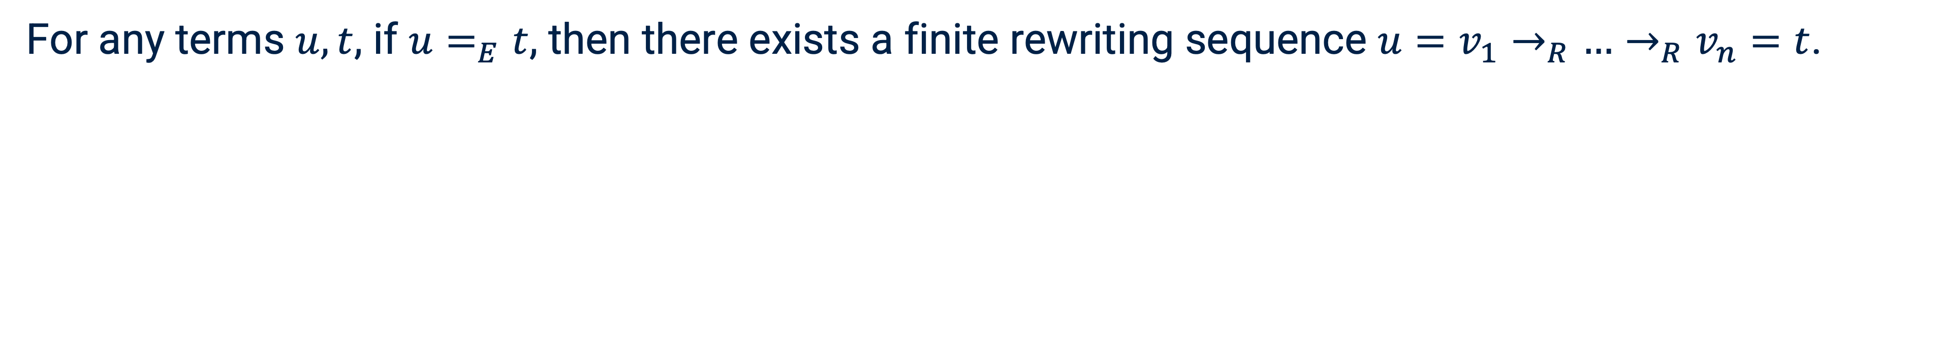
What Does FVP Mean for the Algorithm?
For any terms $u, t$, if $u=_{E}t$, then there exists a finite rewriting sequence $u=v_{1}→_{R}…→_{R}v_{n}=t$.
Notes:
Menthion the order: AC compatible, total on ground term

Slide 10
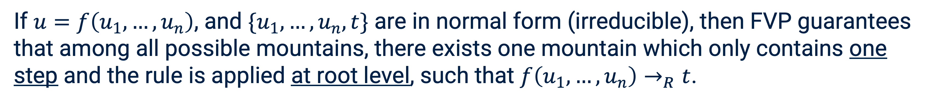
What Does FVP Mean for the Algorithm?
If $u=f\left(u_{1},…,u_{n}\right)$, and $\{u_{1},…,u_{n},t\}$ are in normal form (irreducible), then FVP guarantees that among all possible mountains, there exists one mountain which only contains one step and the rule is applied at root level, such that $f\left(u_{1},…,u_{n}\right)→_{R}t$.

Slide 11
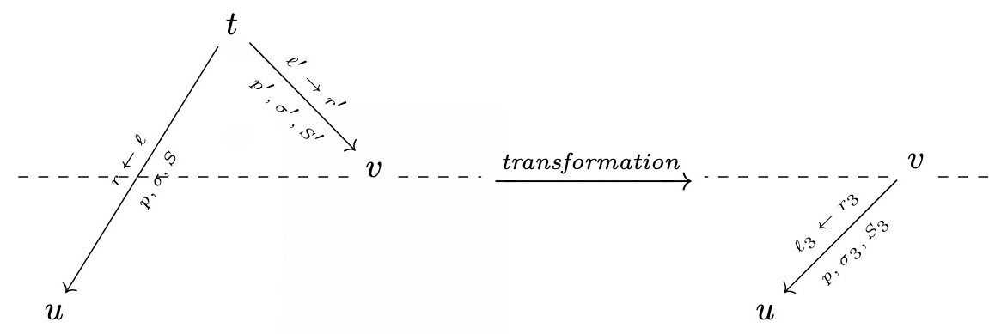

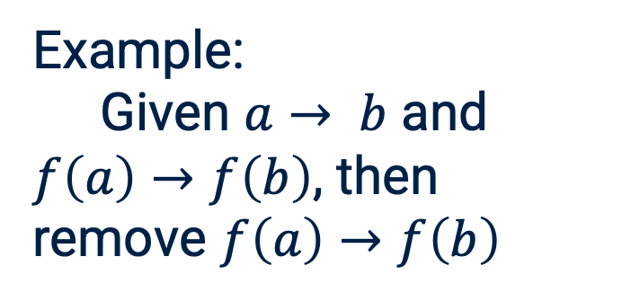
Inside the Algorithm: Saturation Loop
Normalisation procedure
Overlapping procedure
NORMR
NORML
SUB
EQ
Similar to critical pair in the Knuth-Bendix algorithm
Used to generate new rules to guarantee the FVP
Example:
Given $ℓ→ r$, $r→_{R}r’$, and $r > r’$then replace the rule $ℓ→ r$ with $ℓ→ r’$
Example:
Given $a→ b$ and $f\left(a\right)→f\left(b\right)$, then remove $f\left(a\right)→f\left(b\right)$
Improve termination +
Remove redundant rules

Slide 12

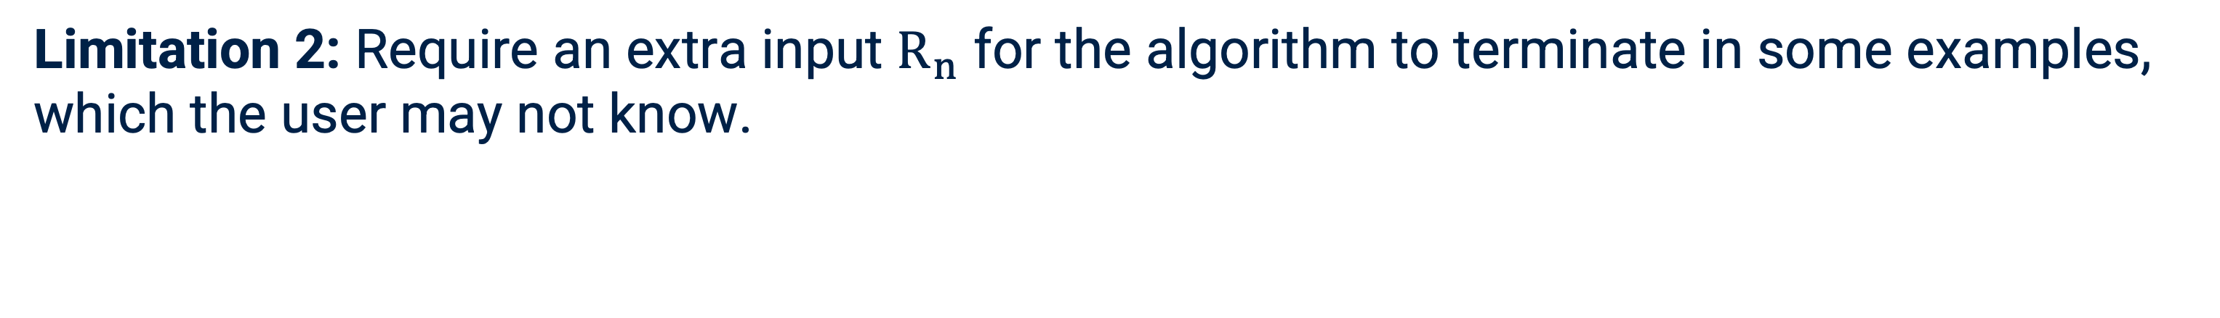
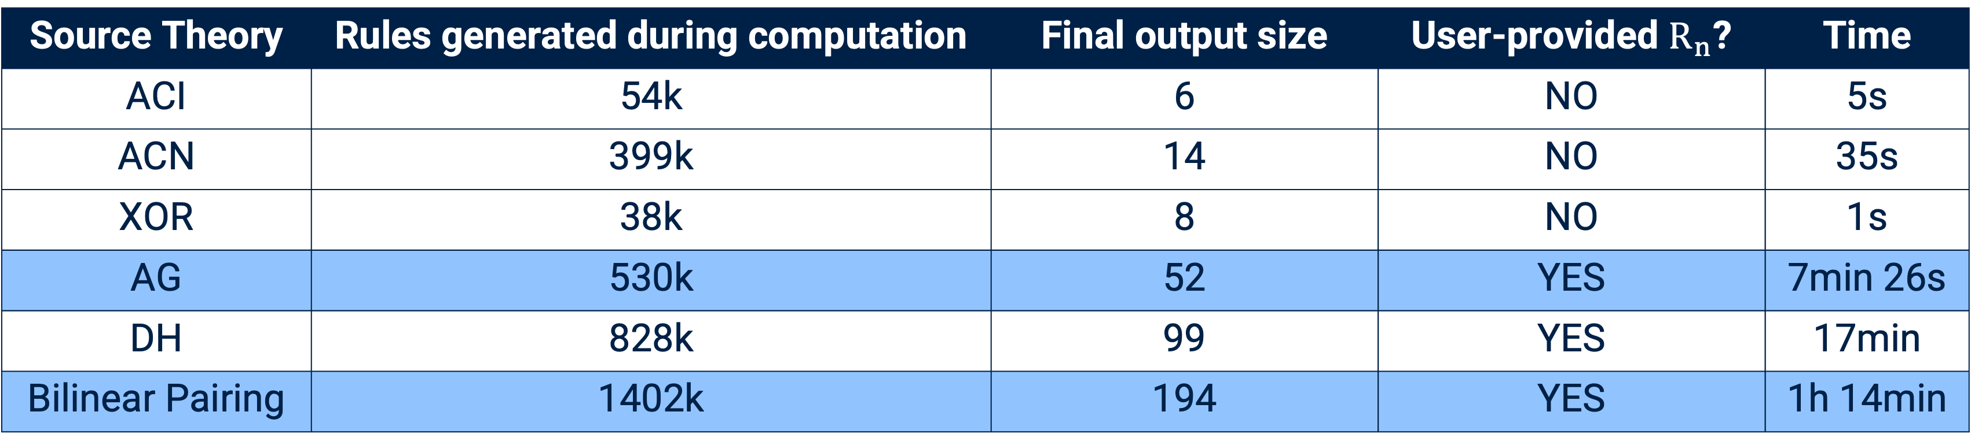
The Limitations in the Algorithm
Target theory: AC
$R_{n}$ is the AC convergent rewrite system modelling the source equational theory
Source Theory | Rules generated during computation | Final output size | User-provided $R_{n}$? | Time
ACI | 54k | 6 | NO | 5s
ACN | 399k | 14 | NO | 35s
XOR | 38k | 8 | NO | 1s
AG | 530k | 52 | YES | 7min 26s
DH | 828k | 99 | YES | 17min
Bilinear Pairing | 1402k | 194 | YES | 1h 14min
Limitation 1: Too many AC-redundant rules during the computation
$$\{x+y →y+x, (x+y)+z →x+(y+z), (x+z)+y →y+(z+x)\}$$
Limitation 2: Require an extra input $R_{n}$ for the algorithm to terminate in some examples, which the user may not know.
Notes:
Rn is the AC convergent rewrite system modelling the equational theory(source)

Slide 13

Improvement: Classic Terms to Flattened Normal Terms
f
f
f
+
f
+
$$flat_{↓}$$
2
1
+
1
2
1
1
2
3
2
3
Intuition: The flattened normal terms provide a canonical form of AC terms
Notes:
half

Slide 14
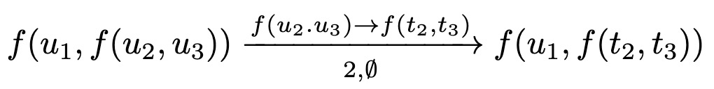
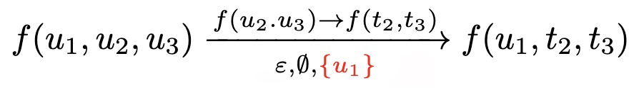

Flattening: Benefits and Challenges
Benefits
Challenges
Well aligned with ProVerif’s future development
AC/XOR unification.
More efficient
Simplify normalisation procedure
AC-equivalence check $→$ syntactic equality check
Remove AC-redundant rules
Definitions must be rebuilt
Inspired by: [Jouannaud, 2008])
Example:
Correctness proof is not simply transferable
The previous proof relies on binary AC-symbols, but are now unbounded
Need a new ranking function for the proof
Need to develop a new overlapping procedure

Slide 15







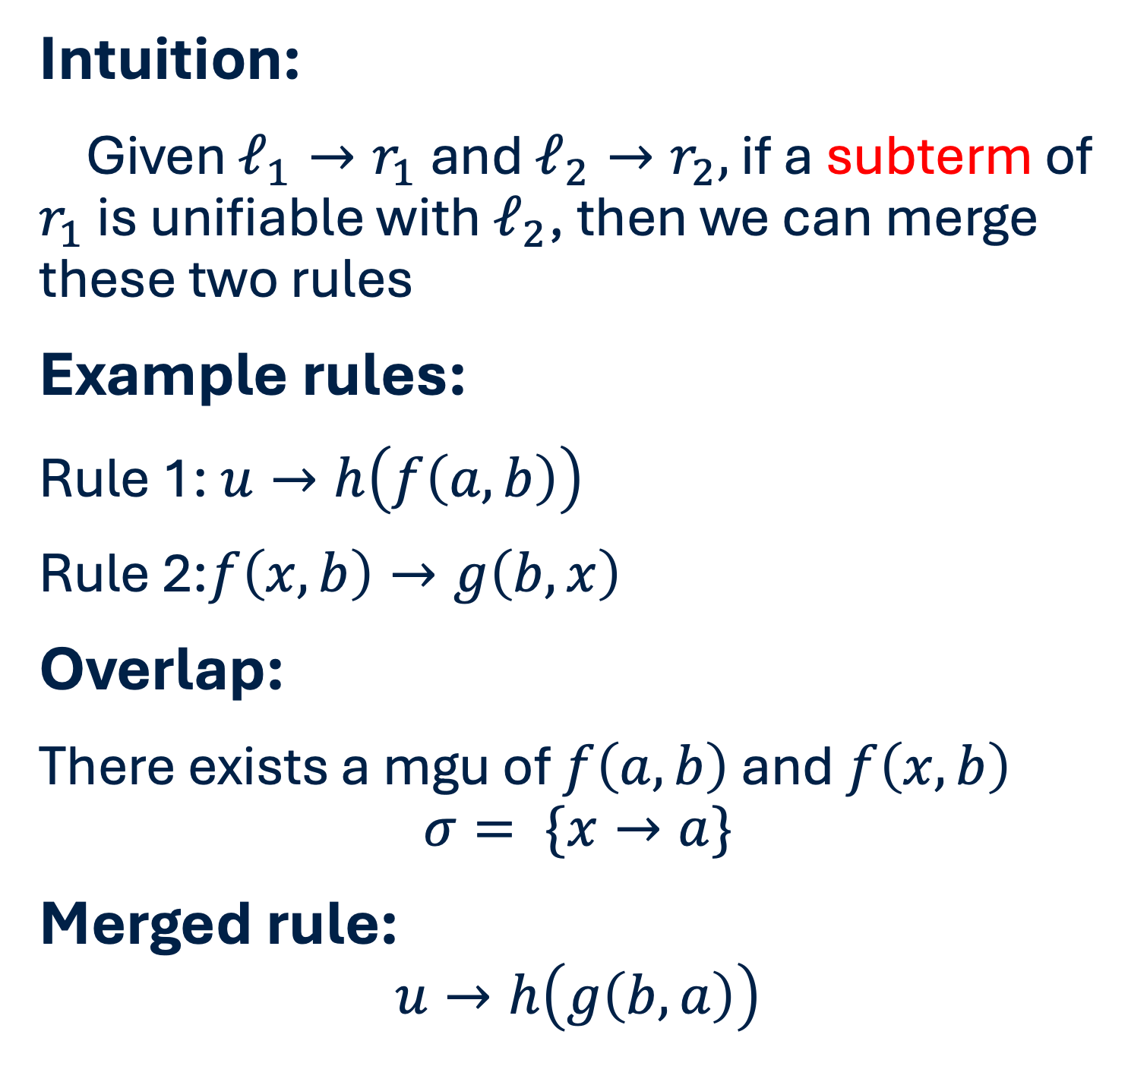










Overlapping: Classic case
Intuition:
Given $ℓ_{1}→r_{1}$ and $ℓ_{2}→r_{2},$ if a subterm of $r_{1}$ is unifiable with $ℓ_{2}$, then we can merge these two rules
Example rules:
Rule 1: $u→h\left(f\left(a,b\right)\right)$
Rule 2:$f\left(x,b\right)→g\left(b,x\right)$
Overlap:
There exists a mgu of $f\left(a,b\right)$ and $f\left(x,b\right)$
$$σ= \{x→a\}$$
Merged rule:
$$u→h\left(g\left(b,a\right)\right)$$
$$h$$
$$u$$
$$f$$
$$a$$
$$b$$
$$f$$
$$g$$
$$x$$
$$b$$
$$b$$
$$x$$
$$h$$
$$u$$
$$g$$
Apply $σ$
$$b$$
$$a$$

Slide 16



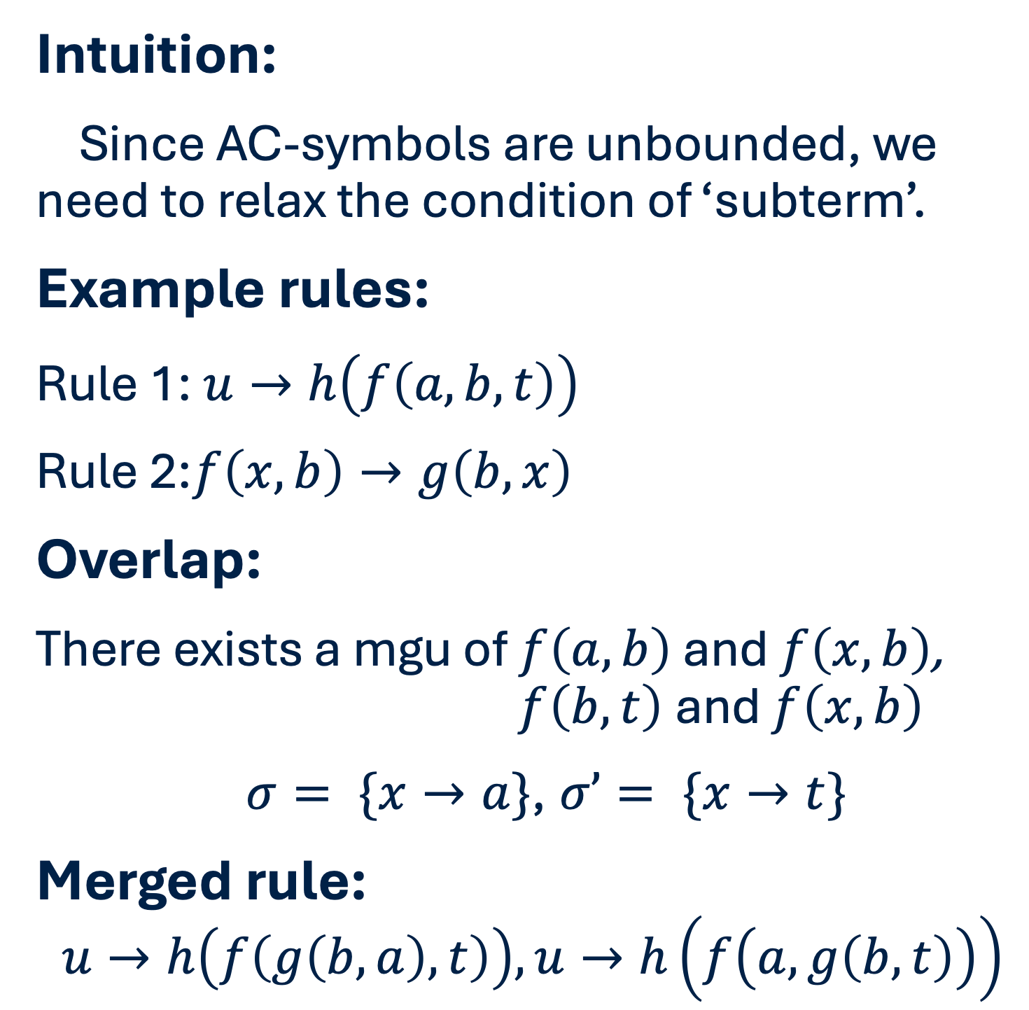





Overlapping: Extended case (NEW)
Intuition:
Since AC-symbols are unbounded, we need to relax the condition of ‘subterm’.
Example rules:
Rule 1: $u→h\left(f\left(a,b,t\right)\right)$
Rule 2:$f\left(x,b\right)→g\left(b,x\right)$
Overlap:
There exists a mgu of $f\left(a,b\right)$ and $f\left(x,b\right)$, $f\left(b,t\right)$and $f\left(x,b\right)$
$σ= \{x→a\}$, $σ’= \{x→t\}$
Merged rule:
$$u→h\left(f\left(g\left(b,a\right),t\right)\right), u→h\left(f\left(a,g\left(b,t\right)\right)\right)$$
$$h$$
$$u$$
$$f$$
$$a$$
$$b$$
$$t$$
$$f$$
$$g$$
$$x$$
$$b$$
$$b$$
$$x$$
$$h$$
$$u$$
$$f$$
$$g$$
$$t$$
Apply $σ$
$$b$$
$$a$$

Slide 17




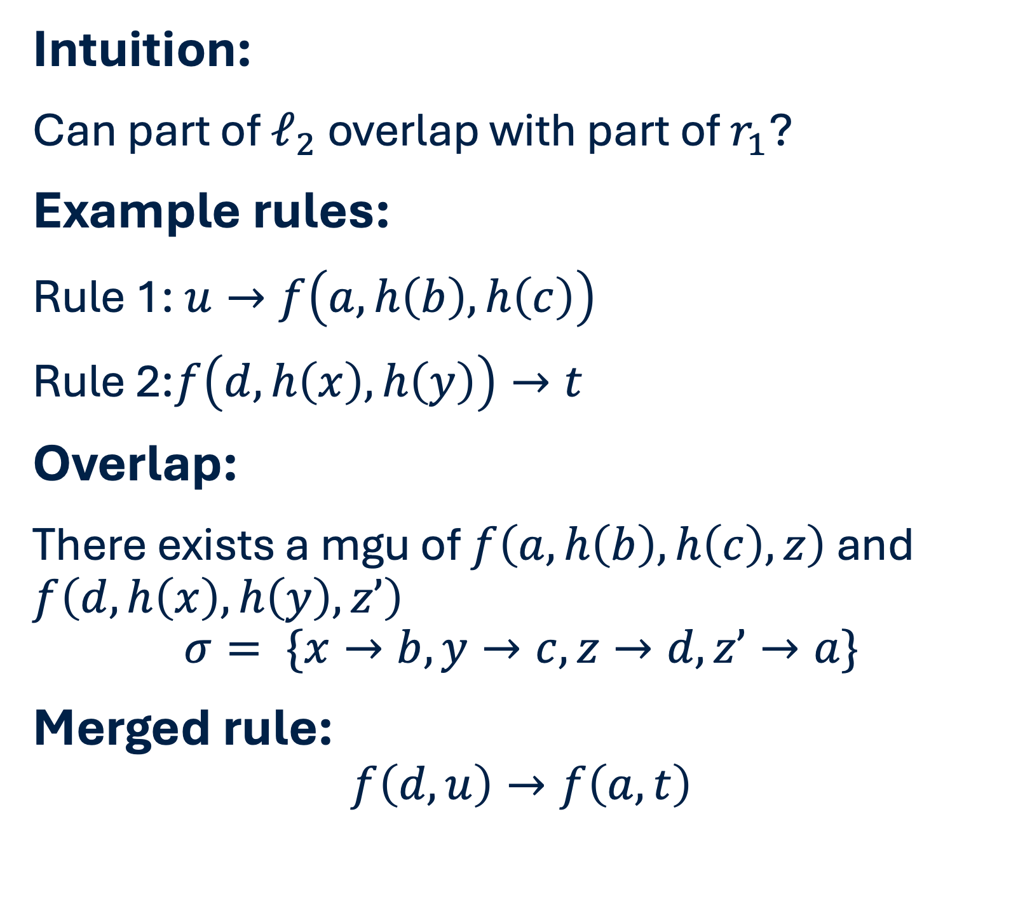























Overlapping: An unexpected case (NEW)
Intuition:
Can part of $ℓ_{2}$ overlap with part of $r_{1}$?
Example rules:
Rule 1: $u→f\left(a,h\left(b\right),h\left(c\right)\right)$
Rule 2:$f\left(d,h\left(x\right),h\left(y\right)\right)→t$
Overlap:
There exists a mgu of $f\left(a,h\left(b\right),h\left(c\right),z\right)$ and $f\left(d,h\left(x\right),h\left(y\right),z’\right)$
$$σ= \{x→b, y→c,z→d,z’→a\}$$
Merged rule:
$$f\left(d,u\right)→f\left(a,t\right)$$
$$f$$
$$f$$
$$u$$
$$z$$
$$a$$
$$h$$
$$h$$
$$z$$
$$b$$
$$c$$
$$f$$
$$f$$
$$d$$
$$h$$
$$h$$
$$z’$$
$$t$$
$$z’$$
$$x$$
$$y$$
$$f$$
$$f$$
$$d$$
$$u$$
Apply $σ$
$$a$$
$$t$$
Notes:
For correctness proof

Slide 18
Sample Result: ACN
FVPgen – Original Output
FVPgen – Flattened Output
Contains 14 rules, but many are AC-redundant
(X_2 plus X_1) -> (X_2 plus X_1)
zero -> zero
(X_1 plus X_1) -> zero
((X_1 plus zero) plus X_1) -> zero
(X_1 plus (X_1 plus zero) -> zero
...
Can be used to compute ACN-MGUs.
Only contains 3 rules!
(X_2 plus X_1) -> (X_2 plus X_1)
zero -> zero
(X_1 plus X_1) -> zero
BUT!!! Not sufficient for MGU computation!
Key issue: AC-redundant does not mean unnecessary for MGU computation

Slide 19
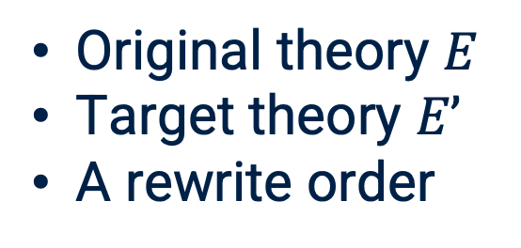
FVPgen 2.0
Not enough
Input
Same Output
Original theory $E$
Target theory $E’$
A rewrite order
New main loop
Restoration
A rewrite theory
Eliminate all AC-redundant rules
Add useful AC-redundant rules
Notes:
The restoreation is only the final step. The main computation still happen in the main loop, and after it saturate, the final step is a fast step to add the required rules back

Slide 20
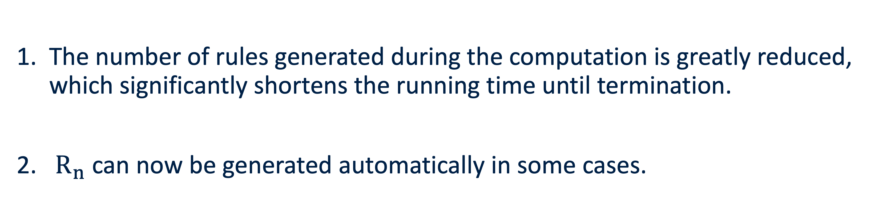
Experimental results
The number of rules generated during the computation is greatly reduced, which significantly shortens the running time until termination.
$R_{n}$ can now be generated automatically in some cases.

Slide 21






Abelian Group and Bilinear Pairing
Abelian Group
x
before vs after flattening
same input
Bilinear Pairing
before vs after flattening
same input
Rules generated during computation
Running time
Rules generated during computation
Running time
530k → 9k
7min 26s → 3s
1402k → 37k
1h 14min → 23s
before vs after flattening
without extra $R_{n }$
before vs after flattening
without extra $R_{n}$
Rules generated during computation
Running time
Rules generated during computation
Running time
$∞$ → 26k
$∞$→ 4s
$∞$ → 107k
$∞$→ 4min 5 s

Slide 22
Main Contributions
Theory
Application
Redesign the definitions, algorithm, and proofs for the flattened setting, with a termination proof.
Major efficiency gains: Abelian groups from 7+ min to seconds; bilinear pairing from 1+ hour to < 1 min.
Eliminate AC-redundant rules, significantly reducing the size of the generated rewrite system.
Automatically construct the auxiliary rewrite system, removing the need for user-provided input in some cases.

Slide 23
Future work
Further optimise the theory and implementation There are still many opportunities to simplify definitions and proofs, and improve efficiency of the code.
Integrate the prototype into ProVerif and Tamarin This would make the approach directly usable in existing protocol verification tools.
Extend the theory beyond AC The current theory only supports the target theory to be AC. A natural next step is to handle more general equational theories, such as XOR (efficiency), XORh (scope).
Any questions?

