Slide 1

XZPLORE
Xzplore is an open world space exploration game with a vast majority of planets to document and discover. Through your journey you will uncover and identify rare and uncommon space resources while avoiding or eliminating the many different parasites that inhabit the galaxy.
ztdnzun

Slide 2

GAMEPLAY TRAILER

Slide 3
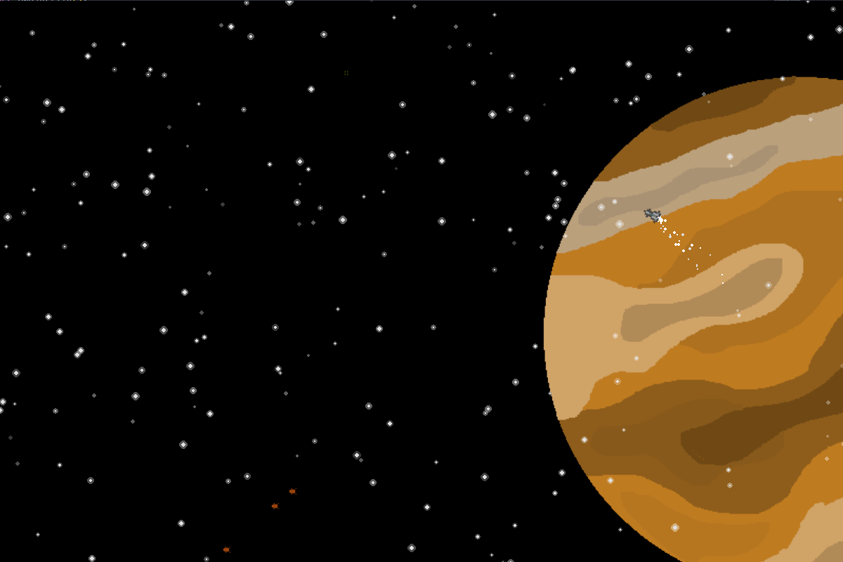
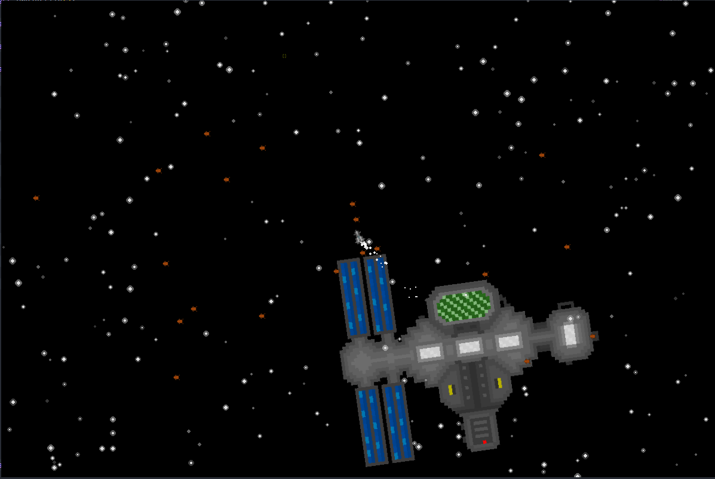
Screenshots

Slide 4



ACHIVEMENTS
Unlock achievements and collectibles as you travel and Xplore this never ending adventure.
PARASITES
Avoid or destroy the many parasites that will come and attack you

