Slide 1

Pixel Baseball
Description: Still like the feel of old school games? Well you have come to the right game! Pixel Baseball is a
simple pitch and hit game. Get your time down just right for a powerful hit!
Objective: Easy, hit as many homeruns as you can! There is no score keeping!

Slide 2
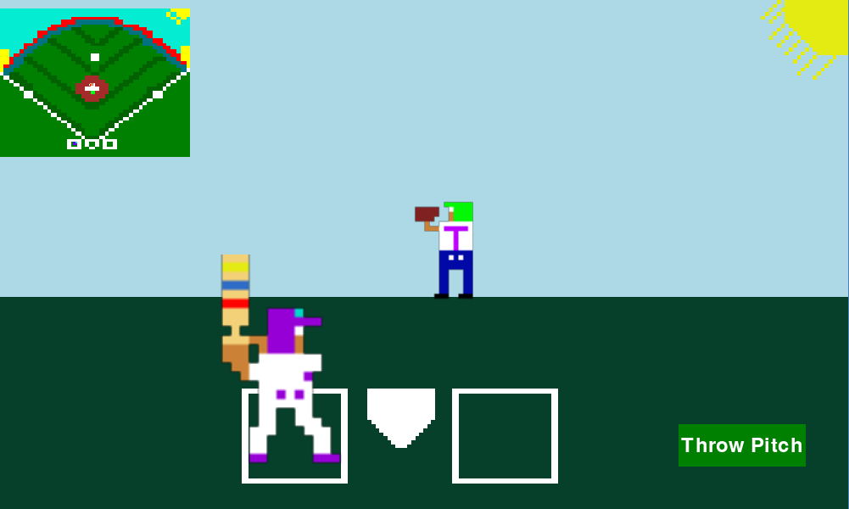
B-Ball Page
Small bug: If you hit the ball to center field, expect a delay before throwing the next pitch. To know the pitcher is ready to pitch, the baseball will reappear on the pitcher's mound on the minimap.
Author:
T.Houston

