Slide 1
Powerlifting: An Exploration on the Data
Zach Eanes & Dalton Rogers

Slide 2
What is “Powerlifting”?
As an easy description, powerlifting is the open sport of competing to see who can lift the most total weight across three primary lifts. These lifts being Squat, Bench, and Deadlift (referred to as SBD throughout this project).

Slide 3
The general structure of many of these competitions includes many little factors:
Everyone is split into weight classes, gender, and age classes. This is to ensure everyone is competing fairly and no one has a clear advantage.
Every lifter has 3 attempts for each lifting, leaving 9 total lifts across the competition.
Drug free! No steroids or substances that may boost someone’s performance, and these competitors are tested to ensure they are drug free.
The concept of good and failed lifts: There’s 3 judges for a lift, all viewing a different perspective of the lifter. In order for a lift to be good, 2/3 judges must deem it a good lift. Some common failures include not getting enough depth squatting, not controlling the drop after a deadlift, or of course literally not getting the weight up.

Slide 4
Linear Progression of Weight Classes? (Section 1)
This one is simple, do heavier weights classes generally lift higher amounts than lower? We can observe the best successful lift for each SBD and find an average for each weight class group and then we can compare the classes to see if there’s a linear progression.

Slide 5
Weight Classes for IPF
IPF lists their male weight classes as: 59.0 kg Class: up to 59.0 kg 66.0 kg Class: from 59.01 kg up to 66.0 kg 74.0 kg Class: from 66.01 kg up to 74.0 kg 83.0 kg Class: from 74.01 kg up to 83.0 kg 93.0 kg Class: from 83.01 kg up to 93.0 kg 105.0 kg Class: from 93.01 kg up to 105.0 kg 120.0 kg Class: from 105.01 kg up to 120.0 kg 120.0+ kg Class: from 120.01 kg up to unlimited
IPF lists their female weight classes as: 47.0 kg Class: up to 47.0 kg 52.0 kg Class: from 47.01 kg up to 52.0 kg 57.0 kg Class: from 52.01 kg up to 57.0 kg 63.0 kg Class: from 57.01 kg up to 63.0 kg 69.0 kg Class: from 63.01 kg up to 69.0 kg 76.0 kg Class: from 69.01 kg up to 76.0 kg 84.0 kg Class: from 76.01 kg up to 84.0 kg 84.0+ kg Class: from 84.01 kg up to unlimited

Slide 6
Functions Used
# This function gets the average of the best lift for each factor and arranges it # by the weight class itself # # Args: class - the class we want to get the average weights for avg_weights <- function(class) { class |> filter(!is.na(best3squat_kg) & !is.na(best3bench_kg) & !is.na(best3deadlift_kg)) |> group_by(weight_class_kg) |> # group by their respective classes summarize( avg_squat = sum(best3squat_kg) / n(), # get avg squat avg_bench = sum(best3bench_kg) / n(), # get avg bench avg_dead = sum(best3deadlift_kg) / n()) |> # get avg deadlift arrange(weight_class_kg) # arrange to make it better } # This function takes our data and makes the data itself tidier and simple to use for # both data exploration and graphing. # # Args: class - the class we want to make tidier make_avgs_tidyer <- function(class) { # pivot to long format to graph easier class |> pivot_longer(cols = c(avg_squat, avg_bench, avg_dead), names_to = "lift", values_to = "avg_weight") }

Slide 7
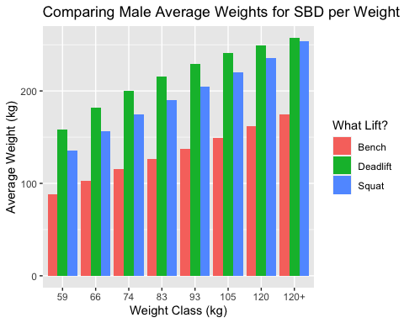
Male Weight Classes
# get those in proper weight classes, and make weight_class_kg a factor for organization male_factors = c(59, 66, 74, 83, 93, 105, 120, "120+") male_classes <- ipf |> filter(weight_class_kg %in% c(59, 66, 74, 83, 93, 105, 120, "120+") & sex == "M") |> mutate(weight_class_kg = factor(weight_class_kg, levels = male_factors)) # get information we need for our data and make it usable weights_male <- avg_weights(male_classes) |> make_avgs_tidyer() # group by the weight class and put sbd all next to each other in group weights_male |> ggplot(aes(x = weight_class_kg, y = avg_weight, fill = lift)) + geom_bar(stat = "identity", position = "dodge") + labs( title = "Comparing Male Average Weights for SBD per Weight Class", x = "Weight Class (kg)", y = "Average Weight (kg)" ) + scale_fill_discrete(name = "What Lift?", labels = c("Bench", "Deadlift", "Squat"))

Slide 8
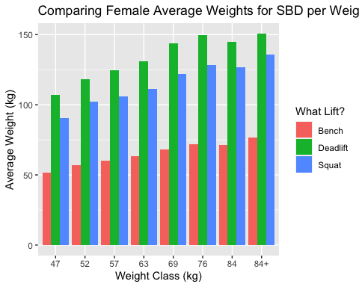
Female Weight Classes
# get those in proper weight classes, and make weight_class_kg a factor for organization female_factors = c(47, 52, 57, 63, 69, 76, 84, "84+") female_classes <- ipf |> filter(weight_class_kg %in% c(47, 52, 57, 63, 69, 76, 84, "84+") & sex == "F") |> mutate(weight_class_kg = factor(weight_class_kg, levels = female_factors)) # get information we need for our data and make it usable weights_female <- avg_weights(female_classes) |> make_avgs_tidyer() # group by the weight class and put sbd all next to each other in group weights_female |> ggplot(aes(x = weight_class_kg, y = avg_weight, fill = lift)) + geom_bar(stat = "identity", position = "dodge") + labs( title = "Comparing Female Average Weights for SBD per Weight Class", x = "Weight Class (kg)", y = "Average Weight (kg)" ) + scale_fill_discrete(name = "What Lift?", labels = c("Bench", "Deadlift", "Squat"))

Slide 9
Failures…
In order to get this information together, we had many failures and attempts at using the data is a less tidy manner. The biggest change was the inclusion of the pivot_longer in order to allow us to create more rows and make the graphing easier. It allows us to group and place each lift inside of the group, as well as creating a cleaner chart in general. Beforehand, we broke some of the basic policies of tidy data, including storing too much information inside of a cell and “double dipping”. We had numbers in the columns for the lift itself, and in the end out newest form is tidiest and surely best for our purposes. Below is some of the attempts we had beforehand, which ended as a failure in all honesty.

Slide 10
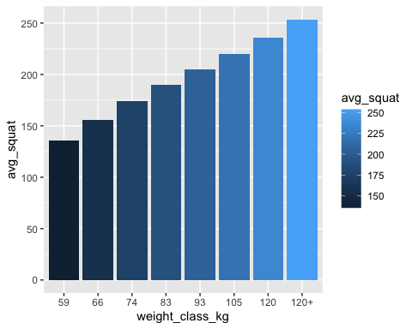
R Code for Failure
# recreate our data set for demonstration purposes male_classes <- ipf |> filter(weight_class_kg %in% c(59, 66, 74, 83, 93, 105, 120, "120+") & sex == "M") |> mutate(weight_class_kg = factor(weight_class_kg, levels = male_factors)) # this was the dataset before avg_weights(male_classes)
## # A tibble: 8 × 4 ## weight_class_kg avg_squat avg_bench avg_dead ## <fct> <dbl> <dbl> <dbl> ## 1 59 136. 88.5 158. ## 2 66 156. 103. 181. ## 3 74 174. 115. 201. ## 4 83 190. 126. 216. ## 5 93 205. 137. 229. ## 6 105 220. 149. 241. ## 7 120 236. 162. 250. ## 8 120+ 254. 175. 257.
# this was out plot before the pivot_longer, as we just had each lift in thier own graph avg_weights(male_classes) |> ggplot(aes(x = weight_class_kg, y = avg_squat, fill = avg_squat)) + geom_bar(stat = "identity")

Slide 11
Conclusion for Section 1
Overall, we were able to find that there is a general linear progression of weight classes and the amount of weight lifted. This is a trend we expected, as the heavier weight classes generally have more muscle mass and are able to lift more weight.
Interestingly, we found that the womens 76kg class completely beat out the class above them, the 84kg. Along with this, towards the higher classes, there’s a slight taper on the deadlifts, and our guess is because of grip strength limitations.

Slide 12
Percentage of Failed Lifts Across all Nine Attempts (Section 2)
In this section, we wanted to observe if for certain lifts, competitors are more likely to fail the lift. In the database, if a life begins with a “-”, this means it was a failure. Using this, we may be able to get the percentage of good lifts to failed lifts for each lift, all 3 for SBD.

Slide 13
Setup for Graphing
# first we remove bad entries, where any of their lifts are na. sum up only data we want # to observe good_lifts <- ipf |> # filter our bad entries filter(!is.na(squat1kg) & !is.na(squat2kg) & !is.na(squat3kg) & !is.na(bench1kg) & !is.na(bench2kg) & !is.na(bench3kg) & !is.na(deadlift1kg) & !is.na(deadlift2kg) & !is.na(deadlift3kg)) |> # only get what we need summarize(name, squat1kg, squat2kg, squat3kg, bench1kg, bench2kg, bench3kg, deadlift1kg, deadlift2kg, deadlift3kg)
# pivot longer to get the data as column lift with a value of the column name and weight # as a value in another good_lifts <- good_lifts |> # split the dataset into lift and weight, to observe entries as group easier pivot_longer(cols = c(squat1kg, squat2kg, squat3kg, bench1kg, bench2kg, bench3kg, deadlift1kg, deadlift2kg, deadlift3kg), names_to = "lift", values_to = "weight")

Slide 14
Getting the Percentage of Failed Lifts
# this function gets the percentage of failed lifts for each lift. because the dataset # lists the failed lifts beginning with a -, we can use regex to explore failure # to success # # Args: class - the data we want to get the percentage of failed lifts for percentage_failed <- function(class) { class |> # group by lifts to see the success/fail rate of each group_by(lift) |> # get the percentage of failed lifts for each lift summarize( # get the lift and their respective failure/success rate failed = sum(str_detect(weight, "^-.*")) / n() * 100, num_failed = sum(str_detect(weight, "^-.*")), success = 100 - failed, num_success = n() - num_failed, total = failed + success ) } # get the percentage of failed lifts for each lift rates <- percentage_failed(good_lifts)

Slide 15
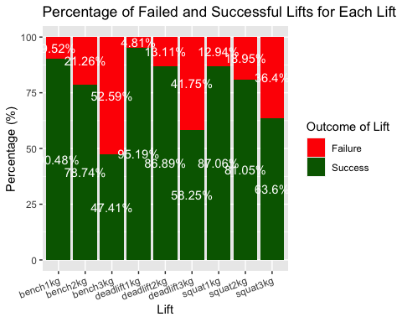
Graphing the Data
# longer data in order to graph easier :) lift_data_long <- rates |> pivot_longer(cols = c(failed, success), names_to = "outcome", values_to = "percentage") # Plot ggplot(lift_data_long, aes(x = lift, y = percentage, fill = outcome)) + # bar chart of the percentage of failed and successful lifts for each lift geom_bar(stat = "identity") + # add text to the chart showing the percentage itself geom_text(aes(label = paste0(round(percentage, 2), "%")), position = position_stack(vjust = 0.5), color = "white") + labs( title = "Percentage of Failed and Successful Lifts for Each Lift", x = "Lift", y = "Percentage (%)", fill = "Outcome" ) + # colors for the percentages themselves scale_fill_manual(values = c("success" = "darkgreen", "failed" = "red"), name = "Outcome of Lift", labels = c("Failure", "Success")) + # make the x axis text easier to read theme(axis.text.x = element_text(angle = 20, hjust = 1))

Slide 16
Conclusion for Section 2
Looking at the chart itself, there’s some shocking results. First, we never expected the last bench attempt to have the highest failure rate. This is because the bench press is generally attempted safely, as competitors still have the deadlift after to try and get more. Our guess was that the last deadlift would have the highest failure rate, for many reasons: 1) It’s the last lift, so competitors will be more fatigued from the rest of the event. 2) Since it’s the last, many competitors go “all-out” to attempt to place on the podium. 3) In generality, deadlift is the hardest lift to get up, because grip strength is a large limiting factor for the strongest competitors.
Lastly, we were able to conclude that there is some trend to where the first lift is the most successful, and the last lift is the least successful. This is because the first lift is generally the lightest, and the last lift is generally the heaviest. This is a trend we expected, but it’s nice to see it confirmed in the data.

Slide 17
Is Powerlifting a growing sport? (Section 3)
In this section, we simply want to see if the data supports the idea that powerlifting is a growing sport. It’s been said to be a growing sport, and many say that the explosion of social media especially backs this up. To do this, we can observe the total amount of competitors in each year, and see if there’s a trend of growth.

Slide 18
Questions to Answer
There’s also some other interesting ideas we’d like to see: 1) Did the pandemic of COVID-19 have an effect on the amount of competitors? If so, what years were most affected by it? 2) Which years had the largest percent growth from the previous? 3) Which years had the largest percent decrease from the previous? 4) What is the average growth rate of competitors per year?
By being able to look at the data to support this idea, especially for the largest powerlifting federation, IPF, we can see if the sport is truly growing or not.

Slide 19
TODO (Section 4)

Slide 20
TODO (Section 5)

Slide 21
Conclusion

