Slide 1
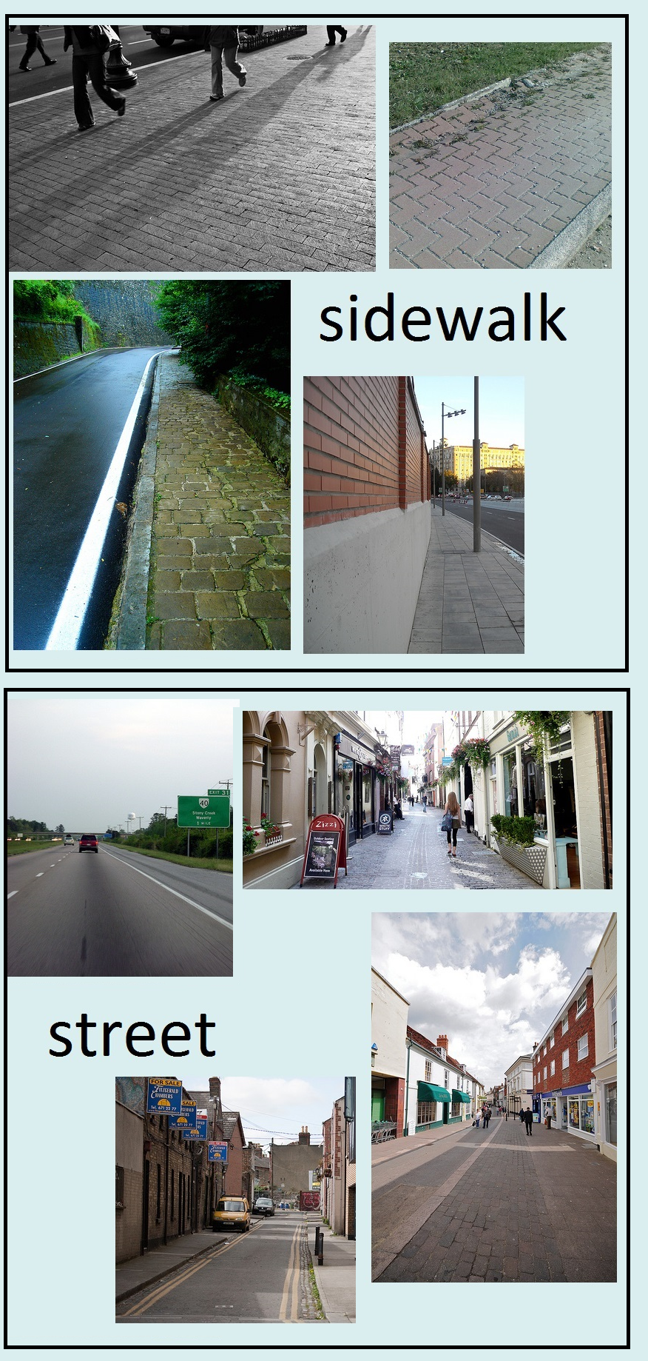
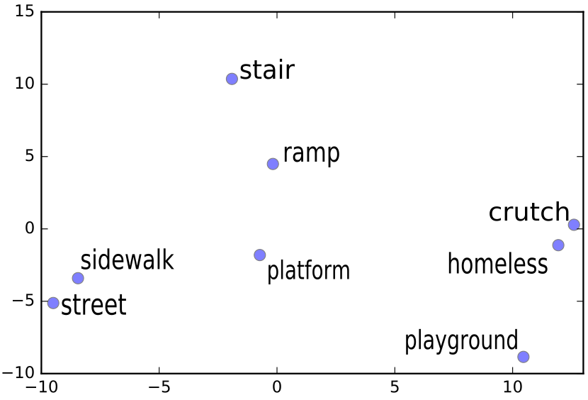
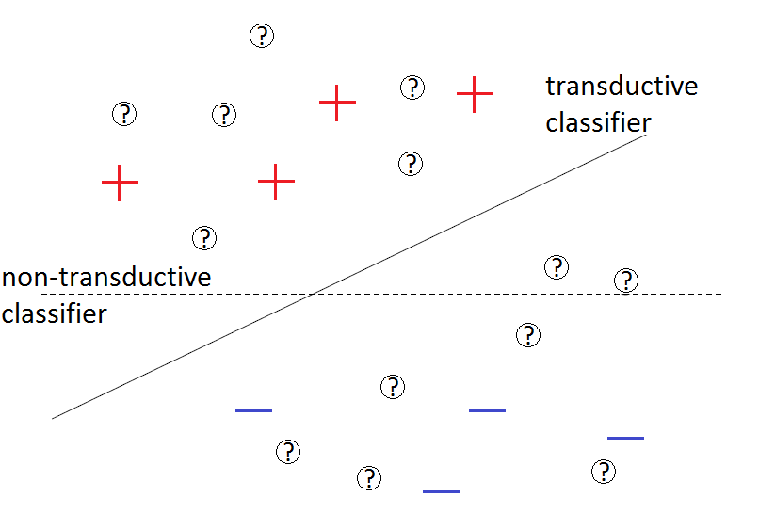
Transferring Visual
Knowledge into Semantic Roles
Semantic Role Labeling (SRL)
Visual Information
HCI-LIIR
Definition: SRL is the task of recognizing “who”, “does what”, “to whom”, “where”, “when” and “how” in a given sentence.
Main roles:
Example: [Mary A0] gave [Peter A2] [a book A1] [at school LOC] [yesterday TMP].
A0: Agent | A1: Patient
A2: Indirect object | LOC: Location
TMP: Temporal | DIR: Direction
MNR: Manner
Guillem Collell
Ted Zhang
Quynh Ngoc Do
Marie-Francine Moens
MUSTER
project
Transductive Learning
Our Approach
What is new?
Previous research focuses on using language to aid visual tasks. Here, we do the inverse.
Transferring visual information has never been show to improve a complex language task such as SRL.
Approach:
1. Obtain a visual representation for each concept
  Search images in ImageNet (http://image-net.org/) of nouns from our (train and test) vocabulary.
  Obtain feature representation for each image with a convolutional neural network (CNN).
  Average feature representations of all the images of a given concept to obtain a single vector representation.
  Reduce dimensionality from 4096 to 50 with a PCA.
2. Generate new training examples with a recurrent neural network (RNN) language model. (Do et al., 2015)
  Replace arguments in the training sentences by visually similar concepts (nearest neighbors) from the test set.
    This helps the cluster assumption to hold: test examples of the same visual cluster as a particular training example will be “pushed” closer in the semantic role clusters.
3. Train semantic role labeler
  Pipeline: predicate disambiguation → argument identification → argument classification.
  Dataset: CoNLL 2009 (in domain)
4. Testing
  Dataset: Brown corpus (out of domain)
References:
•Chapelle, Olivier, Bernhard Schoelkopf, and Alexander Zien (2010).Semi-Supervised Learning. MIT press.
•Do, Q., Bethard, S., & Moens, M. F. (2015). Domain adaptation in semantic role labeling a neural language model and linguistic resources.IEEE/ACMTrans. on Audio, Speech, and Language Processing, 23 (11), 1812-1823.
28/04/2016
Cluster assumption: If points are in the same cluster they are likely to be of the same class (Chapelle et al. 2010).
Results and Conclusions
Results*
    Other roles (e.g., Manner and Time):
  Overall F1 (all the roles) does not decrease (+0.06%).
*Results indicate absolute gain/loss (in %) with respect to the baseline semantic role labeller that we employed.
Conclusions
  Our setting is specially useful for spatial roles. Visual information is not meant for every role (e.g., temporal).
  The effect of visual information and that of transductive learning are still moderated:
    11% of our (training and test) vocabulary had an image representation available.
    1% of our test examples not present in the training data had an image representation available.
 | Precision | Recall | F1
DIR | -2.43 | +1.89 | +1.14
LOC | -0.92 | +3.43 | +1.27
MNR | -1.483242 | -0.75757 | -1.10948
TMP | 0 | 0 | 0
An assassin in Colombia killed a federal judge on a street
An assassin in Colombia killed a federal judge on a sidewalk

