Slide 1
Multimedia Projekt
SS 2017
Team 4
Pedestrian Detection
Multimedia Project
SS 2017
Team 4
University Augsburg

Slide 2
summary
Evaluation
  Qualitativ evaluation
    Success
    Failures (nach score oder size ?)
    Comparison First and retrained SVM
  Quantitativ evaluation (DET)
Besonderheiten unserer Methode (Samplingstrategien bei hard negavtiv, verwendeter SVM Typ, Schwierigkeiten, Lösungen dazu
Future Work
Demonstration

Slide 3
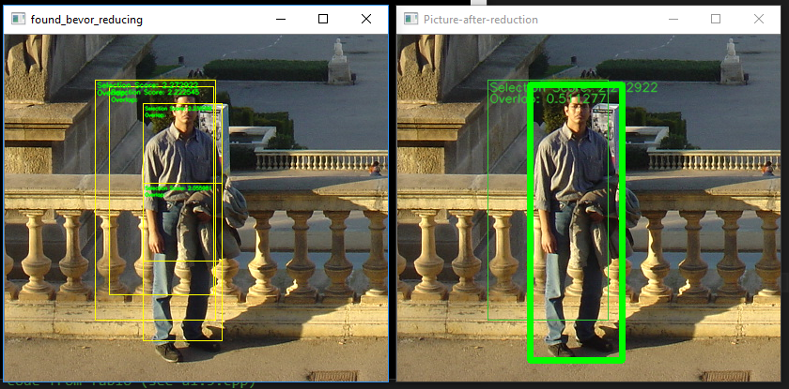
Evaluation - Qualitative

Slide 4
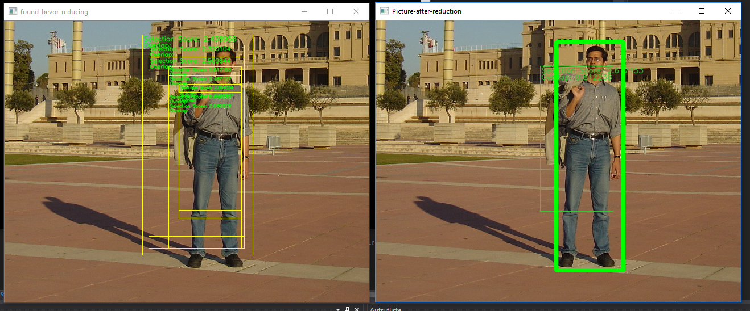
Evaluation - Qualitative
Selection of the best frame? score vs. size

Slide 5
Evaluation - Qualitative
Comparison of first and retrain with pictures

Slide 6
Evaluation - Qualitative
Failures

Slide 7
Evaluation - Quantitativ
DET

Slide 8
Characteristics of our method
Mirrored pictures for training
10 templates for each negative training picture
Oversampling for balanced size
Retraining with „worst“ 5000 hard negatives

Slide 9
Characteristics of our method
SVM parameter
  100.000 iterations
  C = 0.1
  24550 input samples
  Linear kernel
h

Slide 10
Challenges and solutions
Size of HoG
  Smaller templates
  Avoid normalized test data
Time of retraining
  First approach: add 5000 hard negatives
  … ?

Slide 11
Future work
Evaluate influence of iterations

Slide 12
Future work
Evaluate influence of iterations

Slide 13
Demonstration

Slide 14
Questions
Any Questions left ?

