Slide 1
Multimedia Projekt
SS 2017
Team 4
Pedestrian Detection
Multimedia Project
SS 2017
Team 4
University Augsburg
17.07.2017
Multimedia Projekt - SS17 - Team 4

Slide 2
summary
Evaluation
  Qualitative evaluation
  Quantitativ evaluation (DET)
Our Method
Future Work
Demonstration
17.07.2017
Multimedia Projekt - SS17 - Team 4

Slide 3
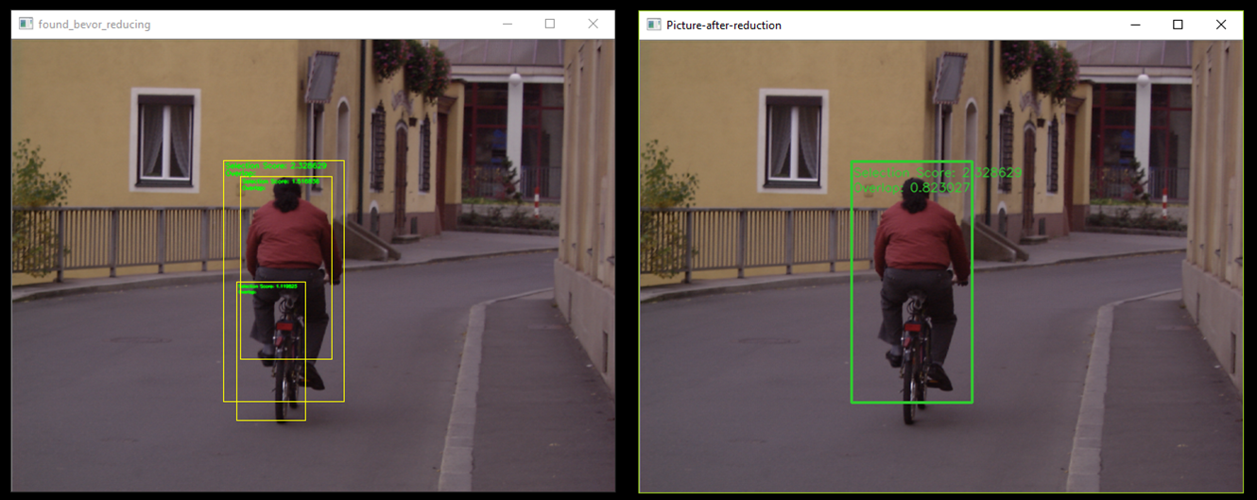
Evaluation - Qualitative
17.07.2017
Multimedia Projekt - SS17 - Team 4

Slide 4
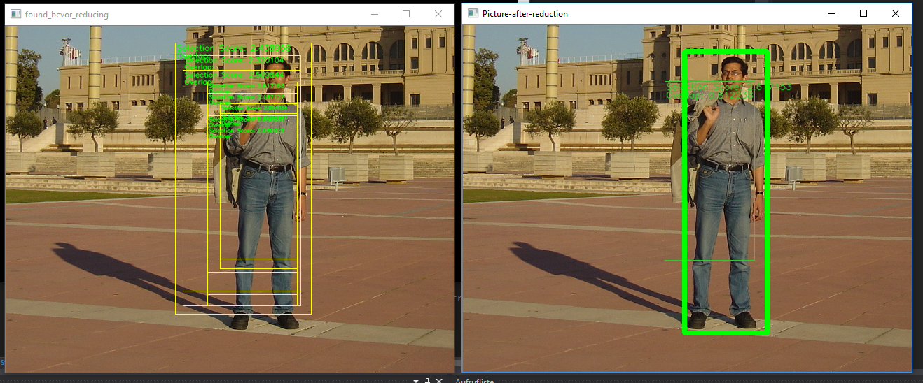
Evaluation - Qualitative
Selection of the best frame? score vs. size
17.07.2017
Multimedia Projekt - SS17 - Team 4

Slide 5
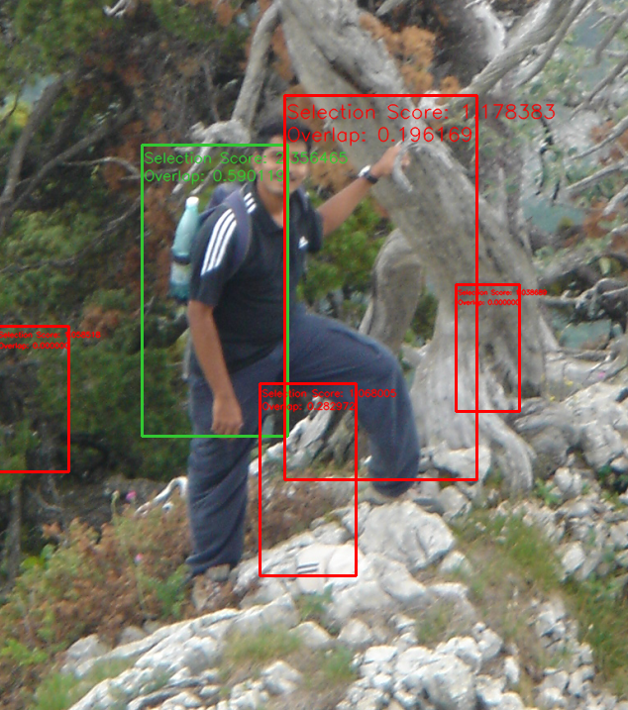
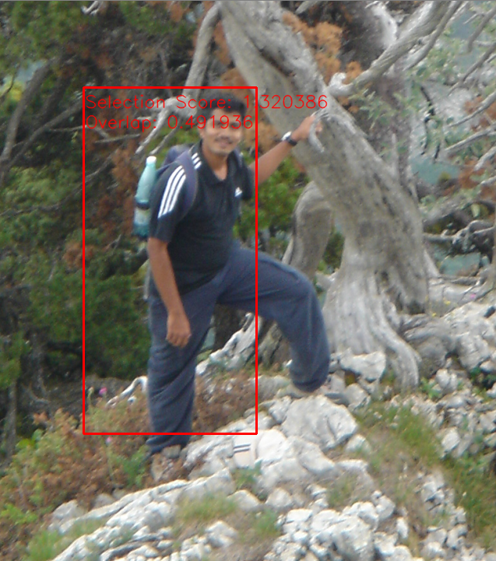
Evaluation - Qualitative
Comparison of first and retrain with pictures
17.07.2017
Multimedia Projekt - SS17 - Team 4

Slide 6
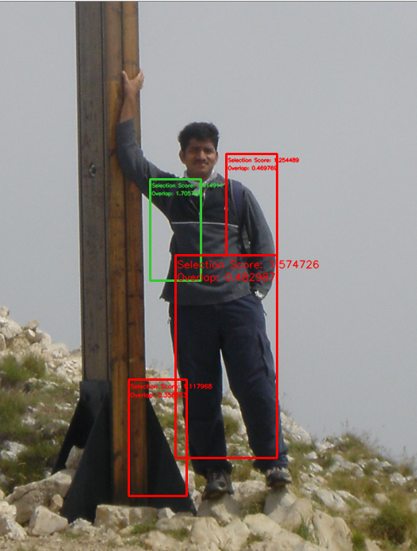
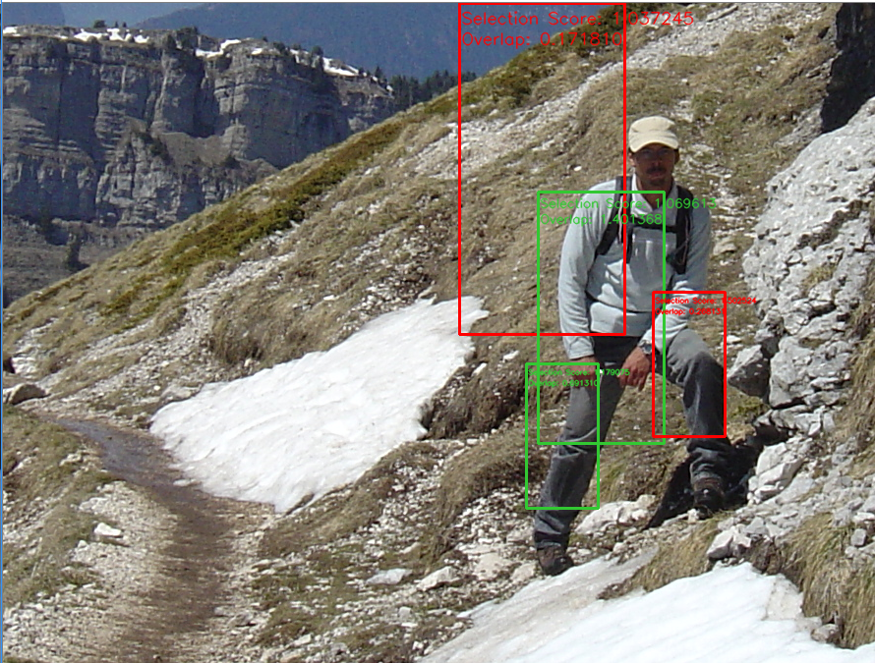
Evaluation - Qualitative
Failures
17.07.2017
Multimedia Projekt - SS17 - Team 4

Slide 7
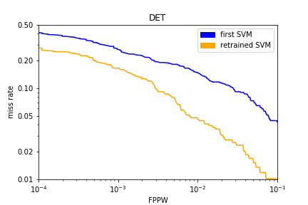
Evaluation - Quantitativ
DET
17.07.2017
Multimedia Projekt - SS17 - Team 4

Slide 8
Characteristics of our method
Mirrored pictures for training
10 random templates for each negative training picture
Oversampling for balanced size
Retraining with „worst“ 2500 hard negatives from positive pictures
17.07.2017
Multimedia Projekt - SS17 - Team 4

Slide 9
Characteristics of our method
SVM parameter
  100.000 iterations
  C = 0.01
  24550 input samples
  Linear kernel
17.07.2017
Multimedia Projekt - SS17 - Team 4

Slide 10
Challenges and solutions
Size of HoG:
    → small templates
    Avoid normalized test data
Template Grid:
    → Only 50% overlap
    75% overlap
17.07.2017
Multimedia Projekt - SS17 - Team 4

Slide 11
Future work
Quantitative evaluation of Kernel-Types
Evaluate influence of iterations
Evaluate best amount of input data
Quantitative evaluation of score vs. scale
Change overlap calculations
Influence of down-scaling method
Add Auto-encoder
Add clustering
17.07.2017
Multimedia Projekt - SS17 - Team 4

Slide 12
Future work
Change size of the Template
Train SVM with Heads and detect body's and Humans
Train extra SVM with parts of a Human body for the sliding window
Importing with several frames of a video
  Detect overlapping persons
Change the 2:1 proportion of the Templates by adding cell rows to it
17.07.2017
Multimedia Projekt - SS17 - Team 4

Slide 13
Demonstration
17.07.2017
Multimedia Projekt - SS17 - Team 4

Slide 14
Conclusion
Not a perfect solution for human detection
Problems:
  Training SVM takes a lot of time
  Detection only on sliding Windows
  Not a good detection Performance
Benefits:
  No matter were the Person is
  No problem with different clothing
  detect Humans in large groups
  detecting any direction of Humans
17.07.2017
Multimedia Projekt - SS17 - Team 4

Slide 15
Questions
Discussions / Questions ?
17.07.2017
Multimedia Projekt - SS17 - Team 4

