Slide 1
Facade Pattern
Joseph Tadesse
Gezihagn Lema

Slide 2
Intent
Provide a unified, high-level interface to a set of interfaces in a subsystem.
Simplifies interaction with complex systems.
Decouples clients from subsystem components.
Promotes loose coupling and layered architecture.

Slide 3
Motivation
In real systems, a client often needs to interact with multiple classes to perform a single task

Slide 4
Problem scenario
A video conversion library contains multiple classes:
VideoFile
CodecFactory
BitrateReader
AudioMixer

Slide 5
To convert a file, the client must
Create a video file object.
Extract codec.
Convert format.
Fix bitrate.
Mix audio.
This tightly couples the client to subsystem internals.

Slide 6
Solution
Introduce a VideoConverterFacade that:
Wraps subsystem complexity.
Exposes a single simple method like convert(filename, format).
Internally coordinates all subsystem interactions.
The client depends only on the facade, not on internal classes.

Slide 7
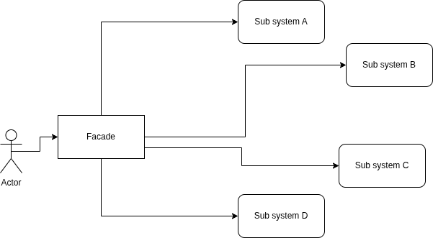
Structure (Conceptual UML)

Slide 8
Thank you! Any questions?

