Slide 1
IXIS Data Challenge
3/1/2024

Slide 2
Data Summary
Year | Month | DeviceCat | Sessions | Transactions | QTY | ECR
2012 | 7 | desktop | 335,429 | 10,701 | 18,547 | 3.2%
2012 | 7 | mobile | 274,443 | 2,576 | 4,557 | 0.9%
2012 | 7 | tablet | 158,717 | 4,884 | 8,700 | 3.1%
2012 | 8 | desktop | 392,079 | 12,912 | 23,316 | 3.3%
2012 | 8 | mobile | 275,556 | 3,165 | 5,572 | 1.1%
2012 | 8 | tablet | 154,858 | 3,202 | 5,760 | 2.1%
2012 | 9 | desktop | 272,771 | 8,898 | 16,507 | 3.3%
2012 | 9 | mobile | 220,689 | 2,381 | 4,050 | 1.1%
2012 | 9 | tablet | 169,193 | 4,379 | 7,869 | 2.6%
2012 | 10 | desktop | 302,682 | 9,373 | 17,675 | 3.1%
2012 | 10 | mobile | 238,849 | 2,418 | 4,446 | 1.0%
2012 | 10 | tablet | 107,108 | 2,484 | 4,505 | 2.3%
2012 | 11 | desktop | 320,717 | 10,350 | 18,778 | 3.2%
2012 | 11 | mobile | 178,828 | 1,994 | 3,407 | 1.1%
2012 | 11 | tablet | 138,235 | 3,183 | 5,947 | 2.3%
2012 | 12 | desktop | 309,718 | 11,613 | 19,947 | 3.7%
2012 | 12 | mobile | 234,481 | 3,158 | 5,672 | 1.3%
2012 | 12 | tablet | 245,435 | 5,158 | 9,133 | 2.1%
2013 | 1 | desktop | 393,723 | 13,793 | 25,424 | 3.5%
2013 | 1 | mobile | 341,668 | 4,360 | 7,257 | 1.3%
2013 | 1 | tablet | 164,601 | 3,407 | 6,165 | 2.1%
2013 | 2 | desktop | 247,632 | 9,699 | 18,437 | 3.9%
2013 | 2 | mobile | 194,996 | 2,071 | 3,915 | 1.1%
2013 | 2 | tablet | 107,599 | 2,396 | 4,696 | 2.2%
2013 | 3 | desktop | 287,837 | 9,679 | 17,362 | 3.4%
2013 | 3 | mobile | 304,832 | 3,644 | 6,455 | 1.2%
2013 | 3 | tablet | 196,151 | 4,481 | 8,265 | 2.3%
2013 | 4 | desktop | 567,510 | 18,868 | 34,200 | 3.3%
2013 | 4 | mobile | 429,864 | 4,280 | 7,752 | 1.0%
2013 | 4 | tablet | 299,239 | 7,221 | 12,994 | 2.4%
2013 | 5 | desktop | 526,330 | 18,176 | 33,208 | 3.5%
2013 | 5 | mobile | 409,796 | 5,413 | 9,790 | 1.3%
2013 | 5 | tablet | 228,513 | 4,800 | 8,631 | 2.1%
2013 | 6 | desktop | 554,940 | 19,370 | 35,146 | 3.5%
2013 | 6 | mobile | 526,481 | 7,412 | 13,017 | 1.4%
2013 | 6 | tablet | 307,413 | 7,756 | 13,728 | 2.5%
Measure | Prev Month | Most Recent Month | Absolute Diff | Relative Diff
sessions | 1,164,639 | 1,388,834 | 224,195 | 19.3%
transactions | 28,389 | 34,538 | 6,149 | 21.7%
QTY | 51,629 | 61,891 | 10,262 | 19.9%
ECR | 2.4% | 2.5% | 0.0% | 2.0%
addsToCart | 136,720 | 107,970 | -28,750 | -21.0%
Device Category | Browser | sessions | transactions | QTY | % of Total Sessions | % of Total Transactions | % of Total QTY
mobile | Safari | 2663112 | 36153 | 64145 | 25.6% | 14.5% | 14.2%
desktop | Chrome | 1954932 | 59833 | 114014 | 18.8% | 24.0% | 25.3%
tablet | Safari | 1894864 | 47324 | 87834 | 18.2% | 19.0% | 19.5%
desktop | Safari | 1394280 | 57370 | 111797 | 13.4% | 23.0% | 24.8%
desktop | Firefox | 489450 | 17313 | 31158 | 4.7% | 6.9% | 6.9%
 |  |  |  |  | 80.6% | 87.3% | 90.7%
Top 5 ‘Device/Browser’ Combinations
80% of Total Sessions
87% of Total Transactions
90% of Total QTY
Focus Website Optimizations on Top 5 for Maximum Benefits

Slide 3
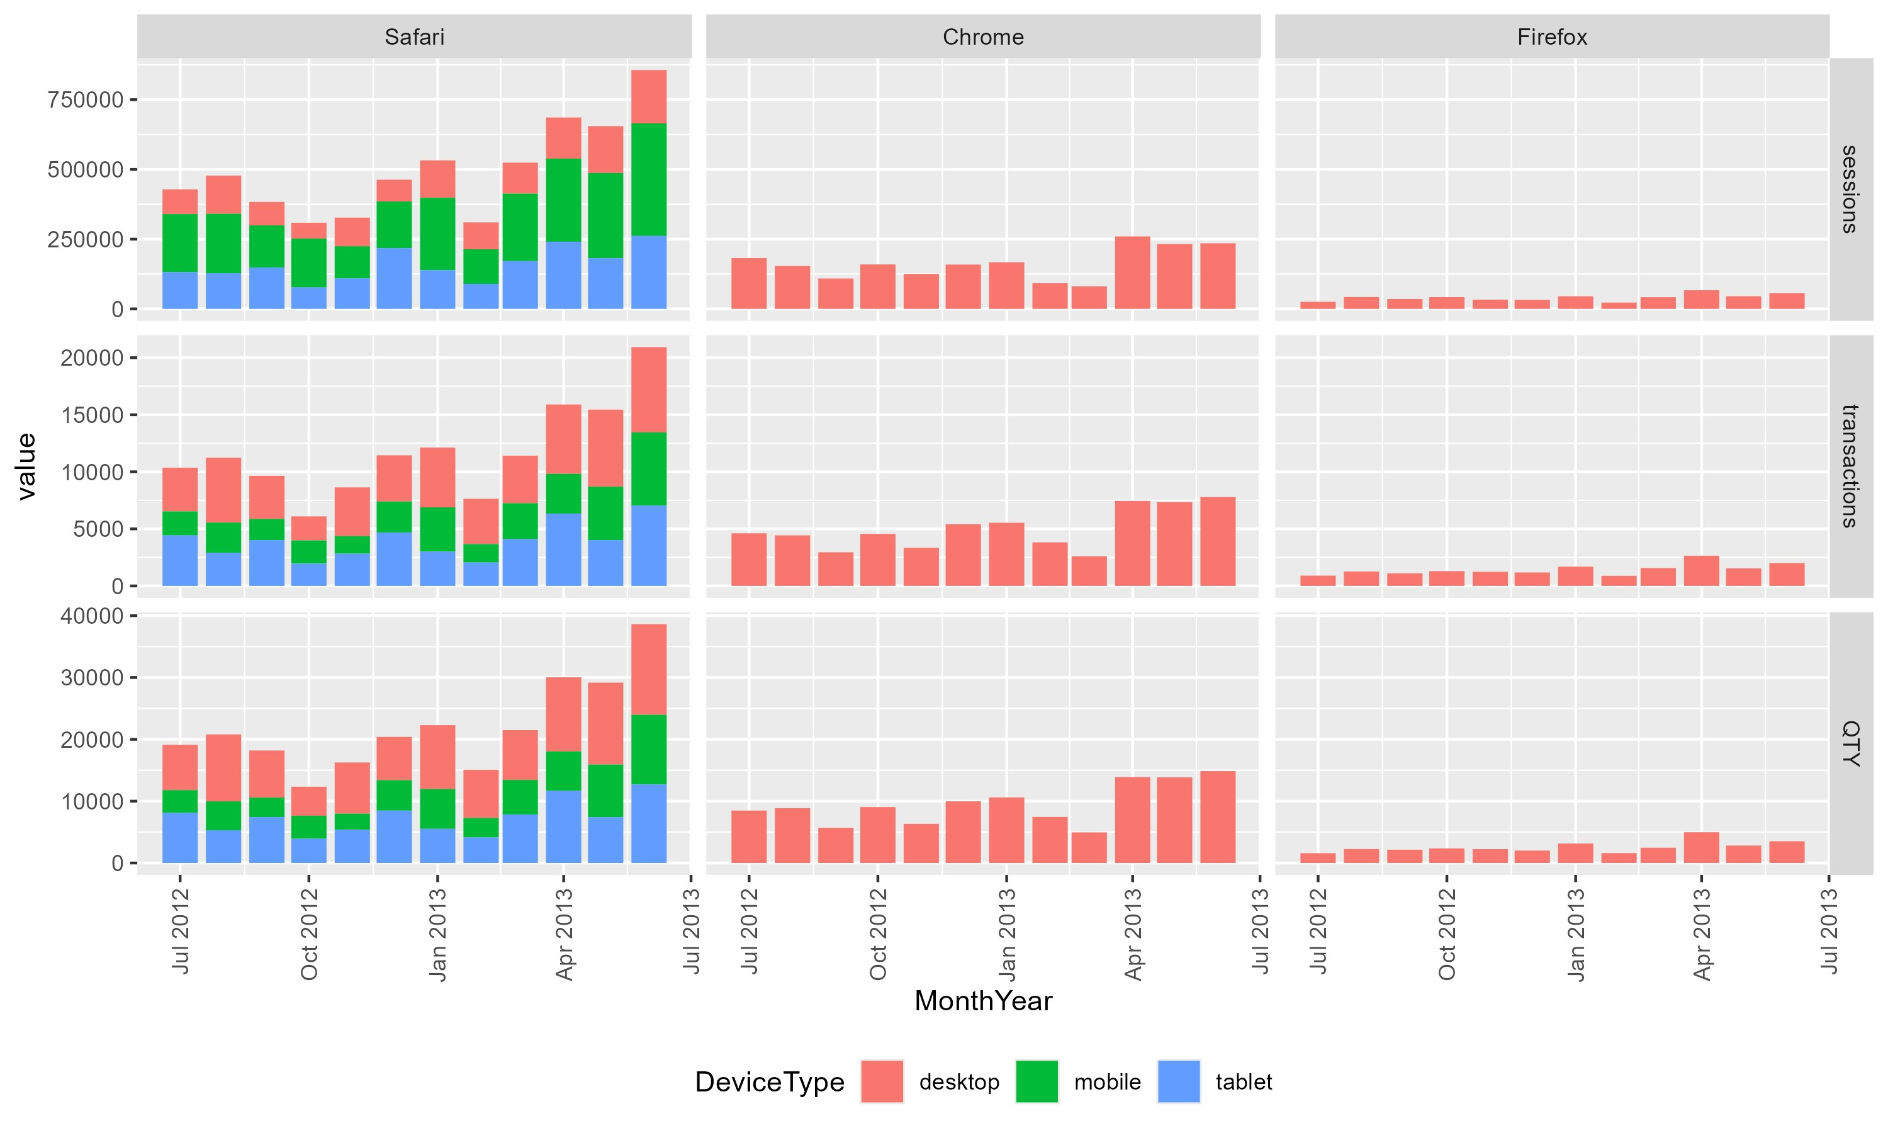
Trend Analysis
Summary
‘Sessions’, ‘Transactions’ and ‘QTY’ are trending up across primary drivers.
Majority of uptrend is driven by website traffic patterns from Safari Browser, across Desktop, Mobile and Tablet devices.
Smaller uptrends also present in Chrome & Firefox Desktop traffic patterns
Conclusion
Website must be optimized for Safari Browser, as it is already the largest single source of site traffic with a strong & continuing uptrend.

Slide 4
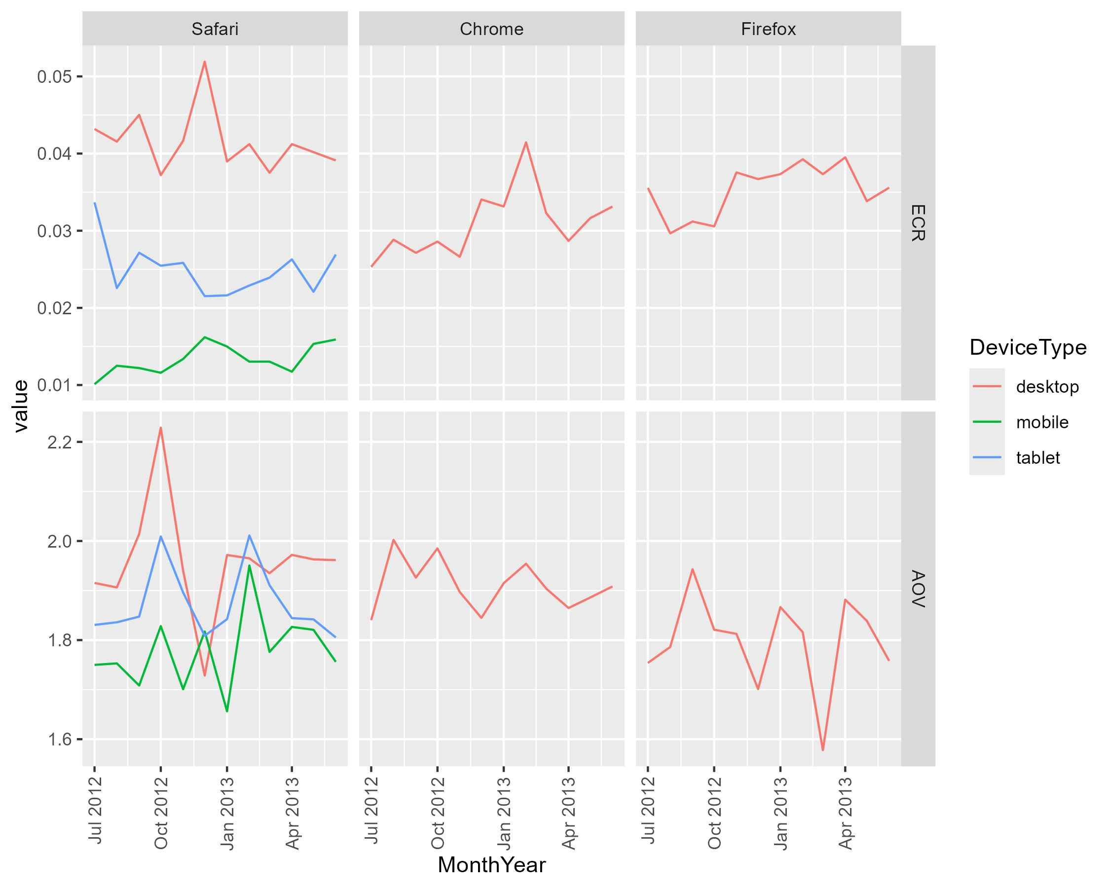
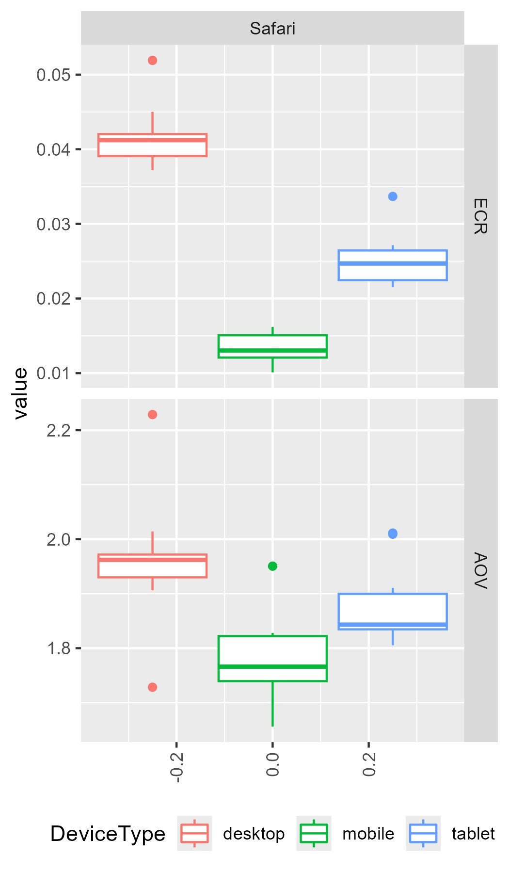
Rate Analysis & Recommendations
Key Insights for Top5 Drivers
Recommended Actions
Top Priority – Significant improvements are required to ECR for Safari Mobile & Tablet as uptrends continue.
Medium Priority – Maintain or improve current AOV across Top 5 Device & Browser Combinations.
Low Priority – Look for opportunities to improve non-significant Device & Browser Combinations.
Ecommerce Conversion Rate (ECR) is significantly lower for Mobile & Tablet relative to Desktop (driven by Safari)
Average Order Value (AOV) is slightly higher for Desktop Devices, though still comparable to Mobile & Tablets

