Slide 1
Linux概述

Slide 2
第1章 Linux概述
什么是Linux?
Linux的发展历史
Linux操作系统的版本
Linux的主要应用领域

Slide 3
什么是Linux
01

Slide 4
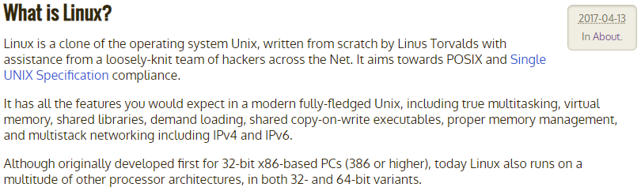
什么是Linux
https://www.kernel.org/linux.html
Notes:
Linux is a clone of the operating system Unix, written from scratch by Linus Torvalds with assistance from a loosely-knit team of hackers across the Net. It aims towards POSIX and Single UNIX Specification compliance.
It has all the features you would expect in a modern fully-fledged Unix, including true multitasking, virtual memory, shared libraries, demand loading, shared copy-on-write executables, proper memory management, and multistack networking including IPv4 and IPv6.
Although originally developed first for 32-bit x86-based PCs (386 or higher), today Linux also runs on a multitude of other processor architectures, in both 32- and 64-bit variants.

Slide 5
Linux的发展历史
02

Slide 6


Linux的发展历史
林纳斯·本纳第克特·托瓦兹（Linus Benedict Torvalds）

Slide 7
Linux的发展历史
1969年，AT&T的贝尔实验室的KenThompson、Dennis Ritchie和Douglas McIlroy开发了著名的UNIX操作系统。
1984年，因为 UNIX 规定“不能对学生提供源码”，Andrew Tanenbaum老师开发兼容于 UNIX 的 Minix，用于教学；
1990年，芬兰赫尔辛基大学学生Linus Torvalds首次接触Minix系统。
1991年年底，Linus Torvalds公开了Linux内核源码0.02版，此版本仅仅是部分代码。
1993年，Linux 1.0版本发行，Linux转向GPL版本协议。
1996年，美国国家标准技术局的计算机系统实验室确认Linux版本1.2.13符合POSIX标准。

Slide 8
Linux的发展历史
Linux的诞生、发展依赖着五个重要支柱：
UNIX 操作系统、
MINIX 操作系统、
GNU计划
POSIX 标准
Internet 网络。

Slide 9

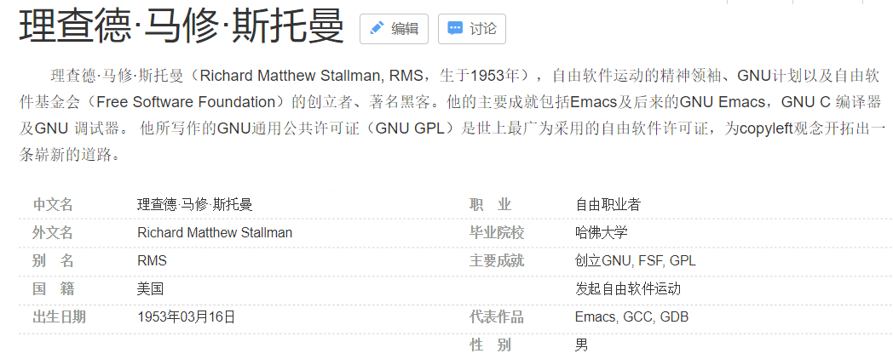
GNU
GNU的开发始于1984年1月，称为GNU Project。
“GNU”是“GNU's Not Unix”的递归首字母缩写词。“GNU”的发音为g'noo。

Slide 10
GNU
GNU是一个类Unix操作系统。它是由多个应用程序、系统库、开发工具乃至游戏构成的程序集合。
类Unix操作系统中用于资源分配和硬件管理的程序称为“内核”。GNU自己的内核，The Hurd，开始于1990年。志愿者们仍在继续开发Hurd。
1993年，Linux 1.0版本发行，Linux转向GPL版本协议。
（GNU/Linux命名争议）
GNU/Linux操作系统与Linux操作系统。

Slide 11

GPL（通用公共许可证）
GPL，是GNU General Public License的缩写（GNU通用公共许可证）。
GPL试图保证你共享和修改自由软件的自由。GPL适用于大多数自由软件基金会的软件。
当我们谈到自由软件（free software）时，我们指的是自由而不是价格。
开源协议代表(BSD,Apache,GPL,LGPL,MIT)

Slide 12
POSIX
POSIX表示可移植操作系统接口（Portable Operating System Interface of UNIX，缩写为 POSIX ），POSIX标准定义了操作系统应该为应用程序提供的接口标准。其正式称呼为IEEE 1003，而国际标准名称为ISO/IEC 9945。
POSIX的诞生和UNIX的发展是密不可分的，IEEE最初开发 POSIX 标准，是为了提高 UNIX 环境下应用程序的可移植性。
POSIX 并不局限于 UNIX。许多其它的操作系统，例如 DEC OpenVMS 支持 POSIX 标准。

Slide 13
Linux操作系统的版本
03

Slide 14
Linux操作系统的版本
Linux kernel（内核）
Linux distribution（发行版）
Notes:
平时大家所说的Linux，根据上下文环境不同，可能存在两种不同的含义：Linux kernel 和 Linux distribution。

Slide 15
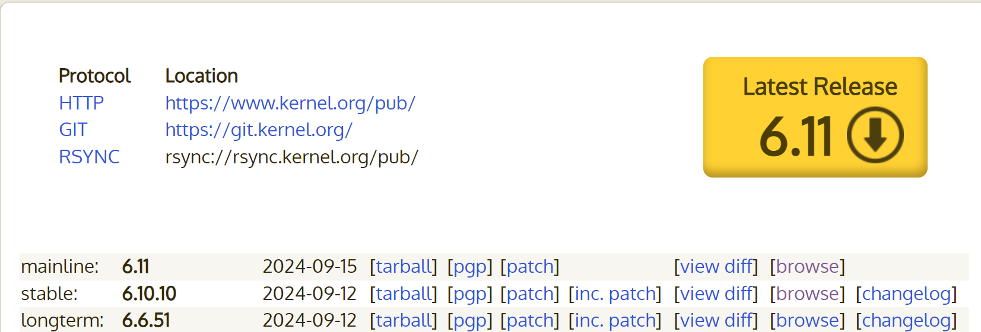
Linux Kernel（Linux内核）
https://www.kernel.org

Slide 16
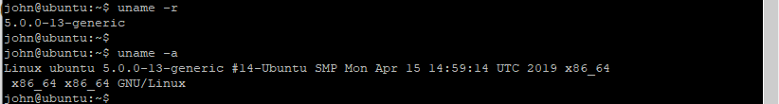
查看linux内核版本
ubuntu-22.04-desktop-amd64.iso

Slide 17
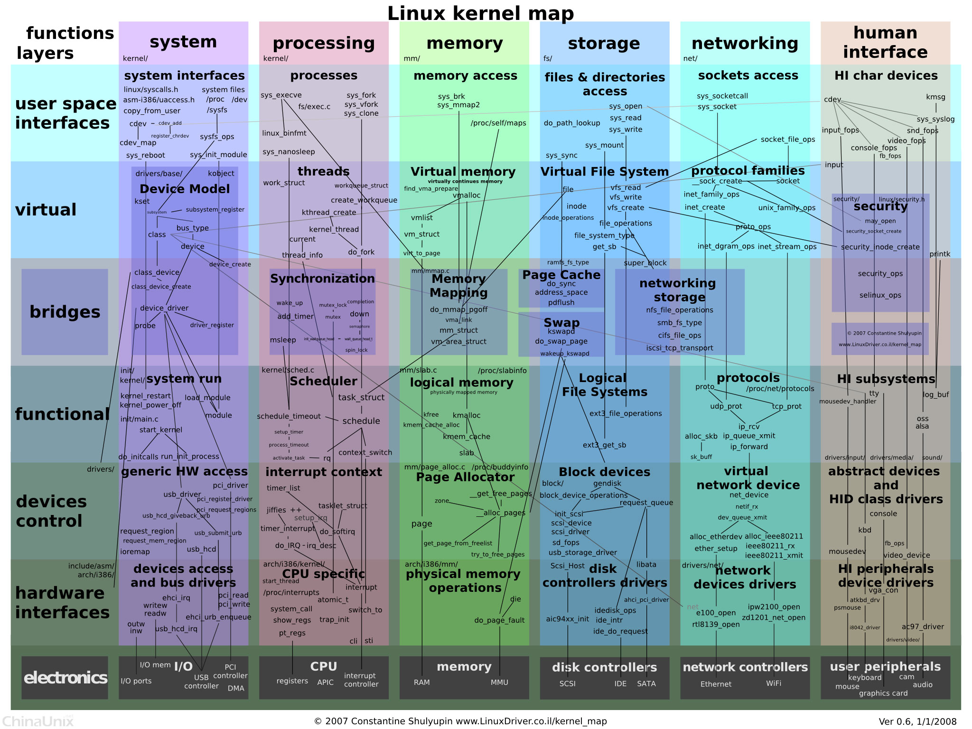

Slide 18
Linux distribution （Linux发行版）
A Linux distribution is an operating system made from a software collection, which is based upon the Linux kernel and, often, a package management system.
A typical Linux distribution comprises a Linux kernel, GNU tools and libraries, additional software, documentation, a window system (the most common being the X Window System), a window manager, and a desktop environment. Most of the included software is free and open-source software.
Almost six hundred Linux distributions exist, with close to five hundred out of those in active development.
https://en.wikipedia.org/wiki/Linux_distribution
Notes:
Linux distribution
A Linux distribution (often abbreviated as distro) is an operating system made from a software collection, which is based upon the Linux kernel and, often, a package management system. Linux users usually obtain their operating system by downloading one of the Linux distributions, which are available for a wide variety of systems ranging from embedded devices (for example, OpenWrt) and personal computers (for example, Linux Mint) to powerful supercomputers (for example, Rocks Cluster Distribution).
A typical Linux distribution comprises a Linux kernel, GNU tools and libraries, additional software, documentation, a window system (the most common being the X Window System), a window manager, and a desktop environment. Most of the included software is free and open-source software made available both as compiled binaries and in source code form, allowing modifications to the original software. Usually, Linux distributions optionally include some proprietary software that may not be available in source code form, such as binary blobs required for some device drivers.[1] A Linux distribution may also be described as a particular assortment of application and utility software (various GNU tools and libraries, for example), packaged together with the Linux kernel in such a way that its capabilities meet the needs of many users.[2] The software is usually adapted to the distribution and then packaged into software packages by the distribution's maintainers. The software packages are available online in so-called repositories, which are storage locations usually distributed around the world.[3][4] Beside glue components, such as the distribution installers (for example, Debian-Installerand Anaconda) or the package management systems, there are only very few packages that are originally written from the ground up by the maintainers of a Linuxdistribution.
Almost six hundred Linux distributions exist, with close to five hundred out of those in active development.[5] Because of the huge availability of software, distributions have taken a wide variety of forms, including those suitable for use on desktops, servers, laptops, netbooks, mobile phones and tablets,[6][7] as well as minimal environments typically for use in embedded systems.[8][9] There are commercially backed distributions, such as Fedora (Red Hat), openSUSE (SUSE) and Ubuntu (Canonical Ltd.), and entirely community-driven distributions, such as Debian, Slackware, Gentoo and Arch Linux. Most distributions come ready to use and pre-compiled for a specific instruction set, while some distributions (such as Gentoo) are distributed mostly in source code form and compiled locally during installation.[10]

Slide 19





Linux代表性的发行版

Slide 20
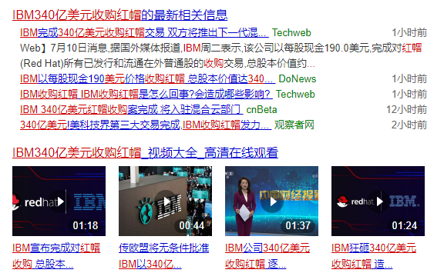
IBM340亿美元收购红帽发力云计算
2019年7月10日消息
Notes:
340亿美元!美科技界第三大交易完成, IBM有史以来最大的一次并购。
2019年7月10日消息，IBM周二宣布以340亿美元正式收购红帽。IBM曾表示希望此次收购交易能帮助公司在云业务方面获得更大发展。
2018年10月28日，IBM宣布以340亿美元收购开源软件公司红帽（红帽），寻求硬件及咨询业务的多元化，增加高利润产品和服务。此次交易不仅是IBM有史以来最大的一次并购，也是美国科技史上第三大交易。美国科技史最大交易为2016年戴尔以670亿美元价格并购数据存储公司EMC。

Slide 21
常见发行版特点
Ubuntu，Linux Mint和PCLinuxOS是其中最易用使用的。想快速部署使用，就可以选择这几个。
Slackware Linux，Arch Linux和FreeBSD是更激进的发行版，更新比较频繁。需要有一定的基础，要不搞崩了都不知道问题所在。
Debian GNU/Linux，openSUSE，Fedora，CentOS和Mageia则是比较保守的发行版。稳定性是他们的特点。但是软件包都比较旧。

Slide 22
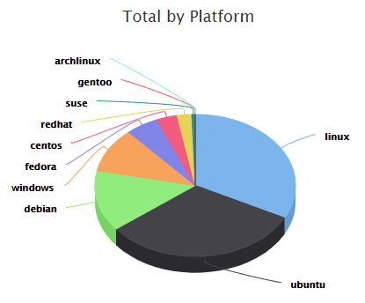
不同Linux发行版市场占有率
EC2中各操作系统的使用比例
Notes:
数据来源：the cloud market 、EC2 Statistics

Slide 23
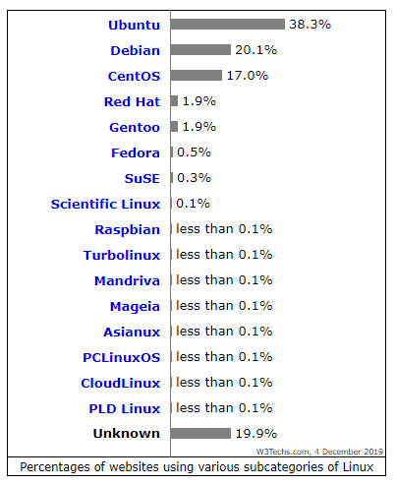
不同Linux发行版市场占有率
Web服务器中Linux各类发行版使用情况
Notes:
数据来源： w3techs

Slide 24
Linux的主要应用领域
04

Slide 25
Linux操作系统主要应用领域
1、传统企业级服务器应用场景
2、嵌入式、物联网、边缘计算等应用场景
3、智能手机、平板电脑等移动终端
4、云计算、区块链、大数据、深度学习等应用场景
5、个人桌面操作系统

Slide 26
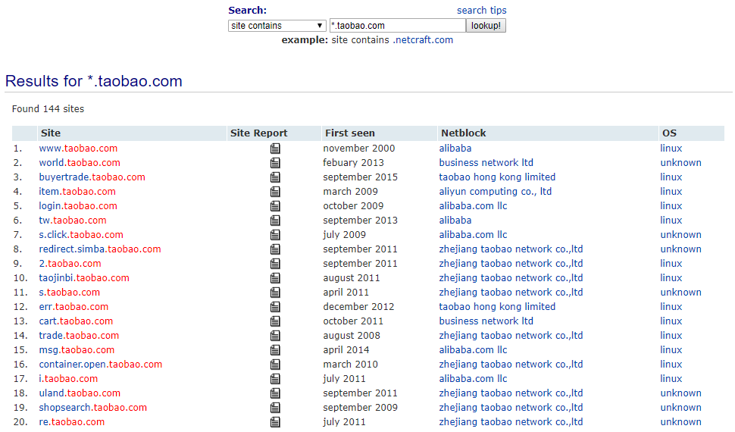
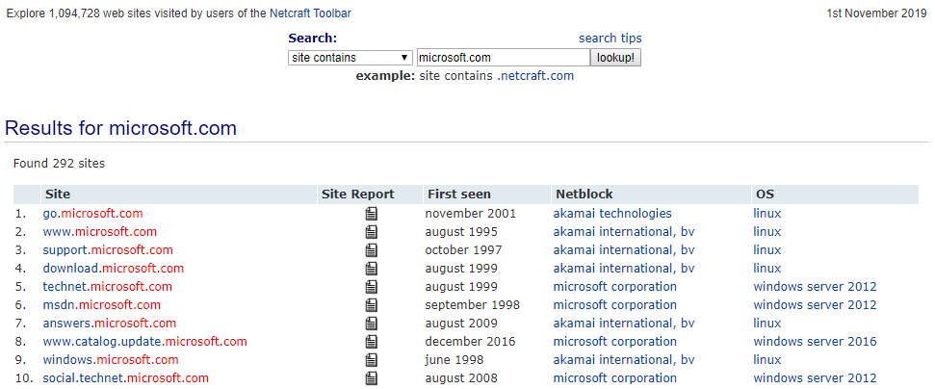
传统企业级服务器应用场景
https://searchdns.netcraft.com
Notes:
数据来源：https://searchdns.netcraft.com

Slide 27
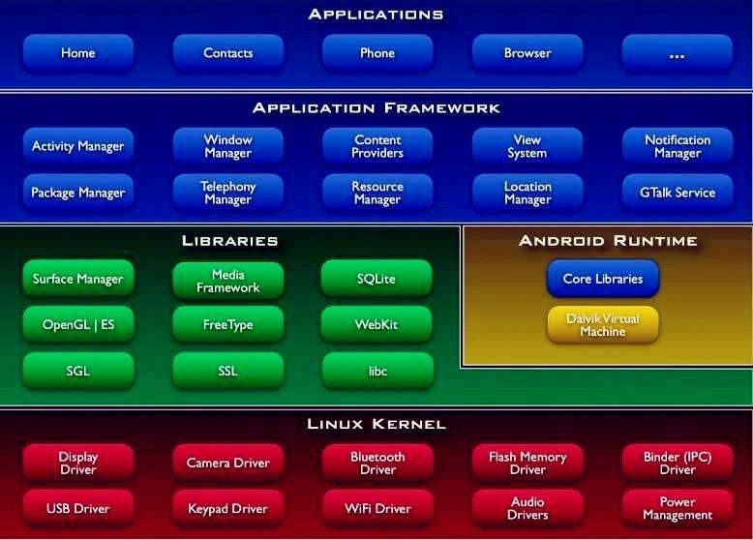
Android

Slide 28
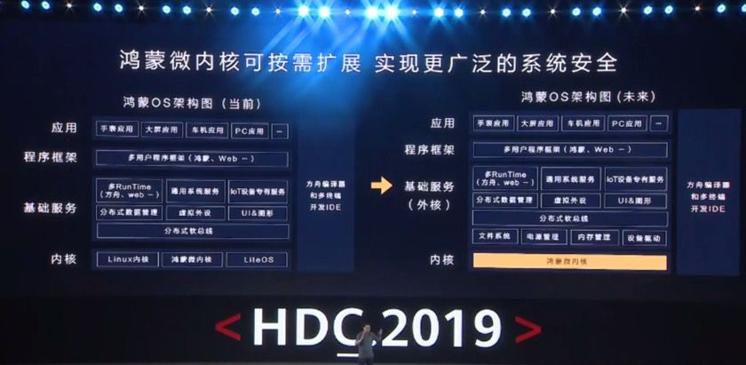
鸿蒙OS
Notes:
华为开发者大会HDC2019，8 月 9 日到 8 月 11 日在东莞松山湖。

Slide 29
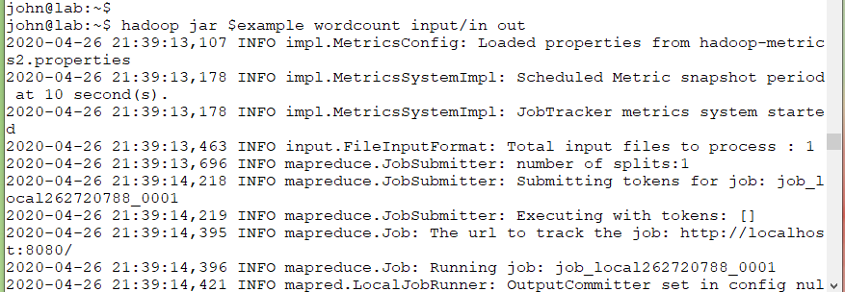
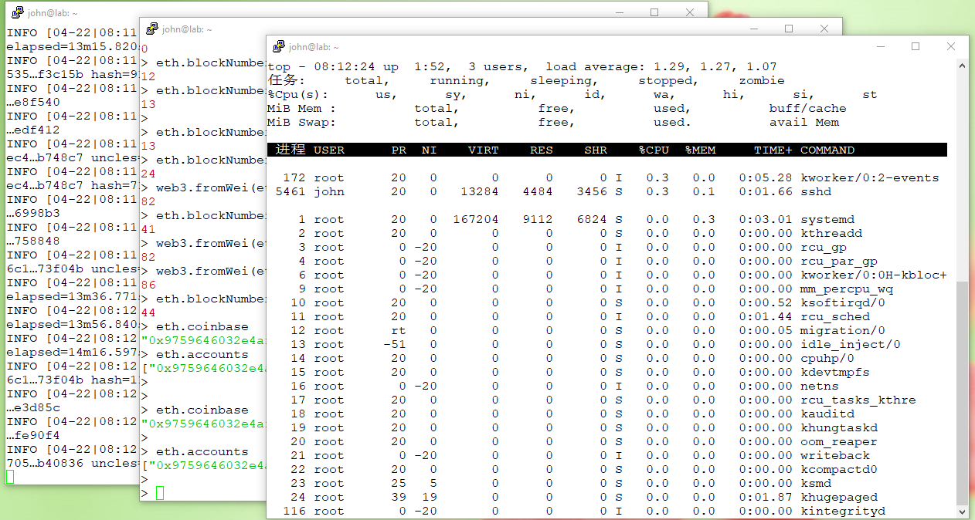
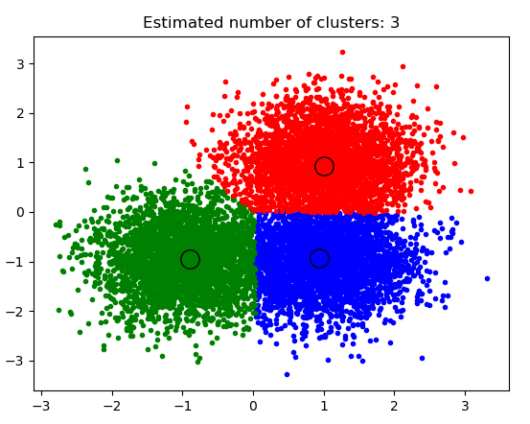
Linux前沿应用场景
大数据
区块链
人工智能

