Slide 1
TubeMaster Database
Team Jay Z (James Easton, Jenna Graves, Jordan Turley, Zeyang Huang)

Slide 2
Intro
What is the purpose of the database?
What does the database design allow for?
How will a final UI interact with the database?

Slide 3
Mission Statement
The purpose of the TubeMaster database is to maintain logistical data necessary to successfully perform jobs requested by clients in the catalyst industry.

Slide 4
Mission Objectives
Maintain reactor logistics.
Maintain accurate equipment availability data.
Maintain up-to-date assembly composition information.
Track the modification information of equipment.
Keep track of pertinent information for projects.

Slide 5
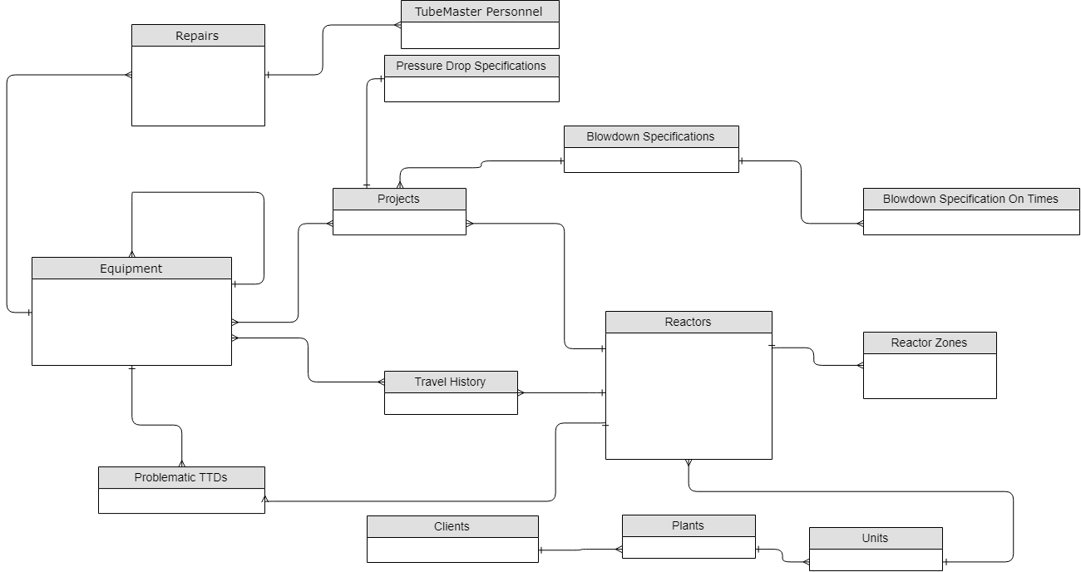
Design

Slide 6
Equipment
Holds all relevant data for each piece of equipment in inventory
Allows retrieval of current assembly parts
Modification to assemblies and sub-assemblies
Can be used to show availability

Slide 7
Travel History
Tracks dates and locations traveled for EACH equipment
Allows ability to see where any piece of equipment is/has ever been
Notes:
Includes location, dates, and the equipment that travelled

Slide 8
Projects
Allows the storage of past job settings for use later
Separates the definitions of blowdown specifications, pressure drop specifications, and reactor settings
More flexibility in job requests without storing unneeded/duplicate data
Ties together equipment and the jobs they are being used for
Notes:
-Projects is what ties everything together
- Gives the ability to hold onto specific job information for a reactor, such as reactor settings, blowdown specs, and pressure drop specs
- Can reference previous job data to make repeat jobs easier
- Separates and allows more autonomy between the reactor settings, blowdown specifications, and pressure drop specs

Slide 9
Additional Functionality
Client, Plant, and Reactor Unit information can be stored and referenced
Multiple Blowdown On Times supported (over 2)
Multiple Reactor Zones supported (over 4)
Repair logs stored for each piece of equipment
Ability to view details of past repairs
Ability to reference and store information on problematic TTDs with a particular reactor

Slide 10
Design, Again
Notes:
-Walk through
-Equipment stores inventory
- Travel History shows what reactors equipment is/has been
- Reactors have important info stored that is related to them, such as location, client ownership, what TTDs are problematic,
And the number of reactor zones it contains
- Projects store all relevent data to a job, including specs and reactor settings, and relevant dates
-Extensive repair logs and personnel associated are kept for every piece of equipment

Slide 11
UI Flow
Home Page
Equipment, Repairs, Personnel
Projects, Project Proposal
Clients, Reactors
Packing Lists
Notes:
Jordan

Slide 12
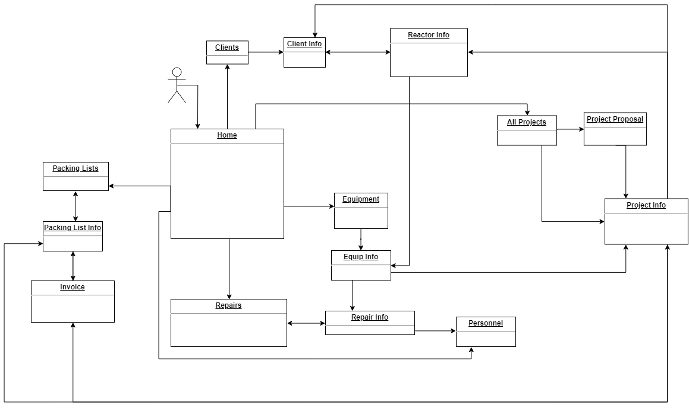
UI Flow
Notes:
Jordan

Slide 13
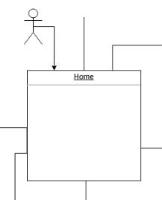
Home Page
On login, start at home page
Links out to all important pages
Notes:
Jordan

Slide 14
Equipment
View all equipment, or specific information
View repair log for specific equipment
Notes:
Jordan
Repair info -
In equipment info page, can go to the projects info page for its related project

Slide 15
Projects
View all projects
New Project Button → Project Proposal
View info for each project
Notes:
As Jenna mentioned, projects are an essential part of the whole database design, it contains information about both the equipment and the reactors.
To be able to access different projects, and have a sense of how many projects are in the database, you can click the button in the homepage to go to the projects summary page to view all of them
On that page, you can click the new project button to create proposals, and access the information like starting date, equipment and so on by simply clicking the title.

Slide 16
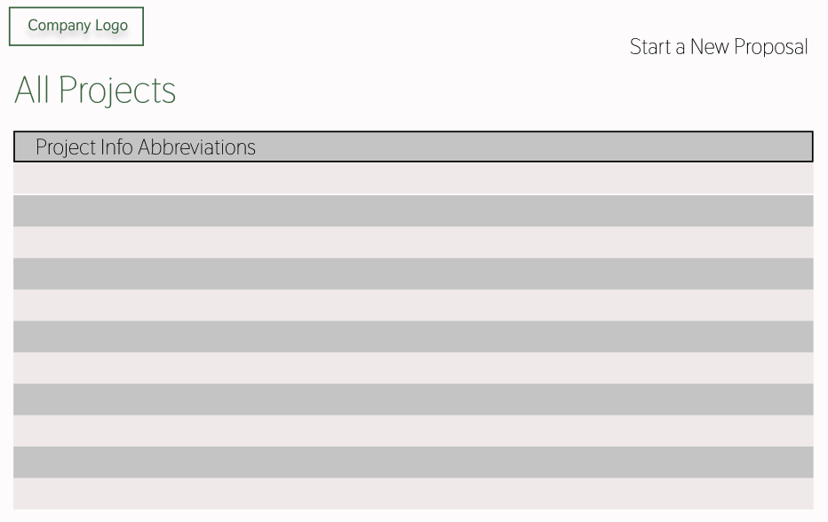

Notes:
Here is how this all projects page may look like . It can also represent the general structure for all other summary pages like all clients page or all equipment pages.
Also, as Jordan mentioned, when you are on the equipment information page, there will be a button shows which project the equipment belongs to, by follow the link, you can go to the projects info page, and by click the return button, you can view all the projects and go to the sample page which is on the screen.
As shown on the screen, it mainly contains a list view that displays the key information of each project to differentiate them. By clicking on the specific row, you can view the projects info in detail.
On the left top corner, there is a clickable company logo for you to return to the homepage, and on the right top corner, there is a link that direct you to the creating new project proposal page.
By the way, this is just a sample page and there is a lot of room to add new functionalities and contents like sorting or filtering.

Slide 17
Clients
View all clients TubeMaster has worked for
View and edit client information
Notes:
Zeyang
After viewing about projects, we also designed pages to view all clients that the company has worked for, by clicking the client button on the home page, you can view and edit their information

Slide 18
Reactors
All Projects → Project Info → Reactor Info
All Clients → Client Info → Reactor Info
Notes:
You can know the reactors information that associates with each client. The way to access that is from the homepage, click all the clients, and select one client to see its information which will contain a link to go to the reactors information that associate with them.
After clicking a specific project and directed to the project information page, there will be information about the reactors that associated with the project.
By clicking on it, you can go to the reactors page. It displays all the general information about reactors like name and year, as well as the specifications like blow down specification and pressure drop specifications.

Slide 19
Packing Lists
View all packing lists, info for each packing list
Packing list for specific project
Invoice: display shipping prices, commercial info
Notes:
After viewing about projects and reactors, you may want to access or prepare for a packing list. We have packing list summary page, it looks very similar to the sample page we just showed to you when talking about the projects.
To access the packing list information, there will be buttons on the homepage to direct you. Also, when viewing the project information, there will be a button that will direct you to the packing list that belongs to the project you are currently viewing.
Moreover, when viewing the packing list specifications, you can also go to a page that contains the corresponding invoices information. As the diagram shows on the powerpoint, all those pages are related to each other and can be accessed back and forth.

Slide 20
UI Flow
Notes:
Jordan

Slide 21
In Summary
We showed the structure of our database and the UI flow illustrating how you may interact with the database.
Design allows for the storage, access, and modification of data important to projects
Supports necessary relationships among tables.
Design minimizes data redundancy and preserves data integrity.
Notes:
To summarize, we showed the structure of our database and the UI flow indicating how you may interact with the database.
Our design allows the storage, access, and modification of not only different data like equipment projects reactors etc but also it supports to maintain various relationships among them.
What is more, our design minimizes the redundancy as well as preserves the data integrity.

Slide 22
Thank You!
Any Questions?
Notes:
To summarize, we showed the structure of our database and the UI flow indicating how you may interact with the database.
Our design allows the storage, access, and modification of not only different data like equipment projects reactors etc but also it supports to maintain various relationships among them.
What is more, our design minimizes the redundancy as well as preserves the data integrity.

