Slide 1

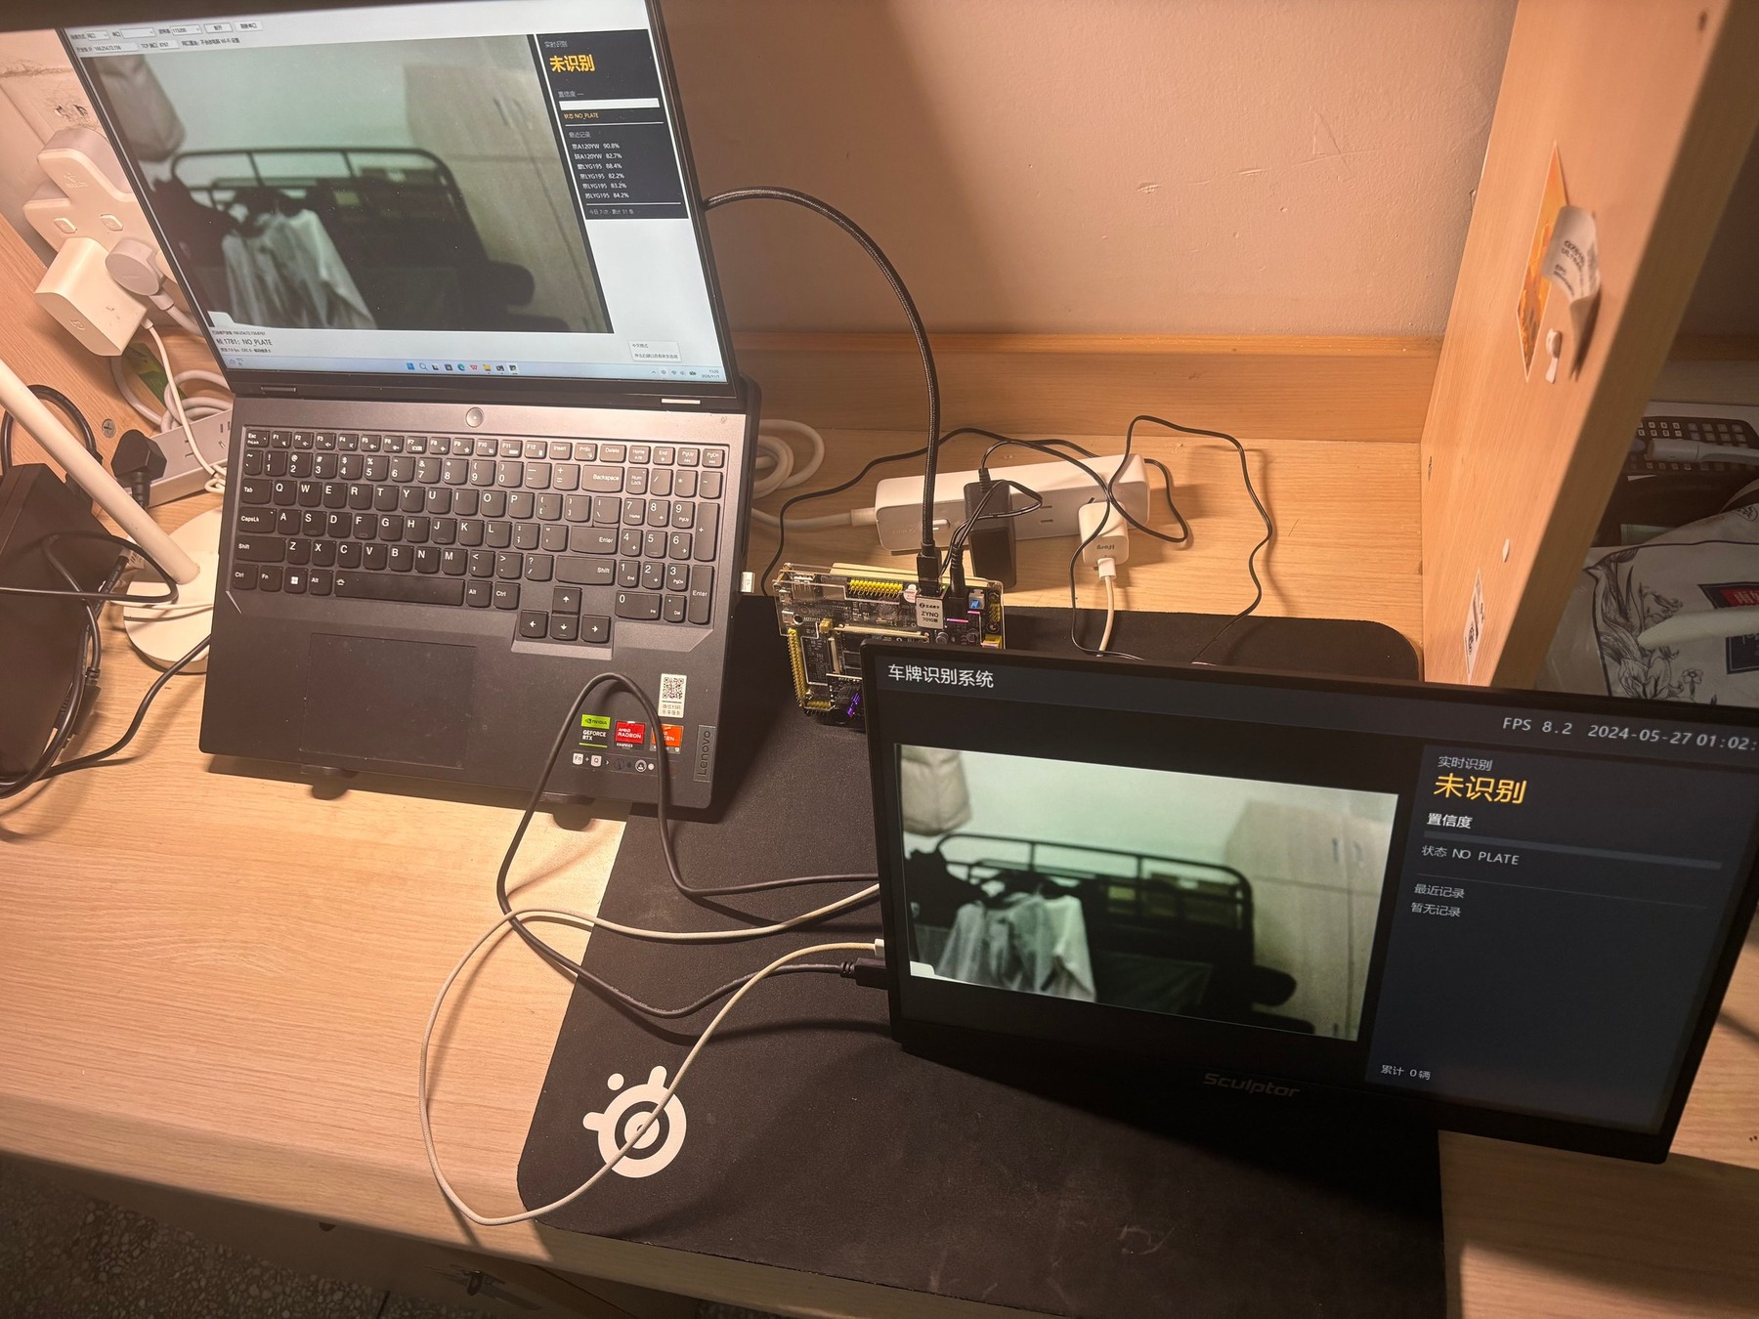
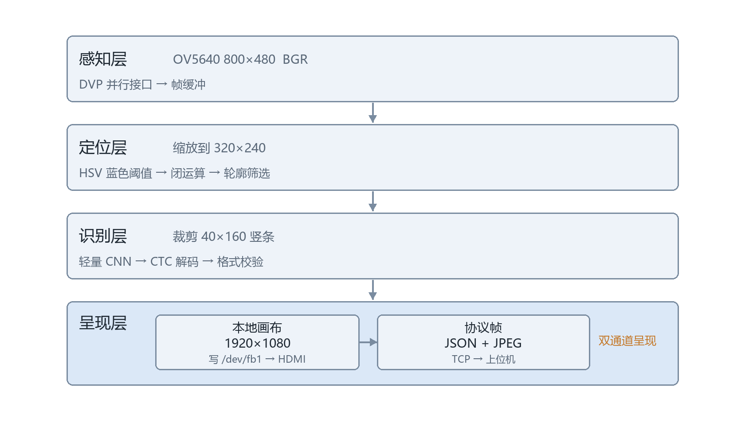
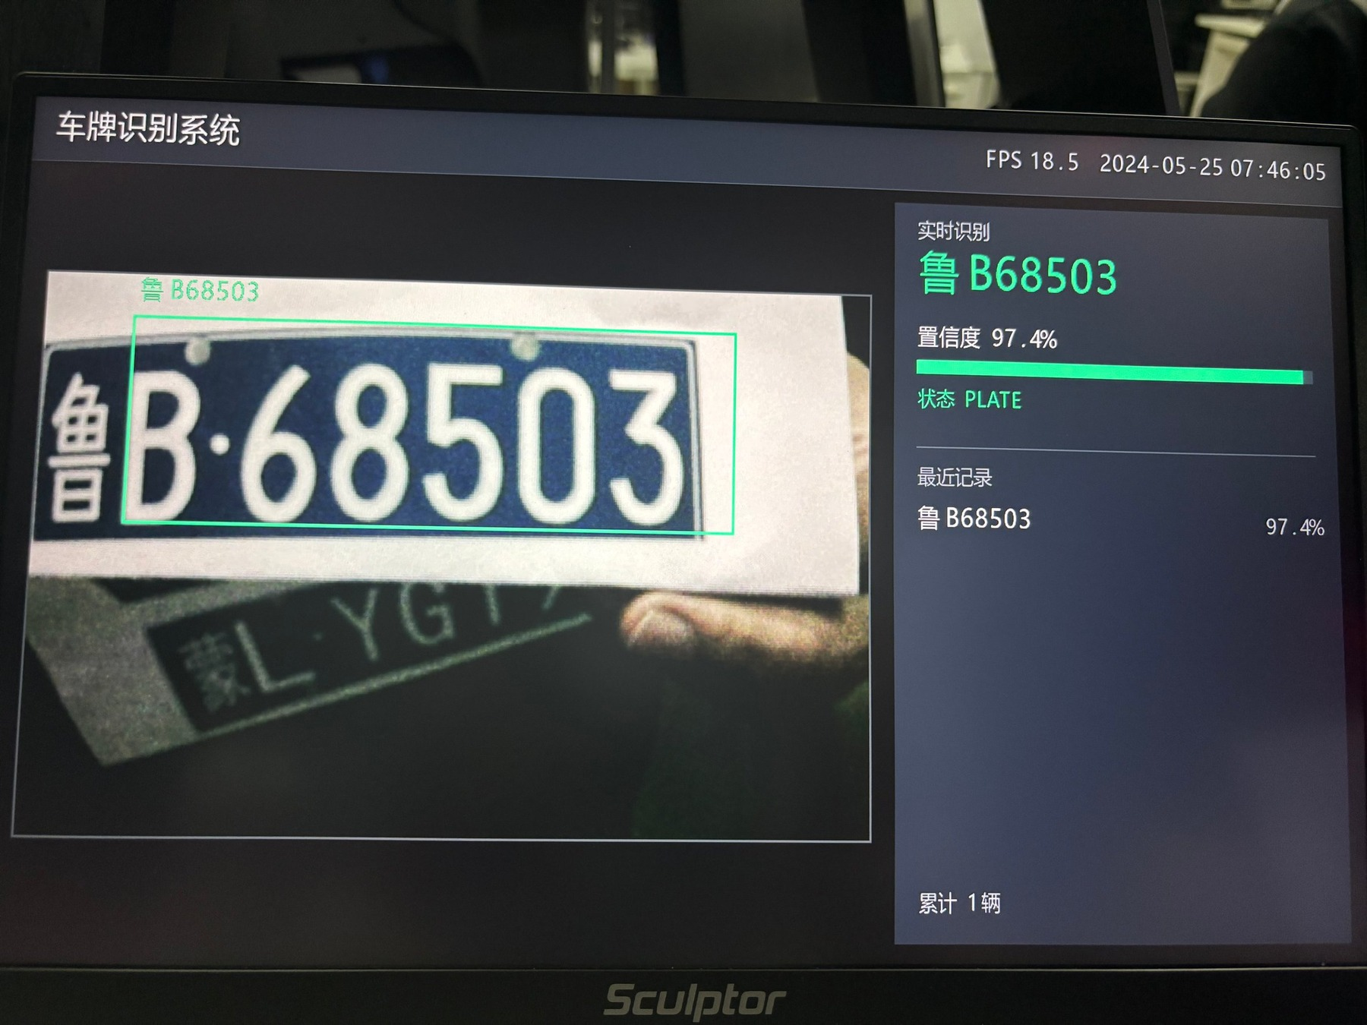
AMD 杯大学生 FPGA 创新设计竞赛 · 作品海报
基于 Zynq-7010 的嵌入式车牌识别与显示系统
参赛队员：章彤 滕航天 梁杰
淮安大学
作 品 简 介
AMD
车牌识别是停车场道闸、路侧停车与园区安防的基础环节。现有实现多依赖 PC 或云端算力，部署成本、功耗与时延难以兼顾；直接移植到低端 SoC，则同时受算力、内存带宽与显示链路三重制约。
本作品在 Xilinx Zynq-7010（XC7Z010CLG400-1）上实现端侧识别与本地显示闭环：OV5640 经 DVP 接口采集 800×480 图像，HSV 颜色定位得到包围框，轻量卷积网络配合 CTC 解码输出车牌；识别结果一路直写帧缓冲经 HDMI 本地呈现，一路经以太网推送至上位机留档。
图 2 系统实物：现场测试
创
新
1. 无桌面环境的自绘界面体系
仅有帧缓冲的嵌入式 Linux 上，用 NumPy 切片构建 1920×1080 界面；118 个字符预渲染为 44×44 点阵图集，不依赖 Qt、X11 与系统字体服务。
2. 显示链路逐项拆解优化
分段计时定位到通道转换、字节串生成、整图拷贝与字形混合四处开销，逐项消除后单帧耗时下降 86%。
关键问题：
系统架构
1. 无 NPU：模型压缩至 2.44 M 参数，纯 ARM 推理，20 时间步 ×84 类输出。
2. 无桌面环境：帧缓冲上自绘 1920×1080 界面，中文由点阵图集渲染。
3. 显示链路慢：渲染加写屏由 250 ms 降至 35 ms 每帧。
4. 单帧易误识：置信度锁定、多帧确认与同牌冷却三级策略。
车牌定位模块（软件 / PL 双实现）
1. 缩放至 320×240，HSV 蓝色阈值 + 形态学闭运算 + 轮廓长宽比筛选，耗时 22–32 ms。
2. PL 版：8×8 图块积分图 + 滑窗打分 Q=B·P²，纯整数实现，不占用 CPU。
3. 资源占用：5 925 LUT（33.7%）、7 个 DSP48E1、162 Kb BRAM。
成
果
实测性能与识别准确率
端到端帧率
14 – 18 fps
定位耗时
22 – 32 ms
渲染 + 写屏
约 35 ms/帧（优化前 250 ms）
本地界面
1920×1080，中文车牌实时刷新
识别准确率
100 张样本整体 71.0%（正对 86.7%）
识别与呈现模块
1. 裁剪转置为 40×160 竖条，轻量 CNN 输出 20 时间步 ×84 类概率。
2. CTC 贪心解码 + 号牌格式校验（7 位、省份、字母数字）。
3. 呈现：1920×1080 画布直写 /dev/fb1；协议帧为 JSON 元数据加 JPEG 预览图。
3. 端侧三级稳定策略
置信度 ≥90% 冻结结果并停止 OCR；连续 3 帧一致才确认入库；同车牌 12 秒冷却去重。
结论与展望
在无 NPU 的低端 SoC 上验证了“轻量定位 + 轻量识别 + 本地自绘显示”的可行性。后续将更换长焦镜头、提高定位分辨率并扩充标注样本，以扩展有效距离与识别准确率。
图 1 HDMI 本地界面：识别成功（鲁B68503，置信度 97.4%）

Slide 2
AMD Cup Student FPGA Innovation Design Competition · Project Poster
An Embedded License Plate Recognition and Display System on Zynq-7010
Zhang Tong · Teng Hangtian ·
Liang Jie
Huai'an University
I N T R O D U C T I O N
AMD
License plate recognition underpins parking gates, roadside parking and campus security. Current implementations rely on PC or cloud compute, trading cost, power and latency against each other; porting them to a low-end SoC runs into limited compute, memory bandwidth and display bandwidth at the same time.
This work builds a closed loop of on-device recognition and local display on a Xilinx Zynq-7010 (XC7Z010CLG400-1). An OV5640 camera captures 800×480 frames over DVP; HSV colour segmentation gives the plate bounding box; a lightweight CNN with CTC decoding produces the string. The result is written to the framebuffer for HDMI display and pushed over Ethernet to a host PC.
Fig. 2 On-board test on AMD ZYNQ-7010
CREATIVE
1. A desktop-free custom UI system
On an embedded Linux with a framebuffer only, the 1920×1080 interface is composed from NumPy slices; 118 characters are pre-rendered into a 44×44 bitmap atlas. No Qt, no X11, no font service.
2. Itemised optimisation of the display path
Timing each stage exposed four costs: colour conversion, byte-string building, full-canvas copy and glyph blending; removing them cut per-frame time by 86%.
Key technical issues addressed:
System Architecture
1. No NPU on the device: model compressed to 2.44 M parameters, ARM-only inference, 20 timesteps × 84 classes.
2. No desktop environment: a 1920×1080 UI drawn on the framebuffer; Chinese glyphs come from a pre-rendered bitmap atlas.
3. Slow display path: rendering plus flush cut from 250 ms to 35 ms per frame.
4. Single-frame errors: confidence lock, multi-frame confirmation and per-plate cooldown.
Plate Localisation (software / PL variants)
1. Frame scaled to 320×240; HSV blue threshold, morphological closing, contour aspect-ratio filter — 22–32 ms.
2. PL variant: 8×8 tile integral images plus sliding-window score Q=B·P², pure integer, no CPU load.
3. Footprint: 5 925 LUT (33.7%), 7 DSP48E1, 162 Kb BRAM.
RESULT
Measured performance and accuracy
Frame rate
14 – 18 fps end to end
Localisation
22 – 32 ms per frame
Render + flush
≈ 35 ms/frame (was 250 ms)
Local display
1920×1080, live Chinese plates
Accuracy
71.0% over 100 samples (86.7% head-on)
Recognition and Presentation
1. Crop transposed to 40×160; a lightweight CNN outputs 20 timesteps × 84 class probabilities.
2. CTC greedy decoding plus plate-format validation (7 characters, province, alphanumerics).
3. Presentation: 1920×1080 canvas written to /dev/fb1; JSON metadata plus a JPEG preview per frame.
3. A three-level stability policy
Above 90% confidence the result is locked and OCR stops; three consistent frames are required before a record is confirmed; the same plate is suppressed for 12 s.
Conclusion and outlook
On a low-end SoC without an NPU, lightweight localisation, lightweight sequence recognition and a self-drawn framebuffer UI prove workable. Next: a longer-focus lens, higher localisation resolution and a larger annotated set.
Fig. 1 Local HDMI interface: successful recognition (Lu B68503, 97.4%)

