Slide 1
Meezy Cutz
Ayman Ibrahim, Kierra McCallum, Zack Munford

Slide 2
Purpose
Booking an appointment made easy for clients
Allow barber to manage and communicate with client
Appointment system allows better time management
Display picture catalog of previous work done by Meezy Cutz
Allow clients to ask questions or express concerns about the website or business via email system

Slide 3
Approach
Used the waterfall method

Slide 4
Requirements
Performance
Dependent on the internet connection of the consumer
Availability
99% besides the maintenance hours
Reliability
Will be at a high percentage due to the website staying steady with performance without crashing or other issues
Maintainability
Will be at a high level due to the developers keeping up with the website constantly
Service
Kept uptodate due to the developers keeping a high level of priority to maintain quality service to consumers

Slide 5
Architecture design
One page scrolling website

Slide 6
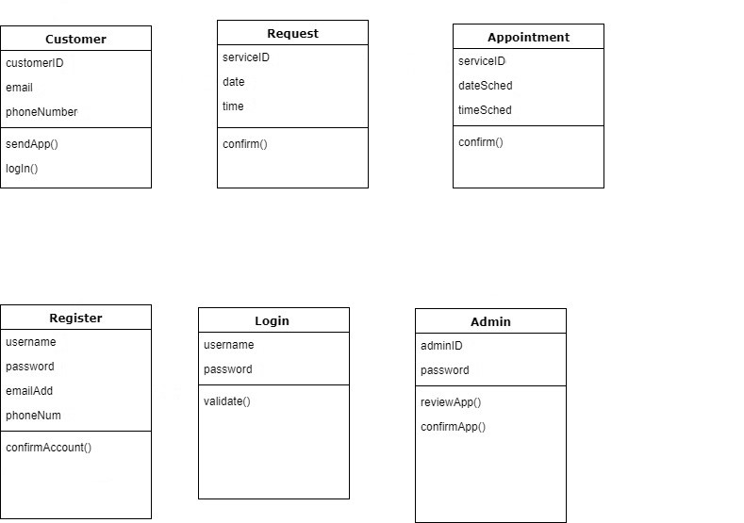
Class diagram

Slide 7
database design
Third party database was used

