Slide 1

WordPress-Media Category
CPT-201-BA: Web content Development
Group Deux:
Nathan Keslar-Programming Major
Zachary Murphy-Programming Major

Slide 2
What is the Media Category
Category used to manage and store all media for your WordPress site.
Pictures
Videos
Graphics
Keeps everything in one place.

Slide 3
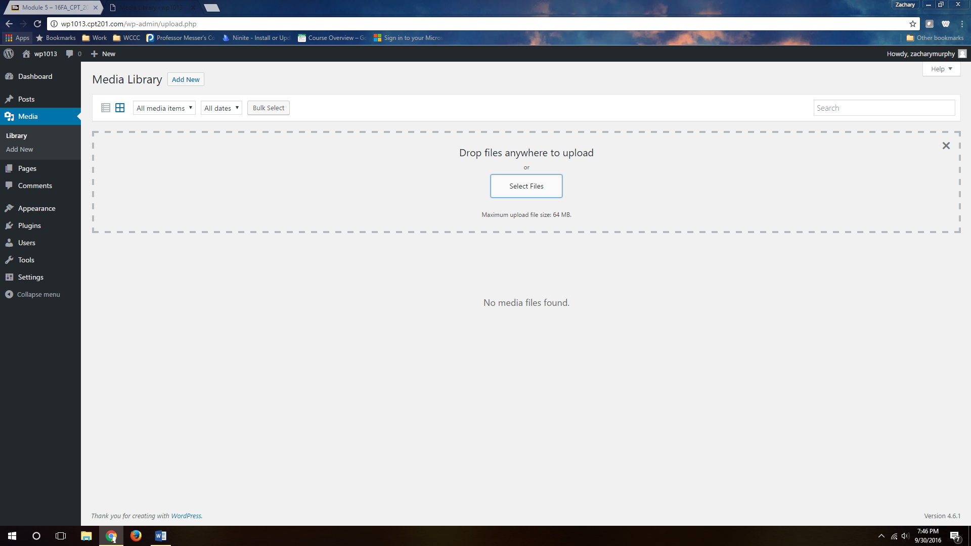
How to use it- Step 1
Notes:
Once you click on the media tab on the left you can select Add New, once you do that you will click select files and a dialog box will come up allowing you to upload files from your PC. You can also just drag and drop them into the dotted area.

Slide 4
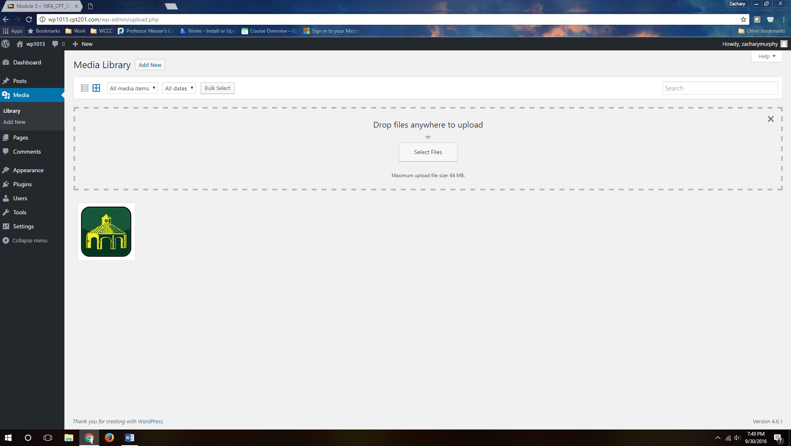
How to use it- Step 2
Notes:
Once you add a media file you will see it listed in your media library. You can click on the item you just uploaded and you will find it provides more information about that item, such as the URL WordPress gives it.

Slide 5
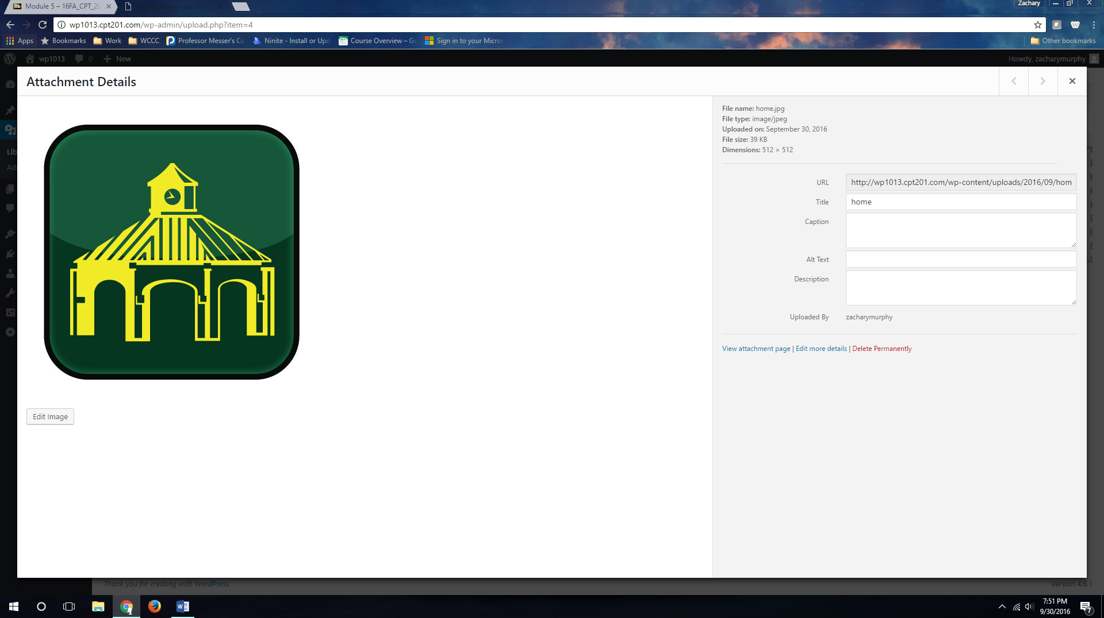
How to use it- Step 3
Notes:
You can also give the media file a tile, caption, alternative text, or description. This is very similar to what you can do when coding HTML.
Recommended Settings:
There are really no settings within this in particular Most of the settings would be made within the media files you upload and that would be up to you to determine what is best for your site.

Slide 6
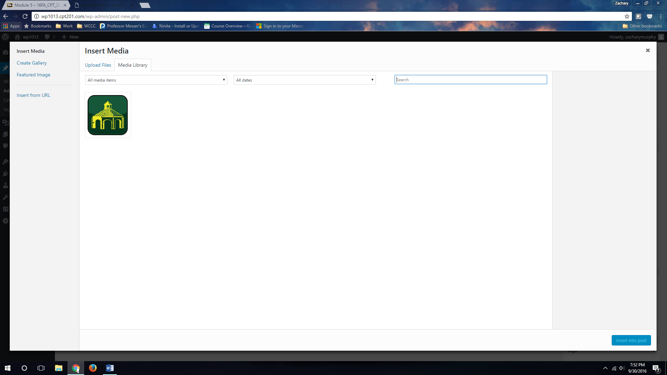
How to use it- Step 4
Notes:
The benefit of using the media library is it stores the media on your account. So when you write a new posts or upload an image to a page, you can find it in your media gallery, even if it’s not saved on the computer you are using.

Slide 7

Subcategories
Library: stores all your media files.
Add Ned: allows you to add new media files both individually and in bulk.
Notes:
The Library category will store all your media files. While the Add New category allows you to add new media files both individually or bulk.

Slide 8
WordPress-Media Category
Notes:
Any questions

