Slide 1
UT/JSC Trick Modeling Initiative 2010
Iterative Targeting Algorithm in the Monte Carlo Framework

Slide 2
Introductions
Thank you for having us out
Group members
Field Manar
Zach Tschirhart
Chun-Yi Wu
Travis Sanders
Szu-Chun Hung
Michael Tarng
James Dearman
Victor Rodriguez
Harsh Shah
Chris Cutlip
Kyle Brill

Slide 3
Background
Motivation
Demonstrate the ability of the Monte Carlo framework in Trick to function as a targeter
Goals
Code simple differential corrections targeter
Integrate targeting algorithm with JEOD to take advantage of more complex models

Slide 4
User Defined Simulation
Extension of Trick Ball++ simulation
Two Body Point Mass
Earth Inertially Fixed
Three Dimensional

Slide 5
User Model Code Structure
Ball++
SIM_Ball++_L1
L1 (FD)
Optim++ (Targeting)
S_define
M_velocity_target
RUN_test/input
Data logging
src (.cpp)
include
src (.cpp)
include
Ball
BallInit
BallDeriv
BallInteg
Ball.dd
Ball.hh
Ball_integ.d
BallState.hh
Optimization
OptimInit
PreJobs
PostJobs
Optimization.hh
Optimization.dd

Slide 6
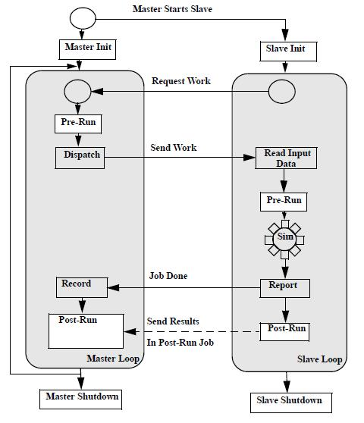
The Monte Carlo Framework
Targeting
Force Model
OptimPreJobs
EOM Integrator
OptimPostJobs
Simulation Definition (S_define)

Slide 7
JEOD Code Structure
models
SIM_1_Optim
JEOD modeling directories
Optim++ (Targeting & FD)
S_define
M_velocity_target
SET_test/RUN_1/input
Data logging
src (.cpp)
include
Optimization
OptimInit
PreJobs
PostJobs
Optimization.hh
Optimization.dd

Slide 8
Three Teams
Jeod
Targeting
Finite Differences
Zach
Travis
Chris
Field
James
Szu-Chun
Michael
Kyle
Chun-Yi
Victor
Harsh

Slide 9
Targeting
Field Manar, James Dearman, Szu-Chun Hung, Michael Tarng

Slide 10


The Math
,
The generic relation between parameters and controls for a targeter can be represented as:
Where c is a vector of constraints, p is a vector of control parameters.
This can be linearized as:
M is the “state relation matrix”

Slide 11

Furthermore
If there are more control variables than there are constraints, there are an infinite number of solutions.
A common method is to choose the “minimum norm” solution.
The linearized equation admits such a solution:

Slide 12


Application to Orbits
Given a state vector:
We can define our δc as the error in our final position and δp as our change in initial velocity
It can be shown for this case that:
Where B is the top right corner of the state transition matrix

Slide 13



Cont.
Where the STM (Φ) is:
The STM arises from the linearizing about a reference trajectory where:
This leaves our targeter with the equation:
This constitutes a single impulse time-fixed position targeter.

Slide 14

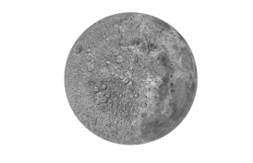





Visual Algorithm

Slide 15
Implementation
MATLAB used for prototyping and familiarizing ourselves with the targeting process.
Once working, the algorithm was ported to the Trick environment in the Monte-Carlo framework.
The post-master contains the targeting algorithm.
The pre-master function contains the stop conditions.

Slide 16
Meanwhile…
Also coded 3 other targeters in Matlab:
A Time-Free Position targeter
An Altitude targeter
A Two Impulse Position targeter (unsuccessful)
Once the time-fixed targeter was running in Trick, tried implementing the time-free version, but ran into trouble.

Slide 17
Time Free MATLAB Plots
Time Fixed
Initial Guess
Time Free
Earth
Initial Location
The del_v is [-1.52798, -0.162514, 0] = 1.5366 [km/s]
Iterations – 5
The del_v is [-1.52798, -0.162514, 0] [km/s]
The time is 2.880000e+004 [s]
Iterations - 5
Target

Slide 18
Altitude
Targets a specific altitude rather than a position
Initial Guess
Target Altitude
Final Position
The del_v is [-0.967235, -1.90185, 0] [km/s]
The time is 1.440000e+004 [s]
Iterations - 7
target - 6.578000e+003
inital - 4.200000e+004
final - 6.578000e+003

Slide 19
Finite Differencing
Kyle Brill, Chun-Yi Wu, Victor Rodriguez, Harsh Shah

Slide 20

Necessity of FD
STM matrix differential equation:
Requires evaluating partials for the Jacobian
JEOD uses complicated models which are not directly available to the targeter

Slide 21
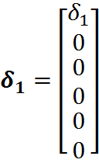
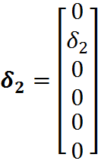
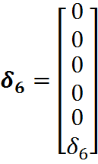




FD method
Define six perturbation vectors
And apply them to the reference trajectory
,
…
+
…
+

Slide 22
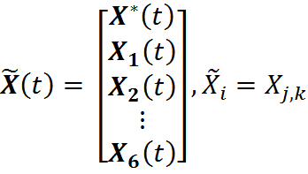
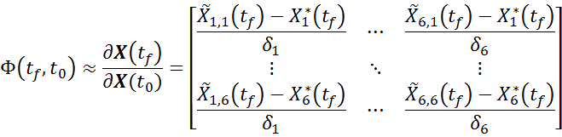
FD method cont.
Now set up a 42 element state vector for numerical integration
We now have all the information to approximate the STM:

Slide 23
MATLAB Verification
Targeting
Targeting
Integrate
Reference State
Integrate
42 Element
State Vector
Finite Differencing
Integrate
Matrix Differential
Equation
Calculate STM
Both methods produced same STM for each iteration
Targeted same desired final position

Slide 24
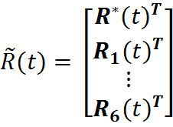

Integration to Trick
Updated Ball state object
Updated Integration and Derivative jobs use 42 element state vector
Added a STM calculator to the slave

Slide 25
Integration 1
FD to Targeting in Trick

Slide 26
Simulation (SIM_Ball++_L1)
S_define
Trick Executive
Monte Carlo
Master
PreJobs
(End Condition)
PostJobs
(Targeting)
Slave
(EOM)
(Finite Differencing)
Input Files

Slide 27
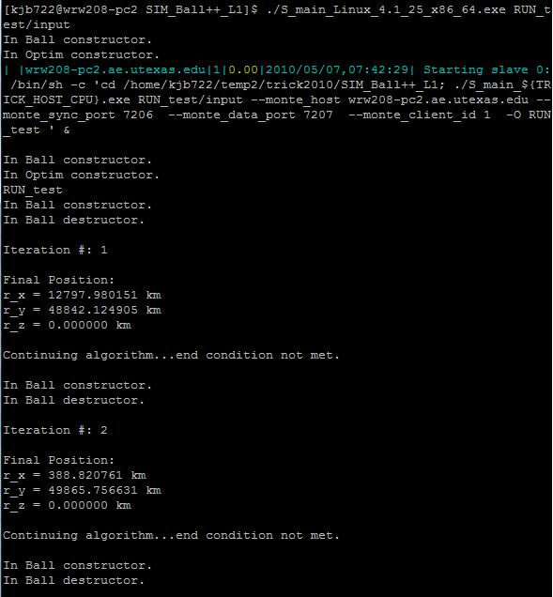
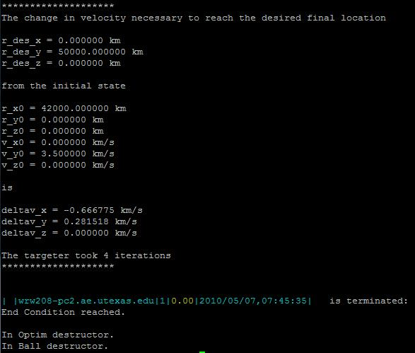
Successful Target Output

Slide 28
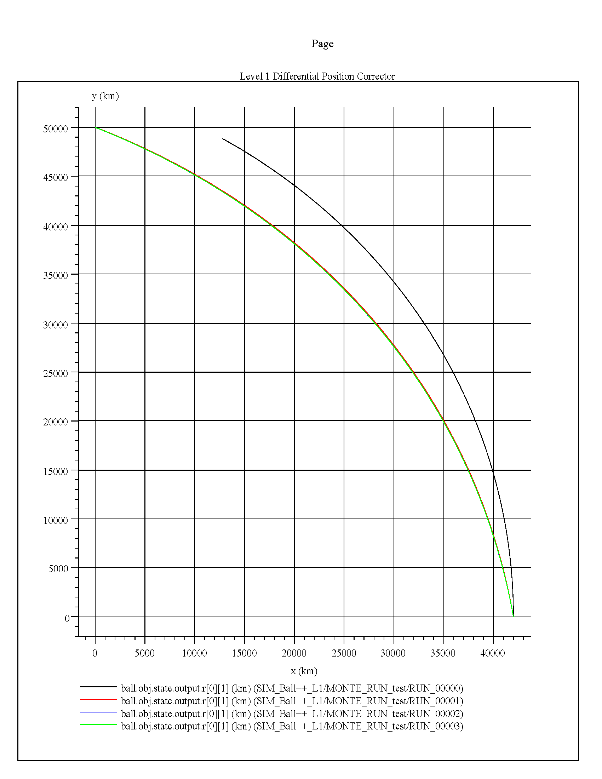
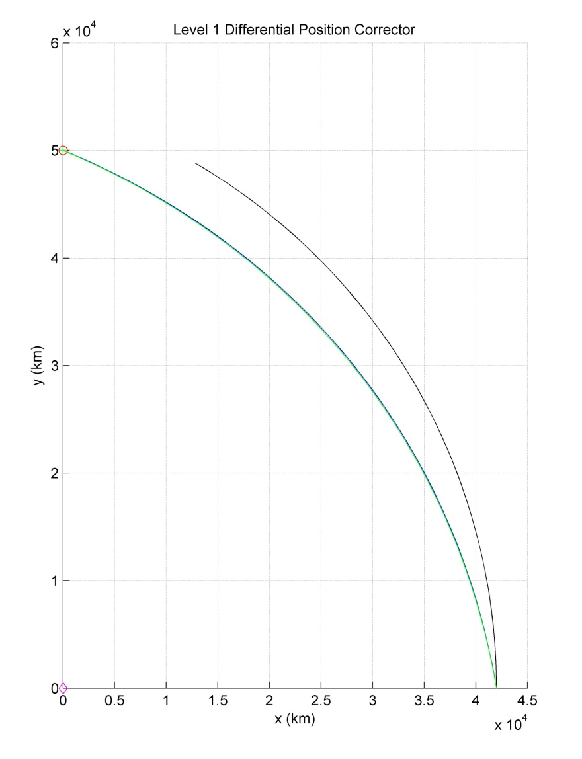
Results
Trick Targeting Curves
MATLAB Targeting Curves
Target Position
Initial Position

Slide 29
JEOD
Zach Tschirhart, Travis Sanders, Chris Cutlip

Slide 30
Simulations
Setup the JEOD environment and successfully ran the tutorial simulations
Modified initial conditions in SIM_1 to compare with the Ball++ orbit in order to help graphically verify that the JEOD models worked as expected
Compared both sets of simulation plots and recorded matching results

Slide 31
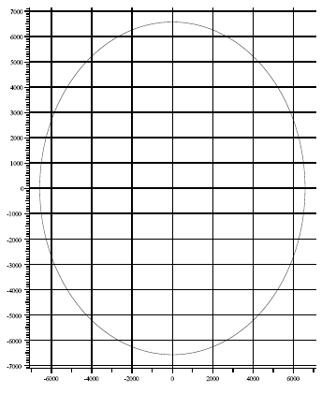
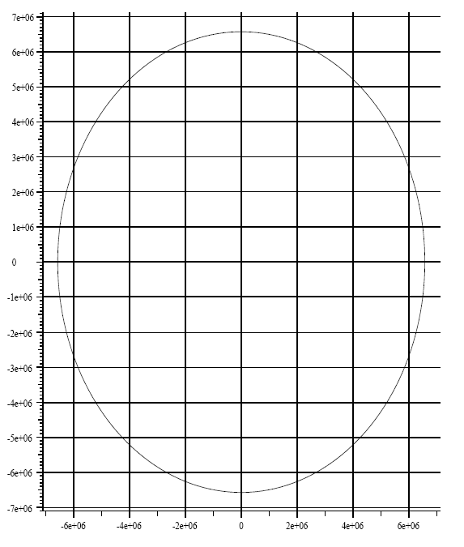
Plot Comparison
Using the existing Ball++ Simulation
Using JEOD models
y(km)
y(m)
x(km)
x(m)

Slide 32
Integration 2
Targeting to JEOD

Slide 33
Goals
Wrap the Targeting Algorithm around SIM_1 from the JEOD Tutorials
SIM_1 is the simple gravity simulation therefore it should recommend the same delta v as the first EOM studied
Modify only the specific simulation files (e.g. S_define, Optimization.cpp, etc.) without interfering with the JEOD models

Slide 34
FD Complications
JEOD does not take in a 42 element vector
Due to the above complications a new method had to be developed to acquire necessary trajectory information
STM calculation moved to Master from Slave
Env, Dyn, Vehicle
Inputs
JEOD
Integrated
Trajectory

Slide 35
Proposed Solution for JEOD Integration
Master Starts Slave
Master Init
Slave Init
Changed input data to include JEOD models.
Earth model (e.g. spherical = true, etc.)
Initial time model (e.g. UTC March 10, 2003, etc.)
Vehicle mass and state (used the same starting conditions, but had to change the vehicle object to interact with JEOD)
Optimization initial conditions had to match with the new JEOD model layout
Request Work
Pre-Run
Send Work
Read Input Data
Dispatch
Pre-Run
Sim
Job Done
Changed objects to include JEOD models instead of the Targeting teams models.
Replaced all Ball objects with JEOD defined objects (used a JEOD Earth model instead of a simple equation to define gravity, etc.)
Changed Post-Run Optimization routine to calculate each perturbation of the state transition matrix individually with a modified switch statement.
Altered Pre-Run to reflect above
Record
Report
Post-Run
Send Results
Post-Run
Master Loop
Slave Loop
Master Shutdown
Slave Shutdown

Slide 36
A Brief Look at Different S_defines
S_define With JEOD
S_define Without JEOD
sim_object: sys;
sim_object: time;
sim_object: env;
sim_object: earth;
sim_object: sv_dyn;
sim_object: dynamics{
/*dynamics/dyn_body: Simple6DofDynBody body*/
}
sim_object: optimizer{
/* Set Simple6DOFDynBody * S = &sv_dyn.body */
}
Integrate () dynamics;
sim_object: sys;
sim_object: ball{
/*Ball++/L1: Ball obj (Ball+ +/L1/include/Ball.dd)*/
}
sim_object: optimizer{
/* Set Ball * B = &Ball.obj */
}
Integrate () ball;

Slide 37
Proposed Algorithm
Modified switch statement to calculate each perturbation of the state transition matrix individually
switch (counter%7)
case 0:
--Apply delta v to initial state in pre master
--Store reference trajectory final state in post master
--counter++
case 1:
--Apply perturbation to the first element of the state vector in the pre master
--Store the output state for the perturbed trajectory in the post master
--counter++
.
.
.
case 6:
--Apply perturbation to the sixth element of the state vector in the pre master
--Store the output state, calculate the STM and apply targeting formula for a new delta v
--counter++

Slide 38
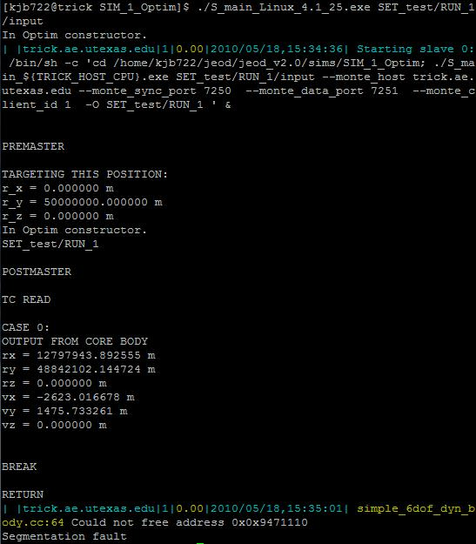
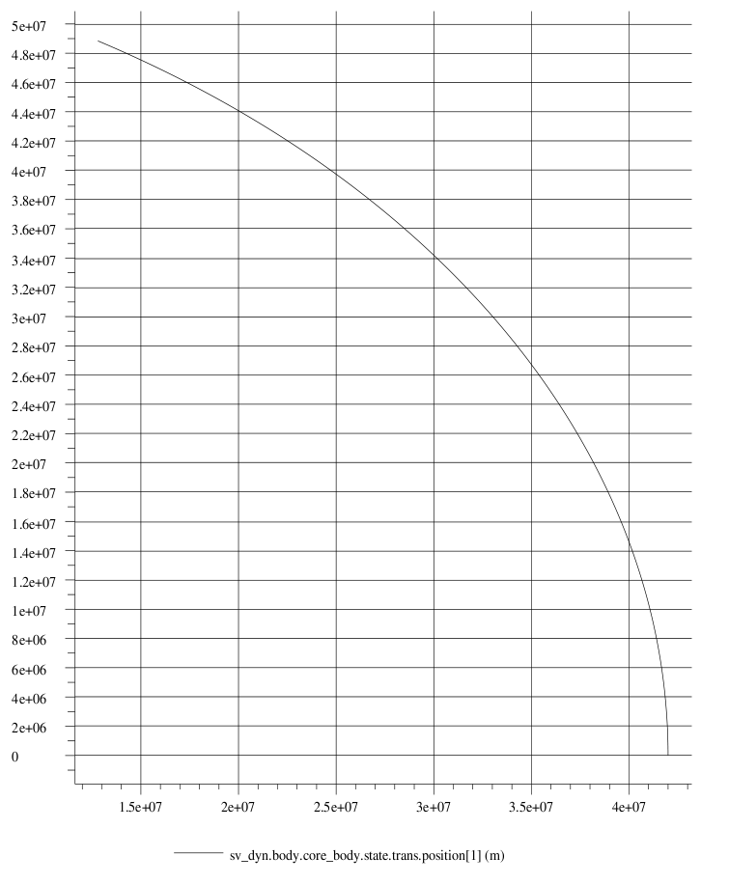
JEOD Targeter Output
Successfully creates Monte Carlo job and integrates the initial reference trajectory

Slide 39
JEOD Targeter Output (cont.)
Error occurred on attempt to iterate to second trajectory:
A JEOD model attempted to delete an object that the Monte Carlo framework was not done with

Slide 40
Attempts to Fix
Commented out the destructor object in the offending JEOD model file
This eliminated the first error but not the Segmentation fault
Attempted to change the pointer references to the JEOD models but received the same error
Any other proposed solutions would require changing the JEOD models directly, which defies the goal of leaving the JEOD code unmodified

Slide 41
JEOD Integration Conclusion
A Segmentation fault is a very broad error. Due to JEOD's status as a black box software tool, this proved to be difficult to find exactly where the problem was.
Without knowing more about how the JEOD models work internally, there may not be an immediate solution to a Targeting Algorithm.
It may be possible the problem lies deep in the JEOD model code. In this case, to get a Targeting Algorithm working it might be required to change the internal structure to accommodate the Optimization framework.

Slide 42
Closing Remarks

Slide 43
Summary
Simple Trick targeter is working with independently coded model
Attempt to integrate with JEOD was mostly unsuccessful
Proposed “black box” targeting algorithm was discussed
Also had difficulty with implementing Time Free targeter in Trick

Slide 44
Suggestions for Future Study
Continue investigation into integration with JEOD
Continue work on implementing more advanced targeters in Trick
Continue MATLAB work on 2 impulse targeter
Work with graphics tools to create a visualization component

Slide 45
Thank you
We appreciate your support of the UT program
Thank you also to Dr. Marchand for working with us on this project

Slide 46
Closing
Questions or Comments?

