Slide 1
ML-Agents Supported Networks
Reinforcement learning: agents learn through trial and error.
Recurrent: use of memory (https://github.com/gzrjzcx/ML-agents/blob/master/docs/Feature-Memory.md) (be aware of limitations).
Curriculum learning: updating the difficulty based on the agent performance (https://github.com/gzrjzcx/ML-agents/blob/master/docs/Training-Curriculum-Learning.md).
Imitation learning: imitate demonstrated behavior (https://github.com/gzrjzcx/ML-agents/blob/master/docs/Training-Imitation-Learning.md).
Supports CNNs.

Slide 2
ML-Agents Imitation Learning
Imitation learning: it is possible to record demonstrations of agent behavior from the Unity Editor, and save them as assets.
Online training (demonstrations in real-time during training, without pre-recording a demonstration file).
Offline training (by supporting .demo files, generated using the Demonstration Recorder as the dataset used to train a behavior).
Provided BC Teacher Helper for resetting the training buffer and start and stop recording experiences.

Slide 3
More on ML-Agents
Custom trainers Plugin (extend ml-agents trainers, optimizers and hyperparameter settings) (currently limited?) (https://github.com/Unity-Technologies/ml-agents/blob/develop/docs/Python-Custom-Trainer-Plugin.md)
rerouting ML-Agents to learn CLI to custom trainers and extending the config files with hyper-parameters specific to your new trainers

Slide 4
Learning Agents Supported Networks
Recurrent: NO! (doesn't directly support incorporating past experiences or information into the decision-making process, i.e. tasks requiring temporal reasoning or long-term planning).
Curriculum learning: NO!
CNNs: NO!
General reinforcement learning: YES!
Imitation learning: YES!
Thus, agents are only trained through Proximal Policy Optimization (PPO) reinforcement learning algorithm or Behavior Cloning (BC) imitation learning algorithm.

Slide 5
More on Learning Agents
Utilizes Blueprint system (≈ Bolt in Unity) or C++ coding as in Unity.
Use C++ to define observations/actions and your neural network structure, as well as the flow-control for the training and inference procedures.
During training, the UE process will collaborate with an external Python process running PyTorch (included a working PyTorch algorithm for PPO and BC).
Overall, the model definition and training process is almost the same as in ML-Agents.

Slide 6
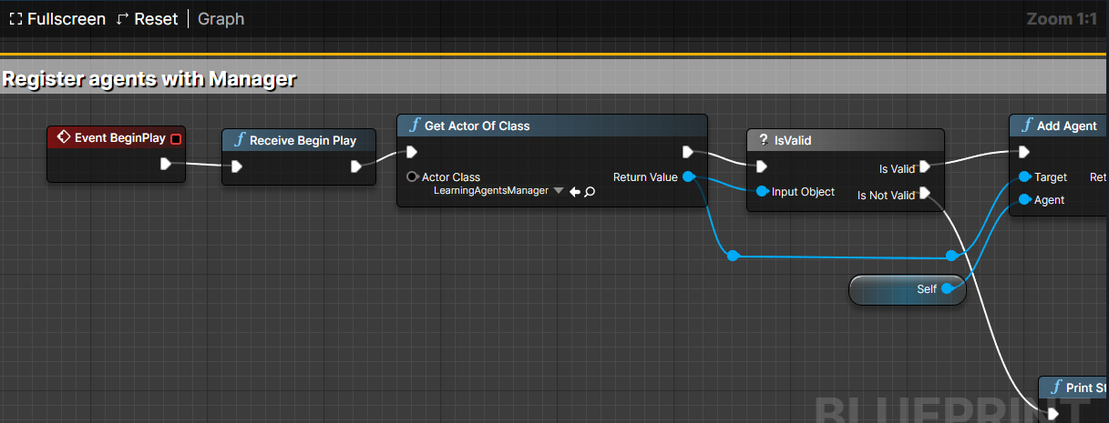
Assigning LearningAgentManager to some Actor (like NPC or car)
Manager Components: gathering observations, taking actions, performing training, and recording data to files.

Slide 7
More on Learning Agents
Used for:
Training AI characters (best to use combination of behavioral trees + NNs)
Physics-based animations (perhaps imitation learning)
Automated QA testing.
Not used for:
Generative AI (images, audio, etc).
Chatting with NPCs.

Slide 8
Unity ML-Agents
Fast development due to open source and large community.
Easy to implement NNs in the Unity environment.
Training/Inference can be controlled via Python API (https://github.com/gzrjzcx/ML-agents/blob/master/docs/Python-API.md)
Many additional features (https://github.com/gzrjzcx/ML-agents/blob/master/docs/ML-Agents-Overview.md#running-example-training-npc-behaviors), such as:
Memory-enhanced agents (Recurrent NNs)
Broadcasting : leverage own algorithms for training. In this case, the Brain typeof an Agent would be set to Learning and be linked to the BroadcastHub and the behaviors of all the Agents in the scene will be controlled within Python. Can even turn an environment into a gym.
Supports use of pre-trained neural network models.

Slide 9
UE Learning Agents
Similar training structure to ML-Agents
No control via Python API?
No easy to follow docs, tutorials yet ☹ (only resources found: https://docs.unrealengine.com/5.3/en-US/BlueprintAPI/LearningAgents/, https://dev.epicgames.com/community/learning/tutorials/8OWY/unreal-engine-learning-agents-introduction, https://dev.epicgames.com/community/learning/tutorials/qj2O/unreal-engine-learning-to-drive, https://medium.com/@gensen/early-explorations-of-learning-agents-in-unreal-engine-ef74b058161e)
Right now most people use behavioral trees or combination of behavioral tress and trained NNs.

Slide 10
Educational Environments Examples
Train a model that would continuously monitor user status, e.g. check whether a user is focused/confused or not when learning some topic. If focused => …, else => …
Continuing with previous example, the game can adapt based on user behavioral data to give different/more difficult/easier problems. E.g. a memorization game that would adapt based on how fast user solves a problem
Adapt educational environments based on user type (identify user type (e.g. visual, audio learners, by bio data user interactions and adapt accordingly).

Slide 11
Educational Environments Examples
Redesign UI or environment based on gaze data.
In Unity VR you can draw, perhaps we can train a model that would continuously analyze user drawing and give suggestions on how to improve it.
If a user learns about something, we can train a model that would create test environments based on the material learned (e.g. how to properly plant a tree).

