Slide 1
ML-Agents Supported Networks
Reinforcement learning: agents learn through trial and error.
Recurrent: use of memory (https://github.com/gzrjzcx/ML-agents/blob/master/docs/Feature-Memory.md) (be aware of limitations).
Curriculum learning: updating the difficulty based on the agent performance (https://github.com/gzrjzcx/ML-agents/blob/master/docs/Training-Curriculum-Learning.md).
Imitation learning: imitate demonstrated behavior (https://github.com/gzrjzcx/ML-agents/blob/master/docs/Training-Imitation-Learning.md).
Supports CNNs.

Slide 2
ML-Agents Imitation Learning
Imitation learning: it is possible to record demonstrations of agent behavior from the Unity Editor, and save them as assets.
Online training (demonstrations in real-time during training, without pre-recording a demonstration file)
Offline training (by supporting .demo files, generated using the Demonstration Recorder as the dataset used to train a behavior.)y
Provided BC Teacher Helper for resetting the training buffer and start and stop recording experiences.

Slide 3
More on ML-Agents
Custom Training and Inference
Any user of the ML-Agents toolkit can leverage their own algorithms for training. In this case, the Brain type would be set to Learning and be linked to the BroadcastHub (with checked Control checkbox) and the behaviors of all the Agents in the scene will be controlled within Python. You can even turn your environment into a gym.
Python API: https://github.com/gzrjzcx/ML-agents/blob/master/docs/Python-API.md

Slide 4
Learning Agents Supported Networks
Recurrent: NO! (doesn't directly support incorporating past experiences or information into the decision-making process, i.e. tasks requiring temporal reasoning or long-term planning)
Curriculum learning: NO!
Imitation learning: YES!
CNNs: NO!
Thus, agents are only trained through Proximal Policy Optimization (PPO) reinforcement learning algorithm or Behavior Cloning (BC) imitation learning algorithm.

Slide 5
More on Learning Agents
Utilizes Blueprint system (see next image).
Use C++ to define observations/actions and your neural network structure, as well as the flow-control for the training and inference procedures.
During training, the UE process will collaborate with an external Python process running PyTorch (included a working PyTorch algorithm for PPO and BC).

Slide 6
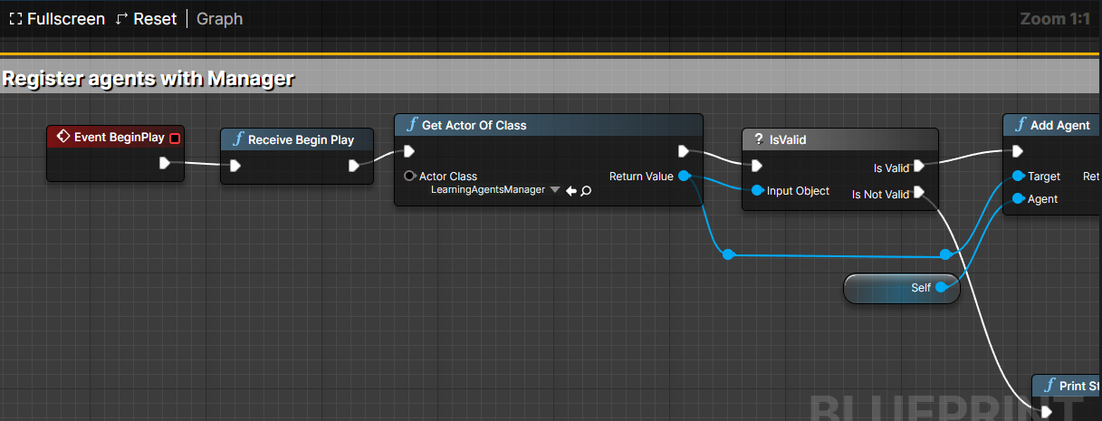
Assigning LearningAgentManager to some Actor (like NPC or car)
Manager Components: gathering observations, taking actions, performing training, and recording data to files.

Slide 7
More on Learning Agents
Used for:
Training AI characters (best to use combination of behavioral trees + NNs)
Physics-based animations (perhaps imitation learning)
Automated QA testing.
Not used for:
Generative AI (images, audio, etc).
Chatting with NPCs.

Slide 8
Unity ML-Agents
Fast development due to open source and large community.
Easy to implement NNs in the Unity environment.
Training/Inference can be controlled via Python API (https://github.com/gzrjzcx/ML-agents/blob/master/docs/Python-API.md)
Many additional features (https://github.com/gzrjzcx/ML-agents/blob/master/docs/ML-Agents-Overview.md#running-example-training-npc-behaviors), such as:
Memory-enhanced agents (Recurrent NNs)
Broadcasting (Agent observations and actions are sent to the Python API)
Supports use pre-trained neural network models.

Slide 9
UE Learning Agents
Uses Blueprint API
No easy to follow docs, tutorials yet ☹ (only resources found: https://docs.unrealengine.com/5.3/en-US/BlueprintAPI/LearningAgents/, https://dev.epicgames.com/community/learning/tutorials/8OWY/unreal-engine-learning-agents-introduction, https://dev.epicgames.com/community/learning/tutorials/qj2O/unreal-engine-learning-to-drive)
Possible use case: train multiple NNs which are different in difficulty and use behavioral tree to then choose one based on the user actions.

Slide 10
Educational Environments Examples
1. Analyze user eye data (focused, bored), puzzle game, help choosing user which topics he wants to learn about: “I see you are too focus, keep thinking; I see you are bored, let us try another topic?” (perhaps example of Imitation Learning)
2. Continuing with previous example, the game can adapt based on user behavioral data to give different/more difficult/easier problems. E.g. the size of the hole where you put an object gets bigger; or if the person takes too many tries, you remove some components that make the game difficult (can this be done just using “behavioral” trees?)
3. Narrator talks about something, if user frowns, narrator says: "Oh, I see you are confused. Let me explain it in more detail.". Might be great for education when explaining some topics to users from different backgrounds.

Slide 11
Educational Environments Examples
Adapt educational environments based on user type (identify user type (e.g. visual, audio learners, by bio data and adapt accordingly).
Play therapy (cure e.g. ADHD through gaming).
Redesign UI based on gaze data.
In Unity, you can train model to generate scenes, perhaps use them to generate e.g. more difficult scenes if user successfully passed tests.

