Slide 1

Challenge of tSNE as an objective metric
Oct.7 LI XINWEI
group 24

Slide 2
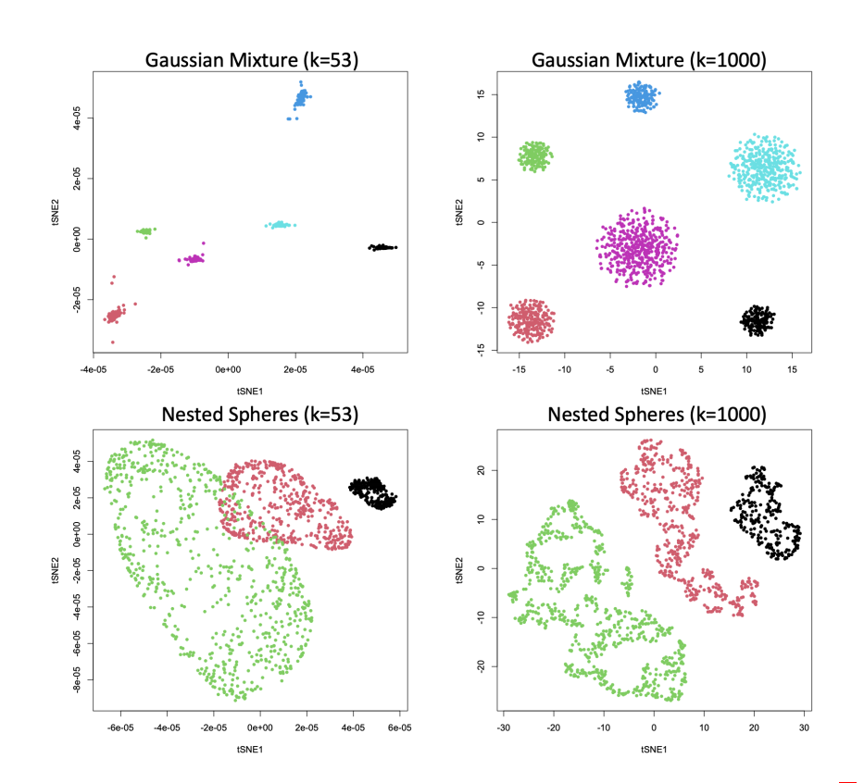
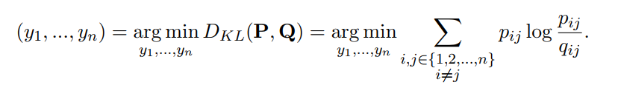
Challenge of tSNE as An Objective Metric
Problem Statement
The unreliability of tSNE plot as an objective metric for model performance given by theoretical research
Unclear comparison objective between raw data and modelled data
Intuitively, the better model has a better-separated clustering plot.
However, given the examples below, this standard isn’t precise.
How can I tell the visual differences between tSNE plots of raw data and modelled data are attribute to the effort of model instead of parameter tunning?
Brief Mathematical Rationale of tSNE
Target
Two Phrases of tSNE Mapping (solution to the optimization)
Early Exaggeration Stage : To speed up gradient decreasing algorithm convergence rate.
Embedding Stage
As k goes large, the cluster performance maybe worse (top two plots). Best k value differs case by case.

Slide 3
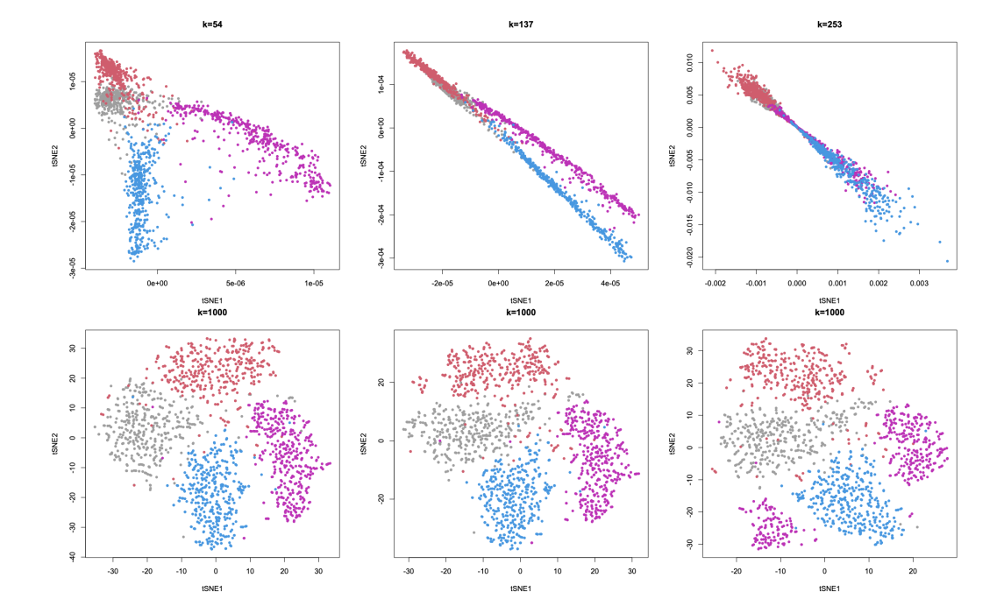
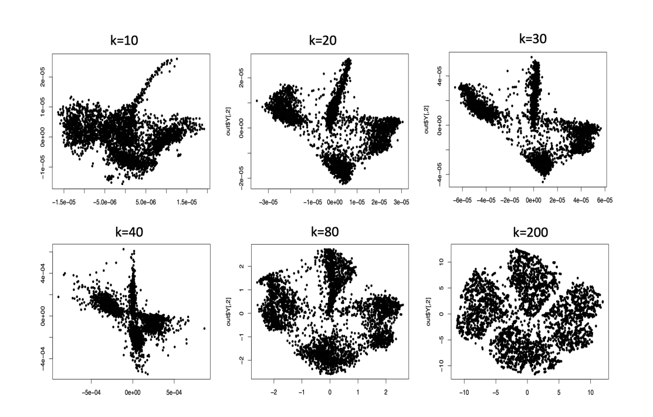
Challenge of tSNE as An Objective Metric
Example of tSNE (from MNIST dataset)
As k goes large, the cluster visualization may be worse (the distance between two clusters)
Given the same k, tSNE plots also contain randomness. (bottom three plots) The relative position of clusters aren’t meaningful.

Slide 4
Challenge of tSNE as An Objective Metric
Conclusion
t-SNE visualization based on random initialization and early exaggeration is reliable in terms of cluster membership but not relative position of clusters. For example, the neighboring clusters in visualization may not be interpreted as neighboring clusters in the original data.
By tunning parameters, tSNE plots of the same dataset can be quite different.
Therefore, taking tSNE as objective metric for model performance isn’t extremely convincing and has a high risk of over interpretation.
Reference
[1] Cai, T. T., and Ma, R.*, Theoretical Foundations of t-SNE for Visualizing High-Dimensional Clustered Data. Submitted [arxiv]
[2] Kobak, D., Linderman, G.C. Initialization is critical for preserving global data structure in both t-SNE and UMAP. Nat Biotechnol 39, 156–157 (2021). https://doi.org/10.1038/s41587-020-00809-z
[3] Lecture Series—Trends in Statistics: Dr Rong Ma, 22 Sept, 9–10 am, at Department of Statistics and Data Science, NUS

