Slide 1

Employee Attrition
Classification
Aysenur Oya OZEN - 2107501
Zeynep TUTAR - 2106038

Slide 2
Introduction to Dataset
The objective of this project is to develop at least two predictive models to determine employee attrition. Additionally, it aims to identify and understand the key factors that contribute to employee turnover.
The dataset used for this project is a simulated dataset designed for the analysis and prediction of employee attrition.
It contains detailed information about various aspects of an employee's profile, including demographics, job-related features, and personal circumstances.
The dataset contains 74,498 samples and 22 features. Each record includes a unique Employee ID and features that influence employee attrition.

Slide 3
Description of the Features

Slide 4
Exploraty Data Anlaysis (EDA) Step by Step
Removing Columns
Employee.ID and Company.Tenure dropped as they are not useful for predictive modeling.Company.Tenure column gives logically incorrect numerical values.
Changing Features Type
Some numeric columns are converted that represent categories (Number.of.Promotions, Number.of.Dependents) to factors to treat them appropriately in analyses and visualizations.
Numerical and Categorical Variables Separation
Numerical and categorical variables were separated for targeted analysis. Summary statistics were then used to provide a quick overview of the distribution of numerical features.

Slide 5
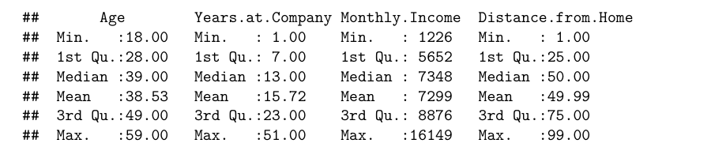
Summary Statistics for Numerical Variables

Slide 6
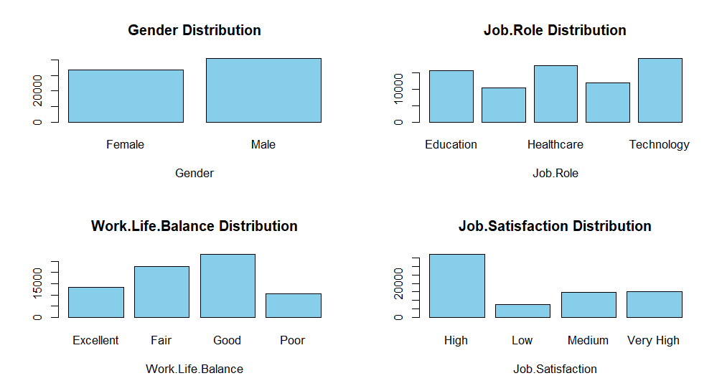
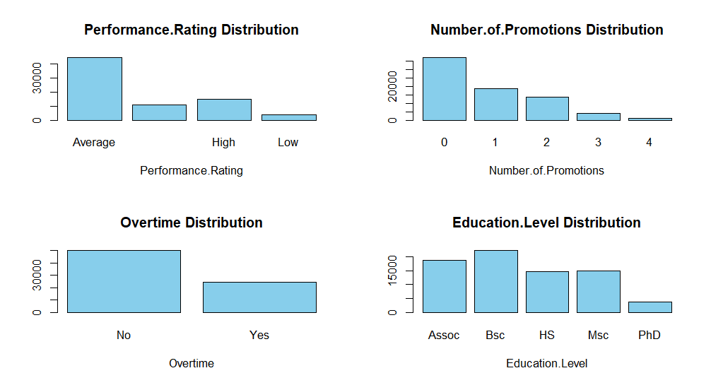
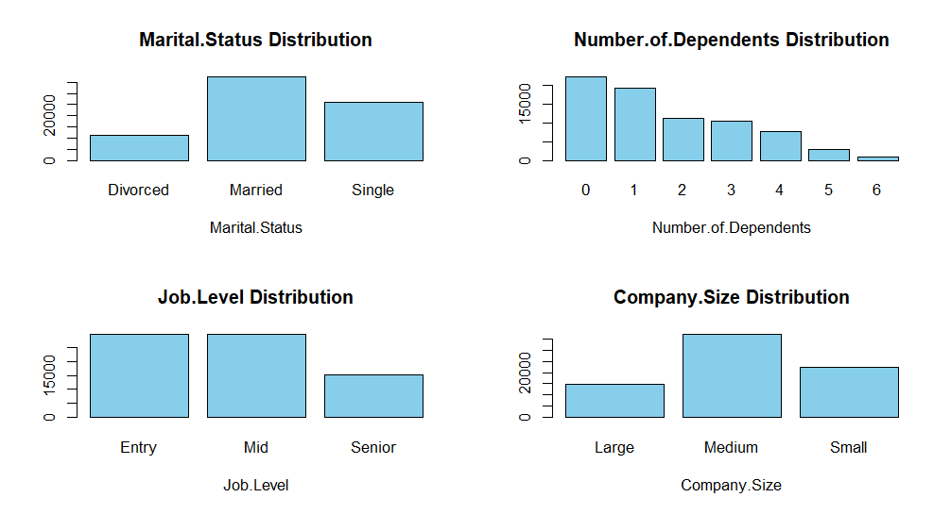
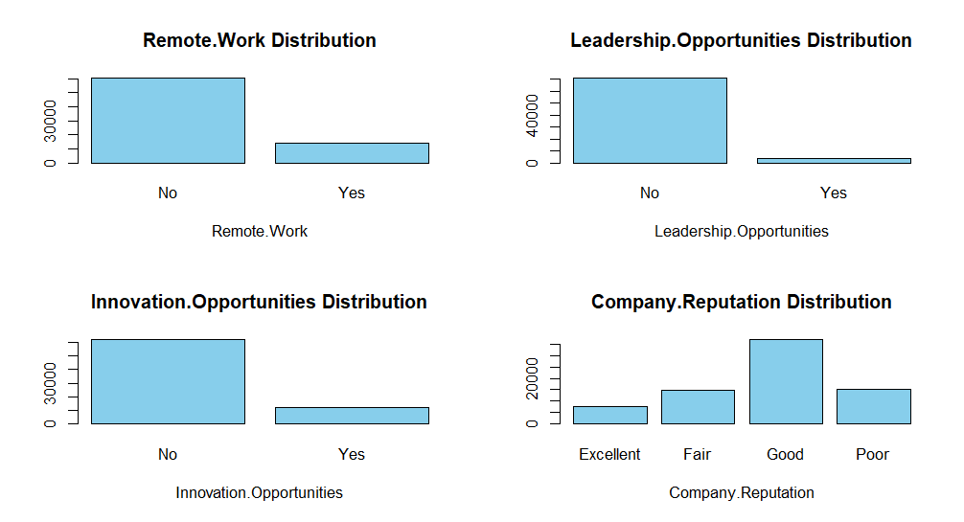
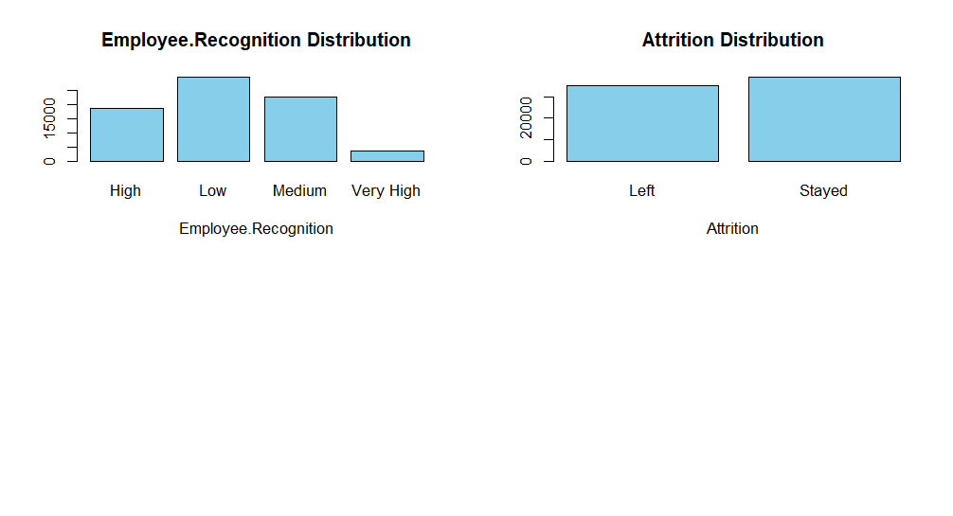
Categorical Variables Distribution

Slide 7
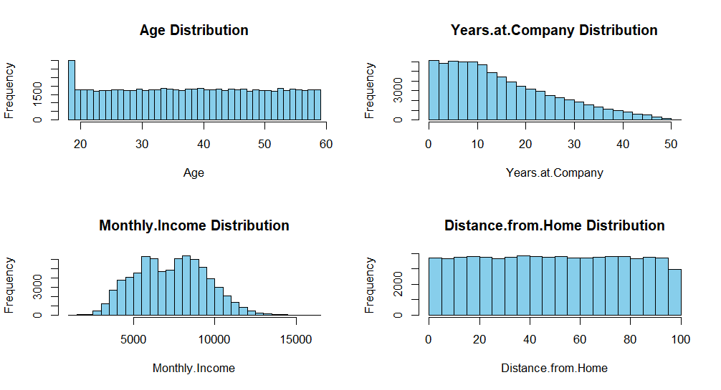
Numerical Variables Distribution

Slide 8
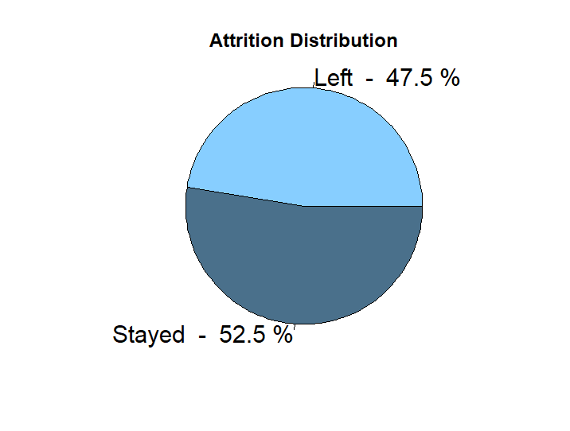
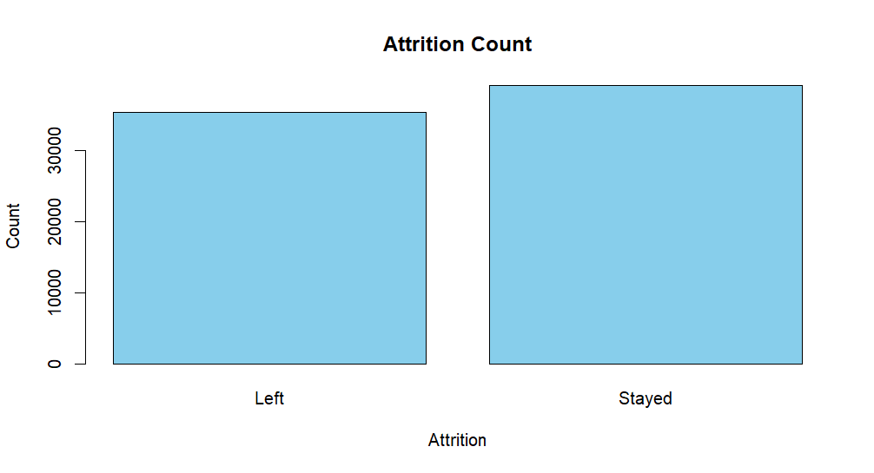
Target Value Distribution

Slide 9
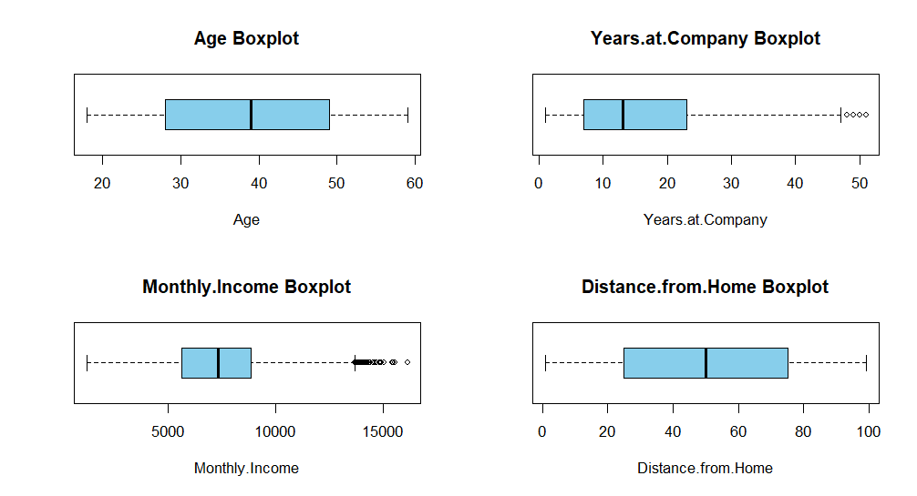
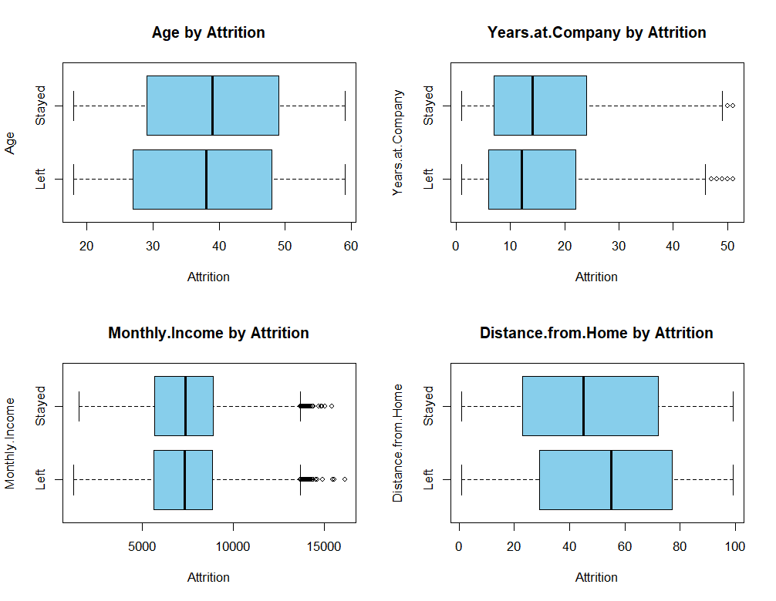




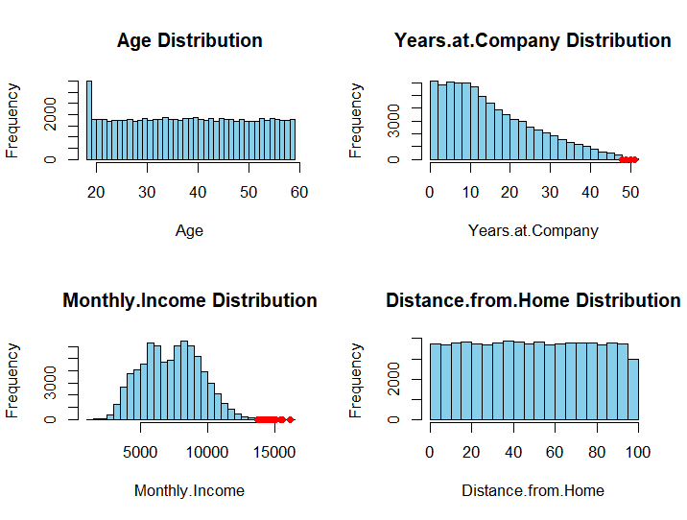

Outlier Analysis

Slide 10
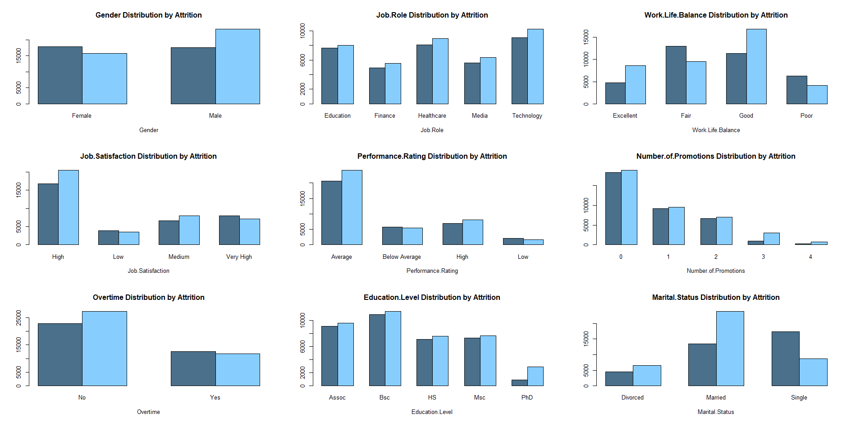
Transforming Numerical Variables into Categorical Variables
This methodology effectively transforms continuous numeric variables into categorical bins, facilitating better visualization and comparative analysis of attrition.

Slide 11
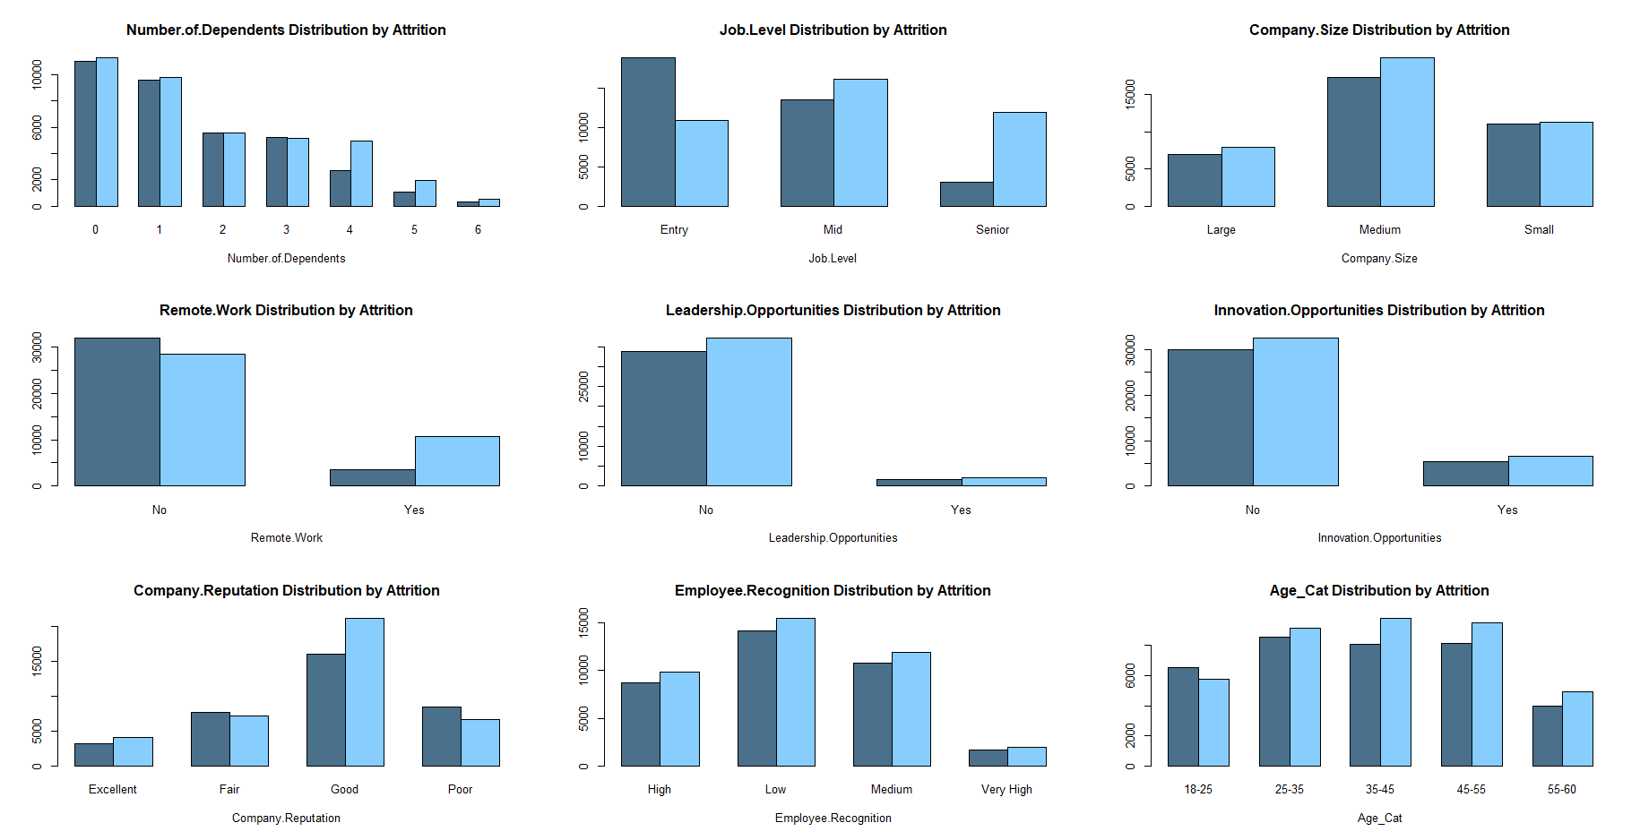
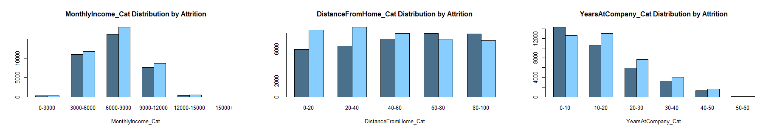

Slide 12
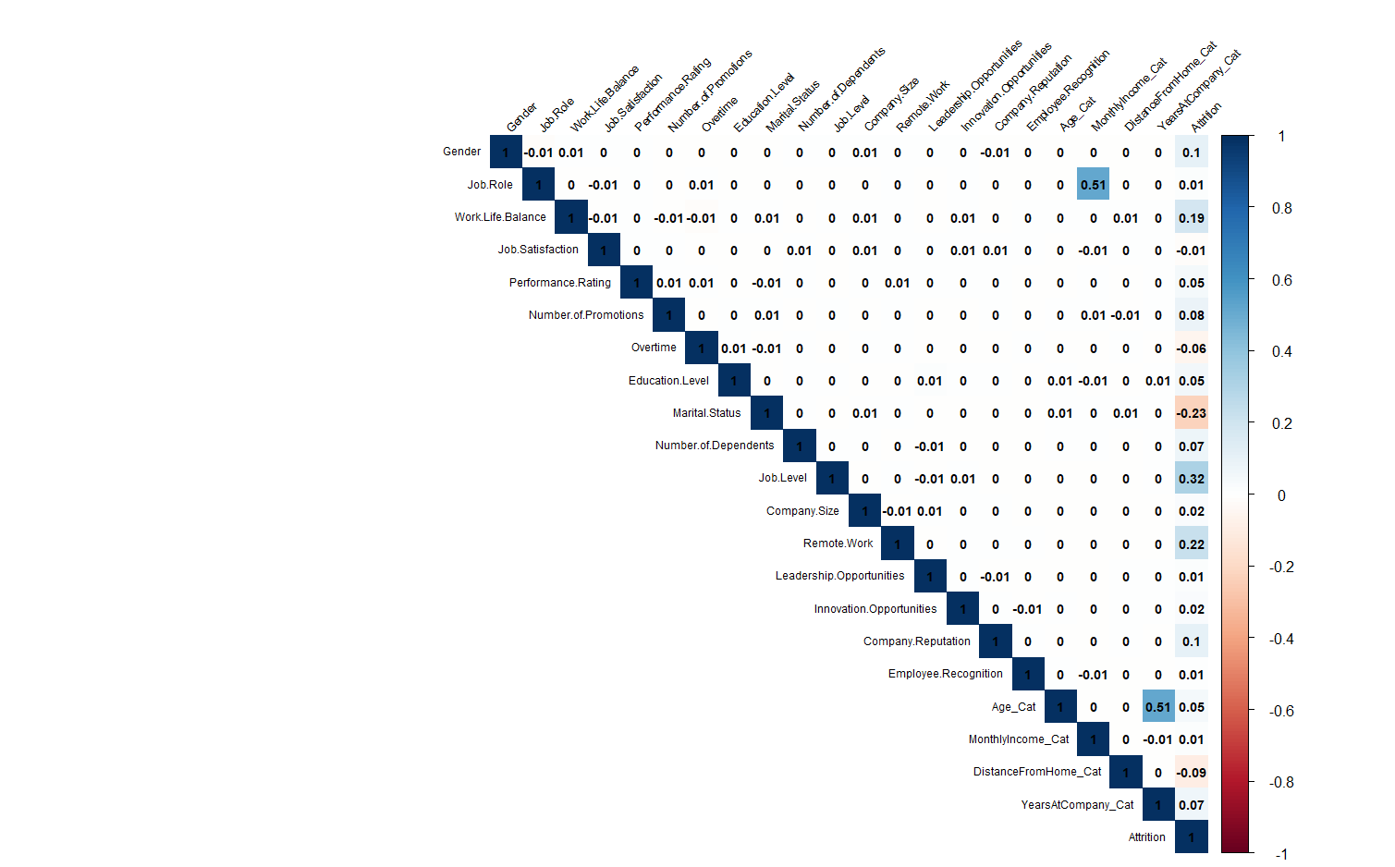
Correlation

Slide 13
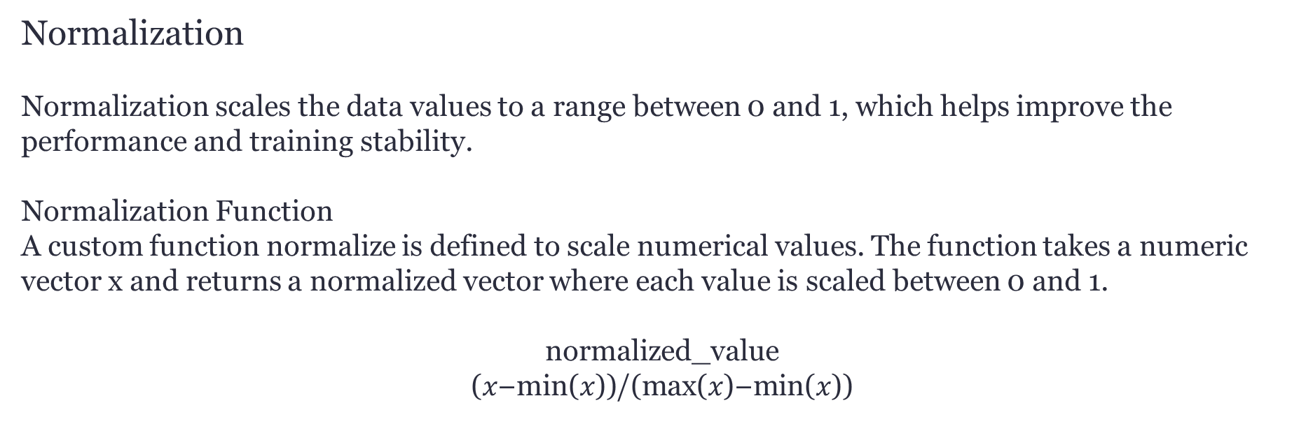
Data Preparation
Handling Categorical Features
In order to use the categorical features in the model,we need to convert categorical features to numeric (ordinal or nominal) representations.
Normalization
Normalization scales the data values to a range between 0 and 1, which helps improve the performance and training stability.
Normalization Function
A custom function normalize is defined to scale numerical values. The function takes a numeric vector x and returns a normalized vector where each value is scaled between 0 and 1.
$$\text{normalized}\text{_}\text{value}$$
$$\text{(}\text{x}\text{−}\text{min}\text{(}\text{x}\text{))}\text{/}\text{(}\text{max}\text{(}\text{x}\text{)−}\text{min}\text{(}\text{x}\text{))}$$
Train-Test Split
To evaluate the performance of the predictive models, the dataset is split into training and testing sets. 80% of the rows in data as train and the remaining 20% of the data is used for the testing set.

Slide 14
Checking Dataset Dimensions and Balance
Before proceeding to the modeling step, it is essential to examine the dimensions and balance of the datasets. This helps ensure that the training and testing sets are appropriately sized and balanced for effective model training and evaluation.
Number of samples in training data: 59,598
Number of samples in testing data: 14,900
y_train
y_test

Slide 15
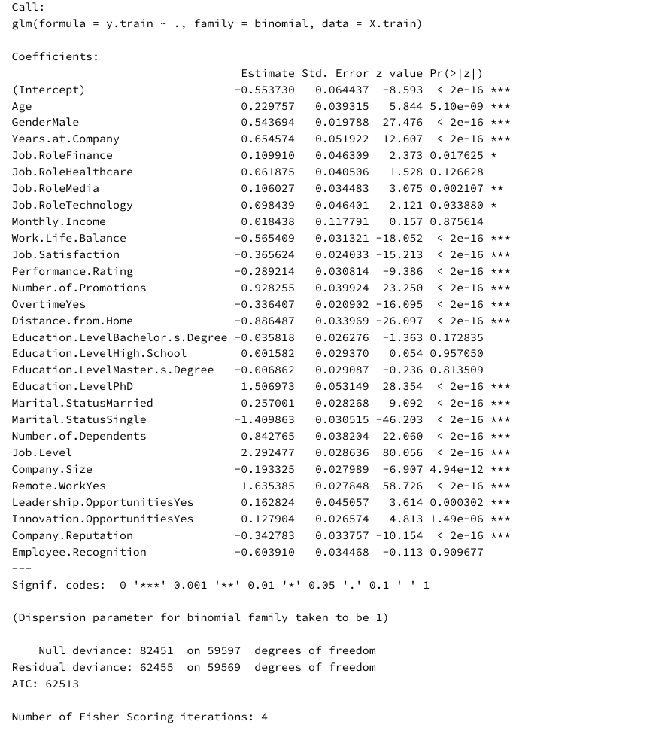
Predictive Classification Models
Logistic Regression
Logistic regression is a model that estimates the odds of the dependent variable occurring and applies the logit (log-odds) transformation to express this relationship.
Basic Logistic Classifier

Slide 16
Understanding Model Fit Using 𝑅2 Statistics
R2 provides an indication of how well the independent variables in the model explain the variability of the dependent variable.
A higher 𝑅2 value indicates a better fit of the model to the data.
With the full model the value of 𝑅2 24.25% indicates that approximately 24.25% of the variance in the target can be explained by the features in the model.
It suggests that the model is not capturing much of the underlying pattern in the data.

Slide 17
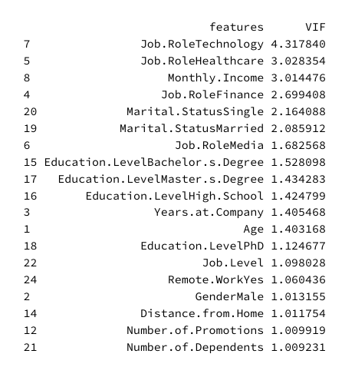
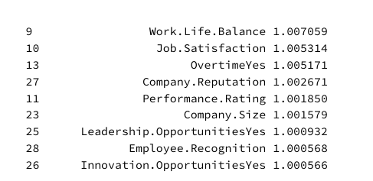
Evaluating Multicollinearity Using VIF Values
A VIF value of 1 indicates no correlation, values between 1 and 5 indicate moderate correlation, and values above 5 suggest significant multicollinearity, leading to unreliable coefficient estimates.

Slide 18
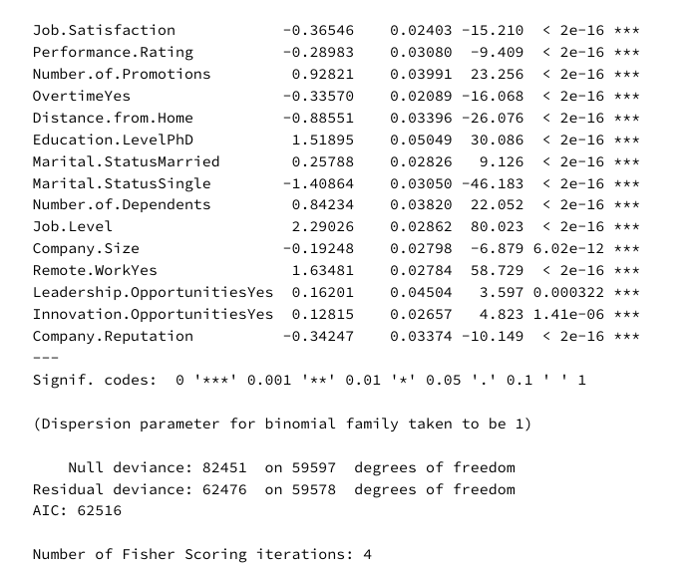
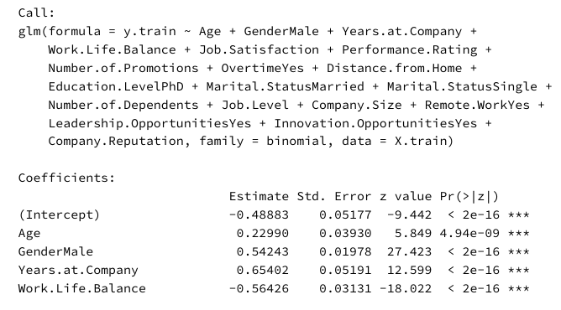
Logistic Regression with Backward Stepwise Search
Backward stepwise selection is a greedy algorithm that iteratively removes the least significant features to develop a predictive model. The goal is to find the best subset of features that improve model performance.

Slide 19
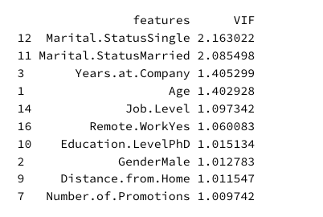
Backward Stepwise Search Results
This method decreased VIF scores, p-values, and the AIC score. Although 𝑅2 slightly decreased to 24.23%, this is expected with fewer features. Most importantly, reducing the variance inflation factor makes the model more stable.

Slide 20
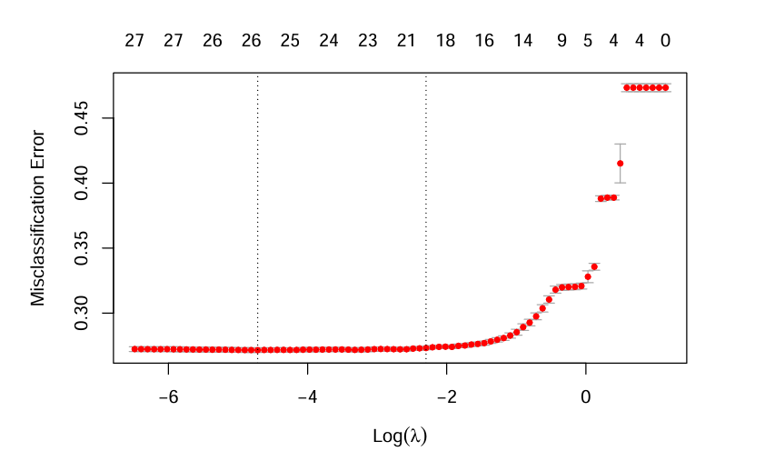
Logistic Regression with Shrinkage Methods
Shrinkage methods prevent overfitting by adding a penalty for large coefficients, thus reducing their variance and enhancing generalizability.
Ridge Regression: Adds a penalty to shrink all coefficients, useful for keeping all features in the model.
Lasso Regression: Introduces a penalty that can shrink some coefficients to zero, aiding in feature selection.
Elastic Net: Combines Ridge and Lasso penalties, allowing for feature selection and handling multicollinearity, leveraging the strengths of both methods.

Slide 21
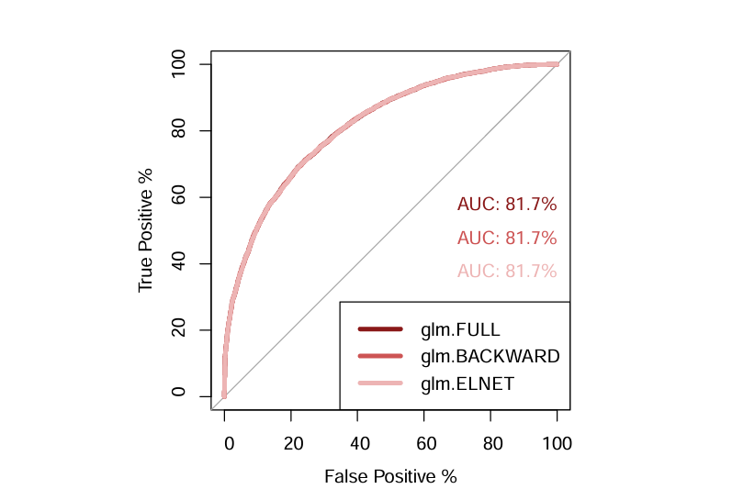
Comparison of Logistic Classifiers
The ROC curve is a tool for assessing the performance of binary classification models, plotting true positive rate against false positive rate at various thresholds.
The Area Under the Curve (AUC) provides a measure of the model’s ability to predict the target values, with higher values indicating better performance.

Slide 22
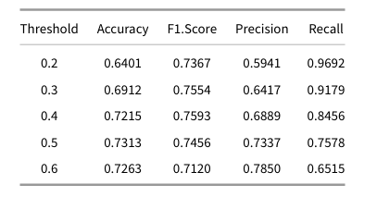
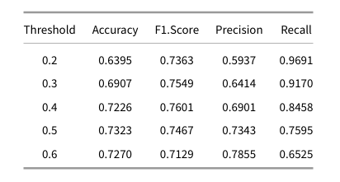
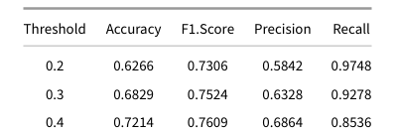
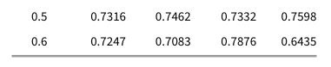
Logistic Model Performance Metrics at Different Thresholds
Basic Logistic Classifier
Feature Selection with Backward Stepwise Search
Elastic Net Shrinkage Method

Slide 23
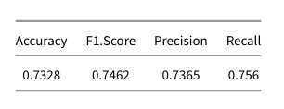
Linear Discriminant Analysis (LDA)
LDA is a classification algorithm that finds a linear combination of features that best separates two or more classes.
It assumes that the features follow a multivariate normal distribution with a common mean and variance for all classes.
LDA Results

Slide 24
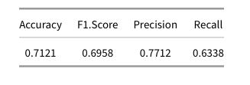
Quadratic Discriminant Analysis (QDA)
QDA is similar to LDA but allows for different mean and variance for each class. This results in quadratic decision boundaries.
QDA Results

Slide 25
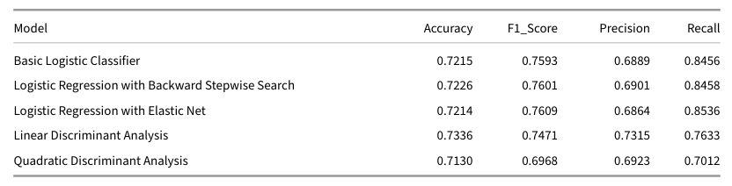
Conclusion
This study compares the performance of multiple predictive models for employee attrition classification, focusing on Logistic Regression , LDA, and QDA. Each model was evaluated using Accuracy, F1 Score, Precision, and Recall.
Three variations were examined: Basic Logistic Classifier, Logistic Regression with Backward Stepwise Search, and Logistic Regression with Elastic Net Regularization.
In conclusion, the Elastic Net regularization approach in logistic regression (gml.ELNET) emerged as the best performer due to its optimal balance of generalization, precision, and recall. This model is recommended for practical applications in predicting employee attrition and devising targeted retention strategies.

Slide 26

Thanks!
Do you have any questions?

