Slide 1

Employee Attrition
Classification
Aysenur Oya OZEN - 2107501
Zeynep TUTAR - 2106038

Slide 2
Introduction to Dataset
The objective of this project is to develop at least two predictive models to determine employee attrition. Additionally, it aims to identify and understand the key factors that contribute to employee turnover.
The dataset used for this project is a simulated dataset designed for the analysis and prediction of employee attrition.
It contains detailed information about various aspects of an employee's profile, including demographics, job-related features, and personal circumstances.
The dataset contains 74,498 samples and 23 features. Each record includes a unique Employee ID and features that influence employee attrition.

Slide 3
Description of the Features

Slide 4
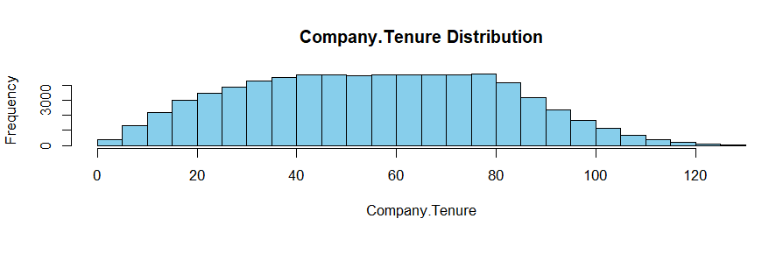
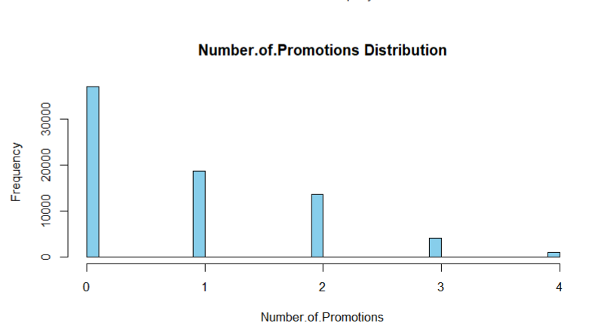
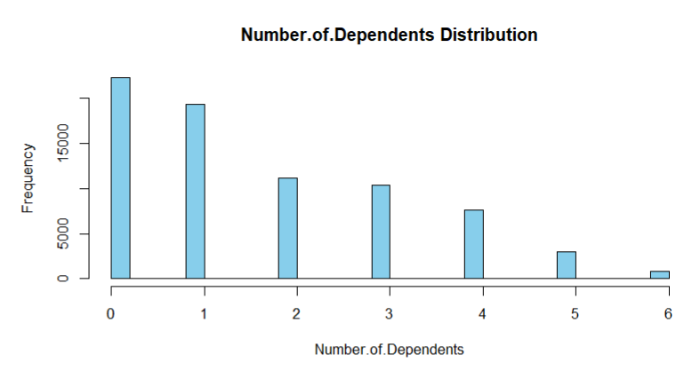
Exploratory Data Analysis (EDA) Step by Step
"The number of rows where Company.Tenure is >= 60 : 45.16%"
Removing Columns
Employee.ID and Company.Tenure dropped as they are not useful for predictive modeling. Company.Tenure column gives logically incorrect numerical values.
Changing Features Type
Some numeric columns are converted that represent categories (Number.of.Promotions, Number.of.Dependents) to factors to treat them appropriately in analyses and visualizations.
Numerical and Categorical Variables Separation
Numerical and categorical variables were separated for targeted analysis. Summary statistics were then used to provide a quick overview of the distribution of numerical features.

Slide 5
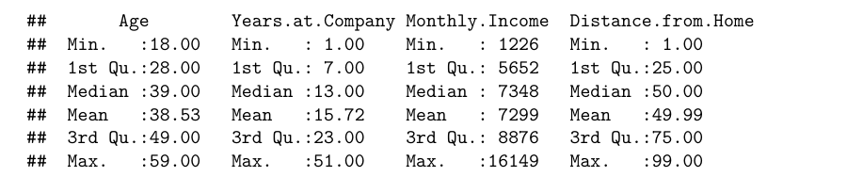
Summary Statistics for Numerical Variables

Slide 6
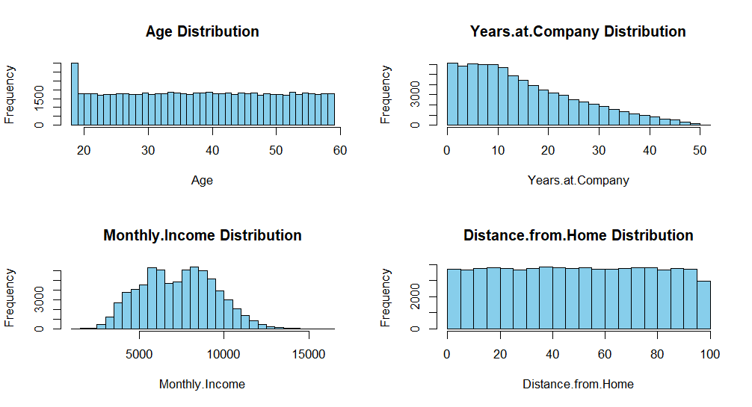
Numerical Variables Distribution

Slide 7
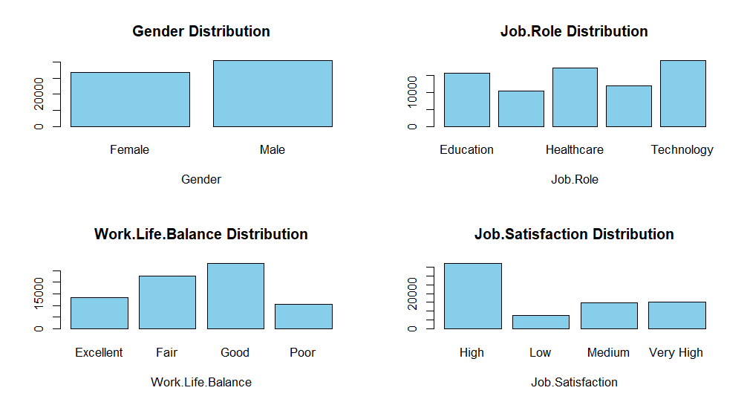
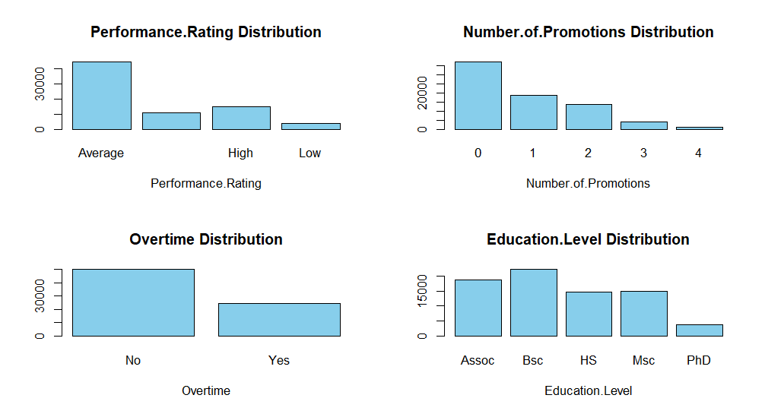
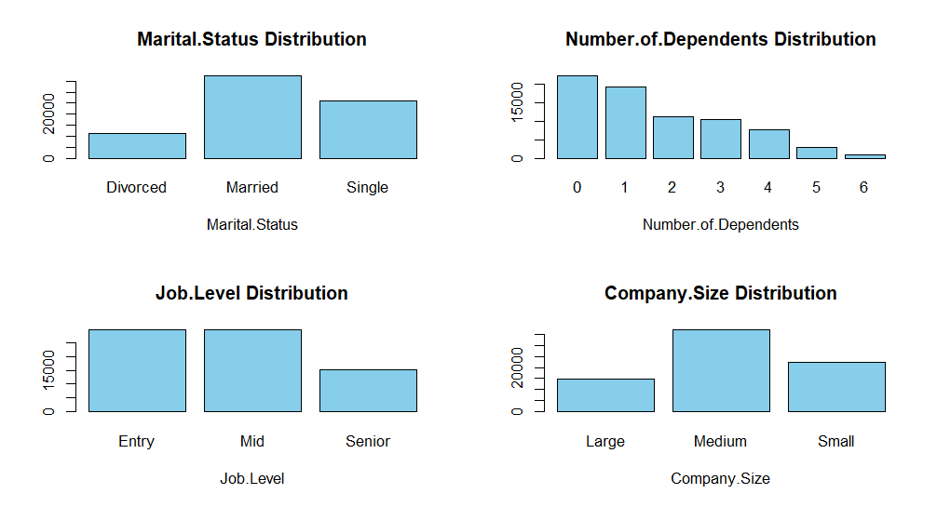
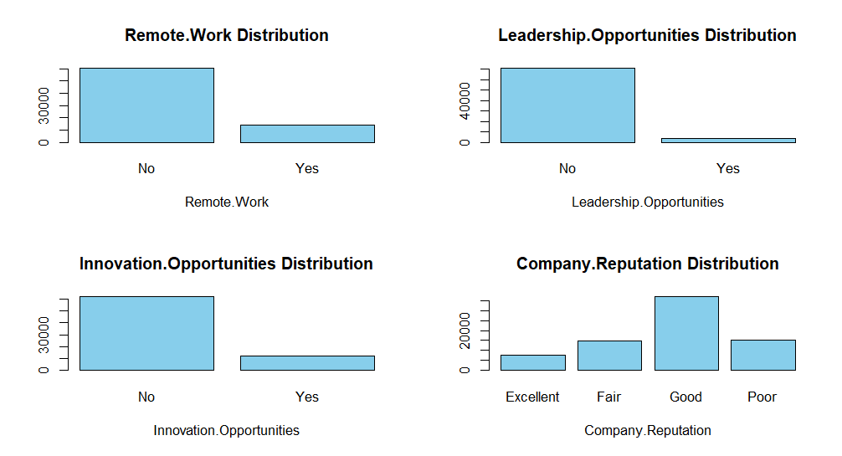
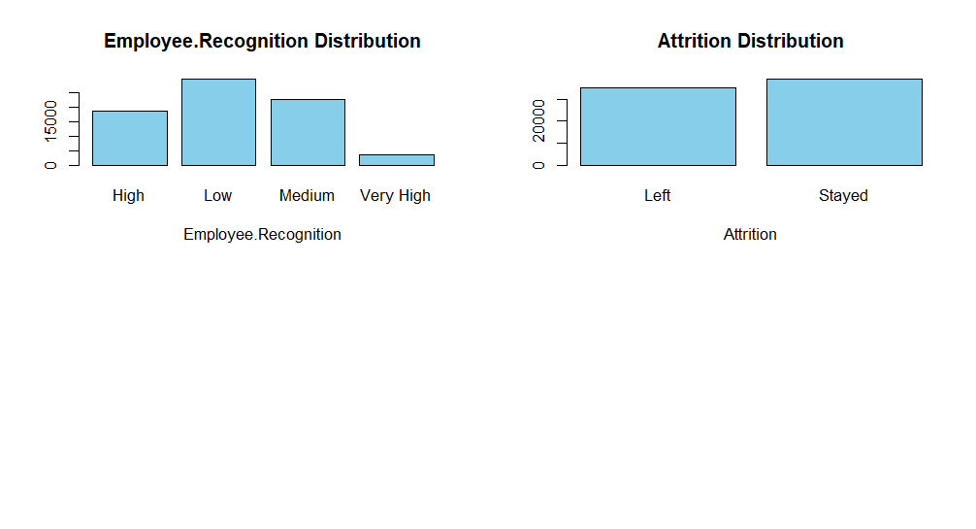
Categorical Variables Distribution

Slide 8
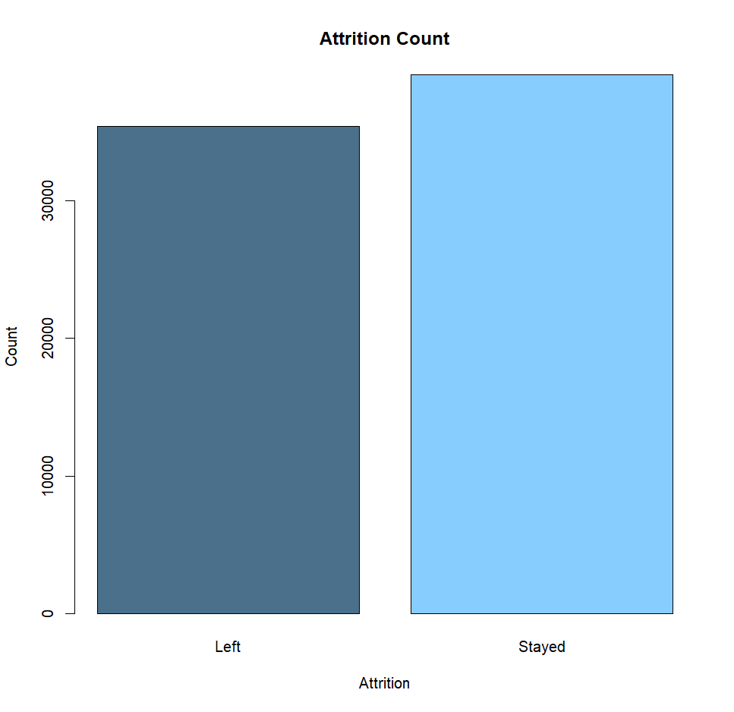
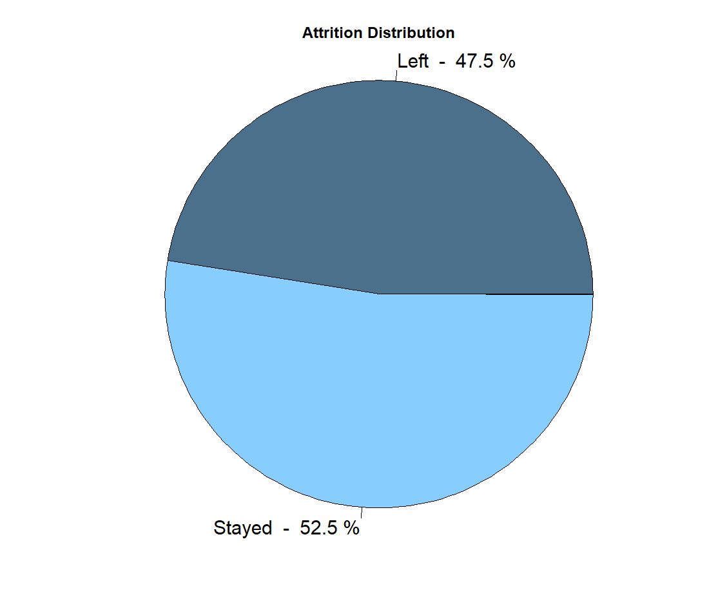
Target Value Distribution

Slide 9
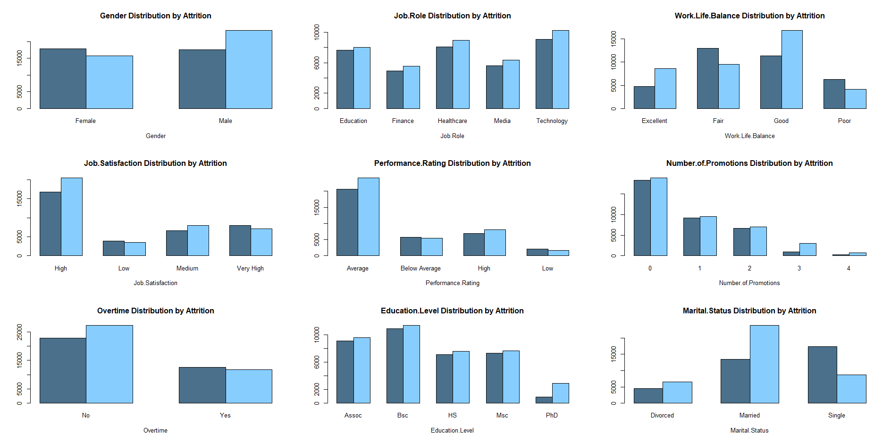
Transforming Numerical Variables into Categorical Variables
Employees with high job satisfaction with low employee recognition take place of 20% of the data. Among these 45% left the company
This methodology effectively transforms continuous numeric variables into categorical bins, facilitating better visualization and comparative analysis of attrition.

Slide 10
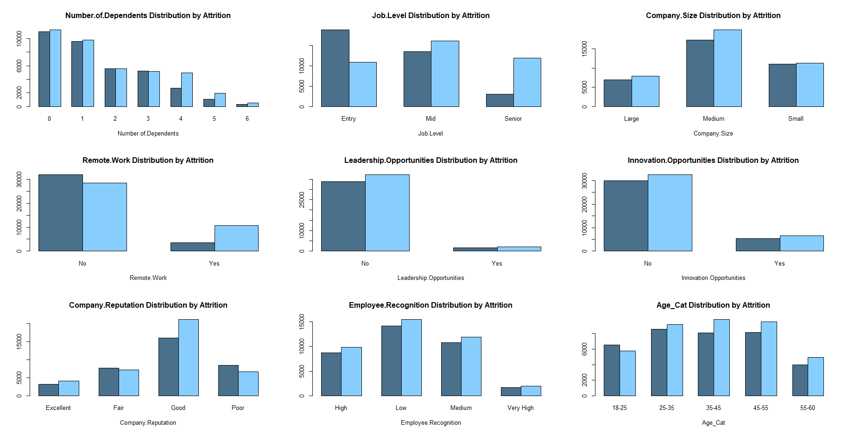
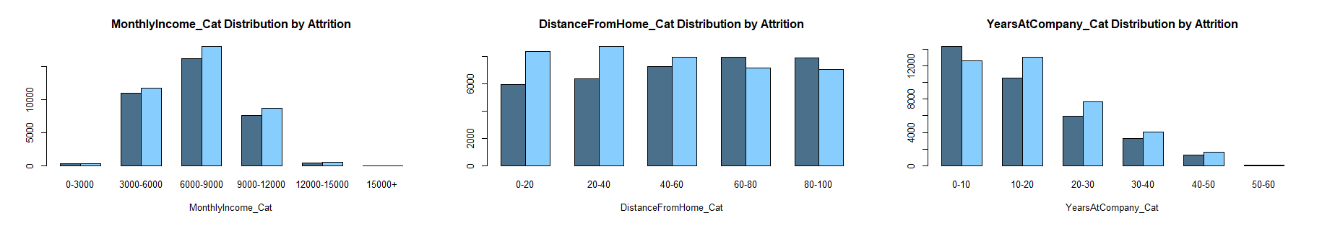
43% of employees who did not have a remote work option left the company.
Employees who did not have a remote work option and do overtime work take place 26% of the data.
Among these 57% left the company.
36% of employees with monthly income between 3000-9000 left the company.
45% of those who worked in a job without leadership opportunities left the company.
Employees at the entry level with low employee recognition take place of 16% of the data. Among these 64% left the company.

Slide 11
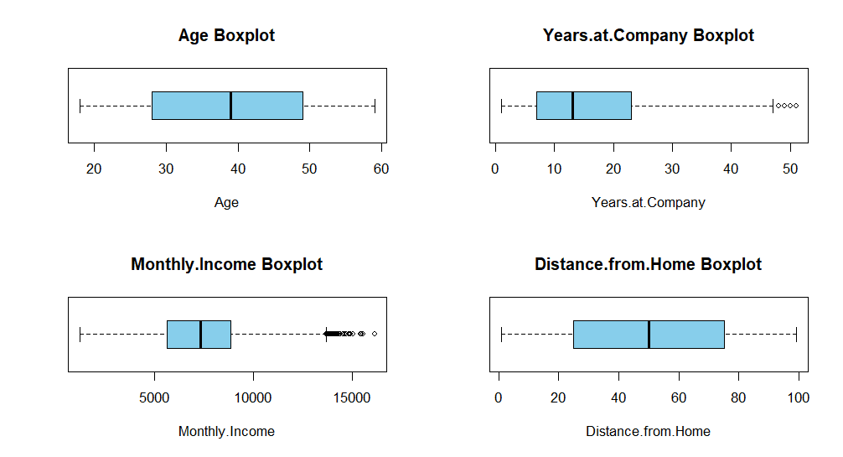
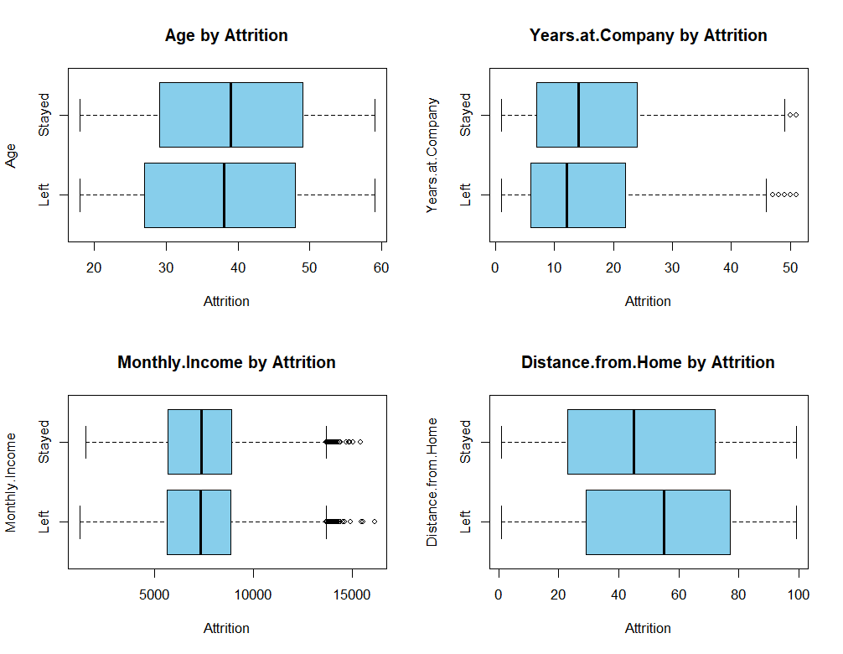




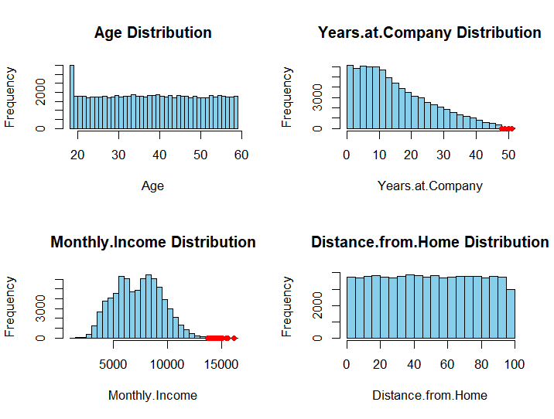

Outlier Analysis

Slide 12
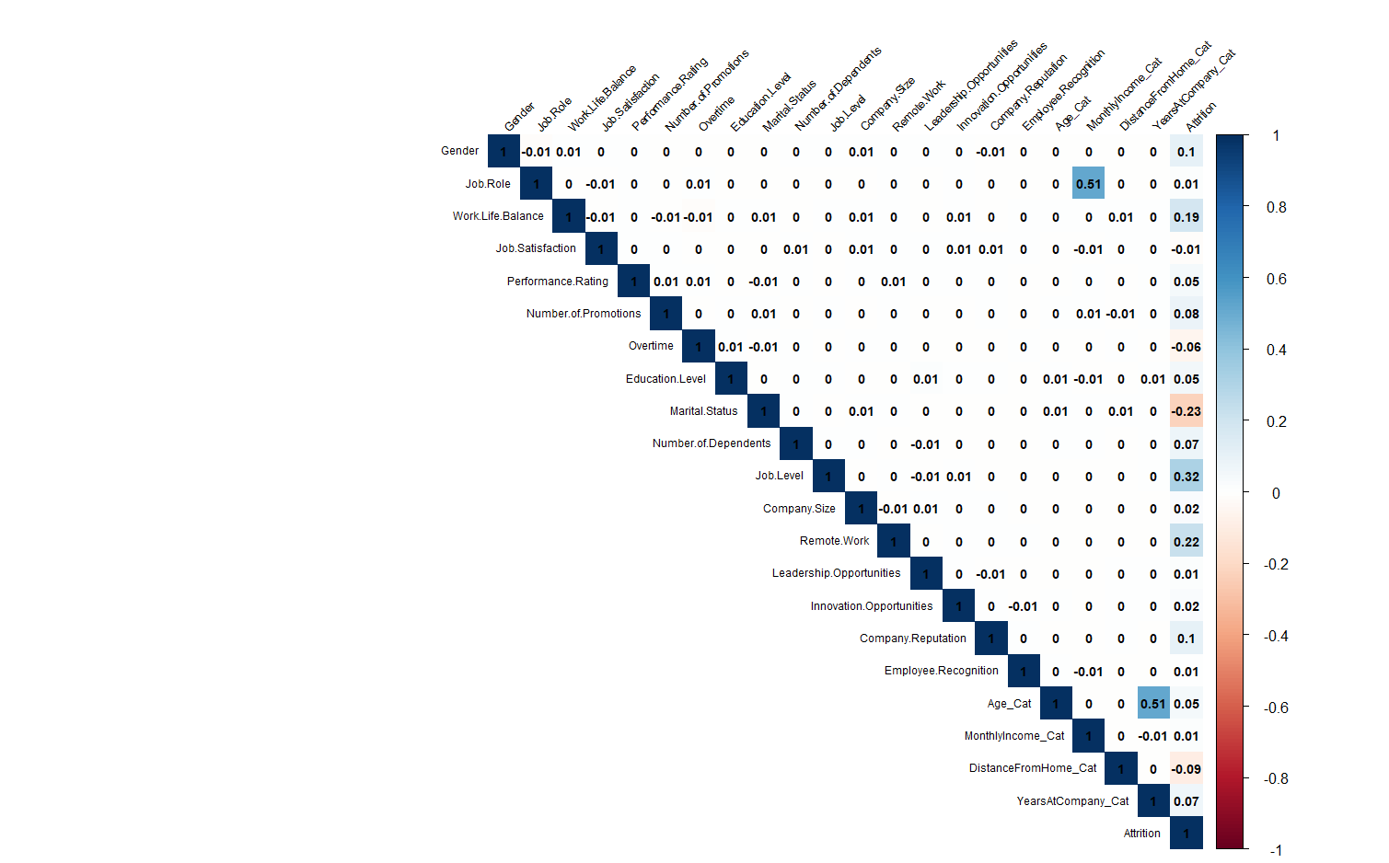
Correlation

Slide 13
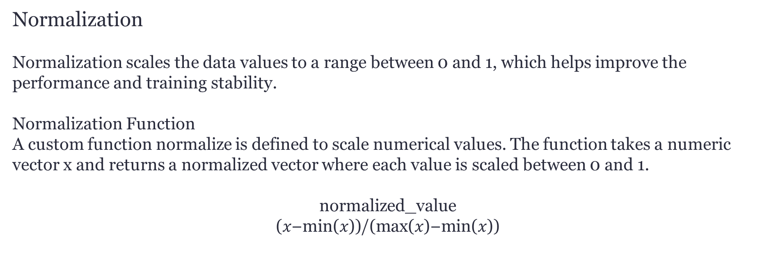
Data Preparation
Handling Categorical Features
In order to use the categorical features in the model,we need to convert categorical features to numeric (ordinal or nominal) representations.
Normalization
Normalization scales the data values to a range between 0 and 1, which helps improve the performance and training stability.
Normalization Function
A custom function normalize is defined to scale numerical values. The function takes a numeric vector x and returns a normalized vector where each value is scaled between 0 and 1.
$$\text{normalized}\text{_}\text{value}$$
$$\text{(}\text{x}\text{−}\text{min}\text{(}\text{x}\text{))}\text{/}\text{(}\text{max}\text{(}\text{x}\text{)−}\text{min}\text{(}\text{x}\text{))}$$
Train-Test Split
To evaluate the performance of the predictive models, the dataset is split into training and testing sets. 80% of the rows in data as train and the remaining 20% of the data is used for the testing set.
Notes:
Data Preparation:
In our project, we began the data preparation process by handling categorical features. To effectively use these features in our model, we converted them to numeric representations, both ordinal and nominal. For ordinal features, such as Work-Life Balance, Job Satisfaction, and Performance Rating, we assigned numeric values based on their levels. For nominal features, we created dummy variables to represent the categorical data.
Next, we performed normalization to scale our data values between 0 and 1. This step is crucial as it helps the features contribute equally to the model's learning process.
Following normalization, we split our dataset into training and test sets in order to evaluate the performance of our predictive models accurately.

Slide 14
Checking Dataset Dimensions and Balance
Before proceeding to the modeling step, it is essential to examine the dimensions and balance of the datasets. This helps ensure that the training and testing sets are appropriately sized and balanced for effective model training and evaluation.
Number of samples in training data: 59,598
Number of samples in testing data: 14,900
y.train
y.test
Notes:
Before moving further, we ensured that both training and test sets maintained a balance in the proportion of employees who stayed vs those who left, ensuring representative samples for both sets. So as we can see, the data sets maintained the balance.

Slide 15
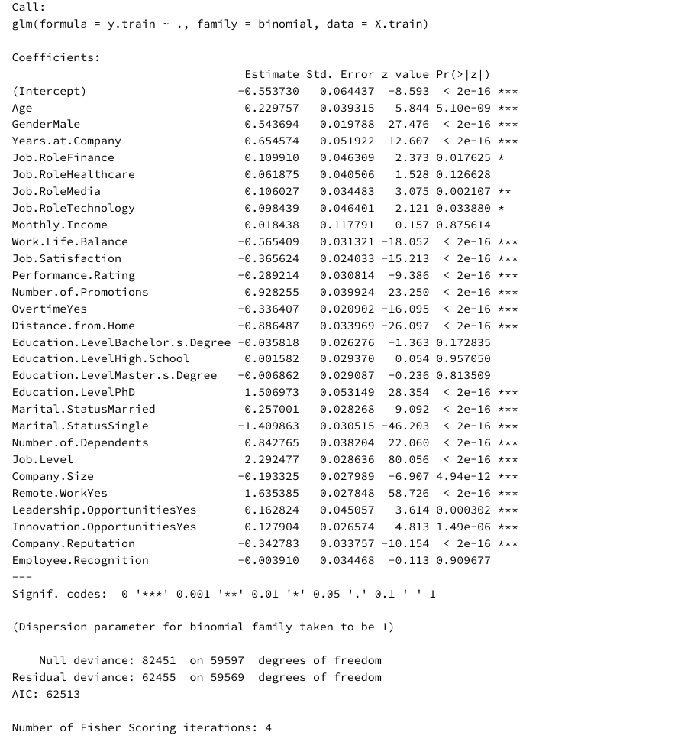
Predictive Classification Models
Logistic Regression
Logistic regression is a model that estimates the odds of the dependent variable occurring and applies the logit (log-odds) transformation to express this relationship.
Basic Logistic Classifier
Notes:
Predictive Classification Models:
We developed several predictive classification models, starting with logistic regression.
Our initial model, the Basic Logistic Classifier, included all features and provided insights into the significance of each feature. Despite identifying some features with high p-values, we retained all features initially to apply feature selection later.

Slide 16
Understanding Model Fit Using 𝑅2 Statistics
R2 provides an indication of how well the independent variables in the model explain the variability of the dependent variable.
A higher 𝑅2 value indicates a better fit of the model to the data.
With the full model the value of 𝑅2 24.25% indicates that approximately 24.25% of the variance in the target can be explained by the features in the model.
It suggests that the model is not capturing much of the underlying pattern in the data.
Notes:
To evaluate how well our model fits the data, we used the 𝑅2 statistic. This statistic provides an indication of how much of the variance in the dependent variable can be explained by the independent variables in the model. A higher 𝑅2 value suggests a better fit. In our case, the 𝑅2 value was approximately 24.25%

Slide 17
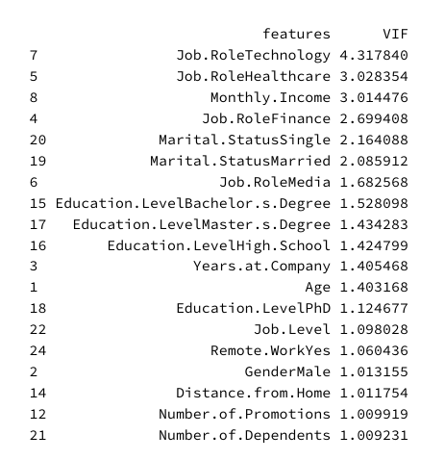
Evaluating Multicollinearity Using VIF Values
A VIF value of 1 indicates no correlation, values between 1 and 5 indicate moderate correlation, and values above 5 suggest significant multicollinearity, leading to unreliable coefficient estimates.
Notes:
We also evaluated multicollinearity among the features using Variance Inflation Factor (VIF) values. Multicollinearity occurs when features are highly correlated, which can lead to unreliable coefficient estimates.
Most of our features had VIF values close to 1. However, a few variables had VIF values between 1 and 5, suggesting moderate multicollinearity.
These variables included Job Role and Marital Status, which are mostly dummy features of nominal variables and dummy variables are often correlated because they represent categories of the same nominal variable.

Slide 18
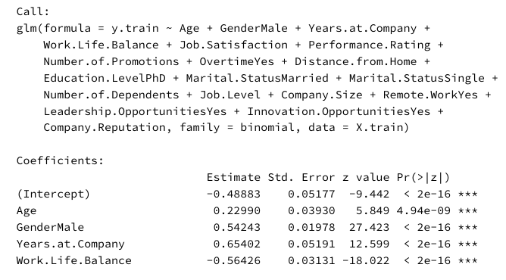
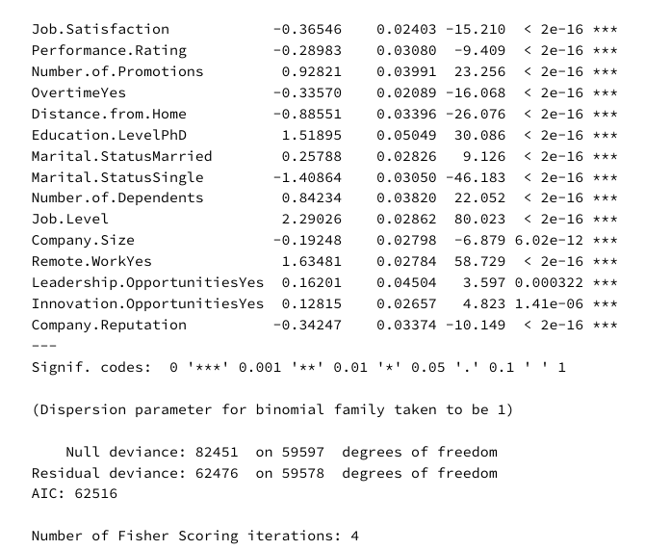
Logistic Regression with Backward Stepwise Search
Backward stepwise selection is a greedy algorithm that iteratively removes the least significant features to develop a predictive model. The goal is to find the best subset of features that improve model performance.
Notes:
To improve our model, we performed a backward stepwise search, iteratively removing the least significant features.
This process helped us identify the best subset of features that contribute to the model's performance.
We used the Bayesian Information Criterion (BIC) to guide our selection.
The model ended up removing the features with high p-values which are the dummy variables created for Job roles, all dummy variables created for education levels except Phd, employee recognition and interestingly Monthly income.

Slide 19
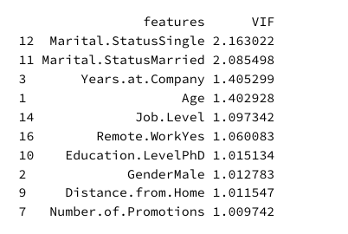
Backward Stepwise Search Results
This method decreased VIF scores, p-values, and the AIC score. Although 𝑅2 slightly decreased to 24.23%, this is expected with fewer features. Most importantly, reducing the variance inflation factor makes the model more stable.
Notes:
With backward feature selection we were able to decrease the VIF scores, p‑values and AIC score. Although 𝑅2 slightly decreased to 24.23%, this is expectable since the number of features in the model decreased. But most importantly we decreased the VIF score so the model is more stable.

Slide 20
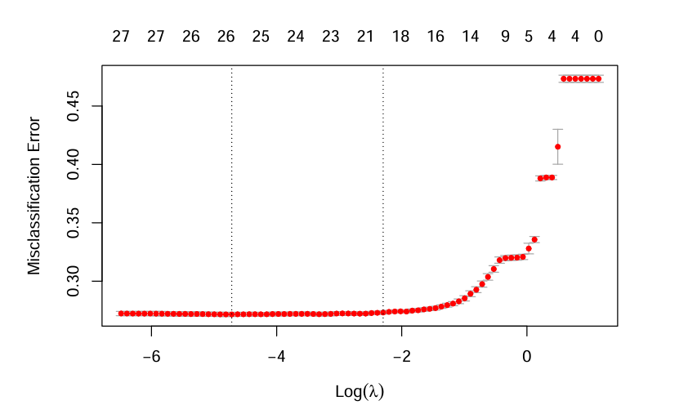
Logistic Regression with Shrinkage Methods
Shrinkage methods prevent overfitting by adding a penalty for large coefficients, thus reducing their variance and enhancing generalizability.
Ridge Regression: Adds a penalty to shrink all coefficients, useful for keeping all features in the model.
Lasso Regression: Introduces a penalty that can shrink some coefficients to zero, aiding in feature selection.
Elastic Net: Combines Ridge and Lasso penalties, allowing for feature selection and handling multicollinearity, leveraging the strengths of both methods.
Notes:
Additionally, we explored logistic regression with shrinkage methods such as Ridge and Lasso regression, which are used to control model complexity and reduce overfitting. Instead of selecting a subset of predictors or setting some coefficients to zero, these methods regularize the feature coefficients to improve model generalizability. In our case we made use of the hybrid method called Elastic Net which combines Lasso and Ridge leveraging the strengths of both methods.
Employee.Recognition and Education.LevelHigh.School dropped.

Slide 21
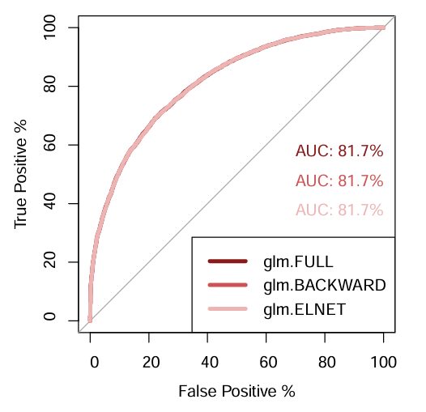
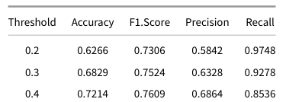
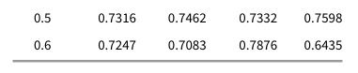
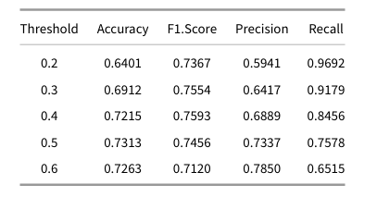
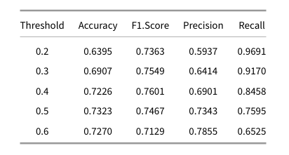
Comparison of Logistic Classifiers
Elastic Net Shrinkage Method
Basic Logistic Classifier
Feature Selection with Backward Stepwise Search
Notes:
Although the AUC values were same, to better analyze the differences between the model performances we compared the evaluation metrics.
All of the models have the highest F1 score at threshold level 0.4.
And among the models, Elastic Net Regularization emerged as the best performer on the test set in means of F1.Score and Recall.
For employee attrition, If retaining employees is a high priority and the cost of missing a potential leaver is significant, focusing on recall or the F1 score would be the best approach.

Slide 22
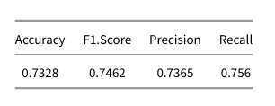
Linear Discriminant Analysis (LDA)
LDA is a classification algorithm that finds a linear combination of features that best separates two or more classes.
It assumes that the features follow a multivariate normal distribution with a common mean and variance for all classes.
LDA Results
Notes:
We also implemented LDA and QDA to classify employee attrition. LDA assumes common mean and variance for all classes and tries to find linear combinations of features that best separate the classes.

Slide 23
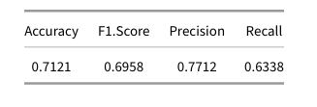
Quadratic Discriminant Analysis (QDA)
QDA is similar to LDA but allows for different mean and variance for each class. This results in quadratic decision boundaries.
QDA Results
Notes:
QDA is similar to LDA, but QDA allows for different means and variances for each class, resulting in quadratic decision boundaries.
QDA had an Accuracy of 0.71 and an F1 Score of 0.69. Its higher complexity likely led to overfitting, resulting in lower performance compared to LDA and LR models.

Slide 24
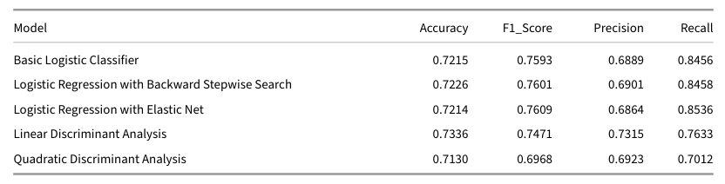
Conclusion
This study compares the performance of multiple predictive models for employee attrition classification, focusing on Logistic Regression , LDA, and QDA.
Notes:
For employee attrition, If retaining employees is a high priority and the cost of missing a potential leaver is significant, focusing on recall or the F1 score would be the best approach.
Recall: It's crucial to identify as many employees who are likely to leave as possible. Missing out on an employee who is at risk of leaving (false negative) could mean losing valuable talent without taking any preventive measures.
F1 Score: Since F1 score balances both precision and recall, it is useful when you want a balance between catching as many leavers as possible and ensuring the predictions are accurate. This helps in making sure that the efforts to retain employees are both efficient and effective.
If retaining employees is a high priority and the cost of missing a potential leaver is significant, focusing on recall or the F1 score would be the best approach.

Slide 25

Thanks!
Do you have any questions?

