Slide 1
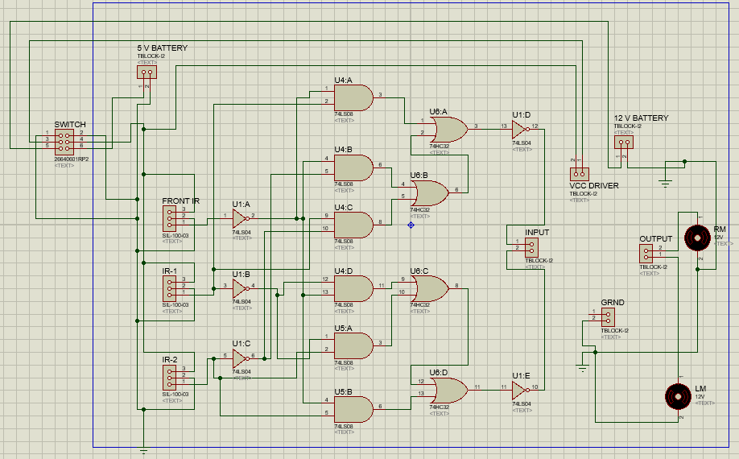
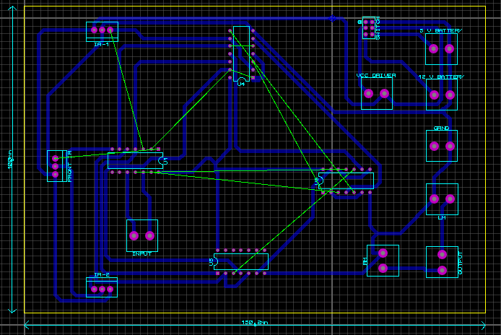


Obstacle Avoidance Robot (using logic circuit)
Zain Ul Abidin ->2100077 , Muhammad Turab -> 21100293
Department of Electrical Engineering, School of Science and Engineering, LUMS, Lahore, Pakistan
Introduction
Block Diagram
Since most navigation robot require some sort of obstacle avoidance we decided to opt this approach for our project since this strategy is imperative in robot functionality
In lieu of micro controller we used logic circuit hence reducing cost and power supply of the robot
Left DC Motor
Input from IR sensors
(obstacle Detector)
Digital Logic Circuit
L293D
Motor Driver Circuit
Applications
Right DC Motor
With some further alteration and advancement this robot can be use as household service robot with application such as vacuum and mop robot.
For scientific exploration and emergency rescue since it can access place where human cannot go directly
As an industrial robot since they are required to avoid human workers and equipment
Results and Outcomes
Proposed Approach
.In order for the Digital logic circuit output( which in turn drivers the motors ) to correspond to the binary logic of IR sensors we use K-maps to devise how many basic gates AND, OR and NOT while be used and in what orientation.
Movement of robot in left, right or forward direction is dependent on the output of logic circuit. IR sensor gives logic 1 when obstacle detected
Output from IC’s manipulate the motor driver which driver the motor corroborating to IR sensor detection of obstacle
Conclusions
Future Work
In peroration, obstacle avoidance is widely researched and applied in the world, and it is probable that most robots in the future should have obstacle avoidance function.
We discerned the working principle of IR sensors and motor driver.
We apprehended the shortcoming that resulted as a consequence of not using micro controller ( Arduino ).
How applicability of obstacle avoidance is integrated in other industrial robots.
Instead of IR sensor we can use ultrasonic sensor as IR sensor have a short range while ultrasonic sensor can detect obstacle up to 6m. Furthermore, IR sensor are rendered useless in dark while ultrasonic sensor are operational. Our robot come to halt at detecting obstacle at only front side as it could not decide in which direction (left or right) to move as this decision making will require some intelligence so this domain can be further improved.
Use LDR so that can Robot can be used as path ;locator in dark places.
EE 220L – DIGITAL LOGIC CIRCUITS LAB

