Slide 1
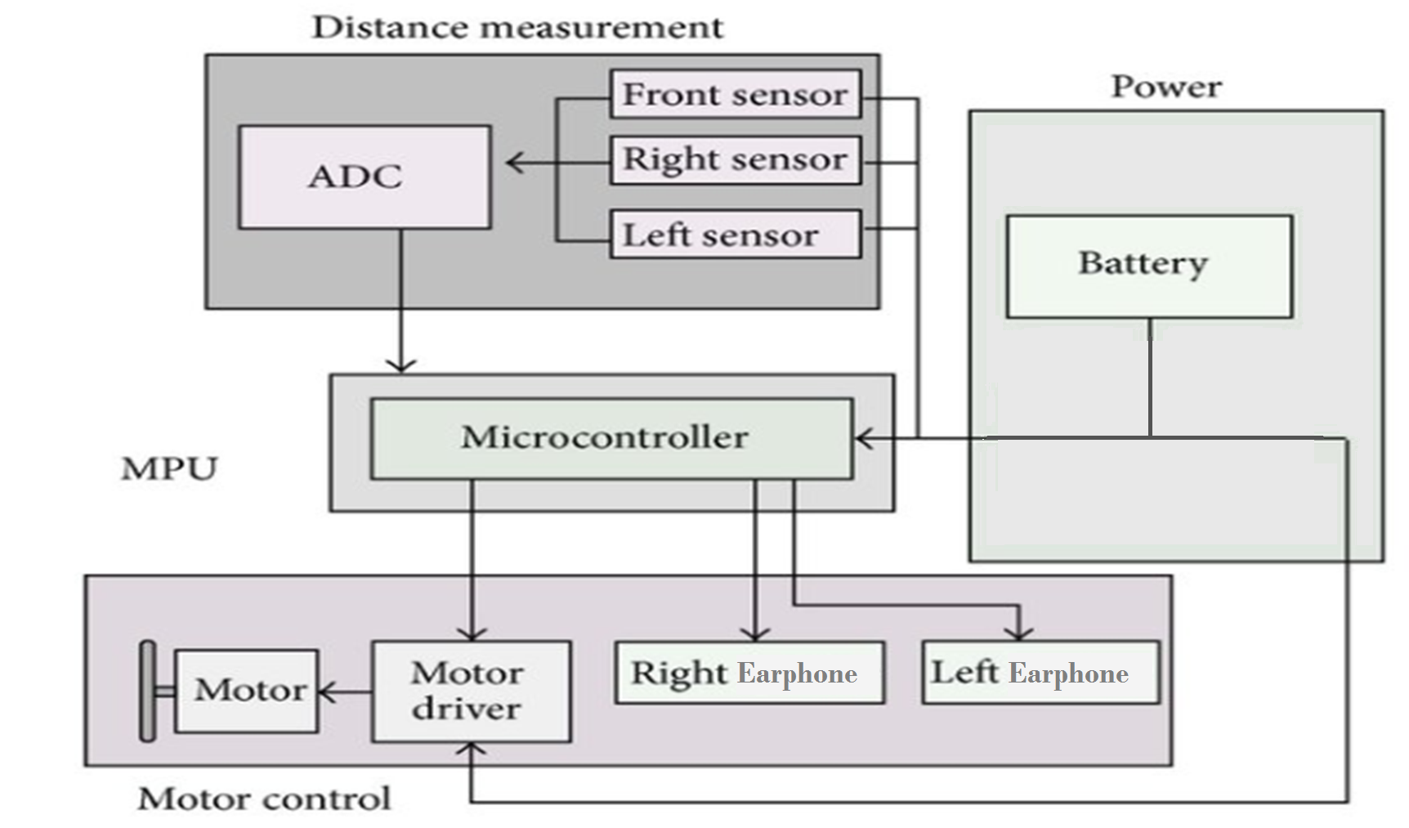
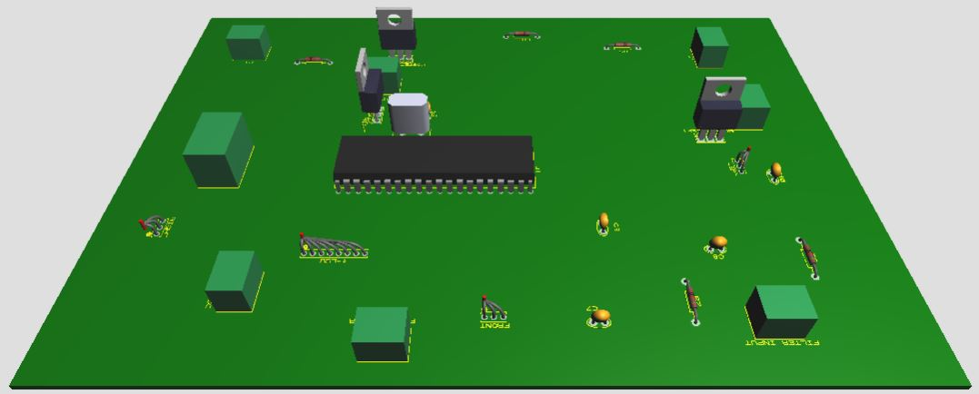
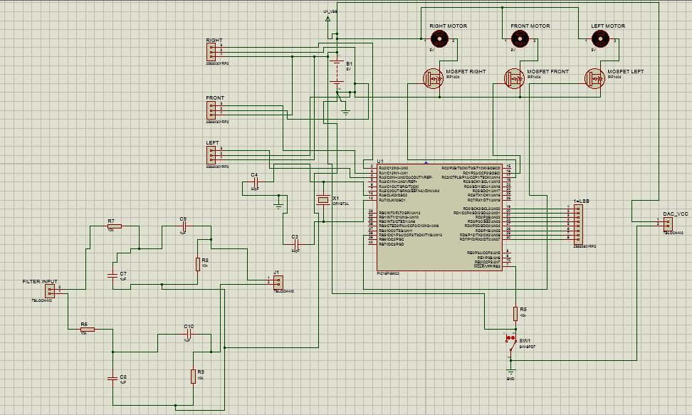
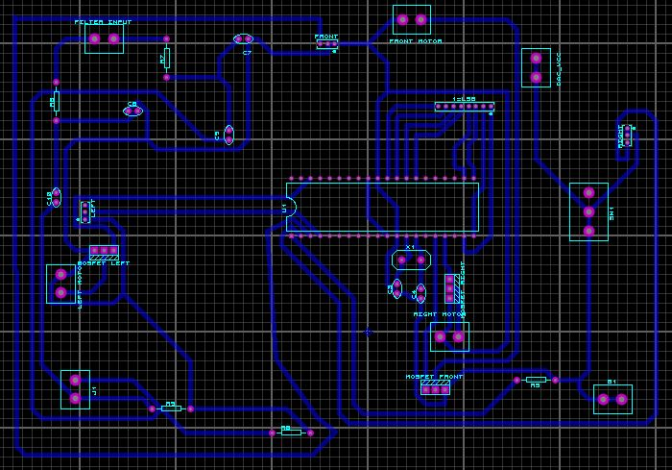


Sonar Cap
Zain Ul Abidin 21100077
Ghulam Mustafa Bashir 21100182
Department of Electrical Engineering, School of Science and Engineering, LUMS, Lahore, Pakistan
Introduction
Block Diagram
The IR Cap works on the principal of using sensors to detect obstacles and communicates this information to the wearer. We aim to give a chance to the disabled to become a valuable part of the community.
Applications
The Cap works as virtual eyes for the user making daily activities less of a burden and ensuring their safety. Furthermore the user friendly interface and simple functionality makes it more reliable.
Results and Outcomes
Proposed Approach
Three IR long range sensors pointing forward, left and right would give an analog value to the PIC microcontroller with which we would be able to calculate the distance. The microcontroller would produce a square wave. Depending on the data received from the sensors the microcontroller would vary the PWM (duty cycle of the output wave). The duty cycle would increase as obstacles gets closer and this PWM signal would be fed to the mosfet. Mosfet would then control the two vibration motors, one placed on the left, front and right side of the cap. The vibration of the right motor indicates that obstacle is present on the right and vice versa. The intensity of the vibration would indicate how close the obstacle is. Furthermore the nearest obstacle’s direction is outputted in audio form through a DAC using earphones.
Conclusions
Future Work
The IR long range sensors need to be calibrated from time to time, their readings keep varying.
Microcontroller's ROM capacity is low so it hinders the output of more audio commands.
More compact and advanced vibration motors could make the project better.
Design a smart stick that works together with the cap.
Use Google Maps and Artificial Intelligence to help user move from their current location to another location.
Use better and highly calibrated sensors to make the cap more accurate in its results.
EE324L Microcontrollers and interfacing Lab

