Slide 1
CSE 438 PRESENTATION HANDS-ON ASSIGNMENT

Slide 2
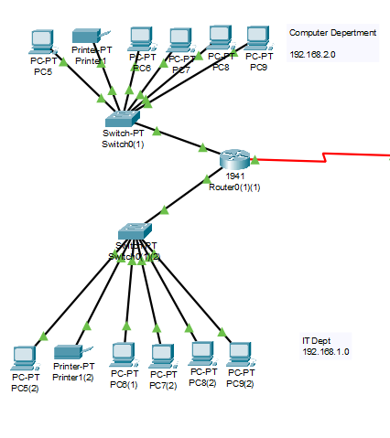
COMPUTER DEPARTMENT AND ROUTER CONFIGURATION
Computer Department Configuration
Statically Configured
No settings for Switches
Router configuration
Modules
Configuration of ports

Slide 3
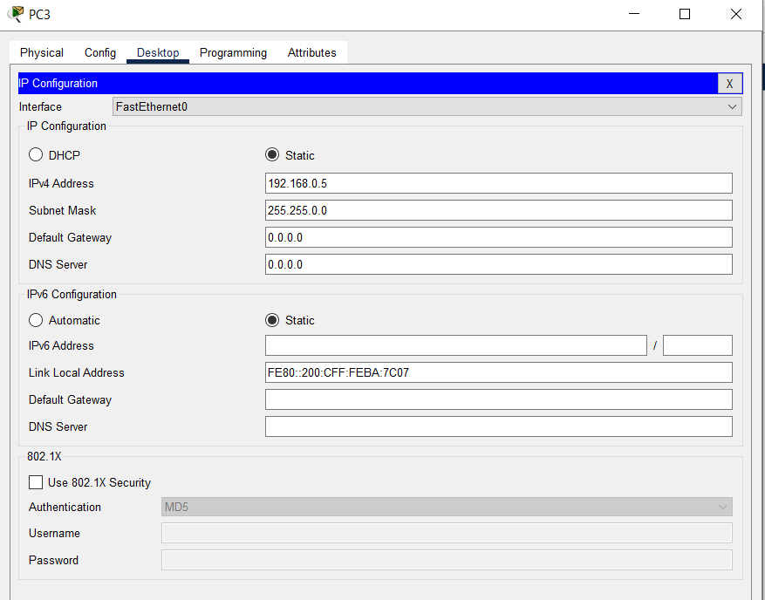
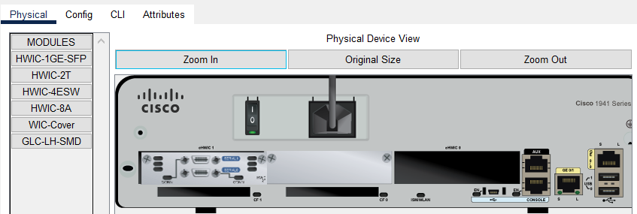
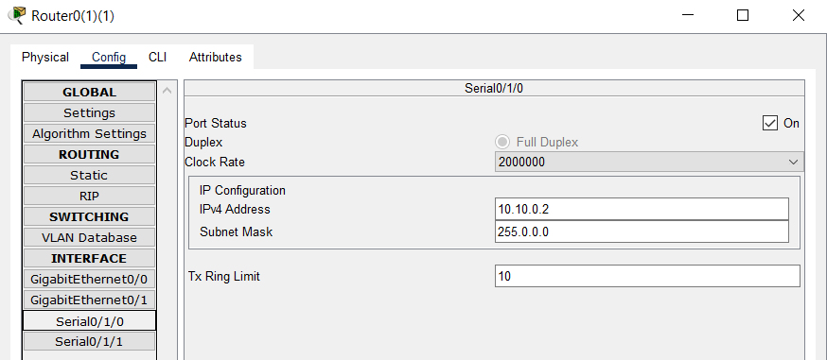
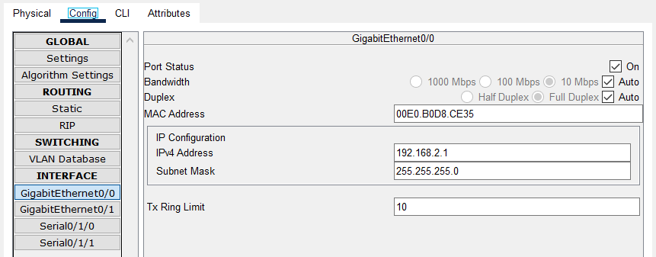

Slide 4
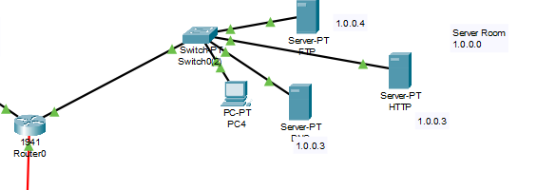
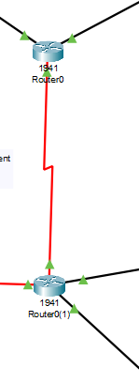
SERVER NETWORK AND ROUTER CONFIGURATION
Server Network Configuration
FTP server
WEB Server
DNS Server
Router configuration
Modules
Configuration of ports

Slide 5
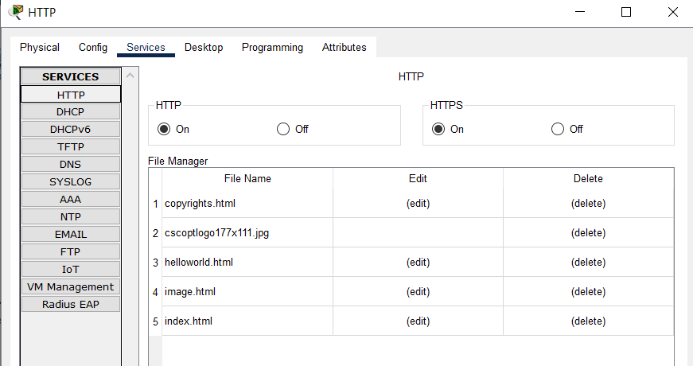
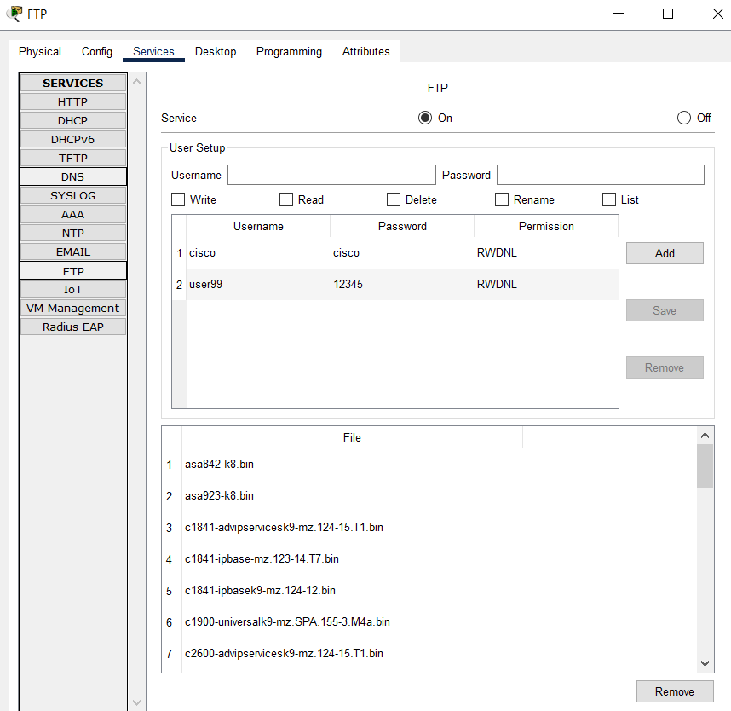
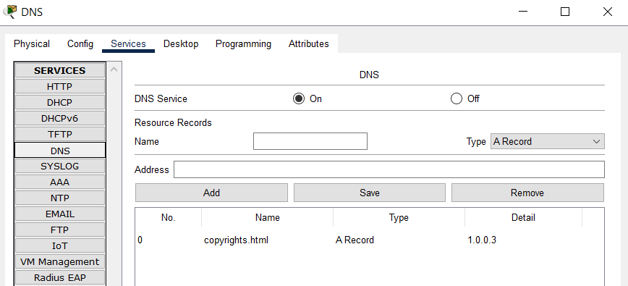

Slide 6
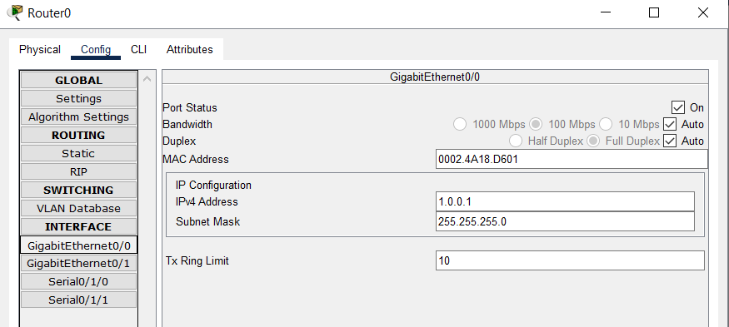
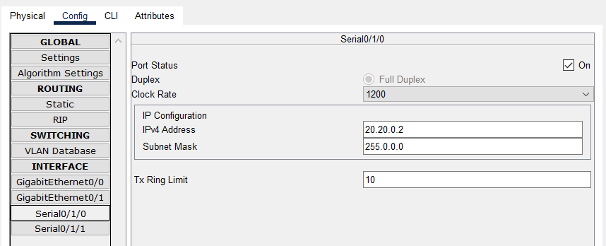

Slide 7
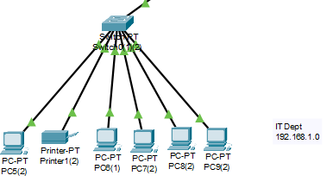
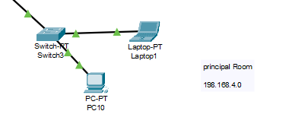
IT DEPARTMENT AND PRINCIPLE ROOM CONFIGURATION
IT Department Network Configuration
Principle room Network Configuration
Statically Configured.

Slide 8
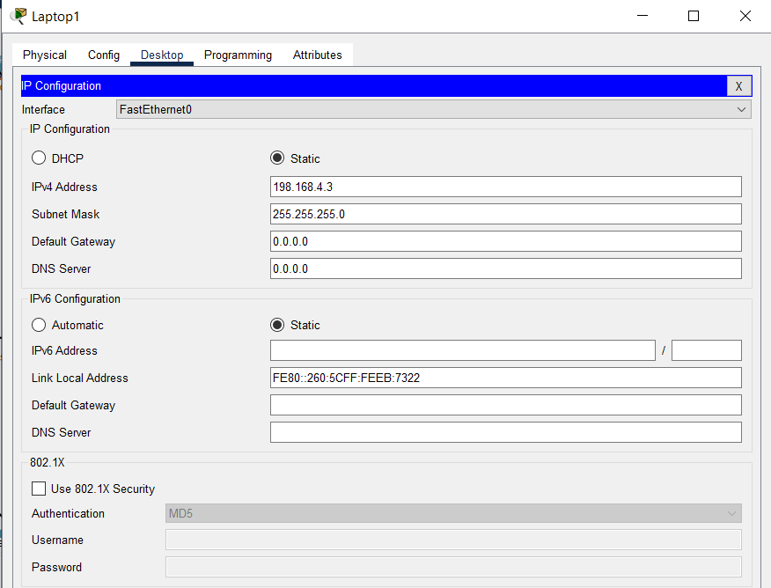
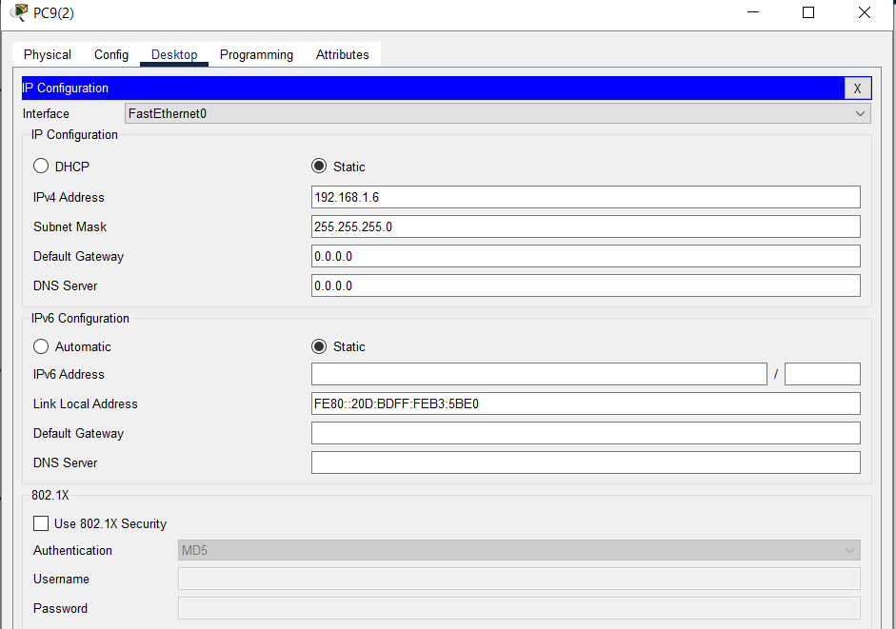

Slide 9
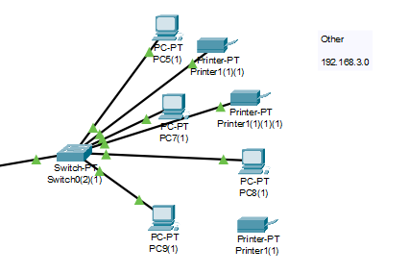
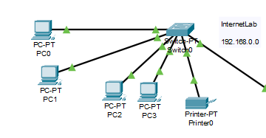
OTHER AND INTERNET LAB CONFIGURATION
Other Network Configuration
Internet Lab Network Configuration
Statically Configured.

Slide 10
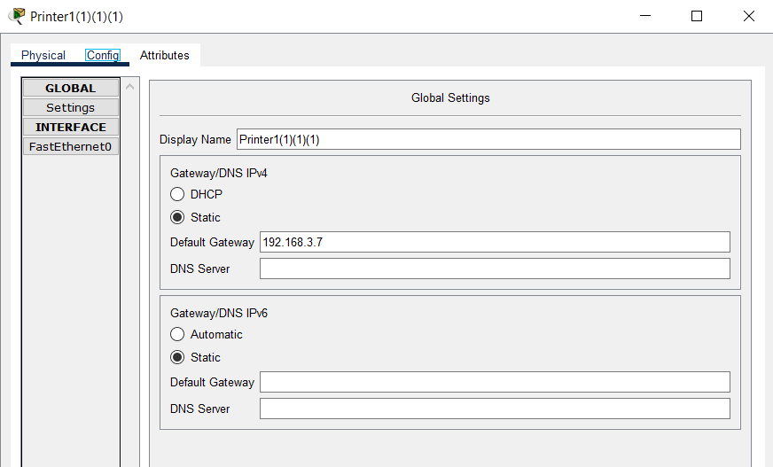
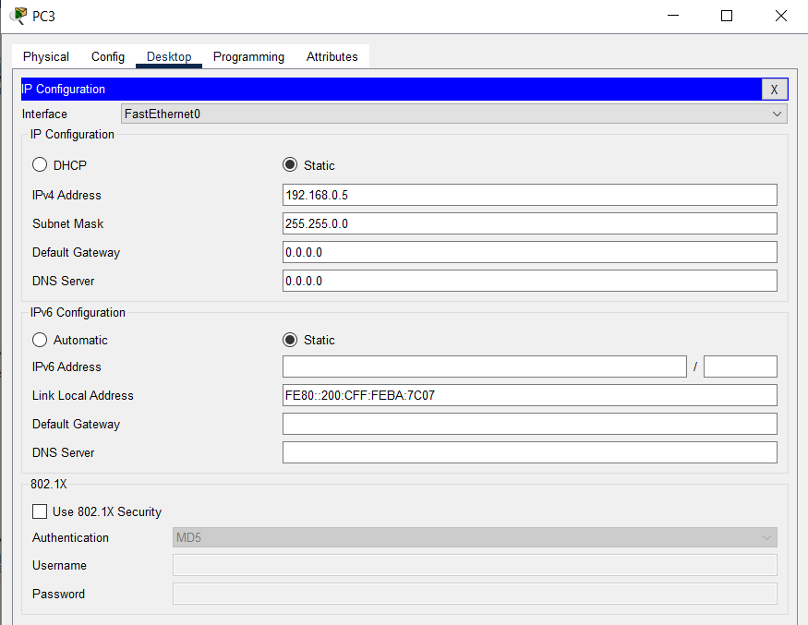

Slide 11
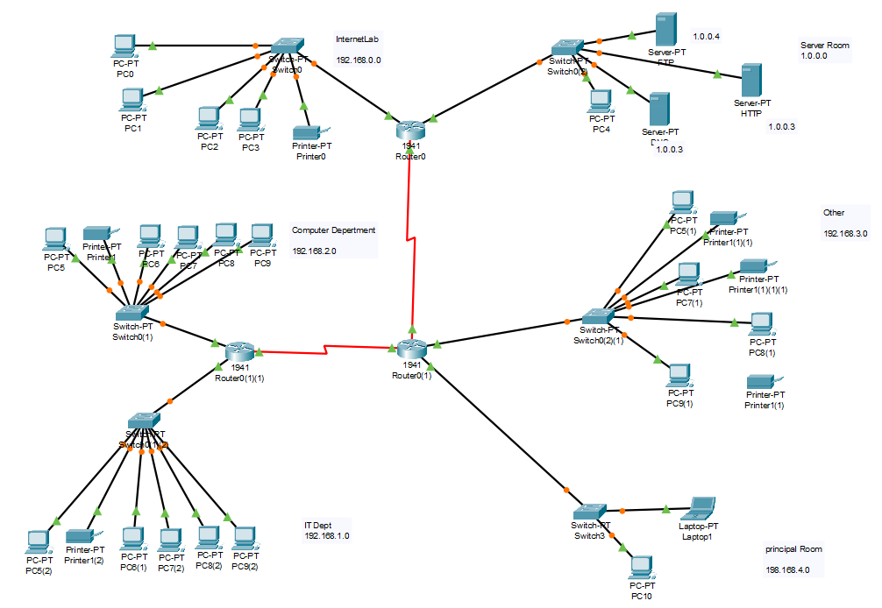
FINAL IMPLEMENTED NETWORK

Slide 12


