Slide 1
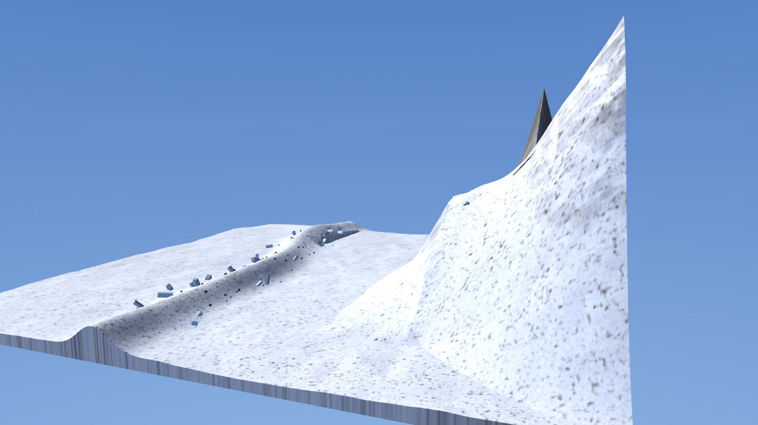
CRAMPON
Keeping a Unitree G1 on its feet on ice, in wind and in cold.
A humanoid that falls at 8000 m and cannot recover is not a broken robot. It is a body someone has to climb up and retrieve.
Every metre of extra footing is a rescue not mounted.
Himalaya Robotics Hack, 29 to 30 Aug 2026 · Track 1: Movement · Unitree G1, 29 actuated DoF, 33.3 kg
github.com/zubair480/crampon
Notes:
Crampon. An RL locomotion policy for a Unitree G1 on high altitude ice, wind and cold. A fall at 8000 m is a rescue, not a repair.

Slide 2
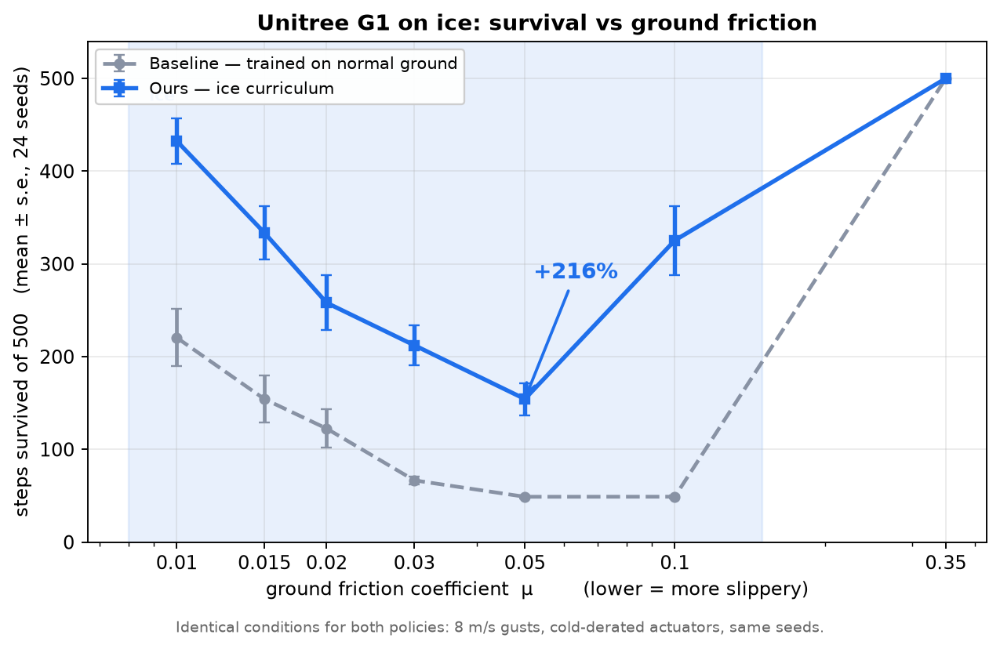
HEADLINE RESULT, LIKE FOR LIKE
2x to 6.6x longer on ice, at every icy friction level
2x to 6.6x
longer survival on ice against a baseline trained on normal ground
19 to 24 / 24
seeds where the ice policy is ahead, at every icy friction level
No regression
on normal ground. At μ = 0.35 both policies saturate at 500 steps
Metric: steps survived of 500 before the torso tips past horizontal. · 24 seeds per friction level.
2
Notes:
Two policies, identical evaluation. Ours trained with an ice curriculum, the baseline on normal ground. Two to six point six times the survival on ice, and nothing lost on dry ground.

Slide 3
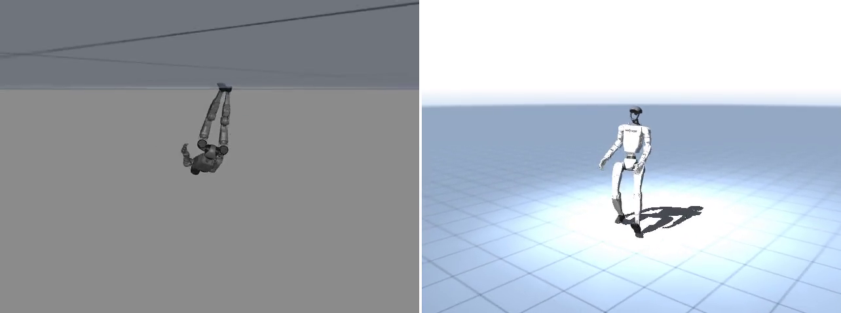
HEADLINE RESULT, SIDE BY SIDE
The same ice, the same gusts, the same seed
Left: baseline. Right: ours. Same ice (μ = 0.05), same gusts, same seed. Baseline falls at step 50, ours at 129, both at their measured medians across 24 seeds, so this is a typical run, not a chosen one.
Crampon · Himalaya Robotics Hack 2026 · github.com/zubair480/crampon
3
Notes:
Same ice, same gusts, same seed. The baseline falls at step fifty. Ours keeps going to one hundred and twenty nine. Both are the measured medians across twenty four seeds, so this is a typical run and not a chosen one.

Slide 4
THE NUMBERS
Steps survived of 500, by ground friction
μ | Baseline | Ours | Delta | Seeds ahead
0.010 | 220.5 | 432.5 | +96% | 21 / 24
0.015 | 154.2 | 333.5 | +116% | 21 / 24
0.020 | 122.5 | 258.0 | +111% | 19 / 24
0.030 | 66.6 | 212.2 | +219% | 23 / 24
0.050 | 48.9 | 154.3 | +216% | 22 / 24
0.100 | 49.0 | 325.3 | +564% | 24 / 24
0.350 | 500.0 | 500.0 | both saturate | –
μ = 0.35 is a dry gym floor
Both policies run the full 500 steps. Training on ice costs nothing on normal ground.
Ahead on 19 to 24 of 24 seeds
At every icy friction level, with the same wind, the same cold derating and the same seeds for both policies.
Stock Playground never sees this
MuJoCo Playground samples floor friction from U(0.4, 1.0). The mountain sits entirely below that band.
Crampon · Himalaya Robotics Hack 2026 · github.com/zubair480/crampon
4
Notes:
The full sweep. Mean steps survived over 24 seeds at each friction level, and the count of seeds where our policy is ahead.

Slide 5
EXTREME CONDITION MODELLING
We replaced the gym floor with the mountain
Ice and packed snow
Cold, thickened grease
Contact pair friction over U(0.02, 0.35), against the stock U(0.4, 1.0) of a dry gym floor.
Joint dry friction × U(1.5, 3.0). Joint damping × U(1.2, 2.0).
Cold, battery sag
Wind as a sustained force
Servo gain kp × U(0.7, 0.9), so the actuators answer more weakly than nominal.
A held force on the torso from the drag equation F = 0.5 ρ Cd A v², with gusts drawn from an Ornstein Uhlenbeck process so they stay correlated over about 2 s.
348 N of wind against a 327 N robot
ρ = 0.45 kg/m³, the air density at about 8000 m, near a third of sea level. At 200 km/h the drag force is a sideways shove slightly harder than gravity, and it is sustained rather than the instantaneous impulse that push_config applies. Surviving a kick is a different skill from leaning into a headwind.
Crampon · Himalaya Robotics Hack 2026 · github.com/zubair480/crampon
5
Notes:
Four axes of randomization, all of them the mountain rather than the lab: ice friction, cold stiffened joints, sagging servo gain, and wind as a sustained drag force rather than a push.

Slide 6
THE FINDING
Naive domain randomization fails. A curriculum works.
What diverges
1
Learn to walk on normal ground
Training from scratch on the full ice band does not converge. An exploring policy on near frictionless ground reaches enormous velocities, which produce enormous observations, and the network goes NaN.
A stable policy first, before any ice is introduced.
2
Warm start onto ice
Our first attempt returned reward = nan at every evaluation across 85M steps.
The friction band annealed downward from there, observations clipped.
Throwing the whole mountain at an untrained policy produces a NaN, not a mountaineer.
3
Hold the full wind back
200 km/h stays an evaluation condition, never a training one.
Crampon · Himalaya Robotics Hack 2026 · github.com/zubair480/crampon
6
Notes:
This is the intellectual contribution. Wide randomization on its own diverges. Learn on normal ground, warm start onto annealed ice with clipped observations, and keep full wind for evaluation only.

Slide 7
ENGINEERING FINDING
Walking and getting up want incompatible collision models
A MuJoCo model cannot change its collision set in the middle of an episode, so the two skills fight over one scene.
Flat scene
Everest terrain
0.81 m
every collision geom active
2.09 m
with knee contact
shin and torso capsules catch on the terrain, the robot stays crouched
falls at step 249
7.30 m
feet only contact
18.40 m
no knee contact
walks upright
hikes the moraine
Resolved with collision bitmasks. The robot capsules meet the terrain but never each other, so one scene serves the walking policy without the self collisions that pin it to a crouch.
Crampon · Himalaya Robotics Hack 2026 · github.com/zubair480/crampon
7
Notes:
Measured both ways. Restrictive contact pins the robot in a crouch, feet only contact walks. The fix is collision bitmasks rather than a compromise scene.

Slide 8
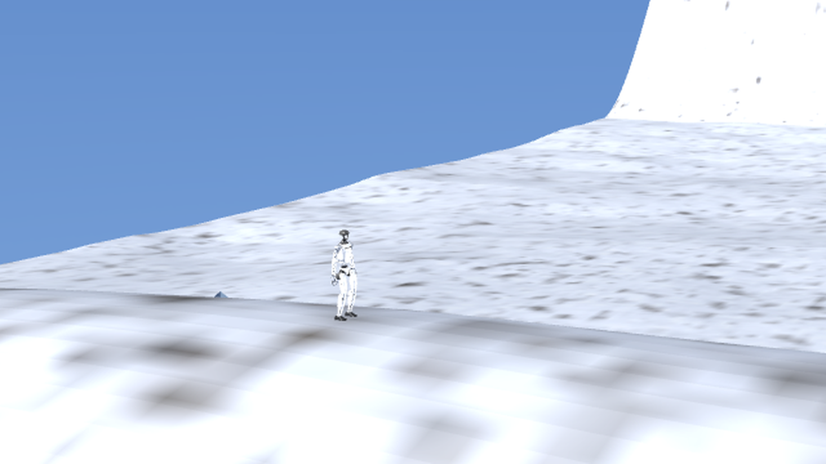
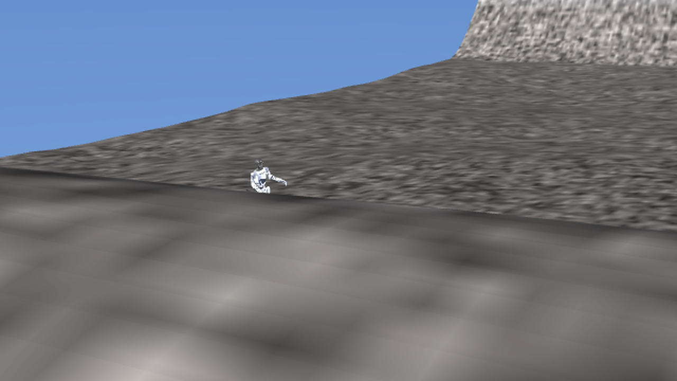
THE ENVIRONMENT WE BUILT
The Everest Base Camp approach, built from the real route
The trek follows the lateral moraine of the Khumbu Glacier, a rock debris ridge. Ice seracs flank the trail near Base Camp and the Everest and Nuptse walls rise behind.
The policy hikes the moraine, then slips on the ice at step 348. A fall on the trail, not off an edge.
400 m square, 188 m relief
20.3° mean slope
26 ice seracs, 70 boulders
92% snow cover
768 × 768 heightfield
p90 60°, the graded moraine trail 13.4°
embedded along the moraine
colour painted from the heightfield, bare rock on 100% of faces above 72°
Crampon · Himalaya Robotics Hack 2026 · github.com/zubair480/crampon
8
Notes:
The terrain is generated from the real route rather than from noise: moraine ridge, seracs, boulders, and colour painted from the heightfield itself.

Slide 9
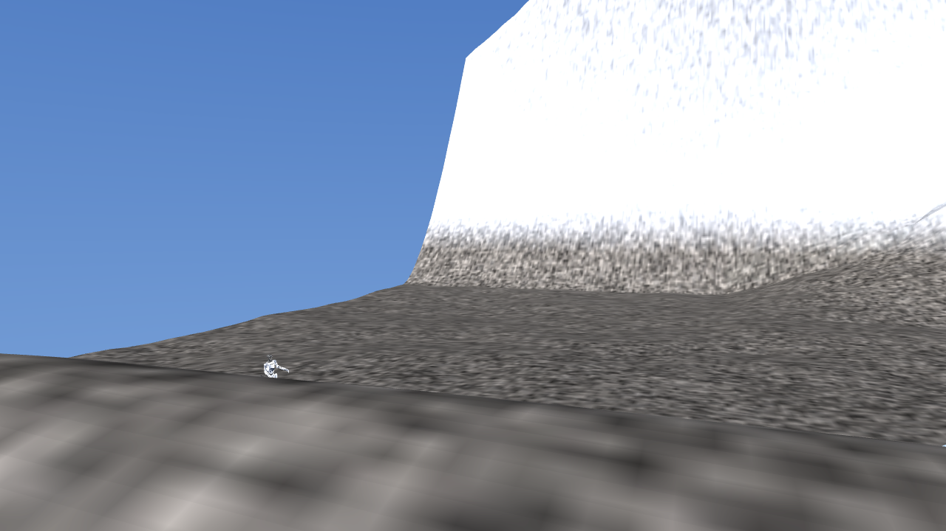
THE ENVIRONMENT WE BUILT
Walking the Everest Base Camp approach
Hiking the lateral moraine. Slips on the ice at step 348.
Crampon · Himalaya Robotics Hack 2026 · github.com/zubair480/crampon
9
Notes:
The policy hikes the lateral moraine and slips on the ice at step three hundred and forty eight.

Slide 10
FEASIBILITY
462 Hz on a laptop CPU, with no GPU
462 Hz
2.17 ms
20 ms
control rate, measured
per control step
the budget per step
One control step against its budget
measured
2.17 ms
budget
20 ms
Native MuJoCo at deployment, not MJX
One code path
MJX trains thousands of robots at once on a GPU. Deployment is a single robot on native MuJoCo, which is the shape of what a Jetson Thor would run.
The same policy and the same loop drive the live demo and would drive the robot. Nothing is re-implemented between them.
Crampon · Himalaya Robotics Hack 2026 · github.com/zubair480/crampon
10
Notes:
The policy is not GPU bound. Two point one seven milliseconds per step against a twenty millisecond budget, on a laptop CPU, on the shape of hardware a robot would actually carry.

Slide 11
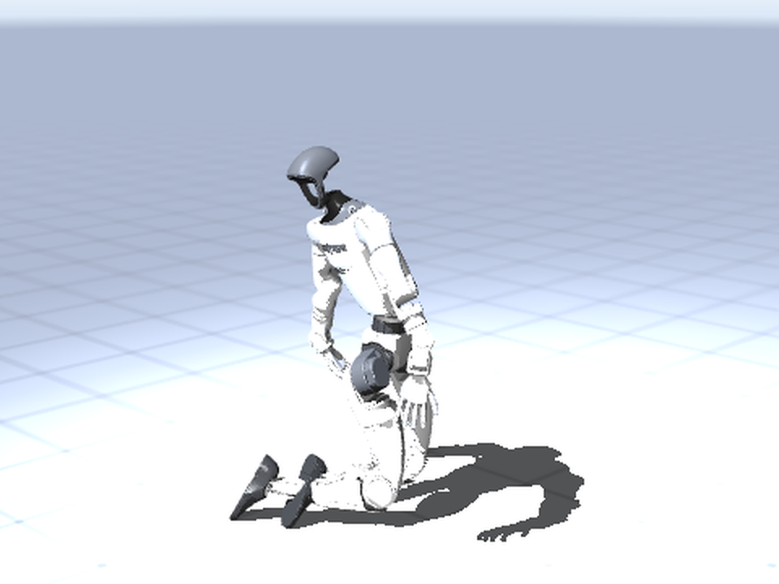
WHAT DOES NOT WORK
Fall recovery is unfinished
Seven training runs. Each failed for a genuinely different, diagnosed reason. v6 got the furthest.
1
Inverted up vector sign. the reward was paying the robot for ending upside down
2
Unbounded reward terms. raw sums of actuator force and squared joint acceleration, going NaN
3
Degenerate reset poses. uniform joint sampling folded the arms through the torso
4
A NaN leak. the env terminates on NaN in qpos and qvel, but the observation is built before that check, and jnp.clip(nan) returns nan while clip(inf) returns the bound. One diverging env out of 8192 poisoned the gradient permanently
5
A saturated reward. the total was clipped to 1.0 while the orientation term alone maxed at 1.0, so standing up earned nothing. It learned to sit up and stop
6
v6 reached kneeling. recovers from lying reliably, but only in a scene with knee contact
v6, recovered to kneeling on its training ground
Where it stands: reliable recovery from lying at 0.09 m to kneeling at 0.545 m, 16 of 16 seeds, but only with knee contact, which the walking scene cannot provide. A foot based stand is not achieved.
Crampon · Himalaya Robotics Hack 2026 · github.com/zubair480/crampon
11
Notes:
Stated plainly because the judges will find it in Q and A. The get up does not stand. Seven runs, each with a different diagnosed cause, and the diagnostic chain is itself the evidence of rigour.

Slide 12
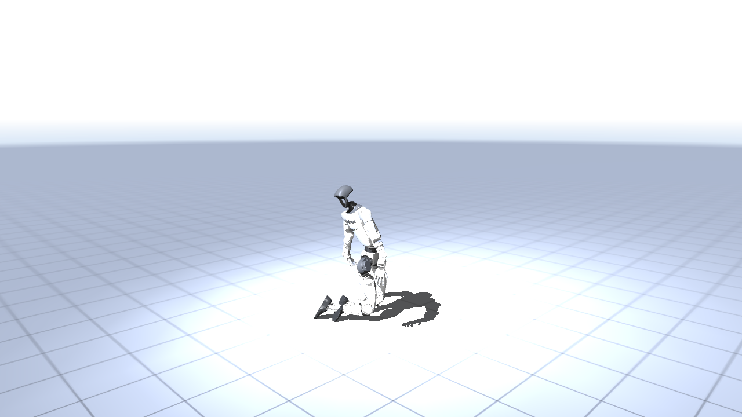
WHAT DOES NOT WORK
Fall recovery reaches kneeling, not standing
Three recoveries from random fallen orientations: 0.09 m lying to 0.545 m kneeling, 16/16 seeds. Reaches its knees, not its feet.
Crampon · Himalaya Robotics Hack 2026 · github.com/zubair480/crampon
12
Notes:
Three recoveries from random fallen orientations. It reaches kneeling at zero point five four five metres, sixteen of sixteen seeds. It reaches its knees and not its feet.

Slide 13
CRAMPON
Measured, honest, and it runs on the hardware a robot carries
Result
Method
2x to 6.6x longer survival on ice, ahead on 19 to 24 of 24 seeds at every icy friction level, and no regression on normal ground.
Ice, cold stiffened joints, sagging servo gain and sustained 8000 m wind, learned through a curriculum because naive randomization diverges.
Deployment
Open
462 Hz on a laptop CPU with no GPU. 2.17 ms against a 20 ms budget, on the same code path a robot would run.
Fall recovery reaches kneeling, 16 of 16 seeds, and not standing. That is the honest gap today.
github.com/zubair480/crampon
Himalaya Robotics Hack 2026 · Track 1: Movement · Unitree G1
Notes:
Every number on these slides is measured under identical conditions. The gap is named. The demo runs the same code path a robot would.

