Slide 1
Modelling using
UML Class Diagrams

Slide 2
Let’s revisit Process Sale Use case
Preconditions: Cashier is identified and authenticated on a sales terminal.
Main flow:
Customer arrives at POS checkout with goods and/or services to purchase.
Cashier starts a new sale.
Cashier enters item identifier.
System records sales line item and presents item description, price, and running total. Price calculated from a set of price rules.
< Cashier repeats steps 3-4 until indicates done >
System presents total with taxes calculated.
Cashier tells Customer the total, requests payment.
Customer pays and System handles payment.
System logs completed sale and sends sale and payment information to the external Accounting System and Inventory System.
System presents receipt.
Customer leaves with receipt and goods (if any).
Alternative flow:
3a. Customer asks cashier to remove an item from the purchase.
1. Cashier enters item identifier for removal from sale.
2. System displays updated running total.

Slide 3
Moving from Use cases to solution design
Customer arrives at POS checkout with goods and/or services to purchase.
Cashier starts a new sale.
Cashier enters item identifier.
System records sales line item and presents item description, price, and running total. Price calculated from a set of price rules.
< Cashier repeats steps 3-4 until indicates done >
System presents total with taxes calculated.
Cashier tells Customer the total, requests payment.
Customer pays and System handles payment.
System logs completed sale and sends sale and payment information to the external Accounting System and Inventory System.
System presents receipt.
Customer leaves with receipt and goods (if any).

Slide 4
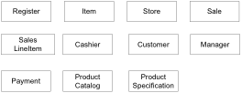
Conceptual Classes
Note: These are not software classses

Slide 5
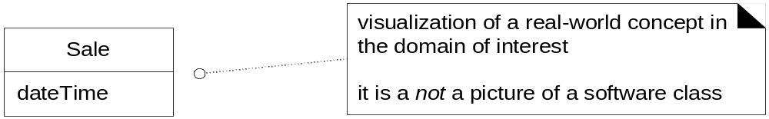
Representing Problem/Domain Concepts using class diagrams

Slide 6
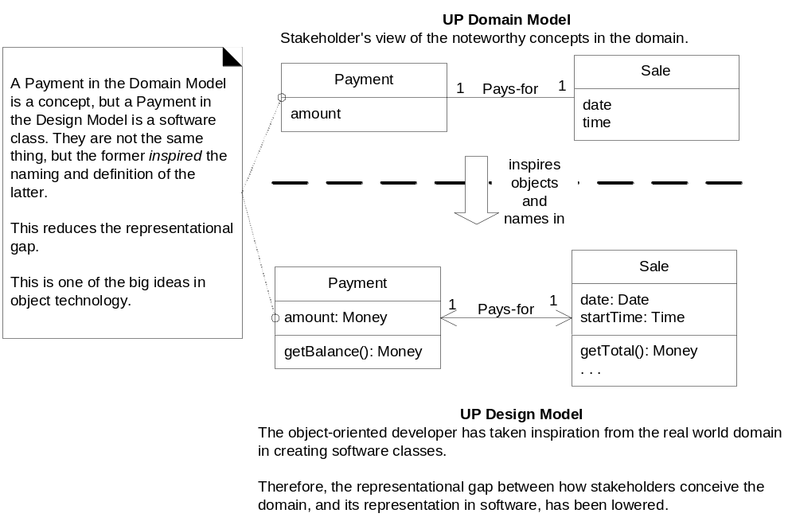
Requirements class vs. design class

Slide 7
Rendering Concepts
A depicted class has the following structure:
  Name compartment (mandatory)
  Attributes compartment (optional)
Every class must have a distinguishing name.
Notes:
Examples: page 186;
Responsibility example: User guide, page 53

Slide 8
Attributes
An attribute is a named property. Each concept instance associates value(s) with each attribute of a concept.
OOA syntax
name [multiplicity] [: type] [{property-string}]

Slide 9
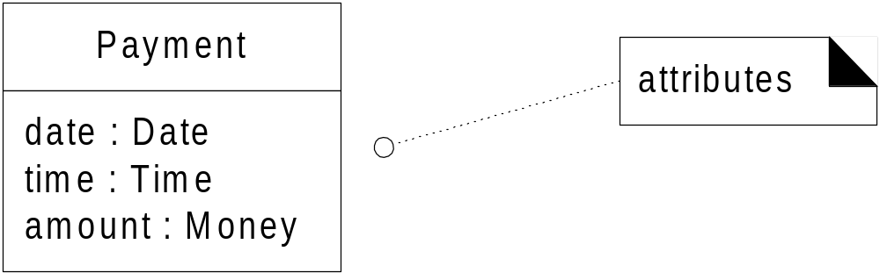
Attributes
Show only “simple” relatively primitive types as attributes.
Connections to other concepts are to be represented as associations, not attributes.

Slide 10
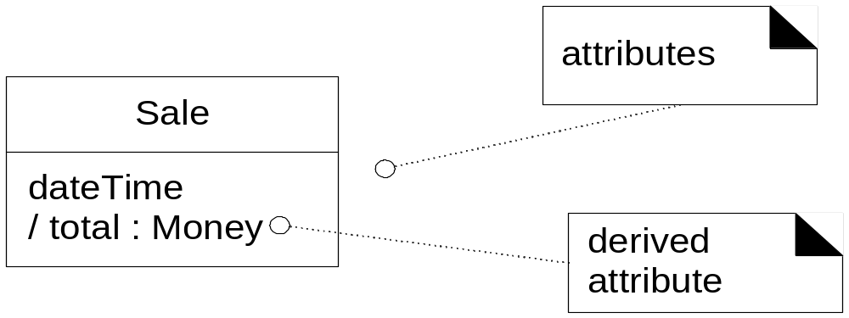
Derived Attributes

Slide 11
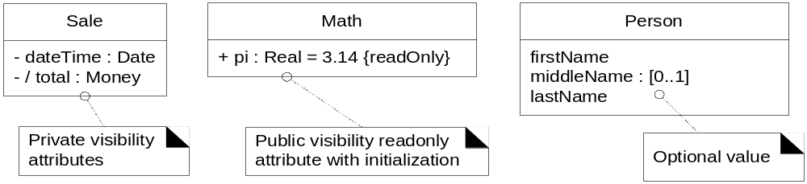
Access Modifiers

Slide 12
Modeling Static Relationships
Two kinds of static relationships:
  Associations
    Represent structural relationships among objects
  Generalizations
    Represent generalization/specialization class structures
The two kinds of relationships are orthogonal

Slide 13
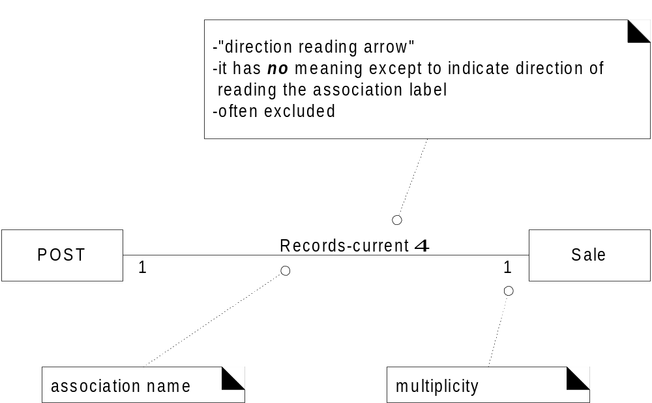
Associations

Slide 14
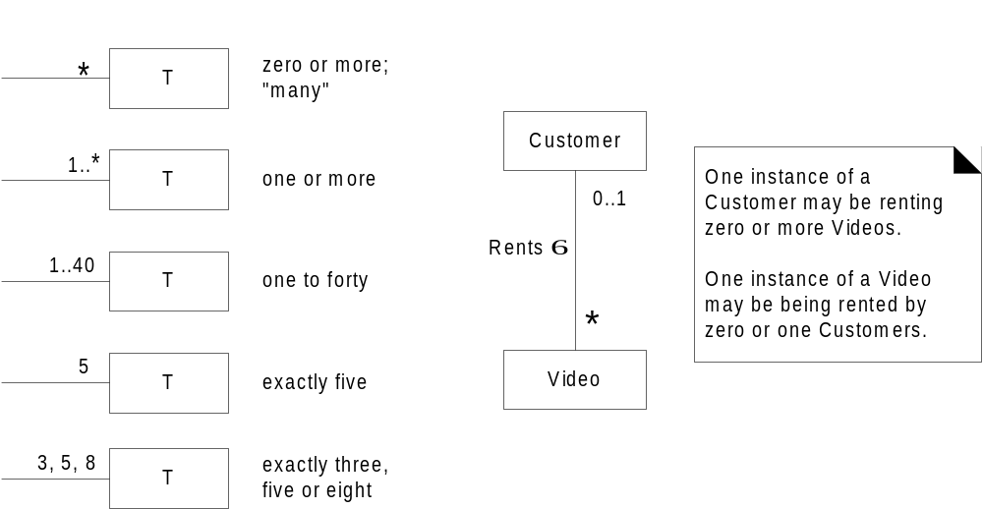
Multiplicity

Slide 15
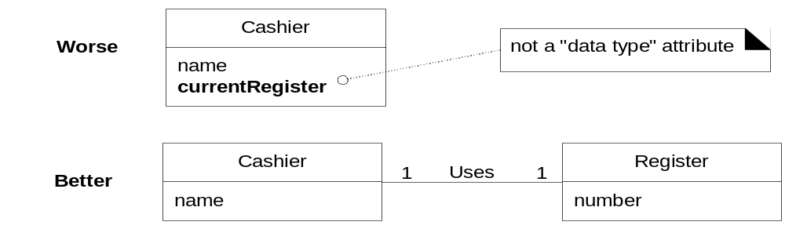
Association vs. Attribute

Slide 16
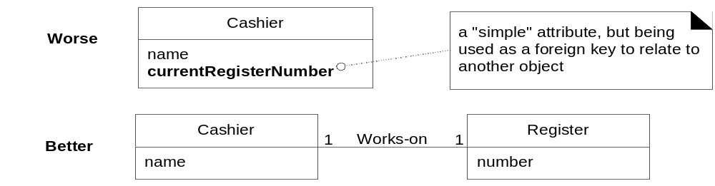
Do not use attributes to represent foreign keys

Slide 17
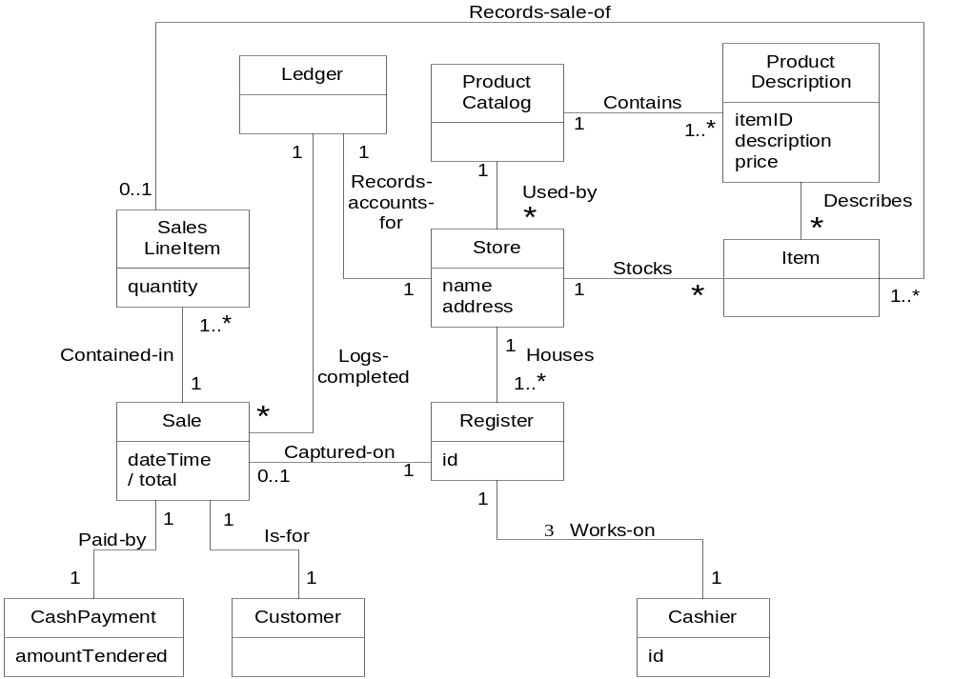

Slide 18
Association Roles
When a class is part of an association it plays a role in the relationship.
You can name the role that a class plays in an association by placing the name at the class’s association end.
Formally, a class role is the set of objects that are linked via the association.

Slide 19
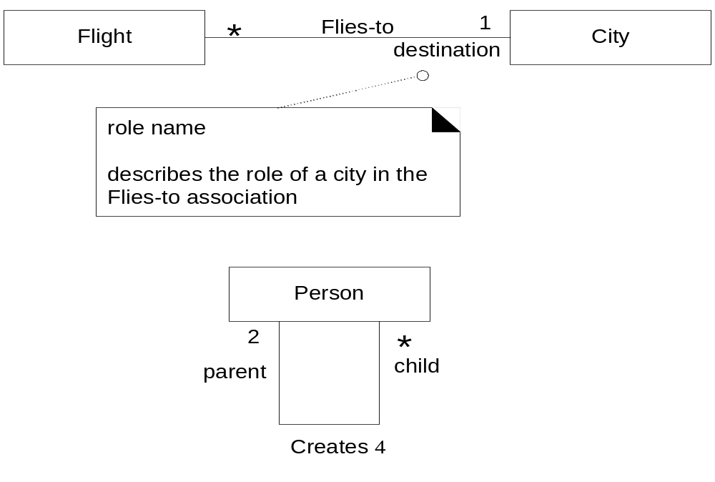
Examples of Association Roles

Slide 20
Association Constraints
Users can define constraints on how objects are linked via associations.
Constraints can be expressed in the Object Constraint Language (OCL).

Slide 21
Aggregation
Aggregation is a special form of association
  reflect whole-part relationships
The whole delegates responsibilities to its parts
  the parts are subordinate to the whole
  unlike associations in which classes have equal status

Slide 22
UML Forms of Aggregation
Composition (strong aggregation)
  parts are existent-dependent on the whole
  parts are generated at the same time, before, or after the whole is created (depending on cardinality at whole end) and parts are deleted before or at the same time the whole dies
  multiplicity at whole end must be 1 or 0..1

Slide 23
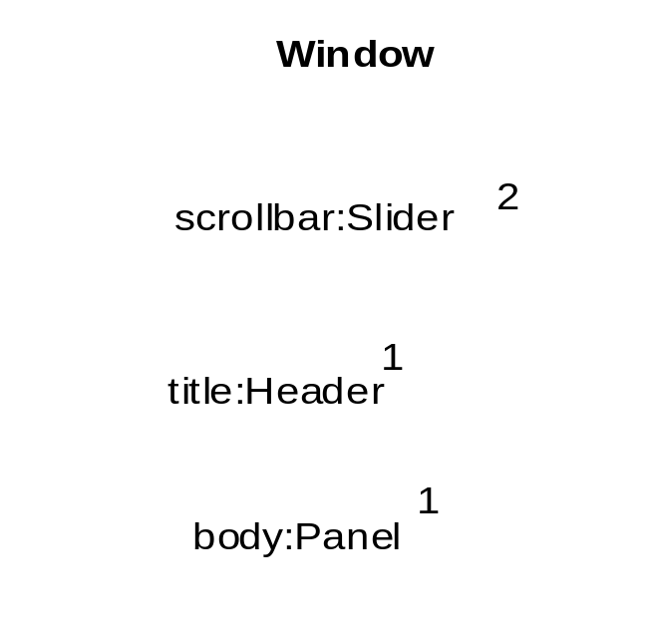
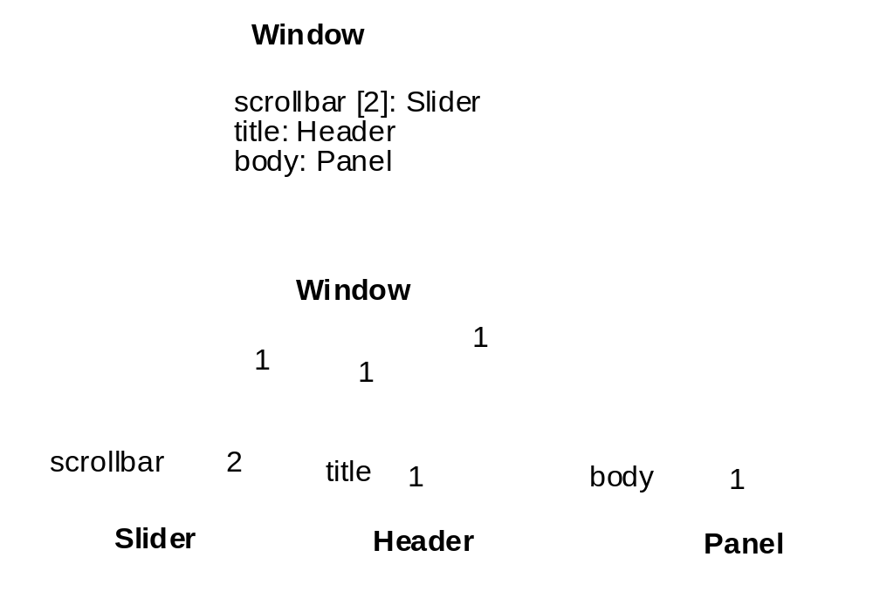
Composition
Fig. 3-45, UML Notation Guide

Slide 24
Generalization/Specialization
A generalization (or specialization) is a relationship between a general concept and its specializations.
  Objects of specializations can be used anywhere an object of a generalization is expected (but not vice versa).
Example: Mechanical Engineer and Aeronautical Engineer are specializations of Engineer

Slide 25
Rendering Generalizations
Generalization is rendered as a solid directed line with a large open arrowhead.
  Arrowhead points towards generalization
A discriminator can be used to identify the nature of specializations

Slide 26
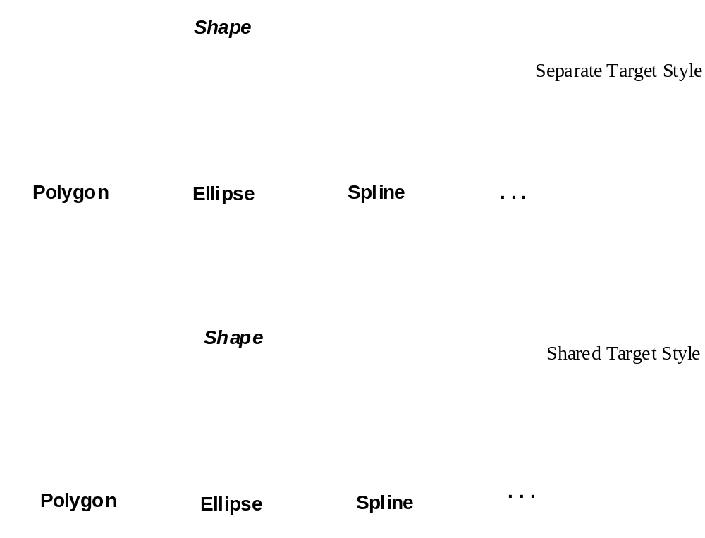
Generalization

Slide 27
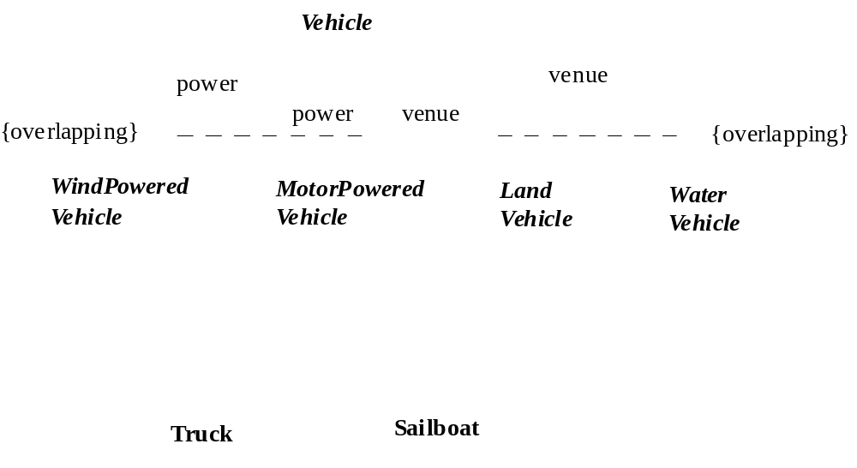
Generalization
Fig. 3-48, UML Notation Guide

Slide 28
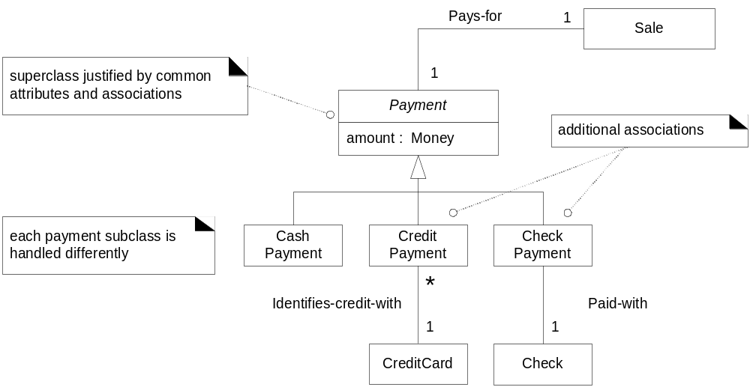
Inheritance of associations

Slide 29
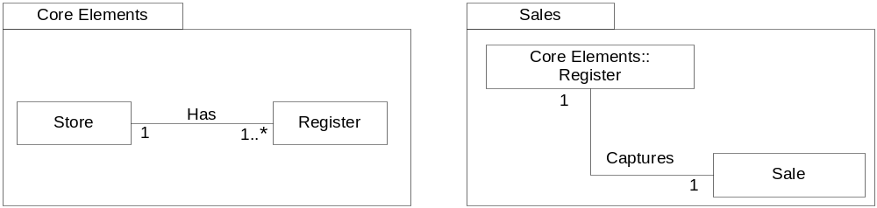
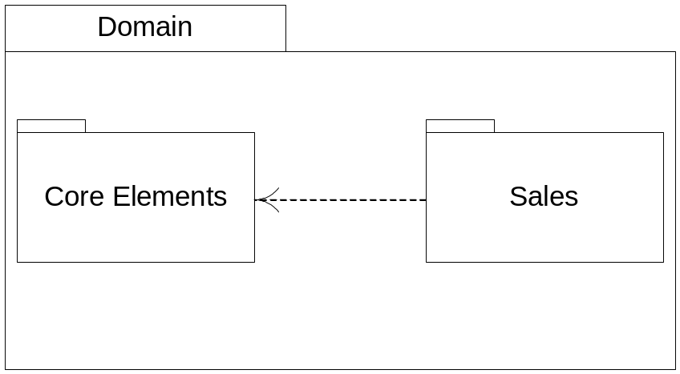
Handling Large Domain Models

Slide 30
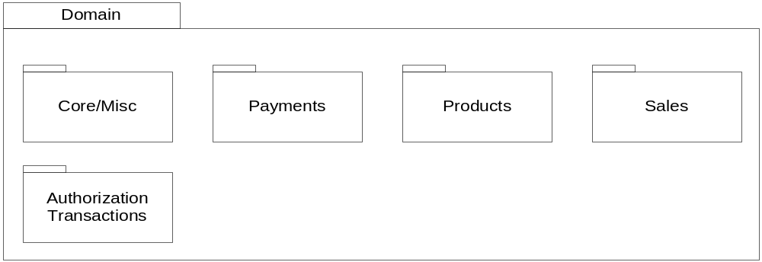
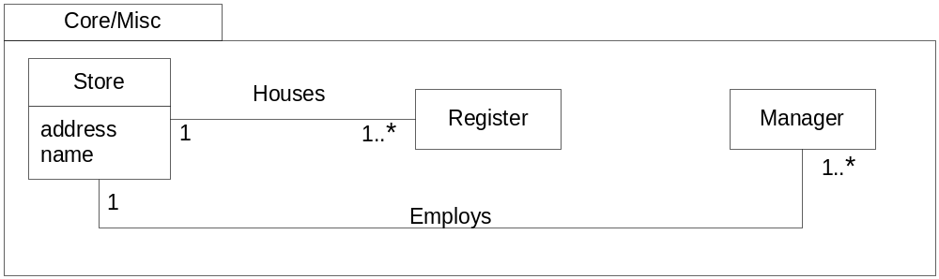

Slide 31
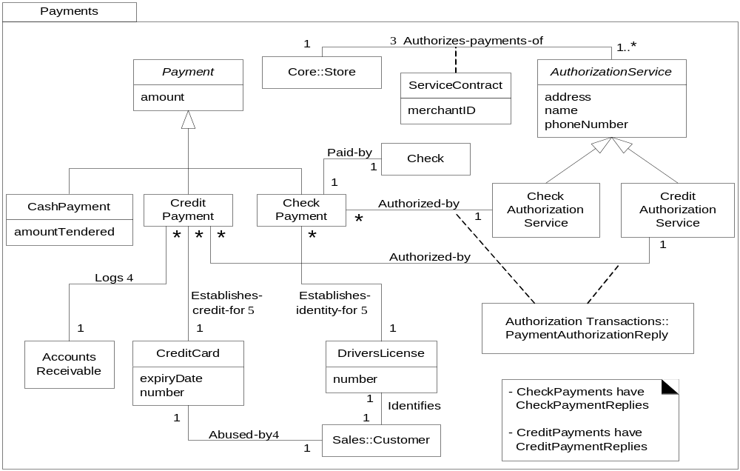
Payments Package

Slide 32
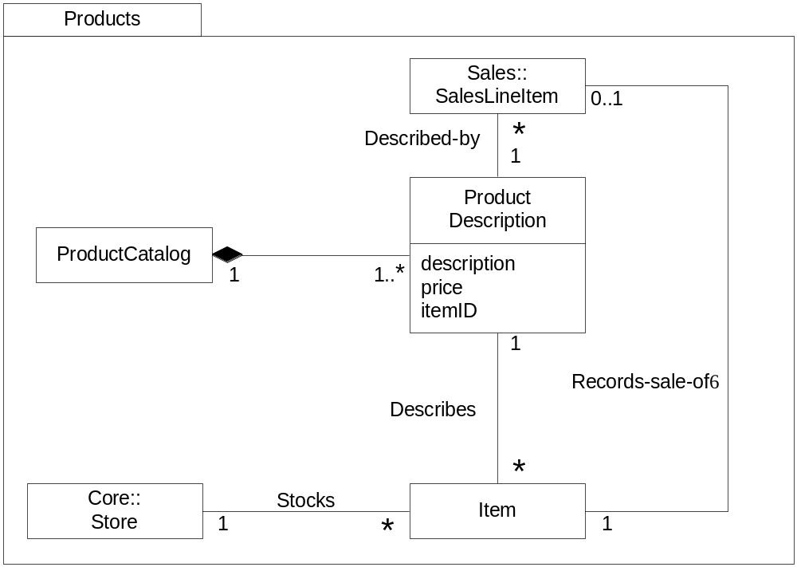
Products Package

Slide 33
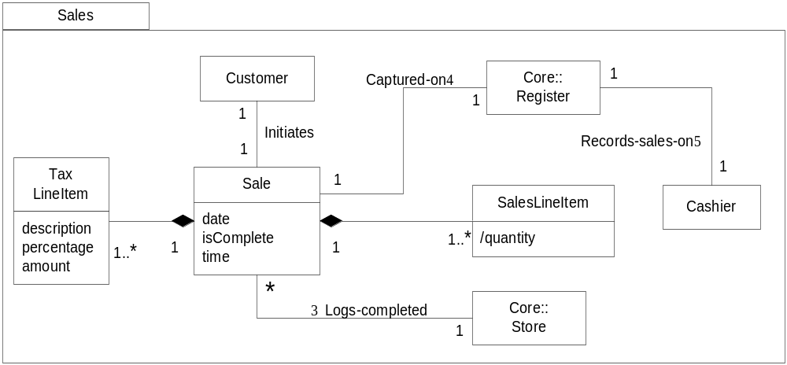
Sales Package

Slide 34
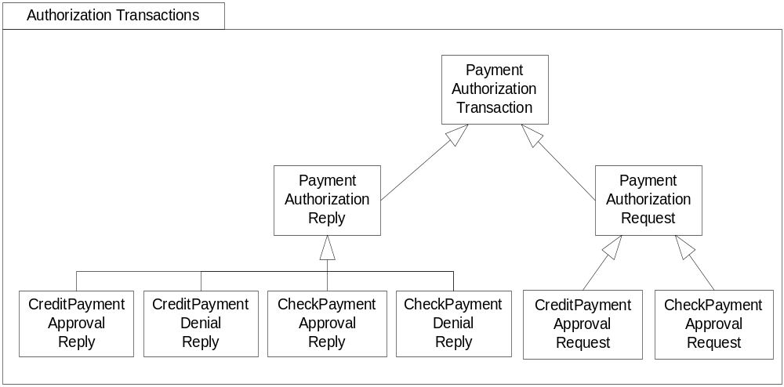
Authorization Transactions Package

Slide 35
Summary
Requirements models are used to represent conceptual elements and their relationships at the problem level
UML may be used as a specification language. However UML is semi-formal
How do we write formal specifications?
  For example, constraints may be added to make it more formal. Object Constraint Language (OCL) may be used for this purpose

