Slide 1
UML use cases
(week 5)
Some content adapted Applying UML and patterns by Craig Larman

Slide 2
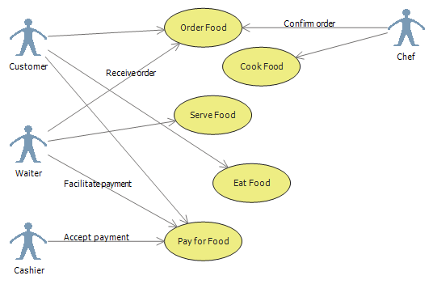
Pizza?

Slide 3
Use Cases
Use cases tell stories of actors using a system.
A use case scenario is a sequence of actions a system performs that yields an observable result of value to a particular actor.
It describes an end-to-end process --- from when a user starts to use the system for a particular purpose until they are done (for that purpose).
Use cases are an excellent mechanism to express functional requirements. They emphasize thinking from the viewpoint of the users.
We use use cases to "drive" the process. Our goal during development is to make specific use cases operational.

Slide 4
Scenarios
The boundary, which defines the system of interest in relation to the world around it.
The actors, usually individuals involved with the system defined according to their roles.
The use cases, which are the specific roles played by the actors within and around the system.
The relationships between and among the actors and the use cases.

Slide 5
Use Cases in UML 2.X
Use cases are associated with subjects
  A subject can be a system, a subsystem in a system, or a class
A use case describes interactions between users (clients) and a subject

Slide 6
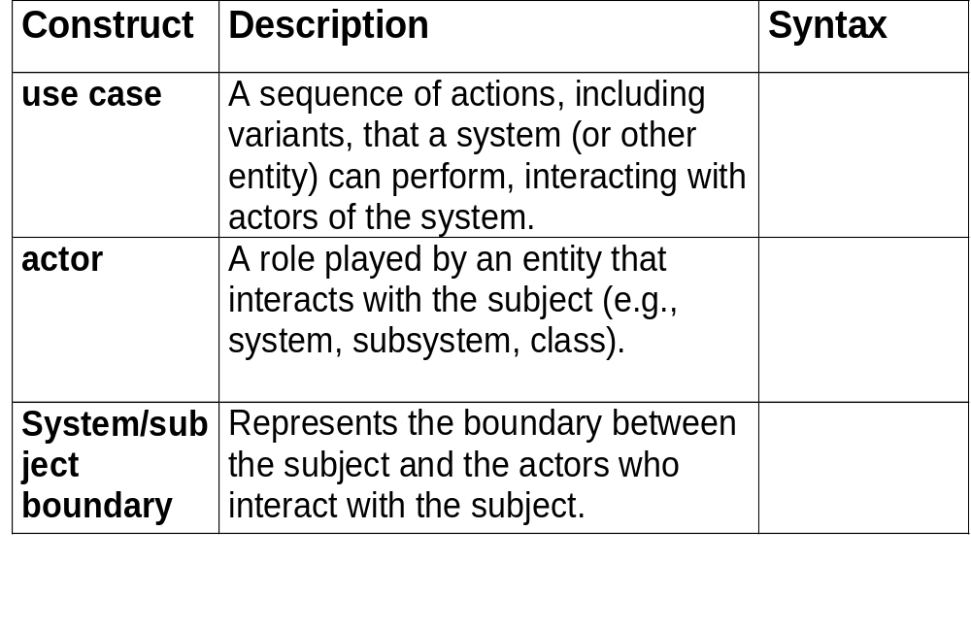
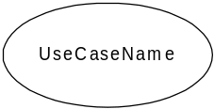
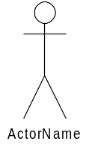

Use Case Modeling: Core Elements
Notes:
Both use cases and actors are classifiers.
An actor is a set of roles that a user of the system plays when interacting with the system.
An actor can be human, a hardware device, or another automated system
Example: For a Banking System, a person can play the role of a Loan Officer, and, if the person also has an account there, a Customer.
Actors are external to the system.
A use case describes a set of typical interactions between an external entity, called an actor, and the system.
The behavior described by a use case is the functionality of a system-level operation.
Example: For an ATM system, the withdraw cash operation can be described by a use case

Slide 7
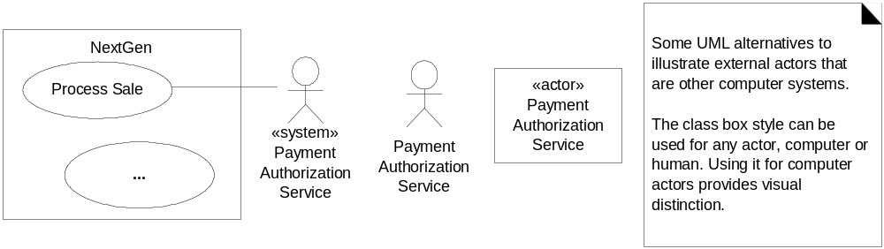
Depicting actors

Slide 8
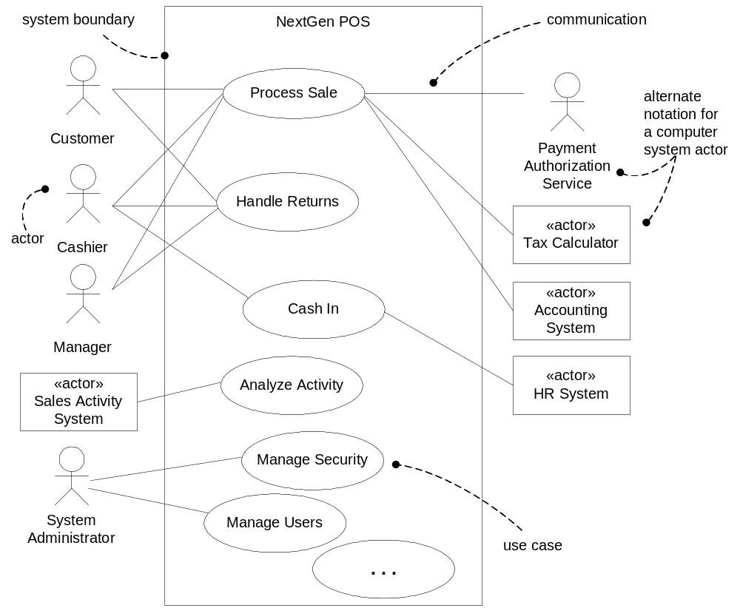
Use Case Diagram

Slide 9
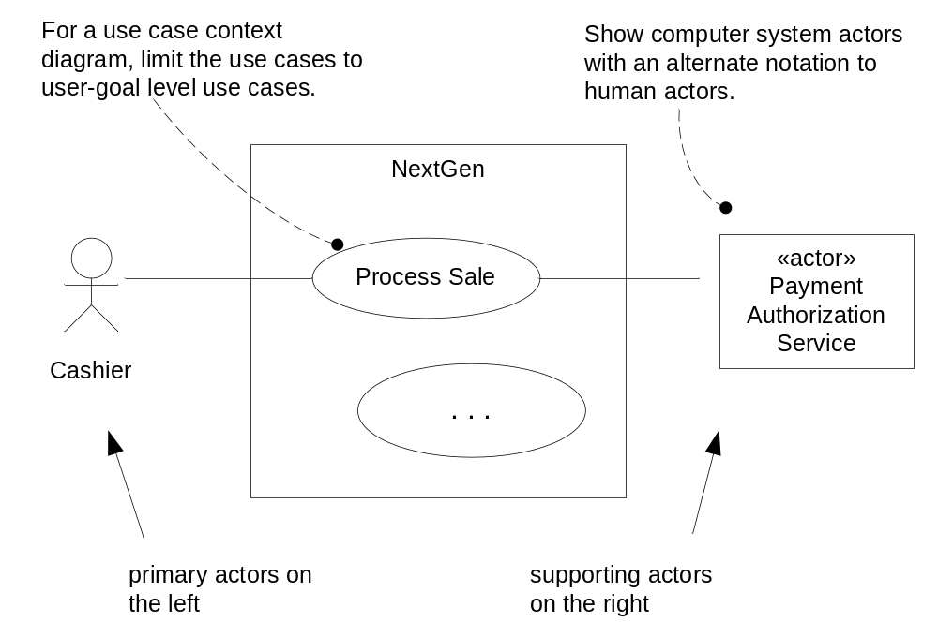
Use Case Diagram Style

Slide 10
Use Cases as Requirements
Use cases can be used to capture functional requirements
  System attributes associated with a system operation can be documented in a use case
Not all requirements can be captured by use cases
  System attributes that span use cases are documented as supplementary requirements

Slide 11
Use Case Instance (Scenario)
A scenario is a particular sequence of actions in a use case.
  A use case is a related set of scenarios that yields an observable result of value to a particular actor
A use case instance is an execution of a scenario.
  Often use case instance and scenario are used synonymously in informal discussions.

Slide 12
Levels of Rigor
Brief: One paragraph summaries of functionality
Casual: Multiple paragraphs that cover multiple scenarios
Fully-dressed (Detailed): Structured, detailed description of scenarios

Slide 13
Essential vs. Concrete Use Cases
Essential Use Cases describe functionality in implementation independent terms
  Requirements level use cases must be essential
Concrete Use Cases describe external functionality in system dependent terms
  Use cases can be used during design to document externally observable behavior of subsystems

Slide 14
Requirements Use Case Template - 1
Use Case Number
EU-xxxx : Indicates an essential use case, i.e., a use case that describes activity in system independent terms
Use Case Name
Enter name of Use Case.
Overview
Describe the purpose of the Use Case and give a brief description.
Type
Enter Use Case priority (primary, secondary, optional)
Actors
List all actors that participate in this Use Case. Indicate the actor that initiates the use case by placing “initiator” in brackets after the actor name. Also, indicate primary actors by placing “primary” in brackets after actor name.
Properties
Performance:
Security:
Other:

Slide 15
Use Case Template – cont’d
Pre-condition
Enter the condition that must be true when the main flow is initiated. This should reference the conceptual model.
Flow
Main Flow: Steps should be numbered.
Subflows: Break down of main flow steps
Alternate Flows: Include the post condition for each alternate flow if different from the main flow.
Post Condition
Enter the condition that must be true when the main flow is completed. This should reference the conceptual model. Include the following information in this section:
Cross References
References to other Use Cases or textual requirements that relate to this Use Case.

Slide 16
Use case example
Use Case Number: | EU-0001
Use Case Name: | Withdraw Money
Overview: | Customer withdraws money from an ATM .
Type: | primary
Actors: | Customer
Pre-condition: | Customer has selected withdraw option
Main flow: | System requests customer PIN Customer keys in PIN and submits to system If the PIN is valid ten the system acknowledges valid entry and asks for amount to be withdrawn Customer enters amount to be withdrawn If amount entered in less than amount in Customer’s account, system dispenses the cash, else system informs customer that amount cannot be withdrawn
Alternate flow | 3. If the PIN is invalid then the use case is restarted. If this occurs 3 consecutive times then the system cancels the transaction and prevents the customer from interacting for 60 seconds
Alternate flow | 2. The customer can cancel the PIN validation at anytime. Cancellation causes the use case to restart
Alternate flow | 2. The customer can clear and reenter the PIN any number of times before submitting the PIN
Post-condition | True
Cross-reference: | Validate PIN

Slide 17
Actor Types
Primary: actor whose goal is accomplished by the use case
Supporting: actor that provides services to the system
  E.g., authorization service
Offstage: an actor that has an interest in the use case but is not primary or supporting
  E.g., regulating agency

Slide 18
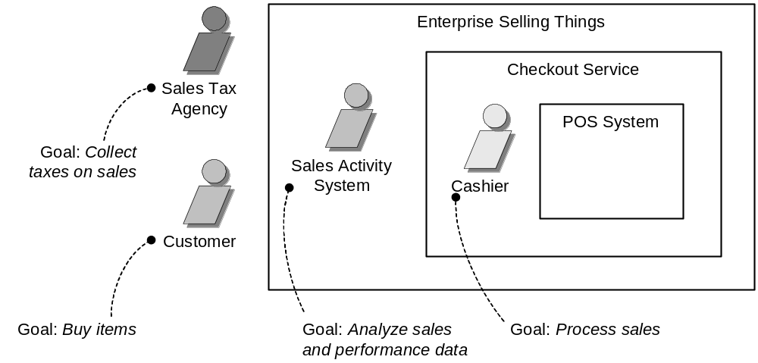
Use Case Scope
A use case should describe end-to-end functionality
  Should describe a task carried in response to an event generated by an actor that produces a result of value to a subset of its actors and leaves the system in a stable state (one in which it is not waiting for a restricted set of inputs)

Slide 19
Developing Use Cases
Scope system and identify primary actors that interact with the system
Determine goals of primary actors (can be documented in an Actor-Goal list)
For each actor, consider the ways that the actor typically interacts with the system to accomplish goals
Consider exceptional behaviors

Slide 20
Use Case Modeling Tips
Writing essential use cases: Focus on intent
  Keep user interface terms out
  Ask “what is the goal?”
Write “black-box” use cases
  Do not describe internal operations (e.g., storing to a data base)
Focus only on interactions between system and actors
  Ignore interactions between actors
Focus on text description
  Use diagrams for presentation purposes only
A use case diagram should
  contain only use cases at the same level of abstraction
  include only required actors

Slide 21
How do I know I have a good use case?
Use case should describe an activity that yields an observable result of value to an actor.
A use case can describe an elementary business process: a sequence of tasks performed to handle a business event
Use cases are typically not single steps or single low-level actions.

Slide 22
Organizing Use Cases
Specializing/generalizing use cases
Including use cases
Extending use cases

Slide 23
Specializing Use Cases
Generalizing/Specializing use cases
  A specialized use case inherits the behavior (sequence of actions) of its parent(s)
  A specialized use case can override some of the behavior of its parent(s). It can also add to the behavior
  A specialized use case can be used anywhere the general use case is expected.

Slide 24
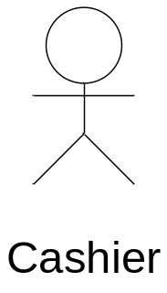
Specializing Use Cases
Payment System
Make Payment
Make Credit
Payment
Make Cash
Payment

Slide 25
Including Use Cases
A use case can include another use case at a specified location
  Used to avoid writing the same flow of events across a number of use cases.
  The included use case must not be a stand-alone use case.

Slide 26
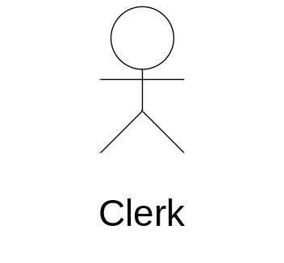
Including Use Cases
Library System
Check out
<<includes>>
Database Retrieval

Slide 27
Extending Use Cases
A use case can extend a base use case by incorporating additional behavior at specified locations of the base use case
  The base use case can act as a stand-alone use case.
  The base use case can only be extended at specified points called extension points.
  Often used to separate optional behavior from mandatory behavior
  Also used to model a separate flow that is executed under certain conditions

Slide 28
Including Use Cases
Order Processing System
Make Payment
<<extends>>
Validate Payment

Slide 29
Summary
Use case model the behavior of the system
  Functional requirements are mapped to use cases
  Non-functional requirements can be specified as constraints (not done in most of the cases)

