Slide 1
APACHE SOLR

Slide 2
Installation Instructions
The installations instructions have been updated on moodle and the resources modified. These modifications are necessary due to dependency incompatabilities
Please make sure you have the modified versions.
Modifications have been made due to time constraints.

Slide 3
Apache Solr
Solr is an open-source search platform which is used to build search applications. It was built on top of Lucene (full text search engine). Solr is enterprise-ready, fast and highly scalable.
Apache solr Lucene supports (File endings considered are
xml,json,csv,pdf,doc,docx,ppt,pptx,xls,xlsx,odt,odp,ods,ott,otp,ots,rtf,htm,html,txt,log)

Slide 4
Disadvantages
Not an ACID compliant Data Store
Does not support Transactions and Distributed Transactions
Does NOT supports Joins and Complex Queries
Does NOT useful to work with Normalized Data

Slide 5
Terminology
Instance: this term refers to the application server, which runs inside a JVM
Core: A Solr Core is a running instance of a Lucene index that contains all the Solr configuration files required to use it.
Schema: Solr’s schema is a single file (in XML) that stores the details about the fields and field types Solr is expected to understand. The schema defines not only the field or field type names, but also any modifications that should happen to a field before it is indexed.

Slide 6
2 Modes
Use “schemaless” mode - by default lucene guesses field types.
Use “schema” mode - has specific schema - (i.e) we can add extra fields Which can be made through schema.xml file or schema API

Slide 7
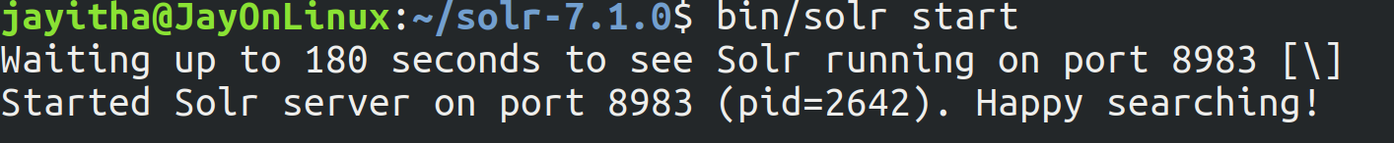
Schema Mode
User defines the schema
Start solr
  bin/solr start

Slide 8
Schema Mode
Core Admin
Can open the gui version using the link http://localhost:8983/solr/#/

Slide 9
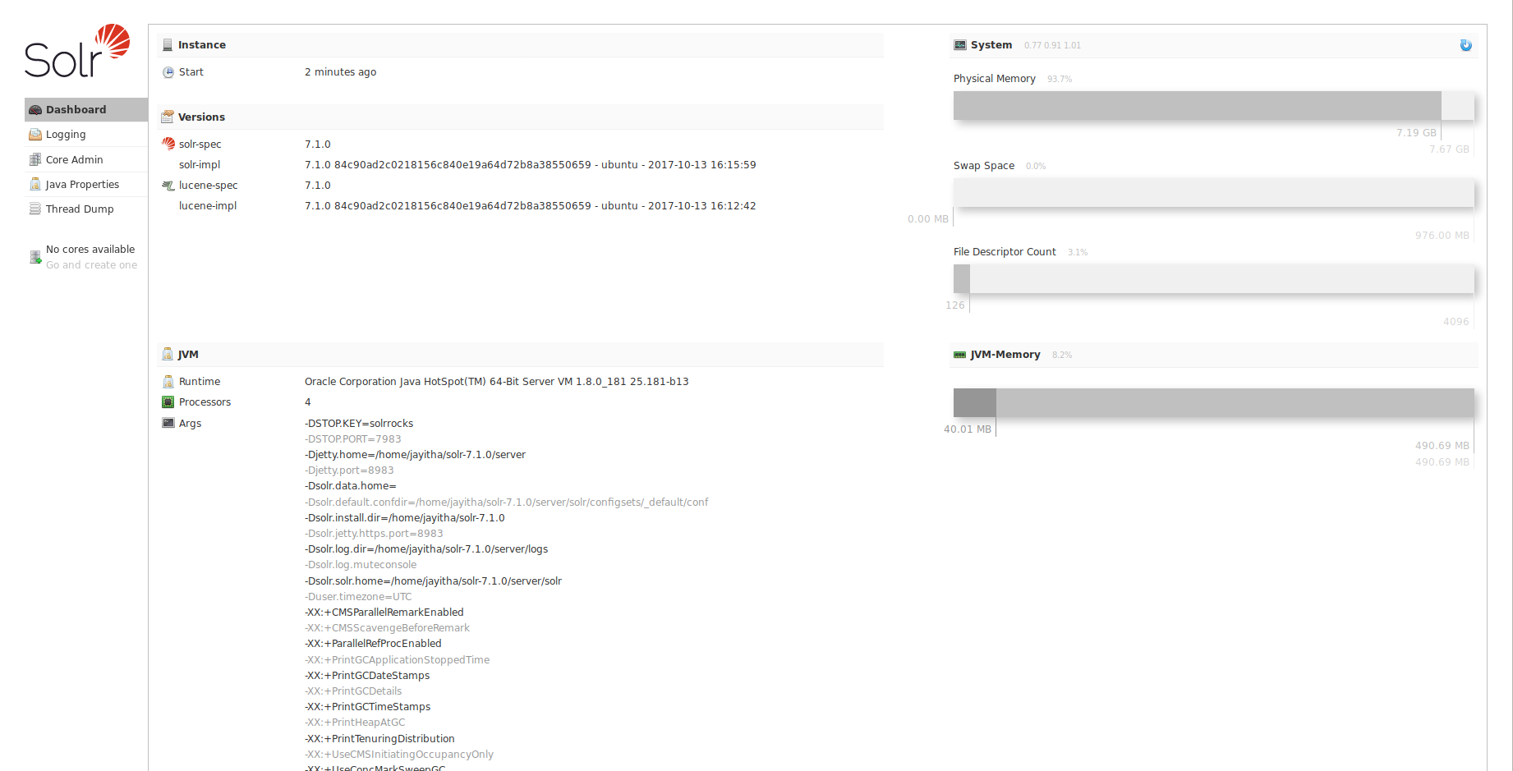

Slide 10
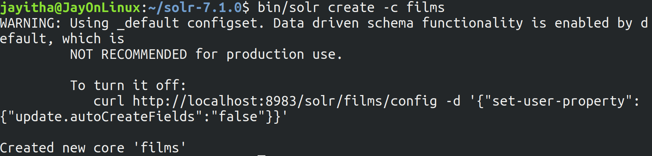
Schema Mode
Create core
bin/solr create -c films

Slide 11
Schema Mode
Set the schema
Use the command in the schemaMode.txt file provided

Slide 12
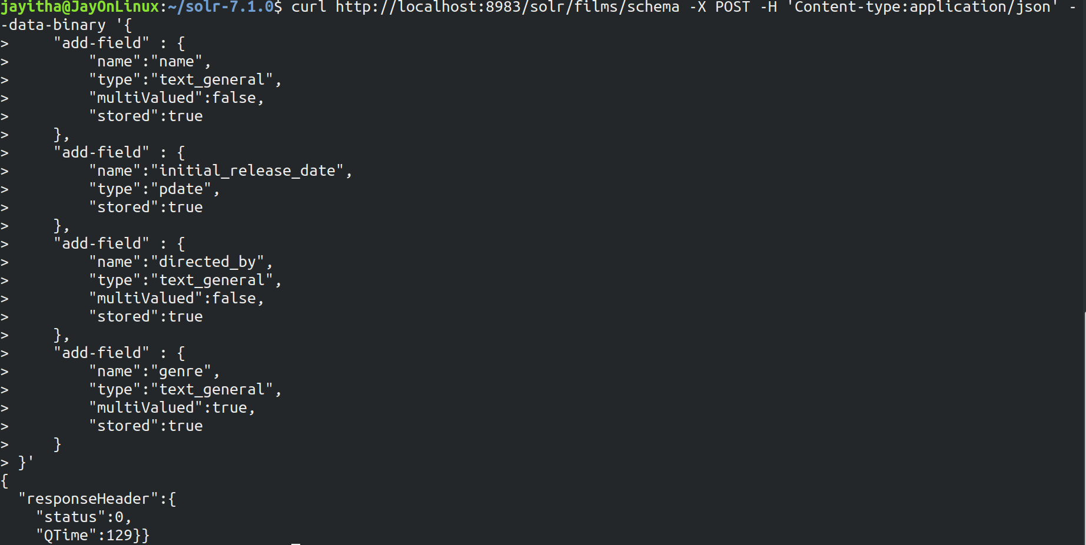

Slide 13
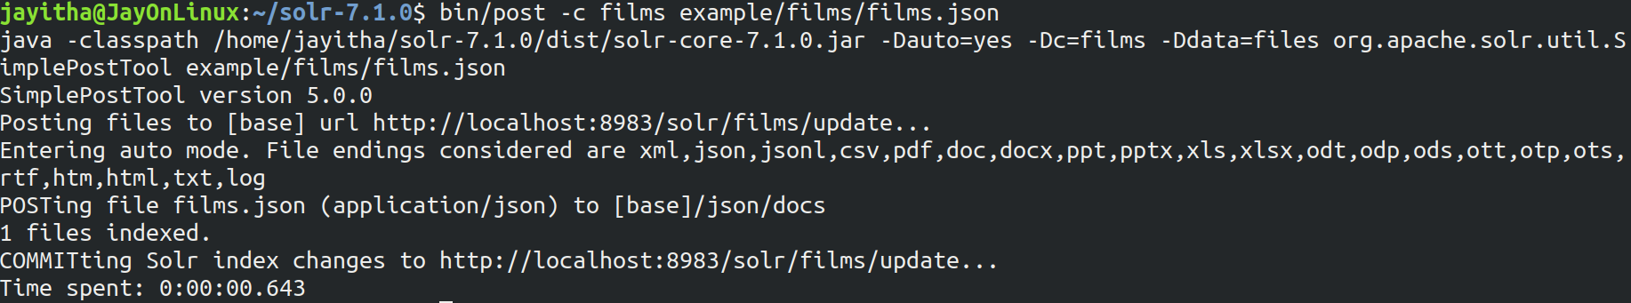
Schema Mode
Index the data run the following or any of the other commands given in the .txt file
bin/post -c films example/films/films.json

Slide 14
Queries
Basic Queries - A “term” query is a single word query in a single field that must match exactly.
q = text:hello
Phrase Query - A phrase query matches multiple terms (words) in sequence.
q = text:"yonik seeley"
Proximity Query - A proximity query, is like a phrase query with a tilda (~) followed by a slop that
specifies the number of term position moves (edits) allowed.
q = text:"solr analytics"~1
Boolean Query - A boolean query contains multiple clauses.
q = solr search
( OR condition) (returns values matching atleast one clause)
Boosted Query - Any query clause can be boosted with the ^ operator.
text:solr^10 text:rocks
Range Query - Range queries work on numeric fields, date fields, and even string and text fields.
age:[18 TO 30] name:[apple TO banana]
Filter Query , Query Comments

Slide 15
Queries
http://localhost:8983/solr/films/select?fl=name%20directed_by&fq=genre:%22Superhero%20movie%22&q=*:*&sort=initial_release_date%20desc

Slide 16
Schemaless Mode
Solr attempts to find the schema itself
Start solr
  bin/solr start -e schemaless
Automatically creates core “gettingstarted”

Slide 17
References
https://lucene.apache.org/solr/guide/6_6/schemaless-mode.html Schemaless Mode
http://yonik.com/solr-tutorial/
http://yonik.com/solr/query-syntax/
https://cwiki.apache.org/confluence/display/solr/About+This+Guide

