Slide 1
Intro to Question Answering
Manish Shrivastava

Slide 2

A Question on questions
Can we ask
Who is Narendra Modi ?
Where was the current prime minister born ?
Where is Gujarat/ Gandhinagar ?
Why is rupee falling in comparison to dollar?

Slide 3
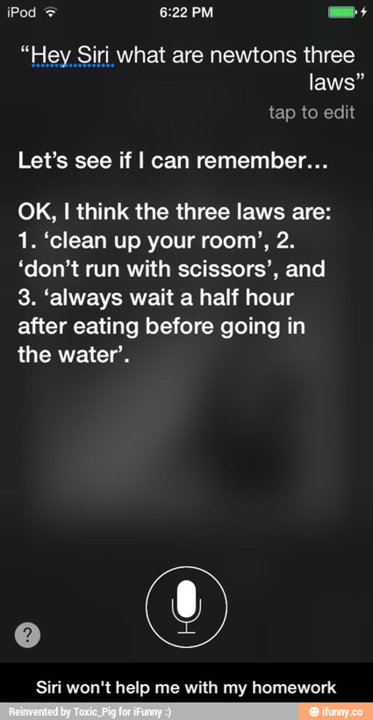

Question answering
'Watson' computer wins at 'Jeopardy'
credit: ifunny.com

Slide 4
Question answering
Go beyond search

Slide 5

Go beyond traditional web search
Answer queries using structured knowledge
Google Knowledge Graph
Facebook Graph Search
Bing’s Satori
Need to understand the query!
The following slides are modified from Christopher Manning & Pandu Nayak’s intro. to IR.

Slide 6

Why is QA hard?
Understanding that a query means a question.
Translating the question into a sequence of tokens useful for retrieval.
Retrieve appropriate units of text (vanilla IR may not work!)
Filter, rank, and/or combine the units into an answer.
Summarize the answer.
Visualize it.
Different types of question need different treatments.

Slide 7
Factoid Questions
Who founded Virgin Airlines?
What is the average age of the onset of autism?
Where is Apple Computer based?
Courtesy: Speech and Language Processing by Dan Jurafsky and James Martin, Chapter 23.

Slide 8

Non-factoid Questions
Who is Celia Cruz?
What is a Hajj?
In children with an acute febrile illness, what is the efficacy of single-medication therapy with acetaminophen or ibuprofen in reducing fever?
Courtesy: Speech and Language Processing by Dan Jurafsky and James Martin, Chapter 23.

Slide 9

Factoid vs Non-factoid QA
Factoid QA needs information extraction, followed by ranking.
Non-factoid QA needs filtering and summarization on top of that.
Query-based summarization
Focused summarization
PERSON, LOCATION, ORGANIZATION and TIME questions are generally easier to handle than REASON and DESCRIPTION questions.

Slide 10

What role does IR play in QA?
We need to retrieve and rank units of text in response to a query.
The units should best be indexed beforehand.
Snippets are very helpful.

Slide 11
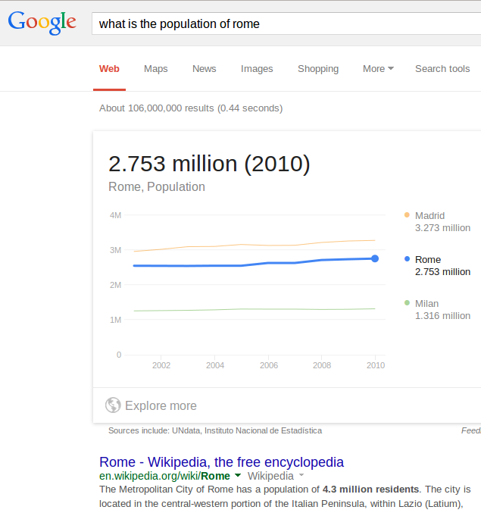

What role does IR play in QA?
Snippets are very helpful.

Slide 12
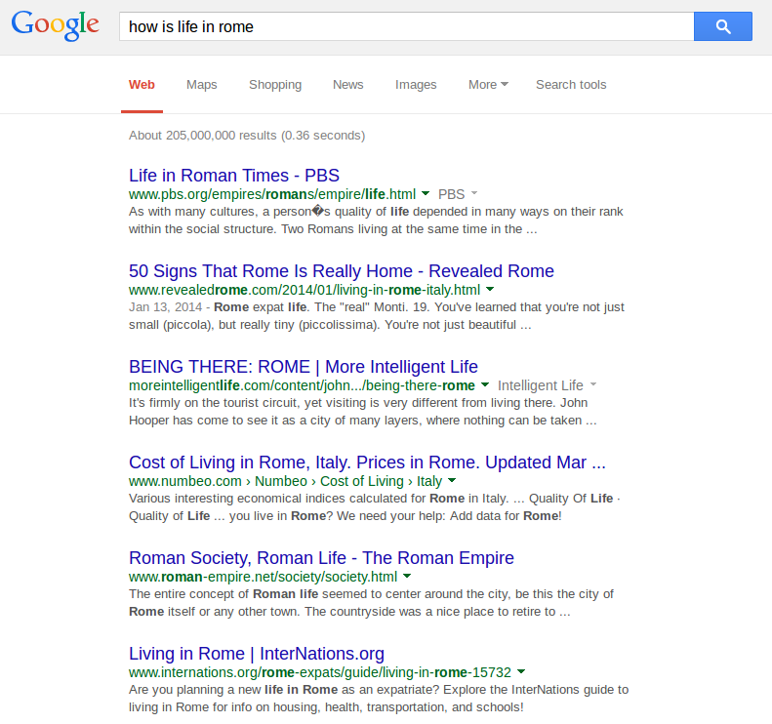
What role does IR play in QA?
Snippets are very helpful.

Slide 13
Question Answering from Text
An idea originating from the IR community
With massive collections of full-text documents, simply finding relevant documents is of limited use: we want answers from textbases
QA: give the user a (short) answer to their question, perhaps supported by evidence.
Notes:
Of course it is a difficult area to evaluate the performance of systems as different people have different ideas as to what constitutes an answer, especially if the systems are trying to return exact answers.

Slide 14

People Want to Ask Questions…
Examples from AltaVista query log
who invented surf music?
how to make stink bombs
where are the snowdens of yesteryear?
which english translation of the bible is used in official catholic liturgies?
how to do clayart
how to copy psx
how tall is the sears tower?
Examples from Excite query log (12/1999)
how can i find someone in texas
where can i find information on puritan religion?
what are the 7 wonders of the world
how can i eliminate stress
What vacuum cleaner does Consumers Guide recommend
Around 12–15% of query logs

Slide 15

Applications
General search for information
Education
Tutoring systems
Healthcare
Customer service
Travel reservations

Slide 16

Traditional IR
Document Collection
Query
Document retrieval
Document Ranking

Slide 17

Question Answering
Typical pipeline
“When is the next train to Delhi?”
QA
SYSTEM
Text Corpora
“8:35, Monday.”

Slide 18

QA Pipeline
Simple
Query keyword extraction
Send to search engine
Retrieve docs
Extract answer passage
Rank and select answer
query
Query keyword extraction
Docs
Search Engine
Answer
Extract Answer Passage
Rank and Select Answers

Slide 19
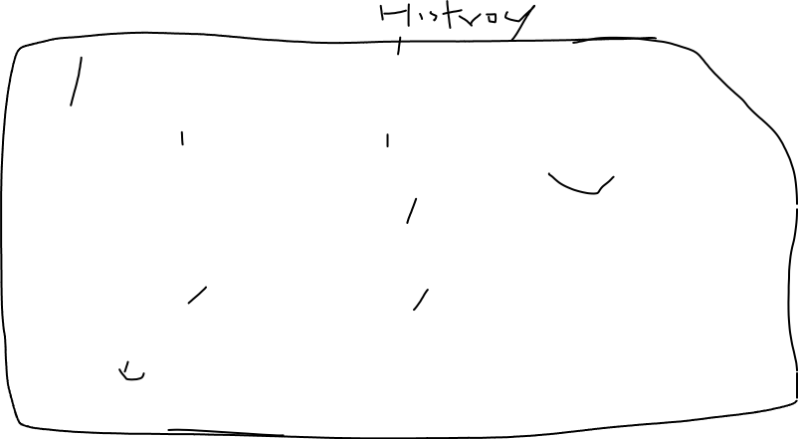
Generalized Pipeline
NL question
Question Analyzer
IR Query
Document Retriever
Answer Type
Documents
Passage Retriever
Passages
Answer Extractor
Answers

Slide 20
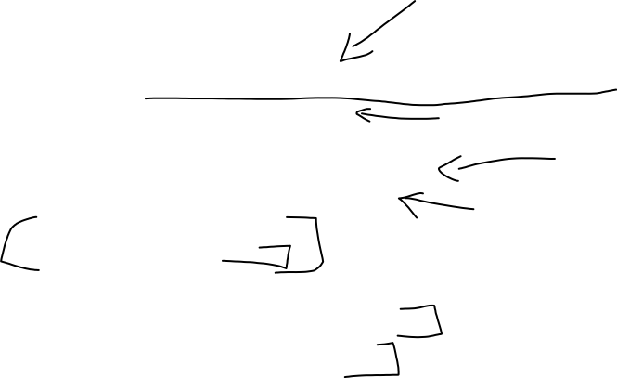
Challenges
Acquiring high-quality, high-coverage lexical resources
Improving document retrieval
Improving document understanding
Expanding to multi-lingual corpora
Flexible control structure
“beyond the pipeline”
Answer Justification
Why should the user trust the answer?
Is there a better answer out there?

Slide 21

Question Analysis
Question word cues
Who → person, organization, location (e.g., city)
When → date
Where → location
What/Why/How → ??
Head noun cues
What city, which country, what year...
Which astronaut, what blues band, ...
Adjective cues
How long, how fast, how far, how old, ...

Slide 22
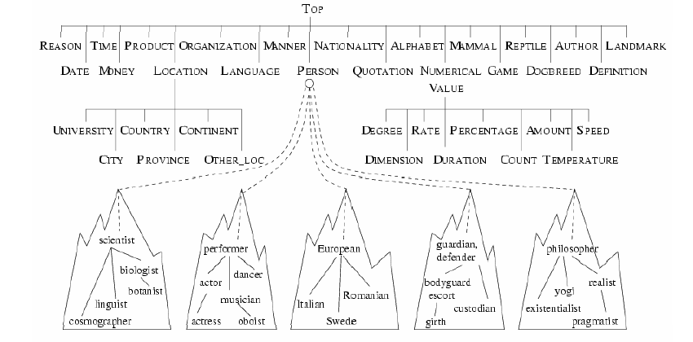
Answer Types

Slide 23

Advanced Issues in IR
Query Expansion
Typical queries very short
Expand user query using an initial search and taking words from top N docs, using a thesaurus, using term clustering or WordNet to find synonyms….
Tasks beyond Ad Hoc query support
Passage Retrieval, Multilingual IR, Speech IR, Summarization, Question Answering…

Slide 24
Question-Answering Systems
Beyond retrieving relevant documents -- Do people want answers to particular questions?
Three kinds of systems
Finding answers in document collections
Interfaces to relational databases
Mixed initiative dialog systems
What kinds of questions do people want to ask?

Slide 25
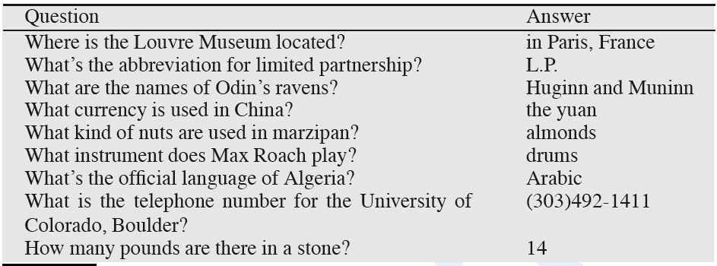
Factoid Questions

Slide 26
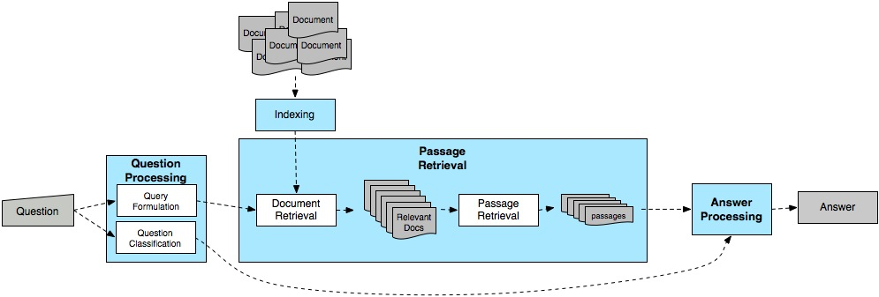

Typical Q/A Architecture

Slide 27

Question Processing
Two main tasks
Question classification: Determine the type of the answer
Query formulation: Extract keywords from the question and formulate a query

Slide 28

Answer Types
Factoid questions…
Who, where, when, how many…
Answers fall into limited, fairly predictable set of categories
Who questions will be answered by…
Where questions will be answered by …
Generally, systems select answer types from a set of Named Entities, augmented with other types that are relatively easy to extract

Slide 29
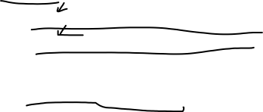
Answer Types Can Be More Complicated
Who questions can have organizations or countries as answers
Who sells the most hybrid cars?
Who exports the most wheat?
Which questions can have people as answers
Which president went to war with Mexico?

Slide 30

Taxonomy of Answer Types
Contains ~9000 concepts reflecting expected answer types
Merges NEs with the WordNet hierarchy

Slide 31

Answer Type Detection
Use combination of hand-crafted rules and supervised machine learning to determine the right answer type for a question
But how do we make use of this answer type once we hypothesize it?

Slide 32

Query Formulation: Extract Terms from Query
Questions approximated by sets of unrelated words (lexical terms)
Similar to bag-of-word IR models
Question (from TREC QA track) | Lexical terms
Q002: What was the monetary value of the Nobel Peace Prize in 1989? | monetary, value, Nobel, Peace, Prize
Q003: What does the Peugeot company manufacture? | Peugeot, company, manufacture
Q004: How much did Mercury spend on advertising in 1993? | Mercury, spend, advertising, 1993
Q005: What is the name of the managing director of Apricot Computer? | name, managing, director, Apricot, Computer

Slide 33
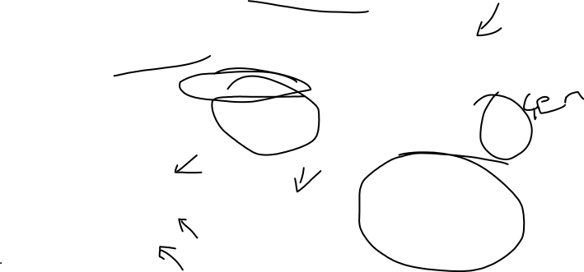
Passage Retrieval
Extracts and ranks passages
using surface-text techniques
Captures the semantics of the question
Selects keywords for PR
Extracts and ranks answers
using NL techniques
Question Semantics
Q
Question
Processing
Passage
Retrieval
Answer
Extraction
A
Keywords
Passages
WordNet
WordNet
Document
Retrieval
Parser
Parser
NER
NER

Slide 34
Answer Extraction
Extracts and ranks passages
using surface-text techniques
Captures the semantics of the question
Selects keywords for PR
Extracts and ranks answers
using NL techniques
Question Semantics
Q
Question
Processing
Passage
Retrieval
Answer
Extraction
A
Keywords
Passages
WordNet
WordNet
Document
Retrieval
Parser
Parser
NER
NER

Slide 35

Ranking Candidate Answers
Q066: Name the first private citizen to fly in space.
Answer type: Person
Text passage:
“Among them was Christa McAuliffe, the first private citizen to fly in space. Karen Allen, best known for her starring role in “Raiders of the Lost Ark”, plays McAuliffe. Brian Kerwin is featured as shuttle pilot Mike Smith...”

Slide 36

Ranking Candidate Answers
Q066: Name the first private citizen to fly in space.
Answer type: Person
Text passage:
“Among them was Christa McAuliffe, the first private citizen to fly in space. Karen Allen, best known for her starring role in “Raiders of the Lost Ark”, plays McAuliffe. Brian Kerwin is featured as shuttle pilot Mike Smith...”
Best candidate answer: Christa McAuliffe
How is this determined?

Slide 37

Features Used in Answer Ranking
Number of question terms matched in the answer passage
Number of question terms matched in the same phrase as the candidate answer
Number of question terms matched in the same sentence as the candidate answer
Flag set to 1 if the candidate answer is followed by a punctuation sign
Number of question terms matched, separated from the candidate answer by at most three words and one comma
Number of terms occurring in the same order in the answer passage as in the question
Average distance from candidate answer to question term matches
SIGIR ‘01

Slide 38
How does this approach compare to IE-based Q/A?
When was Barack Obama born?
Where was George Bush born?
What college did John McCain attend?
When did John F Kennedy die?

Slide 39

Is Q/A Different on the Web?
In TREC (and most commercial applications), retrieval is performed against a small closed collection of texts
More noise on the Web and more diversity
Different formats
Different genres
How likely are you to find the actual question you asked?
How likely are you to find a declarative version of your question?

Slide 40

QA over Semi-Structured data
Intuitive ways of accessing RDF data become more and more important.
Question answering approaches have been proposed as a good compromise between intuitiveness and expressivity.
general way: a triple-based representation
e.g. Who wrote The Neverending Story? (PowerAqua):
<[person,organization], wrote, Neverending Story>.
<Writer, IS_A, Person>
<Writer, author, The Neverending Story>

Slide 41
1. (a) Which cities have more than three universities?
(b) <[cities], more than, universities three>
(c) SELECT ?y WHERE {
?x rdf:type onto:University .
?x onto:city ?y .
}
HAVING (COUNT(?x) > 3)
2. (a) Who produced the most films?
(b)<[person,organization], produced, most films>
(c) SELECT ?y WHERE {
?x rdf:type onto:Film .
?x onto:producer ?y .
}
ORDER BY DESC(COUNT(?x)) OFFSET 0 LIMIT 0
the original semantic structure of the question can not be faithfully captured using triples.

Slide 42
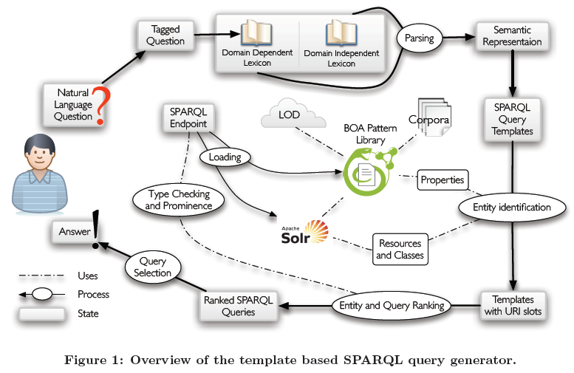
POS tagger

Slide 43
Who produced the most films?
POS tagger
(a) who/WP produced/VBD the/DT most/JJS films/NNS
Parsing and template generation
Domain independent lexicon:
107 entries: light verbs ,question words ,determiners, negation words, coordination and the like.
(b) Covered tokens: who, the most, the, most
Domain dependent lexicon: built on-the-fly.
POS tag ——> syntactic and semantic properties.
(c) Building entries for: produced/VBD, films/NNS

Slide 44
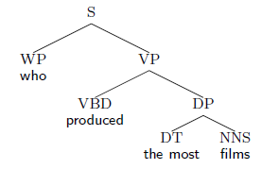
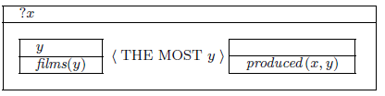
POS tag ——> syntactic and semantic properties.
Heuristics:
Named entities , resources.
Nouns , classes, properties.
Verbs, properties. If no contribution, instead by noun
(Which cities have more than 2 million inhabitants?)
syntactic representation semantic representation

Slide 45
SPARQL templates:
Who produced the most films?
(a) SELECT ?x WHERE {
?x ?p ?y .
?y rdf:type ?c .
}
ORDER BY DESC(COUNT(?y)) LIMIT 1 OFFSET 0
Slots:
<?c, class, films>
<?p, property, produced>
(b) SELECT ?x WHERE {
?x ?p ?y .
}
ORDER BY DESC(COUNT(?y)) LIMIT 1 OFFSET 0
Slots:
<?p, property, films>

Slide 46

Entity identification
String s——knowledge base K ——similar entity
Generic approach
S
Property detection
Large number of expressions can be used to denote the same predicate.
(X, the creator of Y and Y is a book by X )
BOA pattern library
WordNet
Label(e)
Entities e
S(s)

Slide 47




Pairs: I(p)={(x,y):(x p y)∈K}
NLE Ѳ : the form ?D? representation ?R? or ?R? representation ?D?
Distinguish patterns that are Specific to property p .
Support
Typicity
Specificity
pairs
x p y
Sentences: …"label(x) *label(y)" or "label(y) * label(x)"…
NLE Ѳ
Pairs (p, Ѳ)
BOA patterns

Slide 48

Query ranking and selection
String similarity, prominence of entities and the schema of the knowledge base to score a query.
Entities score:
type checks on queries . (?x p e e p ?x )
Return:
the highest scored query with a non-empty result.

Slide 49
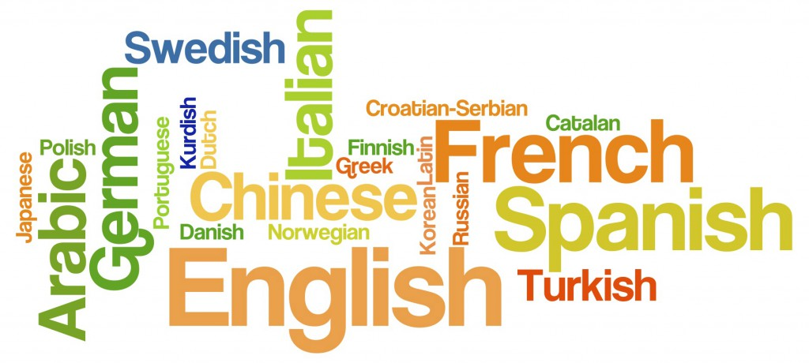
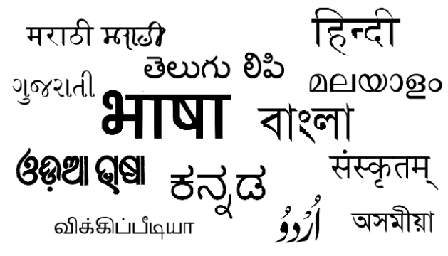

NLIDB Introduction
Who are your team mates ?
మీ జట్టు సభ్యులు ఎవరు?
Natural Language Interface
to Databases
(NLIDB)
SELECT ID, Name
FROM TeamMembers
WHERE ID > 100

Slide 50
Outline
History
Advantages
Challenges
Approaches to NLIDB
Syntactic
Semantic

Slide 51
History
NLIDB has been around since late 1960s (and longer than relational database systems)
NLIDB research peaked in 1980s, but failed to gain commercial acceptance—why?
Simpler interfaces took off: graphical and form-based
More precise interfaces became easier: SQL
Intrinsic problems with NL interfaces
How would DBMS development affect NLIDB?
Object-oriented DBMS? More complex structures?
Pervasiveness pushing the envelope of usability?

Slide 52
Advantages
User friendly
User doesn't need to learn artificial languages
Better for some questions
Which research center has no programmers ?
Discourse
Some NLIDBs support elliptical expressions

Slide 53
Challenges
Current NLIDBs deal with subset of NLs
Domain, FAQs patterns etc..
Inappropriate medium -> Forms
Linguistic problems
Modifier Attachment
List all the students in the college with ID card
Quantifier Scoping
Has every student taken some course
Conjunction disjunction
List all students who live in Bakul and OBH
What is the average score of MS and MTech students in NLP
Anaphora , Elliptical expressions etc...

Slide 54
NLIDB Introduction
q_{NL}
q_{dbL}

Slide 55
Major focus in NLIDB
Inherent Ambiguity in Natural languages
Domain Expert dependency
Mapping :
Semantic items (NL) : Triples (dbL)
Surface level models
Syntax/Semantic level models

Slide 56
Surface Level: Keyword Matching Model
Concentrates on Identifying Domain keywords
Matches with the semantic patterns
Apt for simple queries
Can't handle complex queries
Needs large number of patterns
Tends to Language dependent
Ex: PRECISE

Slide 57
Syntax/Semantic level Model
Depends on linguistic information
Tokenizer, Morph Analysis, POS Tagger, Chunker
Uses PST/Dependency trees
Extracts domain terms
Uses semantic frames

