Slide 1
Neural Machine Translation
Manish Shrivastava

Slide 2
Reference Materials
Deep Learning for NLP by Richard Socher http://cs224d.stanford.edu/
Tutorial and Visualization tool by Xin Rong http://www-personal.umich.edu/~ronxin/pdf/w2vexp.pdf
Word2vec in Gensim by Radim Řehůřek http://rare-technologies.com/deep-learning-with-word2vec-and-gensim/
Slides by Girish K, Vagelis Hristidis, Richard Socher and many others.

Slide 3
Deep Learning
Number of Applications
Primary premise:
Word Representation : Words represented as dense vectors embedded in a vector space
Many different approaches to learn
Many different applications
Some new ones : Word Analogies, Semantic Similarity etc.

Slide 4
Role of Deep Learning in NLP
Similarity?
France:Paris::Russia:Moscow
E(King)-E(Man)+E(Woman) =E(Queen)

Slide 5
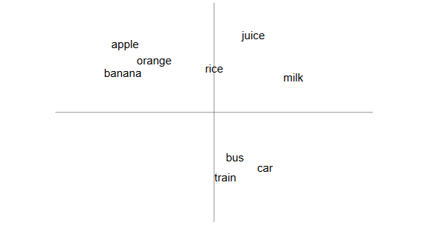
“You shall know a word by the company it keeps!”
Firth (1957)

Slide 6
Role of Deep Learning in NLP
Similarity?
Not Really!!
Methods for Semantic Similarity have existed for a long time.
Distributional Semantics

Slide 7
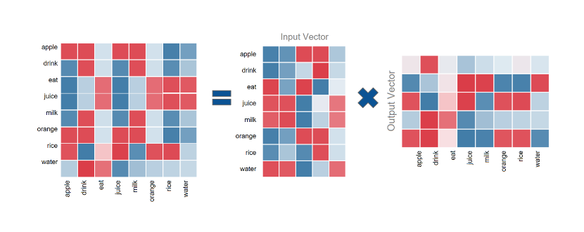
Singular Value Decomposition
The problem with this method, is that we may end up with matrices having billions of rows and columns, which makes SVD computationally restrictive.

Slide 8
Singular Value Decomposition (SVD)
Handy mathematical technique that has application to many problems
Given any m×n matrix A, algorithm to find matrices U, V, and W such that
A = U W V^{T}
U is m×n and orthonormal
W is n×n and diagonal
V is n×n and orthonormal

Slide 9
SVD
Treat as black box: code widely available

Slide 10
SVD
The w_{i} are called the singular values of A
If A is singular, some of the w_{i} will be 0
In general rank(A) = number of nonzero w_{i}
SVD is mostly unique (up to permutation of singular values, or if some w_{i} are equal)

Slide 11
SVD and Inverses
Why is SVD so useful?
Application #1: inverses
A⁻¹=(V^{T})⁻¹ W⁻¹ U⁻¹ = V W⁻¹ U^{T}
Using fact that inverse = transpose for orthogonal matrices
Since W is diagonal, W⁻¹ also diagonal with reciprocals of entries of W

Slide 12
SVD and Inverses
A⁻¹=(V^{T})⁻¹ W⁻¹ U⁻¹ = V W⁻¹ U^{T}
This fails when some w_{i} are 0
It’s supposed to fail – singular matrix
Pseudoinverse: if w_{i}=0, set 1/w_{i} to 0 (!)
“Closest” matrix to inverse
Defined for all (even non-square, singular, etc.) matrices
Equal to (A^{T}A)⁻¹A^{T} if A^{T}A invertible

Slide 13
SVD and Eigenvectors
Let A=UWV^{T}, and let x_{i} be i^{th} column of V
Consider A^{T}A x_{i}:
So elements of W are sqrt(eigenvalues) and columns of V are eigenvectors of A^{T}A
What we wanted for robust least squares fitting!

Slide 14
Word Representations
Traditional Method - Bag of Words Model | Word Embeddings
Uses one hot encoding Each word in the vocabulary is represented by neighbouring words For example, if we have a vocabulary of 10000 words, and “Hello” is a word in the dictionary, it would be represented by: [12 3 1 0 0 4 1 50 … 0 ] Each number (in this instance) is the frequency of surrounding words in all contexts Dimensions are words. | Stores each word in as a point in space, where it is represented by a vector of fixed number of dimensions (generally 300) Unsupervised, built just by reading huge corpus For example, “Hello” might be represented as : [0.4, -0.11, 0.55, 0.3 . . . 0.1, 0.02] Dimensions are basically projections along different axes, more of a mathematical concept.

Slide 15
Applications of Word Vectors
Word Similarity
Easily identifies similar words and synonyms since they occur in similar contexts
Stemming (thought -> think)
Inflections, Tense forms
eg. Think, thought, ponder, pondering,
eg. Plane, Aircraft, Flight

Slide 16
Applications of Word Vectors
2. Machine Translation
I am a cook .
நான் ஒரு சமையல்காரன்.
मैं एक बावर्ची हूं ।
Je suis un cuisinier .

Slide 17
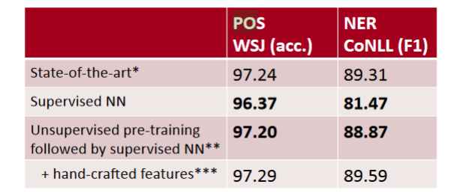
Applications of Word Vectors
Part-of-Speech and Named Entity Recognition

Slide 18
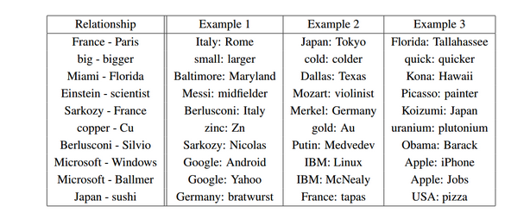
Applications of Word Vectors
4. Relation Extraction

Slide 19
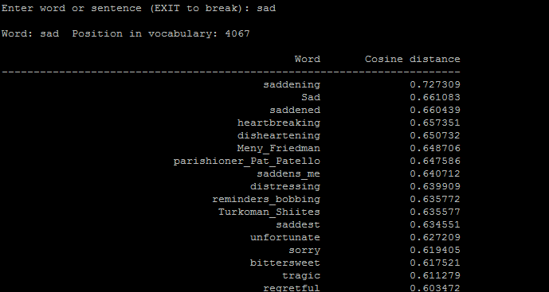
Applications of Word Vectors
5. Sentiment Analysis
Cassifying sentences as positive and negative
Building sentiment lexicons using seed sentiment sets
No need for classifiers, we can just use cosine distances to compare unseen reviews to known reviews.

Slide 20
Applications of Word Vectors
6. Co-reference Resolution
Chaining entity mentions across multiple documents - can we find and unify the multiple contexts in which mentions occurs?
7. Clustering
Words in the same class naturally occur in similar contexts, and this feature vector can directly be used with any conventional clustering algorithms (K-Means, agglomerative, etc). Human doesn’t have to waste time hand-picking useful word features to cluster on.
8. Semantic Analysis of Documents
Build word distributions for various topics, etc.

Slide 21
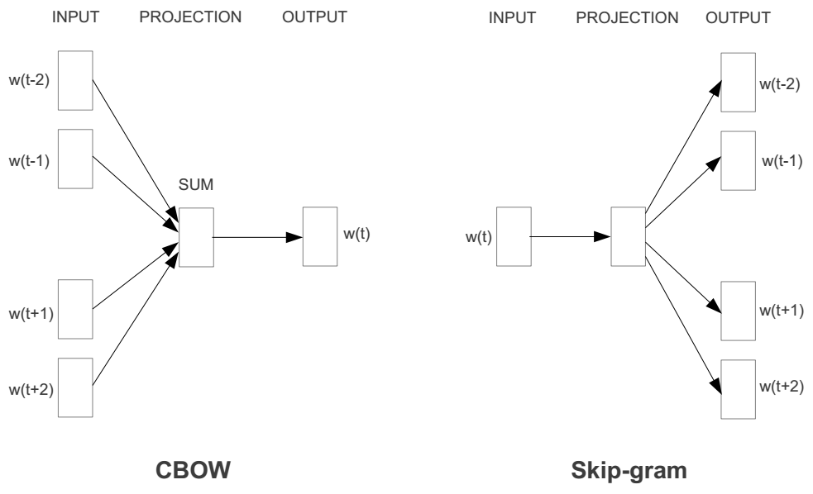
Represent the meaning of word Word2vec
2 basic neural network models:
Continuous Bag of Word (CBOW): use a window of word to predict the middle word
Skip-gram (SG): use a word to predict the surrounding ones in window.

Slide 22
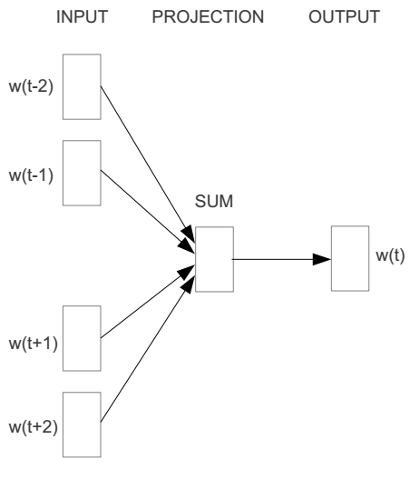
Word2vec – Continuous Bag of Word
E.g. “The cat sat on floor”
Window size = 2
the
cat
sat
on
floor

Slide 23
Input layer
Index of cat in vocabulary
0
1
0
cat
0
Hidden layer
Output layer
0
0
0
0
0
0
…
0
0
0
one-hot
vector
0
sat
one-hot
vector
0
0
0
0
1
0
…
1
0
on
0
0
0
0
…
0

Slide 24



We must learn W and W’
Input layer
0
1
0
cat
0
$$W_{V×N}$$
Hidden layer
Output layer
0
0
0
0
0
0
V-dim
…
0
0
$${W′}_{N×V}$$
0
0
sat
0
0
0
0
1
0
$$W_{V×N}$$
N-dim
…
V-dim
1
0
on
0
0
0
0
V-dim
…
N will be the size of word vector
0

Slide 25
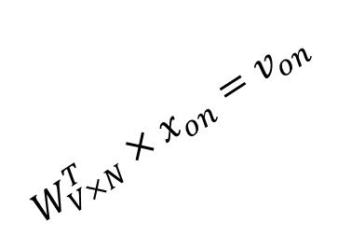

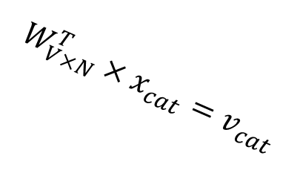



$$W_{V×N}^{T} ×x_{cat}=v_{cat}$$
0.1 | 2.4 | 1.6 | 1.8 | 0.5 | 0.9 | … | … | … | 3.2
0.5 | 2.6 | 1.4 | 2.9 | 1.5 | 3.6 | … | … | … | 6.1
… | … | … | … | … | … | … | … | … | …
… | … | … | … | … | … | … | … | … | …
0.6 | 1.8 | 2.7 | 1.9 | 2.4 | 2.0 | … | … | … | 1.2
0
2.4
2.6
…
…
1.8
Input layer
1
$$×$$
0
$$=$$
0
0
1
0
0
0
x_{cat}
0
0
Output layer
0
0
0
$$W_{V×N}^{T}×x_{cat}=v_{cat}$$
…
0
0
0
0
0
V-dim
…
0
0
$$\hat{v}=\frac{v_{cat}+v_{on}}{2}$$
0
+
0
sat
0
0
0
0
$$W_{V×N}^{T}×x_{on}=v_{on}$$
1
0
…
V-dim
1
Hidden layer
0
x_{on}
0
0
N-dim
0
0
V-dim
…
0

Slide 26

$$W_{V×N}^{T} ×x_{on}=v_{on}$$
0.1 | 2.4 | 1.6 | 1.8 | 0.5 | 0.9 | … | … | … | 3.2
0.5 | 2.6 | 1.4 | 2.9 | 1.5 | 3.6 | … | … | … | 6.1
… | … | … | … | … | … | … | … | … | …
… | … | … | … | … | … | … | … | … | …
0.6 | 1.8 | 2.7 | 1.9 | 2.4 | 2.0 | … | … | … | 1.2
0
1.8
2.9
…
…
1.9
Input layer
0
$$×$$
0
$$=$$
0
1
1
0
0
0
x_{cat}
0
0
Output layer
0
0
0
$$W_{V×N}^{T}×x_{cat}=v_{cat}$$
…
0
0
0
0
0
V-dim
…
0
0
$$\hat{v}=\frac{v_{cat}+v_{on}}{2}$$
0
+
0
sat
0
0
0
0
$$W_{V×N}^{T}×x_{on}=v_{on}$$
1
0
…
V-dim
1
Hidden layer
0
x_{on}
0
0
N-dim
0
0
V-dim
…
0

Slide 27






Input layer
0
1
0
cat
0
$$W_{V×N}$$
Hidden layer
Output layer
0
0
0
0
0
0
V-dim
…
0
0
$$W_{V×N}^{′}×\hat{v}=z$$
0
$$\hat{y}=softmax(z)$$
0
0
0
0
0
$$\hat{v}$$
1
0
$$W_{V×N}$$
…
1
N-dim
0
on
0
${\hat{y}}_{sat}$
0
0
V-dim
0
V-dim
…
N will be the size of word vector
0

Slide 28


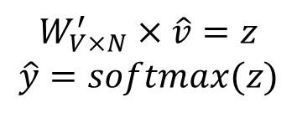
Input layer
0
We would prefer $\hat{y}$ close to ${\hat{y}}_{sat}$
1
0
cat
0
$$W_{V×N}$$
Hidden layer
Output layer
0
0
0
0
0.01
0.02
0.00
0.02
0.01
0.02
0.01
0.7
…
0.00
0
0
V-dim
…
0
0
$$W_{V×N}^{′}×\hat{v}=z$$
$$\hat{y}=softmax(z)$$
0
0
0
0
0
0
$$\hat{v}$$
1
0
$$W_{V×N}$$
…
1
N-dim
0
on
0
${\hat{y}}_{sat}$
0
0
V-dim
0
V-dim
…
N will be the size of word vector
$\hat{y}$
0

Slide 29




$$W_{V×N}^{T}$$
0.1 | 2.4 | 1.6 | 1.8 | 0.5 | 0.9 | … | … | … | 3.2
0.5 | 2.6 | 1.4 | 2.9 | 1.5 | 3.6 | … | … | … | 6.1
… | … | … | … | … | … | … | … | … | …
… | … | … | … | … | … | … | … | … | …
0.6 | 1.8 | 2.7 | 1.9 | 2.4 | 2.0 | … | … | … | 1.2
Contain word’s vectors
Input layer
0
1
0
x_{cat}
0
Output layer
0
0
$$W_{V×N}^{}$$
0
0
0
0
V-dim
…
0
0
$$W_{V×N}^{′}$$
0
0
sat
0
0
0
0
1
0
$$W_{V×N}^{}$$
…
1
0
V-dim
x_{on}
0
Hidden layer
0
N-dim
0
0
V-dim
…
0
We can consider either W or W’ as the word’s representation. Or even take the average.
Notes:
W contains input word vectors.
W’ contains output word vectors.
We can consider either W or W’ as the word’s representation. Or even take the average.

Slide 30
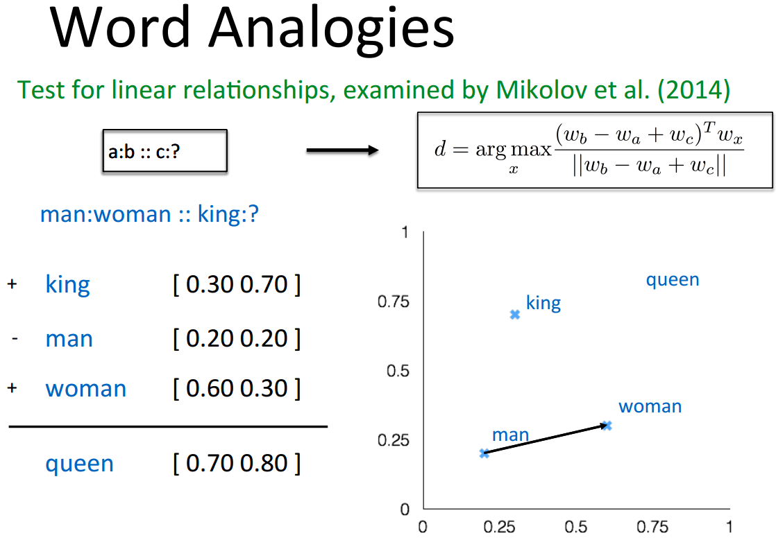
Some interesting results

Slide 31
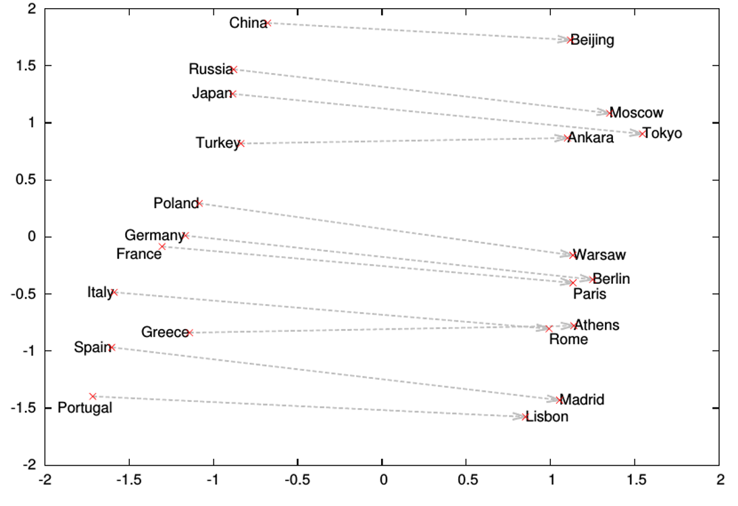
Word analogies

Slide 32
Now what?
Word2Vec == Deep Learning
No!
The first step
Embeddings are dense vectors
Can encapsulate context information
Can serve as information points similar to pixels
Serve as input to Deep learning models
CNNs, RNNs and many more

Slide 33
Deep Learning and NLP
Tasks
Language Modeling
Semantic encoding of larger sentential units
Semantic similarity at larger granularity for various tasks

Slide 34

Language Modelling Problem
Aim is to calculate the probability of a sequence (sentence) P(X)
Can be decomposed into product of conditional probabilities of tokens (works):
In practice, only finite content used

Slide 35

N-Gram Language Model
N-Grams estimate word conditional probabilities via counting:
Sparse (alleviated by back-off, but not entirely)
Doesn’t exploit word similarity
Finite Context

Slide 36
Neural Network Language Models (NNLMs)
Feed-forward NNLM
Recurrent NNLM
Output
Output
Output
aardvark = 0.000041
aardvark = 0.000054
aardvark = 0.0082
…
…
…
drove = 0.045
to = 0.267
store = 0.0191
…
…
…
zygote = 0.00003
zygote = 0.000009
zygote = 0.003
Hidden 2
Recurrent Hidden
Recurrent Hidden
Hidden 1
Embedding
Embedding
Embedding
Embedding
Embedding
Embedding
he
drove
he
drove
to
the

Slide 37
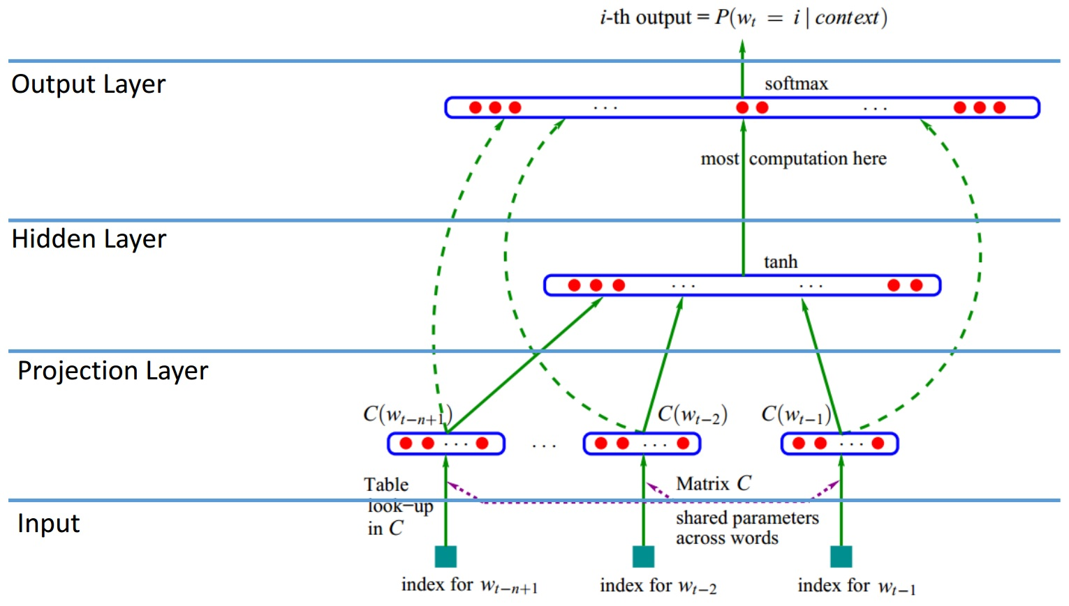
Neural Network Language Model
Y. Bengio et al., JMLR’03

Slide 38
Limitation of Neural Network Language Model
Sparsity – Solved
World Similarity – Solved
Finite Context – Not
Computational Complexity - Softmax

Slide 39
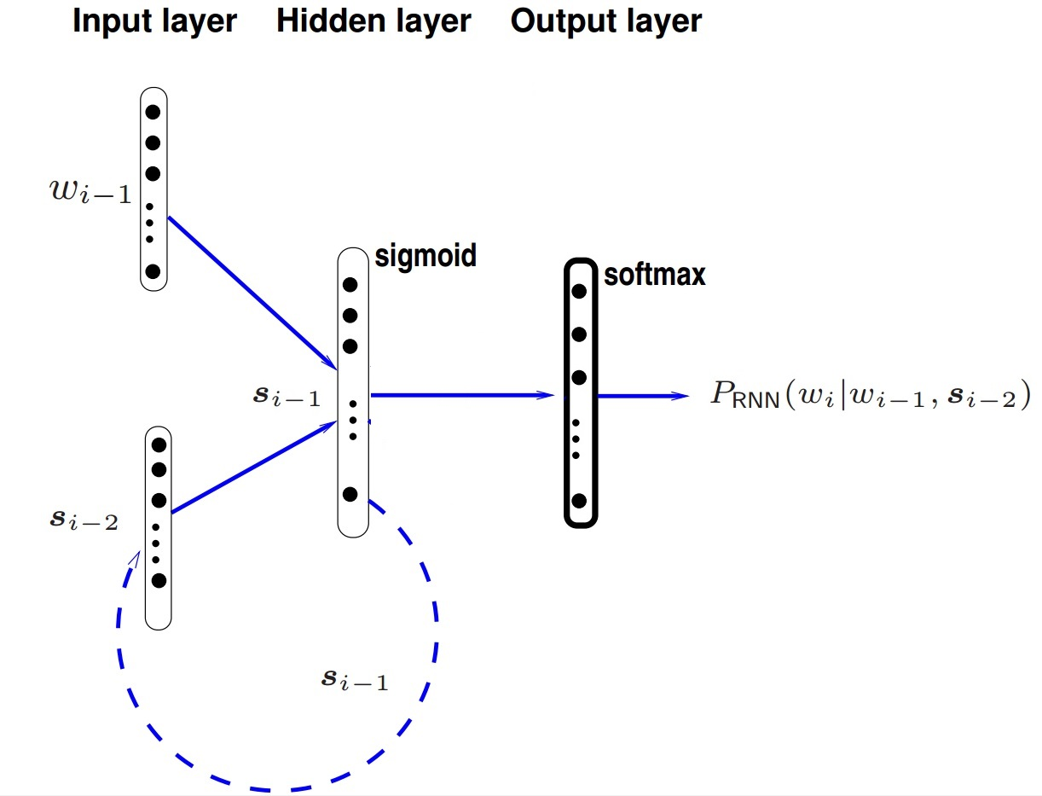
Recurrent Neural Network Language Model
[X. Liu, et al.]

Slide 40
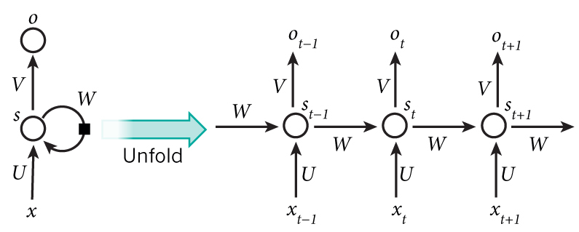

Recurrent Neural Network

Slide 41
How does RNN reduce complexity?
Given function f: h’,y=f(h,x)
h and h’ are vectors with the same dimension
y¹
y²
y³
h⁰
f
h¹
f
h²
f
h³
……
x¹
x²
x³
No matter how long the input/output sequence is, we only need one function f. If f’s are different, then it becomes a feedforward NN. This may be treated as another compression from fully connected network.

Slide 42
Bidirectional RNN
y,h=f₁(x,h)
z,g = f₂(g,x)
x¹
x²
x³
g⁰
f₂
g¹
f₂
g²
f₂
g³
z¹
z²
z³
p¹
p²
p³
p=f₃(y,z)
f₃
f₃
f₃
y¹
y²
y³
h⁰
f₁
h¹
f₁
h²
f₁
h³
x¹
x²
x³

Slide 43
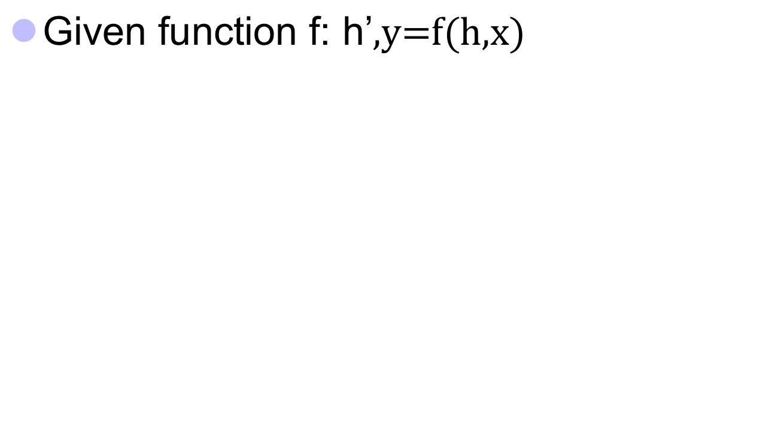



Naïve RNN
y
h'
W^{h}
^{h}
W^{i}
x
h
f
h'
y
Wº
^{h’}
Note, y is computed
from h’
x
softmax
We have ignored the bias

Slide 44
Problems with naive RNN
When dealing with a time series, it tends to forget old information. When there is a distant relationship of unknown length, we wish to have a “memory” to it.
Vanishing gradient problem.

