Slide 1
Neural Machine Translation
Manish Shrivastava

Slide 2
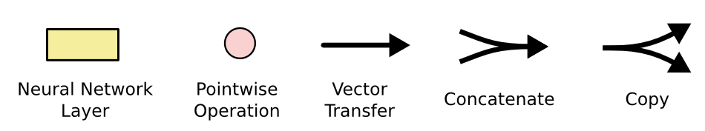
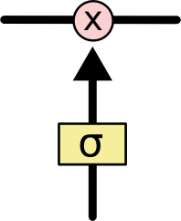
The sigmoid layer outputs numbers between 0-1 determine how much
each component should be let through. Pink X gate is point-wise multiplication.

Slide 3
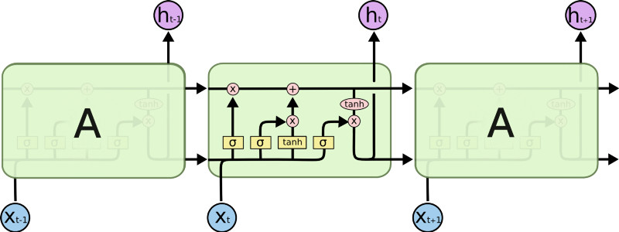
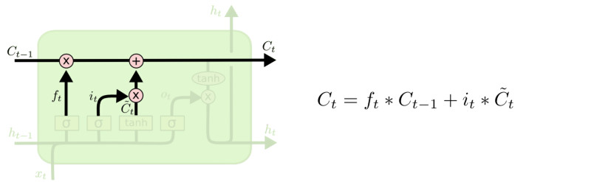
LSTM
Output gate
Controls what
goes into output
This sigmoid gate
determines how much
information goes thru
This decides what info
Is to add to the cell state
C_{t-1}
h_{t-1}
Forget input
gate gate
The core idea is this cell state C_{t}, it is changed slowly, with only minor linear interactions. It is very easy for information to flow along it unchanged.
Why sigmoid or tanh:
Sigmoid: 0,1 gating as switch.
Vanishing gradient problem in
LSTM is handled already.
ReLU replaces tanh ok?

Slide 4
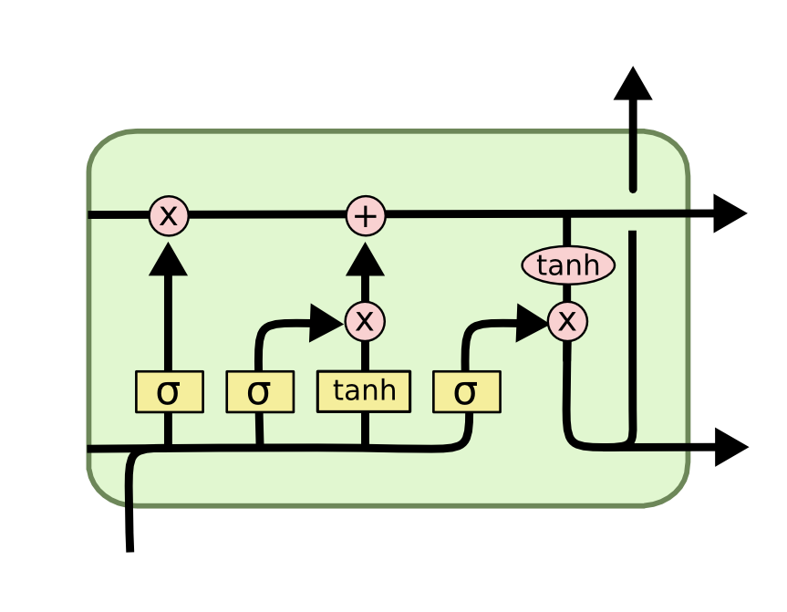
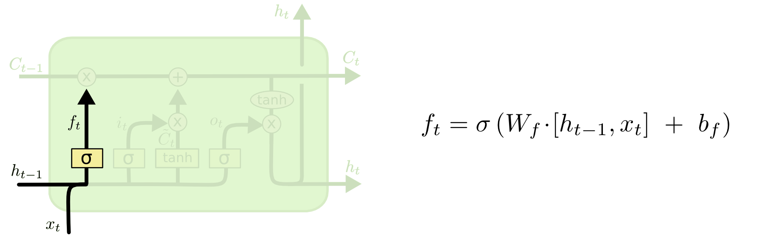
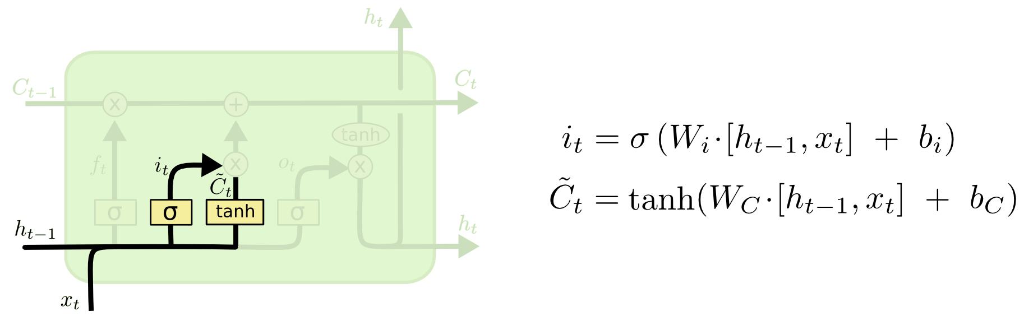
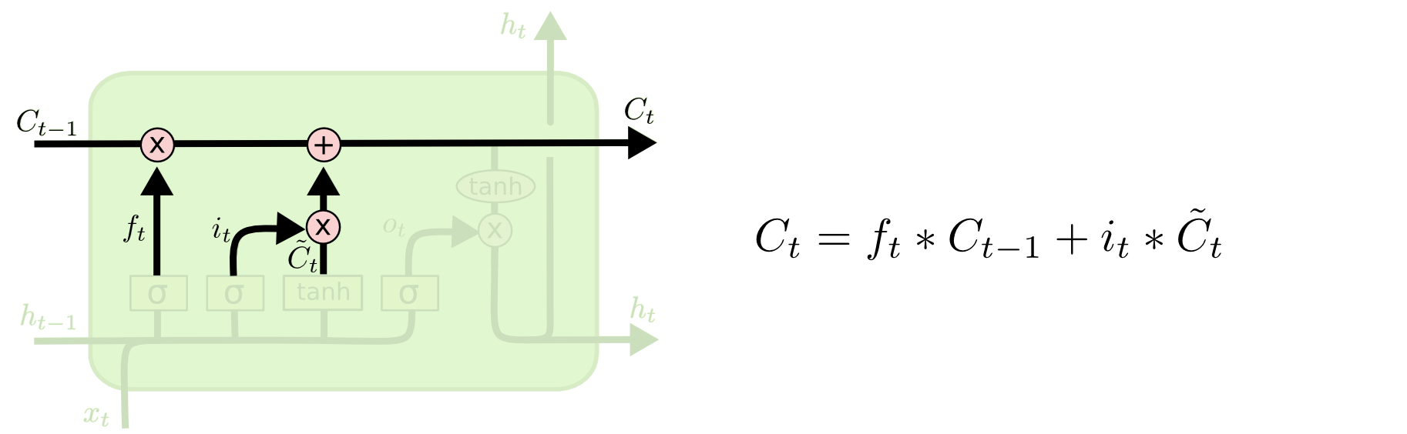
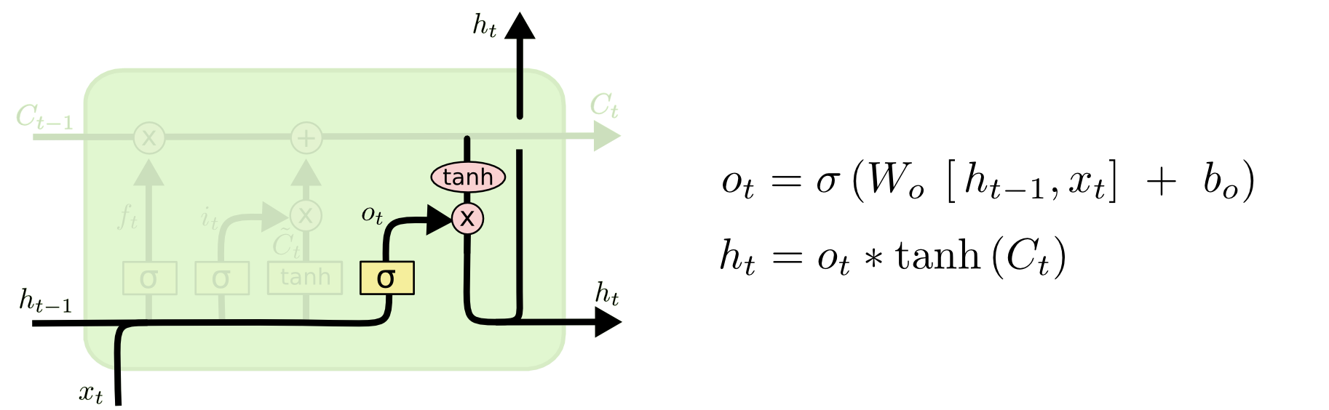
i_{t} decides what component
is to be updated.
C’_{t} provides change contents
Updating the cell state
Decide what part of the cell
state to output

Slide 5
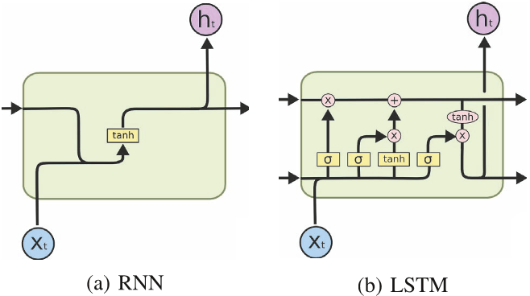
RNN vs LSTM

Slide 6
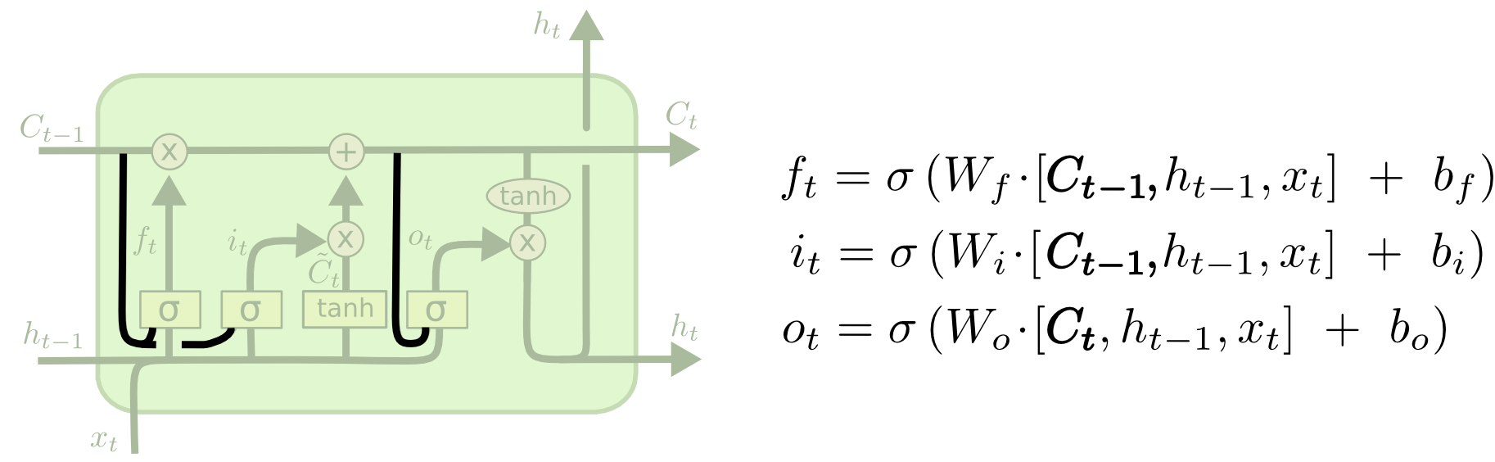
Peephole LSTM
Allows “peeping into the memory”

Slide 7
Naïve RNN vs LSTM
y^{t}
LSTM
c^{t}
y^{t}
c^{t-1}
Naïve
RNN
h^{t}
h^{t}
h^{t-1}
h^{t-1}
x^{t}
x^{t}
c changes slowly
c^{t} is c^{t-1} added by something
h changes faster
h^{t} and h^{t-1} can be very different

Slide 8
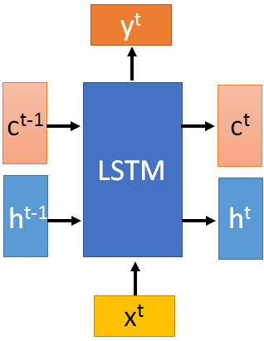

These 4 matrix
computation should
be done concurrently.
x^{t}
z
W
h^{t-1}
c^{t-1}
x^{t}
z^{i}
W^{i}
= σ( )
h^{t-1}
Controls
forget gate
Controls
input gate
Updating
information
Controls
Output gate
W^{f}
x^{t}
z^{f}
= σ( )
h^{t-1}
z^{f}
z^{i}
z
zº
x^{t}
zº
Wº
= σ( )
h^{t-1}
x^{t}
h^{t-1}
Information flow of LSTM

Slide 9
x^{t}
z
W
h^{t-1}
=tanh( )
c^{t-1}
c^{t-1}
diagonal
“peephole”
zº
z^{f}
z^{i}
obtained by the same way
z^{f}
z^{i}
z
zº
h^{t-1}
x^{t}
Information flow of LSTM

Slide 10




Element-wise multiply
y^{t}
c^{t-1}
c^{t}
c^{t} = z^{f}  c^{t-1} + z^{i}z
tanh
h^{t} = zº  tanh(c^{t})
y^{t} = σ(W’ h^{t})
z^{f}
z^{i}
z
zº
h^{t-1}
x^{t}
h^{t}
Information flow of LSTM

Slide 11



LSTM information flow
y^{t}
y^{t+1}
c^{t-1}
c^{t}
c^{t+1}
tanh
tanh
z^{f}
z^{i}
z
zº
z^{f}
z^{i}
z
zº
h^{t+1}
h^{t-1}
x^{t}
h^{t}
x^{t+1}
Information flow of LSTM

Slide 12
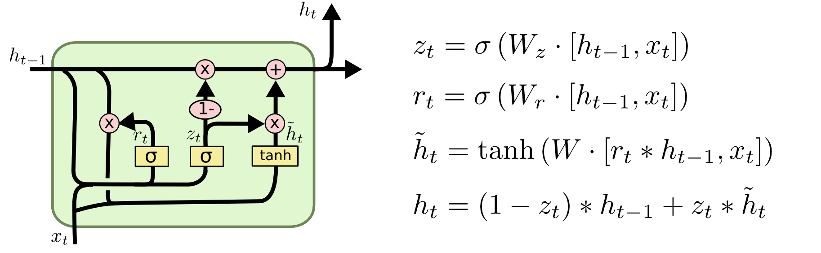
GRU – gated recurrent unit (more compression)
LSTM
reset gate
Update gate
It combines the forget and input into a single update gate.
It also merges the cell state and hidden state. This is simpler
than LSTM. There are many other variants too.
X,*: element-wise multiply

Slide 13
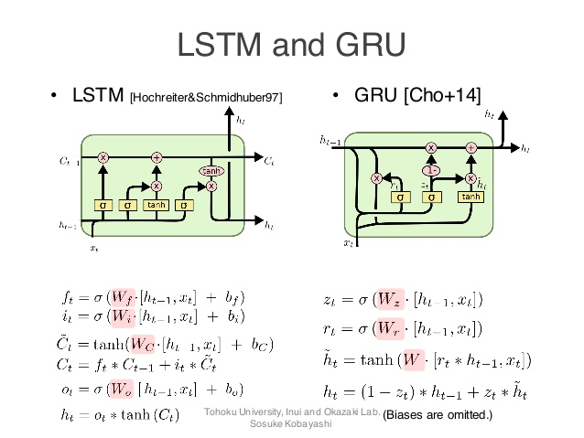
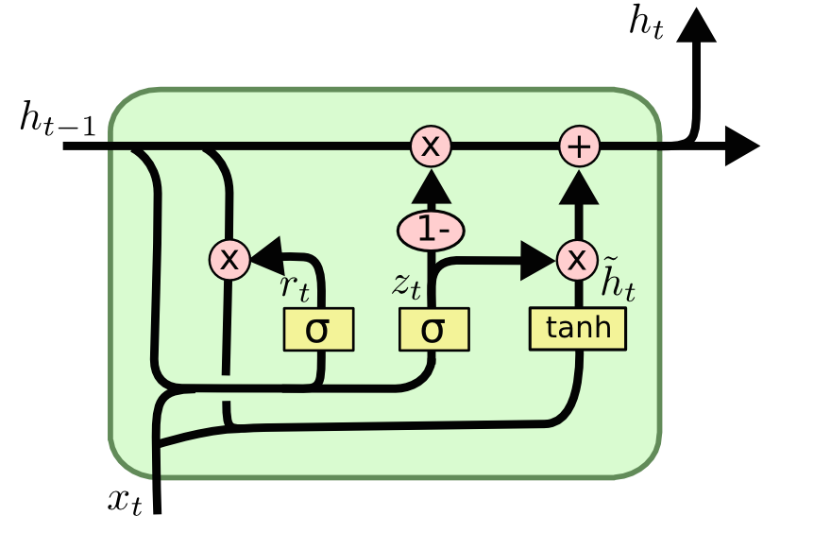
GRUs also takes x_{t} and h_{t-1} as inputs. They perform some calculations and then pass along h_{t}. What makes them different from LSTMs is that GRUs don't need the cell layer to pass values along. The calculations within each iteration insure that the h_{t} values being passed along either retain a high amount of old information or are jump-started with a high amount of new information.

Slide 14
Feed-forward vs Recurrent Network
1. Feedforward network does not have input at each step
2. Feedforward network has different parameters for each layer
x
f₁
a¹
f₂
a²
f₃
a³
f₄
y
t is layer
a^{t} = f_{t}(a^{t-1}) = σ(W^{t}a^{t-1} + b^{t})
h⁰
f
h¹
f
h²
f
h³
f
g
y⁴
x¹
x²
x³
x⁴
t is time step
a^{t}= f(a^{t-1}, x^{t}) = σ(W^{h} a^{t-1} + W^{i}x^{t} + b^{i})
We will turn the recurrent network 90 degrees.

Slide 15
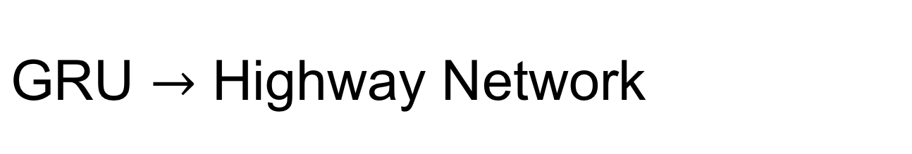

y^{t}
No input x^{t} at each step
a^{t-1}
a^{t}
h^{t-1}
h^{t}
No output y^{t} at each step
1-
a^{t-1} is the output of the (t-1)-th layer
reset
update
a^{t} is the output of the t-th layer
r
z
h'
No reset gate
a^{t-1}
h^{t-1}
x^{t}
x^{t}

Slide 16
h’=σ(Wa^{t-1})
Highway Network
z=σ(W’a^{t-1})
a^{t} = z  a^{t-1} + (1-z)  h
Highway Network
Residual Network
a^{t}
a^{t}
+
a^{t-1}
z controls red arrow
h’
h’
Gate controller
copy
copy
a^{t-1}
a^{t-1}
Training Very Deep Networks
https://arxiv.org/pdf/1507.06228v2.pdf
Deep Residual Learning for Image Recognition
http://arxiv.org/abs/1512.03385

Slide 17
output layer
output layer
output layer
Highway Network automatically
determines the layers needed!
Input layer
Input layer
Input layer

Slide 18
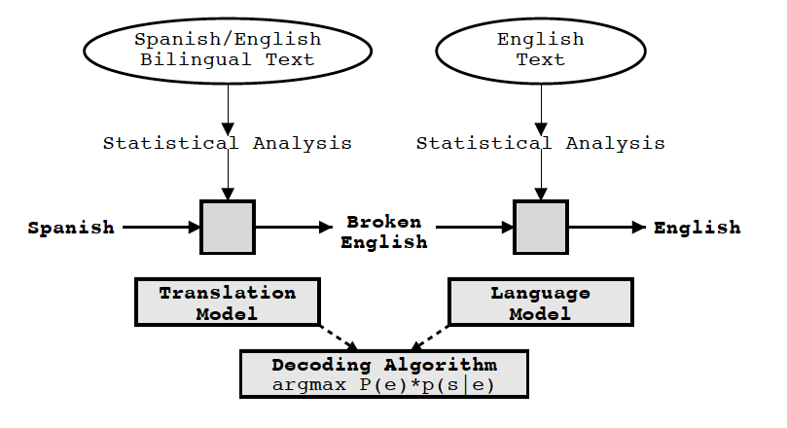
Statistical Machine Translation
Knight and Koehn 2003

Slide 19
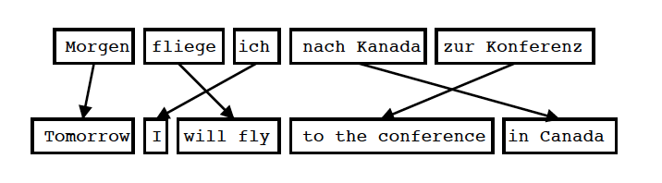
Statistical Machine Translation
Translation model
Input is Segmented in Phrases
Each Phrase is Translated into English
Phrases are Reordered
Koehn 2004

Slide 20
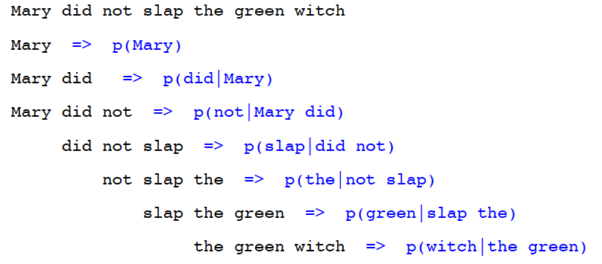
Statistical Machine Translation
Language Model
Goal of the Language Model: Detect good English P(e)
Standard Technique: Trigram Model
Knight and Koehn 2003

Slide 21
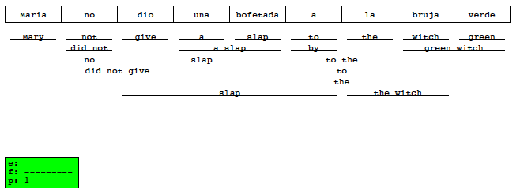
Statistical Machine Translation
Decoding
Goal of the decoding algorithm: Put models to work, perform the actual translation
Koehn 2004

Slide 22
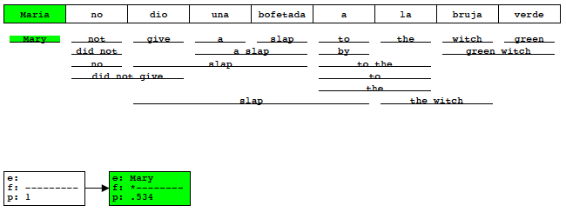
Statistical Machine Translation
Decoding
Goal of the decoding algorithm: Put models to work, perform the actual translation
Koehn 2004

Slide 23
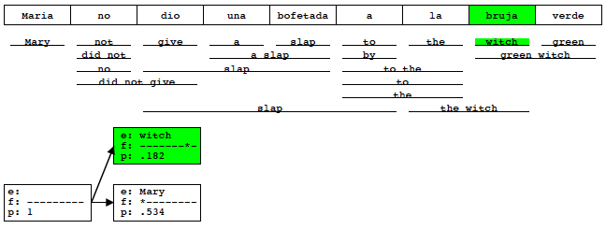
Statistical Machine Translation
Decoding
Goal of the decoding algorithm: Put models to work, perform the actual translation
Koehn 2004

Slide 24
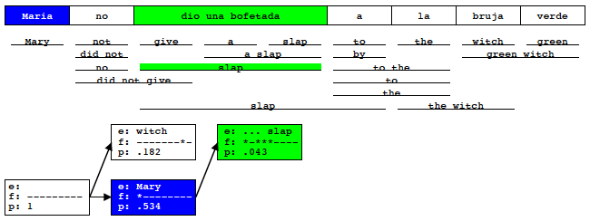
Statistical Machine Translation
Decoding
Goal of the decoding algorithm: Put models to work, perform the actual translation
Koehn 2004

Slide 25
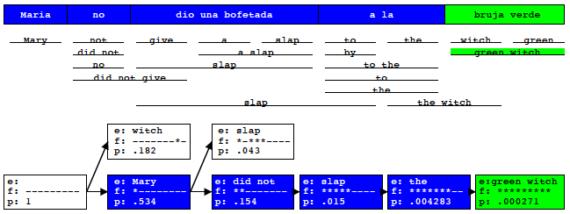
Statistical Machine Translation
Decoding
Goal of the decoding algorithm: Put models to work, perform the actual translation
Koehn 2004

Slide 26
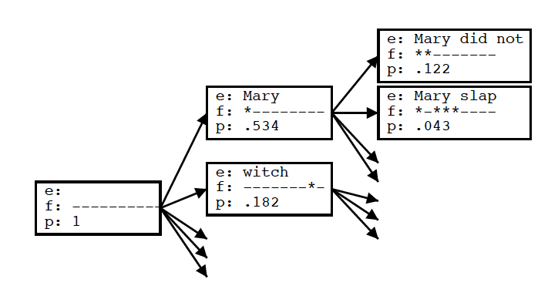
Statistical Machine Translation
Decoding
Goal of the decoding algorithm: Put models to work, perform the actual translation
Koehn 2004

Slide 27
Statistical Machine Translation
Decoding
Goal of the decoding algorithm: Put models to work, perform the actual translation
Prune out Weakest Hypotheses
by absolute threshold (keep 100 best)
by relative cutoff
Future Cost Estimation
compute expected cost of untranslated words

Slide 28
Sutskever et al.,2014
Sequence to Sequence Learning with Neural Networks

Slide 29
Neural Machine Translation
W X Y Z
Model
A B C

Slide 30
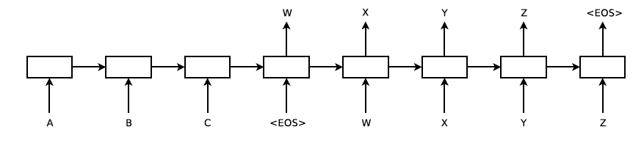
Neural Machine Translation
Model
Sutskever et al. 2014

Slide 31
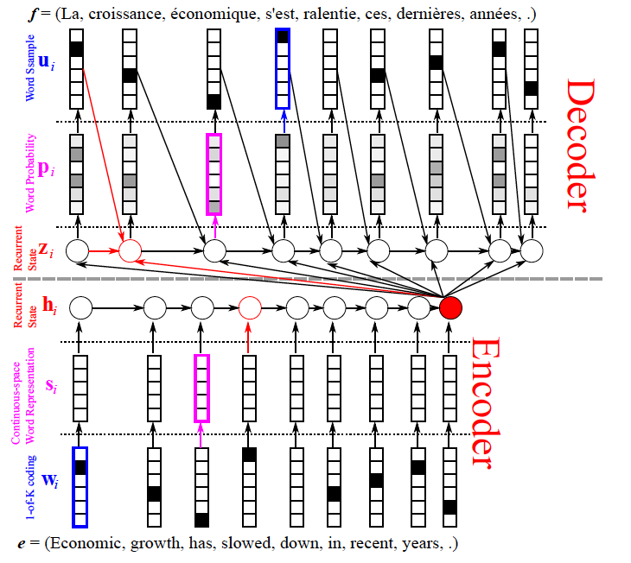
Neural Machine Translation
Model-
Cho: From Sequence Modeling to Translation

Slide 32
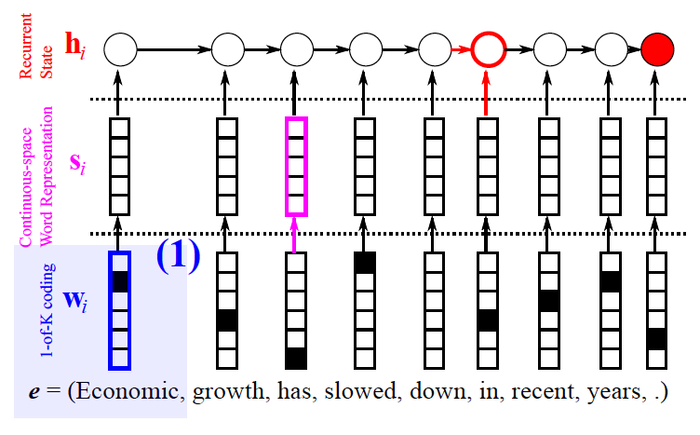
Neural Machine Translation
Model- encoder
Cho: From Sequence Modeling to Translation

Slide 33
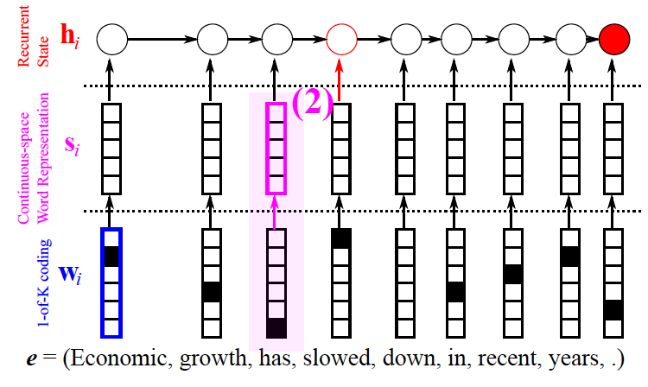
Neural Machine Translation
Model- encoder
Cho: From Sequence Modeling to Translation

Slide 34
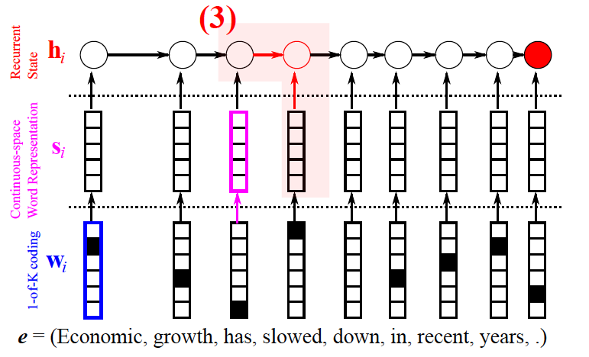
Neural Machine Translation
Model- encoder
Cho: From Sequence Modeling to Translation

Slide 35
Neural Machine Translation
Model- encoder
Cho: From Sequence Modeling to Translation

Slide 36
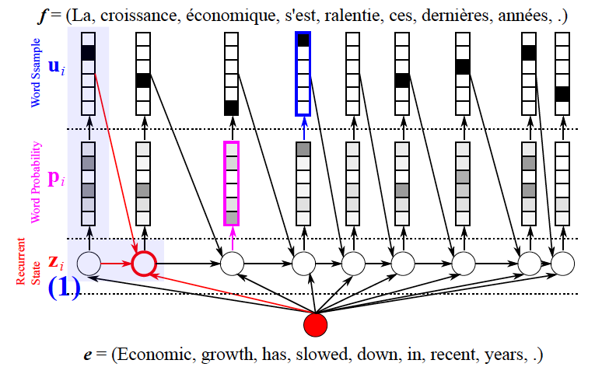
Neural Machine Translation
Model- decoder
Cho: From Sequence Modeling to Translation

Slide 37
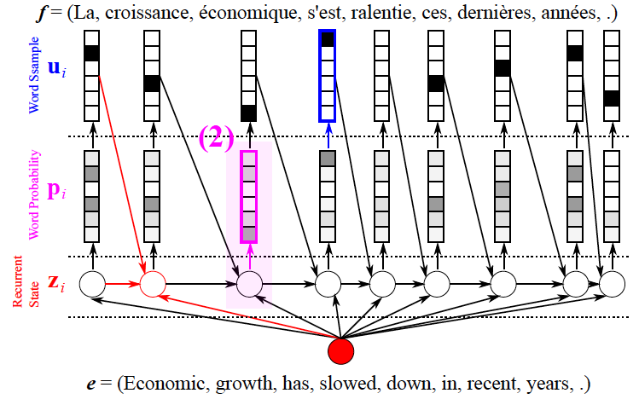
Neural Machine Translation
Model- decoder
Cho: From Sequence Modeling to Translation

Slide 38
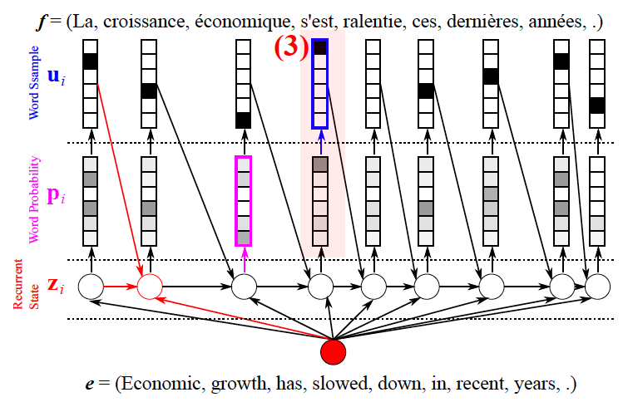
Neural Machine Translation
Model- decoder
Cho: From Sequence Modeling to Translation

Slide 39

Neural Machine Translation
RNN

Slide 40
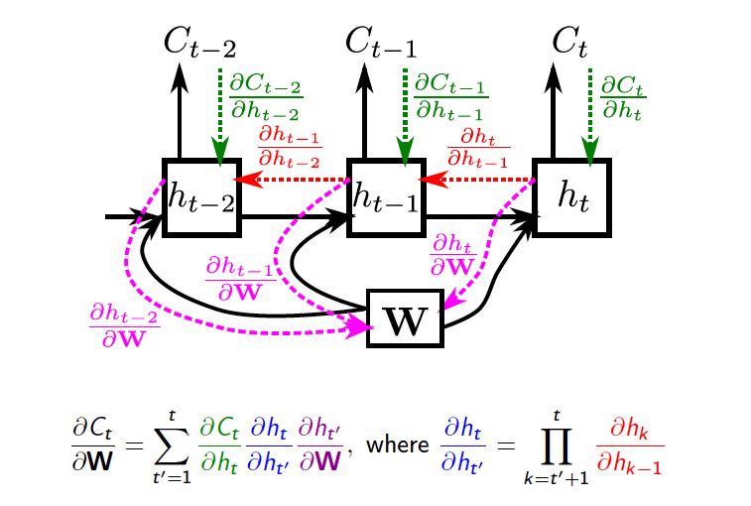
Neural Machine Translation
RNN
Vanishing gradient
Cho: From Sequence Modeling to Translation

Slide 41
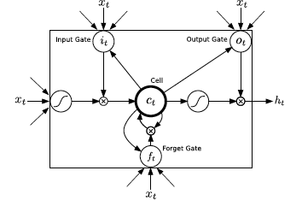
Neural Machine Translation
LSTM
Graves 2013

Slide 42
Neural Machine Translation
LSTM
Problem: Exploding gradient

Slide 43
Neural Machine Translation
LSTM
Problem: Exploding gradient
Solution: Scaling gradient

Slide 44
Sequence to Sequence
Results
BLEU score (Bilingual Evaluation Understudy)
Candidate the the the the the the the
Reference 1 the cat is on the mat
Reference 2 there is a cat on the mat
P = m/w= 7/7 = 1
Papineni et al. 2002

Slide 45
Sequence to Sequence
Results
BLEU score (Bilingual Evaluation Understudy)
Candidate the the the the the the the
Reference 1 the cat is on the mat
Reference 2 there is a cat on the mat
P = 2/7
Papineni et al. 2002

Slide 46
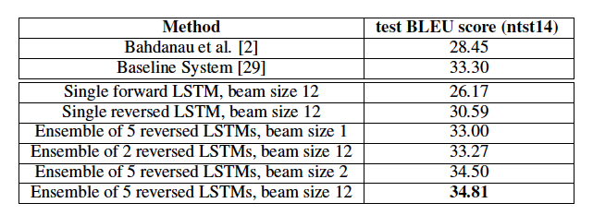
Sequence to Sequence
Results
Sutskever et al. 2014

Slide 47
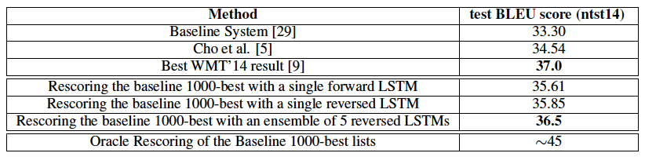
Sequence to Sequence
Results
Sutskever et al. 2014

Slide 48
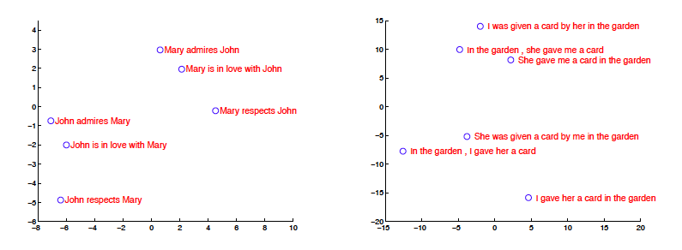
Sequence to Sequence
Model Analysis
Sutskever et al. 2014

Slide 49
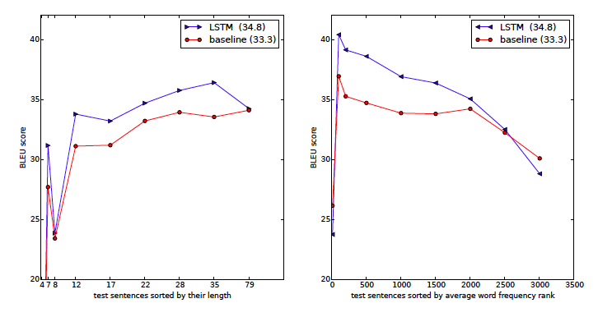
Sequence to Sequence
Long sentences
Sutskever et al. 2014

Slide 50
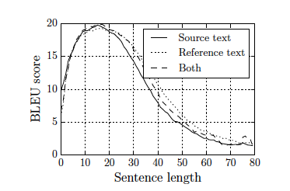
Sequence to Sequence
Long sentences
Cho et al. 2014

Slide 51
Bahdanau et al.,2014
Neural Machine Translation by Jointly Learning to Align and Translate

Slide 52
Sequence to Sequence
Long sentences
Fixed length representation maybe the cause

Slide 53
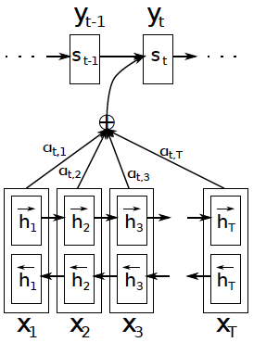

Jointly Learning to Align and Translate
Attention mechanism

Slide 54
Jointly Learning to Align and Translate
Attention mechanism

Slide 55
Jointly Learning to Align and Translate
Attention mechanism

Slide 56
Jointly Learning to Align and Translate
Attention mechanism

Slide 57

Jointly Learning to Align and Translate
Attention mechanism

Slide 58
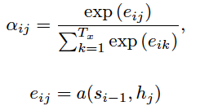
Jointly Learning to Align and Translate
Attention mechanism

Slide 59
Jointly Learning to Align and Translate
Attention mechanism

Slide 60
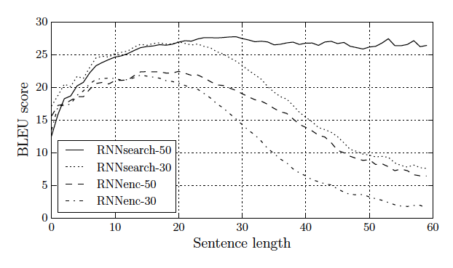
Jointly Learning to Align and Translate
Long sentences
Cho et al. 2014

