Slide 1
Index Compression

Slide 2
Why compression for inverted indexes?
Dictionary
Make it small enough to keep in main memory
Make it so small that you can keep some postings lists in main memory too
Postings file(s)
Reduce disk space needed
Decrease time needed to read postings lists from disk
Large search engines keep a significant part of the postings in memory.
Compression lets you keep more in memory

Slide 3
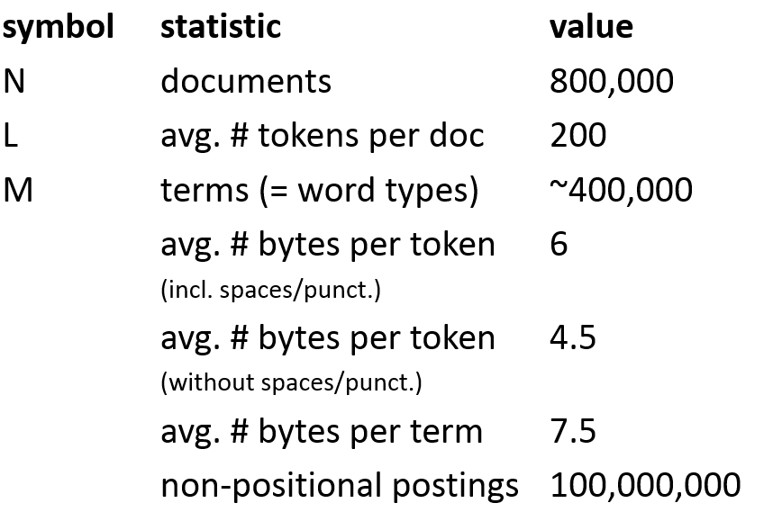
Reuters RCV1 Dataset
Sec. 5.1

Slide 4
DICTIONARY COMPRESSION
Sec. 5.2

Slide 5
Why compress the dictionary?
Sec. 5.2
Search begins with the dictionary
We want to keep it in memory
Memory footprint competition with other applications
Embedded/mobile devices may have very little memory
Even if the dictionary isn’t in memory, we want it to be small for a fast search startup time
So, compressing the dictionary is important

Slide 6
Dictionary storage - first cut
Sec. 5.2
Array of fixed-width entries
~400,000 terms; 28 bytes/term = 11.2 MB.
Dictionary search
structure
20 bytes
4 bytes each

Slide 7
Fixed-width terms are wasteful
Sec. 5.2
Most of the bytes in the Term column are wasted – we allot 20 bytes for 1 letter terms.
And we still can’t handle supercalifragilisticexpialidocious or hydrochlorofluorocarbons.
Written English averages ~4.5 characters/word.
Average dictionary word in English: ~8 characters
Short words dominate token counts but not type average.

Slide 8
Compressing the term list: Dictionary-as-a-String
Sec. 5.2
Store dictionary as a (long) string of characters:
Pointer to next word shows end of current word
Hope to save up to 60% of dictionary space.
….systilesyzygeticsyzygialsyzygyszaibelyiteszczecinszomo….
Total string length =
400K x 8B = 3.2MB
Pointers resolve 3.2M
positions: log₂3.2M =
22bits = 3bytes

Slide 9
Space for dictionary as a string
Sec. 5.2
4 bytes per term for Freq.
4 bytes per term for pointer to Postings.
3 bytes per term pointer
Avg. 8 bytes per term in term string
400K terms x 19 ⇒ 7.6 MB (against 11.2MB for fixed width)
⎫ Now avg. 11
⎬ bytes/term,
⎭ not 20.

Slide 10
Blocking
Sec. 5.2
Store pointers to every kth term string.
Example below: k=4.
Need to store term lengths (1 extra byte)
….7systile9syzygetic8syzygial6syzygy11szaibelyite8szczecin9szomo….
⎫ Save 9 bytes
⎬ on 3
⎭ pointers.
Lose 4 bytes on
term lengths.

Slide 11
Net
Sec. 5.2
Example for block size k = 4
Where we used 3 bytes/pointer without blocking
3 x 4 = 12 bytes,
now we use 3 + 4 = 7 bytes.
Shaved another ~0.5MB. This reduces the size of the dictionary from 7.6 MB to 7.1 MB.
We can save more with larger k.
Why not go with larger k?

Slide 12
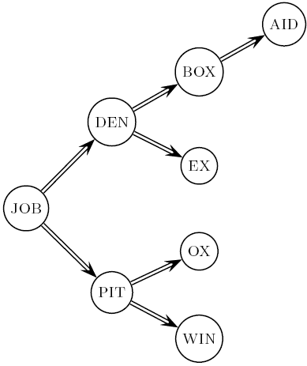
Dictionary search without blocking
Sec. 5.2
Assuming each dictionary term equally likely in query (not really so in practice!), average number of comparisons = (1+2∙2+4∙3+4)/8 ~2.6

Slide 13
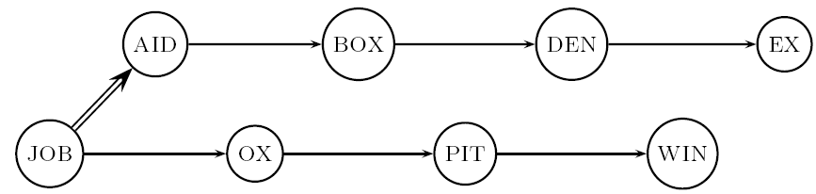
Dictionary search with blocking
Sec. 5.2
Binary search down to 4-term block;
Then linear search through terms in block.
Blocks of 4 (binary tree), avg. = (1+2∙2+2∙3+2∙4+5)/8 = 3 compares

Slide 14
Front coding
Sec. 5.2
Front-coding:
Sorted words commonly have long common prefix – store differences only
(for last k-1 in a block of k)
8automata8automate9automatic10automation
→8automat*a1◊e2◊ic3◊ion
Encodes automat
Extra length
beyond automat.
Begins to resemble general string compression.

Slide 15
RCV1 dictionary compression summary
Sec. 5.2
Technique | Size in MB
Fixed width | 11.2
Dictionary-as-String with pointers to every term | 7.6
Also, blocking k = 4 | 7.1
Also, Blocking + front coding | 5.9

Slide 16
POSTINGS COMPRESSION
Sec. 5.3

Slide 17
Postings compression
Sec. 5.3
The postings file is much larger than the dictionary, factor of at least 10.
Key desideratum: store each posting compactly.
A posting for our purposes is a docID.
For Reuters (800,000 documents), we would use 32 bits per docID when using 4-byte integers.
Alternatively, we can use log₂ 800,000 ≈ 20 bits per docID.
Our goal: use far fewer than 20 bits per docID.

Slide 18
Postings: two conflicting forces
Sec. 5.3
A term like arachnocentric occurs in maybe one doc out of a million – we would like to store this posting using log₂ 1M ~ 20 bits.
A term like the occurs in virtually every doc, so 20 bits/posting is too expensive.
Prefer 0/1 bitmap vector in this case

Slide 19
Postings file entry
Sec. 5.3
We store the list of docs containing a term in increasing order of docID.
computer: 33,47,154,159,202 …
Consequence: it suffices to store gaps.
33,14,107,5,43 …
Hope: most gaps can be encoded/stored with far fewer than 20 bits.

Slide 20
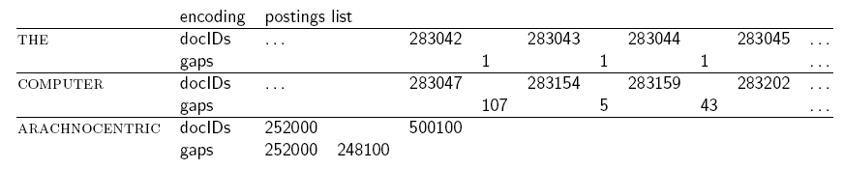
Three postings entries
Sec. 5.3

Slide 21
Variable length encoding
Sec. 5.3
Aim:
For arachnocentric, we will use ~20 bits/gap entry.
For the, we will use ~1 bit/gap entry.
If the average gap for a term is G, we want to use ~log₂G bits/gap entry.
Key challenge: encode every integer (gap) with about as few bits as needed for that integer.
This requires a variable length encoding
Variable length codes achieve this by using short codes for small numbers

Slide 22
Variable Byte (VB) codes
Sec. 5.3
For a gap value G, we want to use close to the fewest bytes needed to hold log₂ G bits
Begin with one byte to store G and dedicate 1 bit in it to be a continuation bit c
If G ≤127, binary-encode it in the 7 available bits and set c =1
Else encode G’s lower-order 7 bits and then use additional bytes to encode the higher order bits using the same algorithm
At the end set the continuation bit of the last byte to 1 (c =1) – and for the other bytes c = 0.

Slide 23
Example
Sec. 5.3
docIDs | 824 | 829 | 215406
gaps |  | 5 | 214577
VB code | 00000110 10111000 | 10000101 | 00001101 00001100 10110001
Postings stored as the byte concatenation
000001101011100010000101000011010000110010110001
Key property: VB-encoded postings are
uniquely prefix-decodable.
For a small gap (5), VB
uses a whole byte.

Slide 24
Other variable unit codes
Sec. 5.3
Instead of bytes, we can also use a different “unit of alignment”: 32 bits (words), 16 bits, 4 bits (nibbles).
Variable byte alignment wastes space if you have many small gaps – nibbles do better in such cases.
Variable byte codes:
Used by many commercial/research systems
Good low-tech blend of variable-length coding and sensitivity to computer memory alignment matches (vs. bit-level codes, which we look at next).

Slide 25
Unary code
Represent n as n 1s with a final 0.
Unary code for 3 is 1110.
Unary code for 40 is
11111111111111111111111111111111111111110 .
Unary code for 80 is:
111111111111111111111111111111111111111111111111111111111111111111111111111111110
This doesn’t look promising, but….

Slide 26
Gamma codes
Sec. 5.3
We can compress better with bit-level codes
The Gamma code is the best known of these.
Represent a gap G as a pair length and offset
offset is G in binary, with the leading bit cut off
For example 13 → 1101 → 101
length is the length of offset
For 13 (offset 101), this is 3.
We encode length with unary code: 1110.
Gamma code of 13 is the concatenation of length and offset: 1110101

Slide 27
Gamma code examples
Sec. 5.3
number | length | offset | γ-code
0 |  |  | none
1 | 0 |  | 0
2 | 10 | 0 | 10,0
3 | 10 | 1 | 10,1
4 | 110 | 00 | 110,00
9 | 1110 | 001 | 1110,001
13 | 1110 | 101 | 1110,101
24 | 11110 | 1000 | 11110,1000
511 | 111111110 | 11111111 | 111111110,11111111
1025 | 11111111110 | 0000000001 | 11111111110,0000000001

Slide 28
Gamma code properties
Sec. 5.3
G is encoded using 2 ⎣log G⎦ + 1 bits
Length of offset is ⎣log G⎦ bits
Length of length is ⎣log G⎦ + 1 bits
All gamma codes have an odd number of bits
Almost within a factor of 2 of best possible, log₂ G
Gamma code is uniquely prefix-decodable, like VB
Gamma code is parameter-free

Slide 29
Gamma seldom used in practice
Sec. 5.3
Machines have word boundaries – 8, 16, 32, 64 bits
Operations that cross word boundaries are slower
Compressing and manipulating at the granularity of bits can be slow
Variable byte encoding is aligned and thus potentially more efficient
Regardless of efficiency, variable byte is conceptually simpler at little additional space cost

Slide 30
RCV1 compression
Sec. 5.3
Data structure | Size in MB
dictionary, fixed-width | 11.2
dictionary, term pointers into string | 7.6
with blocking, k = 4 | 7.1
with blocking & front coding | 5.9
collection (text, xml markup etc) | 3,600.0
collection (text) | 960.0
Term-doc incidence matrix | 40,000.0
postings, uncompressed (32-bit words) | 400.0
postings, uncompressed (20 bits) | 250.0
postings, variable byte encoded | 116.0
postings, γ−encoded | 101.0

Slide 31
Index compression summary
Sec. 5.3
We can now create an index for highly efficient Boolean retrieval that is very space efficient
Only 4% of the total size of the collection
Only 10-15% of the total size of the text in the collection
However, we’ve ignored positional information
Hence, space savings are less for indexes used in practice
But techniques substantially the same.

Slide 32
Take-away Messages
Binary Retrieval
Binary Incidence Matrices
Inverted Index
Positional Inverted Index
Scaling Index Construction
Sort-based Indexing
Naïve in-memory inversion
Blocked Sort-based indexing
Single-pass in-memory indexing
Distributed Indexing
Dynamic Indexing
Index Compression

Slide 33
Further Reading
Chapters 1,2,5 of Manning-Raghavan-Schuetze book
http://nlp.stanford.edu/IR-book/
Chapter 3 (Web Search and Information Retrieval) from Mining the Web
http://www.cse.iitb.ac.in/soumen/mining-the-web/
Original publication on SPIMI: Heinz and Zobel (2003)
F. Scholer, H.E. Williams and J. Zobel. 2002. Compression of Inverted Indexes For Fast Query Evaluation. Proc. ACM-SIGIR 2002.
Variable byte codes
V. N. Anh and A. Moffat. 2005. Inverted Index Compression Using Word-Aligned Binary Codes. Information Retrieval 8: 151–166.
Word aligned codes
As We May Think -- Vannevar Bush
http://www.theatlantic.com/magazine/archive/1945/07/as-we-may-think/303881/

