Slide 1
Text Indexing
Manish Gupta

Slide 2
The Classic Search Model
User task
Info need
Query
Search
engine
Query refinement
Results
Collection

Slide 3
Query on Unstructured Data
Sec. 1.1
Which plays of Shakespeare contain the words Brutus AND Caesar but NOT Calpurnia?
One could grep all of Shakespeare’s plays for Brutus and Caesar, then strip out lines containing Calpurnia?
Why is that not the answer?
Slow (for large corpora)
NOT Calpurnia is non-trivial
Other operations (e.g., find the word Romans near countrymen) not feasible
Ranked retrieval (best documents to return)
Notes:
Grep is line-oriented; IR is document oriented.

Slide 4
Term-Document Incidence Matrices
Sec. 1.1
1 if play contains word, 0 otherwise
Brutus AND Caesar BUT NOT Calpurnia

Slide 5
Incidence Vectors
Sec. 1.1
So we have a 0/1 vector for each term.
To answer query: take the vectors for Brutus, Caesar and Calpurnia (complemented) ➔ bitwise AND.
110100 AND 110111 AND 101111 = 100100

Slide 6
Bigger Collections
Sec. 1.1
Consider N = 1 million documents, each with about 1000 words.
Avg 6 bytes/word including spaces/punctuation
6GB of data in the documents.
Say there are M = 500K distinct terms among these.

Slide 7
Can’t Build the Matrix
Sec. 1.1
500K x 1M matrix has half-a-trillion 0’s and 1’s.
But it has no more than one billion 1’s.
matrix is extremely sparse.
What’s a better representation?
We only record the 1 positions.
Why?

Slide 8
Inverted Index
Sec. 1.2
For each term t, we must store a list of all documents that contain t.
Identify each doc by a docID, a document serial number
Can we used fixed-size arrays for this?
Brutus
1
2
4
11
31
45
173
174
Caesar
1
2
4
5
6
16
57
132
Calpurnia
2
31
54
101
What happens if the word Caesar is added to document 14?

Slide 9
Inverted Index
Sec. 1.2
We need variable-size postings lists
On disk, a continuous run of postings is normal and best
In memory, can use linked lists or variable length arrays
Sorted by docID
Posting
Brutus
1
2
4
11
31
45
173
174
Caesar
1
2
4
5
6
16
57
132
Calpurnia
2
31
54
101
Dictionary
Postings
Notes:
Linked lists generally preferred to arrays
Dynamic space allocation
Insertion of terms into documents easy
Space overhead of pointers

Slide 10

Inverted Index Construction
Sec. 1.2
Documents to
be indexed
Friends, Romans, countrymen.
Tokenizer
Token stream
Friends
Romans
Countrymen
Linguistic modules
Modified tokens
friend
roman
countryman
Indexer
friend
2
4
roman
1
2
Inverted index
countryman
13
16
Notes:
Document icons from free icon set: http://www.icojoy.com/articles/44/

Slide 11
Initial Stages of Text Processing
Tokenization
Cut character sequence into word tokens
Deal with “John’s”, a state-of-the-art solution
Normalization
Map text and query term to same form
You want U.S.A. and USA to match
Stemming
We may wish different forms of a root to match
authorize, authorization
Stop words
We may omit very common words (or not)
the, a, to, of

Slide 12
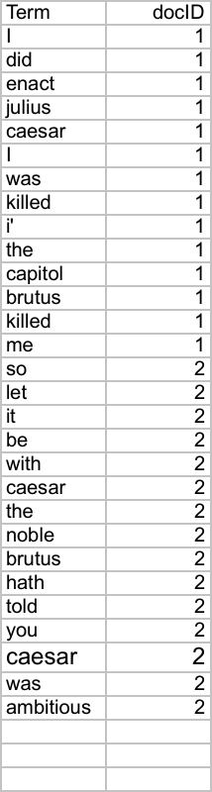
Indexer Steps: Token Sequence
Sec. 1.2
Sequence of (Modified token, Document ID) pairs.
Doc 1
Doc 2
I did enact Julius
Caesar I was killed
i’ the Capitol;
Brutus killed me.
So let it be with
Caesar. The noble
Brutus hath told you
Caesar was ambitious

Slide 13
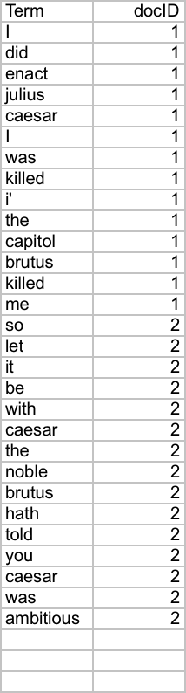
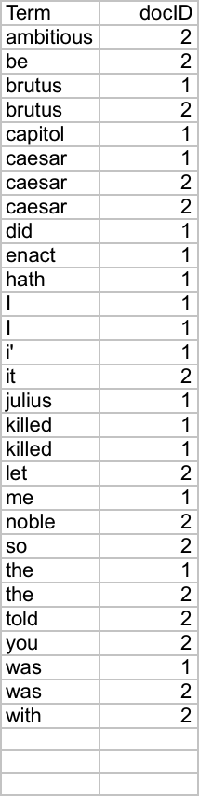
Indexer Steps: Sort
Sec. 1.2
Sort by terms
And then docID
Core indexing step

Slide 14
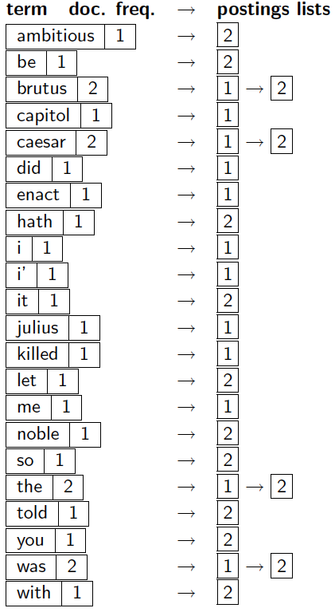
Indexer Steps: Dictionary & Postings
Sec. 1.2
Multiple term entries in a single document are merged.
Split into Dictionary and Postings
Doc. frequency information is added.
Why frequency?
Will discuss later.

Slide 15
Where do we pay in Storage?
Sec. 1.2
Lists of docIDs
Terms and counts
IR system implementation
How do we index efficiently?
How much storage do we need?
Pointers

Slide 16
Query Processing: AND
Sec. 1.3
Consider processing the query:
Brutus AND Caesar
Locate Brutus in the Dictionary;
Retrieve its postings.
Locate Caesar in the Dictionary;
Retrieve its postings.
“Merge” the two postings (intersect the document sets):
2
4
8
16
32
64
128
Brutus
1
2
3
5
8
13
21
34
Caesar

Slide 17
The Merge
Sec. 1.3
Walk through the two postings simultaneously, in time linear in the total number of postings entries
2
4
8
16
32
64
128
Brutus
1
2
3
5
8
13
21
34
Caesar
If the list lengths are x and y, the merge takes O(x+y)
operations.
Crucial: postings sorted by docID.

Slide 18
Boolean Queries: Exact Match
Sec. 1.3
The Boolean retrieval model is being able to ask a query that is a Boolean expression:
Boolean Queries are queries using AND, OR and NOT to join query terms
Views each document as a set of words
Is precise: document matches condition or not.
Perhaps the simplest model to build an IR system on
Primary commercial retrieval tool for 3 decades.
Many search systems you still use are Boolean:
Email, library catalog, Mac OS X Spotlight

Slide 19
Query Optimization
Sec. 1.3
What is the best order for query processing?
Consider a query that is an AND of n terms.
For each of the n terms, get its postings, then AND them together.
Brutus
2
4
8
16
32
64
128
Caesar
1
2
3
5
8
16
21
34
Calpurnia
13
16
Query: Brutus AND Calpurnia AND Caesar

Slide 20
Query Optimization Example
Sec. 1.3
Process in order of increasing freq:
start with smallest set, then keep cutting further.
This is why we kept
document freq. in dictionary
Brutus
2
4
8
16
32
64
128
Caesar
1
2
3
5
8
16
21
34
Calpurnia
13
16
Execute the query as (Calpurnia AND Brutus) AND Caesar.

Slide 21
More General Optimization
Sec. 1.3
e.g., (madding OR crowd) AND (ignoble OR strife)
Get doc. freq.’s for all terms.
Estimate the size of each OR by the sum of its doc. freq.’s (conservative).
Process in increasing order of OR sizes.

Slide 22
Phrase Queries
Sec. 2.4
We want to be able to answer queries such as “stanford university” – as a phrase
Thus the sentence “I went to university at Stanford” is not a match.
The concept of phrase queries has proven easily understood by users; one of the few “advanced search” ideas that works
Many more queries are implicit phrase queries
For this, it no longer suffices to store only
<term : docs> entries

Slide 23
A First Attempt: Bi-word Indexes
Sec. 2.4.1
Index every consecutive pair of terms in the text as a phrase
For example the text “Friends, Romans, Countrymen” would generate the biwords
friends romans
romans countrymen
Each of these bi-words is now a dictionary term
Two-word phrase query-processing is now immediate.

Slide 24
Longer Phrase Queries
Sec. 2.4.1
Longer phrases can be processed by breaking them down
stanford university palo alto can be broken into the Boolean query on biwords:
stanford university AND university palo AND palo alto
Without the docs, we cannot verify that the docs matching the above Boolean query do contain the phrase.
Can have false positives!

Slide 25
Issues for Bi-word Indexes
Sec. 2.4.1
False positives, as noted before
Index blowup due to bigger dictionary
Infeasible for more than bi-words, big even for them
Bi-word indexes are not the standard solution (for all bi-words) but can be part of a compound strategy

Slide 26
Solution 2: Positional Indexes
Sec. 2.4.2
In the postings, store, for each term the position(s) in which tokens of it appear
<term, number of docs containing term;
doc1: position1, position2 … ;
doc2: position1, position2 … ;
etc.>

Slide 27
Positional Index Example
Sec. 2.4.2
For phrase queries, we use a merge algorithm recursively at the document level
But we now need to deal with more than just equality
<be: 993427;
1: 7, 18, 33, 72, 86, 231;
2: 3, 149;
4: 17, 191, 291, 430, 434;
5: 363, 367, …>
Which of docs 1,2,4,5
could contain “to be
or not to be”?

Slide 28
Processing a Phrase Query
Sec. 2.4.2
Extract inverted index entries for each distinct term: to, be, or, not.
Merge their doc:position lists to enumerate all positions with “to be or not to be”.
to:
2:1,17,74,222,551; 4:8,16,190,429,433; 7:13,23,191; ...
be:
1:17,19; 4:17,191,291,430,434; 5:14,19,101; ...
Same general method for proximity searches

Slide 29
Proximity Queries
Sec. 2.4.2
LIMIT! /3 STATUTE /3 FEDERAL /2 TORT
Again, here, /k means “within k words of”.
Clearly, positional indexes can be used for such queries; bi-word indexes cannot.

Slide 30
Further Reading
Chapters 1,2,5 of Manning-Raghavan-Schuetze book
http://nlp.stanford.edu/IR-book/
Chapter 3 (Web Search and Information Retrieval) from Mining the Web
http://www.cse.iitb.ac.in/soumen/mining-the-web/
Original publication on SPIMI: Heinz and Zobel (2003)
F. Scholer, H.E. Williams and J. Zobel. 2002. Compression of Inverted Indexes For Fast Query Evaluation. Proc. ACM-SIGIR 2002.
Variable byte codes
V. N. Anh and A. Moffat. 2005. Inverted Index Compression Using Word-Aligned Binary Codes. Information Retrieval 8: 151–166.
Word aligned codes
As We May Think -- Vannevar Bush
http://www.theatlantic.com/magazine/archive/1945/07/as-we-may-think/303881/

