Slide 1
Relevance Ranking
Manish Gupta

Slide 2
Today’s Agenda
Need for Relevance Ranking
TF and IDF
Vector Space Model

Slide 3
Today’s Agenda
Need for Relevance Ranking
TF and IDF
Vector Space Model

Slide 4
Ranked Retrieval
Ch. 6
Thus far, our queries have all been Boolean.
Documents either match or don’t.
Good for expert users with precise understanding of their needs and the collection.
Also good for applications: Applications can easily consume 1000s of results.
Not good for the majority of users.
Most users are incapable of writing Boolean queries.
Most users don’t want to wade through 1000s of results.
This is particularly true of web search.

Slide 5
Problem with Boolean search: Feast or Famine
Ch. 6
Boolean queries often result in either too few (=0) or too many (1000s) results.
Query 1: “standard user dlink 650” → 200,000 hits
Query 2: “standard user dlink 650 no card found”: 0 hits
It takes a lot of skill to come up with a query that produces a manageable number of hits.
AND gives too few; OR gives too many
Notes:
Cf. our discussion of how Westlaw Boolean queries didn’t actually outperform free text querying

Slide 6
Feast or Famine: OK for Ranked Retrieval
Ch. 6
Rather than a set of documents satisfying a query expression, in ranked retrieval, the system returns an ordering over the (top) documents in the collection for a query
When a system produces a ranked result set, large result sets are not an issue
Indeed, the size of the result set is not an issue
We just show the top k ( ≈ 10) results
We don’t overwhelm the user
Premise: the ranking algorithm works. Is it true?

Slide 7
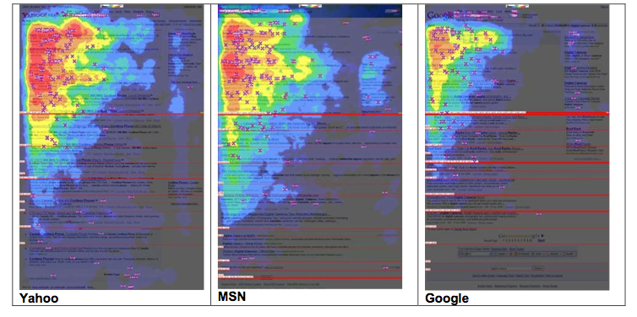
Eye Tracking Study on Search Results
2006
http://www.mediative.com/eye-tracking-google-through-the-years/

Slide 8
Scoring as the Basis of Ranked Retrieval
Ch. 6
We wish to return in order the documents most likely to be useful to the searcher
How can we rank-order the documents in the collection with respect to a query?
Assign a score – say in [0, 1] – to each document
This score measures how well document and query “match.”

Slide 9
Query-Document Matching Scores
Ch. 6
We need a way of assigning a score to a query/document pair
Let’s start with a one-term query
If the query term does not occur in the document: score should be 0
The more frequent the query term in the document, the higher the score (should be)
We will look at a number of alternatives for this.
First take: Jaccard coefficient?

Slide 10
Issues with Jaccard for Scoring
Ch. 6
It doesn’t consider term frequency (how many times a term occurs in a document)
Rare terms in a collection are more informative than frequent terms. Jaccard doesn’t consider this information
We need a more sophisticated way of normalizing for length

Slide 11
Binary Term-Document Incidence Matrix
Sec. 6.2
Each document is represented by a binary vector ∈ {0,1}^{|V|}

Slide 12
Term-Document Count Matrices
Sec. 6.2
Consider the number of occurrences of a term in a document
Each document is a count vector in ℕ^{v}: a column below

Slide 13
Today’s Agenda
Need for Relevance Ranking
TF and IDF
Vector Space Model

Slide 14
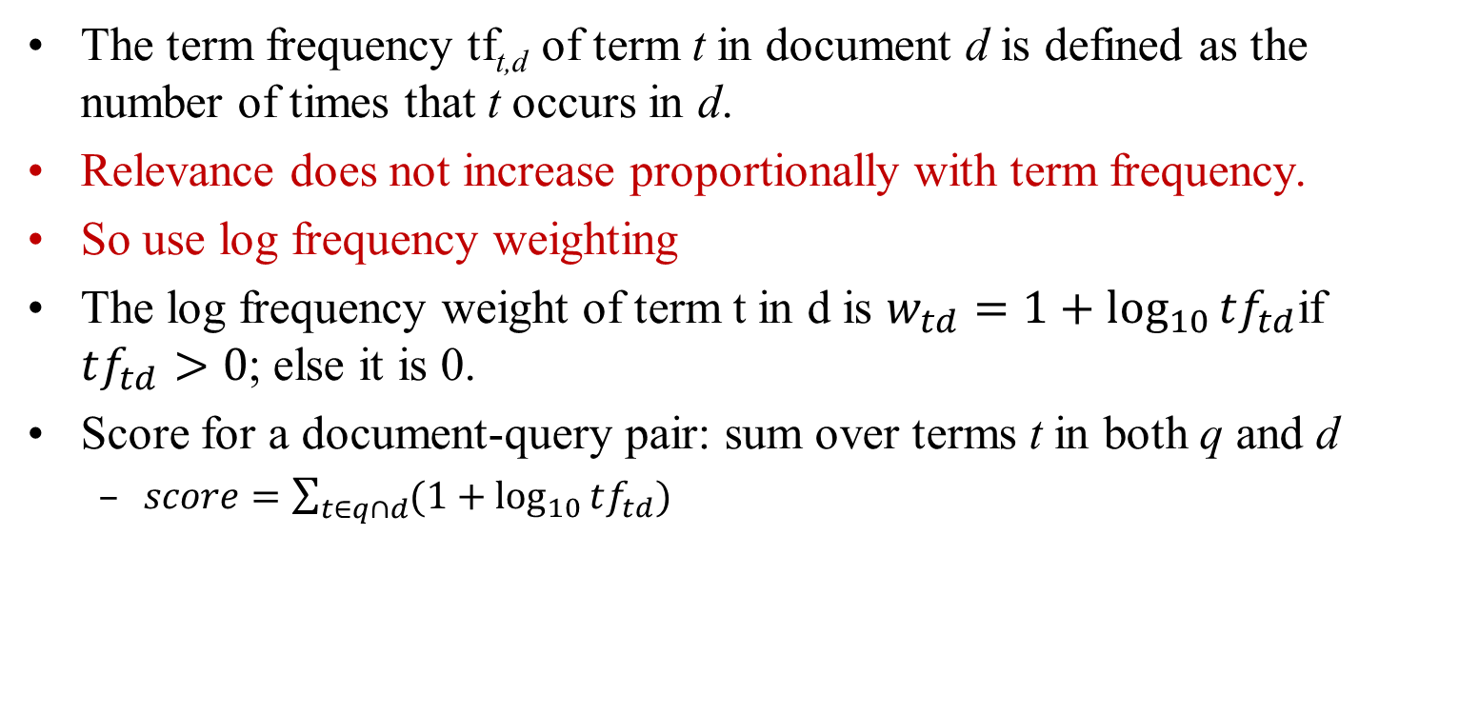
Term Frequency TF
The term frequency tf_{t,d} of term t in document d is defined as the number of times that t occurs in d.
Relevance does not increase proportionally with term frequency.
So use log frequency weighting
The log frequency weight of term t in d is $w_{td}=1+\log_{10}{tf_{td}}$if $tf_{td}>0$; else it is 0.
Score for a document-query pair: sum over terms t in both q and d
$score=\sum_{t∈q∩d}{(1+\log_{10}{tf_{td})}}$

Slide 15
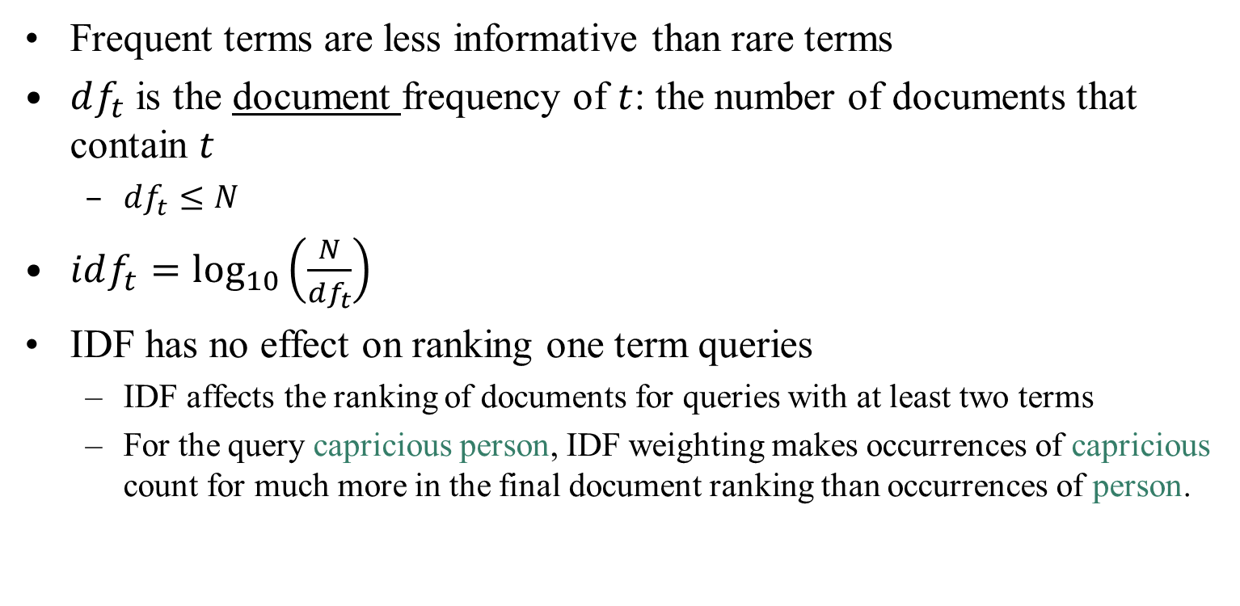
Inverse Document Frequency IDF
Sec. 6.2.1
Frequent terms are less informative than rare terms
$df_{t}$ is the document frequency of $t$: the number of documents that contain $t$
$df_{t}≤N$
$idf_{t}=\log_{10}\left(\frac{N}{df_{t}}\right)$
IDF has no effect on ranking one term queries
IDF affects the ranking of documents for queries with at least two terms
For the query capricious person, IDF weighting makes occurrences of capricious count for much more in the final document ranking than occurrences of person.

Slide 16
TF-IDF Weighting
Sec. 6.2.2
The tf-idf weight of a term is the product of its tf weight and its idf weight.
Score for a document given a query
There are many variants
How “tf” is computed (with/without logs)
Whether the terms in the query are also weighted
…

Slide 17
Binary → Count → Weight Matrix
Sec. 6.3
Each document is now represented by a real-valued vector of tf-idf weights ∈ R^{|V|}

Slide 18
Ranking in Vector Space Model
Represent both query and document as vectors in the |V|-dimensional space
Use cosine similarity as the similarity measure
Incorporates length normalization automatically (longer vs shorter documents)
q_{i} is the tf-idf weight of term i in the query
d_{i} is the tf-idf weight of term i in the document

Slide 19
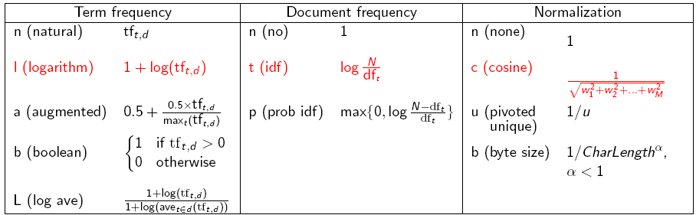
TF-IDF Weighting has many Variants
Sec. 6.4
Columns headed ‘n’ are acronyms for weight schemes.
SMART Notation: denotes the combination in use in an engine, with the notation ddd.qqq, using the acronyms from the previous table
A very standard weighting scheme is: lnc.ltc
Notes:
n default is just term frequency
ltc is best known form of weighting

Slide 20
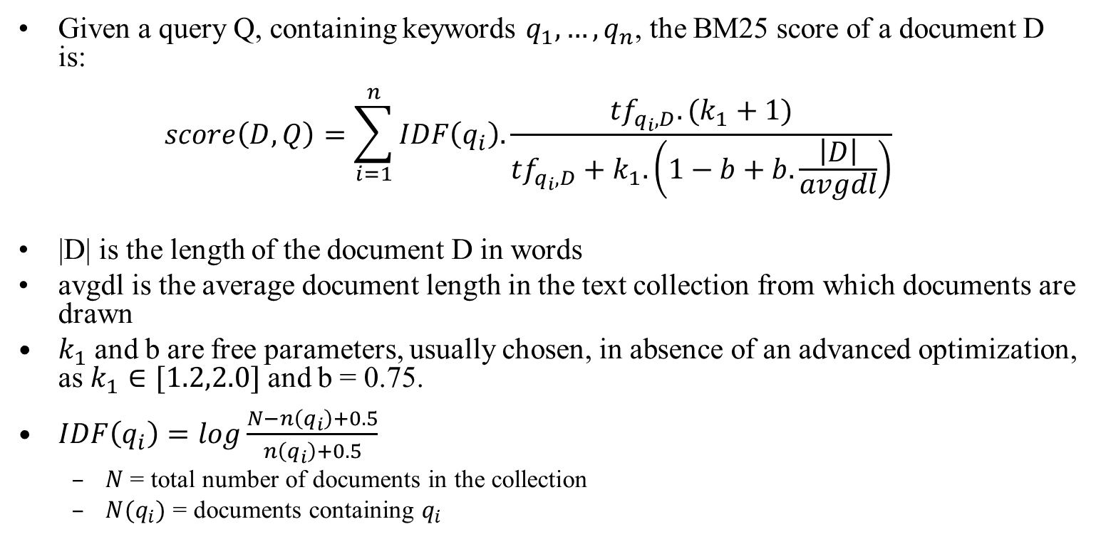
Okapi BM25
Given a query Q, containing keywords $q_{1}, …, q_{n}$, the BM25 score of a document D is: $score\left(D,Q\right)=\sum_{i=1}^{n}{IDF\left(q_{i}\right).\frac{tf_{q_{i}, D}. (k_{1}+1)}{tf_{q_{i},D}+k_{1}.\left(1−b+b.\frac{\left|D\right|}{avgdl}\right)}}$
|D| is the length of the document D in words
avgdl is the average document length in the text collection from which documents are drawn
$k_{1}$ and b are free parameters, usually chosen, in absence of an advanced optimization, as $k_{1}∈[1.2,2.0]$ and b = 0.75.
$IDF\left(q_{i}\right)=log\frac{N−n\left(q_{i}\right)+0.5}{n\left(q_{i}\right)+0.5}$
$N$= total number of documents in the collection
$N(q_{i})$ = documents containing $q_{i}$

Slide 21
Summary – Vector Space Ranking
Represent the query as a weighted tf-idf vector
Represent each document as a weighted tf-idf vector
Compute the cosine similarity score for the query vector and each document vector
Rank documents with respect to the query by score
Return the top K (e.g., K = 10) to the user

Slide 22
Today’s Agenda
Need for Relevance Ranking
TF and IDF
Vector Space Model

Slide 23
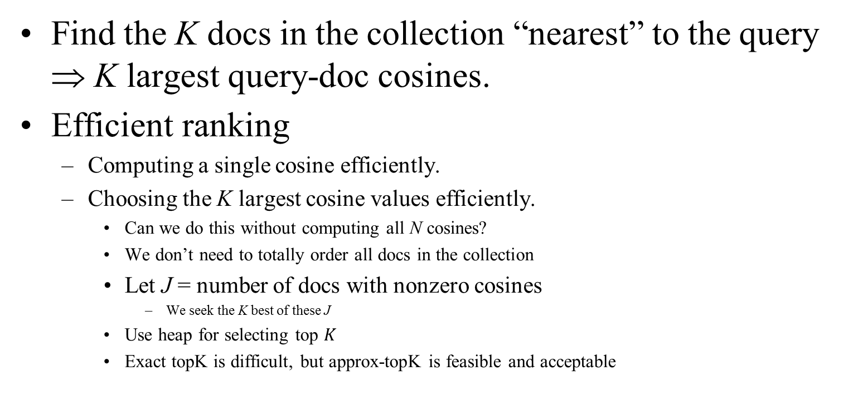
Efficient Cosine Ranking
Find the K docs in the collection “nearest” to the query ⇒ K largest query-doc cosines.
Efficient ranking
Computing a single cosine efficiently.
Choosing the K largest cosine values efficiently.
Can we do this without computing all N cosines?
We don’t need to totally order all docs in the collection
Let J = number of docs with nonzero cosines
We seek the K best of these J
Use heap for selecting top $K$
Exact topK is difficult, but approx-topK is feasible and acceptable

Slide 24
Generic Approach
Find a set A of contenders, with K < |A| << N
A does not necessarily contain the top K, but has many docs from among the top K
Return the top K docs in A
Think of A as pruning non-contenders

Slide 25
Index Elimination
Basic algorithm only considers docs containing at least one query term
Take this further
Only consider high-idf query terms
Only consider docs containing many query terms

Slide 26
Champion Lists
Precompute for each dictionary term t, the r docs of highest weight in t’s postings
Call this the champion list for t
(aka fancy list or top docs for t)
Note that r has to be chosen at index time
At query time, only compute scores for docs in the champion list of some query term
Pick the K top-scoring docs from amongst these

Slide 27
Static Quality Scores
We want top-ranking documents to be both relevant and authoritative
Relevance is being modeled by cosine scores
Authority is typically a query-independent property of a document
Examples of authority signals
Wikipedia among websites
Articles in certain newspapers
A paper with many citations
Many diggs, Y!buzzes or del.icio.us marks
(Pagerank)
Assign to each document a query-independent quality score in [0,1] to each document d
Denote this by g(d)

Slide 28
Net Score
Consider a simple total score combining cosine relevance and authority
net-score(q,d) = g(d) + cosine(q,d)
Can use some other linear combination than an equal weighting
Indeed, any function of the two “signals” of user happiness

Slide 29
PageRank
Manish Gupta
Slides borrowed (and modified) from
http://infolab.stanford.edu/~ullman/mining/2009/index.html
http://www.mpi-inf.mpg.de/departments/d5/teaching/ws11_12/irdm/slides/irdm-4-2-4.pptx

Slide 30
Ranking Web Pages
Web pages are not equally “important”
www.joe-schmoe.com vs www.stanford.edu
Inlinks as votes
www.stanford.edu has 23,400 inlinks
www.joe-schmoe.com has 1 inlink
Are all inlinks equal?
Recursive question
Each link’s vote is proportional to the importance of its source page
If page P with importance x has n outlinks, each link gets x/n votes
Page P’s own importance is the sum of the votes on its inlinks

Slide 31
Simple “Flow” Model
y = y /2 + a /2
a = y /2 + m
m = a /2
Yahoo
y/2
y
a/2
y/2
m
Amazon
M’soft
a/2
a
m

Slide 32
Solving the Flow Equations
3 equations, 3 unknowns, no constants
No unique solution
All solutions equivalent modulo scale factor
Additional constraint forces uniqueness
y+a+m = 1
y = 2/5, a = 2/5, m = 1/5
Gaussian elimination method works for small examples, but we need a better method for large graphs

Slide 33
Matrix Formulation
Matrix M has one row and one column for each web page
Suppose page j has n outlinks
If j != i, then M_{ij}=1/n
Else M_{ij}=0
M is a column stochastic matrix
Columns sum to 1
Suppose r is a vector with one entry per web page
r_{i} is the importance score of page i
Call it the rank vector
|r| = 1

Slide 34
Example
Suppose page j links to 3 pages, including i
j
i
i
=
1/3
M
r
r
y = y /2 + a /2
a = y /2 + m
m = a /2

Slide 35
Eigenvector Formulation
The flow equations can be written as
r = Mr
So the rank vector is an eigenvector of the stochastic web matrix
In fact, its first or principal eigenvector, with corresponding eigenvalue 1
y = y /2 + a /2
a = y /2 + m
m = a /2
y 1/2 1/2 0 y
a = 1/2 0 1 a
m 0 1/2 0 m

Slide 36
Power Iteration Method
Simple iterative scheme (aka relaxation)
Suppose there are N web pages
Initialize: r⁰ = [1/N,….,1/N]^{T}
Iterate: r^{k+1} = Mr^{k}
Stop when |r^{k+1} - r^{k}|₁ < ε
|x|₁ = ∑_{1≤i≤N}|x_{i}| is the L1 norm
Can use any other vector norm e.g., Euclidean

Slide 37
Power Iteration Example
Yahoo
y a m
y 1/2 1/2 0
a 1/2 0 1
m 0 1/2 0
Amazon
M’soft
y
a =
m
1/3
1/3
1/3
1/3
1/2
1/6
5/12
1/3
1/4
3/8
11/24
1/6
2/5
2/5
1/5
. . .

Slide 38
Random Walk Interpretation
Imagine a random web surfer
At any time t, surfer is on some page P
At time t+1, the surfer follows an outlink from P uniformly at random
Ends up on some page Q linked from P
Process repeats indefinitely
Let p(t) be a vector whose i^{th} component is the probability that the surfer is at page i at time t
p(t) is a probability distribution on pages

Slide 39
The Stationary Distribution
Where is the surfer at time t+1?
Follows a link uniformly at random
p(t+1) = Mp(t)
Suppose the random walk reaches a state such that p(t+1) = Mp(t) = p(t)
Then p(t) is called a stationary distribution for the random walk
Our rank vector r satisfies r = Mr
So it is a stationary distribution for the random surfer

Slide 40
Further Reading
Chapters 6,7,8 of Manning-Raghavan-Schuetze book
http://nlp.stanford.edu/IR-book/
S. E. Robertson and K. Spärck Jones. 1976. Relevance Weighting of Search Terms. Journal of the American Society for Information Sciences 27(3): 129–146.
C. J. van Rijsbergen. 1979. Information Retrieval. 2nd ed. London: Butterworths, chapter 6. [Most details of math] http://www.dcs.gla.ac.uk/Keith/Preface.html
N. Fuhr. 1992. Probabilistic Models in Information Retrieval. The Computer Journal, 35(3),243–255. [Easiest read, with BNs]
F. Crestani, M. Lalmas, C. J. van Rijsbergen, and I. Campbell. 1998. Is This Document Relevant? ... Probably: A Survey of Probabilistic Models in Information Retrieval. ACM Computing Surveys 30(4): 528–552.
http://www.acm.org/pubs/citations/journals/surveys/1998-30-4/p528-crestani/

Slide 41
Further Reading
A nice summary of link analysis algorithms from John Kleinberg
http://dl.acm.org/citation.cfm?id=345982
Chapter 5: "Link Analysis" from Mining of Massive Datasets
http://infolab.stanford.edu/~ullman/mmds.html
Chapter 7 (Social Network Analysis) from Mining the Web
http://www.cse.iitb.ac.in/soumen/mining-the-web/
J.M. Kleinberg: Authoritative Sources in a Hyperlinked Environment, JACM 46(5), 1999
S Brin, L. Page: The Anatomy of a Large-Scale Hypertextual Web Search Engine, WWW 1998
M. Najork, H. Zaragoza, M. Taylor: HITS on the Web: How does it Compare?, SIGIR 2007
R. Lempel, S. Moran: SALSA: The Stochastic Approach for Link-Structure Analysis, ACM TOIS 19(2), 2001.
G. Jeh, J. Widom: SimRank: a Measure of Structural-Context Similarity, KDD 2002
Taher Haveliwala: Topic-Sensitive PageRank: A Context-Sensitive Ranking Algorithm for Web Search, IEEE Trans. on Knowledge and Data Engineering, 2003.
G. Jeh, J. Widom: Scaling personalized web search, WWW 2003.
D. Fogaras, B. Racz, K. Csalogany, A. Benczur: Towards Scaling Fully Personalized PageRank: Algorithms, Lower Bounds, and Experiments, Internet Mathematics 2(3): 333-358, 2006.

