Slide 1
Human Brain

Slide 2
Objectives:
To describe the general structure of the Cerebrum and Cerebral Cortex.
To identify the Cerebrum, the Lobes of the Brain, the Cerebral Cortex, and its major regions/divisions.

Slide 3
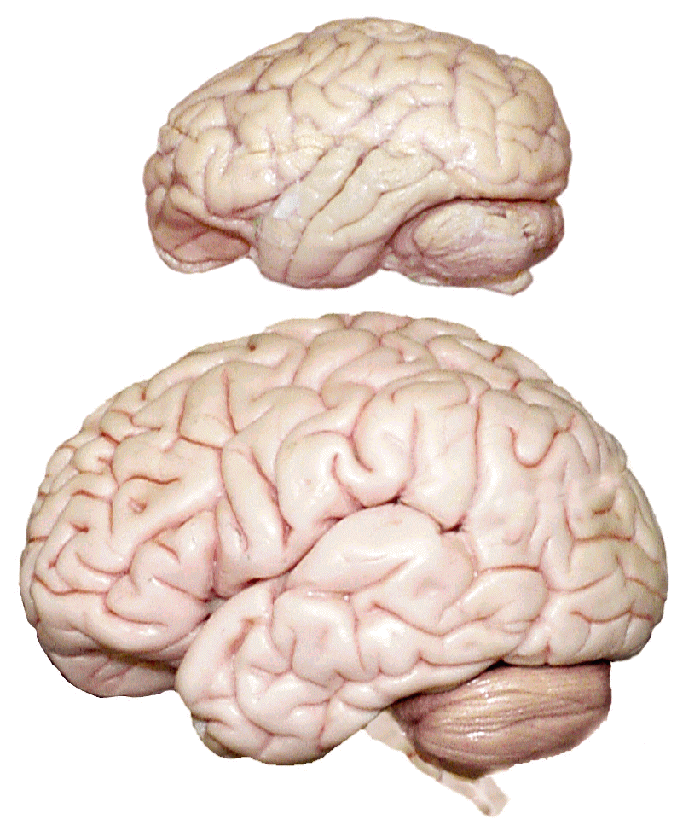
Cerebrum -The largest division of the brain. It is divided into two hemispheres, each of which is divided into four lobes.
Cerebrum
Cerebrum
Cerebellum
http://williamcalvin.com/BrainForAllSeasons/img/bonoboLH-humanLH-viaTWD.gif

Slide 4
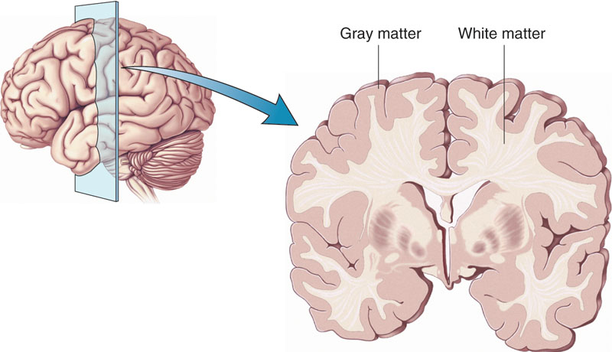
Cerebral Cortex - The outermost layer of gray matter making up the superficial aspect of the cerebrum.
Cerebral Cortex
Cerebral Cortex
http://www.bioon.com/book/biology/whole/image/1/1-6.tif.jpg

Slide 5
Gyri (ridge)
Sulci (groove)
Fissure
(deep groove)
http://williamcalvin.com/BrainForAllSeasons/img/bonoboLH-humanLH-viaTWD.gif

Slide 6
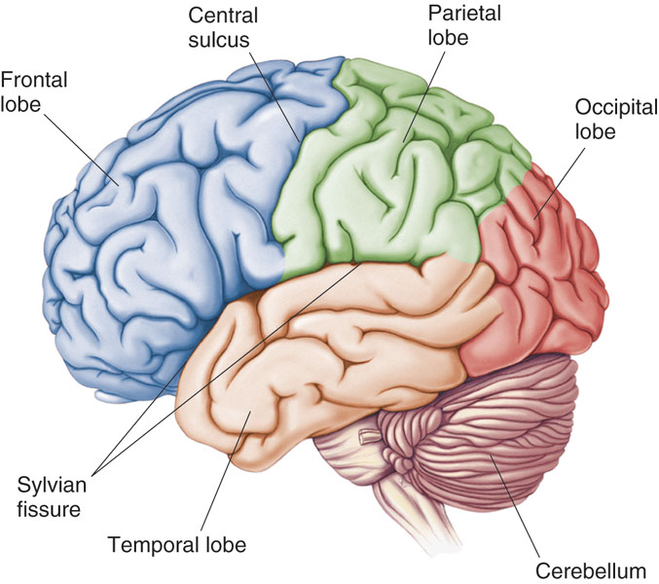
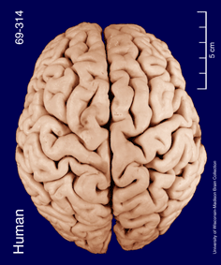
Specific Sulci/Fissures:
Central Sulcus
Longitudinal Fissure
Sylvian/Lateral Fissure
Transverse Fissure
http://www.bioon.com/book/biology/whole/image/1/1-8.tif.jpg
http://www.dalbsoutss.eq.edu.au/Sheepbrains_Me/human_brain.gif

Slide 7
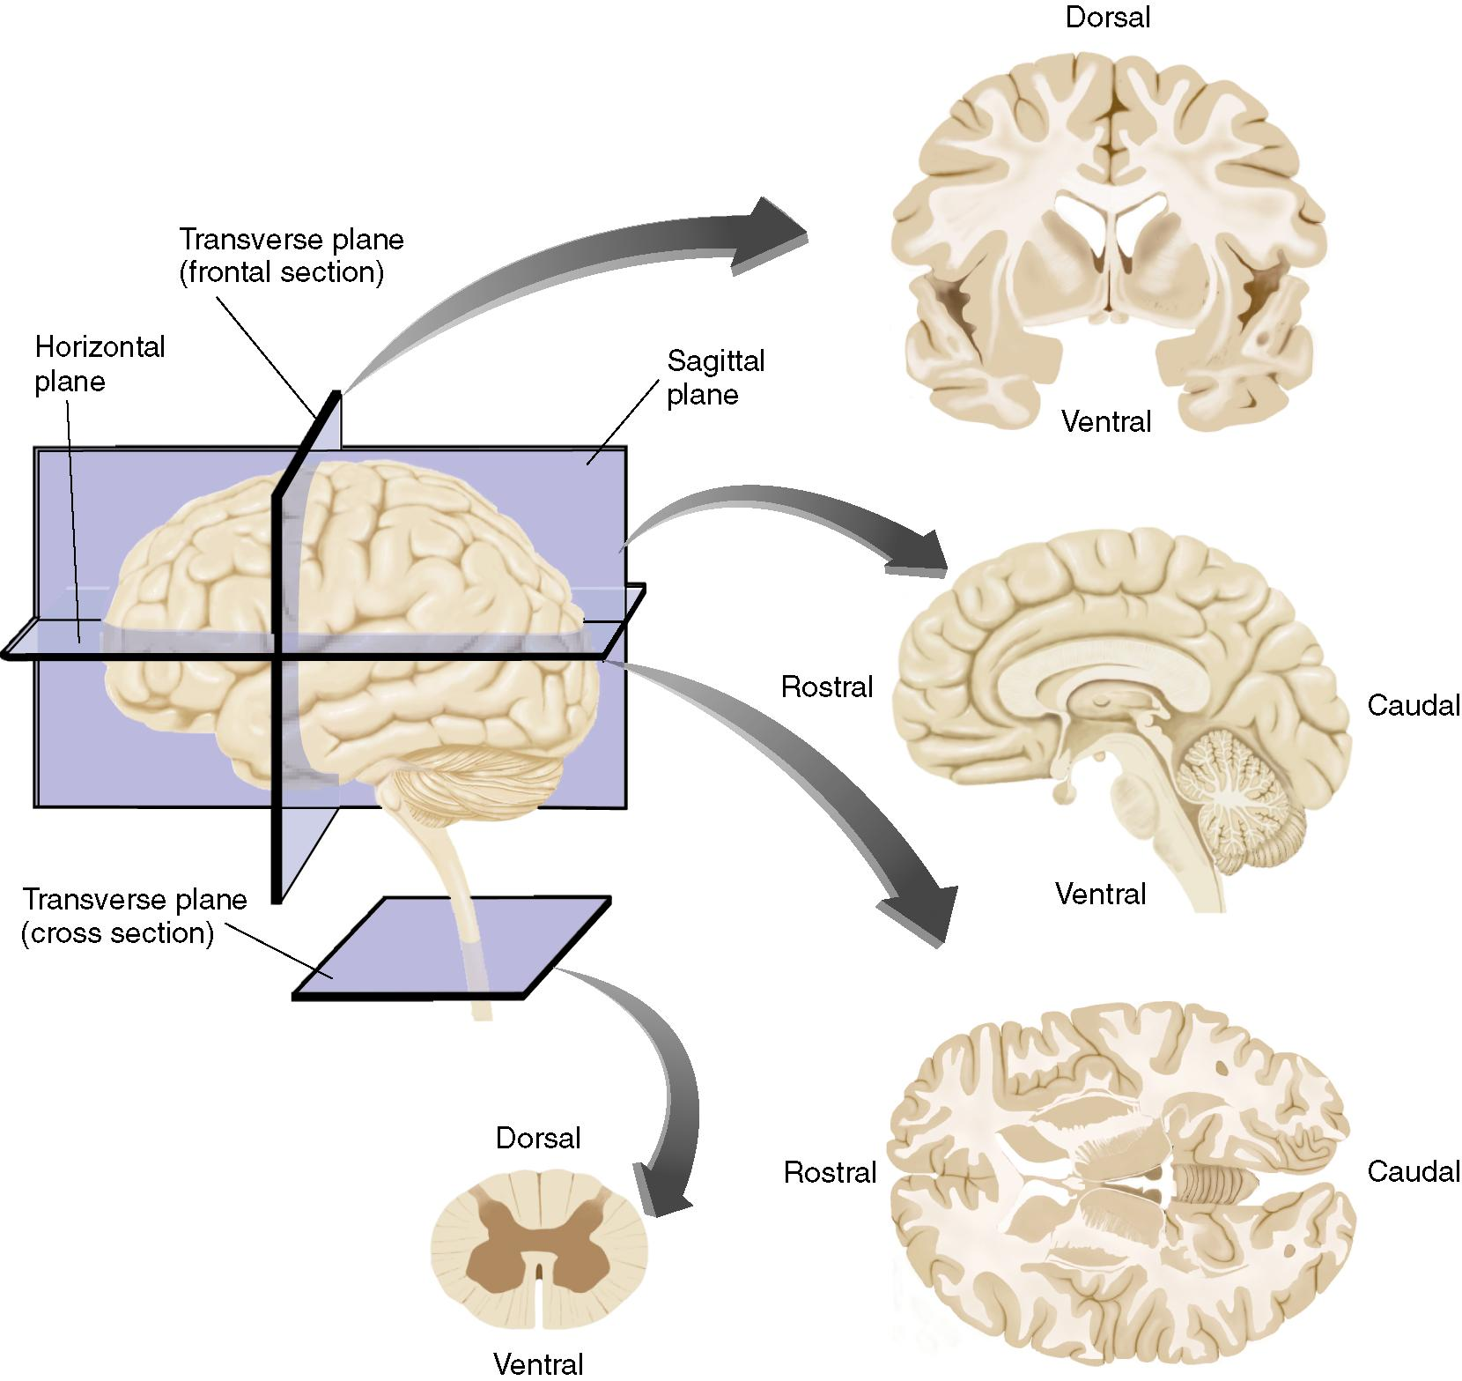
Coronal
Section
(Mid-)Sagittal
Section
Anterior
Posterior
Horizontal
Section

Slide 8
Human Brain
2% of the body weight, 3 pounds approx.
25% of body’s oxygen
70% of glucose
Never rests and its metabolic rate, during both day and night, is more or less the same.
In dreams in fact, the metabolic rate increases slightly.
Notes:
3 pounds = 1.36 Kgs
Basal Metabolic Rate is the number of calories required to keep your body functioning at rest.

Slide 9
Hierarchical Brain: Structure & Functions
Represents approx. 500 million yrs of evolutionary development and fine tuning.
Core structures of brain are the same in all vertebrates
They govern the physiological functions
Built upon these are newer systems that involve complex functions – sensing, emoting, thinking, reasoning etc.
Cerebral cortex is the one which makes us Human

Slide 10
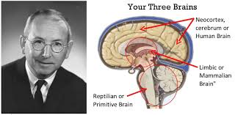
Triune Brain
Paul MacLean (1990) Originally proposed in the 60’s
Reptilian: Brain Stem & Cerebellum: Survival (Fight or Flight)
Paleomammalian: Limbic System: Emotions, Memories, Habits
Neomammalian: Neocortex: Language, Abstract Thought, Imagination, Consciousness

Slide 11
Basic Features of the Nervous System
Anterior:
With respect to the central nervous system, located near or toward the head.
Posterior:
With respect to the central nervous system, located near or toward the tail.
Rostral:
“Toward the “beak”; with respect to the central nervous system, in a direction along the neuraxis toward the front of the face.
Caudal:
“Toward the tail”; with respect to the central nervous system, in a direction along the neuraxis away from the front of the face.

Slide 12
Basic Features of the Nervous System
Dorsal:
“Toward the back”; with respect to the central nervous system, in a direction perpendicular to the neuraxis toward the top of the head or the back.
Ventral:
“Toward the belly”; with respect to the central nervous system, in a direction perpendicular to the neuraxis toward the bottom of the skull or the front surface of the body. Lateral:
Toward the side of the body, away from the middle.
Medial:
Toward the middle of the body, away from the side.
Ipsilateral:
Located on the same side of the body.
Contralateral:
Located on the opposite side of the body.

Slide 13
Basic Features of the Nervous System
Sagittal - lateral sections
Coronal – frontal sections
Horizontal – axial sections

Slide 14
Cerebral Features:
Gyri – Elevated ridges “winding” around the brain.
Sulci – Small grooves dividing the gyri
Central Sulcus – Divides the Frontal Lobe from the Parietal Lobe
Fissures – Deep grooves, generally dividing large regions/lobes of the brain
Longitudinal Fissure – Divides the two Cerebral Hemispheres
Transverse Fissure – Separates the Cerebrum from the Cerebellum
Sylvian/Lateral Fissure – Divides the Temporal Lobe from the Frontal and Parietal Lobes

