Slide 1
IR for NLP Learning Structure for Text Generation
Niyati Chhaya
nchhaya@adobe.com

Slide 2
True or False
Deepweb is indexed by Google
You should always use words for indexing
Stemming is encouraged for IR applications
Syntactic analysis helps understand the meaning of words
Word embeddings are a type of semantic analysis
IR techniques cannot be applied to NLP tasks.

Slide 3
Pulse Check
What is NLP ?
Examples of NLP tasks ?
What applications need NLP approaches ?

Slide 4
Agenda
Learning Structure for Text Generation
AI for Legal Discovery
Structured Document Retrieval

Slide 5
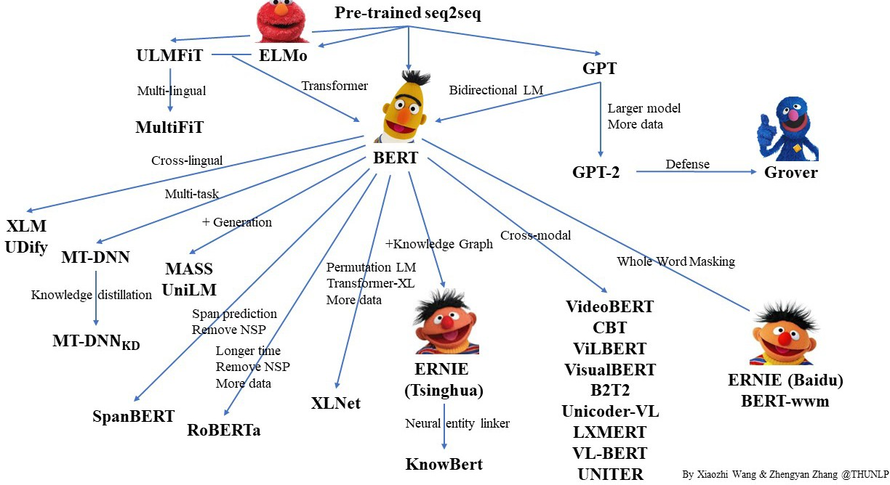
5

Slide 6
Question set A
Note down your name / Role number
List NLP approaches that you are aware of for generation ?
What is BERT ?
What is ELMo ?

Slide 7
Neural Language Models are stronger than ever!
Why do we still do research on text generation ?
7

Slide 8
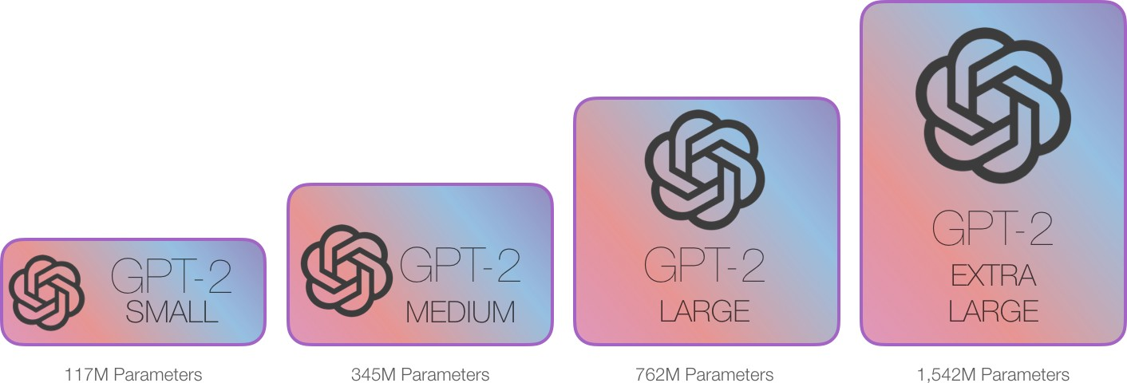
How good are today’s AI writers !
8

Slide 9




GPT-2 Completion
Context (WebText test) as PROMPT
Aaron loves mint chocolate cake, but he
requires that it be paired with mini chocolate chips, so I threw some of those in between the layers. I also had a few Peppermint Jo Jos on hand so I crushed them up and threw some of those in along with some crushed meringue cookies because, why not? It’s a total smorgasbord of minty chocolate chippy cookie crunchy goodness. I didn’t measure how much of each topping I used, but after I tasted the finished product, I wish I had added more. You can add anything you want- crushed candy canes, peppermint bark, etc. And don’t be afraid to use a heavy hand. Texture = good.
If you don’t have 7-inch cake pans, you can get 3 shorter 8-inch layers out of this
recipe. If you do, and you know how to make that cake, then your life will never be the same.
I have two very simple rules when it comes to cookie crumbs or chocolate chips. 1) When I buy raw sugar, I do not use it until it’s cooled down and has at least half a teaspoon of sugar on it.
That’s my rule. And 2) If I have a recipe that calls for something and I want to use it in a recipe, I do not substitute it with something else on-line. Like this.
I found this really cute card with cute little kittens on
Radford, et.al. 2018
9

Slide 10

GPT-2 Completion
recipe, which will likely yield about the same amount of cake.
Context (WebText test) as PROMPT
Aaron loves mint chocolate cake, but he
requires that it be paired with mini chocolate chips, so I threw some of those in between the layers. I also had a few Peppermint Jo Jos on hand so I crushed them up and threw some of those in along with some crushed meringue cookies because, why not? It’s a total smorgasbord of minty chocolate chippy cookie crunchy goodness. I didn’t measure how much of each topping I used, but after I tasted the finished product, I wish I had added more. You can add anything you want- crushed candy canes, peppermint bark, etc. And don’t be afraid to use a heavy hand. Texture = good.
If you don’t have 7-inch cake pans, you can get 3 shorter 8-inch layers out of this
Chocolate Buttermilk Cake Print Chunks of chocolate cake, coated in buttermilk and topped with crunchy chopped chocolate, drizzled with chocolate sauce. Simple but a nice change from chocolate cake!
Author: Momma Made
Ingredients For the chocolate buttermilk cake
1 1/2 cup unsalted butter , room temp. 1 1/2 cup granulated sugar
3 large eggs plus 1 egg yolk For the chocolate glaze 1/3 cup cocoa powder
1 3/4 cups powdered sugar 6 ounces…
Radford, et.al. 2018
10

Slide 11
Weaknesses of MEGA Language Models for
GENERATION!
Inconsistent output
Crippled by length
Coreference issues
unsound, loops
antecedents can go missing
Longer strings that are repeated many times in the dataset
Repeating entities
MLE!
We evaluate them with “perplexity”!
7

Slide 12
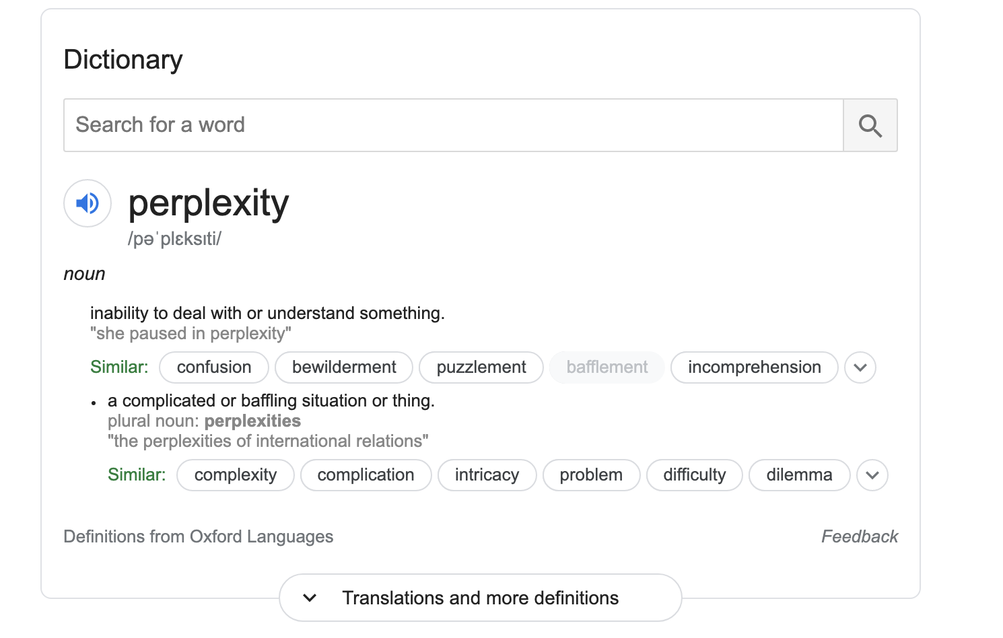
Pulse Check
What is perplexity ?
Perplexity is a measure of uncertainty

Slide 13
Open Questions in Long Text Generation
** Information about what to say next based on probability of observed word sequences (it reads and writes based on that!)
Challenges:
common sense reasoning -> understanding
sentence ordering -> discourse structure
relational information -> entity relations
Structure -> composition, grammar, etc.

Slide 14



Conditional Generation
How do we:
learn narrative flow?
guide long text generation
capture long range dependencies?
leverage knowledge embedded in
pre-trained LMs?
Tasks:
Summarization
Story Generation
Knowledge Graph Completion

Slide 15
Background of Transformer Models for Text Input

Slide 16




























IRE क्लास Microsoft टीमों का उपयोग करके आयोजित की जाती है
The Transformer
Encoder Stack
ENCODER
Decoder Stack
DECODER
ENCODER
DECODER
ENCODER
DECODER
ENCODER
DECODER
ENCODER
DECODER
ENCODER
DECODER
IRE class is conducted using Microsoft Teams
11

Slide 17

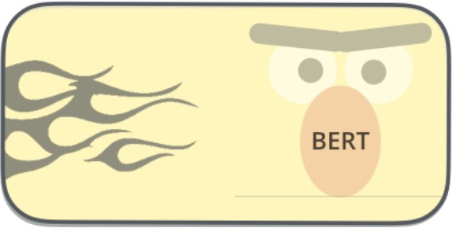

















DECODER
⋯
DECODER
ENCODER
⋯
ENCODER
Recurrent DECODER
⋯
Recurrent DECODER
DECODER
ENCODER
Recurrent DECODER
Open AI
Google
CMU/Google Brain
12

Slide 18
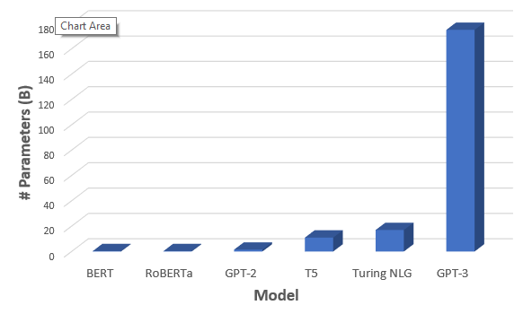
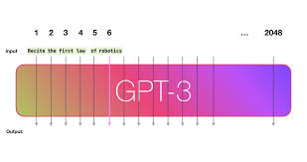
2020

Slide 19
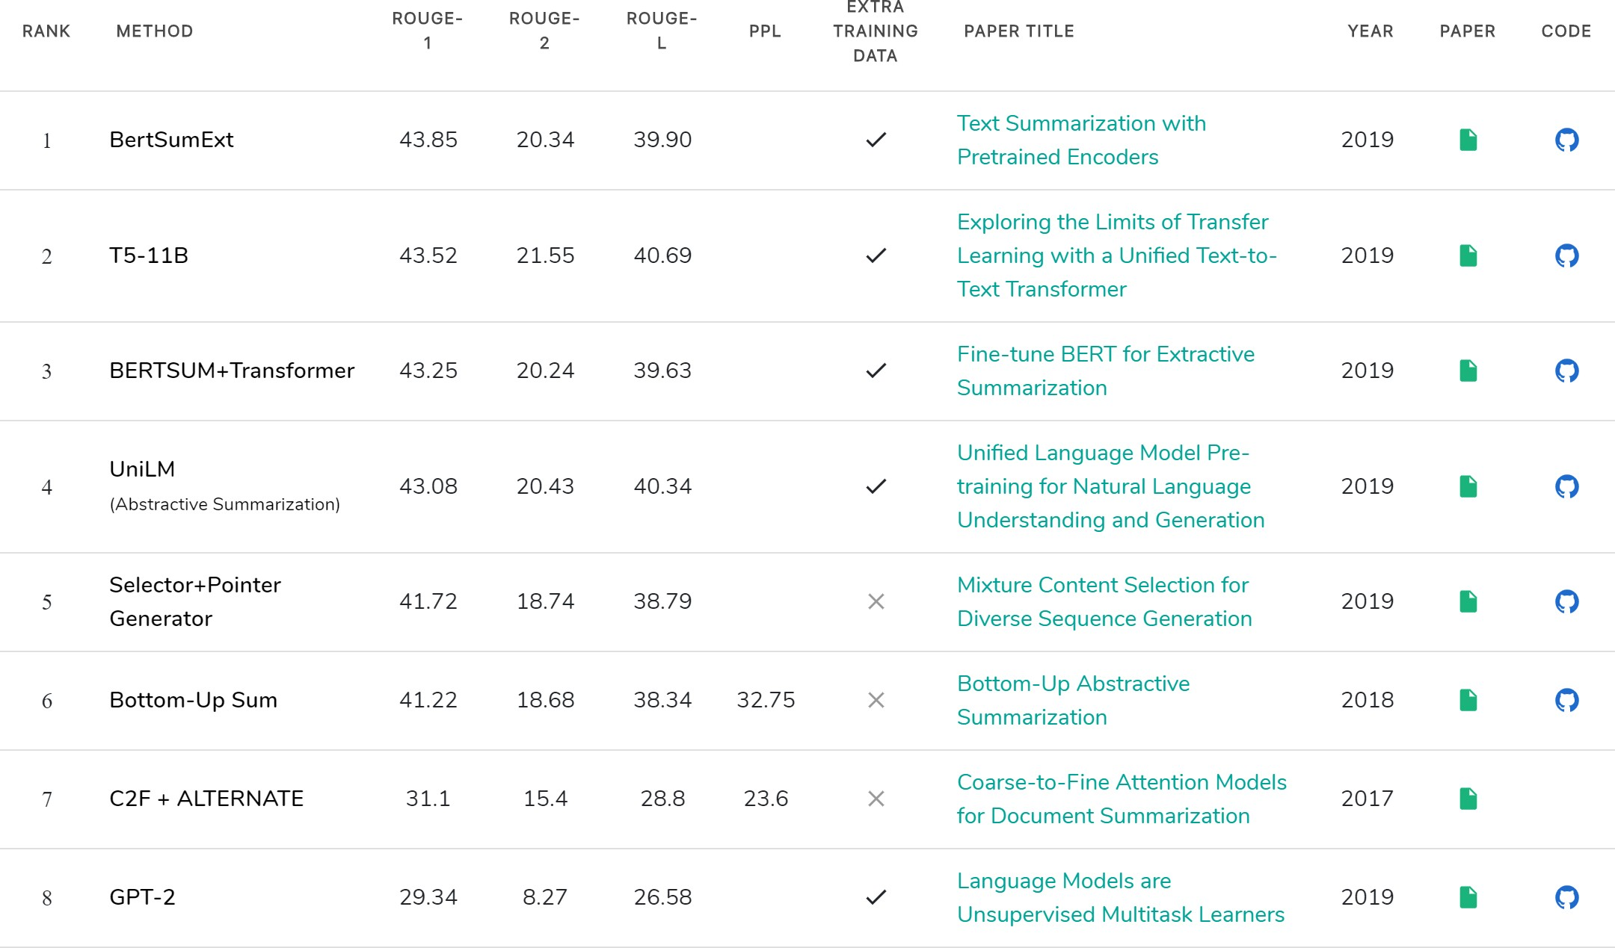



Wait, what, which one? how?
https://paperswithcode.com/sota/document-summarization-on-cnn-daily-mail
13

Slide 20
Generate with discourse understanding!
Research Questions:
Length of summaries
Abstractedness of summaries

Slide 21
Corpora for
Generate with discourse understanding!
Research Questions:
Length of summaries
Abstractedness of summaries

Slide 22


How good are Abstractive Summarization Datasets ? (CNN Example)
Article
CNN - We had no idea how much we would really, really, really, really like tom hanks lip-syncing to a Carly Rae Jepsen song, but we really do. Hanks shows up in the new video for “i really like you,” singing Jepsen 's part throughout.
The oscar-winning actor is apparently playing himself, signing autographs for fans, and generally being a very cheery movie star, before he and Jepsen take part in a flash mob. So what exactly is Tom Hanks doing in this video in the first place?
Turns out he is good friends with Scooter Braun, manager for Jepsen, and Justin Bieber, who also appears in the video. He even sang and danced at Braun's wedding.
ABC reported that Hanks suggested himself to play the role, after Jepsen said it would be amusing for a man to lip-sync her song. The result, as you can see, is kind of magical.
Abstract / Headlines / Summary ?
Tom Hanks makes surprise appearance in Carly Rae Jepsen video dancing and lip-syncing . Hanks is friends with Jepsen's manager, Scooter Braun.
Hanks volunteered to be in the video.
16

Slide 23
Pulse Check
What is the CNN/Dailymail Dataset used for ?

Slide 24






Can we evaluate narrative flow on existing corpora ?
Xsum
1
Avg. # Sentences Avg. # Words
Narrative Flow?
23.26
XSum Newsroom CNN
Daily Mail
Newsroom
1.45
26.7
CNN
3.59
45.7
Daily Mail
3.86
54.65
AAN
SAAS
1
AAN 5.03
106.76
SAAS 6.3
150.85
Summaries à headlines of the news articles
don’t provide inductive bias
unable to learn or measure narrative flow
tend to be extractive
XSum [Narayan et.al, 2018a] Newsroom [Grusky et.al.m 2019] CNN [Hermann et.al. 2015]
Daily Mail [Hermann et.al. 201157]

Slide 25







Scientific Dataset (arXiv – CS+BIO)
Introduction
Introduction of task
Discourse relation characterizes the internal structure and logical relation of a coherent text.
Abstract
Automatically identifying these relations not only plans an important role in discourse comprehension and generation, but also obtains wide applications in many other relevant natural language processing tasks, such as text summarization (Yoshida et. al., 2014), conversation (Higashinaka et.al., 2014), question answering (Verberne et al., 2007)…
Implicit discourse relation recognition is a crucial component for automatic discourse level analysis and natural language understanding.
Body of the introduction, citations
Inter sentence narrative flow
In this paper, instead, we explore generative models and propose a variational neural discourse relation recognizer.
Generally, discourse relations can be divided into two categories: explicit and implicit, which can be illustrated in the following example: The company was disappointed by the ruling …
More detailed description of task
Introductory statements :
“In this paper”
“In this work”
“In the present study”

Slide 26


SAAS : New Abstractive Summarization Dataset
SAAS : Scientific Abstract Summaries
arXiv.org
AAN: ACL Anthology Network
12K NLP articles
700K arXiv articles

Slide 27
SAAS : New Abstractive Summarization Dataset
SAAS : Scientific Abstract Summaries
arXiv.org
Dataset for three new tasks:
Abstract ->Title
Introduction -> Title
Introduction -> Abstract
700K arXiv articles

Slide 28




How Useful Existing Summarization Corpora
Xsum
1
23.26
Avg. # Words Avg. # Sentences
Narrative Flow?
XSum Newsroom CNN
Daily Mail AAN
SAAS
Newsroom
1.45
26.7
CNN
3.59
45.7
Daily Mail
3.86
54.65
AAN
5.03
106.76
SAAS
6.31
150.85
XSum [Narayan et.al, 2018a] Newsroom [Grusky et.al.m 2019] CNN [Hermann et.al. 2015]
Daily Mail [Hermann et.al. 201251]

Slide 29
Generate text discourse understanding!

Slide 30
Co-opNET: Cooperative Generator Discriminator Networks
Gabriel et al., Cooperative Generator-Discriminator Networks for Abstractive Summarization with Narrative Flow https://arxiv.org/abs/1907.01272

Slide 31
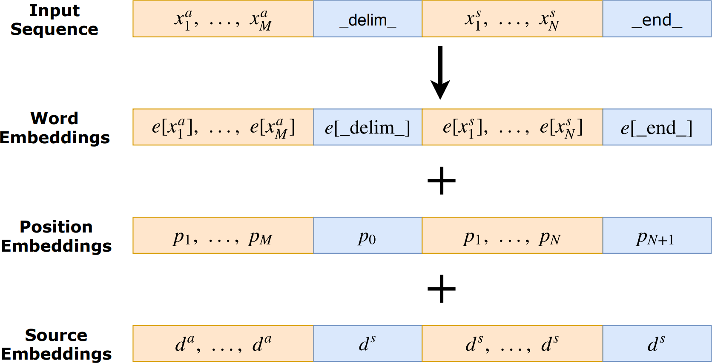
Co-opNET : Generator Networks
24

Slide 32








Co-opNET : Generator Networks
Gold Abstract
This research is concerned with making recommendations to museum visitors based on their history within the physical environment, and textual information associated with each item in their history. (...)
Decoder-Block
×𝑁
Feed Forward NN
Masked Self-Attention
Transformer-Decoder
+
+
+
𝑒! 𝑝!
<s> d [DEL]
𝑝!
𝑝!
Document

Slide 33


Co-opNET : Generator Networks
Gold Abstract
This research is concerned with making recommendations to museum visitors based on their history within the physical environment, and textual information associated with each item in their history. (...)
presents
a
zift
Decoder-Block
×𝑁
Feed Forward NN
Masked Self-Attention
Transformer-Decoder
' (|*|
% log 𝑝(𝑒$|𝑒₊, . . 𝑒$,&)
$%&
^{ℒ}!"# ⁼
Prediction
This paper presents a user-centric perspective on the property of location, focusing on some relevant factors in deciding which exhibit a user intends to visit. (...)
+
+
+
+
+
+
+
+
𝑒!
<s> d
𝑝!
𝑝!
^{𝑝}𝑒!!
𝑝!
𝑝!
𝑒!
𝑝!𝑒!
𝑝!
𝑒!
𝑝!
[DEL] This paper presents a
user-centric
Document

Slide 34
Automatic Metric Evaluations on SAAS Dataset
Co-opNet w/ Discriminator 35.45
Co-opNet (GPT-2)
33.74
PGEN+Coverage
32.55
Lede-3
16.22
20
Rouge-L
0
5
10
15
25
30
35
40
27

Slide 35


Can ‘Generator Only’ Model Improve Coherence ?
Gold Abstract
This research is concerned with making recommendations to museum visitors based on their history within the physical environment, and textual information associated with each item in their history. (...) This study compares and analyses different methods of path prediction including an adapted naive Bayes method, document similarity, visitor feedback and measures of lexical similarity.
Co-opNET (Generator Only) Generated Abstract
This paper proposes a novel approach to measuring the success of machine learning methods in a user’s selection of a particular exhibit to be produced. An unsupervised framework is used to jointly compute the likelihood of the value of the best exhibit to be produced. (...) The experiments show that models produced by supervised methods improve user performance in selecting exhibits over unsupervised methods.
Green: Transitional Phrases
28

Slide 36



Autoregression issue for Summarization Flow
Cannot achieve narrative flow across multiple sentences
No way of telling if the sequence of sentences follow a certain discourse structure or narrative flow!
𝑦!
𝑦"
… _{𝑦#}
Left-to-Right decoding
Left-to-Right decoding
Left-to-Right and Right-To-Left decoding [Zhou et.al., 2019]
à machine translation where alignment matters!
𝑦! 𝑦"
^{… 𝑦}#/"
^{𝑦}#/"
^{… 𝑦}#%!
𝑦#
Right-to-Left decoding
29

Slide 37









Co-opNET: Cooperative Generator Discriminator Networks
Introduction
Abstract
Discourse relation characterizes the internal structure and logical relation of a coherent text.
Automatically identifying these relations not only plans an important role in discourse comprehension and generation, but also obtains wide applications in many other relevant natural language processing tasks, such as text summarization (Yoshida et. al., 2014), conversation (Higashinaka et.al., 2014), question answering (Verberne et al., 2007)…
Implicit discourse relation recognition is a crucial component for automatic discourse level analysis and natural language understanding.
In this paper, instead, we explore generative models and propose a variational neural discourse relation recognizer.
Generally, discourse relations can be divided into two categories: explicit and implicit, which can be illustrated in the following example: The company was disappointed by the ruling …
Transformer Generator
Scoring function for likelihood of adjacency
BERT Discriminator

Slide 38






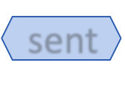
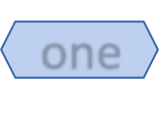


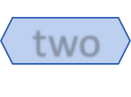









































Co-opNET : Discriminator Networks
Input Sentences
CLS
sent
one
SEP
+
sent
two
SEP
Token Embeddings
^{𝐸}&'(
^{𝐸})*+,
^{𝐸}-+*
^{𝐸}(./
^{𝐸})*+,
^{𝐸},0-
^{𝐸}(./
+
Sentence Indicator Emb.
^{𝐸}&'(
^{𝐸}-+*
^{𝐸}-+*
^{𝐸}(./
^{𝐸},0-
^{𝐸},0-
^{𝐸}(./
+
Position Embeddings
𝐸!
𝐸"
𝐸₁
𝐸₂
𝐸₃
𝐸₄
𝐸₅
Adjacency Classifier (Probability of adjacency between 2 sentences)
Adjacency Learning. (minimize the likelihood of predicting whether 2 sentences are adjacent or not)

Slide 39



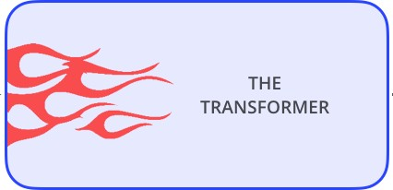



















Co-opNET: Cooperative Generation
Source
Discourse relation characterizes the internal structure and logical relation of a coherent text. Automatically identifying these relations not only plans an important role in discourse comprehension and generation, but also obtains wide (…)
Input Context + Position Embed
Co−opNET
Generator
Pool of hypothesis summaries
summary-1
summary-n
𝑠! 𝑠"
… _{𝑠6}
𝑠! 𝑠"
… _{𝑠7}
…
p(g) = 𝛿
∑|!| 𝑝(𝑤 |𝑤 , ⋯ , 𝑤 )
!"#
$
$ & $'&
-
+ 𝛿_{($)*} + 𝑃_{.(/}(𝑠₊, 𝑠₀)
+,&
𝑠! 𝑠"
𝑠! 𝑠"
𝑠" 𝑠₁
𝑠" 𝑠₁
…
Reranking adjacency scores
…
…
…
^{𝑠}6%!
𝑠₆
^{𝑠}7%!
𝑠₇
Co−opNET
Discriminator

Slide 40
Automatic Metric Evaluations on SAAS Dataset
Co-opNet w/ Discriminator 35.45
Co-opNet (GPT-2)
33.74
PGEN+Coverage
32.55
Lede-3
16.22
Human Evaluations
20
Rouge-L
0
5
10
15
25
30
35
40
Flow
Relevance

Slide 41

Can ‘Generator Only’ Model Improve Coherence ?
Gold Abstract
This research is concerned with making recommendations to museum visitors based on their history within the physical environment, and textual information associated with each item in their history. (...) This study compares and analyses different methods of path prediction including an adapted naive Bayes method, document similarity, visitor feedback and measures of lexical similarity.
Co-opNET (Generator +Discriminator) Generated Abstract
This paper presents a user-centric perspective on the property of location, focusing on some relevant factors in deciding which exhibit a user intends to visit. We exploit variation and infrequency in data from the (...) We make three contributions: (1) Our experimental system provides empirical evidence for the effectiveness of supervised learning techniques in predicting (…); (2) Our structure based method allows unsupervised learning to be applied to multiple sets of related information. (3) Our experimental system uses unsupervised model adaptation in a supervised setting.

Slide 42
Question set B
What is coherence in text (1/2 lines) ?
Co-opNET has a discriminator and a generator (True or False)
Co-opNET can be used for summarize hindi text(True or False)

Slide 43



Conditional Generation
How do we:
learn narrative flow?
guide long text generation
capture long range dependencies?
leverage knowledge embedded in
pre-trained LMs?
Tasks:
Summarization
Story Generation
Knowledge Graph Completion

Slide 44
PLOTMachines: Generate Stories from Outlines
Reference: Raskin et al., PlotMachines: Outline-Conditioned Generation with Dynamic Plot State Tracking
https://arxiv.org/abs/2004.14967

Slide 45




How do human’s write a story ?
big bird’s birthday celebration
cookie monster eats
roller skating ring
big birthday cake

Slide 46







PLOTMachines: Outlines for Better Story Generation
big bird’s birthday celebration
cookie monster eats
roller skating ring
big birthday cake
Story Outline
It is Big Bird's birthday, and he goes to the roller skating rink with his friends . Back at Sesame Street, Maria and Susan take out the big birthday cake and leave it on a table . Cookie Monster sees the cake, but instead of eating it and spoiling the party, he eats a chair and other things all over Sesame Street .
Big Bird and the other skaters return to Sesame Street and are shocked at what Cookie Monster ate, though the cake is safe. Gina and Count Von Count presents the cake to Big Bird . It has 548 candles even though Big Bird is 6 years old . At the end, when Gina announces the sponsors, Cookie Monster eats them along with his cake .

Slide 47



Story-Outline Dataset
Wikipedia Plots Article [Riedl, 2017]
A criminologist narrates the tale of the newly engaged couple, Brad Majors and Janet Weiss, who ﬁnd themselves lost and with a ﬂat tire on a cold and rainy late November evening, somewhere near Denton in 1974 . Seeking a telephone, the couple walk to a nearby castle where they discover a group of strange and outlandish people who are holding an Annual Transylvanian Convention . They are soon swept into the world of dr Frank-N-Furter, a self-proclaimed ”sweet transvestite from Transsexual, Transylvania” . The ensemble of convention attendees also includes servants Riff Raff, his sister Magenta, and a groupie named Columbia . In his lab, Frank claims to have discovered the ”secret to life itself” . His creation, Rocky, is brought to life . The ensuing celebration is soon interrupted by Eddie (an ex-delivery boy, both Frank and Columbia’s ex-lover, (…)
Keypoints using RAKE
the rocky horror picture show
convention attendees also includes servants riff raff
annual transylvanian convention
old high school science teacher
frank justiﬁes killing eddie
enraged rocky gathers frank
rainy late november evening
dr scott investigates ufos
jealous frank kills eddie
live cabaret ﬂoor show

Slide 48
Challenges in Outline Guided Story Generation
Challenge #1:
outline only provides rough elements of the plot
Challenge #2:
appropriate beginning, setting and conclusion required
Challenge #3:
stories should include all the key points in a natural way
keep track of what has been written so far

Slide 49











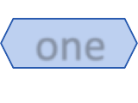

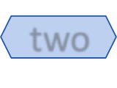













Generate Documents given an Outline
Outline / Keypoints
the detective
strange phone call
detective Leland and another detective Dave
New York police detective
Powerful interests in the city
Leland holds things together
The incorruptible detective presses
relationship between man's suicide and murder
Start
key
one <kw>
key
two <kw>
…
endkey

Slide 50
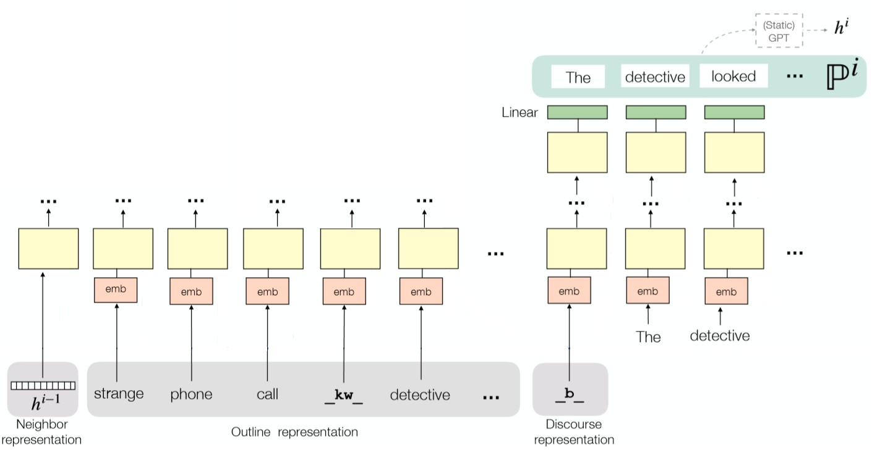
PM: Generate Documents given an Outline

Slide 51
Pulse Check
True / False
The model in the previous slide has a memory unit
The model is based on a seq-seq architecture

Slide 52
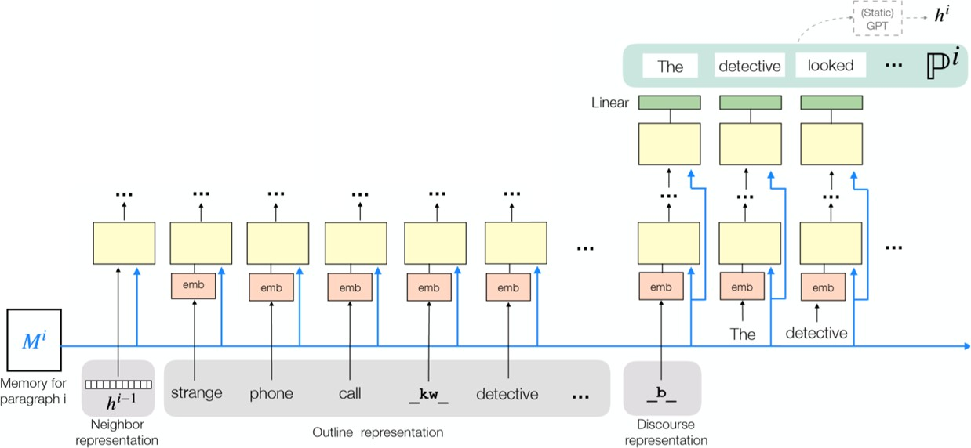
PM: Generate Documents given an Outline w/ Memory
keep track of portions of the outline
maintain semantic coherence across the entire story

Slide 53
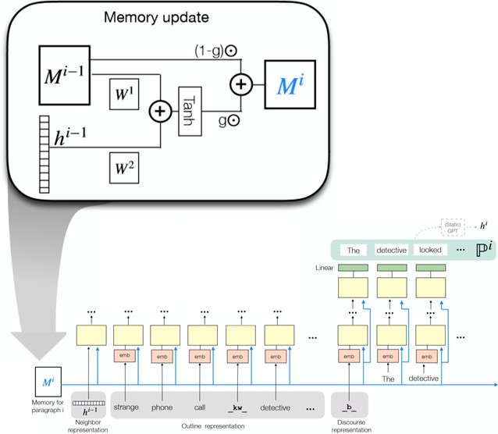
PM: Gated Memory Update Module
_{𝑀 = 𝐾 ∈ ℛ}!×#
_{𝐷 ∈ ℛ}!×#

Slide 54
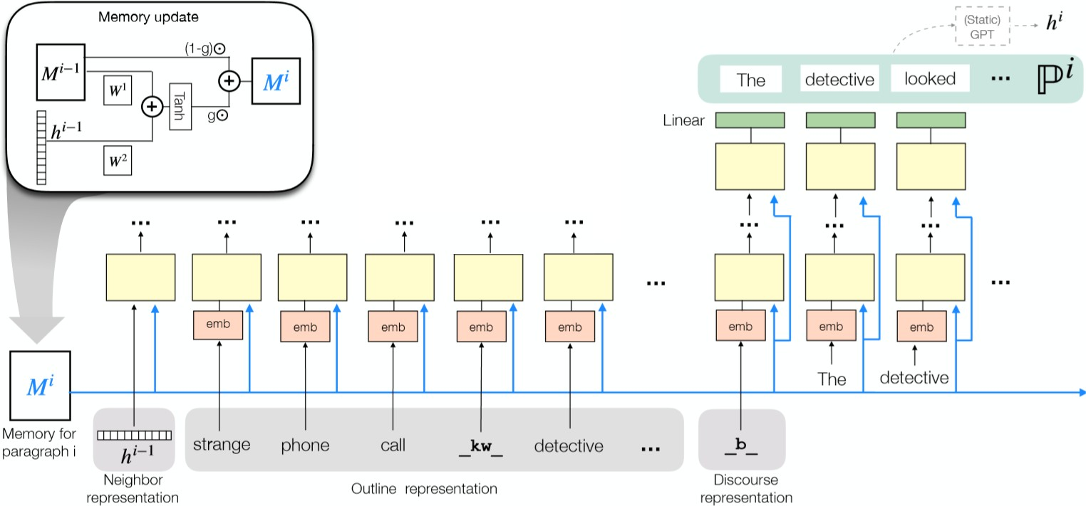
PM: Generate Documents given an Outline w/ Memory

Slide 55
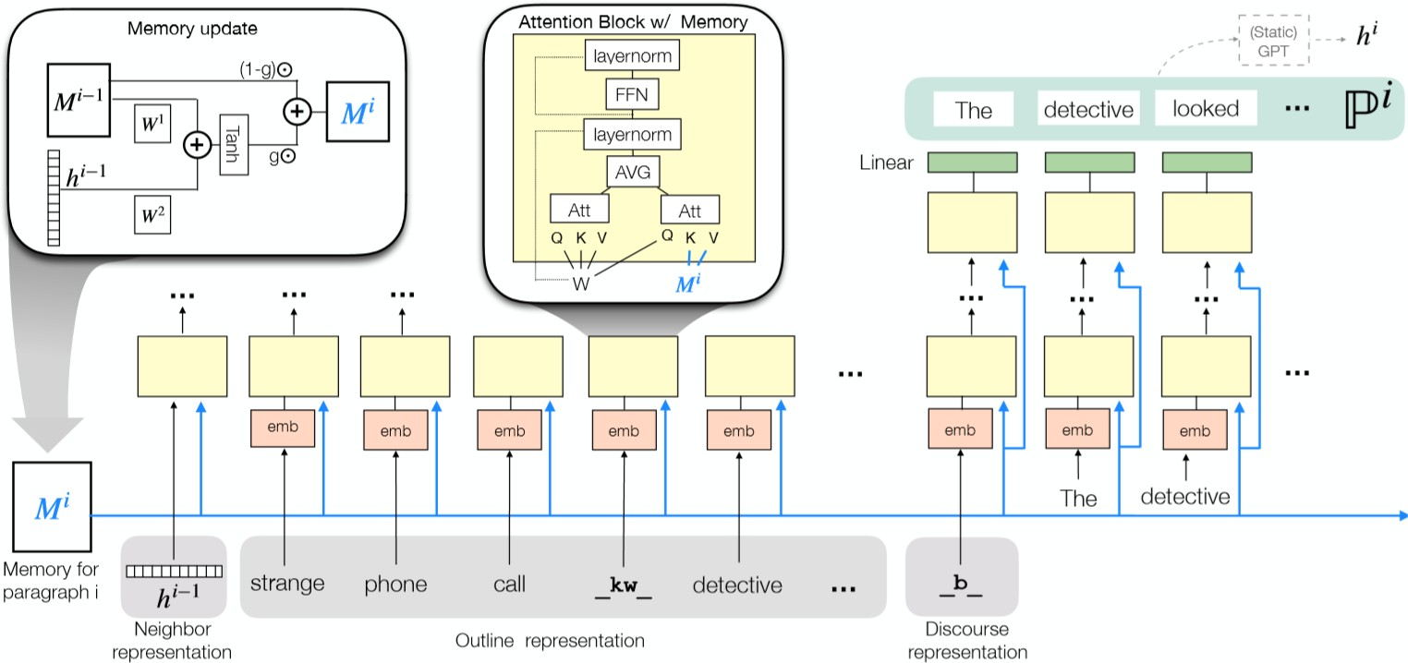
PM: Generate Documents given an Outline w/ Memory

Slide 56
PLOTMachines : Model Variations
PLOTMachines Full Memory
_{𝑀 = 𝐾 ∈ ℛ}!×#
_{𝐷 ∈ ℛ}!×#
PLOTMachines Single Memory
𝑀 = 𝐷 ∈ ℛ$×#
PLOTMachines No Memory
𝑀 = 1

Slide 57
PLOTMachines:
outline conditioned + memory augmented writer
How well does it perform?

Slide 58


Controllable Generation w/ Transformers Baselines
CTRL-Large 1.6B parameters

Slide 59
Pulse check
What is CTRL ?
https://blog.einstein.ai/introducing-a-conditional-transformer-language-model-for-controllable-generation/
Keskar et al., CTRL: A Conditional Transformer Language Model for Controllable Generation
What is PLOTMachine

Slide 60
Automatic Metric Evaluations on WikiPlots Dataset
PLOTMachines (GPT-2)
PLOTMachines (GPT) PLOTMachines (No memory)
CTRL GROVER GPT-2
GPT
16.8
16
7.8
12.6
12.5
13.3
7.9
0 2 4 6 8 10
Rouge-L
12
14
16
18

Slide 61
Human Evaluations: Paragraph base
Outline Usage: (SBS) one is better at utilizing the keywords
Narrative Flow:
(SBS) which paragraph contains a single point line?
(Single) how smooth is the transition to this paragraph from the previous paragraph?
(Single) how repetitive is the information in this paragraph
of the information from the previous paragraph?

Slide 62
Human Evaluations: Overall Story
Which do you think is better at utilizing the keywords ?
Which do you think is more repetitive ?
Which do you think has better transitions ?
Which do you think is better at following single story line ?
Which do you think has a better introduction?
Which do you think has a better conclusion ?
Which do you think has a better order of events ?

Slide 63




Conditional Generation
How do we:
learn narrative flow?
guide long text generation
capture long range dependencies?
leverage knowledge embedded in
pre-trained LMs?
Tasks:
Summarization
Story Generation
Knowledge Graph Completion

Slide 64
COMET: Commonsense Transformers for Automatic Knowledge Graph Construction
Bosselut et al., COMET: Commonsense Transformers for Automatic Knowledge Graph Construction

Slide 65
Generate with common sense knowledge!

Slide 66
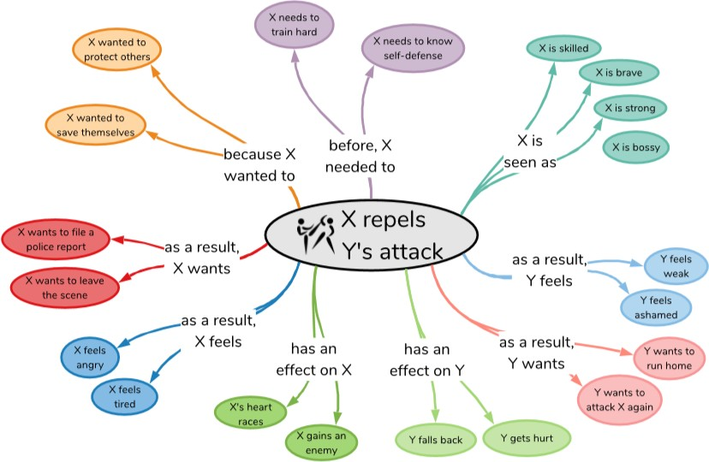
Knowledge Graphs
Slide: Bosselut, 2019

Slide 67
Familiarity Questions
What is a knowledge graph ?
Provide examples of some.

Slide 68
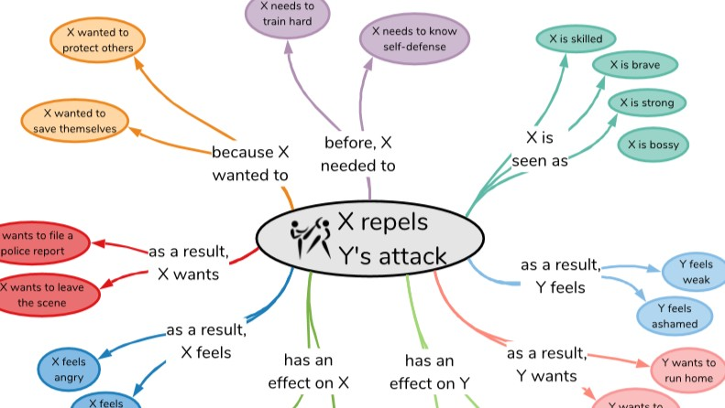
Hard to manually curate:
Scarcity of experts
Costs of crowdsourcing
Expressivity of concepts

Slide 69
Commonsense Knowledge Graphs
Lots of entities
A house, fish, plate, …..
Selling a house around Halloween
Selling a house because it is haunted
Selling a haunted house around Halloween
Lots of relations
You can eat fish
A fish can be on a plate
You can sell your house
A fish probably won’t buy it
Slide: Bosselut, 2019

Slide 70
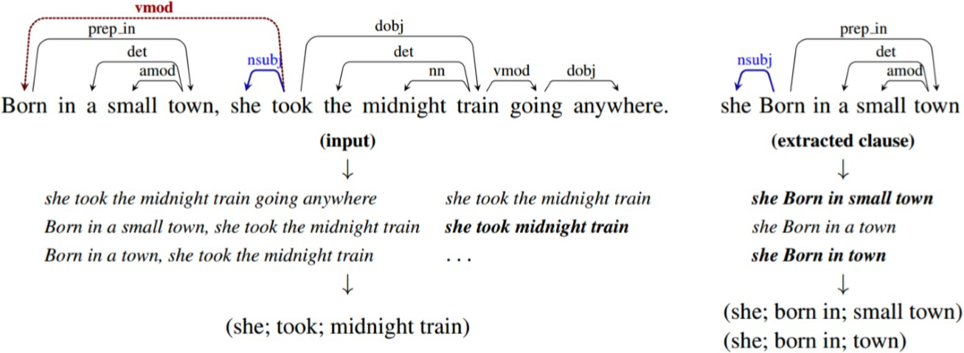
Extractive Knowledge Graph Construction
https://nlp.stanford.edu/software/openie.html
59

Slide 71
Issues: Extractive Knowledge Graph Construction
Knowledge (particularly commonsense) is immeasurably vast, making it diﬃcult to manually enumerate in all its forms
Knowledge can be assumed, therefore not written directly in text
– Extractive methods won’t cover the cases we need
Open text is the most abundant, low-cost resource we have
Slide: Bosselut, 2019
71

Slide 72
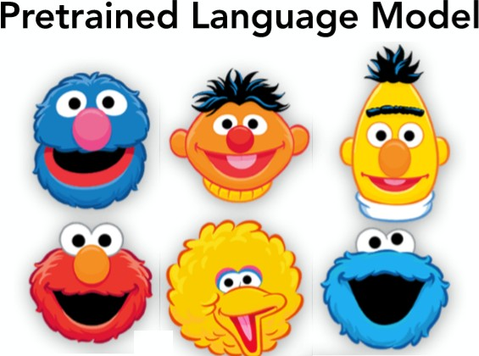
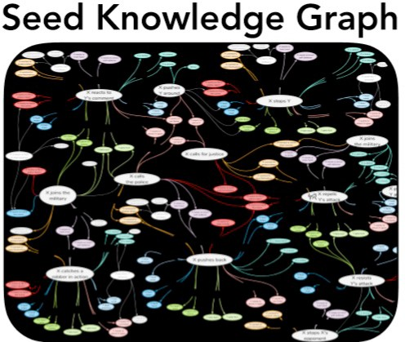

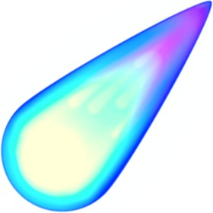


seed set of tuples
72

Slide 73
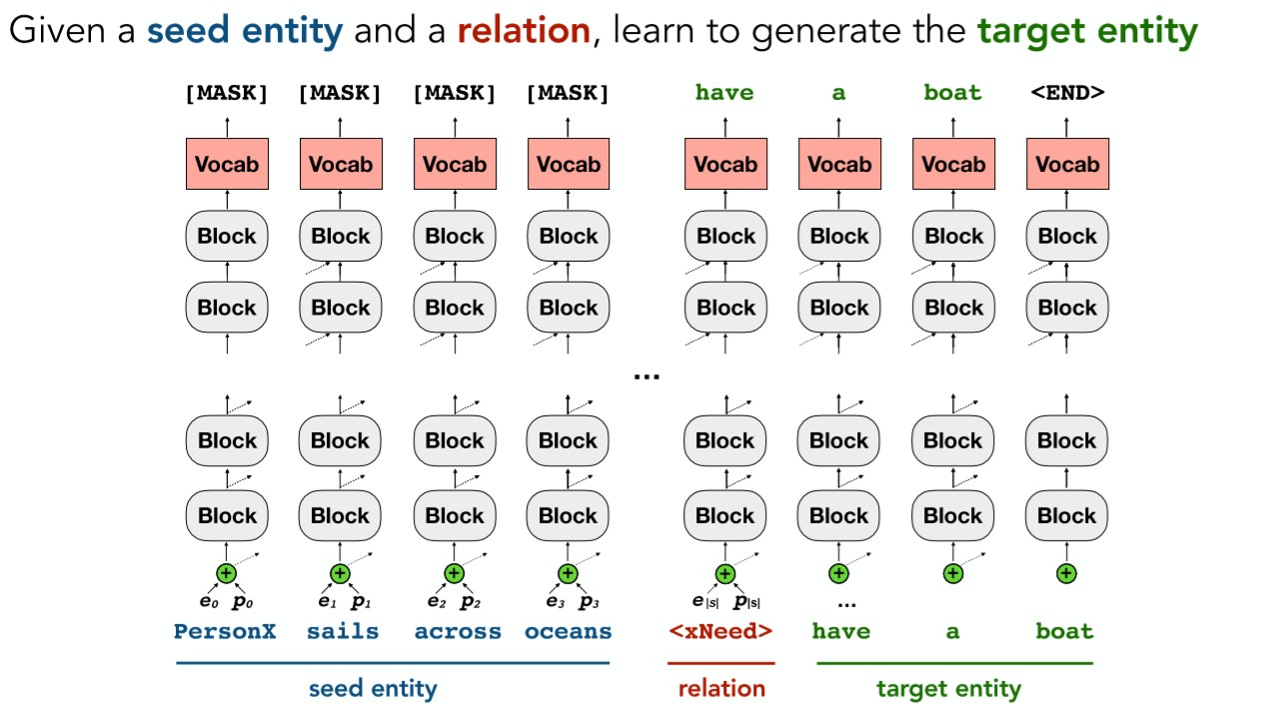
73

Slide 74
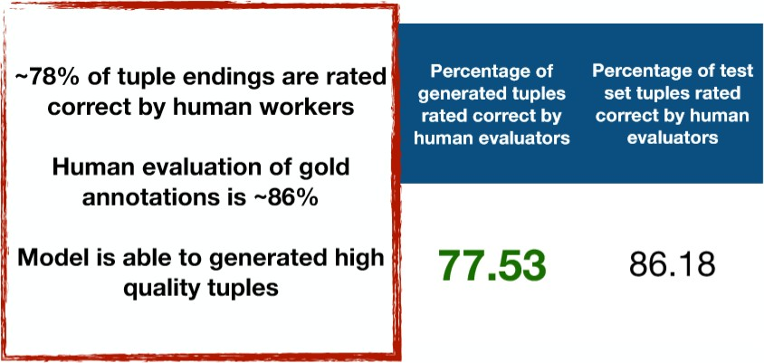
ATOMIC as seed data
74

Slide 75

+
+
Constraint Decoding
75

Slide 76
Briefly….
Transformer models for generation are just attention based
autoregressive decoders
Perplexity is not the only way to train LMs
Long text generation requires learning a better discourse
Introducing implicit evaluators for teaching discourse is beneficial
Humans start writing stories with an outline, so should agents
Transformer based commonsense knowledge can help create more human like stories/text
76

Slide 77

Some of the Challenges in Long Text Generation
Training corpora
Learning discourse, reference, etc.
Loss-Function for high level semantics of the long text
Repetitions and dull sentences (modal collapse)
Maintaining coherence between paragraphs
Sub-optimal evaluation metrics
Word-by-word generation is sub-optimal, can’t see the global context!
Long text generation suffers from lack of implicit “planning” !
Biased pre-trained language models
Domain transfer is ridiculously hard
Outdated generation methods: beam-search, or sampling
Softmax bottleneck issues
Left-to-write generation
77

Slide 78
Question set C [write up the answers]
1. What kind Information Extraction / Information Retrieval was leveraged for COMET (if any)
2. Can we use a system like COMET for generation of
Wikipedia articles
Generating long poems in Hindi
Translating English to Hindi
3. COMET is based on a CNN architecture. (True or False)

Slide 79
Discrete Metrics Don’t Work For Text Generation
 |  | BLEU | ROUGE | CIDEr | SPICE | METEOR | Word Movers
Original | a man wearing a red life jacket is sitting in a canoe on a lake | 1.00 | 1.00 | 10.0 | 1.00 | 1.00 | 1.00
Candidate | a man wearing a life jacket is in a small boat on a lake | 0.45 | 0.67 | 2.19 | 0.40 | 0.28 | 0.19
Synonyms | guy wearing a red life vest is in a small boat on a lake | 0.20 | 0.57 | 0.65 | 0.0 | 0.17 | 0.10
Word Order | in a small boat on a lake a man is wearing a life jacket | 0.26 | 0.38 | 1.32 | 0.40 | 0.26 | 0.19
Kilickaya, et.al., 2017
79

Slide 80
Further Reading
BERT-PLI: https://www.ijcai.org/Proceedings/2020/0484.pdf
Structured Document Retrieval: http://www.cwr.cl/documentRetrival.pdf
ElasticBERT: https://medium.com/analytics-vidhya/elasticbert-information-retrieval-using-bert-and-elasticsearch-51fef465b9ae
Easing Legal News Monitoring with Learning to Rank and BERT - https://www.youtube.com/watch?v=PUqyvKid9TY
Legal Area Classification: A Comparative Study of Text Classifiers on Singapore Supreme Court Judgments - https://arxiv.org/pdf/1904.06470.pdf
Simple Applications of BERT for Ad Hoc Document Retrieval - https://arxiv.org/pdf/1903.10972.pdf

