Slide 1
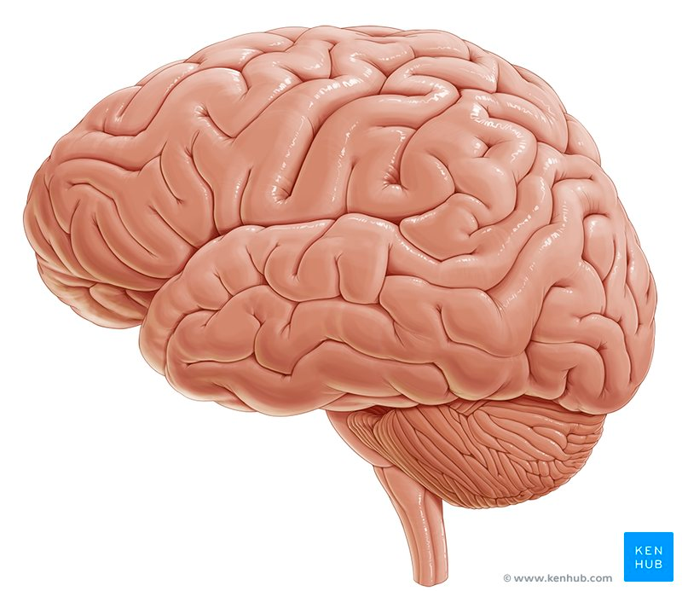
Brain Tumor Segmentation
Presented BY Zubair Idrees

Slide 2
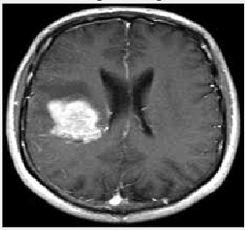
Introduction
Brain tumour is a mass or growth of abnormal cells in your brain.
Brain tumor extraction & its analysis is a challenging task in Medical image processing because brain image is complicated.
Segmentation plays a very vital role in the medical image processing

Slide 3
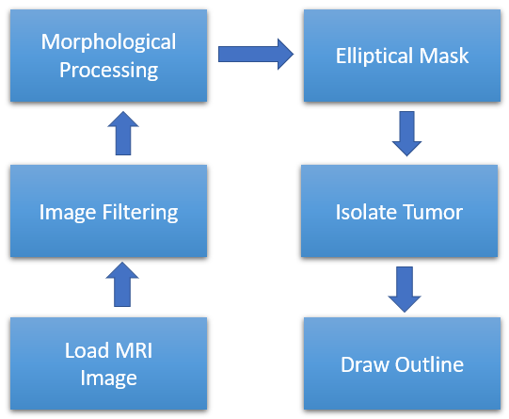
Process Of Tumor Detection

Slide 4
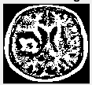

Image filtering & Cleaning
Noise reduction is a pre-processing step to improve the results of later processing
Apply 2D Median Filter to remove noise.
Median filter is a non-linear digital filtering technique, often used to remove noise from an image or signal.

Slide 5
Morphological Operations
Morphological operations apply a structuring element to an input image, creating an output image of the same size.
Value of the each pixel in the output image is based on a comparison of the corresponding pixel in the input image with its neighbours
We will use “Closing” Morphological operation along with disk-shaped structuring element to fill small gaps in image using.
Dilation followed by Erosion is called Closing, to join two nearby blobs into a single blob

Slide 6
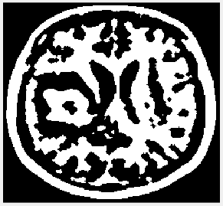
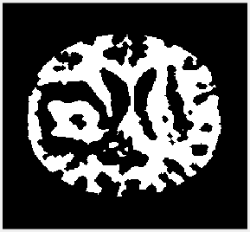
Elliptical Mask
We are only interested in the inner part of the image
By applying the elliptical shape filter, we will remove the outer part

Slide 7
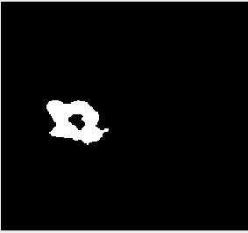
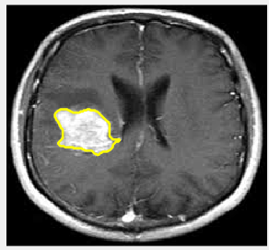
Isolate & Highlight tumor
Extracts all connected components where the area of the objects is in the specific range.
Using the isolated part of the image, draw outline on the original input image

Slide 8
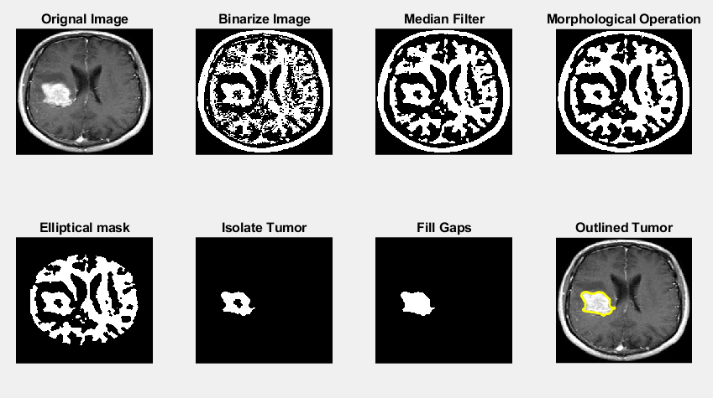
results

Slide 9
conclusion
Selecting the right filters and methods would improve our algorithm relative to regular algorithms.
This work will make the MRI image processing and tumour detection process quicker and cheaper for optimum tumour detection solution using elliptical filters and morphological operators.

Slide 10
Thanks
Questions ?

