Slide 1

Operating Systems
Fall 2026
Course Instructor
Ms. Amna Sarwar Lecturer (Artificial Intelligence)
Department of Creative Technologies
Air University - Islamabad
Notes:
<number>

Slide 2
General Course Policies
Plagiarism of any sort will NOT be tolerated. Student will be awarded an F grade in the course if found guilty.
No makeup quiz/exam/assignment will be taken.
Quizzes will be Announced + Surprised.
No Cell phone use in the classroom or it will be taken
Student coming after first ten minutes will be marked absent.
You are responsible for timely and functional delivery of your project/assignment at the beginning of class on submission date. Late assignments/projects will result in zero marks.
Notes:
<number>

Slide 3

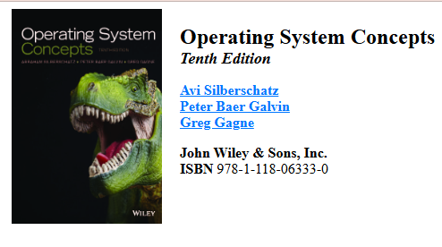
Text Book
“Operating System Concepts” by Silberschatz, Galvin, Gagne 10th Edition”
Notes:
<number>

Slide 4
Course Outline
Overview of Operating systems
  What is an Operating System
  Operating-System Structures
Process Management
  Process Concept & Process Scheduling
  Threads
  CPU Scheduling
Process Synchronization
Deadlocks

Slide 5
Course Outline
Memory Management
  Main Memory Management
  Virtual Memory
Storage Management
  Mass Storage Systems
File Systems
Distributed Operating Systems

Slide 6
Chp1: Introduction
What is an Operating System?
Goals of Operating system
What Operating Systems Do
Computer-System Organization
Computer-System Architecture
Computer-System Structure
Operating-System Operations
Storage Management
Computing Environments

Slide 7
Objectives
To describe the basic organization of computer systems
To provide a grand tour of the major components of operating systems
To give an overview of the many types of computing environments

Slide 8
What is an Operating System?
A program that acts as an intermediary between a user of a computer and the computer hardware
Operating system goals:
  Execute user programs and make solving user problems easier
  Make the computer system convenient to use
  Use the computer hardware in an efficient manner

Slide 9

Computer System Components
Computer system can be divided into four components:
  Hardware – provides basic computing resources
    CPU, memory, I/O devices
  Operating system
    Controls and coordinates use of hardware
    among various applications and users
  Application programs – define the ways in which the system resources are used to solve the computing problems of the users
    Word processors, compilers, web browsers, database systems, video games
  Users
    People, machines, other computers

Slide 10
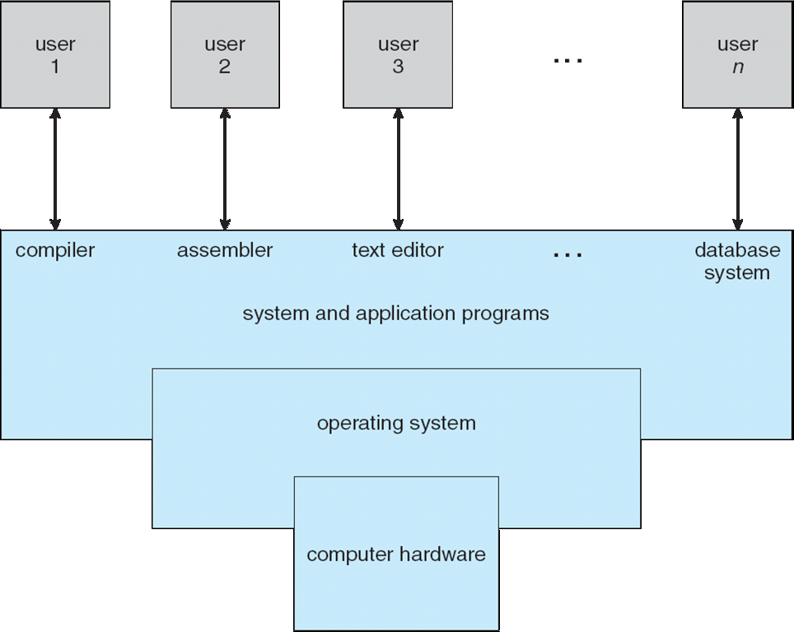
Four Components of a Computer System

Slide 11
What Operating Systems Do
Depends on the point of view
Users want convenience, ease of use and good performance
  Don’t care about resource utilization
But shared computer such as mainframe or minicomputer must keep all users happy
Users of dedicate systems such as workstations have dedicated resources but frequently use shared resources from servers
Handheld computers are resource poor, optimized for usability and battery life
Some computers have little or no user interface, such as embedded computers in devices and automobiles

Slide 12
Operating System Definition
The system view:
OS is a resource allocator
  Manages all resources
  Decides between conflicting requests for efficient and fair resource use
OS is a control program
  Controls execution of programs to prevent errors and improper use of the computer

Slide 13
Operating System Definition (Cont.)
No universally accepted definition
“Everything a vendor ships when you order an operating system” is a good approximation
  But varies wildly
When you buy or install an operating system, the company/vendor usually gives you many programs together, not just the core OS.
For example, Windows may come with:
    Kernel
    File Explorer
    Settings
    Notepad
    Calculator
    Device drivers
    Security tools
    Other utilities
So people sometimes say:
“The operating system is everything the vendor ships with it.”
But “varies wildly” means this is not a precise definition because different vendors include very different amounts of software.
For example:
  One Linux distribution may include only basic tools.
  Another Linux distribution may include a browser, office software, media player, and many utilities.
  Windows and macOS also bundle different applications.
So “varies wildly” = differs a lot from one operating system/vendor to another.

Slide 14
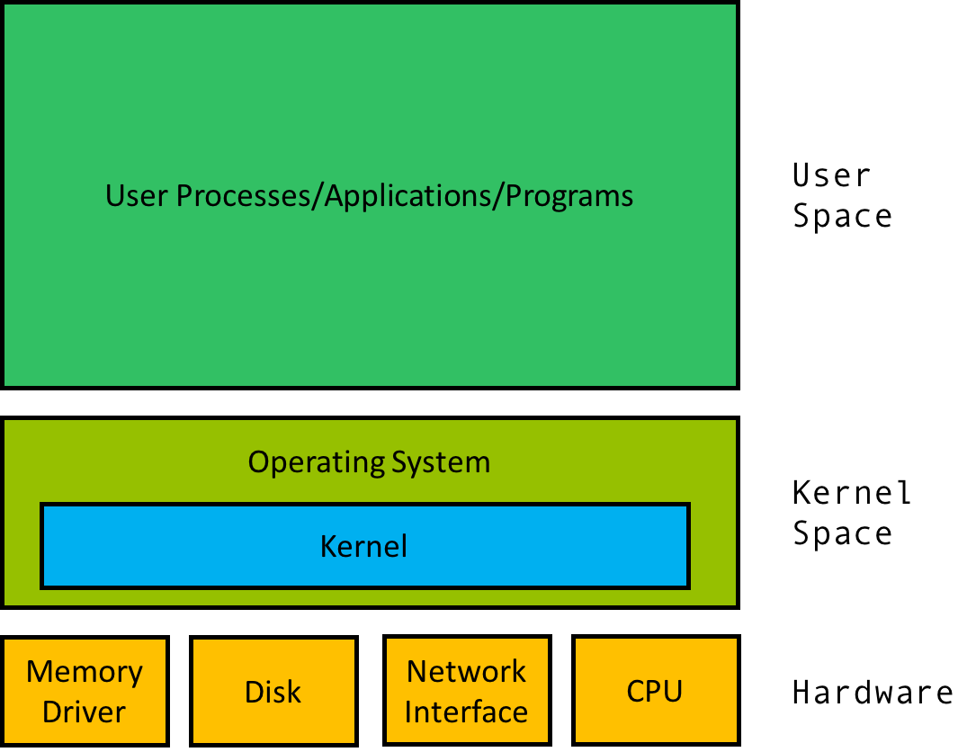
Operating System Definition (Cont.)
“The one program running at all times on the computer” is the kernel, part of the operating system
Everything else is either
  A system program (ships with the operating system, but not part of the kernel) , or
  An application program, all programs not associated with the operating system
Today’s OSes for general purpose and mobile computing also include middleware – a set of software frameworks that provide additional services to application developers such as databases, multimedia, graphics

Slide 15
Components of an Operating System Environment
Think of the OS like a restaurant:
Kernel → kitchen manager controlling CPU, memory, devices.
System programs → staff tools that help operate the system, e.g. File Explorer, command prompt.
Middleware → ready-made services developers use, e.g. database access, graphics, audio/video support.
Applications → programs users actually use, e.g. Chrome, Word, WhatsApp.
Example:
A video app uses middleware for audio/video, while the kernel controls the CPU and hardware underneath.

Slide 16
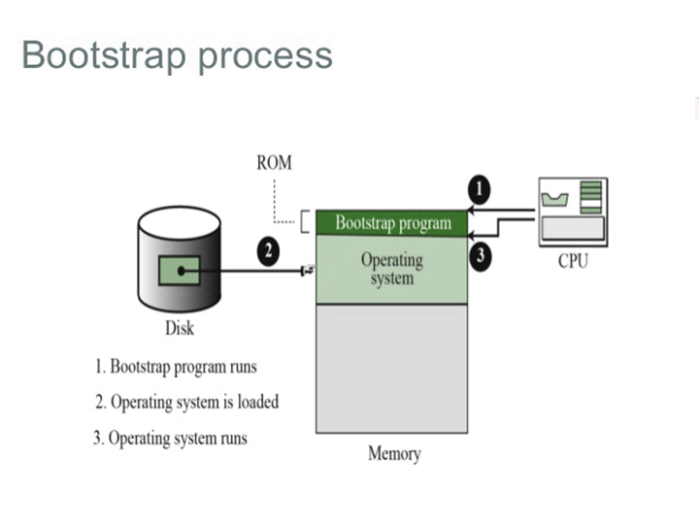
Computer Startup
bootstrap program is loaded at power-up or reboot
  Typically stored in ROM or EPROM, generally known as firmware
  Initializes all aspects of system
  Loads operating system kernel and starts execution

Slide 17
Why should I study Operating Systems?
  Need to understand interaction between the hardware and applications
    New applications, new hardware..
    Inherent aspect of society today
  Need to understand basic principles in the design of computer systems
    efficient resource management, security, flexibility
  Increasing need for specialized operating systems
    e.g. embedded operating systems for devices - cell phones, sensors and controllers
    real-time operating systems – vehicles, aircraft control, multimedia services

Slide 18
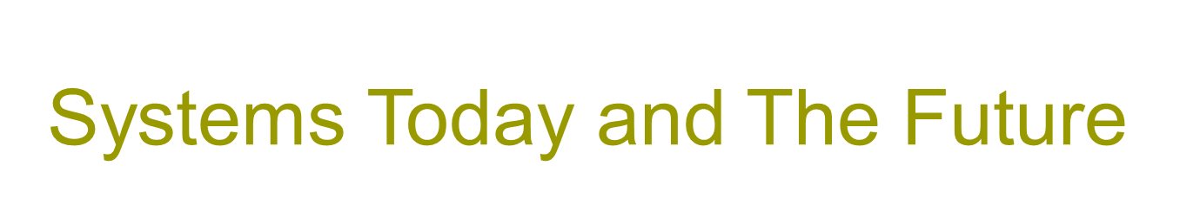
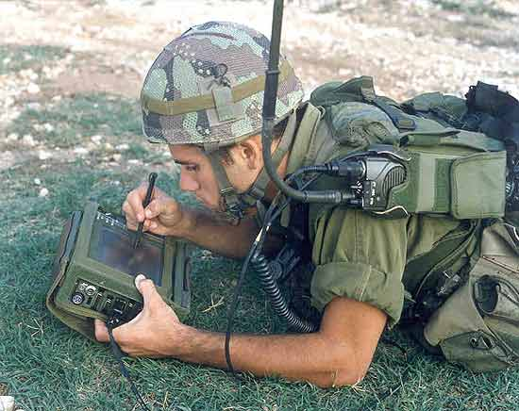
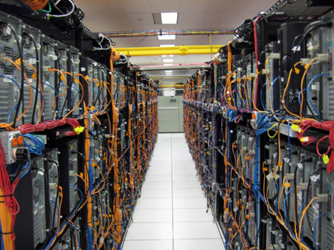
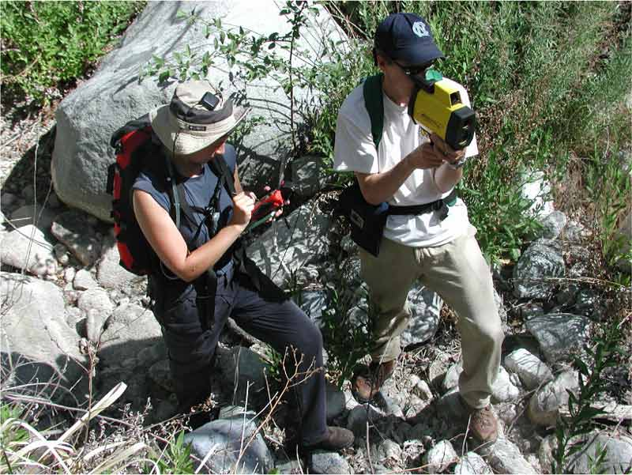
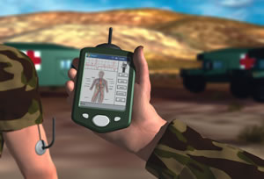
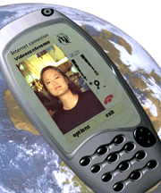

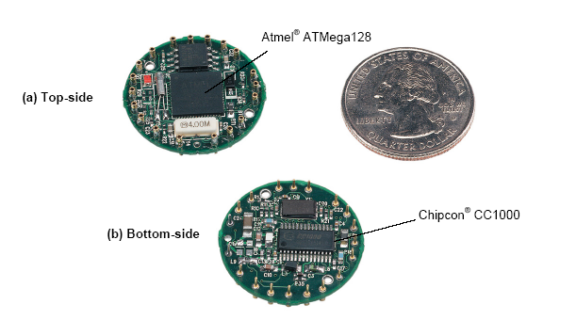
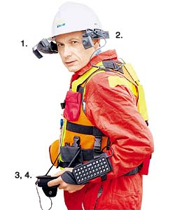
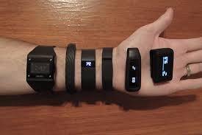

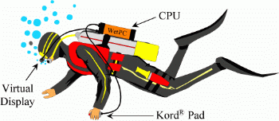

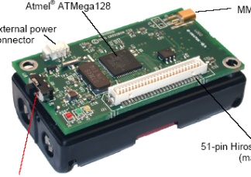

Slide 19
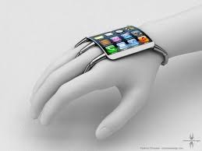
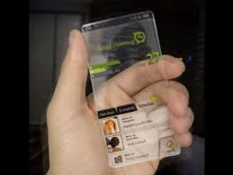
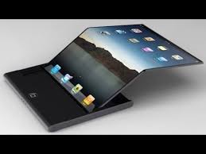
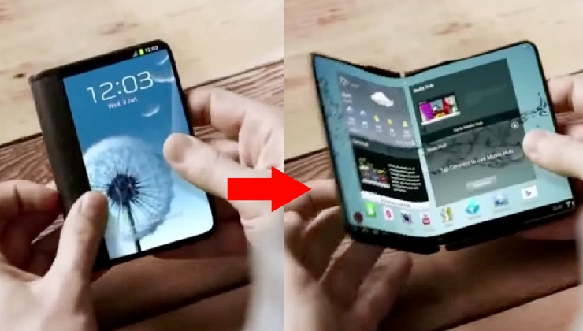

Slide 20
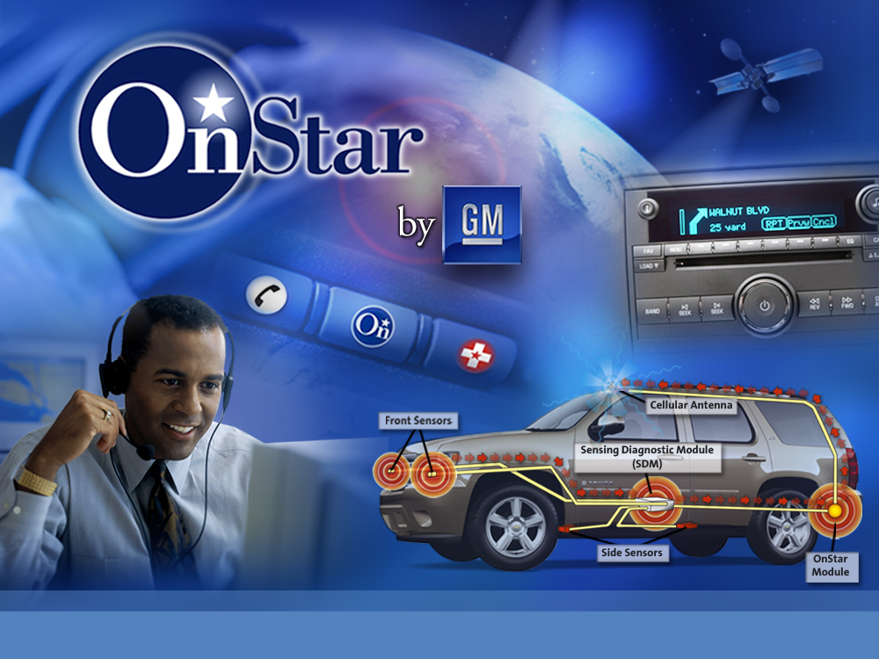
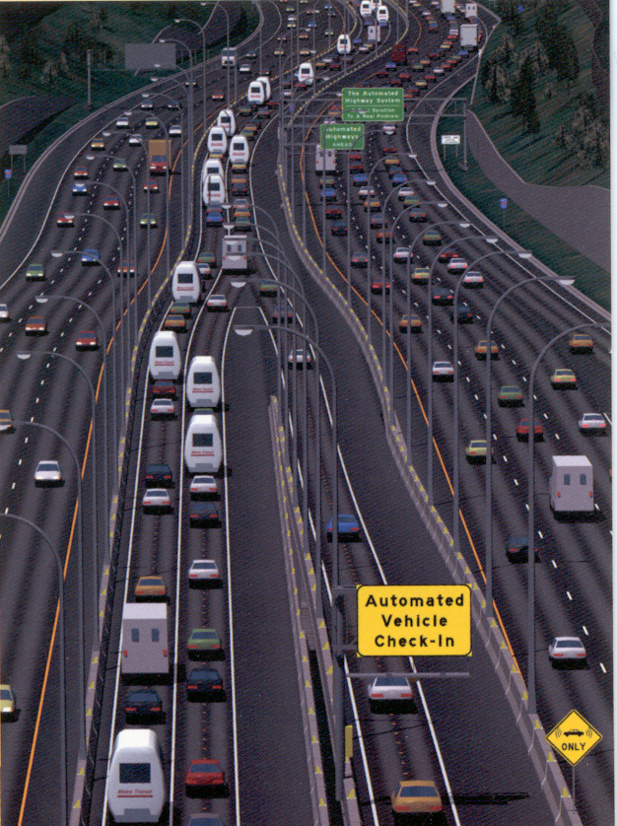
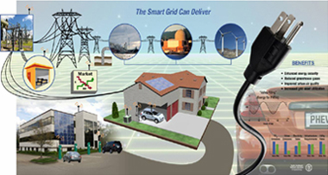
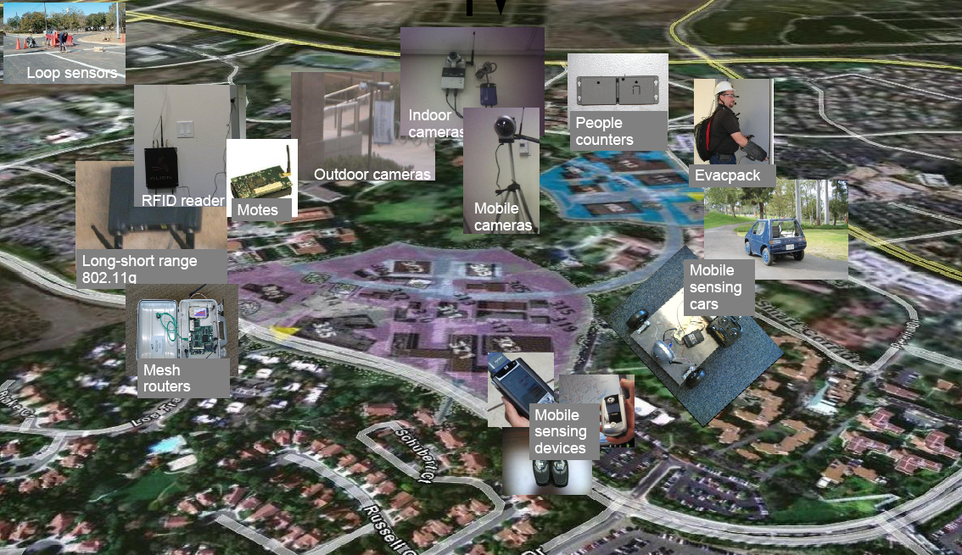

Slide 21
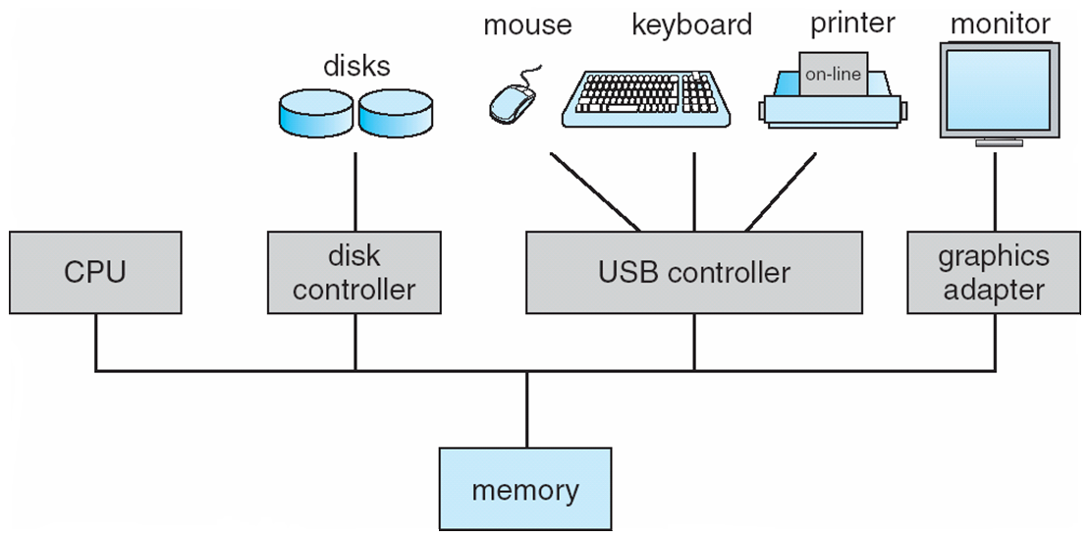
Computer System Organization
Computer-system operation
  One or more CPUs, device controllers connect through common bus providing access to shared memory
  Concurrent execution of CPUs and devices competing for memory cycles

Slide 22
Computer-System Architecture
Most systems use a single general-purpose processor
  Most systems have special-purpose processors as well
Multiprocessors systems growing in use and importance
  Also known as parallel systems, tightly-coupled systems (TCM)
  Advantages include:
    Increased throughput
    Economy of scale
    Increased reliability – graceful degradation or fault tolerance
  Two types:
    Asymmetric Multiprocessing – each processor is assigned a specie task.
    Symmetric Multiprocessing – each processor performs all tasks

Slide 23
Tightly-Coupled vs Loosely-Coupled System
Feature | Tightly-Coupled System | Loosely-Coupled System
Memory | Shared memory (common RAM) | Each processor has private memory
Communication | Shared memory | Message passing via network
OS | Single OS | Each node may run its own OS
Speed | Fast (low latency) | Slower (network delays)
Scalability | Limited | High (easy to add nodes)
Fault Tolerance | Low (failure may affect all) | High (failure of one doesn’t crash system)
Example | SMP servers, multicore PCs | Cloud systems, distributed DBs

Slide 24
Parallel Systems (Cont.)
Symmetric multiprocessing (SMP)
  Each processor runs and identical copy of the operating system.
  Many processes can run at once without performance deterioration.
  Most modern operating systems support SMP
Asymmetric multiprocessing
  Each processor is assigned a specific task; master processor schedules and allocated work to slave processors.
  More common in extremely large systems

Slide 25
Parallel Systems (Cont.)
Feature | Symmetric (SMP) | Asymmetric (AMP)
Control | All CPUs equal | Master–slave model
Resource sharing | Shared memory & I/O | Workers depend on master
Performance | High, scalable | Limited by master
Example | Modern PCs | Old mainframes, some embedded systems

Slide 26
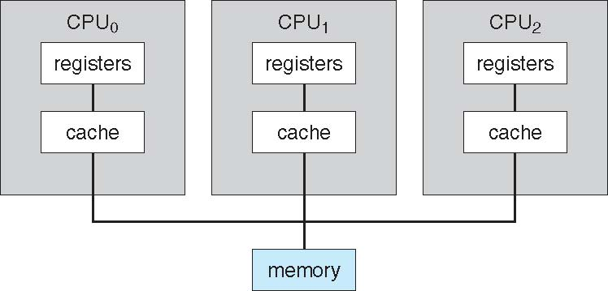
Symmetric Multiprocessing Architecture
1 physical CPU
↓
8 CPU cores
↓
Core 0, Core 1, Core 2, ... Core 7
Those cores can work somewhat like the CPU₀, CPU₁, CPU₂ shown in this SMP diagram.
So SMP (Symmetric Multiprocessing) basically means:
Multiple equal CPUs/cores can run tasks simultaneously and share the same main memory.

Slide 27
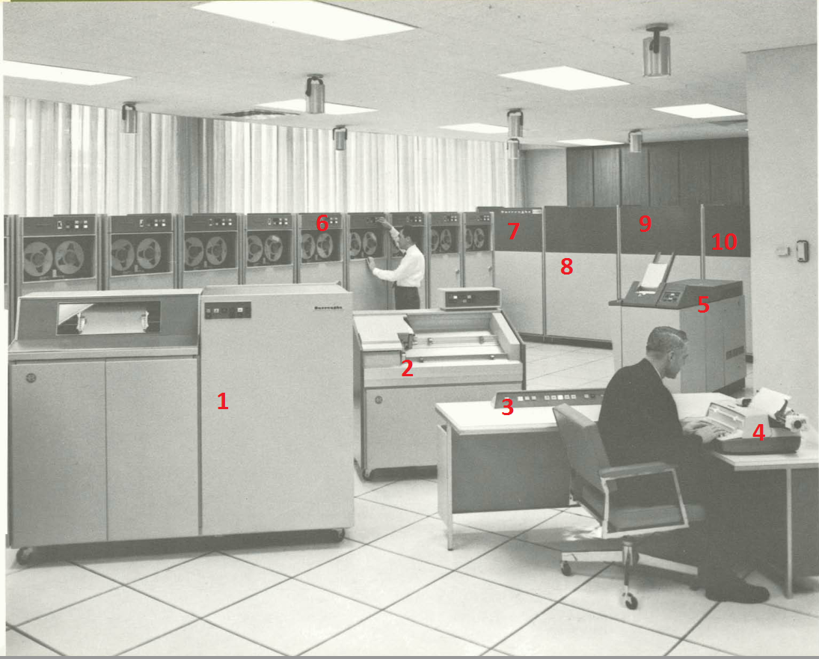
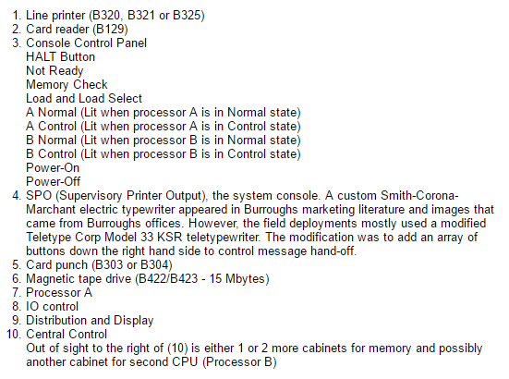
Symmetric Multiprocessing Architecture
Two CPUs were installed in the same computer and both could process work while sharing the same memory/resources.

Slide 28
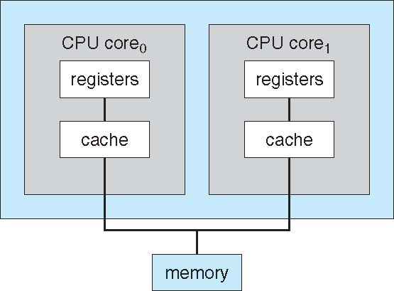
A Dual-Core Design
Multi-chip and multicore
Systems containing all chips
  Chassis containing multiple separate systems
1 CPU chip → 2 cores → both can execute tasks

Slide 29
Distributed Systems
Distribute the computation among several physical processors.
A distributed system is a system where multiple separate computers/processors work together to complete tasks.
  Loosely coupled system (LCM) – each processor has its own local memory; processors communicate with one another through various communications lines, such as high-speed buses or telephone lines.
Advantages of distributed systems.
  Resources Sharing
  Computation speed up – load sharing
  Reliability
  Communications

Slide 30
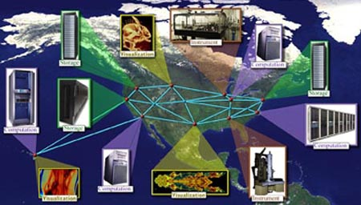
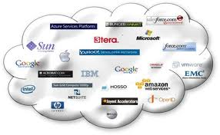
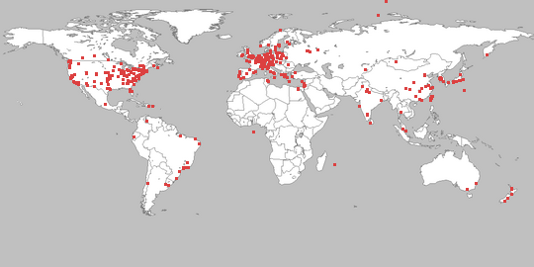
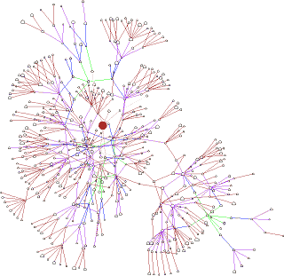
Distributed Computing Systems - Examples
Globus Grid Computing Toolkit
Cloud Computing Offerings
Many computers share processing power for large tasks.
Remote servers provide computing and storage over the internet.
PlanetLab
Gnutella P2P Network
Global research network for networking experiments.
Computers connect directly and share resources.

Slide 31
Clustered Systems
Like multiprocessor systems, but multiple systems working together
  All computers can access the same shared storage called a Storage Area Network (SAN).
  Provides a high-availability service which survives failures
Types of Clustering
    Asymmetric Clustering: One active node runs the application while a standby node stays idle in hot-standby mode, monitoring the active system to take over if it fails.
    Symmetric Clustering: All participating nodes run applications simultaneously, actively processing data and monitoring each other for higher hardware efficiency
  Some clusters are for high-performance computing (HPC)
    Applications must be written to use parallelization
  Some have distributed lock manager (DLM) to avoid conflicting operations

Slide 32
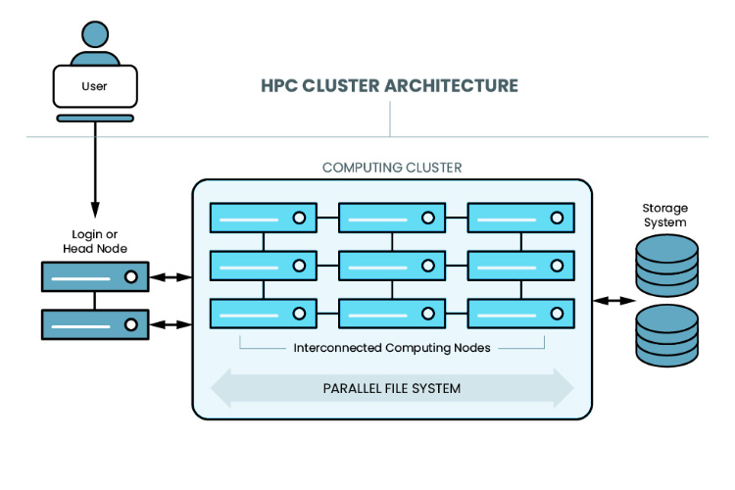

Slide 33
Clustered Systems

Slide 34
Distributed Systems vs Clustered Systems
Distributed system:
Imagine a company has servers in:
Pakistan ↔ UK ↔ Germany
Each server works independently but communicates with the others.
Clustered system:
Imagine one data center has:
Server 1 + Server 2 + Server 3
All three work together to run the same application. If Server 1 fails, Server 2 can continue the service.
Key difference
Think:
Distributed = computers are spread out and cooperate.
Cluster = computers are grouped together and behave more like one powerful/reliable system.
One important point: a cluster is actually a type of distributed system, but not every distributed system is a cluster.
Distributed = distance = loosely coupled
Clustered = close = tightly coupled

Slide 35
Clustered Systems vs Multiprocessor system?
Multiprocessor system = one computer with multiple processors/CPUs working together.
Clustered system = multiple separate computers connected through a network and working together.
Main differences:
  Connection: Multiprocessor CPUs are inside the same system; clustered computers are connected by LAN/high-speed network.
  Memory: Multiprocessor systems usually share the same main memory; clustered systems have separate memory, though they may share storage.
  Main goal: Multiprocessor = faster processing/performance. Cluster = high availability and reliability.
Easy way to remember:
    Multiprocessor = many CPUs in one computer.
    Cluster = many computers working as one system.

Slide 36
Operating System techniques / system types
Multiprogramming (Batch system) needed for efficiency
  Single user cannot keep CPU and I/O devices busy at all times
    Multiprogramming — commonly used in Batch Systems
    Several jobs are kept in memory at the same time.
    The CPU runs one job.
    If that job waits for I/O, the OS switches to another job.
    Job scheduling decides which job runs next.
    Main goal: keep the CPU busy and improve efficiency.
Timesharing (multitasking) means the CPU switches very quickly between multiple running programs so users feel they are running at the same time., creating interactive computing
  Response time should be < 1 second
  Each user has at least one program executing in memory process
  If several jobs ready to run at the same time  CPU scheduling
  If processes don’t fit in memory, swapping moves them in and out to run
  Virtual memory allows execution of processes not completely in memory

Slide 37
Multiprogramming vs Time Sharing
Main difference between multiprogramming and time sharing is that :
  Multiprogramming: is the effective utilization of CPU time, by allowing several programs to use the CPU at the same time but
  Time Sharing: is the sharing of a computing facility by several users that want to use the same facility at the same time. Each user on a time sharing system gets her own terminal and gets the feeling that she is using the CPU alone

Slide 38
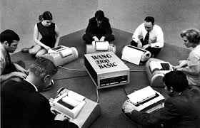
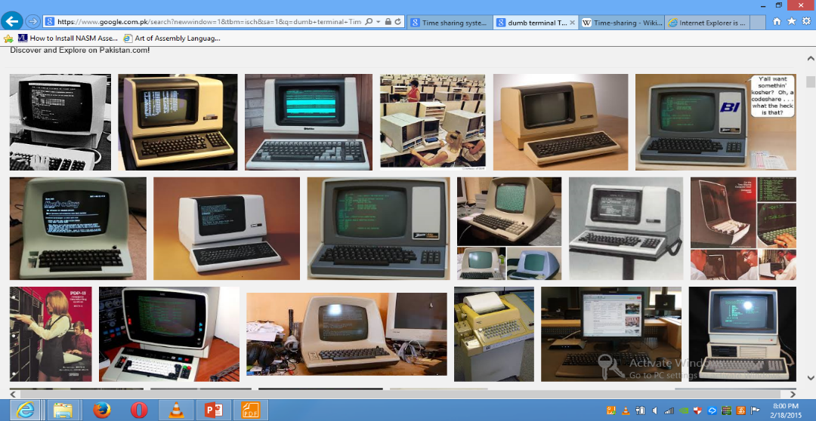
Time-Sharing Systems–Interactive Computing
  Allows multiple users/tasks to use the CPU at the same time.
  CPU gives each task a small time slice (time quantum).
  CPU switches between tasks very quickly.
  Main goal: fast response time for users.
  Uses CPU scheduling + multiprogramming.
  Example: Multiple users working on the same server/system simultaneously.
  Key difference:
  Multiprogramming → maximize CPU usage
  Time-sharing → minimize response time

Slide 39
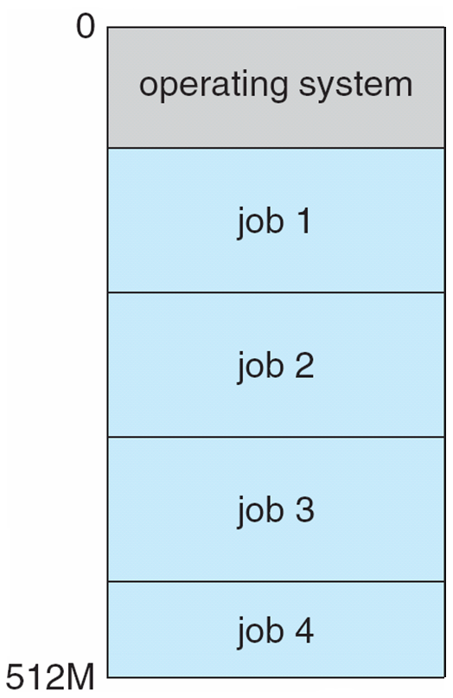
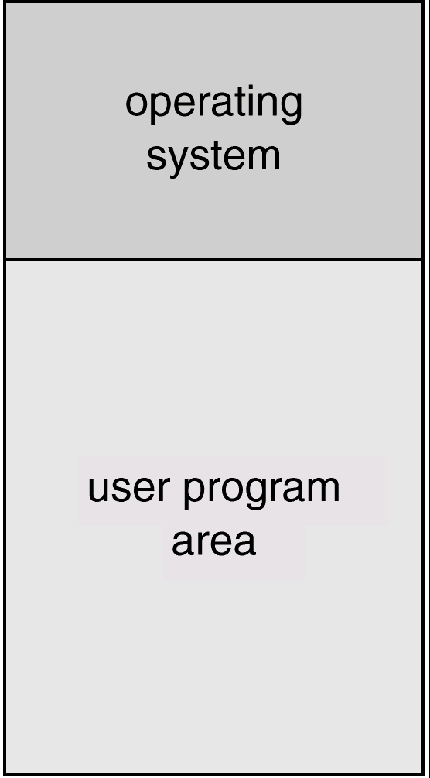
Memory Layout for Multi-programmed System
Multi-programmed Batch Systems
Simple Batch System
Several jobs are kept in main memory at the same time, and the
CPU is multiplexed among them.

Slide 40
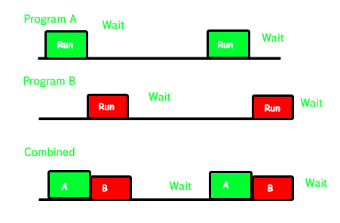
Multitasking

Slide 41
Computing Environments - Traditional
Stand-alone general-purpose machines: Normal computers like desktops and laptops that can work on their own.
  But blurred now: Today, even stand-alone computers are usually connected to other systems through the Internet.
Portals: Websites that give users access to internal company or university systems. Example: a student portal.
Network computers / thin clients: Simple computers that depend heavily on a central server for processing or data. Example: computers in a computer lab connected to one main server.
Mobile computers: Phones and laptops connect using Wi-Fi or mobile networks.
Networking is everywhere: Almost every computer is connected to a network now.
Firewalls: Protect computers and networks from unwanted or malicious Internet traffic.
Traditional computing = normal computers connected through networks, with web access and security protection.

Slide 42
Computing Environments – Distributed
Distributed computing
  Collection of separate, possibly heterogeneous, systems networked together
    Network is a communications path, TCP/IP most common
      Local Area Network (LAN)
      Wide Area Network (WAN)
      Metropolitan Area Network (MAN)
      Personal Area Network (PAN)
  Network Operating System provides communication and resource-sharing features between these computers.
    The key idea of “illusion of a single system” is:
      Even though many computers are working behind the scenes, the user may feel they are using one system.
  Example: Google Drive uses many servers, but to you it looks like one service.

Slide 43
Computing Environments – Client-Server
Client-Server Computing
  Dumb terminals supplanted by smart PCs
  Many systems now servers, responding to requests generated by clients
    Compute-server system provides an interface to client to request services (i.e., database)
    File-server system provides interface for clients to store and retrieve files

Slide 44
Computing Environments - Peer-to-Peer
P2P: A type of distributed system.
    No fixed client/server: All nodes are peers.
    Each peer can act as a client, server, or both.
    A peer must join the P2P network.
    Peers find services using a central lookup or discovery protocol.
Examples: Napster, Gnutella, and early Skype/VoIP.

Slide 45
Computing Environments - Mobile
Mobile devices include smartphones and tablets.
Compared with traditional laptops, they have extra built-in sensors such as GPS, gyroscope, camera, accelerometer, etc.
These extra features allow apps like augmented reality, navigation, fitness tracking, and location-based services.
They connect using Wi-Fi (IEEE 802.11) or cellular networks like 4G/5G.
The main mobile operating systems are Apple iOS and Google Android.
Mobile computing = portable devices + wireless connectivity + special sensors + mobile operating systems.
“what is the functional difference from a laptop?”
mainly points to mobility, touch interface, sensors, battery constraints, and cellular connectivity.

Slide 46
Computing Environments – Real-Time Embedded Systems
Embedded system: a computer built inside a device for a specific job, such as a car ABS system, washing machine, medical device, or traffic signal.
Some embedded systems use a small/special-purpose OS; some may run without a full OS.
A Real-Time Operating System (RTOS) is designed to respond within a fixed deadline.
The result is considered correct only if it is produced on time.
Example: In a car’s airbag system, detecting a crash after 5 seconds is useless. The system must respond within milliseconds.
So the key idea is:
Real-time = correct result + correct timing.

Slide 47
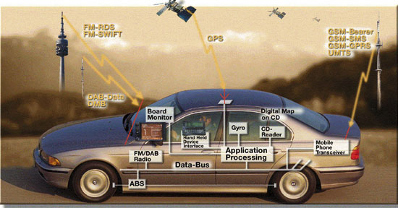
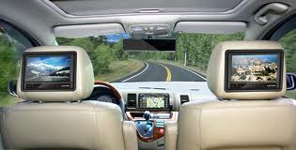
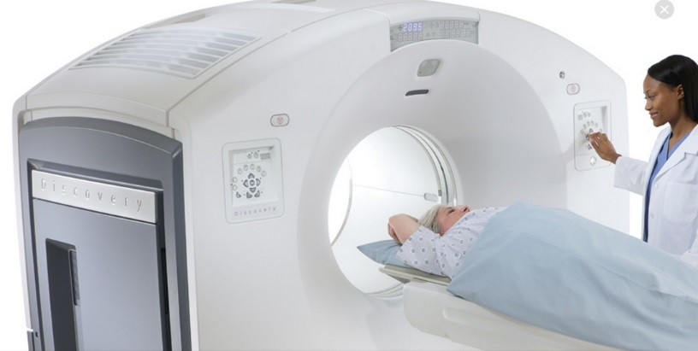
Real-Time Systems
Often used as a control device in a dedicated application such as controlling scientific experiments, medical imaging systems, industrial control systems, and some display systems.
Well-defined fixed-time constraints.
Real-Time systems may be either hard or soft real-time.

Slide 48
Computing Environments - Virtualization
Virtualization means running one or more virtual computers/operating systems inside another computer.
  Example:
    Your real laptop
    → Host OS: Windows 11
    → VirtualBox/VMware
    → Guest OS 1: Ubuntu
    → Guest OS 2: Windows Server
So one physical machine can behave like several separate computers.
Host OS: the main OS installed on the real computer.
Guest OS: the OS running inside the virtual machine.
VMM / Hypervisor: software that creates and manages virtual machines, such as VMware or VirtualBox.
Emulation is different: it imitates a different CPU/hardware architecture, so it is usually slower.
  Example:
    Emulation: ARM/Mac system imitating an Intel x86 machine.
    Virtualization: Intel/x86 computer running another x86 operating system virtually.
Playing a PlayStation 2 game on a PC using a PS2 emulator. Your PC does not have PS2 hardware, so the emulator imitates the PS2 hardware/CPU so the game can run.
Virtualization = same/similar hardware, multiple virtual OSs.
Emulation = imitate different hardware/CPU.

Slide 49
Computing Environments - Virtualization
Use cases involve laptops and desktops running multiple OSes for exploration or compatibility
  Apple laptop running Mac OS X host, Windows as a guest
  Developing apps for multiple OSes without having multiple systems
  QA testing applications without having multiple systems
  Executing and managing compute environments within data centers
VMM can run natively, in which case they are also the host
  There is no general purpose host then (VMware ESX and Citrix XenServer)

Slide 50
Computing Environments - Virtualization

Slide 51
Computing Environments – Cloud Computing
Delivers computing, storage, even apps as a service across a network
Logical extension of virtualization because it uses virtualization as the base for it functionality.
  Amazon EC2 has thousands of servers, millions of virtual machines, petabytes of storage available across the Internet, pay based on usage
Many types
  Public cloud – available via Internet to anyone willing to pay
  Private cloud – run by a company for the company’s own use
  Hybrid cloud – includes both public and private cloud components
  Cloud Services
  Software as a Service (SaaS) – one or more applications available via the Internet (i.e., word processor)
  Platform as a Service (PaaS) – software stack ready for application use via the Internet (i.e., a database server)
  Infrastructure as a Service (IaaS) – servers or storage available over Internet (i.e., storage available for backup use)

Slide 52
Computing Environments – Cloud Computing
Cloud computing environments composed of traditional OSes, plus VMMs, plus cloud management tools
  Internet connectivity requires security like firewalls
  Load balancers spread traffic across multiple applications

Slide 53
Open-Source Operating Systems
Open-source OS: Source code is available to everyone.
Users can study, modify, and share the code.
  FSF: Organization that promotes free software.
  GPL: License that allows software to be used and modified.
  Copyleft: Shared modified versions must also stay free/open.
  Closed-source software: Source code is hidden from users.
Examples: GNU/Linux, BSD UNIX (including core of Mac OS X), and Sun Solaris

Slide 54
End of Lecture 1

