Slide 1

Every card in your wallet, every offer near you — matched before you pay.

Slide 2


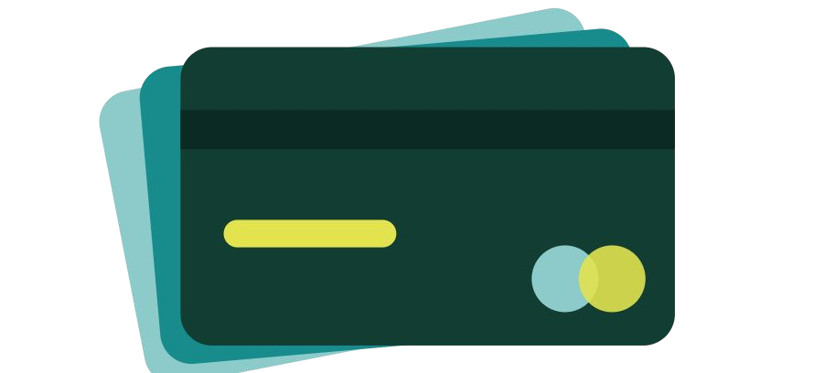
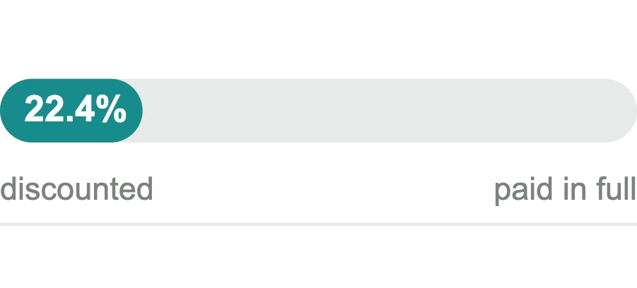
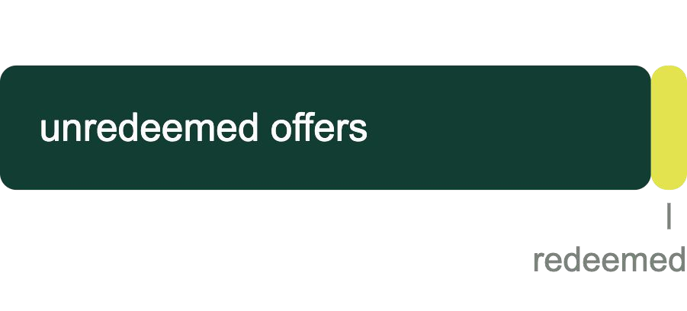
At the counter, nobody knows which card saves money
Every bank shows only its own offers, inside its own app. Someone holding an HBL card, a UBL card and a Meezan card has three places to check, and none of them says what the other two are running. Claiming a discount takes six steps — and almost nobody completes all six. So they guess.
68.25M payment cards
in circulation in Pakistan, March 2026
22.4% average discount
across 1,094 dining outlets carrying bank-card offers
<5% ever redeemed
of the card discounts people already qualify for

Slide 3






An app that holds every card you own and tells you which one to tap
1
2
3
Scan your cards in
Any bank, any number of them, once. The scanner is built in, so we need no bank integration to work.
See what’s near you
Offers around you, matched to your wallet — we name the speciﬁc card of yours that qualiﬁes, before you pay.
Save, and see what you missed
At month end: what you saved, and what you left behind by reaching for the wrong card.

Slide 4



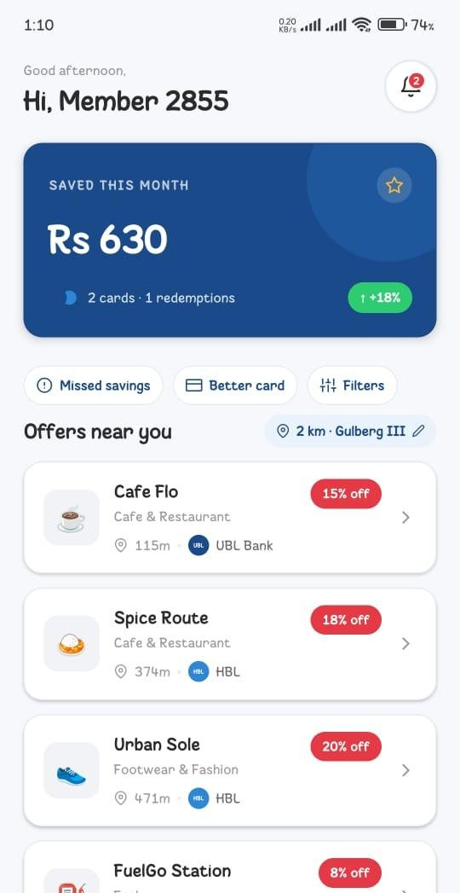
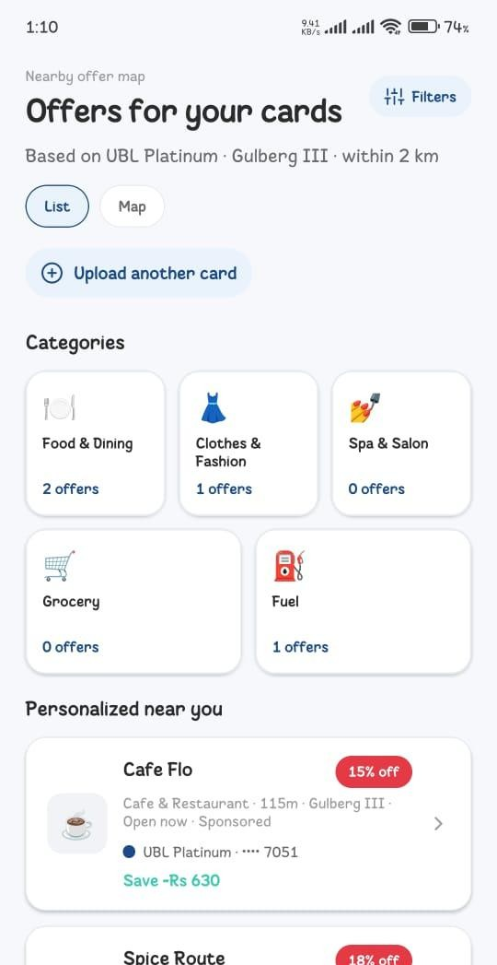
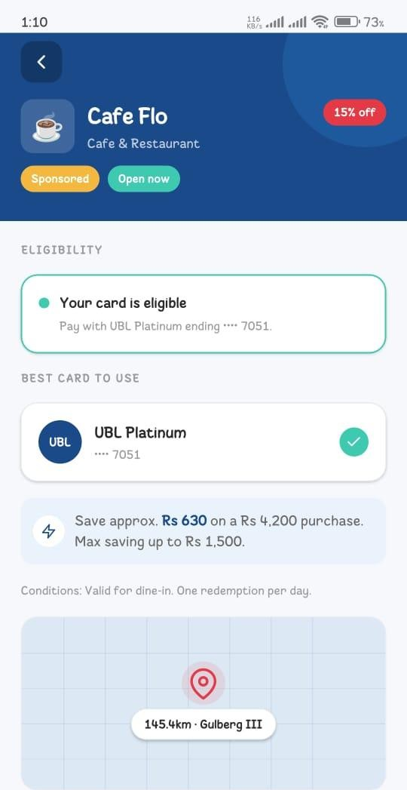
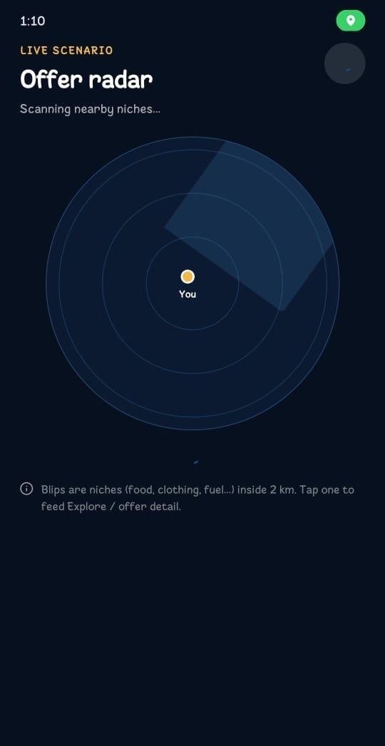
The build, today
Savings and nearby offers
Matched to your cards
Eligibility and best card
Offer radar

Slide 5
Progress to date
A working Android build, shipped with no outside funding
Card scanning, offer discovery, eligibility and savings tracking, all live in the build
Architecture documented; pilot designed with a control group
Registered entity. Submitted to the UBL National Innovation Hackathon 2026
Public launch — not yet

Slide 6



Market sizing
 | DEFINITION | FIGURE | HOW IT IS BUILT
TAM | Card-holding adults in Pakistan | ~17M | 10.6% adult debit ownership (Findex) × ~165M adults
SAM | Card-holding, smartphone-owning adults in the three largest metros | 5–6M | ~40% of cardholders urban (17M × 40% ≈ 6.8M), ~85% smartphone-capable
SOM | Realistic capture in Karachi over 24 months | 6,500 ﬂoor 20,000 target | Bottom-up from 50 merchants; ﬂoor uses Golootlo’s ~130 users per merchant
Cards grew 41% in three years, 48.4M to 68.25M. The “which card do I tap” problem is roughly three years old.

Slide 7
“FlusAI is the only app that knows every card in your wallet and every offer near you at the same time.”
A bank can only ever show its own cards. Directories list offers but don’t know what you carry. We start from your actual cards and end with one answer before you pay.

Slide 8
Competitors and alternatives
Golootlo has 4 million users — proof Pakistanis will put a discount app on their phone, and somebody else paid to teach them. What none of these ﬁve do is start from the cards you already carry.
 | WHAT THEY DO | HOW WE DIFFER
Golootlo | 30,000+ merchants, 158 cities, 4M+ users | Their own network, claimed by QR at the counter — silent on your cards
Peekaboo Guru | Directory of card offers across 13+ banks | A catalogue by bank; you do the matching yourself
Vouch365 | Subscription BOGO vouchers, 14 cities | The consumer pays, and redemption needs a staff action
Bank apps | UBL Digital, HBL Mobile, Meezan | Single-issuer by deﬁnition. Cannot see the rest of your wallet
Wallets | JazzCash, Easypaisa promotions | Wallet-native offers, not card-linked. No cross-issuer eligibility

Slide 9

Revenue streams and cost structure
Revenue — the consumer never pays
Merchant campaign fees, priced on conﬁrmed visits rather than impressions
Featured placement, always labelled
Merchant analytics and attribution reporting, as a subscription
Bank platform fee, tied to reactivations and redemptions, once usage evidence exists
Costs — people, not servers
Merchant onboarding: feet on the ground, the largest line by far Offer-data maintenance, daily — offers expire and terms change Cloud, maps and notiﬁcation infrastructure, scaling with users Founder runway, support, app store fees and tooling
Minimal CAPEX: no hardware, no inventory, no premises.
Pricing is set with merchants, not invented here.

Slide 10

The ask
Use of funds
Sign and verify the ﬁrst 50 merchants in Karachi Acquire the ﬁrst user cohort in the dining category
Backend, savings conﬁrmation and the offer-data pipeline Founder costs through to ﬁrst revenue
Beyond capital
Merchant network introductions Bank and ﬁntech access
Mentorship on partnership structuring and pricing
We can build the product. We can’t introduce ourselves to ﬁfty merchants and three banks. On exit: acquisition by a bank, a payment network or a regional ﬁntech wanting card-linked offer infrastructure.
The ﬁgure is being sized against 18 months of burn.

Slide 11

Thank you
Rs 1,930 saved across three purchases — on spending that was already happening.
TEAM· FLUSAI, KARACHI

