Slide 1
Zubair
Test Project

Slide 2
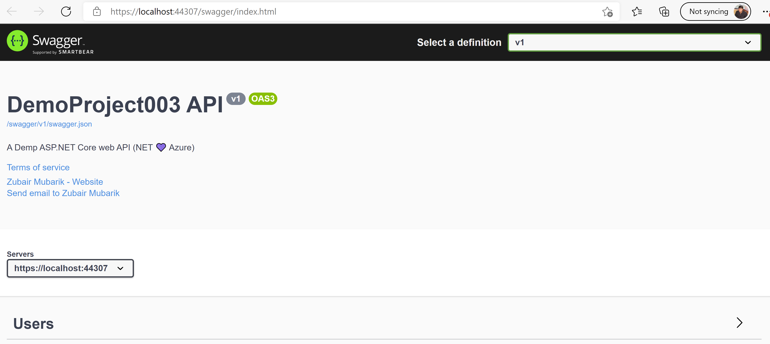
Running Application

Slide 3
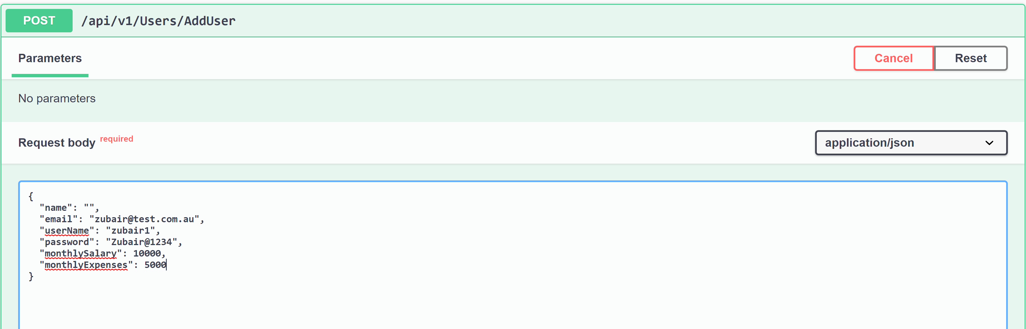
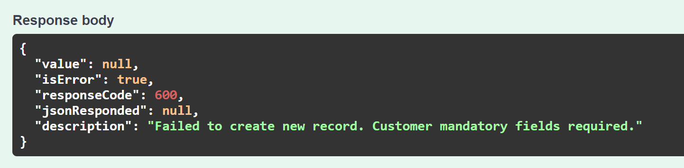
Case 1: AddNewRecord_MissingName_Error
Mandatory fields: Name, Email , UserName , Monthly Salary, Monthly Expenses.

Slide 4
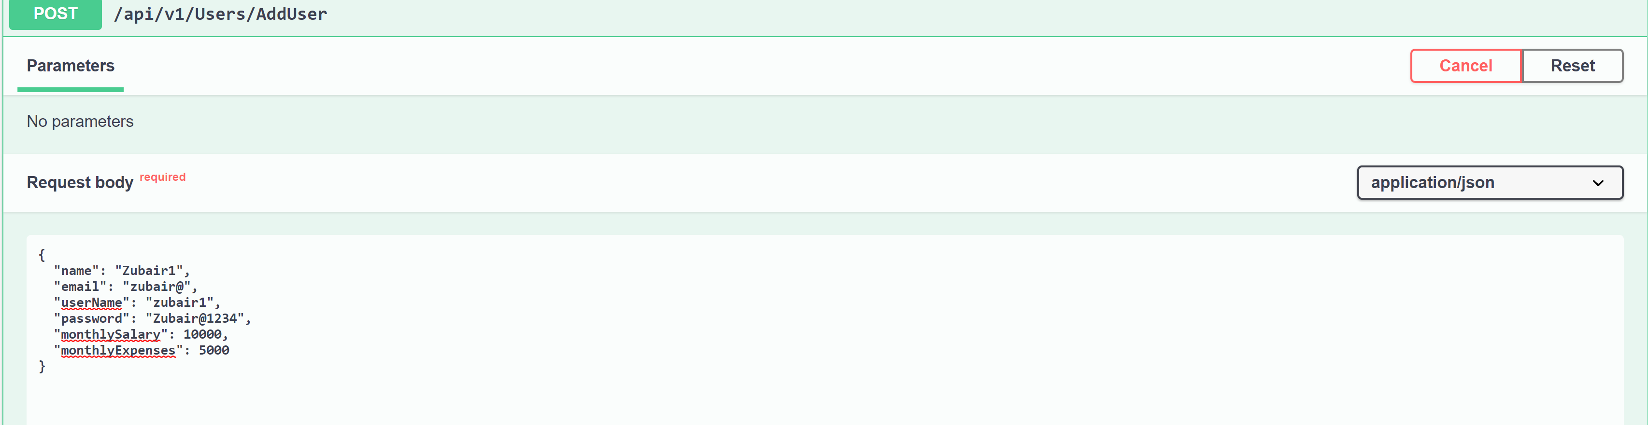
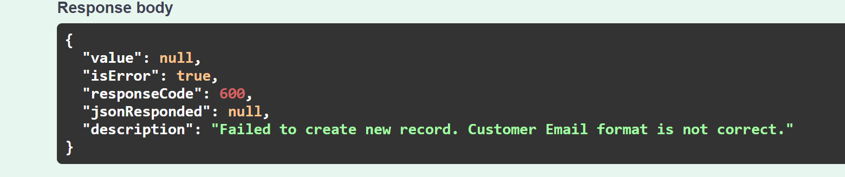
Case 2: AddNewRecord_InvalidEmail_Error

Slide 5
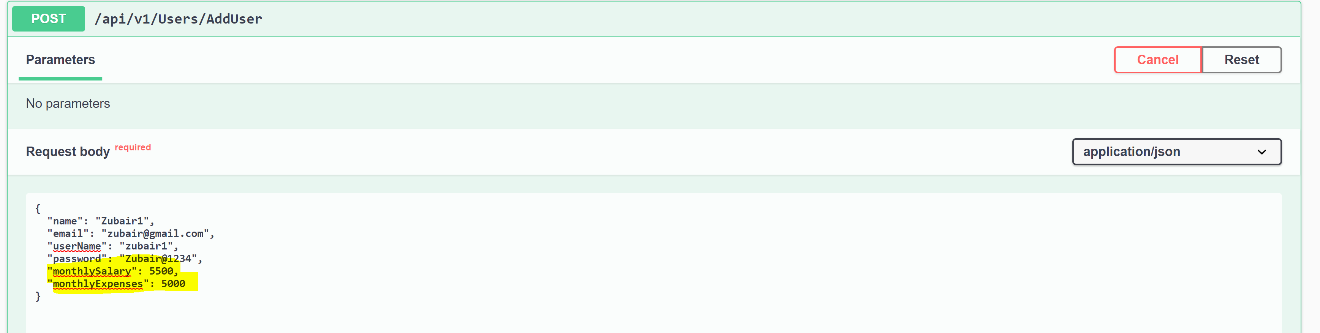
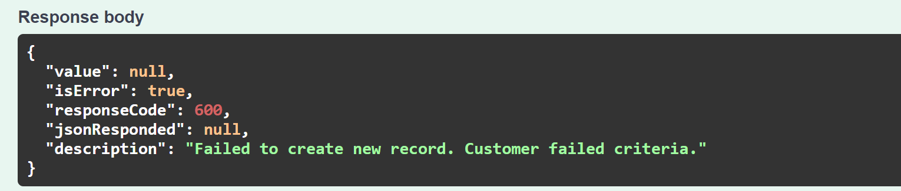
Case 3: AddNewRecord_InvalidExpenseCriteria_Error

Slide 6
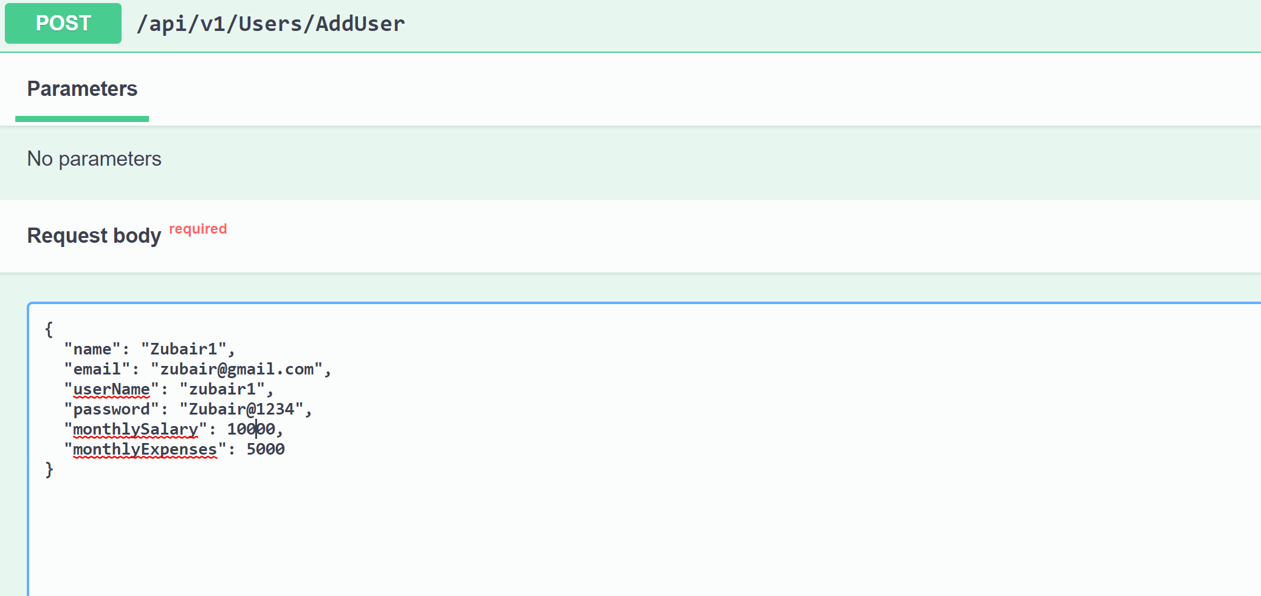
Case 4 : AddNewRecord_Valid_Create

Slide 7
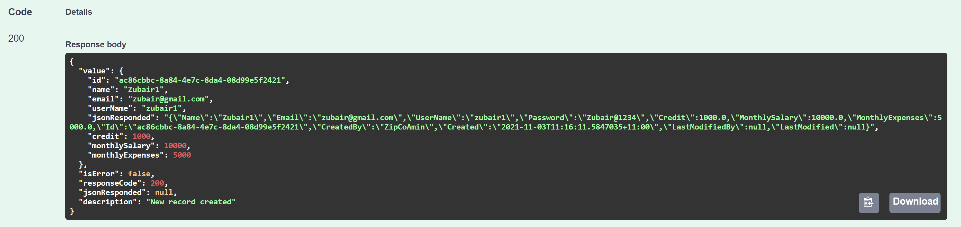
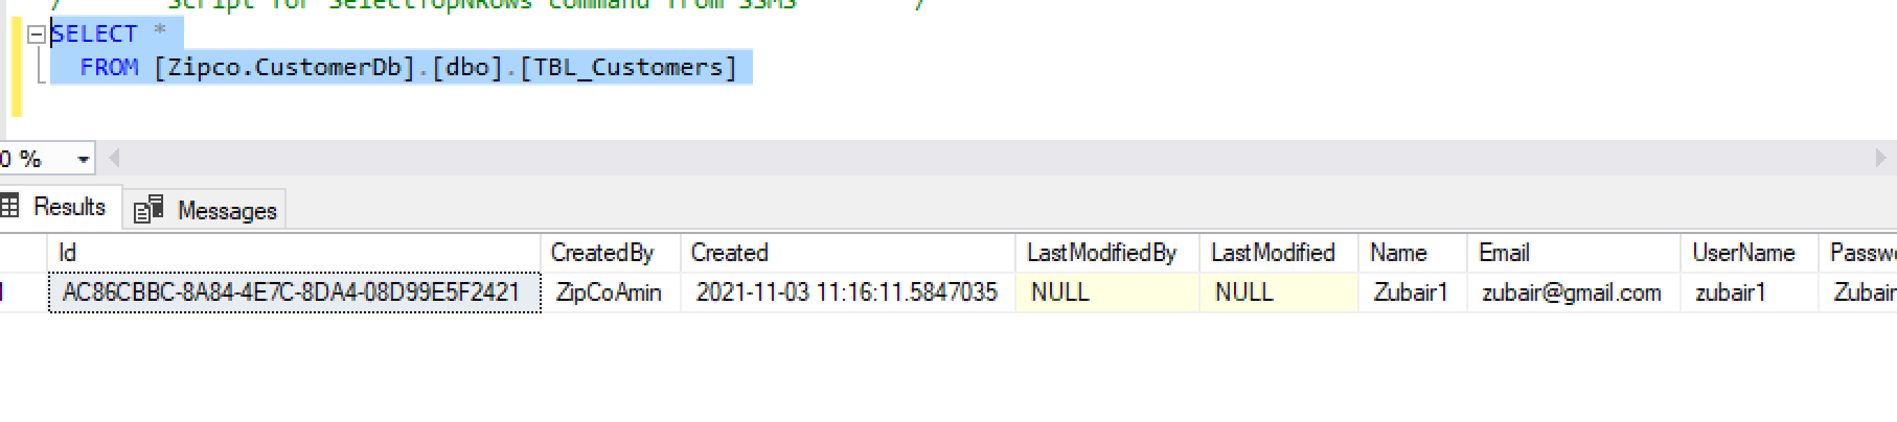

Slide 8
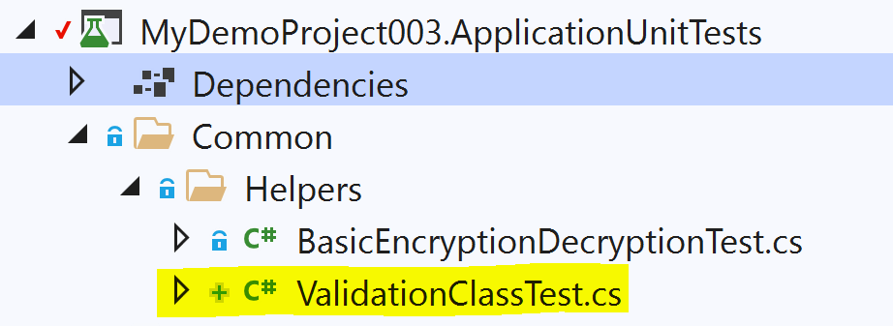
Unit Tests – ValidationClassTest for Business Rules

Slide 9
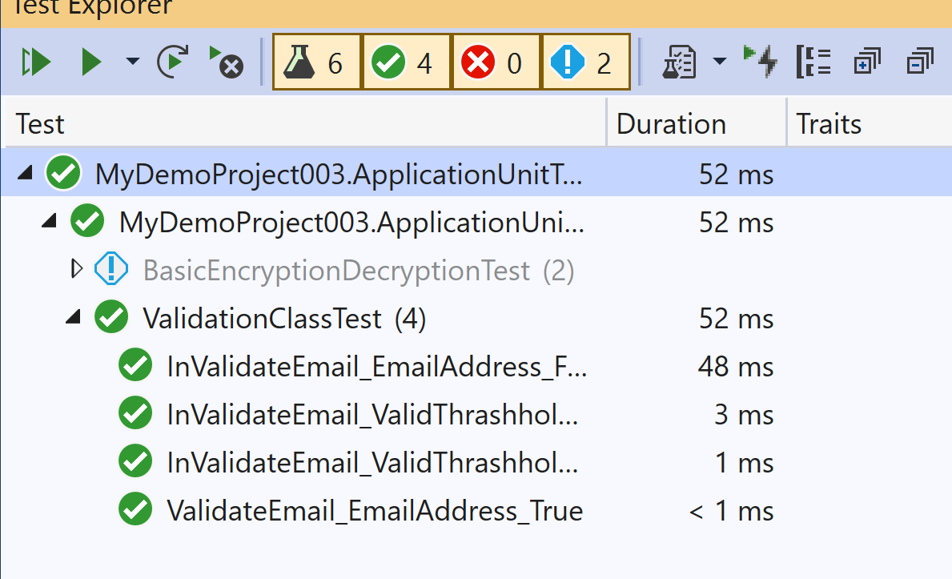
Business Rules in Test Cases

