Slide 1
Classification
Muhammad Zubair Khan

Slide 2
Dataset used
MNIST (Hand written digits)
Training images: 60,000
Testing images: 10,000
Image dimension: 28 x 28
Classes = 10
Channel: 1

Slide 3
Inspirations
LeNet-5
Alexnet

Slide 4
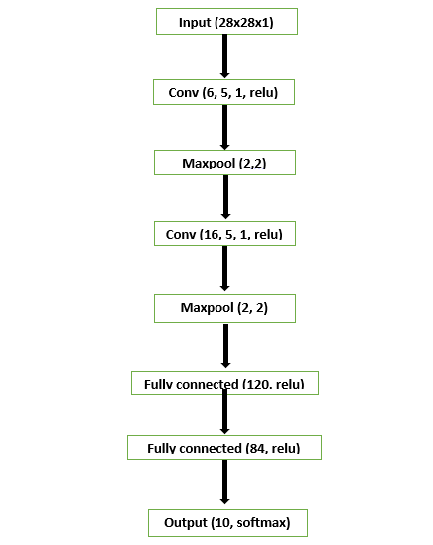
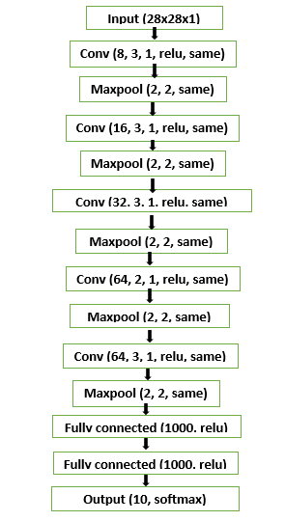
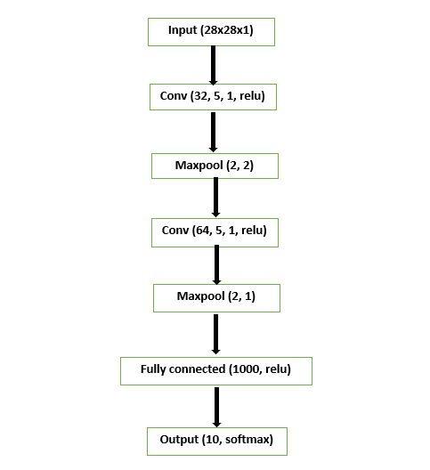
Models applied

Slide 5
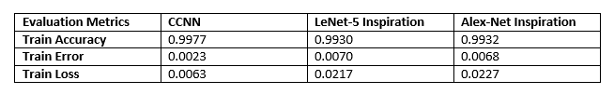
Training summary

Slide 6

Testing summary

Slide 7
Dataset used
Cat-Dog dataset
Training images: 8000
Testing images: 2000
Image dimension: 64x64
Classes = 2
Channel: 3

Slide 8
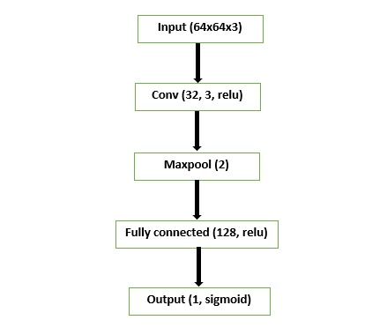
Model applied

Slide 9

Training / Testing summary

