Slide 1
CRICKET PERFORMANCE ANALYTICS
Pakistan Super League (PSL) 2020-2021 — Ball-by-Ball Analysis
A Data Analytics Capstone Project • Python · Pandas · Matplotlib · Seaborn · Streamlit
Notes:
Welcome the audience. Introduce the project as a full data-analytics case study of two PSL seasons using ball-by-ball data, covering the whole pipeline from cleaning to a live dashboard.

Slide 2
INTRODUCTION
Why PSL Ball-by-Ball Data?
PSL is Pakistan's premier T20 franchise tournament, generating rich ball-by-ball data every season.
Ball-level granularity lets us study micro-patterns: pressure, momentum, and phase-wise strategy — not just final scores.
This project builds a complete, reproducible analytics pipeline: cleaning → features → EDA → statistics → visuals → dashboard.
15,164
66
Deliveries Analysed
Matches (2020-21)
6
2
Teams
Seasons
Cricket Performance Analytics | PSL 2020-2021
2
Notes:
Frame the motivation: ball-by-ball data is the richest level of granularity available. Point to the four KPI cards as a quick orientation to dataset scale before diving into details.

Slide 3
PROBLEM STATEMENT
From Raw Deliveries to Decision-Ready Insight
Franchises, broadcasters and fans generate huge volumes of ball-by-ball data but lack tooling to turn it into decisions.
Coaches need to know which overs are most vulnerable; broadcasters need statistically grounded storylines.
Objective: engineer phase-aware features and deliver insights via a report, 20 visuals, and an interactive dashboard.
Clean & Structure
Engineer Features
Analyse & Visualise
Deploy Dashboard
Turn raw logs into an analysis-ready dataset
Phase, boundary & wicket indicators per ball
20 charts answering real business questions
Self-service exploration for stakeholders
Cricket Performance Analytics | PSL 2020-2021
3
Notes:
State the problem plainly: lots of data, not enough decision-ready insight. Walk through the four-step objective flow at the bottom: clean, engineer, analyse, deploy.

Slide 4
DATASET
PSL 2020-2021 Ball-by-Ball Dataset
Grain: one row = one delivery bowled in a PSL match.
26 raw columns: match context, participants, outcomes, and match results.
Restricted to 2020 & 2021 seasons for a focused, internally comparable analysis.
15,164 x 26
Rows x Raw Columns
6 Venues
Across Pakistan & UAE
Field Group | Example Columns
Context | match_id, date, season, venue, inning, over, ball
Participants | batter, bowler, non_striker, fielder
Outcomes | batsman_runs, total_runs, extras_type, is_wicket, dismissal_kind
Result | winner, win_by, match_type, player_of_match
Cricket Performance Analytics | PSL 2020-2021
4
Notes:
Describe the dataset grain (one row per ball) and the four logical field groups. Emphasize the two-season scope keeps the comparison focused and consistent.

Slide 5
DATA PREPARATION
Data Cleaning & Preprocessing
Only player_of_match had genuine missing values (102 rows) — kept as NaN, not imputed.
player_dismissed, dismissal_kind, extras_type & fielder use structural placeholders ('Not Out', 'No Extra') — these are valid categories, not missing data.
No fully duplicated rows found; bowler names & venue text standardised.
Data types corrected: date → datetime, is_wicket → boolean, categorical fields cast for efficiency.
Cricket Performance Analytics | PSL 2020-2021
5
Notes:
Explain the key cleaning insight: most 'missing' values are actually meaningful placeholder categories (structural missingness), not data quality issues, and should never be dropped.

Slide 6
FEATURE ENGINEERING
Turning Deliveries into Signals
dot_ball
four / six / boundary
Bowling pressure / control
Attacking intent & power
wicket
powerplay / middle / death
Simplifies wicket aggregation
Phase-based strategy analysis
run_type
is_extra / extra_runs
Full outcome distribution per ball
Isolates bowler-conceded runs
Cricket Performance Analytics | PSL 2020-2021
6
Notes:
Walk through the six feature families engineered from raw balls: dot balls, boundaries, wickets, match-phase flags, run-type categories, and extras — each purpose-built for a later analysis question.

Slide 7
EXPLORATORY DATA ANALYSIS
What the Data Shows at a Glance
1,027
36
9.77
34%
Runs — Top Scorer
(Babar Azam)
Wickets — Top Bowler
(Shaheen Shah Afridi)
Runs/Over in Death Overs
Deliveries That Are Dot Balls
Run-scoring is heavily right-skewed: most balls are quiet, but boundaries drive most of the total.
Scoring accelerates through the innings, peaking sharply in the death overs.
2021 saw more runs, wickets, and boundaries than 2020 — a trend toward more attacking cricket.
Cricket Performance Analytics | PSL 2020-2021
7
Notes:
Use the four stat cards as a fast headline summary before the detailed chart slides. Mention the right-skew of scoring and the year-on-year rise in aggression from 2020 to 2021.

Slide 8
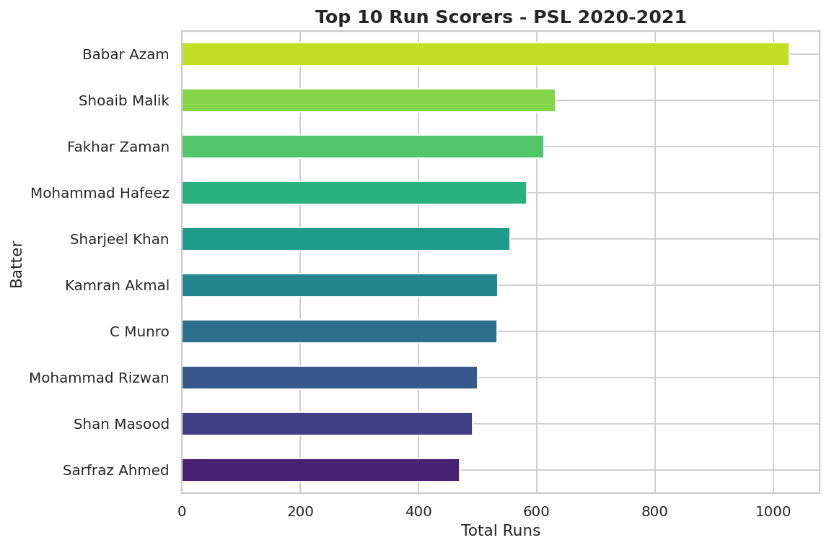
VISUALIZATION 8 OF 20
Top Run Scorers
Business Question: Who scored the most runs across 2020-2021?
Insight: Babar Azam led all batters with 1,027 runs — a franchise-defining anchor performance.
Cricket Performance Analytics | PSL 2020-2021
8
Notes:
Highlight Babar Azam's lead and what it means for batting-order design. Full chart set (all 20 visualizations) is available in the images/ folder and Section 8 of the report.

Slide 9
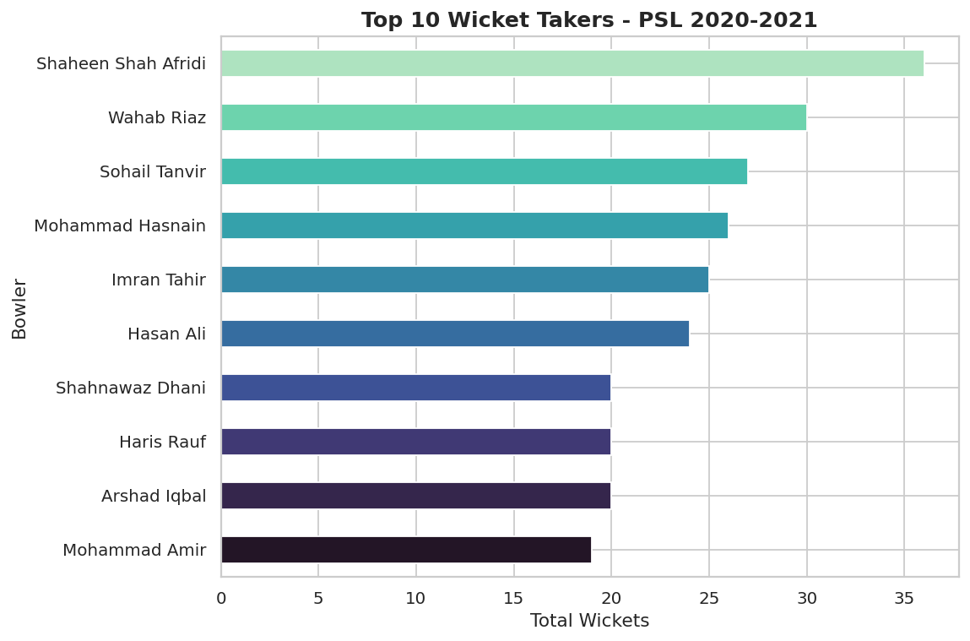
VISUALIZATION 9 OF 20
Top Wicket Takers
Business Question: Which bowlers took the most wickets?
Insight: Shaheen Shah Afridi topped the wicket charts, confirming elite strike-bowling impact.
Cricket Performance Analytics | PSL 2020-2021
9
Notes:
Discuss Shaheen's strike-bowling role and how opponents might plan around him. Full chart set (all 20 visualizations) is available in the images/ folder and Section 8 of the report.

Slide 10
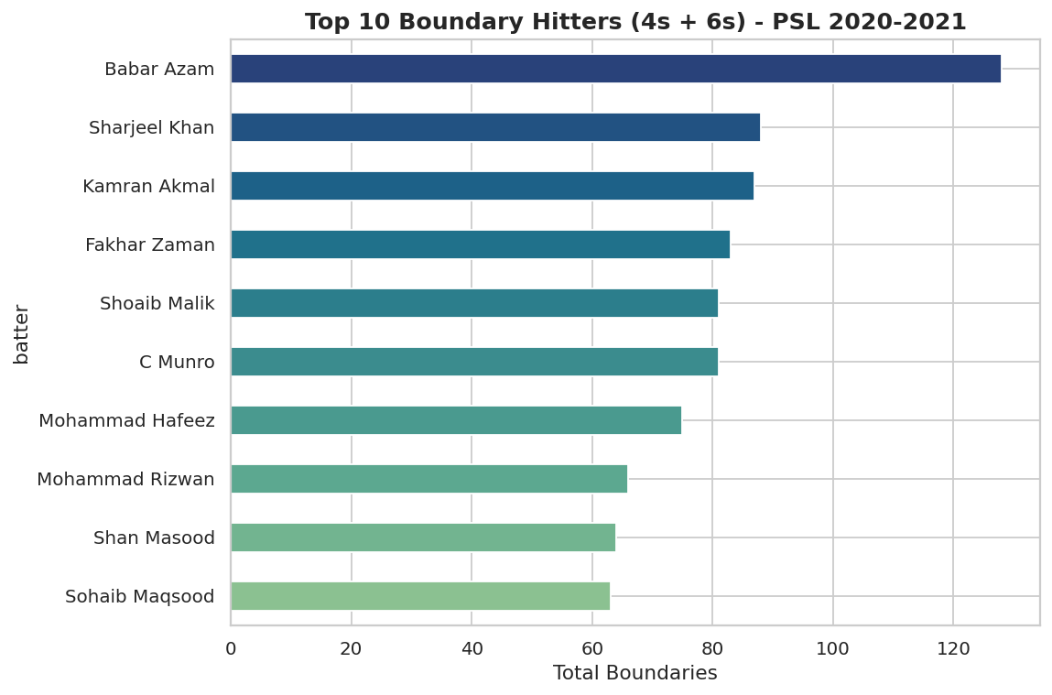
VISUALIZATION 10 OF 20
Top Boundary Hitters
Business Question: Who cleared the ropes most consistently?
Insight: Babar Azam also led combined boundary count (4s+6s), showing balanced accumulation and power.
Cricket Performance Analytics | PSL 2020-2021
10
Notes:
Contrast boundary leaders with six-hitting specialists on the next slides. Full chart set (all 20 visualizations) is available in the images/ folder and Section 8 of the report.

Slide 11
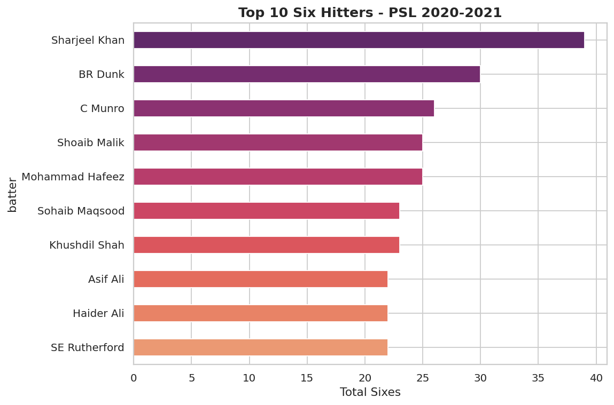
VISUALIZATION 11 OF 20
Top Six Hitters
Business Question: Who is the tournament's premier six-hitter?
Insight: Sharjeel Khan led in sixes specifically — a distinct power-hitting profile.
Cricket Performance Analytics | PSL 2020-2021
11
Notes:
Note this is a different leaderboard than total runs — specialization matters. Full chart set (all 20 visualizations) is available in the images/ folder and Section 8 of the report.

Slide 12
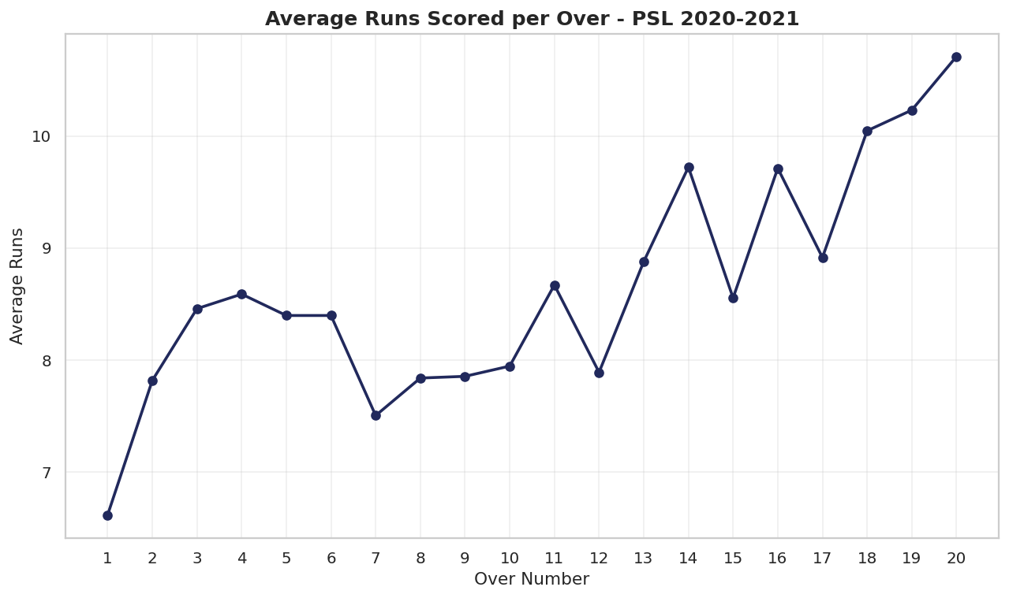
VISUALIZATION 12 OF 20
Average Runs per Over
Business Question: How does scoring evolve across an innings?
Insight: Scoring rises steadily and spikes sharply in the final overs (16-20).
Cricket Performance Analytics | PSL 2020-2021
12
Notes:
Point to the late-innings spike — set up the phase analysis slide next. Full chart set (all 20 visualizations) is available in the images/ folder and Section 8 of the report.

Slide 13
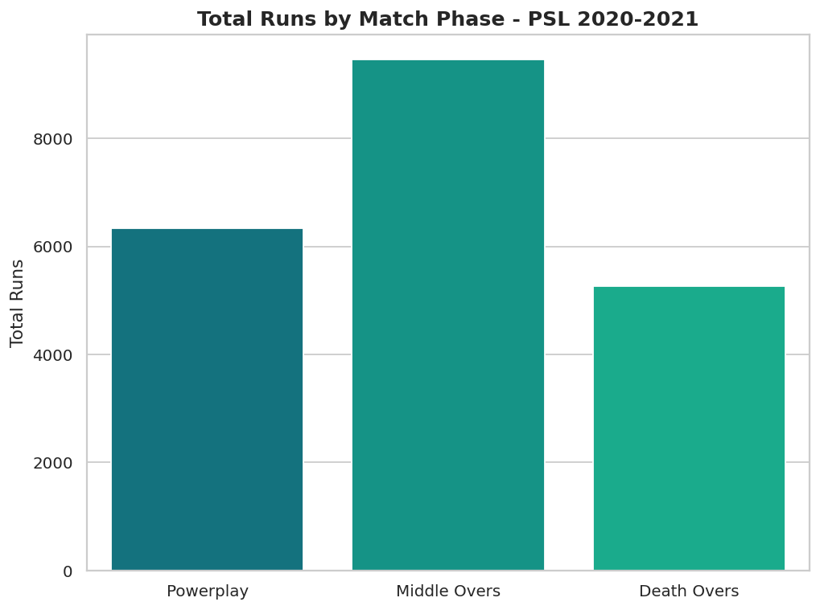
VISUALIZATION 13 OF 20
Runs by Match Phase
Business Question: Which phase contributes most to the total score?
Insight: Death overs and middle overs together generate the majority of runs scored.
Cricket Performance Analytics | PSL 2020-2021
13
Notes:
Tie back to team strategy: preserve wickets in the middle to attack at the death. Full chart set (all 20 visualizations) is available in the images/ folder and Section 8 of the report.

Slide 14
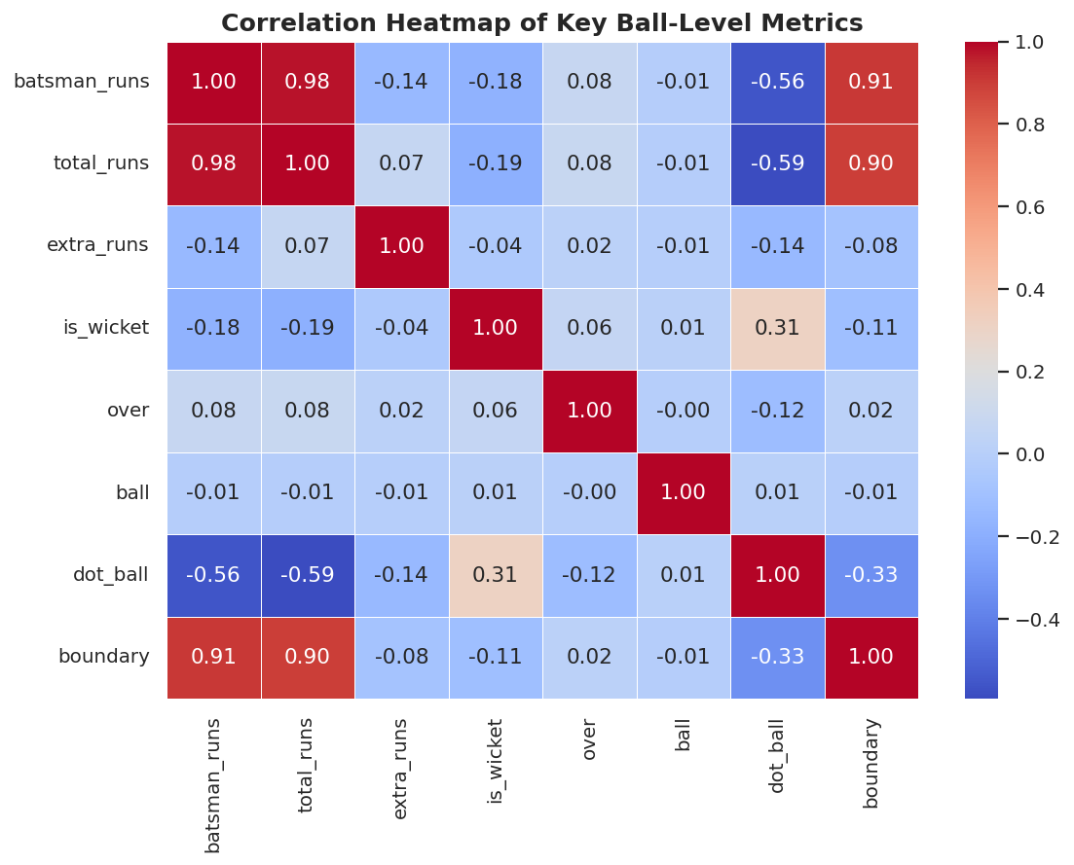
VISUALIZATION 14 OF 20
Correlation Heatmap
Business Question: How are key ball-level metrics related?
Insight: Dot balls are strongly negatively correlated with runs scored — a clean pressure signal.
Cricket Performance Analytics | PSL 2020-2021
14
Notes:
Use this to justify dot-ball percentage as a coaching KPI. Full chart set (all 20 visualizations) is available in the images/ folder and Section 8 of the report.

Slide 15
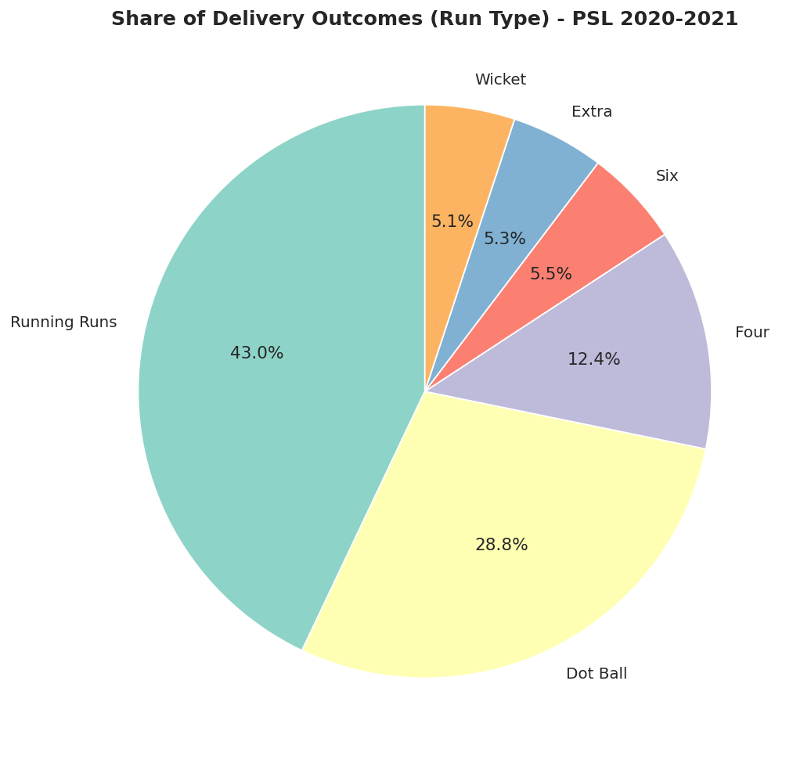
VISUALIZATION 15 OF 20
Delivery Outcome Share
Business Question: What share of deliveries produce each outcome?
Insight: Running runs and dot balls dominate; boundaries are rarer but high-impact.
Cricket Performance Analytics | PSL 2020-2021
15
Notes:
Reinforce that strike rotation, not just boundaries, drives most scoring. Full chart set (all 20 visualizations) is available in the images/ folder and Section 8 of the report.

Slide 16
FINDINGS
Business Insights (Selected)
Babar Azam & Shaheen Shah Afridi were the standout individual performers across both seasons.
Death overs produce the highest run rate (9.77/over) — ~27% higher than the powerplay.
~34% of deliveries are dot balls — a clean, simple bowling-pressure metric.
Catches account for ~65% of dismissals — fielding quality matters as much as bowling.
Wides are the single largest category of extras conceded — a fixable discipline issue.
Total runs, wickets, sixes & fours all rose from 2020 to 2021 — cricket got more attacking.
Full list of 20 insights available in Section 10 of the written report.
Cricket Performance Analytics | PSL 2020-2021
16
Notes:
Present 6 of the 20 total insights as headline takeaways. Mention the full list of 20 lives in the written report for anyone who wants the complete detail.

Slide 17
RECOMMENDATIONS
Business Recommendations (Selected)
Reserve the most economical bowler for overs 18-20, where matches are most often decided.
Track dot-ball percentage as a standing bowling-economy KPI in training review.
Prioritise fielding drills alongside bowling training — catches drive ~65% of wickets.
Build player-specific phase splits (powerplay/middle/death) as standard scouting reports.
Coach strike rotation as heavily as boundary-hitting, given its far higher frequency.
Re-run this pipeline every season to keep the dashboard and report current.
Full list of 20 recommendations available in Section 11 of the written report.
Cricket Performance Analytics | PSL 2020-2021
17
Notes:
Present 6 of the 20 recommendations, chosen for broad relevance to coaching staff and analysts. Full list of 20 is in the report.

Slide 18
DELIVERABLE
Interactive Streamlit Dashboard
Sidebar filters: Season, Team, Batter, Bowler, Venue.
KPI cards: matches, runs, wickets, sixes, fours, run rate, dot-ball %, boundary %.
Tabbed views: Overview, Batting, Bowling, Venue & Phase, and a downloadable Data Table.
Fully interactive — filters recompute every chart and KPI in real time.
streamlit run app.py
dashboard/app.py
Built with Pandas, Matplotlib,
Seaborn & Streamlit.
Data refreshes instantly as
filters change — no reruns
of the analysis scripts needed.
Cricket Performance Analytics | PSL 2020-2021
18
Notes:
Demo or describe the dashboard: five sidebar filters drive KPI cards and five tabs of charts. Emphasize it's a self-service tool for coaches and analysts, not just a static report.

Slide 19
CONCLUSION
A Reusable Analytics Template for Every PSL Season
This project turned a raw ball-by-ball log into a structured analytics asset: cleaned data, engineered features, 20 visuals, statistics, and a live dashboard.
It confirmed cricketing intuition with hard evidence — the death-overs surge, the pressure of dot balls, and the dominance of catches among dismissals.
The pipeline is designed to be re-run on future PSL seasons with minimal changes.
Cricket Performance Analytics | PSL 2020-2021
19
Notes:
Close by reinforcing that this is a repeatable pipeline, not a one-off report — it can be re-run on future seasons with minimal changes.

Slide 20
Questions?
Cricket Performance Analytics | PSL 2020-2021 Ball-by-Ball Dataset
Notes:
Open the floor for questions. Be ready to discuss methodology choices (structural missing values, phase definitions) and any specific player/team/venue findings the audience wants to dig into.

